Slide 1
February 20, 2025
Data Pipeline Town Hall
The goal of the webinar is to provide updates on the Data Pipeline, current, and upcoming data collections. These webinars also provide a forum for districts, BOCES, and Administrative Units to have questions answered about Data Pipeline.

Slide 2
Colorado Department of Education
Identity Management (IdM)
Identity Management Site
Frequently Asked Questions
How do I add myself or others to the email listserv for town hall emails and/or a specific collection?
  Email lists are dependent on a person’s access rights in IdM. Contact your LAM to get an account or be assigned to a specific collection.
Where can I find the IdM role mappings for Data Pipeline and other applications?
  Role Mapping (XLS)
I am a LAM. How do I update the user permissions for someone in my district?
  Follow the steps outlined in the IdM Quick Guide for Access Management (DOCX)
Important: Users are not automatically removed from IdM when their email address is no longer active in your district. The LAM must deactivate their IdM account to ensure only designated staff can access CDE’s data reporting system.
Notes:
LAMs, please check the IdM roles for your district. Remove permissions for users who have retired, left your district, or are no longer assigned to a collection. Add roles for new hires and newly assigned respondents for specific collections.

Slide 3

What is PII?
Student and Staff Personally Identifiable Information (PII) is defined by state and federal laws as information that, alone or in combination, personally identifies an individual
  This includes direct identifiers
  (i.e. student and staff names, SASID, EDID, etc.)
  Includes information that when combined is identifiable
Colorado’s Student Data Transparency and Security Act outlines requirements for how Student PII is collected, used and shared
See the Data Privacy and Security website for prepared guidance on how to comply with this and other privacy laws.

Slide 4

Sharing Data
Use secure methods to transfer any PII to CDE
  Contact Data Collection leads with questions about how to transmit PII securely
    Each Data Collection leads maintains their own Syncplicity folders for specific collections, reach out to the collection lead for access
  Use Syncplicity to encrypt emails to CDE
Avoid sending PII via unencrypted email or to unsecured faxes when sharing data between or within districts
  Use Syncplicity to encrypt emails to CDE
Check local policies for restrictions, requirements, etc. regarding PII
  Do not use PII in trainings, presentations, etc.
  Do not share PII with unauthorized individuals
  Do not share passwords
  Follow local policies when transmitting PII to any third party

Slide 5
Today’s Agenda
Agenda Topic | Presenter
Open Data Collections and Upcoming Deadlines in Data Pipeline | Host: Brooke Wenzel
Teacher Student Data Link | Peter Hoffman
Human Resources | Dawna Gudka
Special Education December Count | Lindsey Heitman
Summer EBT | Collin Slutzky
Student End of Year | Reagan Ward
Student Interchange | Reagan Ward
SBD Collections | Jasmine Carey

Slide 6
Open Collections and
Upcoming Deadlines in
Data Pipeline

Slide 7
Open Collections and Upcoming Dates:
Year-Round & Interchanges
Name | Category | Status | Key Dates
RITS | Year Round | Open | N/A
EDIS | Year Round | Open | N/A
Directory | Year Round | Open | Reduced Academic Calendar: 2/5/2025 to 5/9/2025 School Code Change Requests: 2/5/2025 to 6/30/2025
Student | Interchange | Open | February Recommendation: Update DEM & SSA files
At-Risk | Interchange | Closed | N/A
Title I | Interchange | Open | May 2025: Update file in preparation for SEY and ATS reporting
Special Education IEP | Interchange | Open | Final Dec Count Snapshot Submission Due by 2/21/2025
Staff | Interchange | Open | Error free files required for SPED December and Human Resources
Teacher Student Data Link | Interchange | Open | Opened 12/11/2024
Data Pipeline Resources: Data Pipeline Collection Dates (XLS)

Slide 8
Open Collections and Upcoming Dates:
Snapshots
Name | Category | Status | Final Deadline Date | Next Milestone | Looking Ahead
Special Education December Count | Snapshot | Closing Soon | Feb. 21, 2025 | Interim Deadline: N/A | Collection Deadline 2/21/25
Human Resources | Snapshot | Closing Soon | Feb. 21, 2025 |  | Collection deadline 2/21/25
Teacher Student Data Link | Snapshot | Coming Soon | Aug. 29, 2025 | Interchange Opened: 12/11/2024 | Snapshot Opens: 2/27/2025
Student End of Year | Snapshot | Coming Soon | Dec. 2, 2025 | Soft Open (Optional Phase): 3/31/2025 to 4/24/2025 | Training Event: Collection Overview Training—option 1 of 2 4/2/2025, 9:00-11:00am
Data Pipeline Resources: Data Pipeline Collection Dates (XLS)

Slide 9
Open Collections and Upcoming Dates:
Periodic
Name | Category | Status | Final Deadline Date | Next Milestone | Looking Ahead
Summer EBT | Periodic | Open | Feb. 28, 2025 | Collection Closes: 2/28/2025 LEAs must submit an error-free file
SBD WIDA ACCESS for ELLs | Periodic | Coming Soon | Mar. 26, 2025, 5pm | Collection Opens: 3/17/2025 | Training: 3/1/2025, 1pm
Report Card March | Periodic | Coming Soon | Apr. 11, 2025 | Collection Opens: 3/5/2025
Data Pipeline Resources: Data Pipeline Collection Dates (XLS)

Slide 10
Teacher Student Data Link
Peter Hoffman

Slide 11
2024-2025 TSDL Timeline
Date | Event | Event Description
Thursday, February 27, 2025 | Open | TSDL Snapshot opens.
Friday, May 16, 2025 | Interim Deadline | TARGET: Date by which you should have uploaded the TSDL Upload interchange file at least once
Friday, June 13, 2025 | Interim Deadline | TARGET: Date by which the TSDL Upload interchange should be uploaded and error free.
Friday, June 27, 2025 | Interim Deadline | TARGET: Date by which the TSDL snapshot should be created at least once.
Friday, August 22, 2025 | Interim Deadline | TARGET: Date by which you should have a complete Teacher Student Data Link Snapshot. Complete Teacher Student Data Link Snapshot means: All TSDL interchange errors are resolved All TSDL snapshot errors are resolved If you anticipate that you will not be able to meet this deadline, please contact CDE at TeacherStudentDataLink@cde.state.co.us
Monday, August 25, 2025 – Thursday, August 28, 2025 | Report Review | Final Snapshot Report Review – This is your opportunity to review reports in detail and make any data corrections you deem necessary to make sure you are reporting valid and reliable data. All data corrections must be completed during this time.
Friday, August 29, 2025 | Deadline | Required to have TSDL snapshot error free and finalized before or on this date. TSDL closed and final report is signed and provided to CDE via email TeacherStudentDataLink@cde.state.co.us
Teacher Student Data Link
TeacherStudentDataLink@cde.state.co.us

Slide 12
CDE Identity Management Roles for TSDL
Users will require 2 roles to complete TSDL, one for the interchange / data file upload, and one for the snapshot
Teacher Student Data Link Interchange Roles:
  TSL~ LEAUSER – upload and modify TSDL interchange files OR
  TSL~LEAVIEWER – view (only) TSDL interchange data
Teacher Student Data Link Snapshot Roles:
  TLS~LEAAPPROVER – Approves, creates, views Snapshot OR
  TLS~LEAUSER - creates, views Snapshot OR
  TLS~LEAVIEWER- views snapshot
Please note the swapped letters in the prefix TLS vs TSL
  Often, users are given 2 roles with the TLS prefix in error which does block access
  “S” at the end is for “Snapshot”
Teacher Student Data Link
TeacherStudentDataLink@cde.state.co.us

Slide 13
TSDL Snapshot data and HB24-1282
2024-2025 TSDL data will be utilized as a part of 9th grade success reporting. Please ensure that your course completion status field is being calculated / populated correctly.
  Link to Colorado Legislature HB24-1282
  The number and percentage of first-time ninth grade students who at the end of the school year have not earned at least four core credits or have failed one or more core credits
  Reported for the school in total and disaggregated by race, ethnicity, gender, English language learner status, and whether the student has an individualized education program
Teacher Student Data Link
TeacherStudentDataLink@cde.state.co.us

Slide 14
HB24-1282 Impact on TSDL Snapshot
No new fields in the TSDL Interchange – only impacts the TSDL Snapshot
Course Completion Status data field (column Y2) will be utilized for reporting requirements- must include all core courses, even those not completed:
Code | Description
1 | Completed – No Credit / No Grade / No Mark
2 | Completed – Pass
3 | Competed – Satisfactory
4 | Completed – Unsatisfactory
5 | Completed – Fail
6 | Incomplete – No Credit / No Grade / No Mark
7 | Withdrew – No Credit / No Grade / No Mark
Teacher Student Data Link
TeacherStudentDataLink@cde.state.co.us

Slide 15
2024-2025 Snapshot Updates
New error: 100% in one course completion field being reported for the school. Note – this is an error that is eligible for an exemption.
New warning: There are no records for 9th grade students with a core subject areas for schools that include 090 grade.
New warning: AP courses should be set to course level “G” since the AP SCED code designates it as an AP course.
New warning: a single student has more than 15 records for a single subject area (01,02,03,04)
Additional student demographics fields will be included in snapshot (Race/Ethnicity, ELL Status, IEP Status, Foster Status) and a new one for second year 9th graders will be added.
Teacher Student Data Link
TeacherStudentDataLink@cde.state.co.us

Slide 16
Questions & Resources: TSDL
Peter Hoffman
720-925-8611
Email for the Teacher Student Data Link

Slide 17
Human Resources Snapshot Collection
Dawna Gudka

Slide 18

Final Deadline-Tomorrow, February 21st, 2025
Human Resources Snapshot Collection
HumanResourcesData@cde.state.co.us

Slide 19
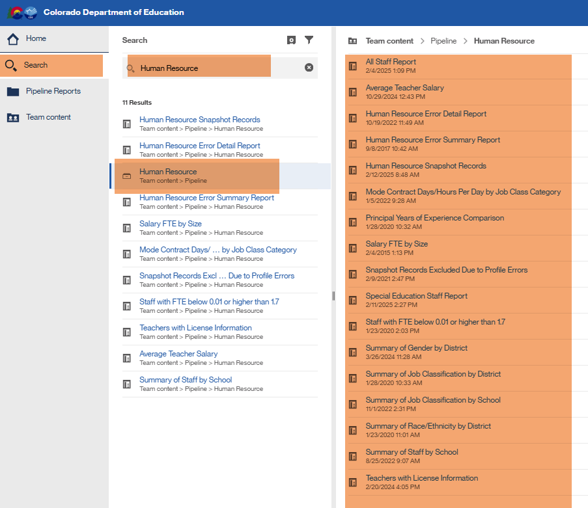
Validating your Data
Using Cognos Reports
Human Resources Snapshot Collection
HumanResourcesData@cde.state.co.us

Slide 20
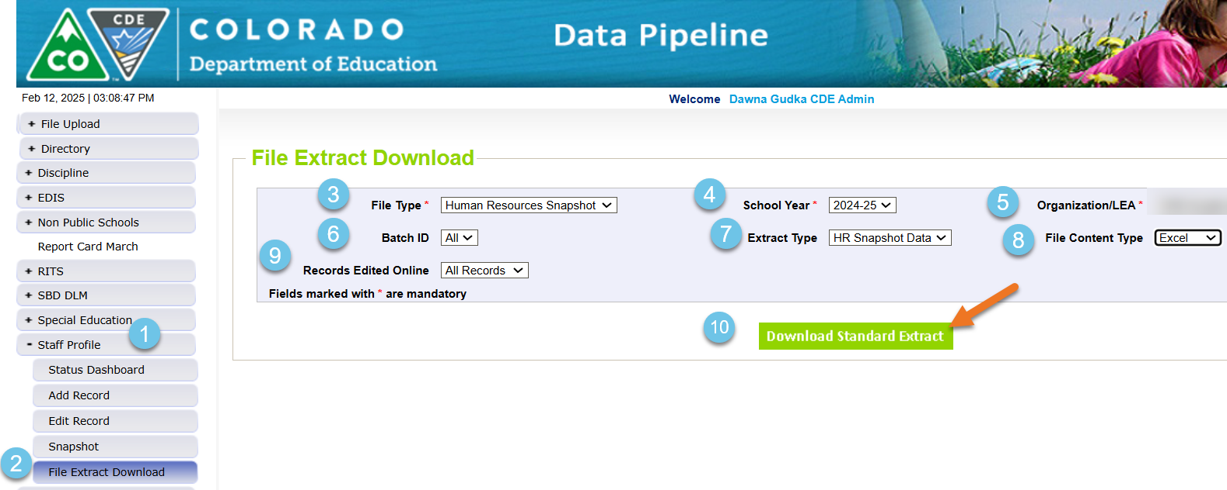
Validating your Data
Verifying that all Non-Special Education Staff and their assignments pulled in the Human Resources Snapshot
Human Resources Snapshot Collection
HumanResourcesData@cde.state.co.us

Slide 21
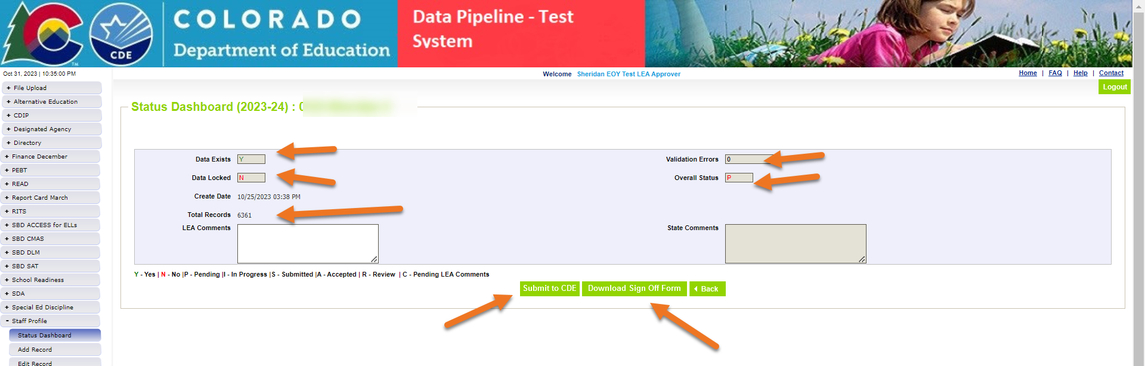
Getting your Human Resources Snapshot Data Submitted
Human Resources Snapshot Collection
HumanResourcesData@cde.state.co.us

Slide 22
Questions & Resources:
Human Resources Snapshot Collection
HumanResourcesData@cde.state.co.us
Dawna Gudka
Collection lead
(303) 598-7901

Slide 23
Special Education December Count
Lindsey Heitman

Slide 24
Special Education December Count:
Final Deadline – Friday, February 21st
Tuesday, February 18 – Friday, February 21 - Final report review and submission to CDE.
  Print and review the 16 reports required for signature by your special education director.
Upload 16 signed reports to the ESSU Data Management System
Approve and lock final snapshot in Data Pipeline by clicking ‘Submit to CDE’ button.
69 AUs -December Count Snapshot Final Submission Status
18 AUs – approved and locked in Data Pipeline→ Data Locked= Y
51 AUs – not yet approved
*NOTE: report 2.10 takes at least 15 minutes to download. Clear your browser cache log out of Data Pipeline. Open a fresh browser and try running it from there. Give it plenty of time to run.
December Count – Lindsey Heitman
SpedDecCount@cde.state.co.us

Slide 25
Special Education December Count:
Steps for Reports Submission
Download the 16 numbered reports from Pipeline (export to PDF- some automatically export as PDF) and make sure all the reported numbers are accurate.
Sign the reports and scan them into one PDF.
Download the “Year-to-Year Flag Explanation Document” found under the Reports section if needed. Special Education December Snapshot webpage
Explain the A flagged count differences using the templates in the flag document (2nd page).
Upload the following to the ESSU Data Management System under Documents:
  Signed and scanned reports (in one single PDF)
  Filled out Flag Explanation template (separate Word document) if necessary
December Count – Lindsey Heitman
SpedDecCount@cde.state.co.us

Slide 26
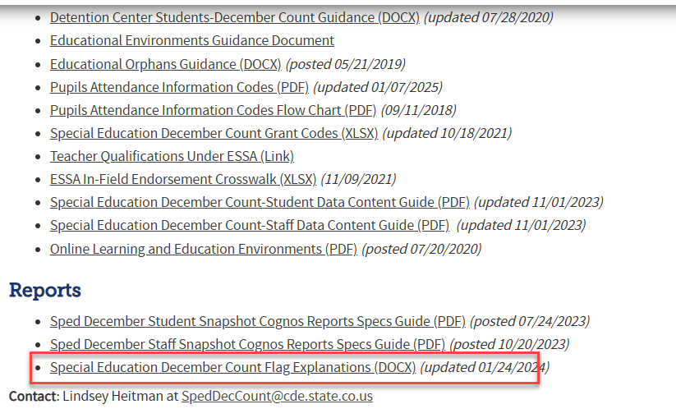
Special Education December Count
Flag Explanation Template
AUs are required to submit an explanation for each A flag on the year-to-year reports.
Use the flag explanation templates in the technical assistance document found on the Special Education December Count Snapshot webpage under the Reports section
December Count – Lindsey Heitman
SpedDecCount@cde.state.co.us

Slide 27
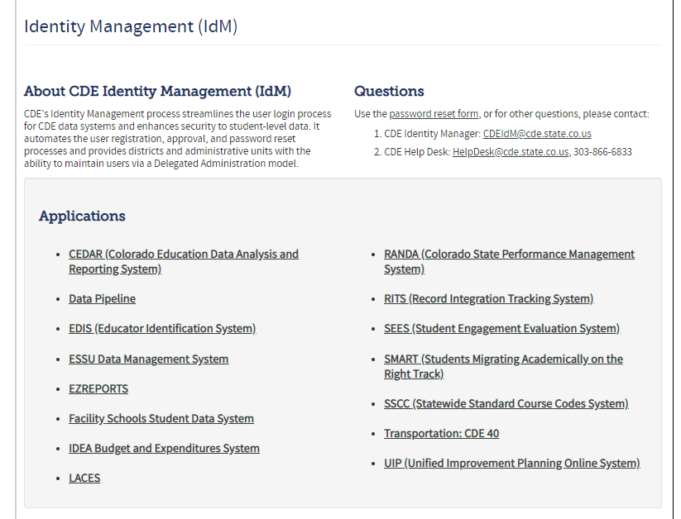
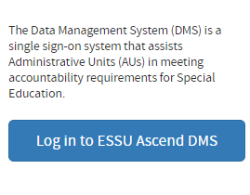
Uploading Reports to the
Data Management System
Log into the Ascend Data Management System
Click “ESSU Data Management System” Link to Data Pipeline Single Sign-on Page (opens in browser)
December Count – Lindsey Heitman
SpedDecCount@cde.state.co.us

Slide 28
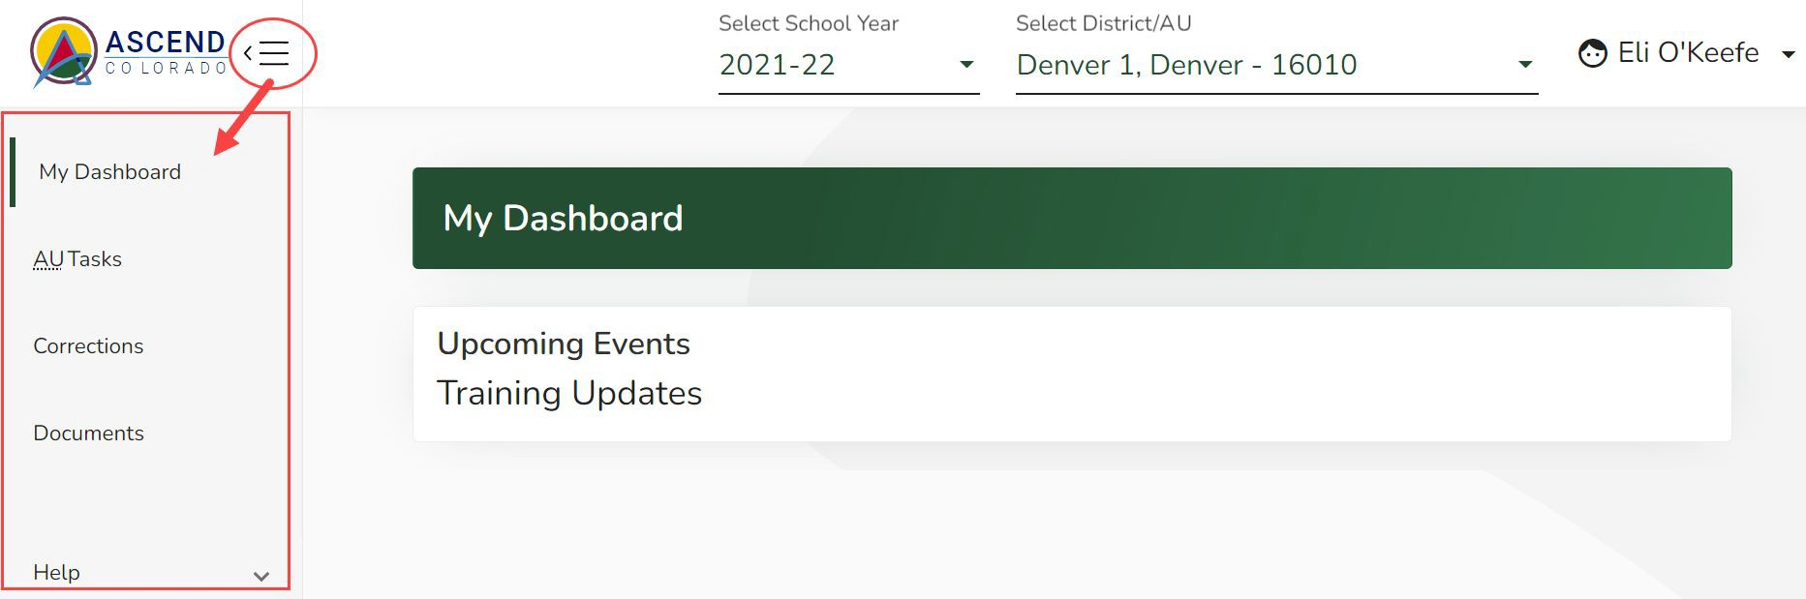
Special Education December Count – Reports Due for Upload to the Data Management System
By February 21, 2025
  Upload Required Reports to the Data Management System
    Staff Report #’s: 1.0, 1.1,1.2, 1.4, SAM 1.5
    Student Report #’s: 2.0, 2.1, 2.2, 2.3, 2.4, 2.5, 2.6, 2.7, 2.8, 2.9, 2.10
If you have questions on uploading reports to the DMS or would like confirmation of your upload, please email Josh Fails (Fails_J@cde.state.co.us).
Reports are to be uploaded to the Data Management System to the Documents section (Same location as the Discipline and EOY Reports)
SpedDecCount@cde.state.co.us
Notes:
28

Slide 29
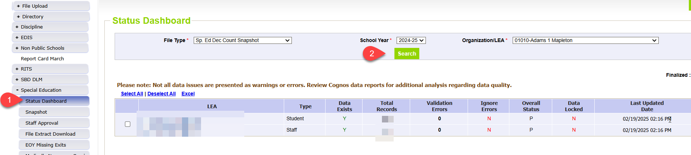
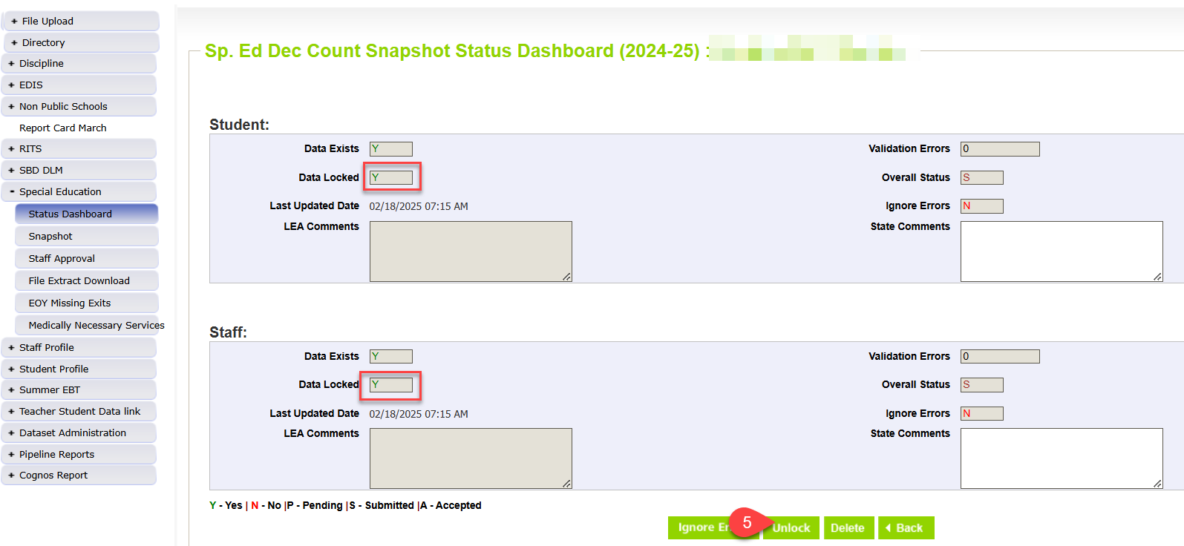
Last Step – Approve and lock final snapshot in Data Pipeline!
SPED December Count – Lindsey Heitman
SpedDecCount@cde.state.co.us

Slide 30
Questions & Resources:
Special Education December Count
Lindsey Heitman
SpedDecCount@cde.state.co.us
(720) 456-2033
Special Education IEP Interchange Webpage
Special Education December Snapshot Webpage

Slide 31
Summer EBT
Collin Slutzky

Slide 32
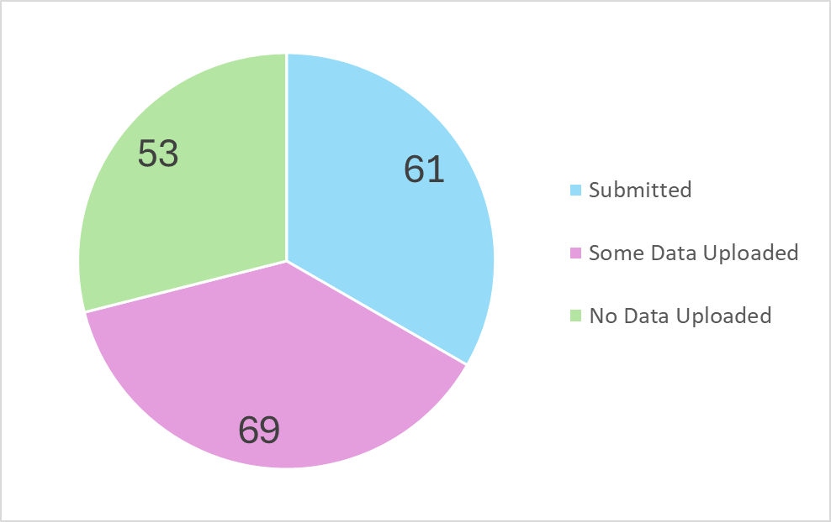
Summer EBT:
Submissions
Summer EBT
s-ebt@cde.state.co.us

Slide 33
Summer EBT Data Collection
Data Collection opened February 3rd.
File layout is unchanged from last year.
Error-free files must be submitted by February 28th.
Districts have the following options for submitting student records:
  Submit data for all students enrolled in National School Lunch Program sites only.
  Submit data for all students enrolled in NSLP sites and data for any F/R eligible transfer students to non-NSLP sites during the school year (any student that was enrolled at a NSLP site, even for a short period of time, would be eligible for S-EBT benefits)
  Submit data for all enrolled students at both NSLP sites and non-NSLP sites.
Submitting data for all enrolled students will be the easiest option for most districts, as your S-EBT reports from your SIS likely use this option.
Summer EBT
s-ebt@cde.state.co.us
Notes:
Your district schools are most likely receiving calls from families to update their address, make sure you are in contact with the appropriate people to make sure this updated information is being captured in the summer EBTcorrections.

Slide 34
Summer EBT Data Collection:
Preparing your file
Verify that Free and Reduced Lunch status is up-to-date for all students.
Every student must have one listed parent/guardian with a valid address.
  Issues with parent/guardian info will delay benefit issuance.
Check the S-EBT report in your SIS and make sure it matches the S-EBT file layout available on the data collection resource page.
  If the S-EBT report from your SIS is missing or incorrect, please contact your vendor immediately and include Collin Slutzky (slutzky_c@cde.state.co.us) on communications.
Bookmark the form to schedule office hours in case you have issues uploading your file or resolving errors.
A data collection manual covering the basic process of submitting S-EBT data is available soon on the collection resources page.
Summer EBT
s-ebt@cde.state.co.us

Slide 35
Summer EBT Data Collection:
Additional Notes
Some errors were not behaving correctly and have been changed to warnings:
  PB272: There are students included in the October Student Count report that are not included in the S-EBT submission for the District.
    This error did not account for students included in October Count for administrative purposes only.
  PB276: Parent's Primary Telephone Number must be a valid year but phone number.
    This error contradicts guidance in the file layout to use “None” for parents/guardians with no phone number.
Please let us know if you think any other errors are behaving incorrectly.
Summer EBT
s-ebt@cde.state.co.us

Slide 36
Questions & Resources:
Summer EBT
Collin Slutzky
s-ebt@cde.state.co.us
(720) 760-3569
S-EBT Data Collection Resources

Slide 37
Student End of Year
Reagan Ward

Slide 38
SEY Collection Phases
Date | Event | Event Description
03/31/2025 to 04/23/2025 | Soft Open Phase | Optional phase LEAs may create snapshots and begin working on SEY snapshot Business rules are still being updated and won’t be finalized until Regular Phase Documentation and resources updated throughout the Spring
05/01/2025 to 09/04/2025 | Regular Phase | Primary collection phase Adjustment File Opens 05/01/2025 SE001 to SE500 series business rules All LEAs must submit their initial error-free snapshot by the 09/04/2025 state deadline
09/18/2025 to 10/16/2025 | Cross LEA Phase | First clean-up phase to validate data across Colorado LEAs SE700 series business rules Final opportunity to update student demographic information, including Title 1 targeted assistance status
10/23/2025 to 11/18/2025 | Post-Cross LEA Phase | Second clean-up phase to validate data across Colorado LEAs SE900 series business rules Anticipated Year of Graduation (AYG) reconciliation Cross references Student October 2025-2026 Data is updated, not ulocked Extremely limited changes
11/21/2025 to 12/02/2025 | Final Review & Superintendent Verification | Final opportunity to review data Superintendent Verification (Sign-Off) form due No changes may occur to data once collection closes
Jan 2026 (date TBD) | Data Release | Graduation/Completion, Dropout, Mobility/Stability rates publicly released Data is embargoed until the release
Student End of Year – Reagan Ward
StudentEndofYear@cde.state.co.us

Slide 39
SEY Training
Critical Training
Additional Support
Collection Overview
  Primary training for SEY collection
  Offered in two identical sessions
    4/2, 9-11am
    4/28, 1-3pm
SEY Collection Manual (PDF)
SEY CEDAR/COGNOS Report Guide (PDF)
Sept. & Oct. Office Hours
  9/16 Focus: Cross LEA Phase
  10/21 Focus: Post-Cross LEA Phase
Collaborative Webinar
  Designed for program staff and data staff to attend together
  Special Education 18-21 Transition
    *Tentative* 4/22, 1-2pm
Monday Office Hours
  Ongoing support
  Select Wednesdays 10:30-11:30am
    5/13, 6/10, 7/15, 8/12, 9/16, 10/21
Short Byte Videos
  Pre-recorded topic-based videos
  Approximately 5 to 15 minutes long
Registration Links and Detailed Training Schedule available on SEY Website
Student End of Year – Reagan Ward
StudentEndofYear@cde.state.co.us

Slide 40
2025 Collection Notes
Changes/Focus?
Reminders
No data field changes
Fixes (from 2024 feedback)
  Migrant internal flag so FRL errors don’t trigger during Post-Cross LEA
  SPED Student internal flag to ensure all students attending SPED Programs indicated as ‘Yes’ when applicable
Minor tweaks and upgrades as needed
  CEDAR/COGNOS reports
  Business Rules
    Gifted and Talented check
    Prior Graduates entry and exit checks, especially related to SPED 18-21 Transition
    Expand use of ‘error details’ for cross collection checks
    Expand change threshold to +/-15% for FRL school level errors (SE181, SE182, SE183)
Include all enrollment records for PK-12 students in attendance at any point during the year
  July 1, 2024, through June 30, 2025
  Some students may have multiple enrollment records
  Include one-day records for students who completed 2023-2024 (school exit type 00) that transferred out of your LEA before the start of 2024-2025
Graduates/completers may be counted through August 31, 2025
Graduation Guidelines required for all graduating students
Required IdM Roles:
  STD~LEA User
  SEY~LEA User or SEY~LEA Approver
Optional IdM Roles for staff reviewing reports:
  STD~LEA Viewer
  SEY~LEA Viewer
Student End of Year – Reagan Ward
StudentEndofYear@cde.state.co.us

Slide 41
Graduation Guidelines:
SAT Math Cut Score Change
September 2024: SBE temporarily adjusted cut score for digital SAT math on the GG menu
  Revised cut-score of 480 ONLY applies to tests completed in 2024 through 2026
    GG Completion years 20232024, 20242025, 20252026
  SAT Math cut-score for tests completed in 2023 and earlier remains 500
No change to GG data reporting
Change impacts the use of SAT Math data
  Impacts student Graduating in 2025 and 2026 (exit 90, 95, 96)
TBD: Impact for students graduating in 2027 and beyond
Technical Information (PDF) posted on SEY Website
Impact to AYG cohorts
AYG Cohort | Graduating in 2024-2025 Digital SAT Math >= 480 | Graduating in 2025-2026 Digital SAT Math >= 480 | Students Graduating in 2026-2027 or beyond cut score TBD
2027 |  | 3-year graduates | 4-, 5-, 6-, and 7-year graduates
2026 | 3-year graduates | 4-year graduates | 5-, 6-, and 7-year graduates
2025 | 4-year graduates | 5-year graduates | 6- and 7-year graduates
2024 | 5-year graduates | 6-year graduates | 7-year graduates
2023 | 6-year graduates | 7-year graduates
2022 | 7-year graduates
Student End of Year – Reagan Ward
StudentEndofYear@cde.state.co.us

Slide 42
Questions & Resources:
Student End of Year
StudentEndOfYear@cde.state.co.us
720-484-9057
  Student End of Year Collection Website
  Student Interchange Website
  Graduation Guidelines (Program) Website

Slide 43
Student Interchange
Reagan Ward

Slide 44
Spring Key Dates
Date | Event | Event Description
February & March 2025 | Suggestion | Upload DEM, SSA, and GG files and clear DEM errors
04/10/2025 | Suggestion (Other Date) | Upload Graduation Guidelines (GG) file and review COGNOS reports
05/01/2025 | Adjustment File | Adjustment File opens (supports Student End of Year collection)
05/09/2025 | Interim Deadline | Upload initial end of year interchange files (DEM, SSA, GG) *Upload date of 04/01/2025 or later expected to meet this interim deadline
06/11/2025 | Interim Deadline | Error free interchange files (DEM, SSA, GG)
March 2025 | Connected Collection | ACCESS for ELLs SBD
April—June 2025 | Connected Collection | READ Spring Assessments
May 2025 | Connected Collections | Assessment SBDs (CMAS/CoAlt, SAT/PSAT, DLM)
07/11/2025 | Connected Collection | Student Attendance: Snapshot Submission Deadline
07/31/2025 | Connected Collection | Student Discipline: Snapshot Submission Deadline
08/01/2025 | Connected Collection | Special Education Discipline: Collection Closes
08/29/2025 | Connected Collection | Teacher/Student Data Link: Snapshot Submissions Deadline
09/04/2025 | Connected Collection | Student End of Year: Snapshot Submission Deadline (Regular Phase)
09/30/2025 | Connected Collection | Special Education End of Year: Collection Closes
Student Interchange – Reagan Ward
StudentEndofYear@cde.state.co.us

Slide 45
Monitoring Graduation Guidelines
CEDAR/COGNOS Student Profile Reports
Graduation Guidelines Student Summary List
  List of every SASID on your untagged SSA file that has at least one reported GG measure
  Shows if SASID has met minimum Math and minimum English requirement
Graduation Guidelines Student Completion List
  List of every reported measure for SASIDs on your untagged SSA file that have at least one reported GG measure
  Includes benchmark met Y/N
Graduation Guidelines: SASID Lookup
  Includes every reported measure for a specific SASID
  Includes benchmark met Y/N
Resource: GG File General Information and District Considerations (PDF)
Reminders
GG records matched to student by SASID across school years and districts
School Year of Completion field may determine the applicable benchmark for a specific GG (e.g., SAT Math)
  See the GG File Layout (Student Interchange Site) or GG Menu of Options (GG Site) for benchmarks
Check your LEA’s local policies for any additional expectations regarding specific GG measures
Student End of Year checks for minimum GG when a student is also indicated as a graduate (school exit type 90, 95, 96)
Student Interchange – Reagan Ward
StudentEndofYear@cde.state.co.us

Slide 46
Exception Request Process
Download exception request template
Complete template, copying information directly from your error report
  Grade level may be left blank for DEM exceptions
Upload completed request to your LEA’s Syncplicity student folder
  Folder: LEA Code – LEA Name – Student (SEY 2024-25 subfolder)
Email Student End of Year collection to notify request is ready for review
Notes:
School Year 2024-2025 DEM and SSA exceptions handled by SEY Collection lead January 2025 through December 2025
Mid-Year English Learner changes require additional supporting documentation when student has more than 2 years of EL history in Colorado
Template and Directions available on Student Interchange site
Student Interchange – Reagan Ward
StudentEndofYear@cde.state.co.us

Slide 47
Questions & Resources:
Student Interchange
StudentEndOfYear@cde.state.co.us
720-484-9057
  Student Interchange Website
  Graduation Guidelines (Program) Website

Slide 48
SBD Collections
Jasmine Carey
Leon Merker

Slide 49
Introductions
Jasmine Carey
  Back up SBD Collection Lead, SBD support
  Carey_j@cde.state.co.us
Leon Merker
  SBD Collection Lead, Primary SBD support
  Merker_l@cde.state.co.us
SBD Collections
Merker_L@cde.state.co.us

Slide 50
What is the SBD Review?
SBD reviews provide districts with a final opportunity to verify the accuracy of student level demographic and testing administration data for all 3-11 state administered assessments prior to public reporting and accountability calculations.
The data being reviewed during SBD comes from the systems of the vendors who administer the assessment. SBD review gives a final opportunity to review the data within the CDE Data Pipeline system and provides additional checks such as State Student Identifier validation.
Once the review is complete, the data for districts that completed their review are updated and loaded back into the vendor system. The updated data are then used in the final data files and reports, as well as in public reporting and accountability calculations.
SBD Collections
Merker_L@cde.state.co.us

Slide 51
Student Biographical Data (SBD) Timeline
SBD Collections
  There are four collections, one for each assessment vendor
  Details are in the Periodic Collections on the Data Pipeline page
    Documents are currently available for WIDA ACCESS SBD
    Timelines are subject to change; please make sure you have users in each collection group to receive emails about the specific collection
 | Assessment | Data Pipeline Group | SBD Review Window
1 | ACCESS for ELLs® ACCESS for ELLs Alternate | ACC | March 17 – 26, 2025
2 | Colorado PSAT/SAT | SAT | May 13 – 21, 2025
3 | Colorado Measures of Academic Success (CMAS): Mathematics, ELA, CSLA, Science and Social Studies Colorado Alternate (CoAlt): Science and Social Studies | CMS | May 15 – 28, 2025
4 | Colorado Alternate (CoAlt): English Language Arts and Mathematics (Dynamic Learning Maps) | DLM | May 28 – June 4, 2025
SBD Collections
Merker_L@cde.state.co.us

Slide 52
Trainings
WIDA ACCESS for ELLs training webinar will be held March 4th at 1pm
  A Teams invite will be sent to all active users in the ACC group and shared with District Assessment Coordinators
Trainings for the other SBD collections will be held in the first week of May
Assessment will continue to attend Townhall and provide updates when documents are available
SBD Collections
Merker_L@cde.state.co.us

Slide 53
Questions & Resources:
SBD Collections
sbdsupport@cde.state.co.us
SBD WIDA ACCESS for ELLs
SBD PSAT9, PSAT10, and SAT
SBD CMAS and CoAlt
SBD Dynamic Learning Maps

Slide 54
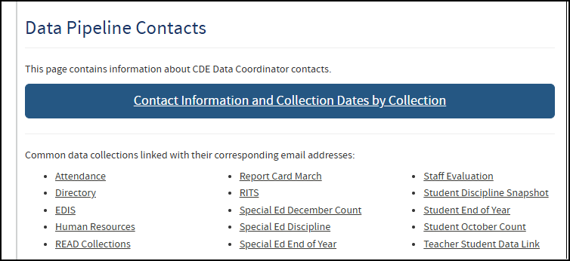
Thank you for joining us today!
Next Town Hall will be February 27th
Reminder:
Many data collections have a specific collection email address. Please use these email addresses when reaching out to CDE collection leads. Visit the Data Pipeline Contact Us page for a list of contacts or visit an individual collection webpage.

