Slide 1
February 13, 2025
Data Pipeline Town Hall
The goal of the webinar is to provide updates on the Data Pipeline, current, and upcoming data collections. These webinars also provide a forum for districts, BOCES, and Administrative Units to have questions answered about Data Pipeline.

Slide 2
Colorado Department of Education
Identity Management (IdM)
Identity Management Site
Frequently Asked Questions
How do I add myself or others to the email listserv for town hall emails and/or a specific collection?
  Email lists are dependent on a person’s access rights in IdM. Contact your LAM to get an account or be assigned to a specific collection.
Where can I find the IdM role mappings for Data Pipeline and other applications?
  Role Mapping (XLS)
I am a LAM. How do I update the user permissions for someone in my district?
  Follow the steps outlined in the IdM Quick Guide for Access Management (DOCX)
Important: Users are not automatically removed from IdM when their email address is no longer active in your district. The LAM must deactivate their IdM account to ensure only designated staff can access CDE’s data reporting system.
Notes:
LAMs, please check the IdM roles for your district. Remove permissions for users who have retired, left your district, or are no longer assigned to a collection. Add roles for new hires and newly assigned respondents for specific collections.

Slide 3

What is PII?
Student and Staff Personally Identifiable Information (PII) is defined by state and federal laws as information that, alone or in combination, personally identifies an individual
  This includes direct identifiers
  (i.e. student and staff names, SASID, EDID, etc.)
  Includes information that when combined is identifiable
Colorado’s Student Data Transparency and Security Act outlines requirements for how Student PII is collected, used and shared
See the Data Privacy and Security website for prepared guidance on how to comply with this and other privacy laws.

Slide 4

Sharing Data
Use secure methods to transfer any PII to CDE
  Contact Data Collection leads with questions about how to transmit PII securely
    Each Data Collection leads maintains their own Syncplicity folders for specific collections, reach out to the collection lead for access
  Use Syncplicity to encrypt emails to CDE
Avoid sending PII via unencrypted email or to unsecured faxes when sharing data between or within districts
  Use Syncplicity to encrypt emails to CDE
Check local policies for restrictions, requirements, etc. regarding PII
  Do not use PII in trainings, presentations, etc.
  Do not share PII with unauthorized individuals
  Do not share passwords
  Follow local policies when transmitting PII to any third party

Slide 5
Today’s Agenda
Agenda Topic | Presenter
Open Data Collections and Upcoming Deadlines in Data Pipeline | Host: Peter Hoffman
Human Resources | Dawna Gudka
Special Education December Count | Lindsey Heitman
Summer EBT | Collin Slutzky

Slide 6
Open Collections and
Upcoming Deadlines in
Data Pipeline

Slide 7
Open Collections and Upcoming Dates:
Year-Round & Interchanges
Name | Category | Status | Key Dates
RITS | Year Round | Open | N/A
EDIS | Year Round | Open | N/A
Directory | Year Round | Open | Reduced Academic Calendar: 2/5/2025 to 5/9/2025 School Code Change Requests: 2/5/2025 to 6/30/2025
Student | Interchange | Open | February Recommendation: Update DEM & SSA files
At-Risk | Interchange | Closed | N/A
Title I | Interchange | Open | May 2025: Update file in preparation for SEY and ATS reporting
Special Education IEP | Interchange | Open | Error free files required for SPED December Count
Staff | Interchange | Open | Error free files required for SPED December and Human Resources
Teacher Student Data Link | Interchange | Open | Opened 12/11/2024
Data Pipeline Resources: Data Pipeline Collection Dates (XLS)

Slide 8
Open Collections and Upcoming Dates:
Snapshots
Name | Category | Status | Final Deadline Date | Next Milestone | Looking Ahead
Special Education December Count | Snapshot | Open | Feb. 21, 2025 | Interim Deadline: 02/10/2025 Snapshot error-free again | 2/10/2025 – 2/18/2025 Resolving duplicates and data validity issues
Human Resources | Snapshot | Open | Feb. 21, 2025 | Interim Deadline: 2/14/2025 Error free Interchanges and Snapshot | Collection deadline 2/21/25
Teacher Student Data Link |  | Closed | Aug. 29, 2025 | Interchange Opened: 12/11/2024 | Snapshot Opens: 2/19/2025
Data Pipeline Resources: Data Pipeline Collection Dates (XLS)

Slide 9
Open Collections and Upcoming Dates:
Periodic
Name | Category | Status | Final Deadline Date | Next Milestone | Looking Ahead
Summer EBT | Periodic | Open | Feb. 28, 2025 | Collection Closes: 2/28/2025 LEAs must submit an error-free file
Data Pipeline Resources: Data Pipeline Collection Dates (XLS)

Slide 10
Human Resources Snapshot Collection
Dawna Gudka

Slide 11

Final Deadline-February 21st, 2025
Human Resources Snapshot Collection
HumanResourcesData@cde.state.co.us

Slide 12
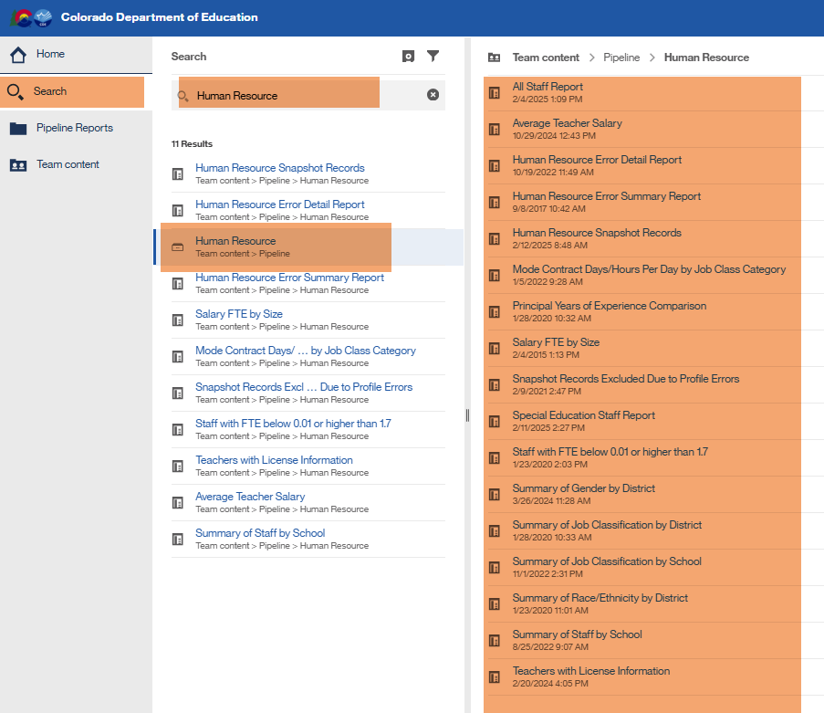
Validating your Data
Using Cognos Reports
Human Resources Snapshot Collection
HumanResourcesData@cde.state.co.us

Slide 13
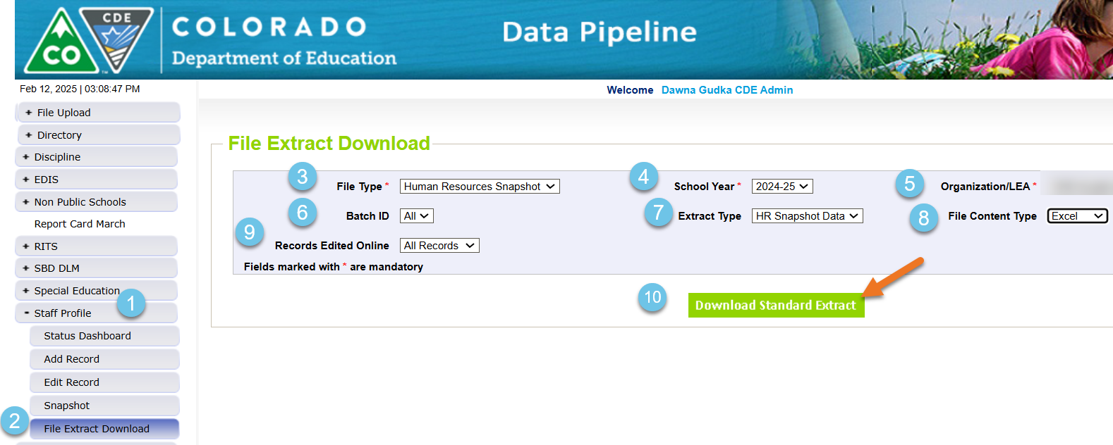
Validating your Data
Verifying that all Non-Special Education Staff and their assignments pulled in the Human Resources Snapshot
Human Resources Snapshot Collection
HumanResourcesData@cde.state.co.us

Slide 14
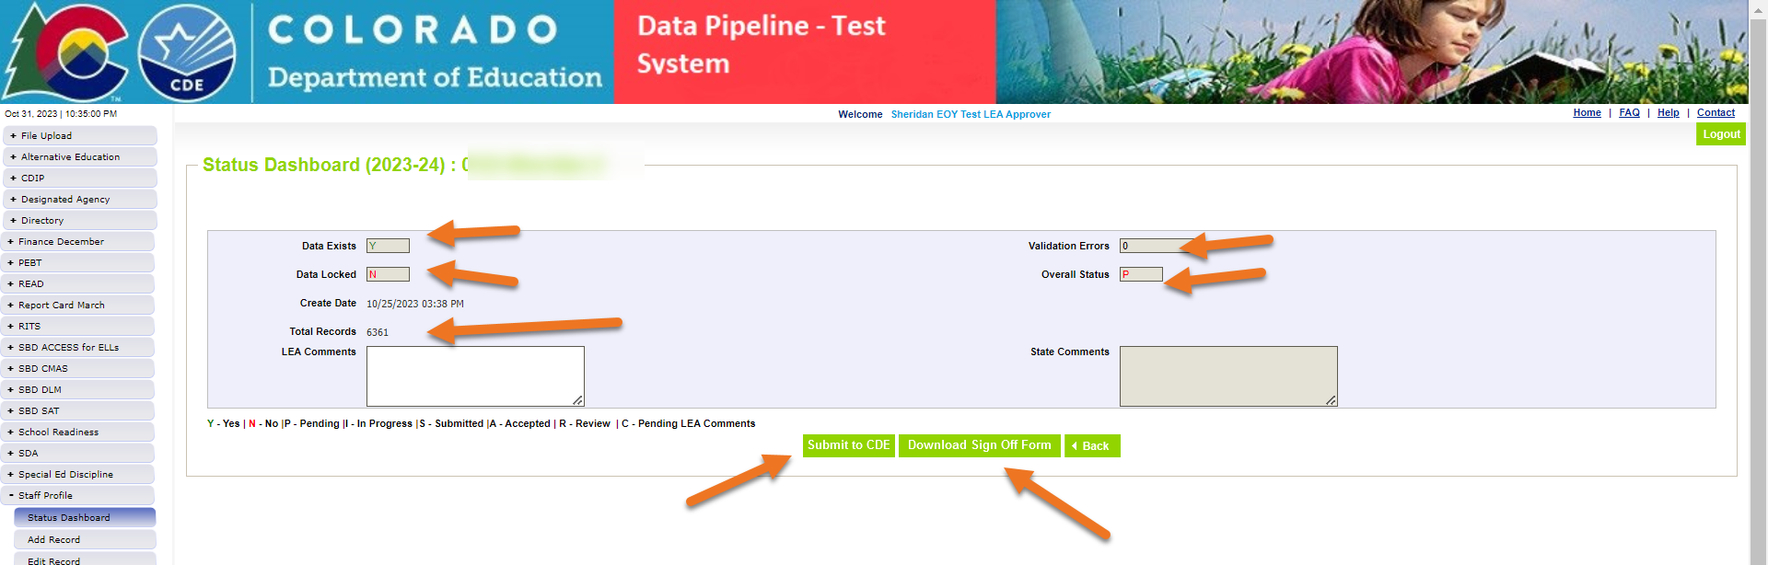
Getting your Human Resources Snapshot Data Submitted
Human Resources Snapshot Collection
HumanResourcesData@cde.state.co.us

Slide 15
Questions & Resources:
Human Resources Snapshot Collection
HumanResourcesData@cde.state.co.us
Dawna Gudka
Collection lead
(303) 598-7901

Slide 16
Special Education
December Count Snapshot
Lindsey Heitman

Slide 17
Special Education December Count:
Final Week Schedule
Tuesday, February 18 - All duplicates resolved and complete error-free snapshot
  we will continue to email you individually until all duplicates are resolved
Tuesday, February 18 – Friday, February 21 - Final report review and submission to CDE.
  Print and review the 16 reports required for signature by your special education director.
Reports and snapshot approval in Pipeline due by Friday, February 21st – Final data file approval in the Data Pipeline and report submission to the ESSU Data Management System
  Remember the final step is clicking ‘Submit to CDE’ in Data Pipeline system
December Count – Lindsey Heitman
SpedDecCount@cde.state.co.us

Slide 18
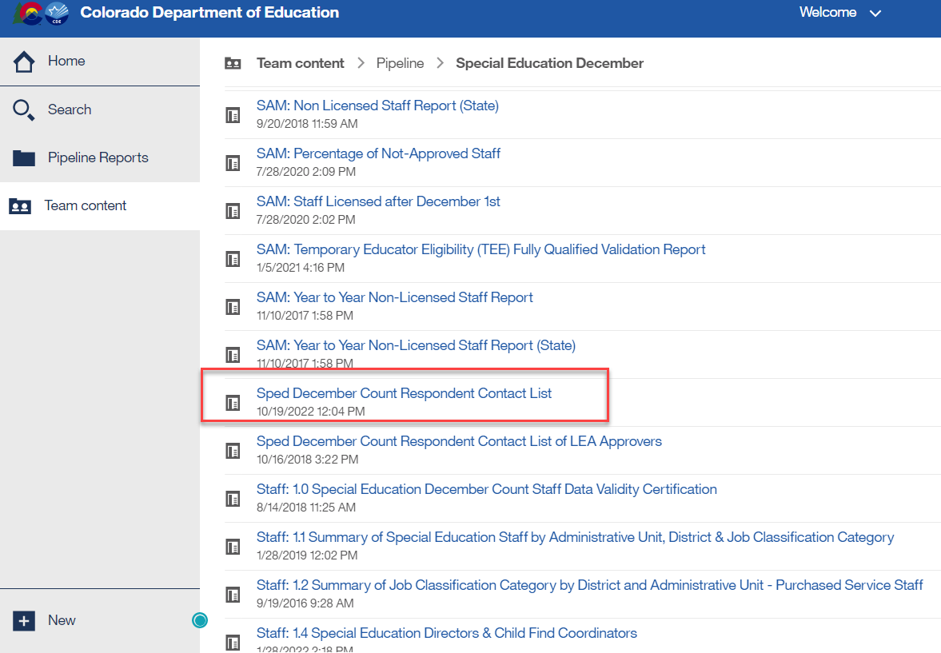
Special Education December Count:
AU Respondent Contact List
To find the other AU contact information, search this report by filtering the Admin Unit # column by your AU #. Be sure to email ALL contacts listed to ensure you catch the right person, sometimes there are many of them.
December Count – Lindsey Heitman
SpedDecCount@cde.state.co.us

Slide 19
Special Education December Count - Student and Staff Signature Reports – Due by February 21st
Cognos Reports→ Special Education December Folder:
December Student Cognos Validation Reports: 2.0 Student Data Validity Certification 2.1 Significant Year to Year Report by Age Group and Disability
2.2 Significant Year to Year Report by Age Group and Race/Ethnicity
2.3 Significant Year to Year Report by Age Group and Educational Environment
2.4 Significant Year-to-Year Educational Orphan Report
2.5 Indicator 5: Number of Students Aged 6-21 by Educational Environment
2.6 Indicator 6: Number of Students Aged 3-5 by Educational Environment
2.7 Number of Reported Students by Special Education Funding Status by Administrative Unit and Disability
2.8 Number of Reported Students Parentally Placed in a Private School by Disability and Type of Service
2.9 Indicator 9: Disproportionate Representation of Racial and Ethnic Groups in Special Education Ages 3-21
2.10 Indicator 10: Disproportionate Representation of Racial and Ethnic Groups in Specific Disability Categories in Ages 3-21
*Please review Student Warnings
December Staff Cognos Validation Reports:
1.0 Staff Data Validity Certification
1.1 Summary of Special Education Staff by Administrative Unit, District & Job Classification Category
1.2 Summary of Job Classification by District Purchased Service Staff
1.4 Special Education Directors & Child Find Coordinators
SAM 1.5 Non-Qualified Personnel Status
*Please review Staff SAM Warnings DC208, DC209, DC210, DC211
SpedDecCount@cde.state.co.us

Slide 20
December Count Staff Report Lists
Reports for Your Director’s Information
District/AU Activity Report
SAM: ALL Certified Staff Report
SAM: Caseload Student Detail (DC210 Detail)
SAM: Caseload Summary (DC210 Summary)
SAM: Percentage of Not-approved Staff
SAM: Staff Licensed after December 1st
SAM: Temporary Educator Eligibility (TEE)
SAM: Year to Year Non-Licensed Staff Report
Detail: Mode Contract Days and Hours Per Day by JCC
Detail: SPED BOCES Staff Reported
Detail: SPED List by JCC
Detail: Teachers with License Info
Grant Project Fund Source Summary
Staff with FTE below 0.01 or higher than 1.7
Summary by Grant Project Code
5 Reports to be Uploaded
1.0 Staff Data Validity Certification
1.1 Summary of Special Education Staff by AU, District & Job Classification Category
1.2 Summary of Job Classification Category by District and AU Purchased Service Staff
1.4 Special Education Directors & Child Find Coordinators
SAM 1.5 Non-Qualified Personnel Status

Slide 21
December Count Student Reports
10 +1 STUDENT Reports to be Uploaded to the Data Management System
Year to Year
Data Summary Reports
    2.7 Number of Reported Students by Special Education Funding Status by AU and Disability
    2.8 Number of Reported Students Parentally Placed in a Private School By Disability and Type of Service
    2.5 Indicator 5
    2.6 Indicator 6
    2.9 Indicator 9
    2.10 Indicator 10
  Year-to-Year:
    2.1 By Age Group and Disability
    2.2 By Age Group and Race/Ethnicity
    2.3 By Age Group and Ed. Environment
    2.4 Educational Orphan
  December Count Flag Explanations if you have flags on any of the above Year-to-Year.
Indicators

Slide 22
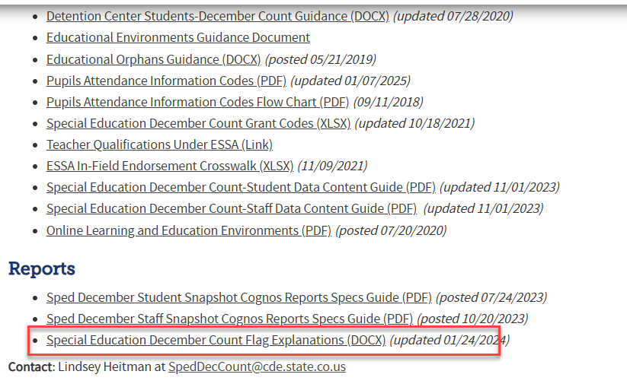
Special Education December Count
Flag Explanation Template
AUs are required to submit an explanation for each A flag on the year-to-year reports.
Use the flag explanation templates in the technical assistance document found on the Special Education December Count Snapshot webpage under the Reports section
December Count – Lindsey Heitman
SpedDecCount@cde.state.co.us

Slide 23
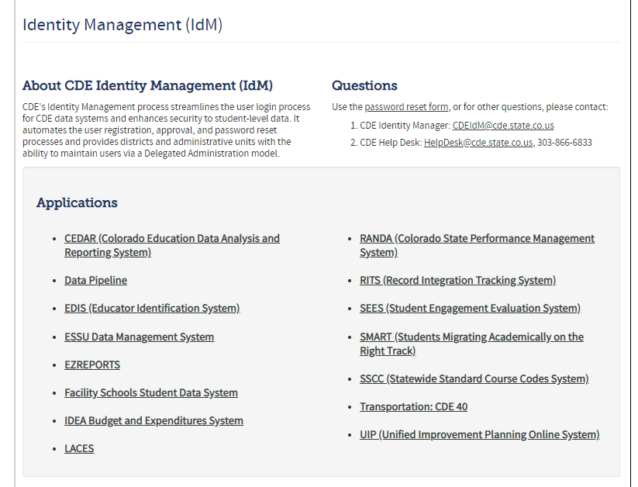
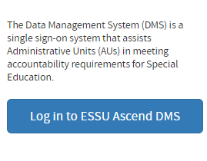
Uploading Reports to the
Data Management System
Log into the Ascend Data Management System
Click “ESSU Data Management System” Link to Data Pipeline Single Sign-on Page (opens in browser)
December Count – Lindsey Heitman
SpedDecCount@cde.state.co.us

Slide 24
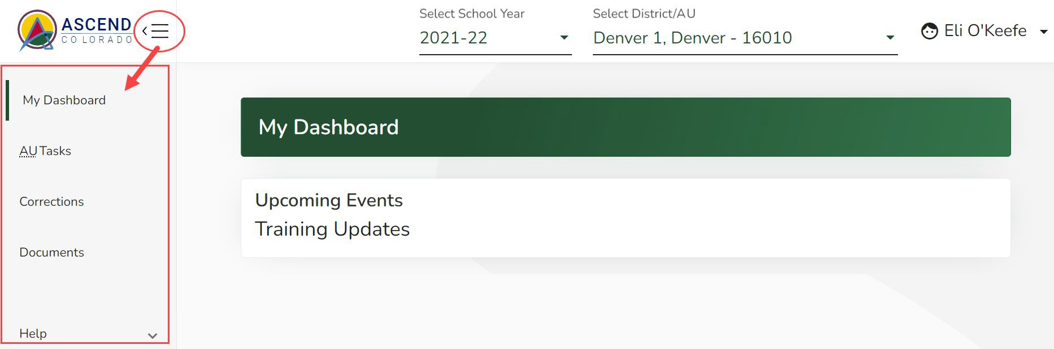
Special Education December Count – Reports Due for Upload to the Data Management System
By February 21, 2025
  Upload Required Reports to the Data Management System
    Staff Report #’s: 1.0, 1.1,1.2, 1.4, SAM 1.5
    Student Report #’s: 2.0, 2.1, 2.2, 2.3, 2.4, 2.5, 2.6, 2.7, 2.8, 2.9, 2.10
Reports are to be uploaded to the Data Management System to the Documents section (Same location as the Discipline and EOY Reports)
If you have questions on uploading reports to the DMS or would like confirmation of your upload, please email Josh Fails (Fails_J@cde.state.co.us).

Slide 25
Questions & Resources:
Special Education December Count
Lindsey Heitman
SpedDecCount@cde.state.co.us
(720) 456-2033
Special Education IEP Interchange Webpage
Special Education December Snapshot Webpage

Slide 26
Summer EBT
Collin Slutzky

Slide 27
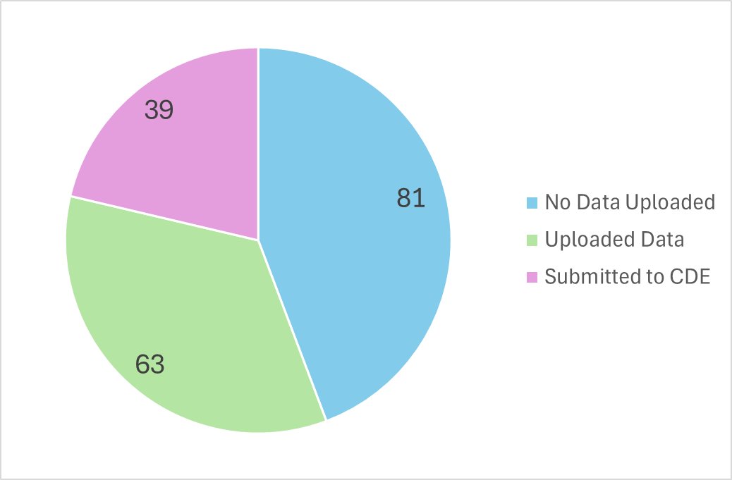
Summer EBT:
Submissions
Summer EBT
s-ebt@cde.state.co.us

Slide 28
Summer EBT Data Collection
Data Collection opened February 3rd.
File layout is unchanged from last year.
Error-free files must be submitted by February 28th.
Districts have the following options for submitting student records:
  Submit data for all students enrolled in National School Lunch Program sites only.
  Submit data for all students enrolled in NSLP sites and data for any F/R eligible transfer students to non-NSLP sites during the school year (any student that was enrolled at a NSLP site, even for a short period of time, would be eligible for S-EBT benefits)
  Submit data for all enrolled students at both NSLP sites and non-NSLP sites.
Submitting data for all enrolled students will be the easiest option for most districts, as your S-EBT reports from your SIS likely use this option.
Summer EBT
s-ebt@cde.state.co.us
Notes:
Your district schools are most likely receiving calls from families to update their address, make sure you are in contact with the appropriate people to make sure this updated information is being captured in the summer EBTcorrections.

Slide 29
Summer EBT Data Collection:
Preparing your file
Verify that Free and Reduced Lunch status is up-to-date for all students.
Every student must have one listed parent/guardian with a valid address.
  Issues with parent/guardian info will delay benefit issuance.
Check the S-EBT report in your SIS and make sure it matches the S-EBT file layout available on the data collection resource page.
  If the S-EBT report from your SIS is missing or incorrect, please contact your vendor immediately and include Collin Slutzky (slutzky_c@cde.state.co.us) on communications.
Bookmark the form to schedule office hours in case you have issues uploading your file or resolving errors.
A data collection manual covering the basic process of submitting S-EBT data is available soon on the collection resources page.
Summer EBT
s-ebt@cde.state.co.us

Slide 30
Summer EBT Data Collection:
Additional Notes
Some errors were not behaving correctly and have been changed to warnings:
  PB272: There are students included in the October Student Count report that are not included in the S-EBT submission for the District.
    This error did not account for students included in October Count for administrative purposes only.
  PB276: Parent's Primary Telephone Number must be a valid year but phone number.
    This error contradicts guidance in the file layout to use “None” for parents/guardians with no phone number.
Please let us know if you think any other errors are behaving incorrectly.
Summer EBT
s-ebt@cde.state.co.us

Slide 31
Questions & Resources:
Summer EBT
Collin Slutzky
s-ebt@cde.state.co.us
(720) 760-3569
S-EBT Data Collection Resources

Slide 32
Thank you for Joining Today!
Next Town Hall will be February 20th
Reminder:
Please do not send PII (Personally Identifiable Information) via email. This includes exception requests!

