Slide 1
February 8th, 2024 Data Pipeline Town Hall
The goal of the webinar is to provide updates on the Data Pipeline, and current or upcoming data collections. These webinars also provide a forum for districts, BOCES, and Administrative Units to have questions answered about Data Pipeline.

Slide 2
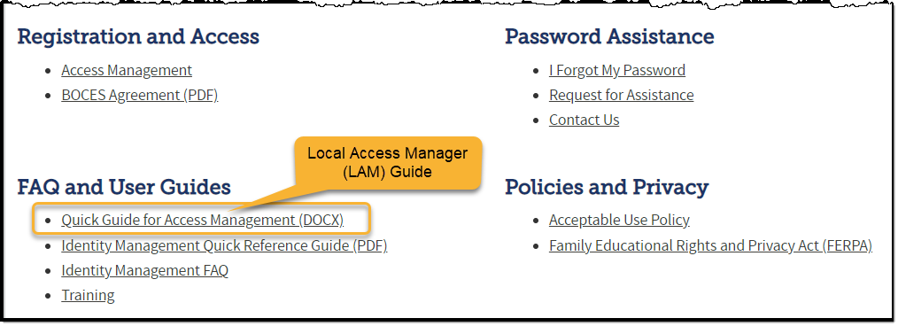
Colorado Department of Education Identity Management (IdM)
Identity Management Site
Frequently Asked Questions
How do I add myself or others to the email listserv for town hall emails and/or a specific collection?
Email lists are dependent on a person’s access rights in IdM. Contact your LAM to get an account or be assigned to a specific collection.
Where can I find the IdM role mappings for Data Pipeline and other applications?
Role Mapping (XLS)

Slide 3
Collection Email Addresses
Additional support has been added to help manage emails for the CDE Team
Some emails may be signed as "Technical Help Support"
The data collection leads you know, and trust are:
Still responding and signing their names as needed
Training & assisting the Technical Help Support staff
Data Collection | Email Addresses
Attendance | Attendance@cde.state.co.us
Directory | DirectoryData@cde.state.co.us
EDIS | EDIS@cde.state.co.us
Human Resources | HumanResourcesData@cde.state.co.us
READ Collections | ReadActData@cde.state.co.us
Report Card March | ReportCard@cde.state.co.us
RITS | RITS@cde.state.co.us
Special Ed December Count | SpedDecCount@cde.state.co.us
Special Ed Discipline | SpedDiscipline@cde.state.co.us
Special Ed End of Year | SpedEndOfYear@cde.state.co.us
Staff Evaluation | StaffEvaluation@cde.state.co.us
Student Discipline Snapshot | StudentDiscipline@cde.state.co.us
Student End of Year | StudentEndOfYear@cde.state.co.us
Student October Count | StudentOctober@cde.state.co.us
Teacher Student Data Link | TeacherStudentDataLink@cde.state.co.us
These email addresses are also posted on the Data Pipeline website and Contact list for reference

Slide 4
What is PII?
Personally Identifiable Information (PII) is defined by state and federal laws as information that, alone or in combination, personally identifies an individual
This includes direct identifiers (i.e. student and staff names, SASID, EDID, etc.)
Includes information that when combined is identifiable
Colorado’s Student Data Transparency and Security Act outlines requirements for how Student PII is collected, used and shared
CDE has prepared guidance on how to comply with this and other privacy laws which can be found here.

Slide 5
Sharing Data
Use secure methods to transfer any PII to CDE
Contact Data Collection leads with questions about how to transmit PII securely
Each Data Collection leads maintains their own Syncplicity folders for specific collections, reach out to the collection lead for access
Use Syncplicity to encrypt emails to CDE
Avoid sending PII via unencrypted email or to unsecured faxes when sharing data between or within districts
Use Syncplicity to encrypt emails to CDE
Check local policies for restrictions, requirements, etc. regarding PII
Do not use PII in trainings, presentations, etc.
Do not share PII with unauthorized individuals
Do not share passwords
Follow local policies when transmitting PII to any third party

Slide 6
Today’s Agenda
Agenda Topic | Presenter
Open Data Collections and Upcoming Deadlines in Data Pipeline
Civil Rights Data Collection (CRDC) | Annette Severson
Human Resources | Dawna Gudka
Special Education December Count | Lindsey Heitman
School Code Change Requests | Jessica Tribbett
Student End of Year | Reagan Ward

Slide 7
Open Collections and Upcoming Deadlines in Data Pipeline

Slide 8
Open Collections and Upcoming Dates – 1 of 2
Name | Category | Status | Key Dates
RITS | Year Round | Open
EDIS | Year Round | Open
Directory | Year Round | Open
Student | Interchange | Open
Title I | Interchange | Open
Special Education IEP | Interchange | Open
Staff | Interchange | Open
TSDL | Interchange | Open
Data Pipeline Resources: Data Pipeline Collection Dates (XLS)

Slide 9
Open Collections and Upcoming Dates – 2 of 2
Name | Category | Status | Final Deadline Date | Deadline Milestone | Looking Ahead
SPED December | Snapshot | Open | Feb. 23, 2024 | Deadline: 2/17/2024 All duplicates and snapshot errors resolved | 02/07/24 – 02/17/24 statewide duplicate process
Human Resources | Snapshot | Open | Feb. 23, 2024 | Deadline 2/15/24 must have a complete error free Human Resources Snapshot | 2/16-2/22 Final Snapshot Report Review
Data Pipeline Resources: Data Pipeline Collection Dates (XLS)

Slide 10
Civil Rights Data Collection 2021-2022 School Year Data
Annette Severson

Slide 11
Overview
The U.S. Department of Education [ED] conducts the Civil Rights Data Collection (CRDC)
Collects data on key education and civil rights issues in our nation's public schools. The CRDC collects a variety of information including, student enrollment and educational programs and services, disaggregated by race/ethnicity, sex, limited English proficiency and disability.
Information collected by the CRDC is also used by other ED offices as well as policymakers and researchers outside of ED.
CRDC 2021-22
Severson_a@cde.state.co.us

Slide 12
CRDC Phases
MAY 15 – JUNE 30 2023
SUMMER/FALL 2023
DEC 11 – FEB 26 2023 - 2024
DEC 11 – FEB 26 2024
SPRING/SUMMER 2024
REGISTRATION
Update and verify contact information and list of schools Update and verify contact information and list of schools
Use tools to review list of data elements and to prepare for the collection School/LEA forms Flat file submission Survey tool guides Excel templates Data elements
REVIEW & SUBMIT DATA
Review and submit data via file upload or manual entry
CERTIFY DATA
COLLECTION TOOLS
Review submitted data and resolve errors and warnings Action plans Reviewing data
DATA QUALITY
Review the data for quality Data quality manuals
PRE-COLLECTION
PRE-COLLECTION
COLLECTION
COLLECTION
POST-COLLECTION
CRDC 2021-22
Severson_a@cde.state.co.us

Slide 13
CRDC Enrollment Error
Elementary Schools with PK grades are showing a CRDC error for the enrollment count
Edit is comparing the PK-12 enrollment count reported to EdFacts by CDE with the K-12 enrollment count reported in the CRDC file
PK counts will cause the error to appear – this is an issue CRDC is aware of but unable to correct at this time
CRDC 2021-22
Severson_a@cde.state.co.us

Slide 14
Verifying PK count is the issue
Compare the CRDC count with the data reported online: 2021-22 PK-12 Race/Ethnicity and Gender by Grade and School
Subtract PK grade level counts to compare with CRDC data
Example below – the total enrollment count minus the PK count equals the K-12 Count for the school
CRDC 2021-22
Severson_a@cde.state.co.us

Slide 15
CRDC Student Enrollment Screen
CRDC 2021-22
Severson_a@cde.state.co.us

Slide 16
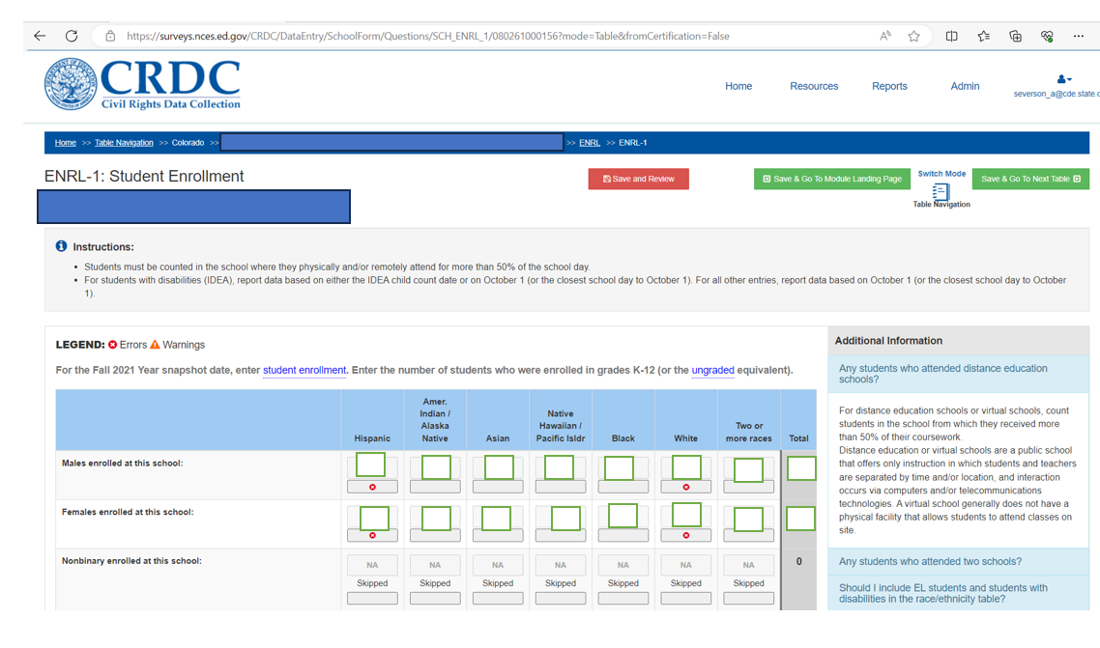
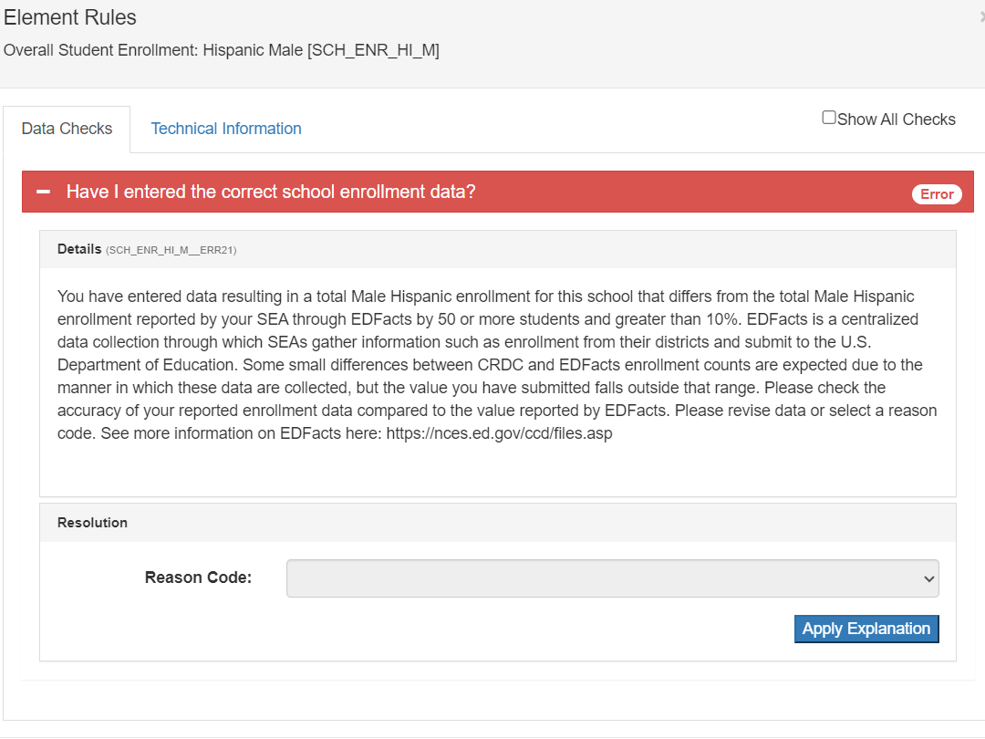
Next Steps for CRDC:
Click on the red x at the bottom of the entry in CRDC
Select a Reason and enter an explanation
Example: PK counts included in EdFacts but not in the CRDC enrollment count
CRDC 2021-22
Severson_a@cde.state.co.us

Slide 17
Contact Information: CRDC 2021-2022
Additional resources: CRDC Resource Center
Questions?
Contact the CRDC Partner Support Center (PSC):
CRDC Partner Support Center
Telephone: 855-255-6901
E - mail: crdc@aemcorp.com
CRDC Resource Center

Slide 18
Human Resources
Dawna Gudka

Slide 19
Human Resources Collection Status
Human Resources Snapshot Collection
Gudka_d@cde.state.co.us

Slide 20
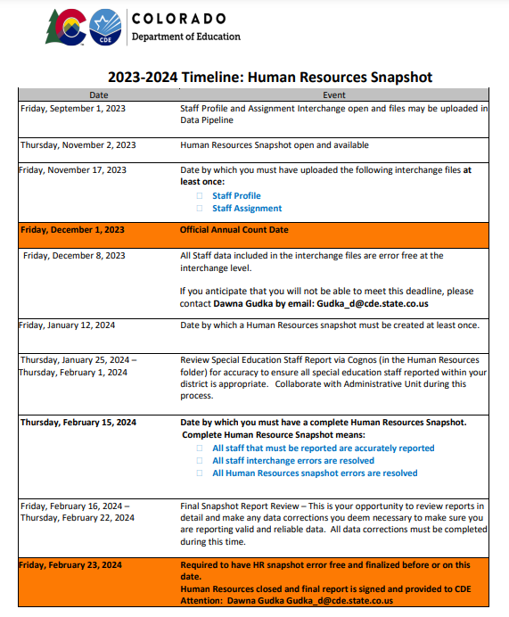
Human Resources Collection Timeline
2/15 Human Resources Snapshot needs to be error free, begin report review
Human Resources Snapshot Collection
Gudka_d@cde.state.co.us

Slide 21
Human Resources Collection Using Pipeline to extract your HR Snapshot Data to validate data
All of your LEA’s NON-SPED staff as of December 1st should be in this extract, that is what gets reported to CDE.
SPED staff get pulled into SPED December count snapshot
Human Resources Snapshot Collection
Gudka_d@cde.state.co.us

Slide 22
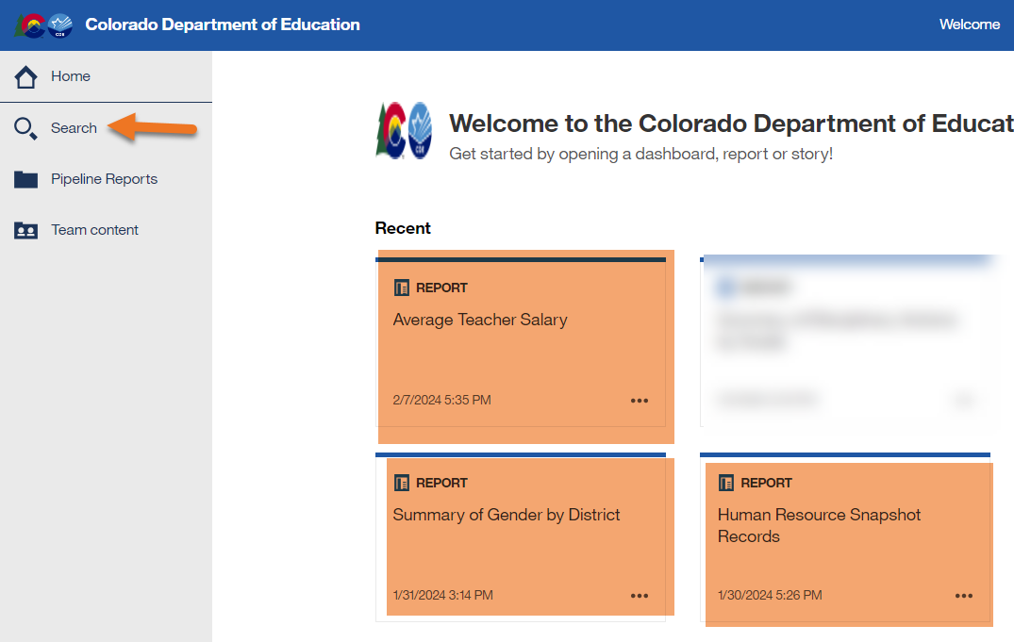
Human Resources Collection Using Cognos to validate data
Use the search to search for all Human Resources reports
Some suggestions:
Human Resources Snapshot Records
Summary of Gender by District
Average Teacher Salary
Human Resources Snapshot Collection
Gudka_d@cde.state.co.us

Slide 23
Human Resources Collection Submit your data to CDE
Human Resources Snapshot Collection
Gudka_d@cde.state.co.us

Slide 24
Questions & Resources for Human Resources Collection
Collection Resources
Staff Interchange
Staff Profile File Layout
Staff Assignment File Layout
Human Resources Snapshot
Questions
Email: Human Resources
Dawna Gudka (303) 598-7901

Slide 25
Special Education December Count
Lindsey Heitman

Slide 26
Special Education December Count – Student Duplicate Resolution Process
Thursday, February 8: AUs notified (either way) of any duplicates by email and received a file in their Syncplicity folder.
February 8 - February 16: AUs research and make file changes to resolve duplicate and data validity issues. Please have all changes made and a complete and error-free snapshot by Friday, February 16th.
February 9– 17: CDE will continue to run the duplicate and validity queries over the next week to verify that all duplicates and data issues are resolved. AUs will be notified once all duplicates and errors are resolved.
Remember this is an on-going process until everyone is duplicate and error free! As AUs make data changes it is possible that new duplicates or validity issues may arise. AUs will be notified as needed should this occur.
*261 student duplicates identified
Special Education December Count - Lindsey Heitman - SpedDecCount@cde.state.co.us (303) 866-5759

Slide 27
Special Education December Count: PAI Coding Help
A-Side District of Attendance Reporting |  | B-Side District of Residence Reporting
01 | Resident, Designated School | n/a | n/a
02 | Resident, Open Enrollment | n/a | n/a
03 | Resident, Non-District Site | n/a | n/a
08 | Resident, Non-Choice | n/a | n/a
04 | Non-Resident, Choice | n/a | n/a
n/a | n/a | 22 | Licensed Eligible Facility Attending On-Grounds School (Approved Facility School)
05 | Non-Resident, Non-Choice | 23 | Licensed Facility, Attending Public School
11 | Non-Resident, Detention Center | 24 | Court-Mandated Juvenile Detention
n/a | n/a | 27 | Non-Oublic School (Contractual Agreement)
n/a | n/a | 28 | Outside of CO, Public Education Agency
n/a | n/a | 29 | Outside of CO, Non-Public School
n/a | n/a | 30 | CO Public Agency (Contractual Agreement)
12 | Non-Resident Administrative Unit Placement | 31 | Administrative Unit (Contractual Agreement)
14 | Resident, Served at District Site | n/a | n/a
15 | Non-Resident, Served at District Site | n/a | n/a
16 | Resident, Non-District Site | n/a | n/a
17 | Non-Resident, Non-District Site | n/a | n/a
19 | State Operated Program | 32 | State Operated Program (AU of residence reporting is optional)
Information on how to report these fields:
School Code
District of Attendance
District of Residence
Funding Status
Helpful coding chart with notes about each code:
http://www.cde.state.co.us/datapipeline/decembercountpaicodes
Special Education December Count - Lindsey Heitman - SpedDecCount@cde.state.co.us (303) 866-5759

Slide 28
Special Education December Count: PAI and Funding Resources
http://www.cde.state.co.us/datapipeline/snap_sped-december
Special Education December Count - Lindsey Heitman - SpedDecCount@cde.state.co.us (303) 866-5759

Slide 29
Special Education December Count: AU Respondent Contact List
To find the other AU contact information, search this report by AU #. Do not search by district name or district code.
Special Education December Count - Lindsey Heitman - SpedDecCount@cde.state.co.us (303) 866-5759

Slide 30
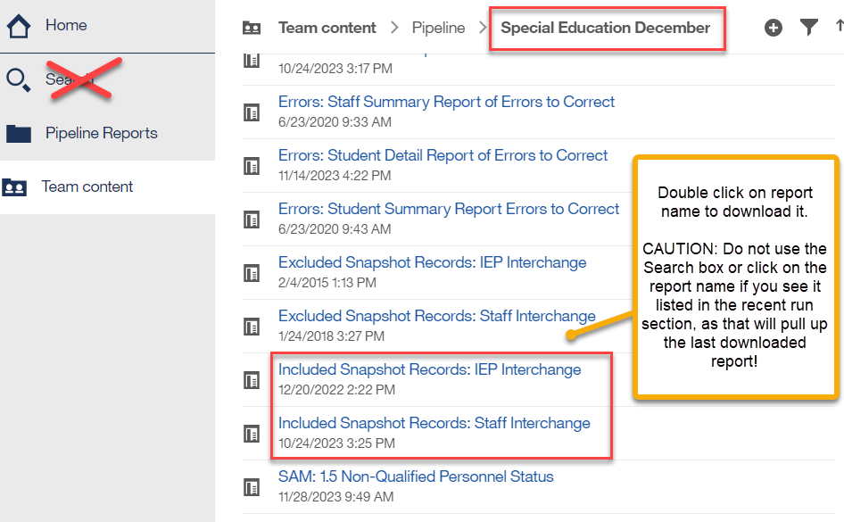
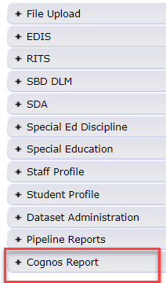
Special Education December Count Snapshot Records Reports
These are your December Student and December Staff Snapshot records.
This is the data you sign off on
These reports contain all records in your final snapshots and can be run for any school year going back at least 10 years.
You can use these reports for internal data requests, to compare and search various data fields, and to see which records are pulling into your snapshot.
I recommend saving a copy of these reports for each snapshot (once final).
Special Education December Count - Lindsey Heitman - SpedDecCount@cde.state.co.us

Slide 31
Pipeline Reports → Records Not in Snapshot
December Count – IMPORTANT CHECK FOR MISSING STUDENT RECORDS:
Records Not in Snapshot Report
Records potentially missing from your snapshot may be found in this report.
Records listed in this report do not meet the snapshot criteria (several reasons this could occur)
Not all records on this report should be in your snapshot. Records are correctly excluded if they have a Start Date or Exit Date that doesn’t overlap 12/01 or no Start Date at all. They are fine to hang out in the Interchange (holding place) until Sped EOY.
Records are excluded from snapshot if :
They have interchange errors - these records should likely be in the snapshot
They don’t have a matching SASID or LASID in the Child and Participation files – these records should likely be in the snapshot
Filter on Snapshot Type ‘December Student’ and each file
Missing records= missed funding! Check for records that were receiving SPED services as of 12/01/23.
Special Education December Count - Lindsey Heitman - SpedDecCount@cde.state.co.us (303) 866-5759

Slide 32
Questions & Resources: Special Education December Count
Lindsey Heitman
SpedDecCount@cde.state.co.us
(303) 866 - 5759
Special Education IEP Interchange Webpage
Special Education December Count Snapshot Webpage

Slide 33
School Code Request
Jessica Tribbett

Slide 34
School Code Request
School Code Changes for 2024-2025 opens on February 5th, 2024
School Code Changes considered are:
New School Code
School Name Change
School Grade Change
Request for Closing/Merging Schools
These request require the School Code Change Request Forms to be submitted for approval. The form requires your superintendents/directors' signature before the request can be reviewed.
School Code Requests – Jessica Tribbett
Jessica_Tribbett@cde.state.co.us

Slide 35
School Code Change Request Process
Request is submitted
School Code Review Committee reviews request
School Code Review Committee votes to approve request or suggest alternative scenarios for moving forward
District notified of approval or SCRC's suggestions for moving forward
Signature page is received
School Code Request – Jessica Tribbett
Jessica_Tribbet@cde.state.co.us

Slide 36
School Code Request Steps
Click here to access the School Code Change Request website
School Code Request – Jessica Tribbett
Jessica_Tribbet@cde.state.co.us

Slide 37
School Code Requests
Questions & Resources Jessica Tribbett Tribbett_Jessica@cde.state.co.us 720-693-6035

Slide 38
Student End of Year
Reagan Ward

Slide 39
New in 2024
Data Fields
Business Rules: Cross Collection
Innovative Learning Opportunities Pilot (ILOP)
From SSA file
Pulled in to mirror Student October fields for analysis by CDE program staff
Last Record School Internal
Existing internal flag that identifies the final enrollment record for a student in a given school
Newly visible to districts on snapshot extract
Complete file layout available on SEY Website
Students who took WIDA Access must be coded with Language Proficiency 1 or 2 (NEP/LEP)
SASID level Assessment to SEY
Homeless status check by SASID
October to SEY
Assessment to SEY
Title 1 Targeted Assistance by SASID
October to SEY
Free Lunch by SASID
October to SEY
Military Connected (SE026)
October to SEY
Language Proficiency (SE209)
October to SEY
Ongoing upgrades: CEDAR/COGNOS reports are under review to update and consolidate reports. Reports that are no longer applicable will be deactivated. Expect updates throughout the Spring regarding this work.
Student End of Year – Reagan Ward
StudentEndOfYear@cde.state.co.us

Slide 40
Timeline Overview
Soft Open (optional) 04/01/24 – 04/26/24
Interim Deadline 4/11/2024 – Upload initial GG file
Regular Phase: 05/02/24 – 09/05/2024
Includes several interim deadlines
Interim Deadlines adjusted to support Student Discipline and Attendance Collection dates
Report Review 08/09/2024 – 09/05/2024
State mandated deadline 09/05/2024
Cross LEA Phase: 09/19/24 – 10/17/24
Post-Cross LEA Phase: 10/24/24 – 11/19/24 noon
Final Review: 11/22/24 – 11/26/24
Districts reconcile any issues found in CDE’s final review process. Impacted districts/BOCES notified directly 11/20-2024-11/21/2024
Superintendent Verification Deadline: 12/03/24
Sign-off form WILL NOT be accepted prior to 11/14/2024
Data Release: 01/14/25
See the Student End of Year website for a detailed collection timeline
Student End of Year – Reagan Ward
StudentEndOfYear@cde.state.co.us

Slide 41
Training
Collection Overview
Offered in two identical sessions
4/3/2024, 1:00-2:30pm
4/29/2024, 9:00-10:30am
Primary training for SEY collection
Strongly suggest that all SEY respondents attend one of the two sessions
Collaborative Webinars
Designed for program staff and data staff to attend together
Postsecondary Programs
3/6/2024, 1:00-2:00pm
Special Education 18-21 Transition
4/22/2024, 1:00-2:00pm
Monthly Office Hours
Ongoing support throughout collection
Select Wednesdays 2:30-3:30pm
5/15, 6/12, 7/17, 8/14, 9/18, 10/23, 11/13
Agenda varies based upon questions from respondents and information pertinent to the specific point in the collection
Short Byte Videos
Pre-recorded topic-based videos
5-15 minutes long
Registration Links & Detailed Schedule available on SEY Website
Student End of Year – Reagan Ward
StudentEndOfYear@cde.state.co.us

Slide 42
General reminders
Business rules are not finalized until the collection opens in May.
Adjustment file does not open until the Regular Phase opens on May 2, 2024.
Documentation and resources updated throughout the Spring.
Tip: begin working on Student Interchange files early
Graduation Guidelines CEDAR/COGNOS reports based upon current interchange information
2023-2024 DEM & SSA exceptions handled by Student End of Year collection lead now through the end of the SEY collection
Graduation Guidelines are required for all graduating students including 5-, 6-, 7- year graduates
Include all enrollment records for PK-12 students in attendance at any point during the year
July 1, 2023 through June 30, 2024
Some students may have multiple enrollment records
Include one-day records for students who completed the prior school year (school exit type 00) that transferred out of your district over the summer
Required Identity Management Roles for respondents completing the collection:
STD~LEA User
SEY~LEA User or SEY~LEA Approver
Optional Role for staff reviewing reports:
STD~LEA Viewer
SEY~LEA Viewer
Student End of Year – Reagan Ward
StudentEndOfYear@cde.state.co.us

Slide 43
Questions & Resources: Student End of Year
Reagan Ward
StudentEndOfYear@cde.state.co.us
720-484-9057
Student End of Year Webpage Student Interchange Webpage Graduation Guidelines Webpage

Slide 44
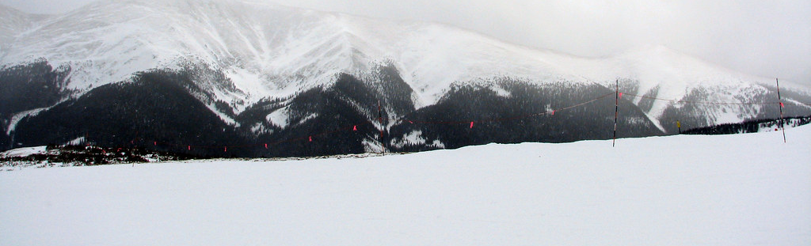
Thank you for joining today!
Next Town Hall will be February 15th, 2024
LAMs: Please review your district’s list of data pipeline users and update permissions as needed.

