Slide 1
February 1st, 2024 Data Pipeline Town Hall
The goal of the webinar is to provide updates on the Data Pipeline, and current or upcoming data collections. These webinars also provide a forum for districts, BOCES, and Administrative Units to have questions answered about Data Pipeline.

Slide 2
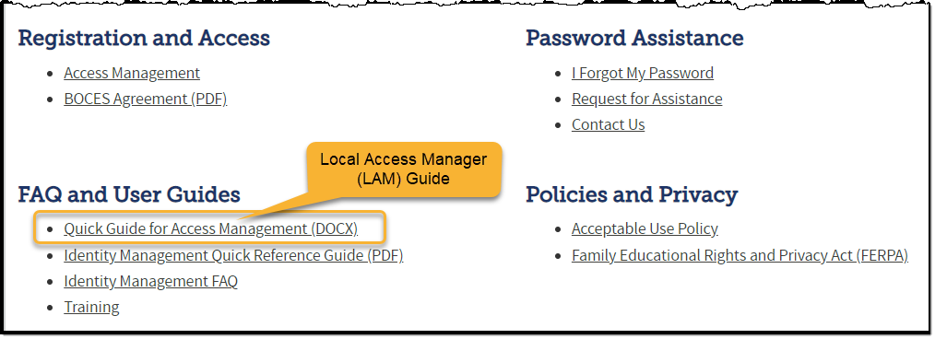
Colorado Department of Education Identity Management (IdM)
Identity Management Site
Frequently Asked Questions
How do I add myself or others to the email listserv for town hall emails and/or a specific collection?
Email lists are dependent on a person’s access rights in IdM. Contact your LAM to get an account or be assigned to a specific collection.
Where can I find the IdM role mappings for Data Pipeline and other applications?
Role Mapping (XLS)

Slide 3
Collection Email Addresses
Additional support has been added to help manage emails for the CDE Team
Some emails may be signed as "Technical Help Support"
The data collection leads you know, and trust are:
Still responding and signing their names as needed
Training & assisting the Technical Help Support staff
Data Collection | Email Addresses
Attendance | Attendance@cde.state.co.us
Directory | DirectoryData@cde.state.co.us
EDIS | EDIS@cde.state.co.us
Human Resources | HumanResourcesData@cde.state.co.us
READ Collections | ReadActData@cde.state.co.us
Report Card March | ReportCard@cde.state.co.us
RITS | RITS@cde.state.co.us
Special Ed December Count | SpedDecCount@cde.state.co.us
Special Ed Discipline | SpedDiscipline@cde.state.co.us
Special Ed End of Year | SpedEndOfYear@cde.state.co.us
Staff Evaluation | StaffEvaluation@cde.state.co.us
Student Discipline Snapshot | StudentDiscipline@cde.state.co.us
Student End of Year | StudentEndOfYear@cde.state.co.us
Student October Count | StudentOctober@cde.state.co.us
Teacher Student Data Link | TeacherStudentDataLink@cde.state.co.us
These email addresses are also posted on the Data Pipeline website and Contact list for reference

Slide 4
What is PII?
Personally Identifiable Information (PII) is defined by state and federal laws as information that, alone or in combination, personally identifies an individual
This includes direct identifiers (i.e. student and staff names, SASID, EDID, etc.)
Includes information that when combined is identifiable
Colorado’s Student Data Transparency and Security Act outlines requirements for how Student PII is collected, used and shared
CDE has prepared guidance on how to comply with this and other privacy laws which can be found here.

Slide 5
Sharing Data
Use secure methods to transfer any PII to CDE
Contact Data Collection leads with questions about how to transmit PII securely
Each Data Collection leads maintains their own Syncplicity folders for specific collections, reach out to the collection lead for access
Use Syncplicity to encrypt emails to CDE
Avoid sending PII via unencrypted email or to unsecured faxes when sharing data between or within districts
Use Syncplicity to encrypt emails to CDE
Check local policies for restrictions, requirements, etc. regarding PII
Do not use PII in trainings, presentations, etc.
Do not share PII with unauthorized individuals
Do not share passwords
Follow local policies when transmitting PII to any third party

Slide 6
Today’s Agenda
Agenda Topic | Presenter
Open Data Collections and Upcoming Deadlines in Data Pipeline
Human Resources | Dawna Gudka
Special Education December Count | Lindsey Heitman
School Code Change Requests | Jessica Tribbett

Slide 7
Open Collections and Upcoming Deadlines in Data Pipeline

Slide 8
Open Collections and Upcoming Dates – 1 of 2
Name | Category | Status | Key Dates
RITS | Year Round | Open
EDIS | Year Round | Open
Directory | Year Round | Open
Student | Interchange | Open | Tip: Upload graduation guidelines (GG) file to utilize GG COGNOS reports in preparation for Spring collections.
Title I | Interchange | Open
Special Education IEP | Interchange | Open
Staff | Interchange | Open
TSDL | Interchange | Open
Data Pipeline Resources: Data Pipeline Collection Dates (XLS)

Slide 9
Open Collections and Upcoming Dates – 2 of 2
Name | Category | Status | Final Deadline Date | Deadline Milestone | Looking Ahead
SPED December | Snapshot | Open | Feb. 23, 2024 | Deadline: 2/05/2024 All snapshot errors resolved | 02/07/24 – 02/16/24 statewide duplicate process
Human Resources | Snapshot | Open | Feb. 23, 2024 | ALL interchange files need to be error free 1/25-2/1 Review process | 2/15/24 must have a complete error free Human Resources Snapshot
Data Pipeline Resources: Data Pipeline Collection Dates (XLS)

Slide 10
Human Resources
Dawna Gudka

Slide 11
Human Resources Collection Status
Human Resources Snapshot Collection
Gudka_d@cde.state.co.us

Slide 12
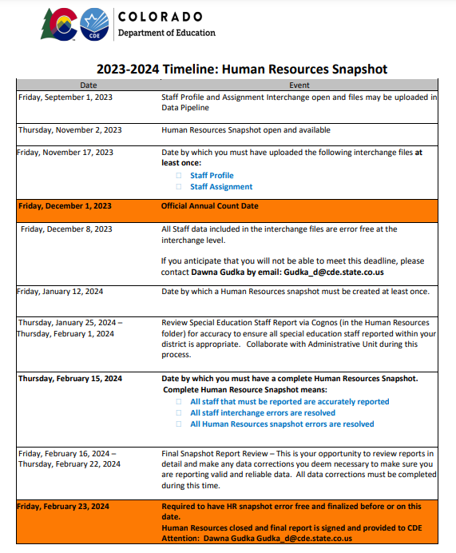
Human Resources Collection Timeline
Interchange files must be error free and LEA's should be working on Snapshot errors. Then files should be reviewed for data accuracy.
Human Resources Snapshot Collection
Gudka_d@cde.state.co.us

Slide 13
Human Resources Collection Educators Shortage Survey
HR230 The Educator Shortage Survey has not yet been indicated as completed. This will be updated every Thursday evening. To complete the Educator Shortage Survey
This must be completed before you can submit your Human Resources Data to CDE
Human Resources Snapshot Collection
Gudka_d@cde.state.co.us

Slide 14
Human Resources Collection Using Pipeline to extract your HR Snapshot Data to validate data
All of your LEA’s NON-SPED staff as of December 1st should be in this extract, that is what gets reported to CDE.
SPED staff get pulled into SPED December count snapshot
Human Resources Snapshot Collection
Gudka_d@cde.state.co.us

Slide 15
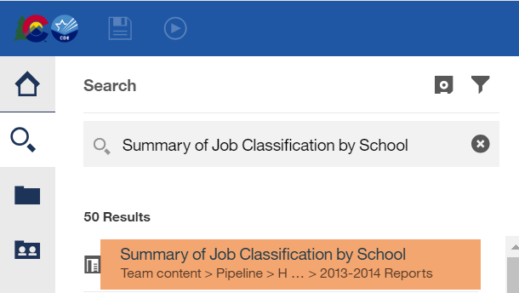
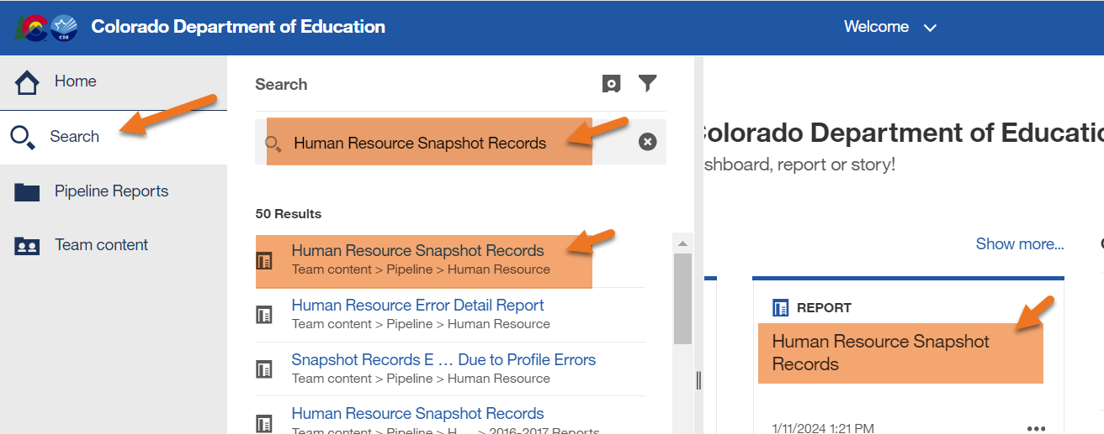
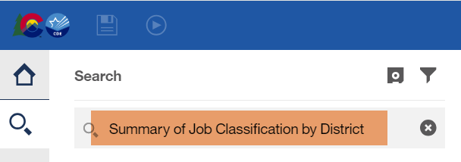
Human Resources Collection Using Cognos to validate data
Human Resources Snapshot Collection
Gudka_d@cde.state.co.us

Slide 16
Human Resources Collection Submit your data to CDE
Human Resources Snapshot Collection
Gudka_d@cde.state.co.us

Slide 17
Questions & Resources for Human Resources Collection
Collection Resources
Staff Interchange
Staff Profile File Layout
Staff Assignment File Layout
Human Resources Snapshot
Questions
Email: Human Resources
Dawna Gudka (303) 598-7901

Slide 18
Special Education December Count
Lindsey Heitman

Slide 19
Special Education December Count: February Schedule
Monday, February 5 - STATE DEADLINE Date by which the Administrative Unit should have a complete Special Education December Count Snapshot in Data Pipeline
February 7 – February 15 – Duplicate Process – AUs work together to resolve duplicate student records
February 15 – February 23 – Final Report Review Complete error-free snapshot and reports submission due to CDE due by the 23rd
February 23 – Final submission due to CDE – approve snapshot in the Data Pipeline and upload student and staff reports to the Data Management System
Special Education December Count- Lindsey Heitman SpedDecCount@cde.state.co.us

Slide 20
December Count - Student and Staff Signature Reports – Please review now but not due for upload until February 23
1.0 Staff Data Validity Certification
2.0 Student Data Validity Certification
These two reports are due with the final reports
They list all of the signature reports (listed on the left here) that should be reviewed by your director
Special Education December Count- Lindsey Heitman SpedDecCount@cde.state.co.us

Slide 21
SAM Warnings DC208, DC209, DC210, DC211
SAM Warnings are found in your Special Education December Staff Error/Warning Reports (view in either Pipeline error reports or Cognos error reports)
SAM Warning DC208 – Staff did not hold a valid license on December 1st (high severity issue)
SAM Warning DC209 – Staff does not hold an appropriate endorsement for the assignment
SAM Warning DC210 – Staff does not hold an appropriate endorsement for the caseload
SAM Warning DC211 – Staff does not hold a valid license (high severity issue)
Note: Snapshot errors should be resolved before you review SAM Warnings DC209/DC210 (caseload).
Typically, both DC209/DC210 generate for special education teachers (202) and speech-language pathologists (238) who do not satisfy SAM approval criteria.
SAM Warnings should be investigated - some may be resolved by correction of data, i.e., incorrect SSN, job code miscoding, student disability caseload discrepancy.

Slide 22
Special Education December Count: SAM Reference Documents Reference Documents
Guidance documents to assist in proper job coding, allowable license types and appropriate special education endorsements are posted at: https://www.cde.state.co.us/datapipeline/snap_sped-december
Staff Approval Matrix (SAM) and Licensing References:
Special Education Licensing Requirements by Job Classification and Fully Qualified Status
Special Education Endorsement Qualifications by Assignment, Disability, and Age of Student
(50% caseload match criteria by student disability)
Staff Approval Matrix (SAM: 1.5) Report Fact Sheet
Special Education December Count- Lindsey Heitman SpedDecCount@cde.state.co.us

Slide 23
Special Education December Count: SAM – Staff Approval Matrix
Sam Warnings DC209/DC210 – Student Disability Caseload issues
Will trigger if the majority of the student disability types in the caseload are not appropriate for the Primary Provider license/endorsement
Example: A sped teacher/202 is serving a caseload majority of students with disability 08.
Students with a disability of 08 Speech or Language Impairment should have a primary provider of a 238 Speech Language Pathologist.
An SLP should be the Primary Provider but a 202 could be the secondary provider
Use SAM: DC210 Caseload Detail Report to see the staff and student primary disability type breakdown
Refer to the Special Education Endorsement Requirements per Student Disability spreadsheet posted here to determine which disability types are appropriate for that staff’s endorsement
Refer to the Special Education Licensing Requirements by Job Classification and Fully Qualified Status report to see which endorsements are considered fully qualified per job code – if this doesn’t align SAM DC209 warning will trigger
Special Education December Count- Lindsey Heitman SpedDecCount@cde.state.co.us

Slide 24
Questions & Resources: Special Education December Count
Lindsey Heitman
SpedDecCount@cde.state.co.us
(303) 866 - 5759
Special Education IEP Interchange Webpage
Special Education December Count Snapshot Webpage

Slide 25
School Code Request Jessica Tribbett

Slide 26
School Code Request
School Code Changes for 2024-2025 opens on February 5th, 2024
School Code Changes considered are:
New School Code
School Name Change
School Grade Change
Request for Closing/Merging Schools
These request require the School Code Change Request Forms to be submitted for approval. The form requires your superintendents/directors' signature before the request can be reviewed.
Contact me at Tribbett_Jessica@cde.state.co.us

Slide 27
School Code Request
The process for a school code change request is as follows:
Request is submitted
School Code Review Committee reviews request
School Code Review Committee votes to approve request or suggest alternative scenarios for moving forward
District notified of approval or SCRC's suggestions for moving forward
Signature page is received
Contact me at Tribbett_Jessica@cde.state.co.us

Slide 28
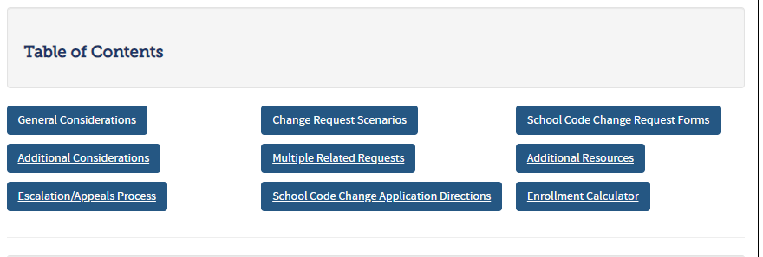
School Code Request
School Code Change Request website:
https://www.cde.state.co.us/datapipeline/schoolcodechanges
Contact me at Tribbett_Jessica@cde.state.co.us

Slide 29
School Code Requests
Questions & Resources Jessica Tribbett Tribbett_Jessica@cde.state.co.us 720-693-6035

Slide 30
Thank you for joining today!
Next Town Hall will be February 8th, 2024
Please use our collection lead email addresses when reaching out with questions!

