Slide 1
January 25th, 2024 Data Pipeline Town Hall
The goal of the webinar is to provide updates on the Data Pipeline, and current or upcoming data collections. These webinars also provide a forum for districts, BOCES, and Administrative Units to have questions answered about Data Pipeline.

Slide 2
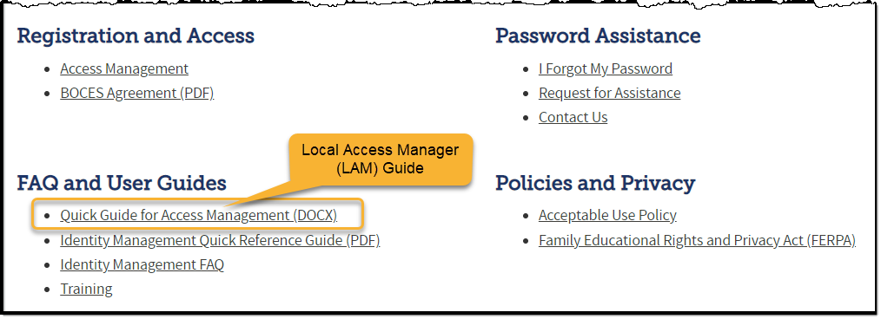
Colorado Department of Education Identity Management (IdM)
Identity Management Site
Frequently Asked Questions
How do I add myself or others to the email listserv for town hall emails and/or a specific collection?
Email lists are dependent on a person’s access rights in IdM. Contact your LAM to get an account or be assigned to a specific collection.
Where can I find the IdM role mappings for Data Pipeline and other applications?
Role Mapping (XLS)

Slide 3
Collection Email Addresses
Additional support has been added to help manage emails for the CDE Team
Some emails may be signed as "Technical Help Support"
The data collection leads you know, and trust are:
Still responding and signing their names as needed
Training & assisting the Technical Help Support staff
Data Collection | Email Addresses
Attendance | Attendance@cde.state.co.us
Directory | DirectoryData@cde.state.co.us
EDIS | EDIS@cde.state.co.us
Human Resources | HumanResourcesData@cde.state.co.us
READ Collections | ReadActData@cde.state.co.us
Report Card March | ReportCard@cde.state.co.us
RITS | RITS@cde.state.co.us
Special Ed December Count | SpedDecCount@cde.state.co.us
Special Ed Discipline | SpedDiscipline@cde.state.co.us
Special Ed End of Year | SpedEndOfYear@cde.state.co.us
Staff Evaluation | StaffEvaluation@cde.state.co.us
Student Discipline Snapshot | StudentDiscipline@cde.state.co.us
Student End of Year | StudentEndOfYear@cde.state.co.us
Student October Count | StudentOctober@cde.state.co.us
Teacher Student Data Link | TeacherStudentDataLink@cde.state.co.us
These email addresses are also posted on the Data Pipeline website and Contact list for reference

Slide 4
What is PII?
Personally Identifiable Information (PII) is defined by state and federal laws as information that, alone or in combination, personally identifies an individual
This includes direct identifiers (i.e. student and staff names, SASID, EDID, etc.)
Includes information that when combined is identifiable
Colorado’s Student Data Transparency and Security Act outlines requirements for how Student PII is collected, used and shared
CDE has prepared guidance on how to comply with this and other privacy laws which can be found here.

Slide 5
Sharing Data
Use secure methods to transfer any PII to CDE
Contact Data Collection leads with questions about how to transmit PII securely
Each Data Collection leads maintains their own Syncplicity folders for specific collections, reach out to the collection lead for access
Use Syncplicity to encrypt emails to CDE
Avoid sending PII via unencrypted email or to unsecured faxes when sharing data between or within districts
Use Syncplicity to encrypt emails to CDE
Check local policies for restrictions, requirements, etc. regarding PII
Do not use PII in trainings, presentations, etc.
Do not share PII with unauthorized individuals
Do not share passwords
Follow local policies when transmitting PII to any third party

Slide 6
Today’s Agenda
Agenda Topic | Presenter
Open Data Collections and Upcoming Deadlines in Data Pipeline
Human Resources | Dawna Gudka
Special Education December Count | Lindsey Heitman
Teacher Student Data Link | Peter Hoffman
Reduced Academic Calendar | Jessica Tribbett
School Code Change Requests | Jessica Tribbett

Slide 7
Open Collections and Upcoming Deadlines in Data Pipeline

Slide 8
Open Collections and Upcoming Dates – 1 of 2
Name | Category | Status | Key Dates
RITS | Year Round | Open
EDIS | Year Round | Open
Directory | Year Round | Open
Student | Interchange | Open | Tip: Upload graduation guidelines (GG) file to utilize GG COGNOS reports in preparation for Spring collections.
Title I | Interchange | Open
Special Education IEP | Interchange | Open
Staff | Interchange | Open
TSDL | Interchange | Open
Data Pipeline Resources: Data Pipeline Collection Dates (XLS)

Slide 9
Open Collections and Upcoming Dates – 2 of 2
Name | Category | Status | Final Deadline Date | Deadline Milestone | Looking Ahead
SPED December | Snapshot | Open | Feb. 23, 2024 | Deadline: 1/25/2024 All snapshot errors resolved | 1/25/24 – 02/02/24 December Count Staff, SAM, and Student Reports Review. Complete and error free Snapshot by Feb 2.
Human Resources | Snapshot | Open | Feb. 23, 2024 | ALL interchange files need to be error free 1/25-2/1 Review process | 2/15/24 must have a complete error free Human Resources Snapshot
Data Pipeline Resources: Data Pipeline Collection Dates (XLS)

Slide 10
Human Resources
Dawna Gudka

Slide 11
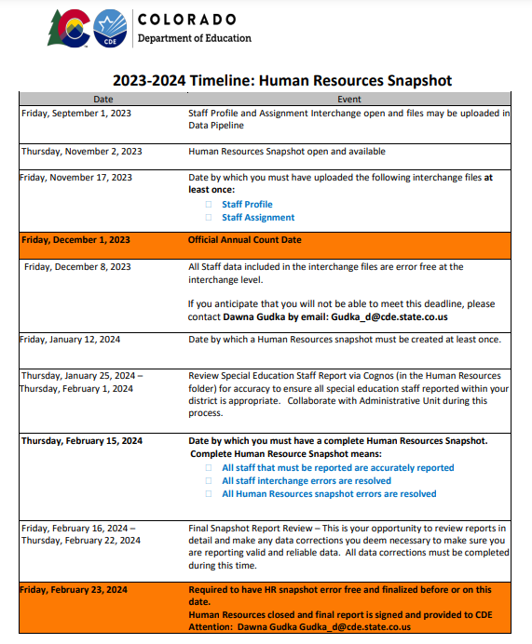
Human Resources Collection Timeline
Interchange files must be error free and LEA's should be working on Snapshot errors. Then files should be reviewed for data accuracy.
Human Resources Snapshot Collection
Gudka_d@cde.state.co.us

Slide 12
Human Resources Collection Educators Shortage Survey
HR230 The Educator Shortage Survey has not yet been indicated as completed. This will be updated every Thursday evening. To complete the Educator Shortage Survey
This must be completed before you can submit your Human Resources Data to CDE
Human Resources Snapshot Collection
Gudka_d@cde.state.co.us

Slide 13
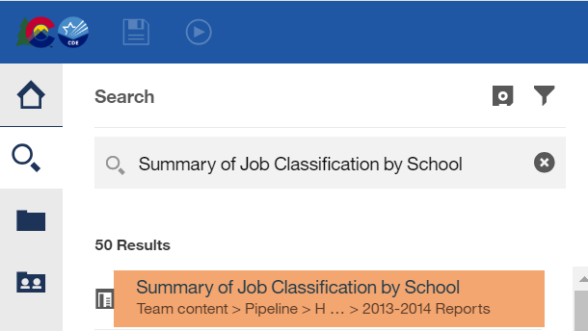
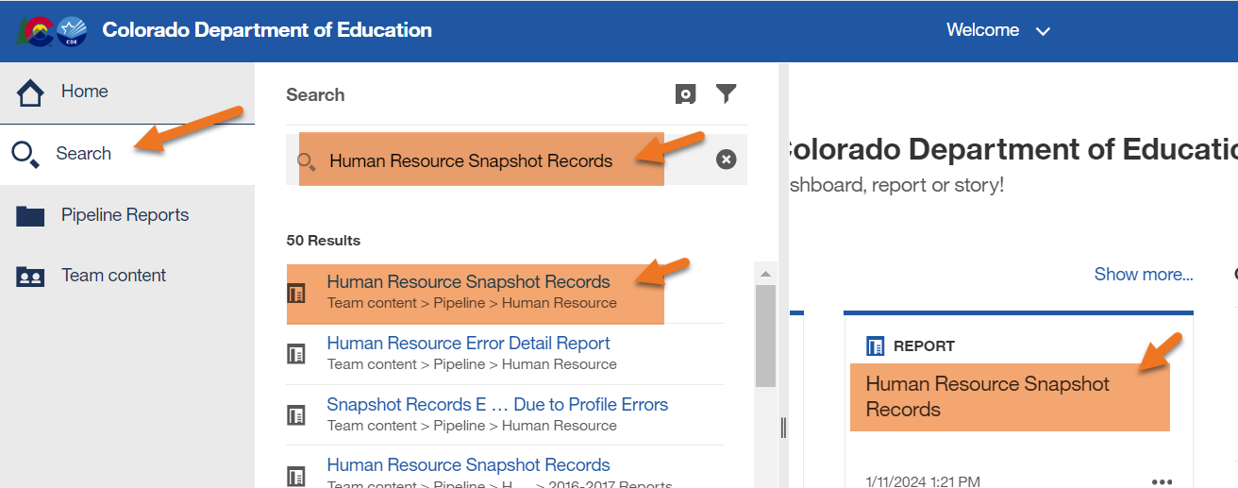
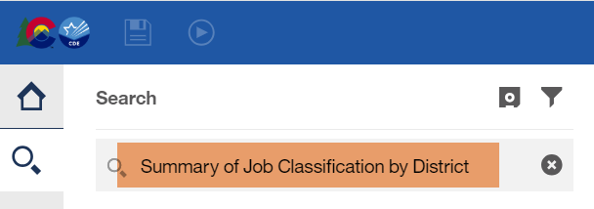
Human Resources Collection Using Cognos to validate data
Human Resources Snapshot Collection
Gudka_d@cde.state.co.us

Slide 14
Human Resources Collection Submit your data to CDE
Human Resources Snapshot Collection
Gudka_d@cde.state.co.us

Slide 15
Questions & Resources for Human Resources Collection
Collection Resources
Staff Interchange
Staff Profile File Layout
Staff Assignment File Layout
Human Resources Snapshot
Questions
Email: Human Resources
Dawna Gudka (303) 598-7901

Slide 16
Special Education December Count
Lindsey Heitman

Slide 17
Special Education December Count: January/February Schedule
Thursday, January 25 – December Count Snapshot Error-Free
All Sped IEP and Sped Staff Interchange errors resolved
All December Count Snapshot errors resolved
Friday, January 26 – Friday, February 2 – Initial Report Review
Review December Count Staff and Student Cognos Reports
No need to sign and submit any reports to CDE until the final report review week
Friday, February 2 - STATE DEADLINE Date by which the Administrative Unit should have a complete Special Education December Count Snapshot in Data Pipeline
February 7 – February 15 – Duplicate Process – AUs work together to resolve duplicate student records
February 15 – February 23 – Final Report Review Complete error-free snapshot and reports submission due to CDE due by the 23rd
Special Education December Count- Lindsey Heitman SpedDecCount@cde.state.co.us

Slide 18
December Count - Student and Staff Signature Reports – Please review now but not due for upload until February 23
Special Education December Count- Lindsey Heitman SpedDecCount@cde.state.co.us

Slide 19
Special Education December Count: Facility Students
Facility School Students – be sure to check for any resident AU students that your district(s) is paying to attend a facility school
Approved Facility School Code list found here
Facility Schools Directory found here
How to code your resident students attending an approved facility school:
School Code = Facility Schools Code (see list above)
PAI Code = 22
District of Attendance = 0000
District of Residence= your member district
Funding Status= 50 or 51
* This type of record should only be reported by the B-side District of Residence
Special Education December Count- Lindsey Heitman SpedDecCount@cde.state.co.us

Slide 20
Special Education December Count: Duplicates Warnings
Duplicate Students – check for these warnings
DC154: Another AU is also claiming a Funding Status of 50 for this student. Please verify attendance and enrollment records for December 1st. If your record is correct you may leave it the same.
DC214: Another AU is reporting that this student is attending in their AU. Please verify attendance and enrollment records for December 1st. If your record is correct you may leave it the same and ignore this warning.
The other reporting AU is now included in the far right column of the error report
Reference ‘Pupils Attendance Information Codes’ document from December Count Snapshot webpage under Additional Links for help with PAI and Funding Status Codes.
Special Education December Count- Lindsey Heitman SpedDecCount@cde.state.co.us

Slide 21
Special Education December Count: AU Respondent Contact List
To find the other AU contact information, search this report by AU #. Do not search by district name or district code.

Slide 22
Questions & Resources: Special Education December Count
Lindsey Heitman
SpedDecCount@cde.state.co.us
(303) 866 - 5759
Special Education IEP Interchange Webpage
Special Education December Count Snapshot Webpage

Slide 23
Teacher Student Data Link (TSDL)
Peter Hoffman

Slide 24
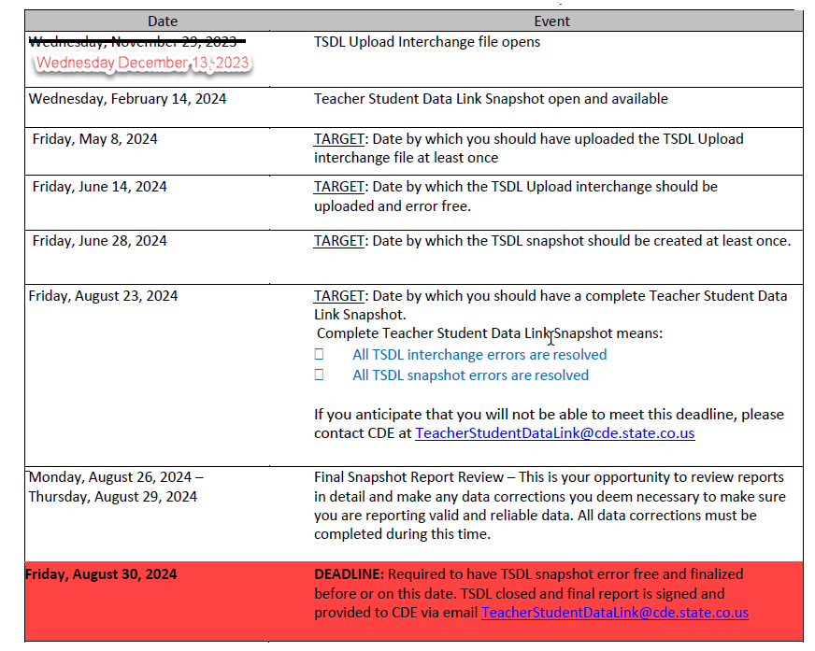
TSDL 2023-2024 Timeline
File layouts and information can be found here:
Teacher Student Data Link Interchange
Utilize first half of the year data to determine what errors you may have come June 2024.
Record expectations: Each student grades 6-12 enrolled for 6 weeks or more in core courses with educator if applicable. Core course means English, Mathematics, Science, and Social Studies.
Peter Hoffman
TeacherStudentDataLink@cde.state.co.us

Slide 25
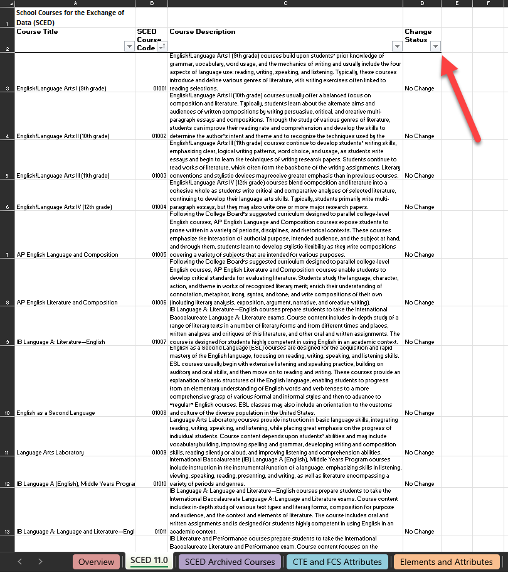
TSDL SCED Codes
Reminder: TSDL uses NCES SCED codes for State Course Codes
SCED Core courses typically start with 01, 02, 03, and 04.
SCED 11 has 26 new courses!
The latest SCED code file can be found at either:
Teacher Student Data Link Interchange or
NCES SCED Codes
Peter Hoffman
TeacherStudentDataLink@cde.state.co.us

Slide 26
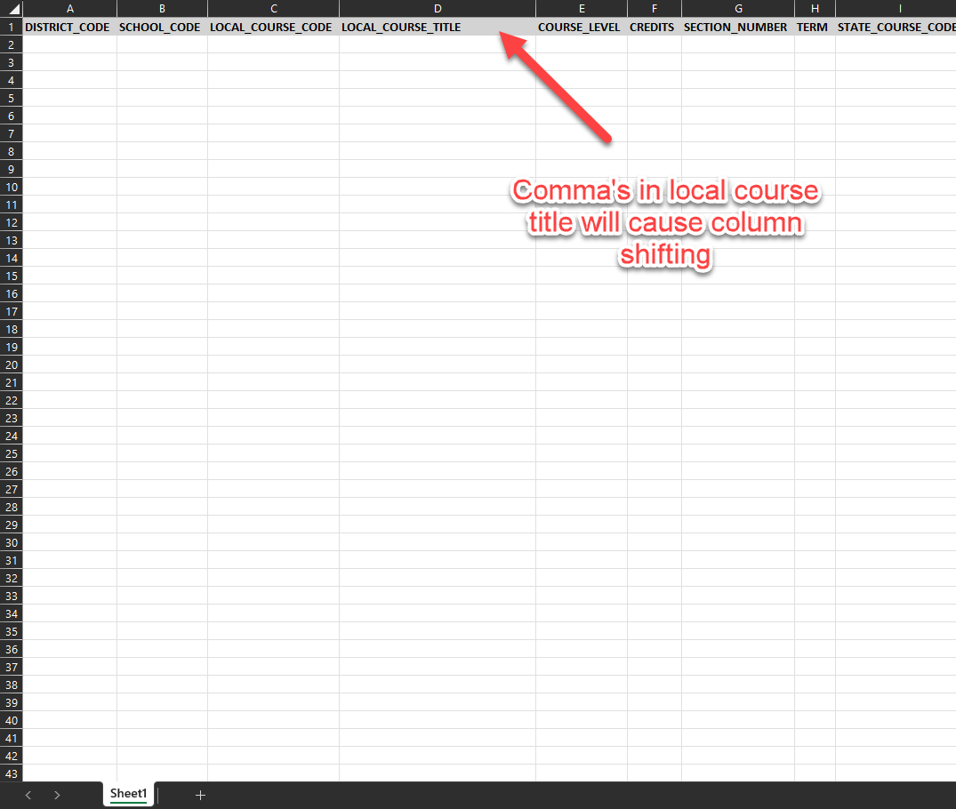
Common Errors
Archived SCED course code
Commas in the Local Course Title
Leading Zeros - if you must manually edit file after extract from SIS, help with keeping leading zeros can be found here.
Peter Hoffman
TeacherStudentDataLink@cde.state.co.us

Slide 27
Questions & Resources: TSDL
Peter Hoffman
720-925-8611
Teacher Student Data Link
TeacherStudentDataLink@cde.state.co.us

Slide 28
Reduced Academic Calendar
Jessica Tribbett

Slide 29
Reduced Academic Calendar
Reduced Academic Calendar Requests*
Fewer than 160 contact days
2/26/2024 – 5/10/2024
*Formally the 4 Day School Week
The general process is the same:
Complete Reduced Academic Calendar Request form in Data Pipeline.
If your district is on a district wide improvement plan, you will need to extra documentation to field services via this webform.
Field services and the commissioner will approve by 6/30/2024 and districts will be notified.
Contact me at Tribbett_Jessica@cde.state.co.us

Slide 30
Reduced Academic Calendar
Request form field updates:
Field Name | Previous Location | New Location
Reduced Academic Calendar (Y/N) | Previously named 4 Day Week Y/N - school level data | Name change – school level data
4 Day School Week | School level data | School level data
Day Not in Session | District level data | School level data
# of Days is Session | District level data | School level data
# of Elem. Hours Scheduled | District level data | School level data
#of Secondary Hours Scheduled | District level data | School level data

Slide 31
Reduced Academic Calendar
Questions & Resources DirectoryData@cde.state.co.us

Slide 32
School Code Request Jessica Tribbett

Slide 33
School Code Request
School Code Changes for 2024-2025 opens on February 5th, 2024
School Code Changes considered are:
New School Code
School Name Change
School Grade Change
Request for Closing/Merging Schools
These request require the School Code Change Request Forms to be submitted for approval. The form requires your superintendents/directors' signature before the request can be reviewed.
Contact me at Tribbett_Jessica@cde.state.co.us

Slide 34
School Code Request
The process for a school code change request is as follows:
Request is submitted
School Code Review Committee reviews request
School Code Review Committee votes to approve request or suggest alternative scenarios for moving forward
District notified of approval or SCRC's suggestions for moving forward
Signature page is received
Contact me at Tribbett_Jessica@cde.state.co.us

Slide 35
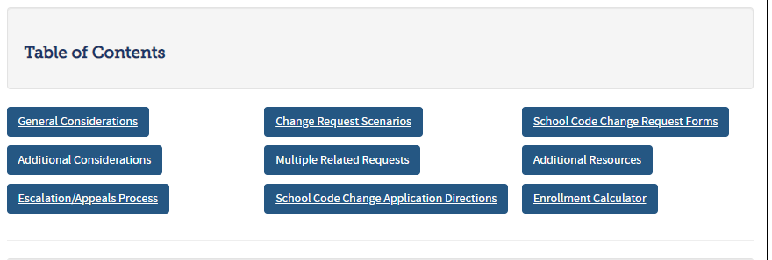
School Code Request
School Code Change Request website:
https://www.cde.state.co.us/datapipeline/schoolcodechanges
Contact me at Tribbett_Jessica@cde.state.co.us

Slide 36
School Code Requests
Questions & Resources Jessica Tribbett Tribbett_Jessica@cde.state.co.us 720-693-6035

Slide 37
Thank you for joining today!
Next Town Hall will be February 1st, 2024
Please use our collection lead email addresses when reaching out with questions!

