Slide 1
January 23, 2025
Data Pipeline Town Hall
The goal of the webinar is to provide updates on the Data Pipeline, current, and upcoming data collections. These webinars also provide a forum for districts, BOCES, and Administrative Units to have questions answered about Data Pipeline.

Slide 2
Colorado Department of Education
Identity Management (IdM)
Identity Management Site
Frequently Asked Questions
How do I add myself or others to the email listserv for town hall emails and/or a specific collection?
  Email lists are dependent on a person’s access rights in IdM. Contact your LAM to get an account or be assigned to a specific collection.
Where can I find the IdM role mappings for Data Pipeline and other applications?
  Role Mapping (XLS)
I am a LAM. How do I update the user permissions for someone in my district?
  Follow the steps outlined in the IdM Quick Guide for Access Management (DOCX)
Important: Users are not automatically removed from IdM when their email address is no longer active in your district. The LAM must deactivate their IdM account to ensure only designated staff can access CDE’s data reporting system.
Notes:
LAMs, please check the IdM roles for your district. Remove permissions for users who have retired, left your district, or are no longer assigned to a collection. Add roles for new hires and newly assigned respondents for specific collections.

Slide 3

What is PII?
Student and Staff Personally Identifiable Information (PII) is defined by state and federal laws as information that, alone or in combination, personally identifies an individual
  This includes direct identifiers
  (i.e. student and staff names, SASID, EDID, etc.)
  Includes information that when combined is identifiable
Colorado’s Student Data Transparency and Security Act outlines requirements for how Student PII is collected, used and shared
See the Data Privacy and Security website for prepared guidance on how to comply with this and other privacy laws.

Slide 4

Sharing Data
Use secure methods to transfer any PII to CDE
  Contact Data Collection leads with questions about how to transmit PII securely
    Each Data Collection leads maintains their own Syncplicity folders for specific collections, reach out to the collection lead for access
  Use Syncplicity to encrypt emails to CDE
Avoid sending PII via unencrypted email or to unsecured faxes when sharing data between or within districts
  Use Syncplicity to encrypt emails to CDE
Check local policies for restrictions, requirements, etc. regarding PII
  Do not use PII in trainings, presentations, etc.
  Do not share PII with unauthorized individuals
  Do not share passwords
  Follow local policies when transmitting PII to any third party

Slide 5
Today’s Agenda
Agenda Topic | Presenter
Open Data Collections and Upcoming Deadlines in Data Pipeline | Host: Dawna Gudka
CRDC | Annette Severson
Special Education December Count | Lindsey Heitman
Summer EBT | Collin Slutzky
Human Resources | Dawna Gudka
Student Discipline | Dawna Gudka

Slide 6
Open Collections and
Upcoming Deadlines in
Data Pipeline

Slide 7
Open Collections and Upcoming Dates:
Year-Round & Interchanges
Name | Category | Status | Key Dates
RITS | Year Round | Open | N/A
EDIS | Year Round | Open | N/A
Directory | Year Round | Open | N/A
Student | Interchange | Open | January Recommendation: Update DEM & SSA files
At-Risk | Interchange | Closed | N/A
Title I | Interchange | Open | May 2025: Update file in preparation for SEY reporting
Special Education IEP | Interchange | Open | Error free files required for SPED December Count
Staff | Interchange | Open | Error free files required for SPED December and Human Resources
Teacher Student Data Link | Interchange | Open | Opened 12/11/2024
Data Pipeline Resources: Data Pipeline Collection Dates (XLS)

Slide 8
Open Collections and Upcoming Dates:
Snapshots
Name | Category | Status | Final Deadline Date | Next Milestone | Looking Ahead
Student End of Year | Snapshot | Closed | Nov. 19, 2024 | Data Release: 1/14/2025 1/22/2025 | SEY 2024-2025 Timeline should be posted mid-February at the latest!
Special Education December Count | Snapshot | Open | Feb. 21, 2025 | Interim Deadline: 01/30/2025 Snapshot error-free | 1/30/2025 – 2/07/2025 Report Review
Human Resources | Snapshot | Open | Feb. 21, 2025 | Interim Deadline: 1/24/2025 Human Resources Snapshot Error Free | 1/24-1/31/2025 Report Review
Teacher Student Data Link |  | Closed | Aug. 29, 2025 | Interchange Opened: 12/11/2024 | Snapshot Opens: 2/19/2025
Data Pipeline Resources: Data Pipeline Collection Dates (XLS)

Slide 9
Open Collections and Upcoming Dates:
Periodic
Name | Category | Status | Final Deadline Date | Next Milestone | Looking Ahead
Summer EBT | Periodic | Closed | Feb. 28, 2025 | Collection Opens: 2/3/2025 LEAs may begin uploading Summer EBT files to Pipeline
Data Pipeline Resources: Data Pipeline Collection Dates (XLS)

Slide 10
Civil Rights Data Collection
Annette Severson

Slide 11
Data Issue- Staff Counts
The Staff Counts pre-populated by CDE was inaccurately calculated
School Form -> STAF table -> STAF-5a: Current Year Teacher Counts
CDE is currently updating the calculations for this field and will provide next steps via email soon (within a week)
Thank you for your understanding and patience as we review and resolve this issue
CRDC
Severson_a@cde.state.co.us

Slide 12
Special Education
December Count Snapshot
Lindsey Heitman

Slide 13
Special Education December Count:
Staff and Student Snapshot Timeline
November Due Dates
December Due Dates
January Due Dates
30th - Thursday - All errors resolved – complete snapshot
February Due Dates
10th – 18th - Monday – Tuesday - Resolving Duplicates
1st - Sunday - Official count date (or last date prior your school was in session)
30th - Feb 7th Thursday – Friday - Report Review
18th – 21st - Tuesday - Friday - Final Report Review
21st - Friday - Final Submission Due
1st - Friday – Sped December Count Snapshot available in Data Pipeline
13th – Wednesday - Interchange files uploaded - Sped Child, Sped Participation, Staff Profile, Staff Assign
18th - Wednesday: Interchange files error free and at least one snapshot created
Next deadline is Thursday, January 30th
6 more business days!
  Date to have a complete Special Education December Count Snapshot:
    All Staff and IEP Interchange errors resolved
    All Dec Staff Snapshot errors resolved
    All Dec Student Snapshot errors resolved
Please download the full 24-25 Timeline from the Special Education December Count Snapshot webpage.
Special Education December Count – Lindsey Heitman
SpedDecCount@cde.state.co.us

Slide 14
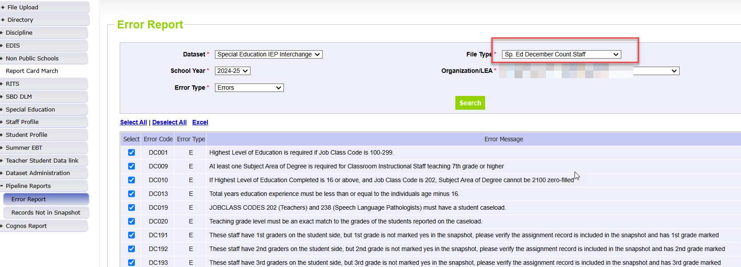
Special Education December Count:
Sp. Ed December Count Staff Error Report
AU respondents are responsible for this error report, but staff respondents can check it too (from Staff interchange cognos folder)
Changes to resolve the errors may be needed in the Staff files OR the IEP Participation File
Special Education December Count – Lindsey Heitman
SpedDecCount@cde.state.co.us

Slide 15
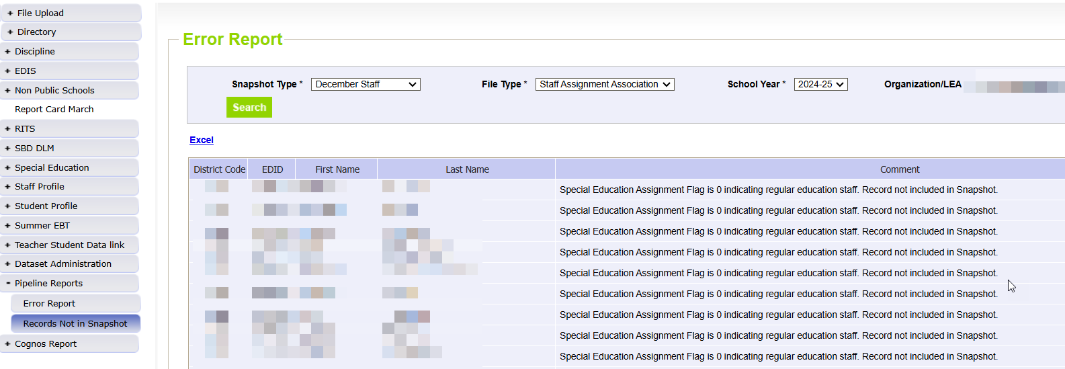
Special Education December Count:
Helpful Report to find why staff EDIDS are missing from your Dec Count Snapshot
Records potentially missing from your snapshot may be found in this report.
Records listed in this report do not meet the snapshot criteria (see reasons below right) but they are not errors!
Use this report to find why a staff or student interchange record is missing from your snapshot
AUs please use this report to locate why a Staff record is missing (to help your staff respondent)
Filter on Snapshot Type ‘December Staff’ and each file type
Record may have error in the Staff Interchange files
Record may not be included in one of the Staff Interchange files
Record may not be marked with Sped Assignment Flag = 1
Record may have an End Date of Assignment prior to 12/01/24
Pipeline Reports → Records Not in Snapshot
Special Education December Count- Lindsey Heitman
SpedDecCount@cde.state.co.us

Slide 16
Questions & Resources:
Special Education December Count
Lindsey Heitman
SpedDecCount@cde.state.co.us
(720) 456-2033
Special Education IEP Interchange Webpage
Special Education December Snapshot Webpage

Slide 17
Summer EBT
Collin Slutzky

Slide 18
Summer EBT Data Collection
Data Collection begins February 3rd.
File layout is unchanged from last year.
Error-free files must be submitted by February 28th.
Districts have the following options for submitting student records:
  Submit data for all students enrolled in National School Lunch Program sites only.
  Submit data for all students enrolled in NSLP sites and data for any F/R eligible transfer students to non-NSLP sites during the school year (any student that was enrolled at a NSLP site, even for a short period of time, would be eligible for S-EBT benefits)
  Submit data for all enrolled students at both NSLP sites and non-NSLP sites.
Submitting data for all enrolled students will be the easiest option for most districts, as your S-EBT reports from your SIS likely use this option.
s-ebt@cde.state.co.us
Summer EBT
Notes:
Your district schools are most likely receiving calls from families to update their address, make sure you are in contact with the appropriate people to make sure this updated information is being captured in the summer EBTcorrections.

Slide 19
Summer EBT Data Collection:
Preparing for the Collection
Verify that Free and Reduced Lunch status is up-to-date for all students.
Every student must have one listed parent/guardian with a valid address.
  Issues with parent/guardian info will delay benefit issuance.
Check the S-EBT report in your SIS and make sure it matches the S-EBT file layout available on the data collection resource page.
  If the S-EBT report from your SIS is missing or incorrect, please contact your vendor immediately and include Collin Slutzky (slutzky_c@cde.state.co.us) on communications.
Plan to submit your first file by Friday, February 7th so you have plenty of time to correct errors.
Bookmark the form to schedule office hours in case you have issues uploading your file or resolving errors. Schedule a meeting with us in January if you would like additional training.
Summer EBT
s-ebt@cde.state.co.us

Slide 20
Summer EBT Data Collection:
Additional Resources
CDE Nutrition will be hosting a training today at 2PM.
  Use this link to register
A data collection manual covering the basic process of submitting S-EBT data will be available soon on the collection resources page.
Summer EBT
s-ebt@cde.state.co.us

Slide 21
Questions & Resources:
Summer EBT
Collin Slutzky
s-ebt@cde.state.co.us
(720) 760-3569
S-EBT Data Collection Resources

Slide 22
Human Resources
Dawna Gudka

Slide 23
Human Resources:
Collection Timeline
Date | Event | Event Description
1/24/25 | Interim Deadline | Human Resources Snapshot Error Free
1/24-1/31/25 | Report Review | Review Special Education Staff Report via Cognos in the Human Resources folder) for accuracy to ensure all special education staff reported within your district is appropriate. Collaborate with your LEA’s Administrative Unite during this process. Verify that all staff are accurately reported.
2/14/25 | Interim Deadline | Staff Profile and Staff Assignment interchange files, and Human Resources Snapshot Error Free
2/21/25 | Deadline* | Human Resources Snapshot must be submitted to CDE and verification emailed to Human Resources Snapshot
Human Resources Snapshot Collection
HumanResourcesData@cde.state.co.us

Slide 24
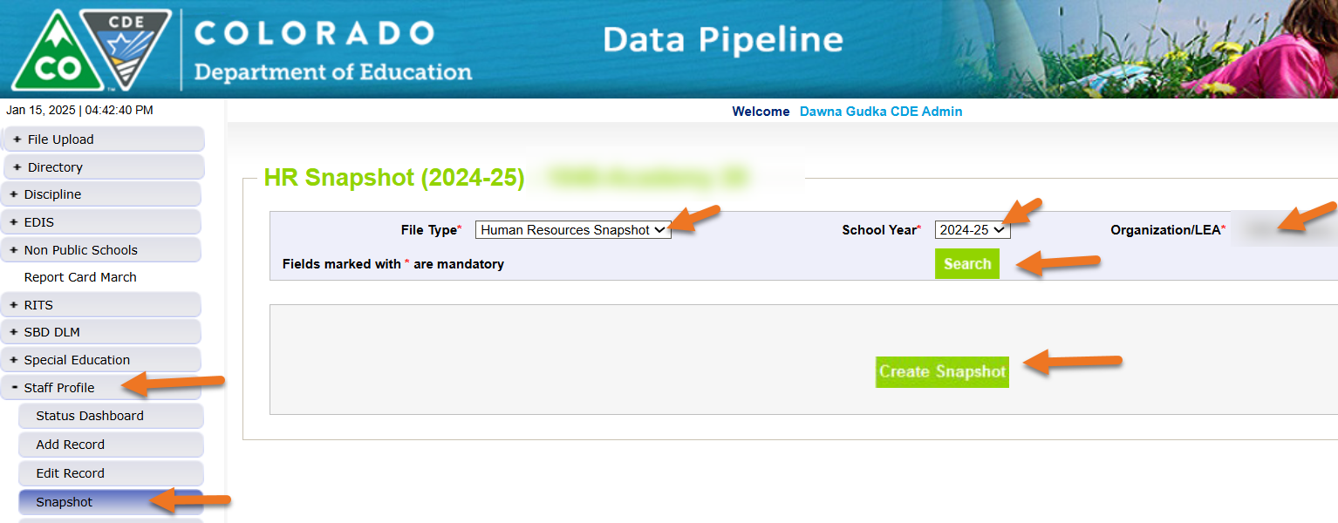
Creating a Human Resources Snapshot
Human Resources Snapshot Collection
humanresourcesdata@cde.state.co.us

Slide 25
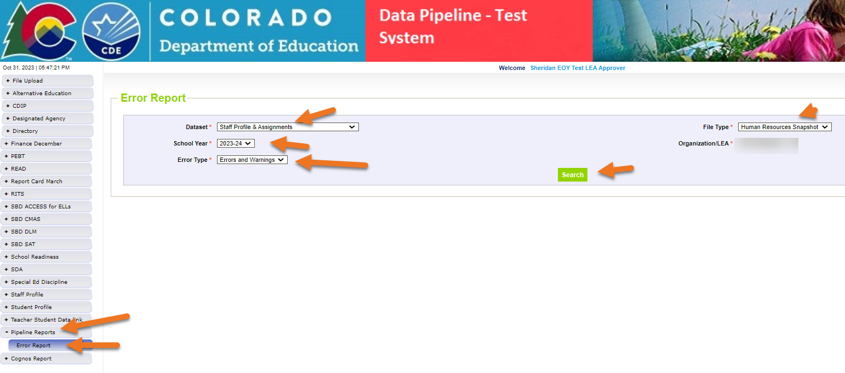
Checking for Snapshot Errors
Click on View Details
Human Resources Snapshot Collection
humanresourcesdata@cde.state.co.us

Slide 26
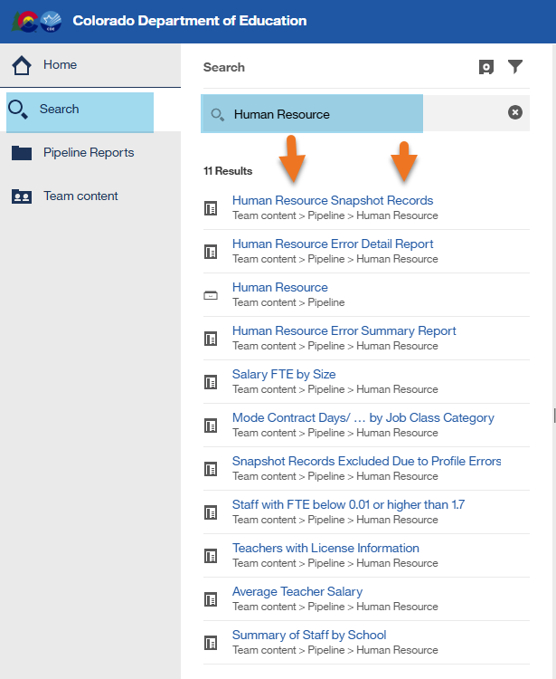
Human Resources Cognos Reports
Use the different Cognos Reports to validate your data before you submit your data
Snapshot Records get reported
Human Resources Snapshot Collection
humanresourcesdata@cde.state.co.us

Slide 27
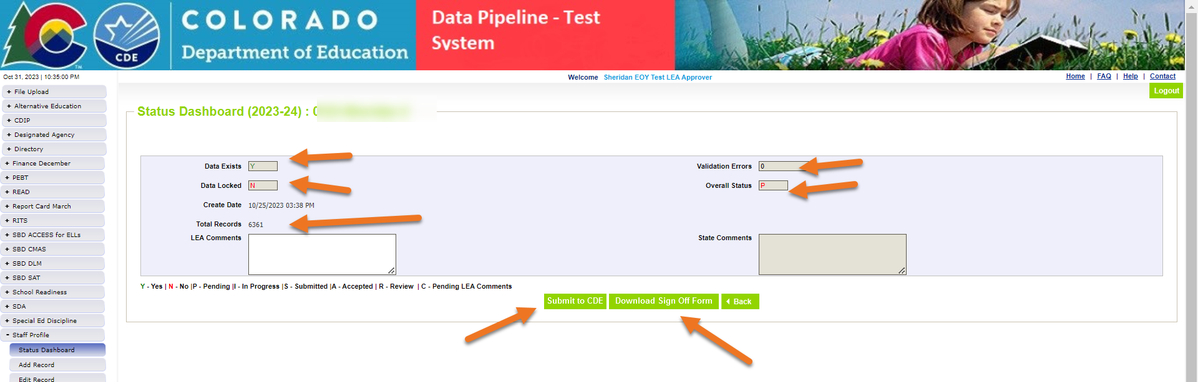
Submit your Human Resources Snapshot Data
Interchange files are error free
Snapshot files are error free
Data has been verified
Time to get you data to submitted
Human Resources Snapshot Collection
humanresourcesdata@cde.state.co.us

Slide 28
Questions & Resources:
Human Resources
Collection Resources:
Staff Interchange website
Human Resources Snapshot website
Dawna Gudka
HumanResourcesData@cde.state.co.us
(303) 598-7901

Slide 29
Discipline Action File Layout Changes
Dawna Gudka

Slide 30
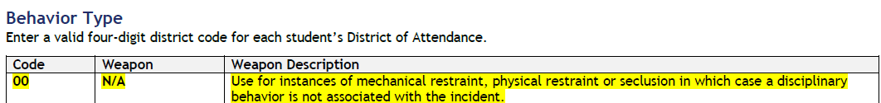
Changes approved by EDAC to the File Layout-Discipline Action File
New Behavior Type
00 N/A Use for mechanical restraint, physical restraint or seclusion
Student Discipline Snapshot
Student Discipline Snapshot

Slide 31

Example of a record in Discipline Action file for student restrained
  Example of Student Physically Restrained
  Discipline Action File
  Behavior 00 (Column G, Behavior code)
  Discipline 00 (Column P, Discipline Action Type)
  Physically Restrained 1 indicating yes (Column T, Physically Restrained)
  Discipline Action record
Student Discipline Snapshot
Student Discipline Snapshot

Slide 32
Example of a record in Discipline Action file for student placed in Seclusion
  Example of Student Placed in Seclusion
  Discipline Action File
  Behavior 00 (Column G, Behavior code)
  Discipline 00 (Column P, Discipline Action Type)
  Placed in Seclusion 1 indicating yes(Column V, Placed in Seclusion)
  Discipline Action record
Student Discipline Snapshot
Student Discipline Snapshot

Slide 33
Questions & Resources:
Student Discipline
Collection Resources:
Discipline Interchange Website
Student Discipline Snapshot Website
StudentDiscipline@cde.state.co.us
Dawna Gudka
(303) 598-7901

Slide 34
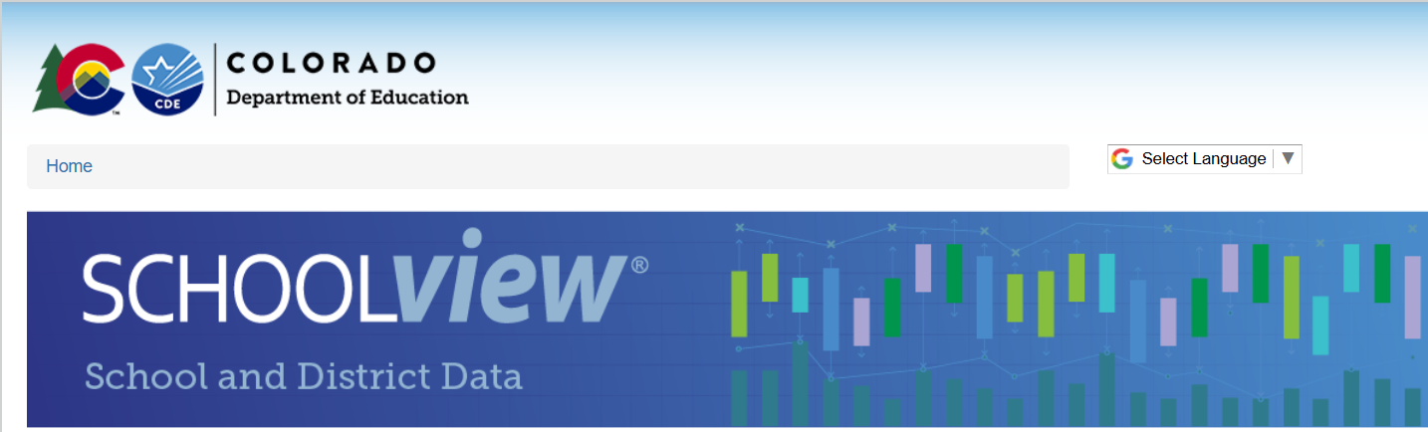

Thank you for Joining Today!
Next Town Hall will be January 30th
Reminder:
Explore School & District Data on our website
Colorado Education Statistics
Staff, Pupil Membership, Graduation, Dropout, Attendance, General Statistics, Race/Ethnicity Guidelines, Federal and State Data Privacy Laws

