Slide 1
January 16, 2025
Data Pipeline Town Hall
The goal of the webinar is to provide updates on the Data Pipeline, current, and upcoming data collections. These webinars also provide a forum for districts, BOCES, and Administrative Units to have questions answered about Data Pipeline.

Slide 2
Colorado Department of Education
Identity Management (IdM)
Identity Management Site
Frequently Asked Questions
How do I add myself or others to the email listserv for town hall emails and/or a specific collection?
  Email lists are dependent on a person’s access rights in IdM. Contact your LAM to get an account or be assigned to a specific collection.
Where can I find the IdM role mappings for Data Pipeline and other applications?
  Role Mapping (XLS)
I am a LAM. How do I update the user permissions for someone in my district?
  Follow the steps outlined in the IdM Quick Guide for Access Management (DOCX)
Important: Users are not automatically removed from IdM when their email address is no longer active in your district. The LAM must deactivate their IdM account to ensure only designated staff can access CDE’s data reporting system.
Notes:
LAMs, please check the IdM roles for your district. Remove permissions for users who have retired, left your district, or are no longer assigned to a collection. Add roles for new hires and newly assigned respondents for specific collections.

Slide 3

What is PII?
Student and Staff Personally Identifiable Information (PII) is defined by state and federal laws as information that, alone or in combination, personally identifies an individual
  This includes direct identifiers
  (i.e. student and staff names, SASID, EDID, etc.)
  Includes information that when combined is identifiable
Colorado’s Student Data Transparency and Security Act outlines requirements for how Student PII is collected, used and shared
See the Data Privacy and Security website for prepared guidance on how to comply with this and other privacy laws.

Slide 4

Sharing Data
Use secure methods to transfer any PII to CDE
  Contact Data Collection leads with questions about how to transmit PII securely
    Each Data Collection leads maintains their own Syncplicity folders for specific collections, reach out to the collection lead for access
  Use Syncplicity to encrypt emails to CDE
Avoid sending PII via unencrypted email or to unsecured faxes when sharing data between or within districts
  Use Syncplicity to encrypt emails to CDE
Check local policies for restrictions, requirements, etc. regarding PII
  Do not use PII in trainings, presentations, etc.
  Do not share PII with unauthorized individuals
  Do not share passwords
  Follow local policies when transmitting PII to any third party

Slide 5
Today’s Agenda
Agenda Topic | Presenter
Open Data Collections and Upcoming Deadlines in Data Pipeline | Host: Jessica Tribbett
Special Education December Count | Lindsey Heitman
Teacher Student Data Link | Peter Hoffman
Summer EBT | Collin Slutzky
Human Resources | Dawna Gudka

Slide 6
Open Collections and
Upcoming Deadlines in
Data Pipeline

Slide 7
Open Collections and Upcoming Dates:
Year-Round & Interchanges
Name | Category | Status | Key Dates
RITS | Year Round | Open | N/A
EDIS | Year Round | Open | N/A
Directory | Year Round | Open | N/A
Student | Interchange | Open | January Recommendation: Update DEM & SSA files
At-Risk | Interchange | Closed | N/A
Title I | Interchange | Open | May 2025: Update file in preparation for SEY reporting
Special Education IEP | Interchange | Open | Error free files required for SPED December Count
Staff | Interchange | Open | Error free files required for SPED December and Human Resources
Teacher Student Data Link | Interchange | Open | Opened 12/11/2024
Data Pipeline Resources: Data Pipeline Collection Dates (XLS)

Slide 8
Open Collections and Upcoming Dates:
Snapshots
Name | Category | Status | Final Deadline Date | Next Milestone | Looking Ahead
Student October | Snapshot | Closed | Nov. 27, 2024 | Data Release: 1/15/2025 Data is embargoed until the release. Data will be posted on the Pupil Membership Ed Stats Website. | n/a
Student End of Year | Snapshot | Closed | Nov. 19, 2024 | Data Release: 1/14/2025 1/22/2025 Data is embargoed until the release. | 1/15/2025 SEY Respondents received embargoed statewide data in preparation for next week’s data release.
Special Education December Count | Snapshot | Open | Feb. 21, 2025 | Interim Deadline: 01/30/2025 Snapshot error-free | 1/30/2025 – 2/07/2025 Report Review
Human Resources | Snapshot | Open | Feb. 21, 2025 | Interim Deadline: 1/24/2025 Human Resources Snapshot Error Free | 1/24-1/31/2025 Report Review
Teacher Student Data Link |  | Closed | Aug. 29, 2025 | Interchange Opened: 12/11/2024 | Snapshot Opens: 2/19/2025
Data Pipeline Resources: Data Pipeline Collection Dates (XLS)

Slide 9
Open Collections and Upcoming Dates:
Periodic
Name | Category | Status | Final Deadline Date | Next Milestone | Looking Ahead
Summer EBT | Periodic | Closed | Feb. 28, 2025 | Collection Opens: 2/3/2025 LEAs may begin uploading Summer EBT files to Pipeline
Data Pipeline Resources: Data Pipeline Collection Dates (XLS)

Slide 10
Special Education
December Count Snapshot
Lindsey Heitman

Slide 11
Special Education December Count:
Staff and Student Snapshot Timeline
November Due Dates
December Due Dates
January Due Dates
30th - Thursday - All errors resolved – complete snapshot
February Due Dates
10th – 18th - Monday – Tuesday - Resolving Duplicates
1st - Sunday - Official count date (or last date prior your school was in session)
30th - Feb 7th Thursday – Friday - Report Review
18th – 21st - Tuesday - Friday - Final Report Review
21st - Friday - Final Submission Due
1st - Friday – Sped December Count Snapshot available in Data Pipeline
13th – Wednesday - Interchange files uploaded - Sped Child, Sped Participation, Staff Profile, Staff Assign
18th - Wednesday: Interchange files error free and at least one snapshot created
These files must be uploaded AND records error-free before they will pull into your December Count Snapshot.
The “missing” staff records will triggers errors DC114-DC115, DC225 – DC229 until they are included
Please download the full 24-25 Timeline from the Special Education December Count Snapshot webpage.
Special Education December Count – Lindsey Heitman
SpedDecCount@cde.state.co.us

Slide 12
Special Education December Count
Timeline
Next deadline is Thursday, January 30th 10 business days!
  Date to have a complete Special Education December Count Snapshot:
    All Staff and IEP Interchange errors resolved
    All Dec Staff Snapshot errors resolved
    All Dec Student Snapshot errors resolved
What to work on now?
  Create December Count Snapshots and work with your staff data respondent(s) until all errors are resolved
  AU respondent is responsible for checking both Dec Student and Staff Snapshot error reports:
    Pipeline Reports/Error Report
      Sp. Ed December Count Staff *common for this error report to be “missed” (being checked)
      Sp. Ed December Count Student
    OR Cognos Reports/Special Education December folder
      Errors: staff detail report of errors to correct
      Errors: student detail report of errors to correct
Special Education December Count – Lindsey Heitman
SpedDecCount@cde.state.co.us

Slide 13
Special Education December Count
Timing Issues
Reminder
Timing is a key factor while working on this collection!
This snapshot pulls data from 3 Interchanges and 6 different files.
  IEP Interchange – Child File and Participation File
  Staff Interchange – Staff Profile File and Staff Assignment File
  Student Interchange – Student Demographic File and Student School Association File
    Any changes in your snapshot may be the result of changes in the Staff files or the Student Interchange Files or your Participation File. Use District Activity Report to research district file status:
AUs will find a District status report found under Cognos Reports/Special Education December folder (DEC role)
District/AU Activity Report
Lists the status of all Staff Profile and Staff Assignment file uploads and # of errors
Breaks it out by district and AU
Special Education December Count- Lindsey Heitman
SpedDecCount@cde.state.co.us

Slide 14
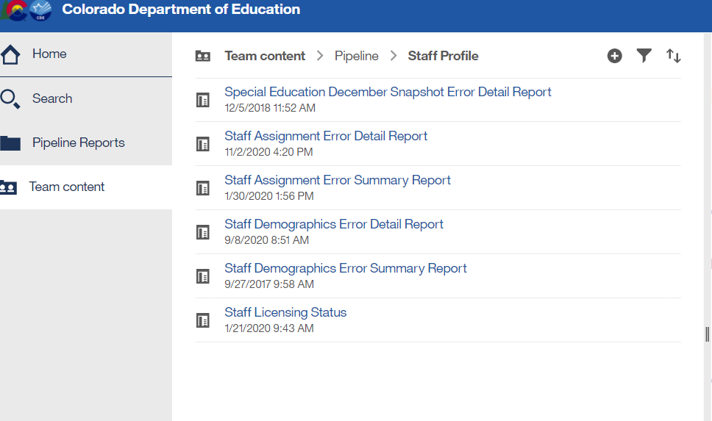
Special Education December Count – Report available for Staff Interchange User to see Dec snapshot errors
Staff Interchange Users and Viewers are able to see their district’s December Count snapshot errors by downloading this report under:
  Cognos Reports- Staff Profile- Special Education December Snapshot Error Detail Report
Those with the STF role have access to this error report
Special Education December Count – Lindsey Heitman
SpedDecCount@cde.state.co.us

Slide 15
Special Education December Count: Troubleshooting Errors DC191 – DC205 (grades of staff and students served for 202 and 238 job codes must match)
DC191 thru DC205 – these errors compare the student’s grades that are reporting that EDID in one of the 5 provider positions to the grades marked on the staff assignment record for that staff.
What to check:
  Use Cognos Reports/Special Education December report “Included Snapshot Records: Staff Interchange” to compare grades for your student and staff snapshot records
    Cognos Reports/Special Education December à Included Snapshot Records: IEP Interchange
    Download snapshot records report and export to Excel
    Highlight the Grade level field and the 5 Primary/Secondary Provider fields
    Click Data/Filter and search all 5 primary/secondary provider fields for the EDIDs triggering errors DC191- DC205
    For each EDID search results scroll to the left to find which grades levels the students are in
      You should eventually locate the student(s) whose grade levels are missing from the Staff Assignment record.
      If you have verified that provider EDID is correct for that student, the change will need to be in the Staff Assignment file – mark a ‘1’ by the missing grades
      If you have verified that provider EDID is incorrect for that student’s record, the change will be in the IEP Participation file and that EDID should be removed from one of the provider fields.
Special Education December Count – Lindsey Heitman
SpedDecCount@cde.state.co.us

Slide 16
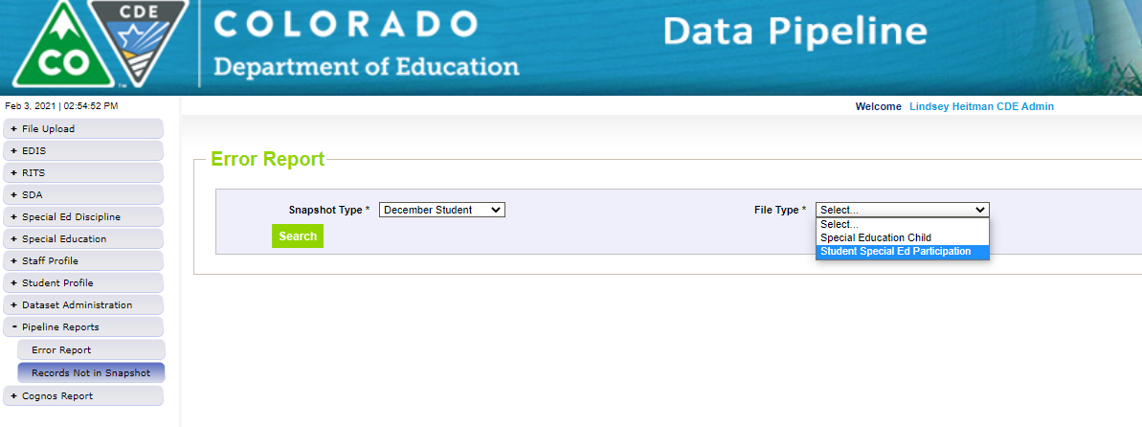
Special Education December Count:
Helpful Report
Records potentially missing from your snapshot may be found in this report.
Records listed in this report do not meet the snapshot criteria (several reasons this could occur)
Use this report to find why a staff or student interchange record is missing from your snapshot
Note: this report will list ALL Staff Interchange and IEP Interchange records that are missing from the snapshot. Keep in mind HR (gen-ed staff records) do not need to be in your snapshot so many of the records may be ignored. Export to Excel and search to find the record you’re looking for.
Filter on Snapshot Type ‘December Student’ or ‘December Staff’ and each file
Missing records= missed funding! Check for records that were receiving SPED services as of 12/01/24.
Pipeline Reports → Records Not in Snapshot
Special Education December Count- Lindsey Heitman
SpedDecCount@cde.state.co.us

Slide 17
Required Staff
Director of Special Education and Child Find Coordinator
ECEA Rules 3.01(1)(c) - Employment of a properly licensed and endorsed professional who will function at least half time as director of special education and who has the authority and responsibility to assure that all the duties and responsibilities of the AU as specified in these Rules are carried out.
Reported job code = 102 Special Education Director
Appropriate endorsement = Director of Special Education
Error that will trigger if you are not reporting a 102 (exception required):
  DC033 - No Special Education Director - Please briefly explain why no special Education Director (JCC 102) was reported in you December Count Snapshot
ECEA Rules 4.02(2)(b) - Each administrative unit and state-operated program shall have one person designated as the child find coordinator who shall be responsible for an ongoing child identification process.
Reported job code = 330 Child Find Coordinator
Appropriate endorsement = any special education license and endorsement (special education teacher, special service provider, special education administrator) appropriate for the age/grade range of students.
Error that will trigger if you are not reporting a 330 (exception required):
  DC043 - No Child find Coordinator - Please briefly explain why no Child Find Coordinator (JCC 330) was reported in your December Count Snapshot
Special Education December Count – Lindsey Heitman
SpedDecCount@cde.state.co.us

Slide 18
Questions & Resources:
Special Education December Count
Lindsey Heitman
SpedDecCount@cde.state.co.us
(720) 456-2033
Special Education IEP Interchange Webpage
Special Education December Snapshot Webpage

Slide 19
Teacher Student Data Link (TSDL)
Peter Hoffman

Slide 20
2024-2025 TSDL Timeline
Date | Event | Event Description
Wednesday, December 11, 2024 | Open | TSDL Upload Interchange file opens.
Wednesday, February 19, 2025 | Open | TSDL Snapshot opens.
Friday, May 16, 2025 | Interim Deadline | TARGET: Date by which you should have uploaded the TSDL Upload interchange file at least once
Friday, June 13, 2025 | Interim Deadline | TARGET: Date by which the TSDL Upload interchange should be uploaded and error free.
Friday, June 27, 2025 | Interim Deadline | TARGET: Date by which the TSDL snapshot should be created at least once.
Friday, August 22, 2025 | Interim Deadline | TARGET: Date by which you should have a complete Teacher Student Data Link Snapshot. Complete Teacher Student Data Link Snapshot means: All TSDL interchange errors are resolved All TSDL snapshot errors are resolved If you anticipate that you will not be able to meet this deadline, please contact CDE at TeacherStudentDataLink@cde.state.co.us
Monday, August 25, 2025 – Thursday, August 28, 2025 | Report Review | Final Snapshot Report Review – This is your opportunity to review reports in detail and make any data corrections you deem necessary to make sure you are reporting valid and reliable data. All data corrections must be completed during this time.
Friday, August 29, 2025 | Deadline | Required to have TSDL snapshot error free and finalized before or on this date. TSDL closed and final report is signed and provided to CDE via email TeacherStudentDataLink@cde.state.co.us
Teacher Student Data Link
TeacherStudentDataLink@cde.state.co.us

Slide 21
CDE Identity Management Roles for TSDL
Users will require 2 roles to complete TSDL, one for the interchange / data file upload, and one for the snapshot
Teacher Student Data Link Interchange Roles:
  TSL~ LEAUSER – upload and modify TSDL interchange files OR
  TSL~LEAVIEWER – view (only) TSDL interchange data
Teacher Student Data Link Snapshot Roles:
  TLS~LEAAPPROVER – Approves, creates, views Snapshot OR
  TLS~LEAUSER - creates, views Snapshot OR
  TLS~LEAVIEWER- views snapshot
Please note the swapped letters in the prefix TLS vs TSL
  Often, users are given 2 roles with the TLS prefix in error which does block access
  “S” at the end is for “Snapshot”
Teacher Student Data Link
TeacherStudentDataLink@cde.state.co.us

Slide 22
Tips for 2024-2025
Upload a file to the TSDL interchange early – we recommend right around winter break if possible.
  This will give you a clear picture into what errors or missing data you will be encountering and give ample time to resolve them or reach out for assistance before the final deadline in summer.
Reminder: 2024-2025 TSDL data will be utilized as a part of 9th grade success reporting. Please ensure that your course completion status field is being calculated / populated correctly.
  Link to Colorado Legislature HB24-1282
Teacher Student Data Link
TeacherStudentDataLink@cde.state.co.us

Slide 23
Tips for 2024-2025 continued
Common Errors:
  Local Course Title Field (column D2) is where we see the most common error that prevents an upload into pipeline. If there are commas in your local course title this will cause a shift in data.
  Leading Zero's – Leading zeros being deleted by opening the file often cause the most errors. CDE has a resource if you need to open your file after extract to keep your leading zeros on our Data Pipeline Resources Page.
  TD087 – Course Completion Status must be valid
    This may be flagging for courses that are still in progress
    Double check what semester the error is flagging for – if it is for the first half of the year corrections may be needed. If it is for current classes, it may resolve once the school year ends.
Teacher Student Data Link
TeacherStudentDataLink@cde.state.co.us

Slide 24
Questions & Resources: TSDL
Peter Hoffman
720-925-8611
Email for the Teacher Student Data Link

Slide 25
Summer EBT
Collin Slutzky

Slide 26
Summer EBT Data Collection
Data Collection begins February 3rd.
File layout is unchanged from last year.
Error-free files must be submitted by February 28th.
Districts have the following options for submitting student records:
  Submit data for all students enrolled in National School Lunch Program sites only.
  Submit data for all students enrolled in NSLP sites and data for any F/R eligible transfer students to non-NSLP sites during the school year (any student that was enrolled at a NSLP site, even for a short period of time, would be eligible for S-EBT benefits)
  Submit data for all enrolled students at both NSLP sites and non-NSLP sites.
Submitting data for all enrolled students will be the easiest option for most districts, as your S-EBT reports from your SIS likely use this option.
s-ebt@cde.state.co.us
Summer EBT
Notes:
Your district schools are most likely receiving calls from families to update their address, make sure you are in contact with the appropriate people to make sure this updated information is being captured in the summer EBTcorrections.

Slide 27
Summer EBT Data Collection:
Preparing for the Collection
Verify that Free and Reduced Lunch status is up-to-date for all students.
Every student must have one listed parent/guardian with a valid address.
  Issues with parent/guardian info will delay benefit issuance.
Check the S-EBT report in your SIS and make sure it matches the S-EBT file layout available on the data collection resource page.
  If the S-EBT report from your SIS is missing or incorrect, please contact your vendor immediately and include Collin Slutzky (slutzky_c@cde.state.co.us) on communications.
Plan to submit your first file by Friday, February 7th so you have plenty of time to correct errors.
Bookmark the form to schedule office hours in case you have issues uploading your file or resolving errors. Schedule a meeting with us in January if you would like additional training.
Summer EBT
s-ebt@cde.state.co.us

Slide 28
Questions & Resources:
Summer EBT
Collin Slutzky
s-ebt@cde.state.co.us
(720) 760-3569
S-EBT Data Collection Resources

Slide 29
Human Resources
Dawna Gudka

Slide 30
Human Resources:
Collection Timeline
Date | Event | Event Description
1/24/25 | Interim Deadline | Human Resources Snapshot Error Free
1/24-1/31/25 | Report Review | Review Special Education Staff Report via Cognos in the Human Resources folder) for accuracy to ensure all special education staff reported within your district is appropriate. Collaborate with your LEA’s Administrative Unite during this process. Verify that all staff are accurately reported.
2/14/25 | Interim Deadline | Staff Profile and Staff Assignment interchange files, and Human Resources Snapshot Error Free
2/21/25 | Deadline* | Human Resources Snapshot must be submitted to CDE and verification emailed to Human Resources Snapshot
Human Resources Snapshot Collection
HumanResourcesData@cde.state.co.us

Slide 31
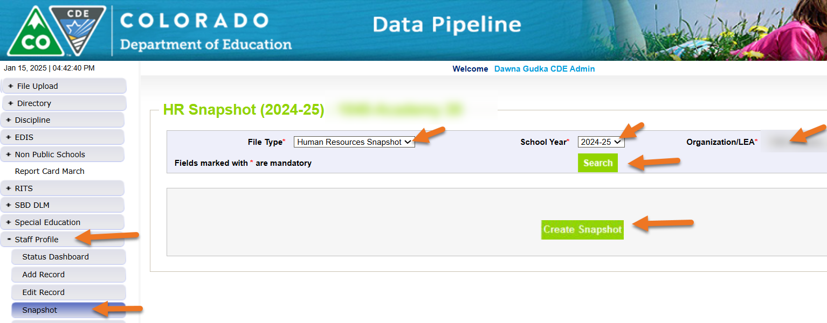
Creating a Human Resources Snapshot
Human Resources Snapshot Collection
humanresourcesdata@cde.state.co.us

Slide 32
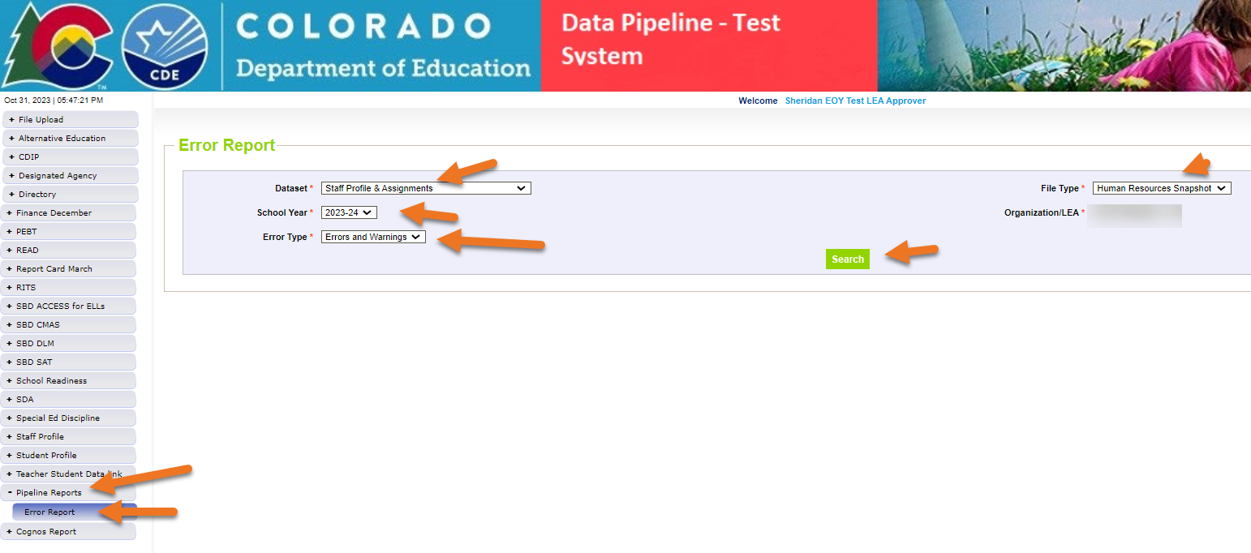
Checking for Snapshot Errors
Click on View Details
Human Resources Snapshot Collection
humanresourcesdata@cde.state.co.us

Slide 33
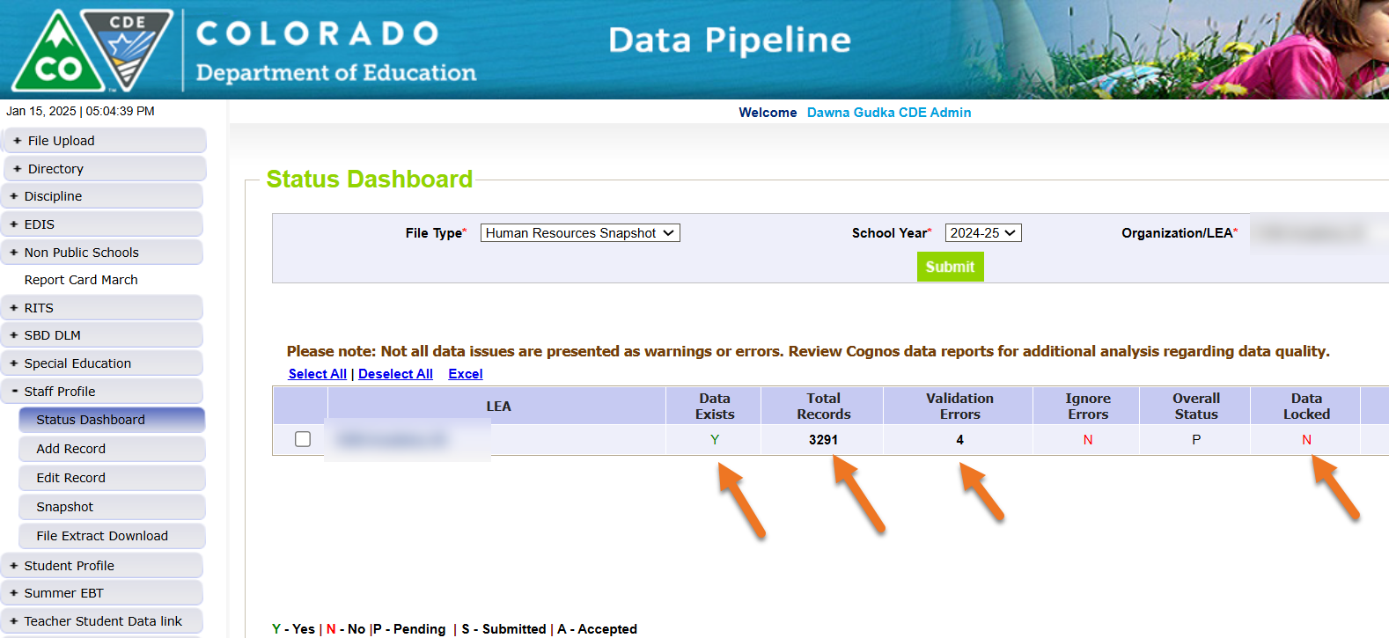
Checking Human Resources Snapshot Status

Slide 34
Common Errors
HR004 Base Salary divided by the FTE is higher than the expected maximum for the job class code. If the hours per day, contract days and salary information (base salary or hourly rate of pay) are all reported correctly, please contact Dawna Gudka at HumanResourcesData@cde.state.co.usfor an exception.
  Verify hours, days and pay are correct
HR201 The subject area of degree 1, 2 or 3 does not match the teaching subject area reported for this teacher. Without this, the 'Demonstrates In-Field Status 1' cannot be reported with code 02 for Degree in Subject Area. Either update the reported Subject Area of Degree 1, 2 or 3 fields in the Staff Profile file or update the 'Demonstrates In-Field Status 1' field to a different code (03=36 Semester Hours; 04=Passed Exam; 06=HQ via 24 Semester Hours or 05=Out of Field).
  Check Demonstrates in-field status
HR230 The Educator Shortage Survey has not yet been indicated as completed. This will be updated every Thursday evening. To complete the Educator Shortage Survey
  Survey must be completed
Human Resources Snapshot Collection
humanresourcesdata@cde.state.co.us

Slide 35
Questions & Resources:
Human Resources
Collection Resources:
Staff Interchange website
Human Resources Snapshot website
Dawna Gudka
HumanResourcesData@cde.state.co.us
(303) 598-7901

Slide 36

Thank you for Joining Today!
Next Town Hall will be January 23rd
Reminder:
LAMs, please review your IdM users to ensure accurate permissions for data respondents in your district. Deactivate users who no longer oversee a data collection in your district.

