Slide 1
2024-2025
Special Education December Count
Office Hours
Staff Approval Matrix (SAM)
^{December 4, 2024}
^{Lindsey Heitman}

Slide 2
Special Education December Count
Contact Information
Lindsey Heitman – SpedDecCount@cde.state.co.us 720-456-2033
  Special Education Dec Count Snapshot submission
  Includes IEP Interchange and Staff Interchange - Sped December Count SPED staff questions
*Please include your AU #, District #, Error code # or cognos report name (if applicable) in emails
Resource Webpages
  Special Education IEP Interchange
  Staff Interchange
  Special Ed December Count Snapshot
  ESSU Data Management System

Slide 3
Special Education December Count:
Staff and Student Snapshot Timeline
November Due Dates
December Due Dates
January Due Dates
30th - Thursday - All errors resolved – complete snapshot
February Due Dates
10th – 18th - Monday – Tuesday - Resolving Duplicates
1st - Sunday - Official count date (or last date prior your school was in session)
30th - Feb 7th Thursday – Friday - Report Review
18th – 21st - Tuesday - Friday - Final Report Review
21st - Friday - Final Submission Due
1st - Friday – Sped December Count Snapshot available in Data Pipeline
13th – Wednesday - Interchange files uploaded - Sped Child, Sped Participation, Staff Profile, Staff Assign
18th - Wednesday: Interchange files error free and at least one snapshot created
These files must be uploaded AND records error-free before they will pull into your December Count Snapshot.
The “missing” staff records will triggers errors DC114-DC115, DC225 – DC229 until they are included
Please download the full 24-25 Timeline from the Special Education December Count Snapshot webpage.

Slide 4
Troubleshooting Dec Count
Grade Case Load Match Errors
If you receive grade caseload match errors such as:
Student errors: DC114, DC115, DC225, DC226, DC227, DC228, DC229
Staff errors: DC019 and DC020
  Fixing DC225 first may result in resolving DC114 and DC115 errors
  Consider fixing them in this order: DC225, DC114, and then any remaining DC115
  DC225– The following students have a Primary Service Provider EDID reported that is not included in the Staff Snapshot. Please verify if the staff has an error free record at the Interchange.
To determine why records are missing from the December Snapshot, check:
Pipeline Reports/Records Not in Snapshot report
Excluded Records Reports in Cognos
  Often-times caseload errors are caused because not all records have made it to snapshot.

Slide 5
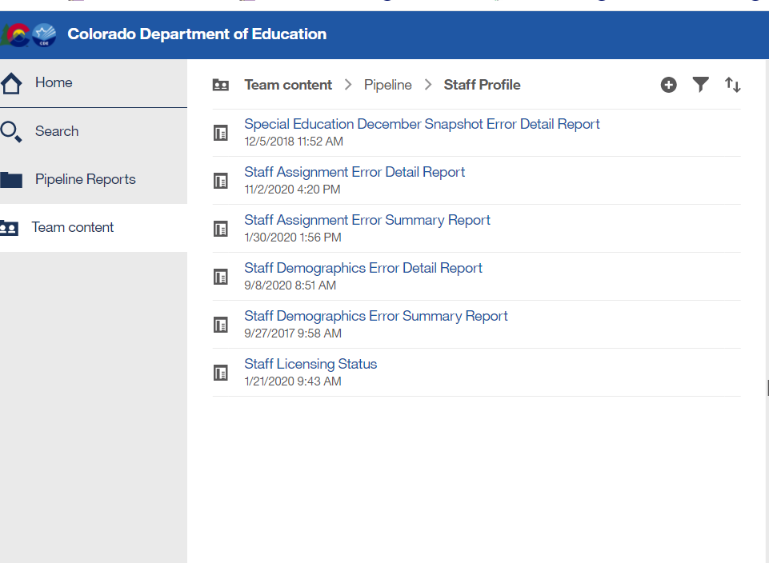
Special Education December Count – Report available for Staff Interchange User to see Dec snapshot errors
Staff Interchange Users and Viewers are able to see their district’s December Count snapshot errors by downloading this report under:
  Cognos Reports- Staff Profile- Special Education December Snapshot Error Detail Report
Those with the STF role have access to this error report

Slide 6
Regulations: IDEA/ECEA
Federal Law IDEA (The Individuals with Disabilities Education Act)
Requires staff who serve students with disabilities to be appropriately licensed and endorsed.
State Rules ECEA (Exceptional Children’s Educational Act-section 3.04 Personnel Qualifications)
All personnel providing special education services to children with disabilities shall be qualified.
Each special education teacher will serve, at a minimum, a majority of special education students with the same identified area of need as that teacher’s special education license endorsement. The endorsement level must be appropriate for the age being taught. (this is the 50% staff to student caseload match)

Slide 7
Purpose of Staff Data
Staff data in the December Count:
provides CDE the ability to verify licensing qualifications ensuring special education staff are qualified for the assignment and student caseload
populates mandatory Federal reporting to the US Department of Education, aggregated by:
    job classification
    age level of assignment/students served (age groups 3-5 and 6-21)
    qualified and non-qualified status

Slide 8
Staff Records to Include in
December Count Snapshot
Include:
  all Special Education staff employed by the district(s) or BOCES
  full or Part-time including teachers, paraprofessionals, special service providers
  Administrators, support staff, IT, office/clerical
  Purchased service/contract staff
Exclude:
  staff that do not support the education of students with disabilities, such as regular education teachers (they pull into the Human Resources snapshot)
  substitutes unless they are long term (90 days or more in the same classroom)
  temporary workers, such as after school coaches

Slide 9
Purchased Service (contracted) Staff
Purchased service staff are:
employed on a contractual basis, typically an annual contract for services
reported in the December Count, regardless of the amount of time, days or hours of the contract
not exempt from state licensing requirements
required to hold a valid and appropriate special education license and endorsement for the assignment and grade range of students served
reported with Employment Status Code = 23 Purchased Services
Note: If the contractual agreement is valid for the period including December 1st, the position is reported regardless of whether the contracted staff is actually “working” on December 1st.
  purchased service/contract staff (link to more information - details on what fields are required)

Slide 10
Long Term Substitute Teacher
Long Term Sub Requirements (serving in job role for 90 days or more) in December Count:
Job code 204 (substitute teacher) does not pull into the December Count snapshot
If they are the primary provider for a Sped student, they should be reported with a job code of 202 or 238
A long-term sub for sped purposes is held to the same licensing requirements as a regular sped teacher or SLP. If the Special Ed license has expired or is not renewed by 12/01 and they are reported with job code 202 or 238, they will trigger a SAM (Staff Approval Matrix) warning.

Slide 11
Staff Interchange Files
    Staff Profile
  General information per staff
  Only 1 record per staff
  Must be uploaded first
  District Code field - report district code or BOCES code that issue the paycheck
    *IMPORTANT: for how data is pulled and displayed for the Staff Evaluation Snapshot
    Staff Assignment
  Provides specifics to actual duties and locations
  multiple records allowed per staff member
  District Code field - report district code or BOCES code that issue the paycheck
    *IMPORTANT: for how data is pulled and displayed for the Staff Evaluation Snapshot
District status report found under Cognos Reports/Special Education December Count (DEC role)
Staff: District/AU Activity Report
Lists the status of all Staff Profile and Staff Assignment file uploads
Breaks it out by district and AU

Slide 12
AU Respondent – Confirm SPED Staff Data Status
1. AU respondents please verify your district(s) staff files are uploaded
2. Confirm whether the files still have a significant # of errors
  Use ‘District/AU Activity Report’ from Cognos to verify staff files’ status and error counts
3. Check in with your district(s) staff data respondents on progress
  NOTE: December 18th is the Staff Profile and Staff Assignment files all errors resolved date
4. AUs begin creating Sped Dec Count Snapshots to confirm staff data is pulling in
IMPORTANT NOTE:
AU respondents cannot proceed with December Count Snapshot error validation until staff records are included in the snapshot
  They must be error free in the Staff Interchange files before they will pull into either the December Count or the Human Resources snapshot

Slide 13
Staff Approval Matrix
(SAM)
The Staff Approval Matrix (SAM):
is an automated process in the December Count
warnings that trigger when a Sp Ed Dec Count Snapshot is created
found under your Sp Ed Dec Count Staff Snapshot warnings report
pulls in data from the Staff Assignment and IEP Interchange files
connects staff data with Educator Licensing and EDIS records via the reported SSN
determines qualified/non-qualified status for positions requiring a CDE license
Triggers DEC Staff snapshot warnings DC208, DC209, DC210, and DC211

Slide 14
Qualified Status
Qualified staff:
Hold a valid and appropriate CDE license for the assignment.
Hold an age level endorsement appropriate for the age range of students served.
Job codes 202 and 238 serve a majority of special education students (50% disability caseload match-special education teachers and speech-language pathologists) with the same identified area of need (primary disability) as the staff’s special education endorsement.
Note: SAM validations (job code, license type, endorsement, and caseload) determine if staff are qualified.

Slide 15
Non-Qualified Status
Non-qualified staff:
Do not hold a CDE license effective as of December 1st.
Do not hold a valid and appropriate CDE license for the assignment.
Do not hold an age level endorsement appropriate for the age range of students served.
Do not serve a majority of special education students (50% caseload match-special education teachers and speech-language pathologists) with the same identified area of need (primary disability) as the staff’s special education endorsement.
Note: SAM validations (job code, license type, endorsement, and caseload) determine if staff are non-qualified.

Slide 16
SAM Warnings
SAM Warning DC208 – Staff did not hold a valid license on 12/01
Remind staff to renew their license
SAM Warning DC209 – Staff does not hold an appropriate endorsement for the assignment
Check to be sure you are reporting the correct job code
SAM Warning DC210 – Staff does not hold an appropriate endorsement for the caseload
Check to be sure the primary providers/job codes are correct (i.e. students with disability type 08 or 11 must have a primary provider with a 238 job code)
SAM Warning DC211 – Staff does not hold a valid license
Check to be sure SSN is correct in COOL system and on your Staff Assignment file and in EDIS system

Slide 17
SAM Warnings
DC208, DC209, DC210, DC211
SAM Warnings are found in your Special Education December Staff Error/Warning Reports (view in either Pipeline error reports or Cognos error reports)
Note: Snapshot errors should be resolved before you review SAM Warnings DC209/DC210 (caseload).
Typically, both DC209/DC210 generate for special education teachers (202) and speech-language pathologists (238) who do not satisfy SAM approval criteria.
SAM Warnings should be investigated - some may be resolved by correction of data, i.e., incorrect SSN, job code miscoding, student disability caseload discrepancy.

Slide 18
Staff to Student
Caseload Match
Every IEP Student Participation File record must have a Primary Provider EDID of a 202 or a 238
All staff reported with Job Code 202 or 238 must be associated with at least one student record (either as a primary or secondary provider) in the Sped Participation file or an error will trigger
Two caseload match checks exist for Special Education Teachers (202) and Speech-Language Pathologists (238):
Grade Caseload Match in the Data Pipeline (staff grades to student grades)
  grades marked “Yes” in the staff assignment record must exactly match the grades of students in the IEP Participation file
Disability/50% Caseload Match in SAM (staff endorsement to student disability)
  Primary provider staff must hold an appropriate special education endorsement for the majority of student disabilities in the IEP Participation file
    based on the staff EDID reported in the Primary Provider field in the IEP Participation file
    Staff EDID reported in any one of the four Secondary Provider fields do not generate a student disability caseload
    SAM warnings DC209/DC210

Slide 19
December 1st License Requirement
Special Education staff must hold a valid and appropriate CDE license on the official count date of December 1^{st.}
Licenses issued with an effective date of December 1st or prior are validated when a snapshot is created in the Data Pipeline. The snapshot generates the Staff Approval Matrix (SAM) process.
Staff who do not hold a valid or appropriate license on December 1st:
will generate SAM Warning DC208
are determined to be non-qualified
display in the SAM: 1.5 Non-Qualified Personnel Status report

Slide 20
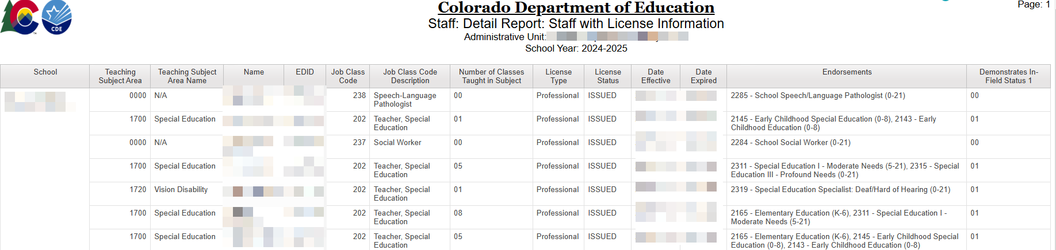
Special Education December Cognos Report
Staff: Detail Report: Staff with License Information
Cognos Reports -> Special Education December -> Staff: Detail Report: Staff with License Information
Find license types, endorsements, date effective, date expired, in-field status

Slide 21
Social Security Number (SSN) Validation
Social security number (SSN) is:
required for all staff
used to validate staff’s license and endorsement
validated against staff’s SSN in educator licensing records and in EDIS (Educator Identification System)
If staff SSN differs in any of the three validation check points (December Count, licensing records, EDIS), SAM Warning DC211 (staff does not hold a valid license) will generate.
To clear DC211 (if staff is licensed), the SSN must be corrected to be an exact match in all three validation check points.

Slide 22
SAM 50% Caseload Match
Special Education Teacher
A special education teacher’s 50% caseload match is satisfied if:
Staff is reported as the Primary Provider (EDID reported in Primary Provider field) to a majority of students identified in the same area of need as the teacher’s special education endorsement and grade range of students served.
Note: The 50% caseload match does not compile on EDIDs placed in any of the four Secondary Provider fields.

Slide 23
SAM 50% Caseload Match
Speech-Language Pathologist
A speech-language pathologist’s 50% caseload match is satisfied if:
Staff is reported as the Primary Provider (EDID reported in Primary Provider field) to a majority of students identified:
disability 08-Speech or Language Impairment (SLI)
disability 11-Developmental Delay (DD)
Staff is reported as a Secondary Service Provider (EDID reported in one of the Secondary Provider fields) to students identified in other disabilities who receive supplemental speech-language services, but SLI (08) or DD (11) is not the primary disability.
Note: The 50% caseload match does not compile on EDIDs placed in any of the four Secondary Provider fields.

Slide 24
Licensing and Caseload
Reference Documents
Guidance documents to assist in proper job coding, allowable license types and appropriate special education endorsements are posted at: https://www.cde.state.co.us/datapipeline/snap_sped-december
Staff Approval Matrix (SAM) and Licensing References:
Special Education Licensing Requirements by Job Classification and Fully Qualified Status
Special Education Endorsement Qualifications by Assignment, Disability, and Age of Student
(50% caseload match criteria by student disability)
Staff Approval Matrix (SAM: 1.5) Report Fact Sheet

Slide 25
Common Miscoding
Special Service Providers
234 Occupational Therapist
235 Physical Therapist
211 Counselor
236 Psychologist
237 Social Worker
Positions often classified as “motor services” with job codes miscoded in data reporting.
Positions often classified as “mental health services” with job codes miscoded in data reporting.
Job code miscoding results in generated SAM Warning (DC209).
Verify staff license and endorsement prior to data reporting.
Ensure that staff positions are coded correctly in Human Resources systems and are in alignment with job codes/definitions in the Chart of Accounts/staff data reporting documents.

Slide 26
Staff Assignment File and
Admin Instructional Area Codes
Separate assignment records are required in these cases:
  Pre-K grade - AIA 0035 Early Childhood/Prekindergarten
    Must break out a separate assignment record for Sped staff job codes serving Pre-k except 211
  Grade K only - AIA 0036 Kindergarten
    AIA code 0036 should be reported for a staff that is only serving grade K
  Grades K, 1, 2 - AIA 0041 Early Childhood/Elementary) (see below)
    AIA code 0041 should only be reported for staff with early childhood Sped endorsement
  Grades 3-12 or K-12 (depending on the staff’s endorsement type) - 0002 Special Education
EDIDs reported in both the Primary Provider and Secondary Provider fields (student IEP Participation data) compile into the grade caseload match for 202 and 238 staff records.
Note: Early Childhood Special Education (age level 0-8) endorsement is appropriate for services to students in grades PreK through 2 only. For SAM to determine qualified status, a separate assignment record for elementary grades K, 1, 2 (any combination of these grades) is reported with AIA 0041.

Slide 27
SAM Cognos Reports
Cognos reports are available to assist with both staff and student December Count data.
Examples:
Errors: Staff Detail Report of Errors to Correct (displays SAM Warnings by individual staff)
SAM: 1.5 Non-Qualified Personnel Status (displays staff by job code with each generated SAM Warning type)
SAM: ALL Certified Staff Report (displays staff in assignments that require a CDE license)
SAM: Caseload Student Detail (DC210 Detail) (displays special education teachers and SLPs with individual primary and secondary students)
SAM: Caseload Summary (DC210 Summary) (displays special education teachers and SLPs with the number of primary students in each disability category)

Slide 28
Cognos Report
SAM: Caseload Summary or Detail Report (DC210)
Displays the number of primary provider students in each disability category for special education teachers (202) and SLPs (238).
Displays the total number of primary caseload students in approved and non-approved disability categories per the staff’s special education endorsement.
Displays the caseload percentage of approved disability categories per the staff’s special education endorsement. (percentage must = at least 50% to satisfy the caseload match requirement)
Displays students in the secondary caseload (students that have these staff listed as secondary providers)
NOTE: Select ‘Approved and Non-Approved Staff’ and ‘Caseload Approved and Non-Approved’ when running this report
If no license is found with a validity date of December 1st, the staff approval matrix (SAM) cannot calculate caseload summary data. These records display with zero number of approved/non-approved students and disability percentage totals.

Slide 29
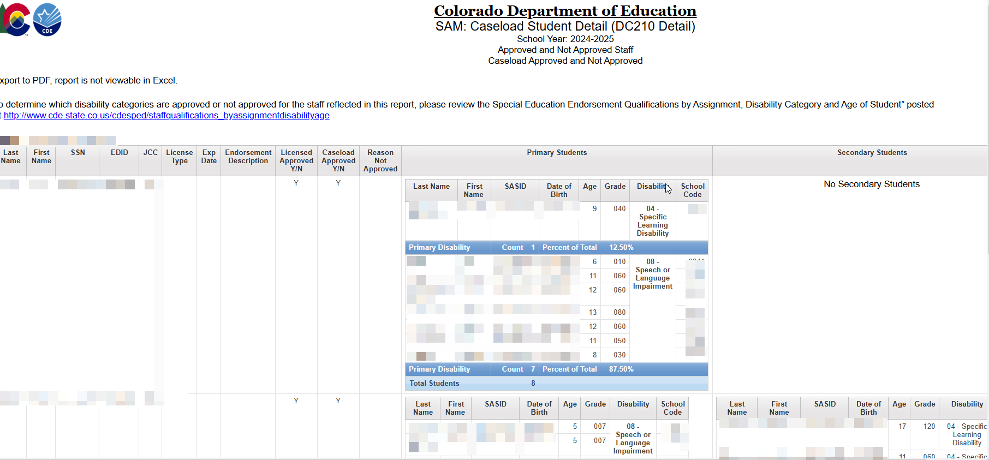
SAM: Caseload Student Detail (DC210 Detail) Report

Slide 30
Special Education December Count:
Unresolved SAM Warnings
December Staff Snapshot Warnings DC208, DC209, DC210, DC211
SAM Warnings will NOT prevent you from finalizing your December Count staff data.
If SAM Warnings remain unresolved at collection close, staff will display in the final SAM: 1.5 Non-Qualified Personnel Status report.
All non-qualified staff are included in the post December Count Correction Tracker accountability process.

Slide 31
Post December Count Collection
Staff Tracker Process
If SAM Warnings remain unresolved at collection close, staff will display in the final SAM: 1.5 Non-Qualified Personnel Status report. These staff are considered non-qualified for one of the reasons we talked about today.
The Tracker is an accountability process between CDE and the AU documenting how the non-compliant issue is either resolved, or how it will be resolved.
AU Responsibility:
During December Count collection and by the closing date February 21st
Upon review of the SAM: 1.5 Non-Qualified Personnel Status report, the AU Special Education Director signs the report verifying the contained data is valid and accurate.
The report is uploaded with other December Count reports in the Documents tab in the ESSU Data Management System (DMS).
Post collection Process:
A Personnel Status Correction Tracker form is completed for each administrative unit listing all staff contained in the SAM: 1.5 report. Director documents how the non-compliant issue will be resolved.
CDE Responsibility:
SAM: 1.5 report data for each administrative unit is reviewed to validate SAM results.
If clarification is needed, Special Education Directors will be contacted by the ESSU’s General Supervision and Monitoring team.

Slide 32

Any questions or concerns you would like to discuss with the group?

