Slide 1
July 17, 2025
Data Pipeline Town Hall
The goal of the webinar is to provide updates on the Data Pipeline, current, and upcoming data collections. These webinars also provide a forum for districts, BOCES, and Administrative Units to have questions answered about Data Pipeline.

Slide 2
Colorado Department of Education
Identity Management (IdM)
Identity Management Site
Frequently Asked Questions
How do I add myself or others to the email listserv for town hall emails and/or a specific collection?
  Email lists are dependent on a person’s access rights in IdM. Contact your LAM to get an account or be assigned to a specific collection.
Where can I find the IdM role mappings for Data Pipeline and other applications?
  Role Mapping (XLS)
I am a LAM. How do I update the user permissions for someone in my district?
  Follow the steps outlined in the IdM Quick Guide for Access Management (DOCX)
Important: Users are not automatically removed from IdM when their email address is no longer active in your district. The LAM must deactivate their IdM account to ensure only designated staff can access CDE’s data reporting system.
Support:
  Michael Threlkeld
  Forgot Password
  Request LAM Assistance
Notes:
LAMs, please check the IdM roles for your district. Remove permissions for users who have retired, left your district, or are no longer assigned to a collection. Add roles for new hires and newly assigned respondents for specific collections.

Slide 3

What is PII?
Student and Staff Personally Identifiable Information (PII) is defined by state and federal laws as information that, alone or in combination, personally identifies an individual
  This includes direct identifiers
  (i.e. student and staff names, SASID, EDID, etc.)
  Includes information that when combined is identifiable
Colorado’s Student Data Transparency and Security Act outlines requirements for how Student PII is collected, used and shared
See the Data Privacy and Security website for prepared guidance on how to comply with this and other privacy laws.

Slide 4

Sharing Data
Use secure methods to transfer any PII to CDE
  Contact Data Collection leads with questions about how to transmit PII securely
    Each Data Collection leads maintains their own Syncplicity folders for specific collections, reach out to the collection lead for access
  Use Syncplicity to encrypt emails to CDE
Avoid sending PII via unencrypted email or to unsecured faxes when sharing data between or within districts
  Use Syncplicity to encrypt emails to CDE
Check local policies for restrictions, requirements, etc. regarding PII
  Do not use PII in trainings, presentations, etc.
  Do not share PII with unauthorized individuals
  Do not share passwords
  Follow local policies when transmitting PII to any third party

Slide 5
Today’s Agenda
Agenda Topic | Presenter
Open Data Collections and Upcoming Deadlines in Data Pipeline | Host: Peter Hoffman
Staff Evaluation | Dawna Gudka
Student Interchange | Reagan Ward
Student Discipline | Carrie Martin
Prevent Harassment or Discrimination | Carrie Martin
Special Education Discipline | Lindsey Heitman
Special Education End of Year | Lindsey Heitman

Slide 6

CDE System Planned Outage
CDE Systems will be offline beginning at 3PM on Friday 7/18.
We anticipate systems to return to normal functionality on Sunday 7/20.
Thank you for your patience as many CDE Applications will be unavailable during this time.
Data Pipeline Landing Page
Data Pipeline Contacts

Slide 7
Open Collections and
Upcoming Deadlines in
Data Pipeline

Slide 8
Open Collections and Upcoming Dates:
Year-Round & Interchanges
Name | Category | Status | Key Dates
RITS | Year Round | Open | N/A
EDIS | Year Round | Open | N/A
Directory | Year Round | Open | School Code Change Requests: Closed
Student | Interchange | 2025 & 2026 Open | 2024-2025: Maintain error free files 2025-2026: Open
At-Risk | Interchange | Open | 2025-2026: Opened 7/16/25
Title I | Interchange | Open | 2024-2025: Maintain error free file 2025-2026: Coming Soon! Scheduled to open in Aug
Special Education IEP | Interchange | Open | Maintain error free files
Staff | Interchange | Open | Staff Profile and Staff Evaluation interchange files are needed for the Staff Evaluation Snapshot
Discipline Action | Interchange | Open | This interchange file is needed for Student Discipline Snapshot and Special Education Discipline Snapshot
Teacher Student Data Link | Interchange | Open | Maintain error free file
Data Pipeline Resources: Data Pipeline Collection Dates (XLS)

Slide 9
Open Collections and Upcoming Dates:
Snapshots
Name | Category | Status | Final Deadline Date | Next Milestone | Looking Ahead
Teacher Student Data Link | Snapshot | Open | Aug. 29, 2025 | Interim Deadline: 8/22/25 error free interchange and snapshot | Report Review: 8/25 to 8/28 Final snapshot report review
Staff Evaluation | Snapshot | Open | Oct. 15, 2025 | Report Review: 7/15 to 8/15 Final snapshot report review | State Deadline: Submitted snapshot and sign-off form
Student End of Year: Regular Phase | Snapshot | Open | Sept. 4, 2025 | Interim Deadline: 7/31/25 submit reporting exception requests *8/1 school level exceptions begin to be processed | Training Event: 8/12, 10:30-11:30am, SEY Office Hours—Reports and Data Validation
Student Attendance | Snapshot | Open | July 25, 2025 | Deadline: 7/11/25 Submit Attendance Snapshot | Deadline: 7/25/25 Collection closes; sign-off form due; data embargoed until Aug. release
Special Education Discipline | Snapshot | Open | Aug. 1, 2025 | Interim Deadline: 7/24 – all snapshot exception requests sent to CDE | Interim Deadline: 7/25 – all snapshot errors resolved
Student Discipline | Snapshot | Open | July 31, 2025 | Report Review: 7/8/25 to 7/26/25; validate data with COGNOS report and submit snapshot when review is complete | State Deadline: 7/31/25 submit data to CDE
Special Education EOY | Snapshot | Open | Oct. 3, 2025 | Interim Deadline: 9/4/25 all exception requests submitted to CDE for review | Interim Deadline: 9/11/25 error free snapshot
Data Pipeline Resources: Data Pipeline Collection Dates (XLS)

Slide 10
Open Collections and Upcoming Dates:
Periodic
Name | Category | Status | Final Deadline Date | Next Milestone | Looking Ahead
Summer EBT: Corrections Period | Periodic | Open | Sept. 3, 2025 | Corrections Period: 5/19/2025 to 9/3/2025
Prevent Harassment or Discrimination | Periodic | Open | August 1, 2025 | Report Review: 7/7/25 to 7/25/25, review reports and submit data once review is complete | State Deadline: 8/1/25 submit data to CDE
READ Training | Periodic | Coming Soon | Aug. 20, 2025 | Training: 7/15/25, 1:00-2:00pm Join via Zoom | Collection Opens: 8/1/25; Teachers, Principals, and Administrators should have training completed by this date
Data Pipeline Resources: Data Pipeline Collection Dates (XLS)

Slide 11
Staff Evaluation
Dawna Gudka

Slide 12
Staff Evaluation Timeline 2024-2025
Date | Event | Event Description
09-01-2024 | Open | Staff Profile Interchange Open
04-22-2025 | Training Event | Collection Training 1-2pm Microsoft Teams Meeting
05-12-2025 | Interim Deadline | Update and upload Staff Profile Interchange file
05-21-2025 | Open | Staff Evaluation Interchange Open
06-05-2025 | Interim Deadline | Error free Staff Profile Interchange file
06-19-2025 | Interim Deadline | Error free Staff Evaluation Interchange file
06-26-2025 | Interim Deadline | Create at least one Staff Evaluation Snapshot in Data Pipeline
07-15-2025 | Interim Deadline | Error free Staff Evaluation Snapshot
07-15- 08-15-2025 | Report Review | Final Snapshot Review- This is your opportunity to review reports in detail and make any data corrections you deem necessary to make sure you are reporting valid and reliable data. All data corrections must be completed during this time. If you anticipate that you will not be able to meet this deadline, please contact Dawna Gudka by email: Staff Evaluation
10-15-2025 | State Deadline | Staff Evaluation Snapshot Final Deadline Required to have Staff Evaluation Snapshot data submitted and sign off page signed and emailed to Staff Evaluation
10-16-2025 | Closed | Collection is no longer available for LEAs to make changes
Staff Evaluation
StaffEvaluation@cde.state.co.us

Slide 13
Staff Evaluation Snapshot Status
Thank you to the LEAs that have completed the collection!!
Staff Evaluation
StaffEvaluation@cde.state.co.us

Slide 14
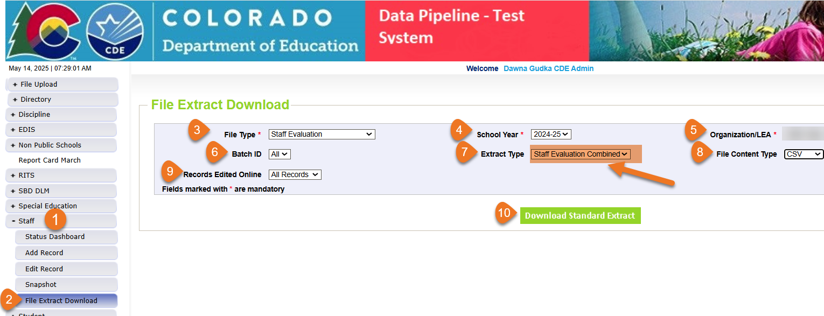
Staff Evaluation Interchange
Step that you should NOT SKIP if your LEA uses COPMS (RANDA)
Staff Evaluation Collection Manual
IMPORTANT STEP IF YOUR LEA USES COPMS (RANDA) do not skip this step. This step can be found on page 8 of the collection manual
Staff Evaluation
StaffEvaluation@cde.state.co.us

Slide 15

Staff Evaluation Snapshot Common Errors
EV030
EV004, EV005, EV006
This EDID was reported as a SSP, teacher or principal for the reported school year. Please add a record for this employee with their appropriate evaluation rating for the school year.
The EDID is listed in the more information section of the error.
The code 06 for teacher overall rating should be used minimally and only in extenuating circumstances (e.g., short-term disability). The percentage of records submitted exceeds 5%. To request an exception, visit cdeinfo.org/ses. For questions, contact EdTalentResearch@cde.state.co.us.
Copy and paste the URL address in a new browser window. There you will fill out EdTalents form to request the exception without providing any PII
Staff Evaluation
StaffEvaluation@cde.state.co.us

Slide 16
Questions & Resources:
Staff Evaluation
Staff Evaluation Snapshot Collection
Staff Interchange website
Staff Evaluation Snapshot website
Dawna Gudka
Collection Lead
(303) 598-7901
staffevaluation@cde.state.co.us

Slide 17
Student Interchange
Reagan Ward

Slide 18
Student Interchange 2024-2025
Date | Event | Event Description
6/11/2025 | Interim Deadline | Error Free interchange files: DEM, SSA, GG
6/12/2025 to 12/2/2025 | Other Date | Maintain error-free interchange files. Errors on DEM or SSA file prevent record from pulling into snapshots and/or may cause errors on student level data collections. Errors on GG file prevent record from connecting to student when validating graduates in SEY collection, causing SE301 SEY Errors Errors on Adj file prevent record from connecting to student to adjust final exit in SEY collection, which may cause Cross-LEA Errors
12/2/2025 | Closes | Student Interchange 2024-2025 Closes
Remaining Connected 2024-2025 Student Collection | Final Deadline
Student Attendance Snapshot | 7/25/2025
Student Discipline Snapshot | 7/31/2025
SPED Discipline Snapshot | 8/1/2025
Teacher Student Data Link Snapshot | 8/29/2025
SPED End of Year Snapshot | 10/3/2025
Student End of Year Snapshot Note: This is the only collection that utilizes GG and ADJ files | Regular Phase: 9/4/2025 Cross LEA Phase: 10/16/2025 Post-Cross LEA Phase: 11/18/2025 noon Superintendent Verification: 12/2/2025
Student Interchange
StudentOctober@cde.state.co.us
StudentEndOfYear@cde.state.co.us

Slide 19
Student Interchange 2025-2026
Date | Event | Event Description
7/14/2025 | Open | DEM, SSA, and GG files open
10/2/2025 | Interim Deadline | Student October: Upload initial DEM & SSA files
10/9/2025 | Interim Deadline | Student October: Error-free DEM & SSA files
12/17/2025 Tentative | Interim Deadline | SPED December: Error-Free DEM & SSA files
11/1/2025 | Other Date | Upload GG file to utilize CEDAR/COGNOS reports to monitor potential 2025-2026 graduates for GG completion, allowing ample time for LEAs to work with students to complete any missing measures during the year.
1/30/2026 | Other Date | Upload DEM, SSA, and GG files and address errors related to mid-year transfers.
4/1/2026 | Other Date | Prepare for Spring student level collections, uploading interchange files and addressing errors as needed.
4/30/2026 | Open | ADJ file opens
5/8/2026 | Interim Deadline | Upload the initial end of year interchange files. (DEM, SSA, GG) LEAs are expected to have an upload date 4/1/2026 or later to meet this interim deadline.
6/1/2026 | Other Date | Error free DEM and SSA records for K-3 students and 4-12 READ Cohort students to prevent errors in the READ Spring Assessments collection
6/10/2026 | Interim Deadline | Error free interchange files. (DEM, SSA, GG)
12/1/2026 | Closed | DEM, SSA, GG, and ADJ files close
Primary Point of Contact:
July 2025 to December 2025 – StudentOctober@cde.state.co.us
January 2026 to December 2026 – StudentEndofYear@cde.state.co.us
Student Interchange
StudentOctober@cde.state.co.us
StudentEndOfYear@cde.state.co.us

Slide 20
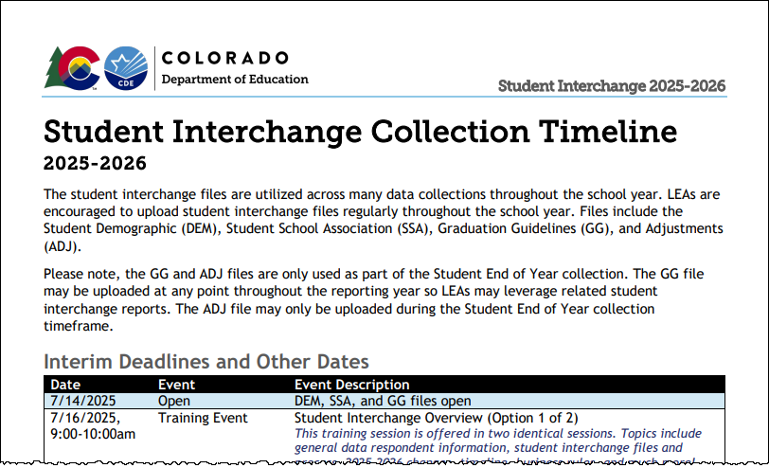
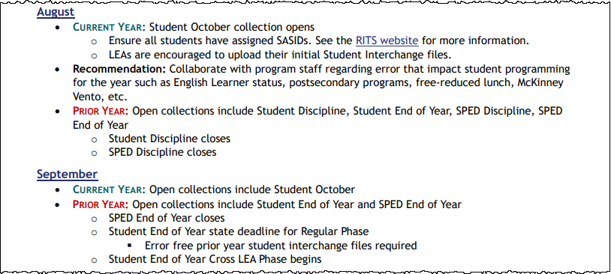
Interchange Timeline Resources
Collection Timeline:
Combined Interim Deadlines
Month-by-Month Timeline
Interim Deadlines for file uploads and error free files
Combines interim deadlines across student data collections
Broad overview of how Student Interchange is utilized throughout the school year
Highlights Prior Year and Current Year tasks each month when two interchange years are open
Student Interchange
StudentOctober@cde.state.co.us; StudentEndOfYear@cde.state.co.us

Slide 21

Upcoming Training
2025-2026
Student Interchange Overview
Collaborative Webinar:
ML Enrollment and Data Reports
This training session is being offered in two identical sessions.
  Topics include general data respondent information, student interchange files and process, 2025-2026 changes, timeline, business rules, and much more!
Option 1 of 2
  July 16, 9:00-10:00am
  Thanks to all who joined!
Option 2 of 2
  August 5, 9:00-10:00am
  Register for 8/5 Training
This collaborative webinar is designed for Data Staff and program staff who support Multilingual Learner identification and placement in LEAs.
  We will cover updates to data reports and business rules designed to support Colorado's standardized ELD Program Requirements.
July 23, 9:00-10:00am
Register for 7/23 Training
Student Interchange
StudentOctober@cde.state.co.us; StudentEndOfYear@cde.state.co.us

Slide 22
COGNOS/CEDAR Report Changes
Multilingual Learner Historical Reporting: SASID Lookup
Multilingual Learner Historical Reporting: District List
Updated report published, old report removed
Former name English Learner Historical Reporting by SASID
Added additional prior year data
  SEY (current and prior year only)
  ACCESS (most recent assessment year, if student was Assessed)
    Alternate ACCESS Y/N
    Overall Composite
    Literacy Composite
Reordered report, most recent school year listed first then in descending order
Updated report coming soon
Former name English Learner Historical Reporting by District
Added additional prior year data
  ACCESS (most recent assessment year, if student was Assessed)
    Alternate ACCESS Y/N
    Overall Composite
    Literacy Composite
This report only reflects current DEM and the prior OCT year
Student Interchange
StudentOctober@cde.state.co.us; StudentEndOfYear@cde.state.co.us

Slide 23
Questions & Resources:
Student Interchange
Student Interchange Website
2024-2025 Student Interchange StudentEndOfYear@cde.state.co.us
2025-2026 Student Interchange
July 2025-Dec 2025: StudentOctober@cde.state.co.us
Jan 2026-Dec 2026: StudentEndOfYear@cde.state.co.us

Slide 24
Student Discipline
Carrie Martin

Slide 25
Student Discipline
Collection Timeline
Date | Event | Event Description
6/21/2025 | Interim Deadline | Create at least one student discipline snapshot
7/08/2025 | Interim Deadline | Student Discipline Snapshot records error free
7/08-7/26/2025 | Report Review | LEAs should use this time to review reports prior to the deadline. Typically, one week prior to the deadline.
7/31/2025 | State Deadline | All LEAs must have a Student Discipline Snapshot submitted in Data Pipeline
8/9/2025 | State Deadline | Signature page emailed to Student Discipline Snapshot
8/31/2025 | Data Release | Data published
StudentDiscipline@cde.state.co.us

Slide 26
LEA Student Discipline Snapshot Status as of 7am today
Thank you to all the LEAs that have completed the collection!!
StudentDiscipline@cde.state.co.us
Student Discipline Snapshot Status

Slide 27
Student Discipline Snapshot State Deadline Approaching
Most Common Error
  SD007- Every school must be included in the Student Discipline Snapshot. If there were no disciplinary incidents to report, please refer to the Exception Request Instructions.
    Submit exception requests through LEAs Syncplicity Folder (example 1234_Discipline)
      If you need access, please send an email to StudentDiscipline@cde.state.co.us
    Exception Request Template and Exception Request Instructions are available on the Student Discipline Snapshot website.
  REMINDER: When you upload an exception request send an email to StudentDiscipline@cde.state.co.us
Student Discipline Snapshot Collection
StudentDiscipline@cde.state.co.us

Slide 28

Snapshot Reminder
  The Student Discipline Snapshot and the Special Education Discipline Snapshot are very closely related and utilize the same files.
  Please collaborate with your Special Education Discipline Snapshot respondent to ensure both snapshots are error free before submitting your data.
Student Discipline Snapshot Collection
StudentDiscipline@cde.state.co.us

Slide 29
Questions & Resources:
Student Discipline
Student Discipline Snapshot Site
Student Discipline Snapshot Timeline
Discipline Interchange Website
Discipline Action File Layout
StudentDiscipline@cde.state.co.us
Carrie Martin-Collection lead
(720) 665-4456

Slide 30
Prevent Harassment or Discrimination
Carrie Martin

Slide 31
Prevent Harassment or Discrimination
Collection Timeline
Date | Event | Event Description
7/3/2025 | Interim Deadline | Error free Prevent Harassment or Discrimination File
7/7-7/25/2025 | Report Review | LEAs should use this time to review reports prior to the deadline. Typically, one week prior to the deadline.
8/1/2025 | State Deadline | PHD Collection Closes- All LEAs must have Prevent Harassment or Discrimination submitted in Data Pipeline.
8/8/2025 | State Deadline | Signature page emailed to Prevent Harassment or Discrimination
PHD Collection
PreventHD@cde.state.co.us

Slide 32
LEA Prevent Harassment or Discrimination Status as of 7 am Today
Thank you to all the LEAs that have completed the collection!!
Prevent Harassment or Discrimination Collection
PreventHD@cde.state.co.us

Slide 33
Prevent Harassment or Discrimination
State Deadline Approaching
Most Common Error
  PH024 - No incidents have been reported for this school. If this is accurate, please refer to the Exception Request Instructions.
    Submit exception through LEAs Syncplicity Folder (example 1234_PHD)
      If you need access, please send an email to PreventHD@cde.state.co.us
    Exception Request Template and Exception Request Instructions are available on the Prevent Harassment or Discrimination website
    REMINDER: When you upload an exception request send an email to PreventHD@cde.state.co.us
Prevent Harassment or Discrimination Collection
PreventHD@cde.state.co.us

Slide 34

Reminder: Completing the Collection
  Error free and ready to complete the collection?
    Verify the data using Pipeline Reports
    Submit to CDE
    Download and complete verification form
    Return form to PreventHD@cde.state.co.us
Prevent Harassment or Discrimination Collection
PreventHD@cde.state.co.us

Slide 35
Questions & Resources:
Prevent Harassment or Discrimination
Prevent Harassment or Discrimination Site
PHD Training Manual, Exception Request Template , Exception Request Instructions
PreventHD@cde.state.co.us
Carrie Martin-Collection lead
(720) 665-4456
Additional Resources and CDE contacts for Harassment, Discrimination, Title IX, and Bullying
Prevention of Harassment, Discrimination, and Bullying in Colorado Schools Site

Slide 36
Special Education Discipline
Lindsey Heitman

Slide 37
Special Education Discipline Snapshot
Steps to complete by Aug 1st:
1. Verify all member districts have uploaded a Discipline Action file or marked no actions
  Use ‘District Activity Report’ found in Cognos Reports/Special Education Discipline or Status Dashboard screen- filter on Discipline Action.
2. Create snapshot and clear snapshot errors
  with help of district respondent
3. Submit any exception requests needed
4. Review validation reports found in Special Education Discipline Cognos folder
  SPED Discipline Data Summary Report
  SPED Discipline: Year to Year Comparison Type of Disciplines Report
SpedDiscipline@cde.state.co.us
Special Education Discipline – Lindsey Heitman

Slide 38
Remaining Timeline
Friday July 25th Complete Snapshot – Error Free:
  Date for AUs to have a complete Special Education Discipline Snapshot dataset by passing all interchange and snapshot validations in preparation for report review
Friday July 25 August 1st - Report Review Week:
  Director and data respondent review validation reports in detail and make any data corrections necessary to ensure data is valid and reliable
Friday August 1st:
    Final snapshot approval due within the Data Pipeline system and signed reports uploaded to ESSU Data Management System.
      *It is okay to do this as soon as you’ve reviewed your reports and signed off on your data!
Special Education Discipline – Lindsey Heitman
SpedDiscipline@cde.state.co.us

Slide 39
Special Education Discipline
Final Deadline – Friday, August 1, 2025
AUs are responsible for completing the following steps to meet the deadline:
  Electronically SUBMIT the data to CDE via the Data Pipeline
  Please upload the two required signed reports to the ESSU Data Management System
    SPED Discipline Data Summary Report (exported to PDF – all 10 pages)
    SPED Discipline Year-to-Year Comparison Type of Disciplines Report (exported to PDF-1 page)
      Flag explanation document required if ‘A’ flags trigger on year to year report. Template found on the Special Education Discipline Snapshot webpage under the Reports section.
    Please upload the Data Summary Report and Year-to-Year Report together in one PDF. The Flag Explanations document should be uploaded separately in a word document.
Districts are responsible for completing the following steps:
  Please send District Authority Sign-Off Form to the AU team
    SPED District Authority Sign-Off Form found in the Discipline Interchange cognos folder
    requested by Special Education Directors for data assurance purposes
  *No need to send to CDE or upload to DMS. This report is for AU records.
Special Education Discipline – Lindsey Heitman
SpedDiscipline@cde.state.co.us

Slide 40

SIGNATURE REPORTS
ADMINISTRATIVE UNIT
SPED Discipline Data Summary Report (10 Pages)
SPED Discipline Year-to-Year Comparison Type of Disciplines Report (1 Page)
  Year-to-Year Flag Explanation Document (Word) if applicable
DISTRICT
District Authority Sign-Off Form
  (requested by Special Education Directors for data assurance purposes and found in the Discipline Interchange cognos folder)
  *No need to send to CDE – for AU records
Special Education Discipline – Lindsey Heitman
SpedDiscipline@cde.state.co.us

Slide 41
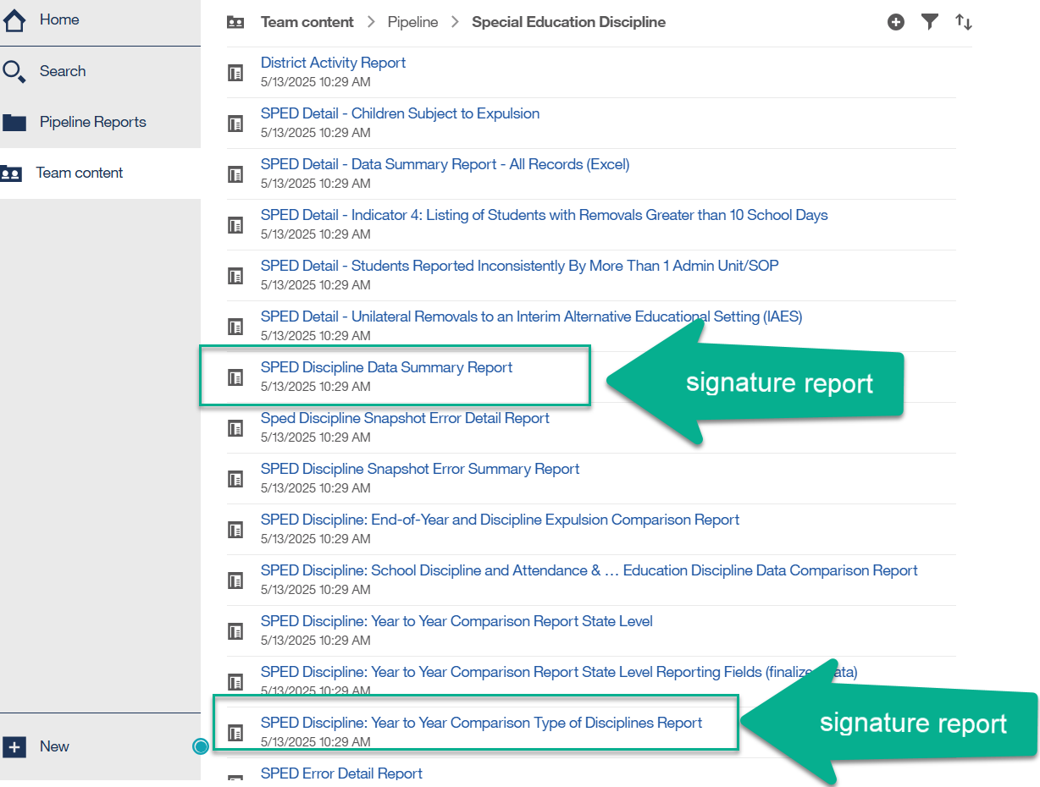
Signature and Detail Reports
2 signature reports required to be uploaded in full to the DMS
The rest of the reports are detail reports for your information
Detail Reports are there to assist Administrative Units in validating the Data Summary and Year-to-Year Comparison Reports
Special Education Discipline – Lindsey Heitman
SpedDiscipline@cde.state.co.us

Slide 42
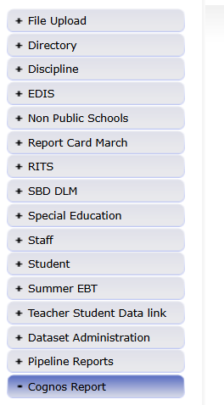
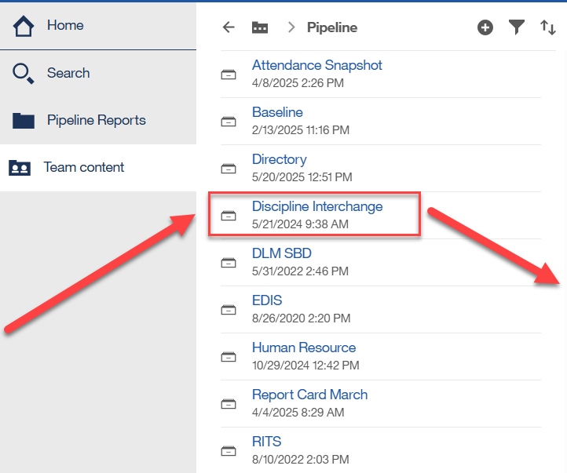
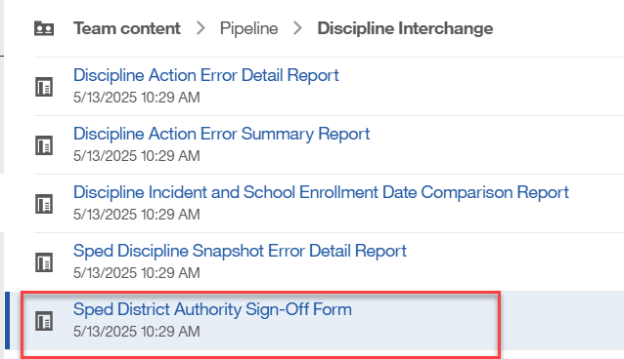
District Authority Sign-Off Due to AU team
District responsibility (DIS role) – send to AU team (not required by CDE)
Found under Cognos Reports/Discipline Interchange
Special Education Discipline – Lindsey Heitman
SpedDiscipline@cde.state.co.us

Slide 43
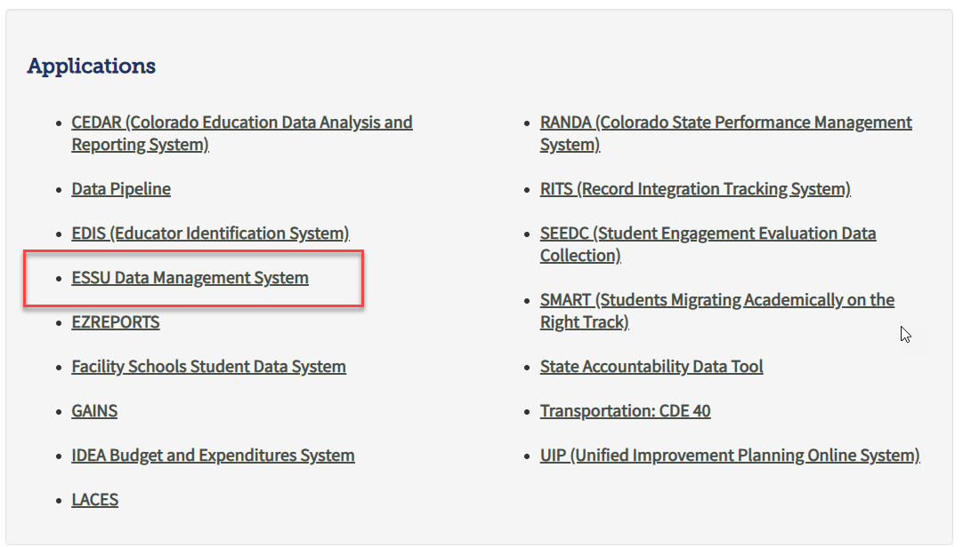
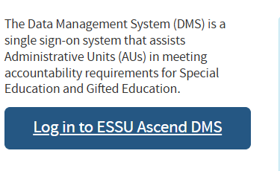
Uploading Reports to the ESSU Data Management System
SPED Director or AU respondent
From IdM homepage log into the ESSU Data Management System
  Click ‘ESSU Data Management System’
  Click ‘Log in to ESSU Ascend DMS’
  Questions on the DMS steps? Contact Josh Fails Fails_j@cde.state.co.us
Special Education Discipline – Lindsey Heitman

Slide 44
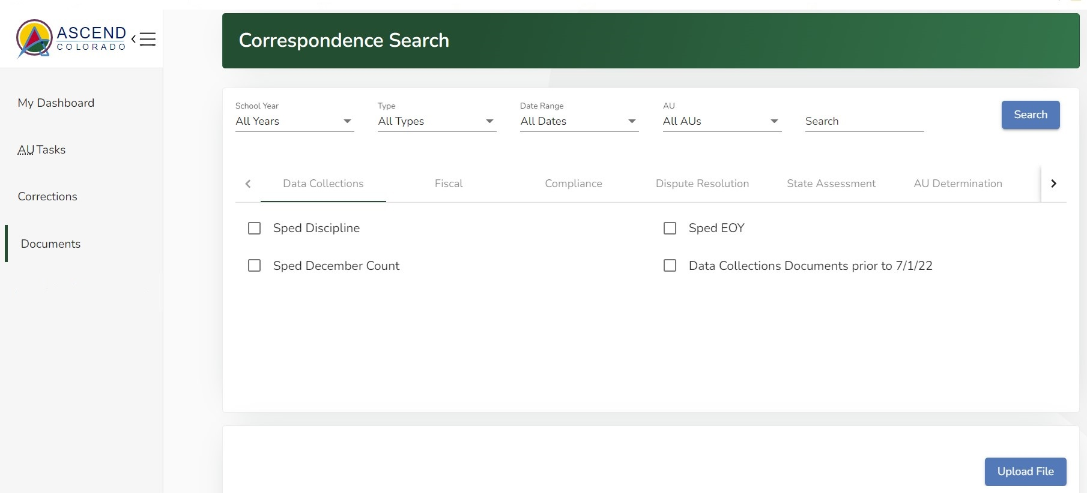
To Upload Documents
Click on “Upload File” button on this Documents Dashboard
Special Education Discipline – Lindsey Heitman
SpedDiscipline@cde.state.co.us

Slide 45
Final Snapshot Approval Steps Within Data Pipeline
*required by August 1, 2025
Within Data Pipeline
1. Click Discipline on the left menu
2. Click Status Dashboard
3. Use the drop downs to select the appropriate values
  File Type: SPED Discipline Snapshot
  School Year: 2024-25
  Organization/LEA: defaults to your AU
Notice the Data Locked value on this screen is set to N
Notice the Overall Status is set to P (pending) indicating the data has not been submitted to CDE.
Check the box next to the Admin Unit name and number and then click on your Admin Unit name to get to the screen which contains the submit button.
Click the Submit to CDE button (Only SPI-APPROVERS will have this ability) (must have 0 errors)
Click OK
  A green message should display above the File Type box indicating the data was submitted
  The Data Locked value should change to Y
  The Overall Status should change to S
Special Education Discipline – Lindsey Heitman
SpedDiscipline@cde.state.co.us

Slide 46
Questions & Resources:
Special Education Discipline
SpedDiscipline@cde.state.co.us
Lindsey Heitman
(720) 456-2033
Discipline Interchange Webpage
Special Education Discipline Snapshot Webpage

Slide 47
Special Education End of Year
Lindsey Heitman

Slide 48
Special Education End of Year
Update on Business Rules
SY295 - Student's record has an exit type of 01, 02, 40, 70, 90, 92, 93, or 94 in the Student EOY snapshot. Please double check the student's exit records to ensure you're reporting applicable exits from Special Education.
  Logic: Trigger an error if Student EOY Snapshot School Exit Type = 01, 02, 40, 70, 90, 92, 93, or 94; and Sped EOY Reason Exit = 00; UNLESS Student EOY Snapshot Retention Code = 3 AND School Exit Type = 90.
    This rule is now an error with additional exit types included
    Exception request may be required in some cases
    Any feedback or concerns?
SE352 - LASID cannot be duplicated within the Administrative Unit when SASID is zero-filled.
  Logic: If LASID is not zero-filled it must be unique in the AU IF SASID is zero-filled. The LASID may duplicate as long as the SASID is unique.
    This Participation and Child file rule switched from an error to a warning last fall and has now been switched back to an error
    Duplicates LASIDs at the AU level are allowed as long as the record has a unique SASID.
Special Education EOY – Lindsey Heitman
SpedEndofYear@cde.state.co.us

Slide 49
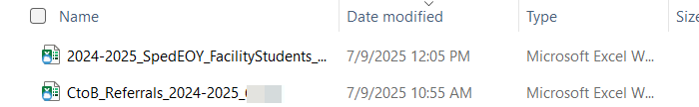
Special Education EOY-
C to B Referrals and Facility Students
Comparison Spreadsheets saved in AU syncplicity folder
You will find the following spreadsheets (for your information) saved in your AU syncplicity folder.
Please compare to your records:
  C to B Referrals 24-25 comparison spreadsheet
    Please compare to your Participation file path 2 initial referrals
    This information was shared with CDE by the Department of Early Childhood and contains a list of children referred from Part C Early Intervention services to Part B Special Education services in your AU during 2024-2025.
  24-25 Facility School Students comparison spreadsheet
    CDE Facility School students (Your AU should be paying for these students)
    This information was shared by the Facility School Unit at CDE per their records from the Facility Schools data
NOTE: If something is incorrect in the comparison spreadsheet, no need to contact CDE, just update your data as you see fit.
Special Education EOY – Lindsey Heitman
SpedEndofYear@cde.state.co.us

Slide 50
Questions & Resources:
SPED End of Year
SpedEndofYear@cde.state.co.us
Lindsey Heitman
(720) 456-2033
Special Education IEP Interchange Webpage
Special Education End of Year Snapshot Webpage

Slide 51
Thank you for Joining Today!
Next Town Hall will be date 7/24/2025
Reminder:
CDE Systems will be offline Friday 7/18 at 3pm through Sunday 7/20

