Slide 1
Student October Postsecondary Training
2024-2025
Brooke Wenzel
StudentOctober@cde.state.co.us

Slide 2
Agenda
Student October Timeline
Postsecondary Programs
  Overview
  ASCENT - Accelerating Students through Concurrent Enrollment
  PTECH - Pathways in Technology Early College High Schools
  TREP - Teacher Recruitment Education and Preparation
  ILOP – Innovative Learning Opportunities Pilot
  Other Programs
CEDAR Report (Cognos)

Slide 3
2024-2025 Student October Timeline

Slide 4
Data Collection and Cleanup Phase Timeline
Date | Event | Event Description
07/15/2024 | Open | Districts may begin uploading Student Interchange Files (Student Demographic and Student School Association).
08/23/2024 | Open | Districts may begin creating snapshots. Student October Snapshot dependencies are the Student Demographic File, Student School Association File, Title I File (if applicable) and At-Risk File.
08/28/2024 | Training Event | Data Pipeline Training 10-11 a.m.
09/05/2024 | Training Event | New Respondent Training 1-2 p.m.
09/10/2024 | Training Event | English Language Learner Training 11-12 p.m.
09/12/2024 | Training Event | Veteran Respondent Training 11-12 p.m.
09/16/2024 | Training Event | Postsecondary Program Coding Training 11-12 p.m.
09/24/2024 | Other Date | First day of Student October Count Window for districts with 5-day school week.
10/01/2024 | Other Date | Official Count Day 2024
10/02/2024 | Interim Deadline | Upload Student Demographic and Student School Association Files. Upload Title I Interchange File (if applicable). Upload At-Risk Interchange File.
10/08/2024 | Other Date | Last day of Student October Count Window for districts with 5-day school week.
10/09/2024 | Interim Deadline | Error free Student Interchange File uploads
10/14/2024 | Training Event | Mid-Collection Office Hours 10-11 a.m.
10/14/2024 | Interim Deadline | Create an initial Student October Snapshot
10/22/2024 | Interim Deadline | Error free Student October Snapshot
10/24/2024 | Training Event | Data Validation, Transfer Enrollment Exceptions and Cognos Reports 1-2 p.m.
10/28/2024 | Training Event | Data Pipeline Duplicate Process and Submission 9-10 a.m.
11/01/2024 | Report Review | Review Student October Cognos Reports for data validation. Submit Student October Snapshot data as soon as review is complete.
11/08/2024 12:00 p.m. | State Deadline | Submit Student October Snapshot data

Slide 5
Duplicate Count Phase Timeline
Date | Event | Event Description
11/12/2024 12:00 p.m. | Deadline | Duplicate funding documentation due to School Auditing Office
11/18/2024 | Other Date | School Auditing makes decisions on funding duplicates
11/27/2024 | Deadline | Resubmit Student October Snapshot data to CDE based on decisions from School Auditing
12/06/2024 | Deadline | Collection closes Secretary of the Board of Education Verification (sign-off) form due. Data remains embargoed until the official release in January.
01/15/2025 | Data Release | Official data release
General Duplicate Count Process
  Begins once all districts have submitted their Student October Snapshot to CDE, Friday, November 8th
  ~3 business days after running the duplicate process Duplicate Documentation is due to The CDE School Auditing Office
  ~2 business days after documentation received decisions will be sent to districts
Signature Page
  Due Friday, December 6th: Signed by Secretary of Board of Education AND the Chief Financial Officer
    If your district needs an extension, please send Student October Collection lead an email with the day when your School Board Secretary will be able to sign the form

Slide 6
Postsecondary Programs
Notes:
Erica

Slide 7
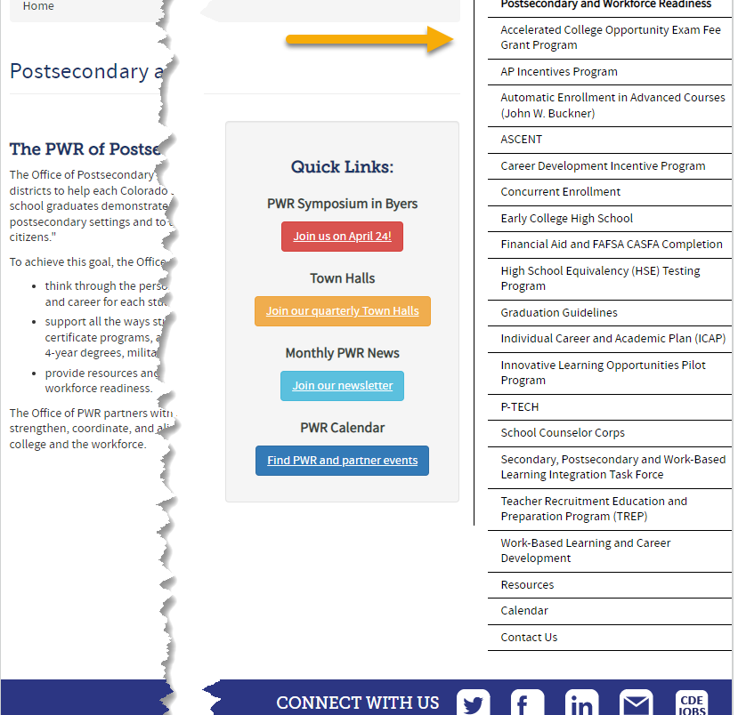
What are Postsecondary Programs?
Provide opportunities for high school students to demonstrate the knowledge and skills (competencies) needed to succeed in postsecondary settings and to advance in career pathways as lifelong learners and contributing citizens.
Support all the ways students can enter into postsecondary education – including certificate programs, apprenticeships and other work-based learning experiences, 2- and 4-year degrees, military, and career training.
Notes:
Erica

Slide 8
General Information:
Types of Postsecondary Programs
Years 1-4
Years 5-6
Concurrent Enrollment
ILIOP
  Participating schools only
Early College
  Participating schools only
Dropout Recovery at a Community College
  Students Ages 16 to 21
P-TECH Years 1-4
  Participating schools only
ASCENT (year 5 only)
P-TECH (years 5 & 6)
  Student must have been coded as PTECH in year 4
  Participating schools only
TREP (years 5 & 6)
  Slot allocation
Note: Number of years in High School is determined by the student’s Anticipated Year of Graduation (AYG). Only students with an AYG indicating they are in their 5th year are eligible for ASCENT. Only students in their 5th or 6th year per AYG are eligible for the applicable years of P-TECH or TREP.
Notes:
Erica

Slide 9
Postsecondary
Annual Coding Cycle
End of Year
October
Monitor for Status Changes
Monitor postsecondary program enrollment changes for students from OCT to SEY
Is the student actively participating in the postsecondary program?
Did the student participate in the postsecondary program at any point in the school year?
Coding remains the same as October unless and enrollment change occurred
Identify students that will be participating in ASCENT year 5, TREP years 5-6, P-TECH years 5-6 during Fall semester (retention code 2)
Reminder: Districts should verify student meets postsecondary requirements
Site: CDE Postsecondary and Workforce Readiness
Site: CDE Audit Resource Guide
Site: Student Interchange File Layout and Definitions-Student School Association
Student October
Is the postsecondary status of the student as of October 1st (Count Date)
Student End of Year
PS code is the summation of the current school year
PS code is not the status of the student for next year
Retention code 2 is the anticipated status for next year

Slide 10
Counting for Graduation Rates vs Received Diploma
Colorado Graduation Rates
Diploma Issued
Students who return to participate in ASCENT, TREP, or P-TECH years 5-6 may be counted as a graduate for graduation rate purposes at the end of their 4th year if they have met local and state graduation requirements.
Prevents students participating in these programs from negatively effecting the 4-year on time graduation rate for the district/school.
Students participating in ASCENT, TREP, and P-TECH years 5-6 programs receive their high school diplomas at the end of their corresponding program.
Diplomas & Transcripts reflect a student’s final exit from K-12 education as the graduation date.

Slide 11
General Business Rule Checks
Postsecondary Program Enrollment code must be a valid code and is required
  2-digit numeric code only, use ’00’ if student is not participating in a postsecondary program
Grade Level checks to ensure student is in the grade level outlined in the restrictions (e.g.,Grade 120 for ASCENT/P-TECH/TREP, Grade 9-12 for CE, etc.)
Students marked as ASCENT/P-TECH years 5-6/TREP in Student October (OCT) are also marked ASCENT/P-TECH years 5-6/TREP in Student End of Year (SEY) within the same year since these are year long programs
ASCENT/P-TECH years 5-6/TREP Students included in the subsequent OCT who do not have retention code 2 in the current year SEY
  Example:
    If 2024-2025 OCT postsecondary code indicating ASCENT/P-TECH years 5-6/TREP
    Then 2023-2024 SEY must have Retention Code 2
AYG checks to verify student is in their 5th or 6th year of high school

Slide 12
ASCENT
Notes:
Erica

Slide 13
ASCENT Program Overview
Accelerating Students through Concurrent Enrollment (ASCENT) is a fifth-year high school program that allows students to participate in concurrent enrollment the year after 12th grade, to enroll in postsecondary courses and earn college credit at no tuition cost.
Districts can choose to cover additional costs, such as textbooks, fees, and transportation.
Students need 9 postsecondary credits to qualify.
Students must submit a FAFSA/CAFSA application.
In 2025-26 ASCENT slots will be limited by district, based on 2024-25 Student October submissions.
ASCENT students are identified to CDE during Student October.
Notes:
Erica

Slide 14
ASCENT: Coding Pattern
Counted as Graduate in 4th Year
Counted as Graduate in 5th Year
Years in HS (per AYG) | 4th | 5th
Grade Level | 120 | 120
Postsecondary Program | 00 or 02 | 01
School Entry Type | 02* | 90
School Exit Type | 90 | 24 or 23
Retention Code | 2 | 0
OCT Funding | 80** | FT, PT, N/A
Years in HS (per AYG) | 4th | 5th
Grade Level | 120 | 120
Postsecondary Program | 00 or 02 | 01
School Entry Type | 02* | 02 or 11
School Exit Type | 00 | 96
Retention Code | 2 | 0
OCT Funding | 80** | FT, PT, N/A
Notes:
*Entry Type in 4th year may be any applicable code
Exit 24 – Previous graduate who completed their ASCENT 5th year.
Exit 23 – Previous graduate who did not complete their ASCENT 5th year.
Diploma/Transcripts reflect exit date in the 5th year as the student’s graduation date.
**October funding in 4th year may be any applicable code

Slide 15
ASCENT: Types of Business Rule Checks
Exit type for ASCENT students should be 96, 23, or 24
  Exit Type 96 cannot be used if Exit Type 90 was used in a prior year
  Exit Type 23 or 24 cannot be used unless the student had Exit Type 90 in a prior year
ASCENT students included in the subsequent OCT who do not have retention code 2 in the current year SEY
  Example:
    If 2023-2024 OCT postsecondary code indicating ASCENT
    Then 2022-2023 SEY must have Retention Code 2
Students in ASCENT should have Non-School Program code 04 (Third Party Program) because they are taking their courses through the IHE
District Code in the current year for ASCENT students must match their last district of attendance in the prior year
Student in ASCENT must be in the 5th year of HS per AYG
Students in ASCENT should not have retention code 2 at the end of their 5th year
Student October (OCT) collection also includes checks to ensure ASCENT students utilize correct funding codes per OCT collection guidelines

Slide 16
PTECH
Notes:
Eivi

Slide 17
P-TECH Program Overview
More information on P-TECH
Site: P-TECH Program Website
Site: P-TECH Students and Parents Website
Pathways in Technology Early College High Schools in CO
An innovative partnership between a school district, a community college(s), and one or more local high growth industry employer(s).
Students begin in 9th grade and go through 14th grade (high school and two equivalent years of college) for a total of 6 years.
Students graduate with both a high school diploma and an industry-recognized associate degree, in addition to gaining relevant workplace skills.
Talent Pipeline Report
P-TECH can be a school, or a program within a school.
Approved P-TECH Programs/Schools
Notes:
Eivi

Slide 18
P-TECH: Coding Pattern
Counted as Graduate in 4th year
Counted as Graduate in 6th Year
Years in HS (per AYG) | 3rd | 4th | 5th | 6th
Grade Level | 110 | 120 | 120 | 120
Postsecondary Program | 15 | 15 | 16 | 16
School Entry Type | *02 | 02 | 90 | 90
School Exit Type | 00 | 90 | 23 | 24 or 23
Retention Code | 0 | 2 | 2 | 0
Years in HS (per AYG) | 3rd | 4th | 5th | 6th
Grade Level | 110 | 120 | 120 | 120
Postsecondary Program | 15 | 15 | 16 | 16
School Entry Type | *02 | 02 | 02 | 02
School Exit Type | 00 | 00 | 00 | 96
Retention Code | 0 | 2 | 2 | 0
Notes:
*Entry type in 3rd year may be any applicable code
Exit 24 – Previous graduate who completed their P-TECH 6th year.
Exit 23 – Previous graduate who completed their P-TECH 5th year and will return for a 6th year or left P-TECH program in the middle of their 5th/6th year.
Diploma/Transcripts reflect exit date in the 6th year as the student’s graduation date (or point left program in middle of 5th/6th year without returning).
Student is expected to be enrolled in P-TECH for the entirety of the school year (both OCT and SEY)

Slide 19
P-TECH: Types of Business Rule Checks
Students in P-TECH programs must be attending an approved P-TECH school code
Students in P-TECH years 5-6 should have been in a P-TECH program in the prior year
Students in P-TECH must be funded full-time
Exit type for P-TECH years 5-6 students should be 00, 96, 23, or 24
  Exit Type 96 or 00 cannot be used if Exit Type 90 was used in a prior year
  Exit Type 23 or 24 cannot be used unless the student had Exit Type 90 in a prior year
Entry Type 90 is required for students with Exit Type 90 in a prior year
12th grade students in P-TECH Years 1-4 program without retention code 2
  Warning to help districts ensure any student continuing into years 5-6 have the appropriate retention code
District Code in the current year for P-TECH years 5-6 students must match their last district of attendance in the prior year
Student in P-TECH years 5-6 must be in the 5th or 6th year of HS per AYG
Student October (OCT) collection also includes checks to ensure P-TECH students utilize correct funding code patterns per OCT collection guidelines

Slide 20
TREP

Slide 21
TREP Program Overview
Teacher Recruitment Education and Preparation
Creates the opportunity for qualified students in an educator career pathway to concurrently enroll in postsecondary courses and earn college credit at no tuition costs to them or their families, for up to two years after the 12th grade year.
Districts can choose to cover additional costs, such as textbooks, fees, and transportation.
Students need to take one class on the pathway in their 12th grade year to be eligible
Limited number of slots available
Districts must submit an Intent to Participate and spreadsheet with student level data to request slots
Notes:
Erica
*Talk about allocation and how that works

Slide 22
Current Year vs. Carryforward
Current Year
Carry Forward
Slots allocated and used in the same year
Funding received by district in same year as the slot was allocated
Can be either year 5 or year 6 slots
Slots that were allocated in the previous year, but not used
Funding was already received by the district in the previous year
Can only be year 5 slots
Notes:
Erica

Slide 23
Postsecondary Program Enrollment
Code | Postsecondary Program | Grade (Restrictions)
17 | TREP Year 5 (Current Year) | Retained 12th Only (12th grade in 5th year of high school per AYG)
18 | TREP Year 5 Carryforward – Full Time | Retained 12th Only (12th grade in 5th year of high school per AYG)
19 | TREP Year 5 Carryforward – Part Time | Retained 12th Only (12th grade in 5th year of high school per AYG)
20 | TREP Year 6 (Current Year) | Retained 12th Only (12th grade in 6th year of high school per AYG)
Notes:
  Current: Student will utilize current year allocation slots
  Carryforward: Student will utilize a carry forward slot that was not used in the prior year
  Carryforward slots must be used before current year
Notes:
To track students that enroll in Postsecondary Programs, we have corresponding codes for each one of our programs. This information is provided to CDE through our Student School Association file to tie the postsecondary program to each student’s enrollment record. This is different in comparison to prior years in which the Postsecondary program enrollment field used to be reported through our Student Demographic File. For our TREP students, we have codes 17, 18, 19 and 20, depending on the TREP allocation slot utilized. Our Year 5 TREP students can be coded with 17, 18 or 19 depending if the student will use a Current Year or Carryforward allocation slot and further, if the student is using a carryforward slot, is the student full-time or part-time. Our code 20 is specifically for our TREP Year 6 students. This students can only use current year slots. Our codes 17 and 20 contribute to each LEAs Current Year Allocation summation and codes 18 and 19 will contribute to your district’s carryforward allocations. Anticipated Year of Graduation (AYG) helps CDE determine if students are in their 5th or 6th years of high school to verify only grade appropriate students are enrolled in the program. Please also note that carryforward slots must be used before current year as these funds have already been allocated to your district.

Slide 24
Allocation/Slot Utilization
Funding Codes -> | 80 | 82 | 85 | 87 | 91 | 92 | 94 | 95 | 96
TREP Year 5-17 Current Year | 1.0 | 0.5 | 0.5 |  | 1.0 | 1.0 | 0.5 | 0.5
TREP Year 5-18 Carryforward (Full Time) |  |  |  | 1.0 |  |  |  |  | 1.0
TREP Year 5-19 Carryforward (Part Time) |  | 0.5 toward Current Year, 0.5 toward Carryforward | 0.5 toward Current Year, 0.5 toward Carryforward | 0.5 |  |  | 0.5 toward Current Year, 0.5 toward Carryforward | 0.5 toward Current Year, 0.5 toward Carryforward | 0.5
TREP Year 6-20 Current Year | 1.0 | 0.5 | 0.5 |  | 1.0 | 1.0 | 0.5 | 0.5
District A has 2.0 Carryforward and 0.5 Current Year Slots
  1 Student Coded as TREP Year 5 (17) with 82 funding = 0.5 Current Year
  2 Students Coded as TREP Year 5 (18) with 87 funding = 2.0 Carryforward (1.0+1.0)
Notes:
Here is a quick chart to show the different TREP Postsecondary Codes in conjunction with their funding codes and how many slots the student would make up with that coding combination. The TREP Postsecondary Codes are listed on the left hand side of the chart while the funding codes are across the top. With a specific coding combination, you will see the allocation slot numbers indicated in red. For example, TREP Year 5 Current Year students (first row) can use funding codes 80, 82, 85, 91, 92, 94 or 95. The blacked out funding codes should not be used with Postsecondary Code 17. Here is a quick allocation example: District A was allocated 2.0 Carryforward slots (since they did not use those allocations in the prior year) and 0.5 Current Year slots. District A coded one student with TREP Year 5 Current Year (code 17) with an 82 funding code. This equates to 0.5 current year slots. They also have 2 students coded as TREP Year 5 Carryforward Full-time (code 18) with 87 funding codes,. This equates to 2.0 carryforward (1.0+1.0). District A has appropriately allocated all TREP slots.

Slide 25
TREP: Coding Pattern
Counted as Graduate in 4th year
Counted as Graduate in 6th year
Years in HS (per AYG) | 4th | 5th | 6th
Grade Level | 120 | 120 | 120
Postsecondary Program | 00 or 02 | 17, 18, 19 | 20
School Entry Type | 02* | 90 | 90
School Exit Type | 90 | 23 | 24 or 23
Retention Code | 2 | 2 | 0
Funding Status (OCT) | 80* | Check Chart | Check Chart
Years in HS (per AYG) | 4th | 5th | 6th
Grade Level | 120 | 120 | 120
Postsecondary Program | 00 or 02 | 17, 18, 19 | 20
School Entry Type | 02* | 02 | 02
School Exit Type | 00 | 00 | 96
Retention Code | 2 | 2 | 0
Funding Status (OCT) | 80* | Check Chart | Check Chart
Notes:
*Entry type and Funding Status in 4th year will be any applicable code
Exit 24 – Previous graduate who completed their TREP 6th year.
Exit 23 – Previous graduate who completed their TREP 5th year and will return for a 6th year or left TREP program in the middle of their 5th/6th year.
Funding Status is in direct relationship with Year 5/Year 6 and Current Year/Carryforward
Notes:
Let’s review two different coding patterns we have for TREP students: students that were counted as a graduate in the 4th year and students that were counted as a graduate in the 6th year. For this presentation’s purpose, we will just review the 4th year graduate to show how to read these charts. Just a reminder, students participating in TREP years 5-6 programs receive their high school diplomas at the end of their corresponding program (year 6).
Students that were counted as a graduate in the 4th year will have the following coding pattern if they anticipate returning as a TREP student in their 5th year (and more than likely their 6th year). These students will be indicated in 12th grade (120). Their postsecondary program in that year will reflect either not in a postsecondary program 00 or 02 which means concurrent enrollment. The school entry type for these students will be any applicable code for that year and the student’s funding status is also any applicable code for that school year (in this case, we have a full-time student – 80). For this example, we are using 02 which means the student continued on as normal from the prior year. The student’s School exit type will need to reflect the student meeting graduation requirements – 90 and marked as retention code 2 meaning that the student plans on returning as a postsecondary student. Moving on to the 5th year column in the orange chart. This is where LEAs will indicate that the student is participating in TREP. The grade level will say consistent with 120 for our 12th grade students. The Postsecondary program for this 5th year student will be 17, 18 or 19 depending on if the student is utilizing a current year or carryforward slot. The School Entry Type will be 90 since the student is returning after being counted as a graduate. Their exit type will be a 23: Previous graduate who completed their TREP 5th year and will return for a 6th year or left TREP. In this case, this student returned for the 6th year. The retention code should stay as a 2 because the student is returning again for their 6th year for our TREP program. The funding code of the student will be dependent on the allocation slot the student is utilizing. Finally moving to our 6th year for this student. The student will move to our Postsecondary code 20 indicating they are a current year TREP year 6 student. Entry will be 90 again because the student graduated in a prior year and is returning. The School Exit Type is depending on if the student completed the TREP program or not. If the student completed the program, you will use code 24. If the student did not complete the program, a code 23 will be used. The Retention code will change from 2 to 0 because the student will not return the next school year and again the funding status will be related to the allocation slot.
For our students that graduate in their 6th year, please use the coding pattern shown in the blue chart as it differs slightly to our other kiddos.

Slide 26
TREP: Types of Business Rule Checks
Students should have exit type 00, 96, 23, or 24
  Exit Type 96 or 00 cannot be used if Exit Type 90 was used in a prior year
  Exit Type 23 or 24 cannot be used unless the student had Exit Type 90 in a prior year
TREP students included in the subsequent OCT who do not have retention code 2 in the current year SEY
  Example:
    If 2023-2024 OCT postsecondary code indicating TREP year 5 or 6
    Then 2022-2023 SEY must have Retention Code 2
Students in TREP should have Non-School Program code 04 (Third Party Program) because they are taking their courses through the IHE
Students cannot be in TREP year 6 if they were not in TREP year 5 in the prior year
District Code in the current year for TREP students must match their last district of attendance in the prior year
Students in TREP year 5 programs must be in the 5th year of HS per AYG
Students in TREP year 6 programs must be in the 6th year of HS per AYG
Students in TREP should not have retention 2 at the end of their 6th year
Student October (OCT) collection also includes checks to ensure TREP students utilize correct funding codes per OCT collection guidelines and checks TREP slot allocation
Notes:
We have a couple of business rule checks for TREP (not all are listed but let’s review a few). Students should be 00, 96, 23, or 24. TREP students included in the subsequent October Count who do not have retention code 2 in the current year Student End of Year Collection will flag an error. For example, if 2023-2024 OCT postsecondary code indicates TREP Years 5 or 6 then 2022-2023 Student End of Year record must have retention code 2 for that student. Students in TREP should have Non-School Program code 04 (Third Party Program) because they are taking their courses through the IHE. Students cannot be in TREP year 6 if they were not in TREP year 5 in the prior year. District Code in the current year for TREP students must match their last district of attendance in the prior year. Students in TREP year 5 programs must be in the 5th year of HS per AYG. The same thing goes for our 6th year TREP students. Also please, Note: Student October (OCT) collection also includes checks to ensure TREP students utilize correct funding codes per OCT collection guidelines and checks TREP slot allocation

Slide 27
ILOP
Notes:
Alexa

Slide 28
ILOP Program Overview
More information on ILOP:
Site: ILOP
Innovative Learning Opportunities Pilot Program
Purpose: to enrich students’ education and support the successful transition to postsecondary or workforce
Allows participating LEPs to offer work-based learning opportunities to students in 9-12th grades (including internships, apprenticeships, competency-based learning, capstone projects)
Students in ILOP receive full-time per pupil funding regardless of seat time at the high school
Schools/districts must apply and be accepted to participate.
  Note: ILOP is due to sunset - expiring July 2025, and no new applications are being accepted at the moment.
Participating Local Education Providers
Notes:
Alexa

Slide 29
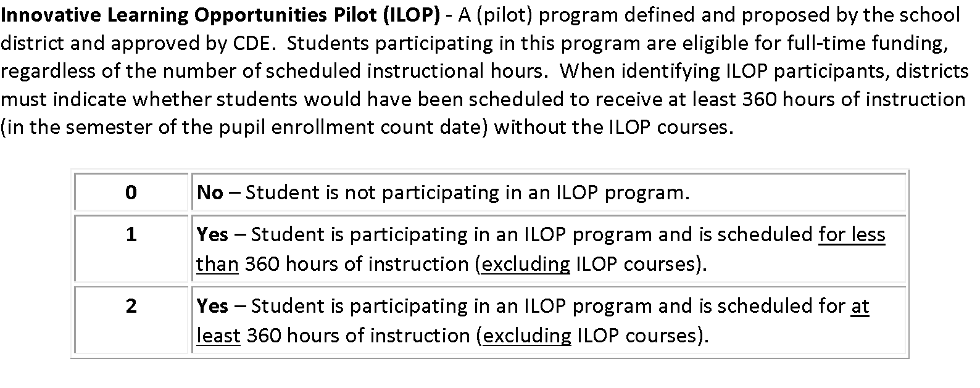
ILOP Coding
Notes:
Brooke

Slide 30
Other Programs

Slide 31
Concurrent Enrollment
More information on CE
Site: Concurrent Enrollment
Site: Student and Parent
A program which allows the simultaneous enrollment of a qualified student in a local education provider and in one or more postsecondary courses, including academic or career and technical education courses, at an institution of higher education at no tuition cost to the student.
Postsecondary Program Code = 02
Student October: Use postsecondary program code ‘02’ to indicate a student who is actively participating in CE courses as of October 1st (Count Date). This will be indicated in the student’s enrollment record (SSA).
Student End of Year: Use postsecondary program code ‘02’ to indicate a student who participated in CE courses at any point during the school year. This will be corresponding to the student’s enrollment record (SSA).
  Example: Student participated in CE courses in Fall but not in Spring – code the student as ’02’ in the Student End of Year (SEY) collection in one of the student’s enrollment records.
*Student’s Postsecondary Program should not change from OCT to SEY. If the Postsecondary Program status does change, more than 1 enrollment record will be needed to reflect status change.
Notes:
We will now step into each postsecondary program with the first being Concurrent Enrollment. Concurrent Enrollment is a program that allows the simultaneous enrollment of a qualified student in a LEP and in one or more postsecondary courses including academic or career and technical education courses at an institution of higher education (IHE) at no tuition cost to the student. To indicate a student is a Concurrent Enrollment student, you will need to indicate the student with a Postsecondary Program Code of 02. During the Student October Collection, you will use postsecondary program code 02 to indicate a student who is actively participating in CE courses as of October 1st or your district’s adoptive count date. This will be indicated in the student’s enrollment record in the Student School Association file. For our Student End of Year Collection, continue to code the student with 02 to indicate a student who participated in CE courses at any point during the school year. The indication corresponds to the student’s enrollment record. For example, a student participated in CE courses in Fall but not in Spring – you will need to code the student as 02 in the Student End of Year collection in one of the student’s enrollment records, specifically the Fall record. The student’s Postsecondary Program should not change from OCT to SEY. If the Postsecondary Program status does change, more than 1 enrollment record will be needed to reflect status change. More information on Concurrent Enrollment can be found on the Concurrent Enrollment website or the Student and Parent Website. On the Student and Parent website, there are videos from students, parents and counselors about the benefit of Concurrent Enrollment programs. You can also learn about how credits will transfer and how to apply for admission as a Concurrent Enrollment student.

Slide 32
Early College
More information on Early College
Site: Early College for Practitioners
Site: Early College for Students and Parents
An Early College, as defined by C.R.S. 22-35-103(10)(a), is a secondary school that provides only a curriculum that requires each student to enroll in and complete secondary and postsecondary courses while enrolled in the four years of high school such that, upon successful completion of the curriculum, the student will have completed the requirements of a high school diploma and an associate's degree or other postsecondary credential or at least sixty credits toward the completion of a postsecondary credential. The curriculum must be designed to be completed within four years.
State Approved Early College List
Postsecondary Program Code = 07
Student October: Use postsecondary program code ‘07’ to indicate a student who is actively participating in Early College as of October 1st (Count Date). This will be indicated in the student’s enrollment record (SSA).
Student End of Year: Use postsecondary program code ‘07’ to indicate a student who participated in Early College at any point during the school year. This will be corresponding to the student’s enrollment record (SSA).
  Example: Student participated in EC in Fall but not in Spring – code the student as ’07’ in the Student End of Year (SEY) collection in one of the student’s enrollment records.
*Student’s Postsecondary Program should not change from OCT to SEY. If the Postsecondary Program status does change, more than 1 enrollment record will be needed to reflect status change.
Notes:
Moving on to Early College.. Early College is a secondary school that provides only a curriculum that requires each student to enroll in and complete secondary and postsecondary courses while enrolled in the four years of high school such that, upon successful completion of the curriculum, the student will have completed the requirements of a high school diploma and an associate’s degree or other postsecondary credential or at least sixty credits toward the completion of a postsecondary credential. The curriculum must be designed to be completed within 4 years. There is a list of approved Early College school codes that are able to enroll Early College students. To indicate a student is enrolled in an early college program, LEAs will need to code the student with Postsecondary Code of 07. During the Student October Collection, you will use postsecondary program code 07 to indicate a student who is actively participating in Early College as of October 1st or your district’s adoptive count date. This will be indicated in the student’s enrollment record in the Student School Association file. For our Student End of Year Collection, continue to code the student with 07 to indicate a student who participated in Early College at any point during the school year. The indication corresponds to the student’s enrollment record. For example, a student participated in Early College in Fall but not in Spring – you will need to code the student as 07 in the Student End of Year collection in one of the student’s enrollment records, specifically the Fall record. Again, the student’s Postsecondary Program should not change from OCT to SEY. If the Postsecondary Program status does change, more than 1 enrollment record will be needed to reflect status change. More information on Early College can be found on the Early College for Practitioners website or the Student and Parent Website.

Slide 33
Dropout Recovery at Community College
A dropout recovery program allowing a student who has dropped out of high school, or a student who is at-risk of dropping out of high school, to complete their high school graduation requirements exclusively at the community college. Any individual age 16 to 21 who has dropped out of school may participate with the permission of the school district.
Postsecondary Program Code = 08
Student October: Use postsecondary program code ‘08’ to indicate a student who is actively participating in Early College as of October 1st (Count Date). This will be indicated in the student’s enrollment record (SSA).
Student End of Year: Use postsecondary program code ‘08’ to indicate a student who participated in Early College at any point during the school year. This will be corresponding to the student’s enrollment record (SSA).
  Example: Student participated in EC in Fall but not in Spring – code the student as ’08’ in the Student End of Year (SEY) collection in one of the student’s enrollment records.
*Student’s Postsecondary Program should not change from OCT to SEY. If the Postsecondary Program status does change, more than 1 enrollment record will be needed to reflect status change.
Notes:
Finally getting into Dropout Recovery at a Community College.. A dropout recovery program allowing a student who has dropped out of high school, or a student who is at-risk of dropping out of high school, to complete their high school graduation requirements exclusively at the community college. Any individual age 16 to 21 who has dropped out of school may participate with the permission of the school district. To indicate a student is enrolled in a dropout recovery program, LEAs will need to code the student with Postsecondary Code of 08. During the Student October Collection, you will use postsecondary program code 08 to indicate a student who is actively participating in dropout recovery as of October 1st or your district’s adoptive count date. This will be indicated in the student’s enrollment record in the Student School Association file. For our Student End of Year Collection, continue to code the student with 08 to indicate a student who participated in dropout recovery at any point during the school year. The indication corresponds to the student’s enrollment record. For example, a student participated in dropout recovery in Fall but not in Spring – you will need to code the student as 08 in the Student End of Year collection in one of the student’s enrollment records, specifically the Fall record. Again, the student’s Postsecondary Program should not change from OCT to SEY. If the Postsecondary Program status does change, more than 1 enrollment record will be needed to reflect status change.

Slide 34
CEDAR Report (Cognos)

Slide 35
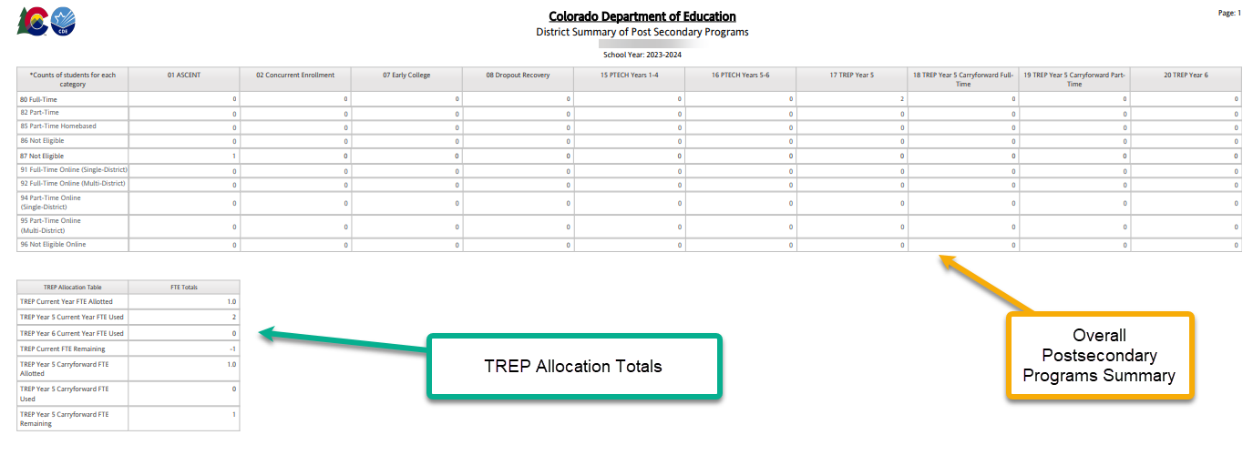
District Summary of Post Secondary Programs

Slide 36
Resources/Links
Brooke Wenzel – Data Services Unit
StudentOctober@cde.state.co.us
720-441-7963
Erica Ryan – Postsecondary Unit (ASCENT, TREP, Early College, Concurrent Enrollment, Dropout Recovery)
ryan_e@cde.state.co.us
720-576-4288
Alexa Enamorado – Postsecondary Unit (ILOP)
enamorado_a@cde.state.co.us
720-955-1641
Eivi Colmenero – Postsecondary Unit (PTECH)
colmenero_e@cde.state.co.us
720-765-1323
Student Interchange Website (Short Bytes)
Student October Website
Postsecondary Unit Website
CDE Audit Resource Guide

