Slide 1
Student October Data Validation Training 2024-2025
Brooke Wenzel StudentOctober@cde.state.co.us

Slide 2
Timeline

Slide 3
Data Collection and Cleanup Phase Timeline
Date | Event | Event Description
07/15/2024 | Open | Districts may begin uploading Student Interchange Files (Student Demographic and Student School Association).
08/23/2024 | Open | Districts may begin creating snapshots. Student October Snapshot dependencies are the Student Demographic File, Student School Association File, Title I File (if applicable) and At-Risk File.
08/28/2024 | Training Event | Data Pipeline Training 10-11 a.m.
09/05/2024 | Training Event | New Respondent Training 1-2 p.m.
09/10/2024 | Training Event | English Language Learner Training 11-12 p.m.
09/12/2024 | Training Event | Veteran Respondent Training 11-12 p.m.
09/16/2024 | Training Event | Postsecondary Program Coding Training 11-12 p.m.
09/24/2024 | Other Date | First day of Student October Count Window for districts with 5-day school week.
10/01/2024 | Other Date | Official Count Day 2024
10/02/2024 | Interim Deadline | Upload Student Demographic and Student School Association Files. Upload Title I Interchange File (if applicable). Upload At-Risk Interchange File.
10/08/2024 | Other Date | Last day of Student October Count Window for districts with 5-day school week.
10/09/2024 | Interim Deadline | Error free Student Interchange File uploads
10/14/2024 | Training Event | Mid-Collection Office Hours 10-11 a.m.
10/14/2024 | Interim Deadline | Create an initial Student October Snapshot
10/22/2024 | Interim Deadline | Error free Student October Snapshot
10/24/2024 | Training Event | Data Validation, Transfer Enrollment Exceptions and Cognos Reports 1-2 p.m.
10/28/2024 | Training Event | Data Pipeline Duplicate Process and Submission 9-10 a.m.
11/01/2024 | Report Review | Review Student October Cognos Reports for data validation. Submit Student October Snapshot data as soon as review is complete.
11/08/2024 12:00 p.m. | State Deadline | Submit Student October Snapshot data

Slide 4
Duplicate Count Phase Timeline
Date | Event | Event Description
11/12/2024 12:00 p.m. | Deadline | Duplicate funding documentation due to School Auditing Office
11/18/2024 | Other Date | School Auditing makes decisions on funding duplicates
11/27/2024 | Deadline | Resubmit Student October Snapshot data to CDE based on decisions from School Auditing
12/06/2024 | Deadline | Collection closes Secretary of the Board of Education Verification (sign-off) form due. Data remains embargoed until the official release in January.
01/15/2025 | Data Release | Official data release
General Duplicate Count Process
Begins once all districts have submitted their Student October Snapshot to CDE, Friday, November 8th
~3 business days after running the duplicate process Duplicate Documentation is due to The CDE School Auditing Office
~2 business days after documentation received decisions will be sent to districts
Signature Page
Due Friday, December 6th: Signed by Secretary of Board of Education AND the Chief Financial Officer
If your district needs an extension, please send Student October Collection lead an email with the day when your School Board Secretary will be able to sign the form

Slide 5
Data Accuracy

Slide 6
Ensure Accurate Data
Complete the basics of the collection early (Get files error free and create snapshots by the middle of October)
An error free snapshot does not guarantee accurately reported data
Review, Review, Review!
Pull in Subject Matter Experts to assist with verifying data (Finance Department, English Learner Department, Special Education, Registrar)
COGNOS Reports for verification
How to ensure your data is accurate?

Slide 7
Some More Tips for Accurate Data Reporting
Data respondents should be coordinating with their district/LEA business officials
Prior to finalizing Student October Count data, districts should review, at a minimum, the counts that will be used to determine Total Program funding. This includes:
FTE counts by grade
Free and Reduced-Price lunch counts for all funded students
New: English language learner counts (language proficiency of NEP or LEP)
*Please note that comparisons between current year data and prior year data should be made to ensure that districts are accurately reporting these counts. Once the data collection is closed, no additional changes can be made until the School Auditing Office conducts the pupil and at-risk count compliance audit (usually 2-5 years after the data is finalized).

Slide 8
Transfer Enrollment Exceptions

Slide 9
Funding Requirement: Transfer Enrollment Exceptions
Students enrolling after the pupil enrollment count date, but before the end of the 11-day count period, may be eligible for funding if they meet the requirements for one of the transfer enrollment exceptions:
Within-District Transfers
Within-State Transfers
Out-of-State Transfers
Submit Transfer Enrollment Exceptions for these students
Template can be found on the Student October Website under “Templates”

Slide 10
Out-of-State Transfer Enrollment Exceptions
Out-of-State Transfer Enrollment Exceptions (1 CCR 301-39 (5.04)(1))
If a student moves to Colorado (from another state or country) within 30 days prior to the applicable count date and enrolls in a district after the applicable count date, but before the end of the 11-day count period, the student may be eligible for funding if:
The student establishes enrollment and attendance at the receiving district prior to the end of the 11-day count period, AND
The student has a schedule at the receiving district prior to the end of the 11-day count period.
New: A sample Out of State Transfer Enrollment Eligibility Sample Form is available as a Word document on the Pupil Count page.

Slide 11
Transfer Enrollment Exceptions Template
What does it look like?
Make sure your comments explain why you can include the student!
Different template than normal exceptions. Template can be found on Student October Website.

Slide 12
CEDAR/Cognos Reports

Slide 13
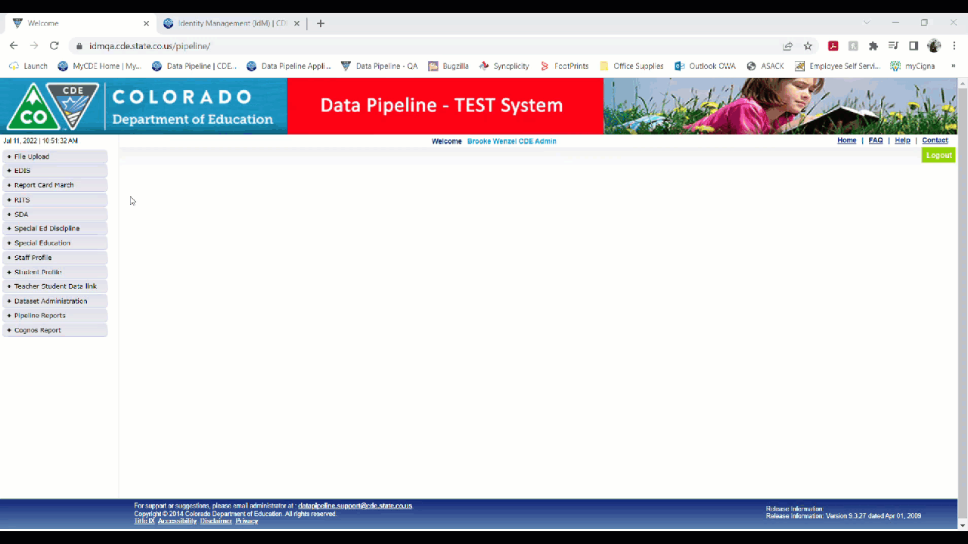
Logging Into Cognos

Slide 14
Student Interchange/Student October Reports

Slide 15
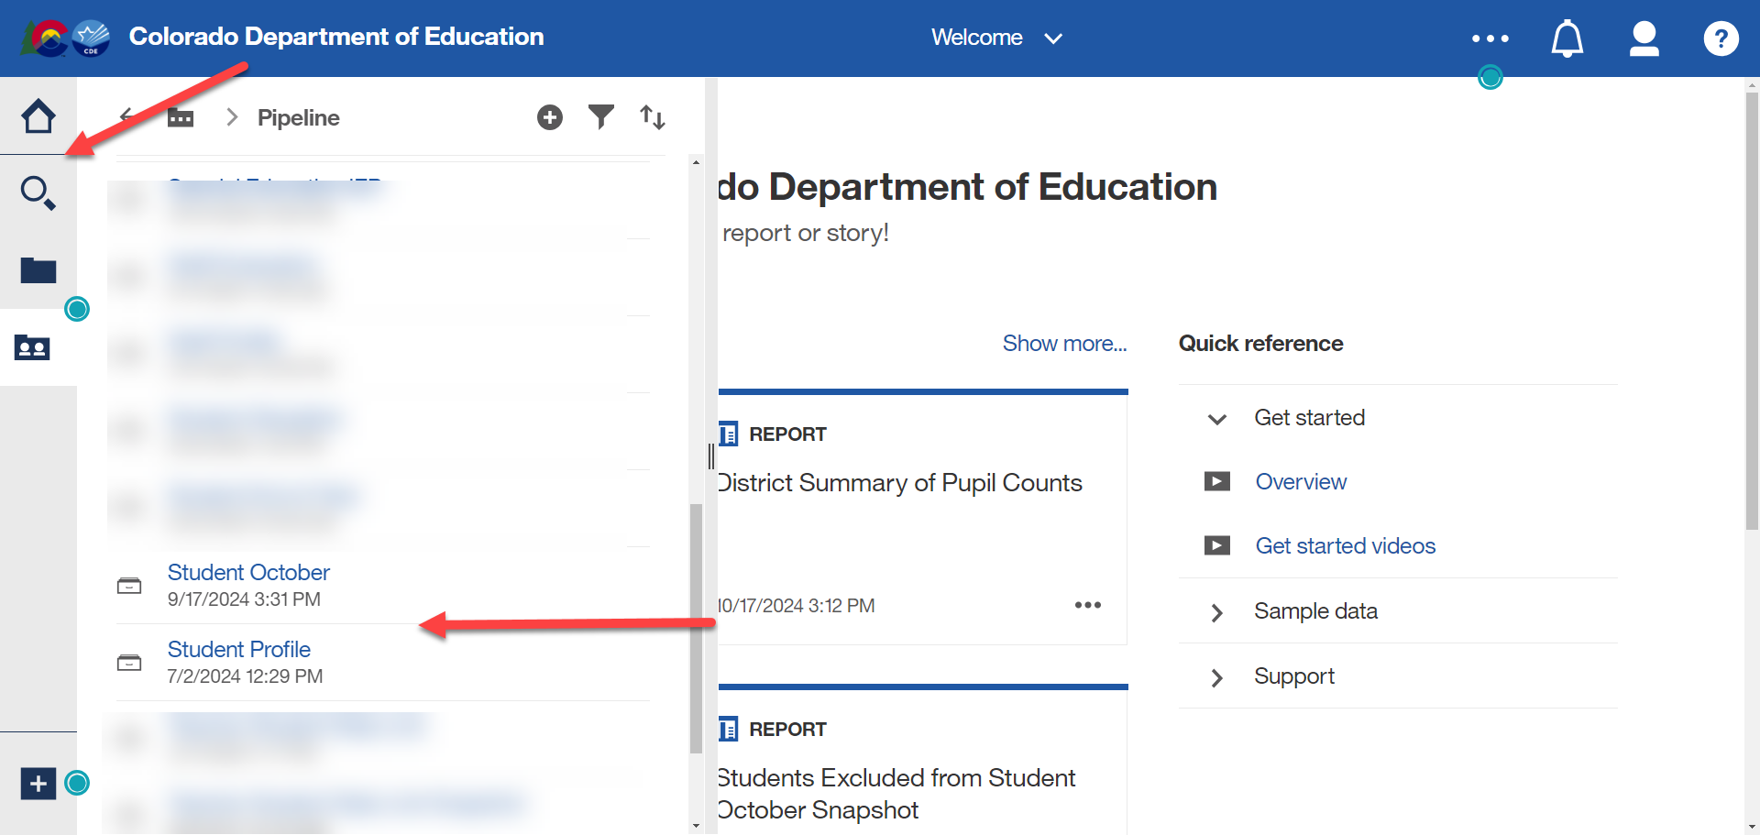
Data Validation and Cognos Reports
More Information About Cognos -> Cognos Report Guide

Slide 16
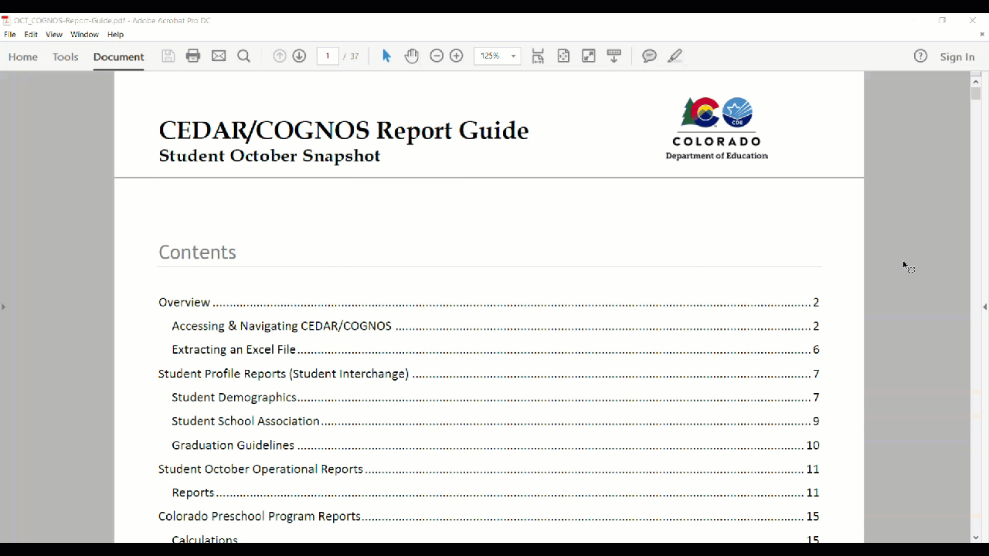
Cognos Report Guide
More Information About Cognos -> Cognos Report Guide

Slide 17
List of Reports (Not All!)
Operational Reports
Summary Reports
October Error Detail Report
October Snapshot Records
Students Excluded From Student October Snapshot
Summary of Pupils Being Reported by Another District
ELL Count Funding Factor Report
ELL Redesignation Report
District Summary of Non-Resident Pupil Counts
District Summary of Postsecondary Programs
District/School Summary of Pupil Counts
Summary of Homeless Students

Slide 18
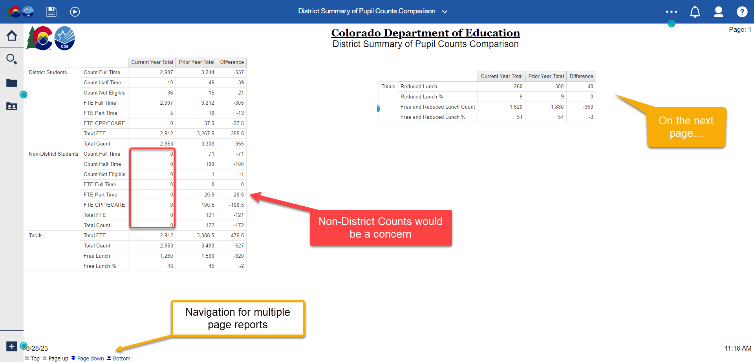
District Summary/School Summary Reports
District Summary of Pupil Counts
District Summary of Pupil Counts Comparison (right)
School Summary of Pupil Counts
School Summary of Pupil Counts Comparison

Slide 19
October Snapshot Records
Review/download a list of all Student October snapshot records for the current year or a prior year
Helpful if you need to validate certain students are being included in your snapshot data.
Tip: Use the find function in your browser to search for a specific student by SASID. (Shortcut Key: CTRL + F)

Slide 20
District Summary of Pupil Counts by Grade, ..

Slide 21
Students Excluded from Student October Snapshot
Includes students who could have errors on the SSA or DEM files but could also contain students that could have zero errors within the interchange, but still are being excluded and therefore are not pulling into the Student October snapshot.
Student could have entry/exit dates that do not align with your district’s count date, the student’s age does not fall within the parameters, etc.
Note: Helpful columns from the Student Interchange have been pulled for your convenience to see if there could be potential reasons the student is not being pulled into the snapshot.

Slide 22
Summary of Pupils Being Reported by Another District

Slide 23
Errors/Warnings

Slide 24
Warnings
Will help greatly to validate data
Could point out data inconsistencies within dataset.
Does not prevent you from submitting your data to CDE, but will help you check your data
Your district’s English Language Learner Count for October is considerably different compared to last year’s count
Your district's Special Education count for October is considerably different compared to last year's count.
OC40
Grade is listed as a valid grade for this school, but no students are reported in this grade.
Your district reported no Homeless pupils.
OC103
OC41
OC30

Slide 25
OC50/OC198 Errors
OC50: The Percentage of K-12 Students classified as Free ('01') and Reduced ('02') exceeds expected tolerances. This 10% tolerance includes K-12 funded students regardless of Pupil Attendance Information Code.
OC198: The Percentage of K-12 funded students (Public School Finance Status = '80', '82', '85', '91', '92', '94', '95') exceeds expected tolerances regarding FTE. This 10% tolerance includes K-12 funded students regardless of Pupil Attendance Information Code..
What do you do next?
Make sure you are close to your final dataset
Verify your data via Cognos Reports (make sure you are not under or over reporting)
Request Exception
Be aware that the error will not pop up again through the completion of the collection (even if you report 0 FRL counts for example!)
Student October – Brooke Wenzel
StudentOctober@cde.state.co.us

Slide 26
Submit Data to CDE

Slide 27
Ready to Submit
Once you have verified the data, submit the snapshot to CDE. Go to:
Student Profile -> Status Dashboard and click ‘Submit to CDE’
Must have OCT~LEAAPPROVER role in IDM to complete this step
Once data is submitted it will be locked, must request unlock to make changes (email or call me to request)

Slide 28
Resources/Links
Brooke Wenzel StudentOctober@cde.state.co.us 720-441-7963
Auditing Office Training Schedule
Auditing Office’s Pupil Count Website
Data Pipeline Town Halls
Identity Management/Data Pipeline Student Interchange Website
Student October Website
Syncplicity

