Slide 1
2024-2025
Student October Data Pipeline Training
Brooke Wenzel
StudentOctober@cde.state.co.us

Slide 2
Data Collection and Cleanup Phase Timeline
Date | Event | Event Description
07/15/2024 | Open | Districts may begin uploading Student Interchange Files (Student Demographic and Student School Association).
08/23/2024 | Open | Districts may begin creating snapshots. Student October Snapshot dependencies are the Student Demographic File, Student School Association File, Title I File (if applicable) and At-Risk File.
08/28/2024 | Training Event | Data Pipeline Training 10-11 a.m.
09/05/2024 | Training Event | New Respondent Training 1-2 p.m.
09/10/2024 | Training Event | English Language Learner Training 11-12 p.m.
09/12/2024 | Training Event | Veteran Respondent Training 11-12 p.m.
09/16/2024 | Training Event | Postsecondary Program Coding Training 11-12 p.m.
09/24/2024 | Other Date | First day of Student October Count Window for districts with 5-day school week.
10/01/2024 | Other Date | Official Count Day 2024
10/02/2024 | Interim Deadline | Upload Student Demographic and Student School Association Files. Upload Title I Interchange File (if applicable). Upload At-Risk Interchange File.
10/08/2024 | Other Date | Last day of Student October Count Window for districts with 5-day school week.
10/09/2024 | Interim Deadline | Error free Student Interchange File uploads
10/14/2024 | Training Event | Mid-Collection Office Hours 10-11 a.m.
10/14/2024 | Interim Deadline | Create an initial Student October Snapshot
10/22/2024 | Interim Deadline | Error free Student October Snapshot
10/24/2024 | Training Event | Data Validation, Transfer Enrollment Exceptions and Cognos Reports 1-2 p.m.
10/28/2024 | Training Event | Data Pipeline Duplicate Process and Submission 9-10 a.m.
11/01/2024 | Report Review | Review Student October Cognos Reports for data validation. Submit Student October Snapshot data as soon as review is complete.
11/08/2024 12:00 p.m. | State Deadline | Submit Student October Snapshot data

Slide 3
Duplicate Count Phase Timeline
Date | Event | Event Description
11/12/2024 12:00 p.m. | Deadline | Duplicate funding documentation due to School Auditing Office
11/18/2024 | Other Date | School Auditing makes decisions on funding duplicates
11/27/2024 | Deadline | Resubmit Student October Snapshot data to CDE based on decisions from School Auditing
12/06/2024 | Deadline | Collection closes Secretary of the Board of Education Verification (sign-off) form due. Data remains embargoed until the official release in January.
01/15/2025 | Data Release | Official data release
General Duplicate Count Process
  Begins once all districts have submitted their Student October Snapshot to CDE, Friday, November 8th
  ~3 business days after running the duplicate process Duplicate Documentation is due to The CDE School Auditing Office
  ~2 business days after documentation received decisions will be sent to districts
Signature Page
  Due Friday, December 6th: Signed by Secretary of Board of Education AND the Chief Financial Officer
    If your district needs an extension, please send Student October Collection lead an email with the day when your School Board Secretary will be able to sign the form

Slide 4
Terminology
Terminology
CEDAR (Cognos): Type of report in which the user can view applicable reports that are formatted in a user-friendly environment.
Interchange: Files or “ingredients” that are uploaded throughout the year in Data Pipeline to CDE. These files are used to make up a collection or snapshot.
Snapshot: A date in time when data is pulled from the appropriate interchanges, also commonly called a collection.
IDM: Identity management. A single sign on system, allowing the user to navigate between the applications without entering user ID information a second time.

Slide 5
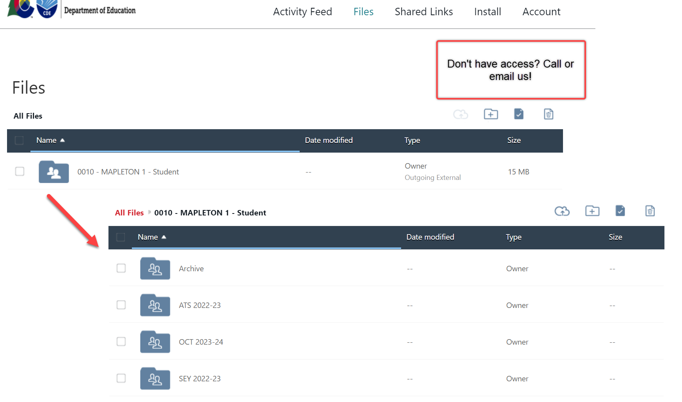
Syncplicity and Town Hall
Syncplicity – CDE’s secure file sharing service of choice
Town Hall – Review various Data Pipeline Collection information/updates
Weekly on Thursdays from 9 – 10 am (Summer has a biweekly schedule)
Email to subscribe: DATASERVICES-subscribe-request@cdelist.cde.state.co.us

Slide 6
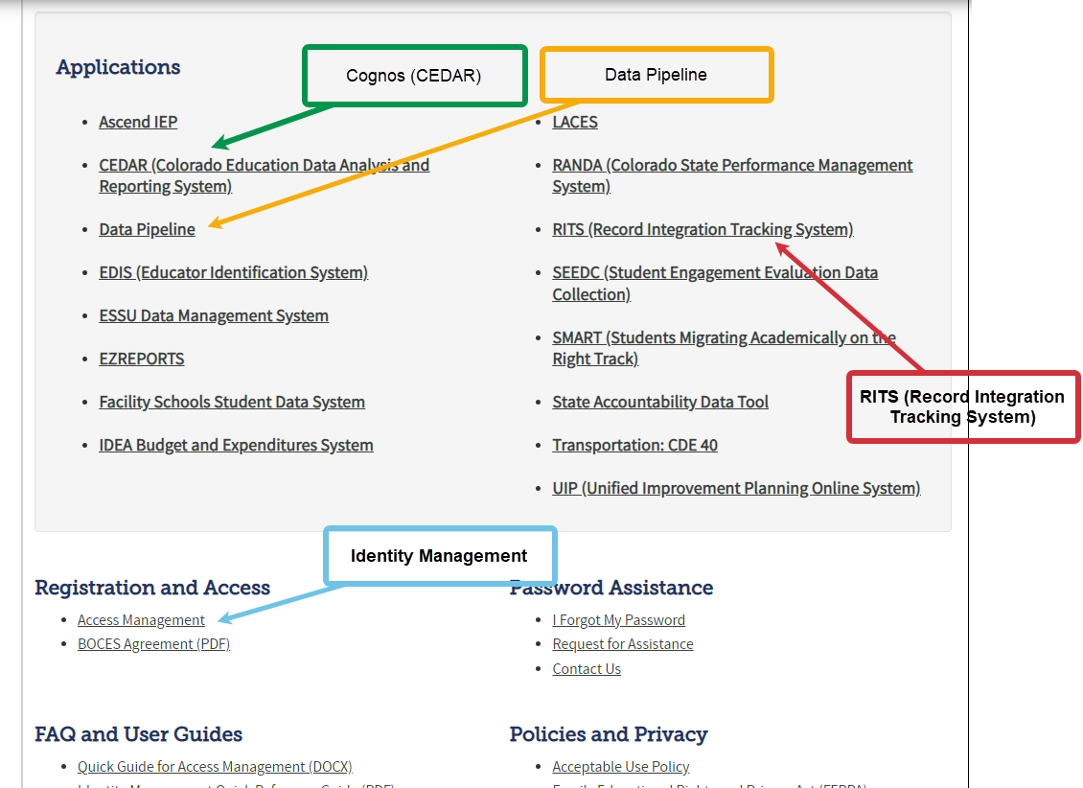
CDE Application Login
IdM Website
Application | Collection | Role | Access Level
Pipeline | Student Interchange | LEA User | Upload and Edit Records for the Student Demographic, School Association, and Graduation Guidelines files
Pipeline | Student October | LEA User | Create Snapshot - cannot submit
Pipeline | Student October | LEA Approver | Create Snapshot and submit
Pipeline | Any | LEA Viewer | View Cognos reports – cannot edit
Pipeline | Title I Interchange | LEA User | Upload and Edit Records
Pipeline | At-Risk Interchange | LEA User | Upload and Edit Records
Notes:
This is our Identity Management System (commonly called IDM). IDM is a one stop shop to all CDE applications including Data Pipeline which you will ultimately use to upload the Student Interchange files as well as other collection data. Please get this webpage book marked, saved or whatever you need to do to remember this site! The IDM page also has a link to RITS (Record Integration Tracking System) which is our system used to track SASIDs for students as well as CEDAR (Colorado Education Data Analysis and Reporting System) commonly called Cognos which creates reports based on the data provided in Data Pipeline to validate data. Reports within this system have many purposes depending on the collection you are working through. There is also a link to Access Management (which we also call Identity Management) which is how you will get registered for these various applications and how you be able to log into Data Pipeline.

Slide 7
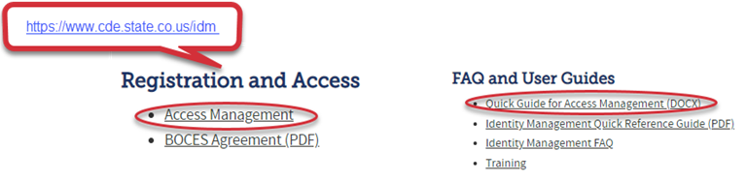
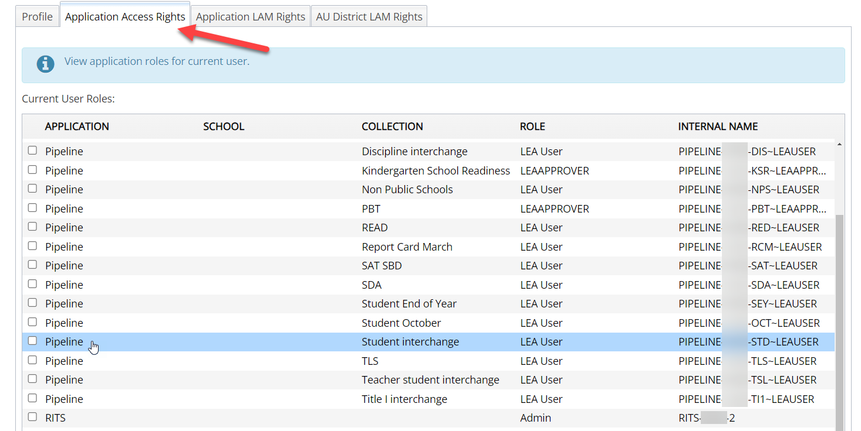
CDE Identity Management
Don’t have access?
Talk to your District’s Local Access Manager (LAM)!
Note: Different roles for different collections

Slide 8
Student Information System (SIS) Extracts
Download reports (files) from your Student Information System
Save each file in an accessible location with naming convention
Upload each file to Data Pipeline (steps shown later)
Student Demographic, Student School Association, Graduation Guidelines (.xlsx is recommended format) – files could be named differently in SIS
Do not open file!
Example: 0110_DEM_10112024.xls (No spaces in file name are allowed)
Keep filing system organized

Slide 9

Student Interchange Files
Student Interchange
Student Demographic File
Student School Association File
Graduation Guidelines File
Adjustment File
One record per student
May include multiple records per student
Expect multiple records per student
As needed for SEY Collection
Secondary students only

Slide 10


Other Interchanges
Title 1
  Targeted Assistance schools only
At-Risk Interchange
  Student Census Information
Note: Partner with the person responsible for these files in your LEA as these files are often overseen by someone other than the OCT data respondent in a LEA.

Slide 11
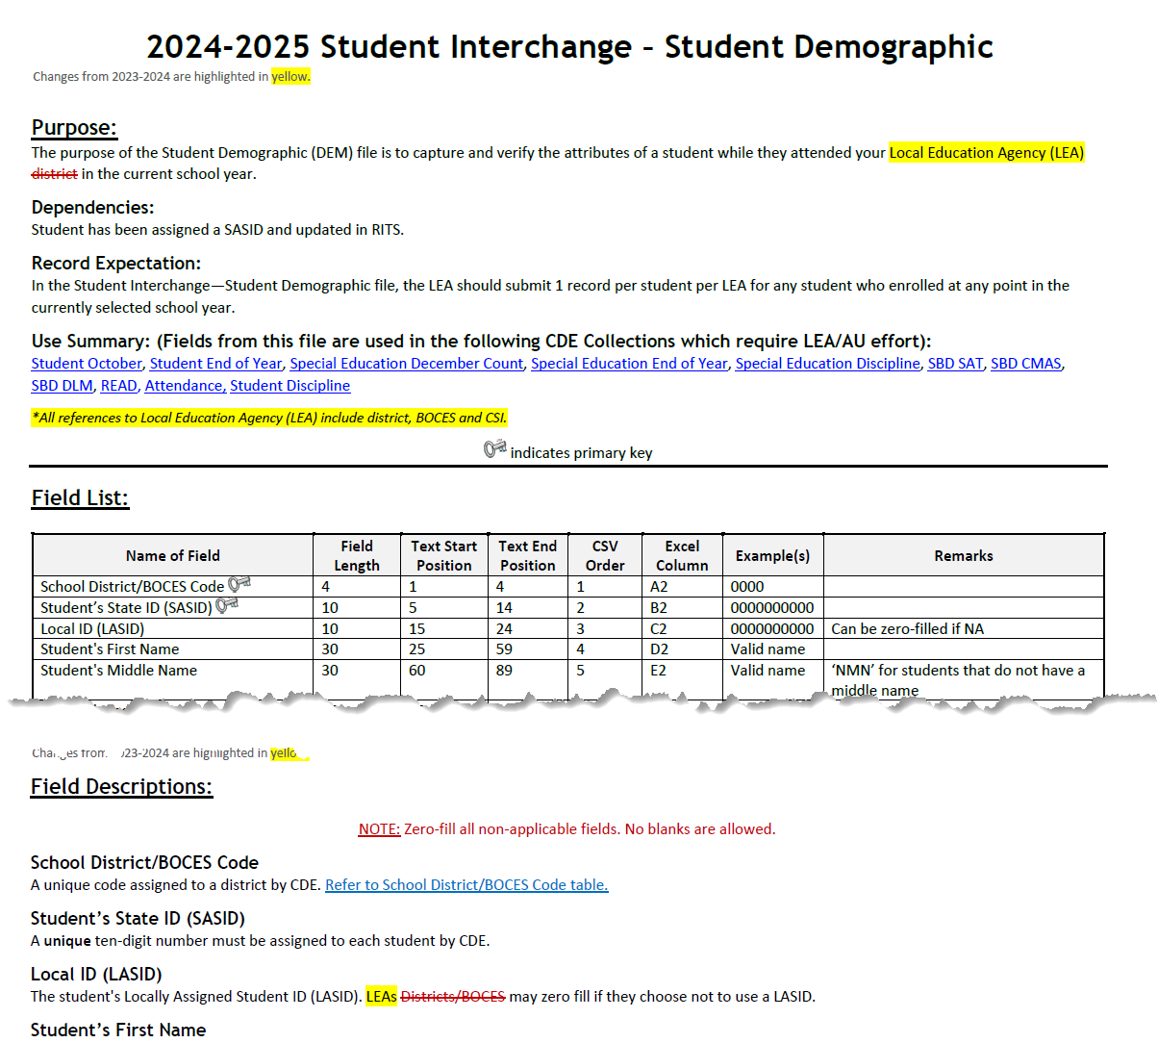
Student Demographic File Layout
One record per student
2024-2025 Student Demographic File Layout
Race/Ethnicity
Language Fields (Proficiency, Background, Program)
Homelessness Information (Homeless, Cause of Housing Crisis, Add. Cause of Housing Crisis)
SPED information (Primary Disability, Alternate Assessment Participant, Transition)
Notes:
Includes fields that are true of student, no matter their enrollment

Slide 12
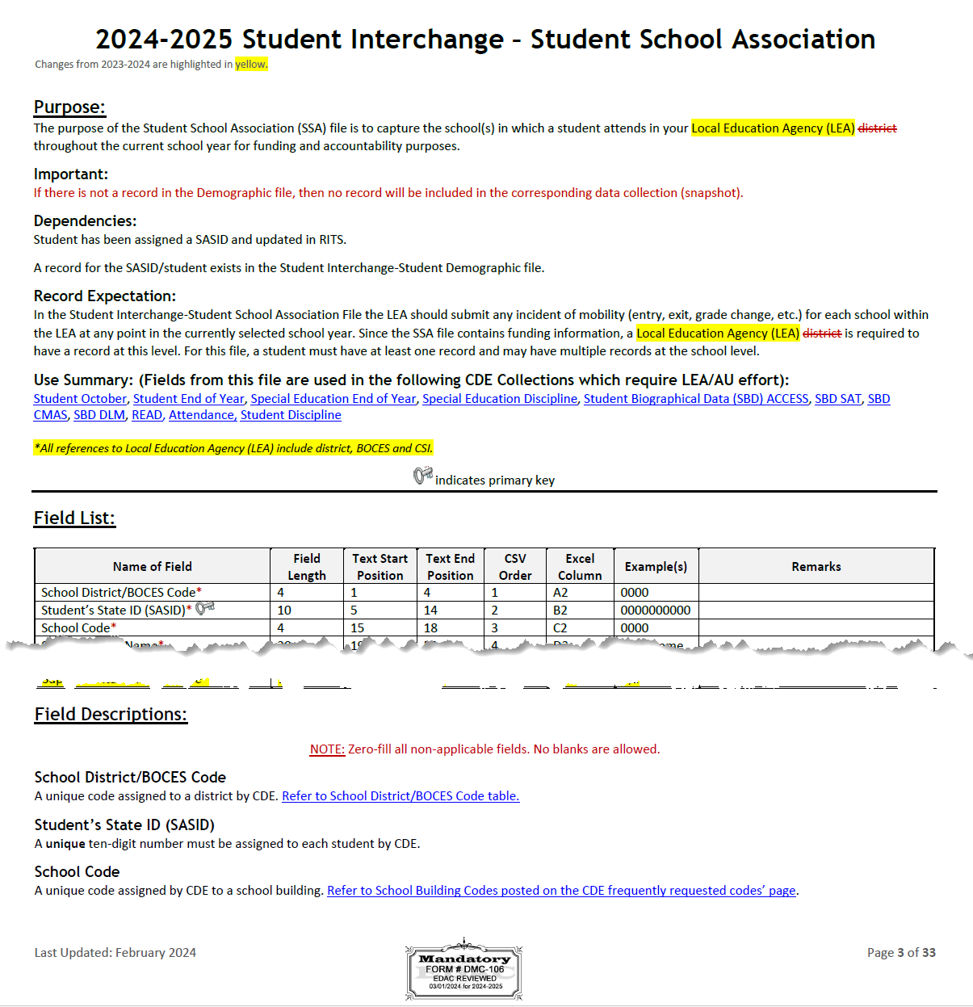
Student School Association File Layout
May include multiple records per student
2024-2025 Student School Association File Layout
Grade Level
Entry/Exit Types
Public School Finance Funding Status
Pupil Attendance Information
Non School Program
Attendance Fields (Total Days Attended, Total Days Excused/Unexcused, Total Possible Days)
Notes:
Includes data fields specific to enrollment
Primary school = 1 are the types of records that pull into the collections. Primary School = 0 may be on your file, but won’t pull into collections.
Entry Exit Type definitions have been updated

Slide 13
Student Interchange Preparation
Upload interchange files
Wait for a Confirmation Email from the Pipeline System
  The email will show you the number of errors in your upload
  Resolve ALL errors in your interchange files
  Check your error reports
Update your Interchange files to address the errors
  Update in SIS → Extract → Upload to Pipeline
  Edit Record Tool (Data Pipeline)
Upload Student Demographic File
Upload Student School Association File
Upload Graduation Guidelines File

Slide 14
What is a Snapshot?
Source File A
Source File B
Internal Flags
File A: Element 2
File A: Element 5
File B: Element 3
Internal Flag: 3
Snapshot
File A: Element 1
File B: Element 1
File A: Element 3
File A: Element 4
File B: Element 2
File B: Element 4
Internal Flag: 1
Internal Flag: 2
Notes:
A data snapshot begins with uploading the corresponding interchange files. These interchange files become the source of information, or source file for specific data fields on a snapshot.
When a snapshot is triggered, it pulls needed information from the source (interchange) files into a new file called the snapshot.
Snapshots typically won’t use every data element on a source file.
Snapshots often pull in information called “internal flags.” These are calculated pieces of data from information provided on the interchange files or from other internal data in data pipeline.

Slide 15
Another Snapshot Visual
Student October
Student Demographic
Student School Association
At-Risk
Title I (if applicable)
Supporting Files (TREP Allocation, Foster, etc.)
Light Green – District Uploads
Gray – CDE Uploads
Light Blue – District “Triggers”

Slide 16
Snapshot Process
No
Extract from SIS/Upload Interchange Files (DEM, SSA, etc.)
Check first phase of errors
Take Student October Snapshot
Check second phase of errors
Are both the phases error-free?
Yes
Validate Data/Submit

Slide 17
What Collections (Snapshots) use the Student Interchange?
Student End of Year
Student October
Attendance
Special Education December Count
Special Education End of Year
Student Discipline
READ Act Assessments
Validates enrollment against SSA file
New Collection 2023-2024
Includes Special Education Discipline
SBD Assessment Collections
Initial assessment files based upon Student October data

Slide 18
Thank You for Attending! – Stick Around for a live demo of Data Pipeline/Student October Website
720-441-7963
StudentOctober@cde.state.co.us
Student October Website
Student Interchange Website
Identity Management/Data Pipeline

Slide 19
Data Pipeline Demonstration

