Slide 1
2024-2025 Student October Training
English Learners Coding: Overview and Progression
Brooke Wenzel – Data Services Unit
StudentOctober@cde.state.co.us
Doris Nguyen – Culturally Linguistically Diverse Education Unit
brock-nguyen_d@cde.state.co.us

Slide 2
Federal Requirements for EL Identification
Every Student Succeeds Act (ESSA), §§1112(e); 3116(b)
Lau Remedies, 1975 (Case law, Civil Rights Act 1964)
Specifies approved approaches, methods, and procedures for: Identifying and evaluating national origin minority students’ English language skills
English Language Proficiency Act, CRS 22-24-105
Requires districts to identify and report the number of English Learners (ELs) in the district to the Colorado Department of Education
Senate Bill 109, CRS 22-24-106
One common assessment to identify EL student: Screener for Kindergarten/WIDA Screener, the state mandated placement assessment must be used as one indicator to determine English Language Proficiency (ELP) and if student is an English Learner (EL)
Requires recipients of Titles I and III to identify ELs and notify parents of the language instruction educational programs available to students
Notes:
There are Federal laws that require LEAs to identify English learners in order to provide appropriate ELD services and scaffolds to enable access to core content instruction. Titles I and III in the Every Student Succeeds Act, the reauthorized ESEA, require recipients of Titles I and/or III to identify ELs in a timely manner and notify parents of the language instruction educational programs available to their students.
The Lau Remedies of 1975 specify approved approaches, methods and procedures for identifying and evaluating a student’s English language skills.
In Colorado, the English Language Proficiency Act, or ELPA, requires all Colorado districts, Charter School Institute, and facility schools to identify English learners.
ELPA also requires
Districts to provide a report of ELs through the Student October Count, including proficiency levels and number of ELs who have exited from the program
ELPA requires Schools & districts to administer and provide evidence-based ELD programs to all identified ELs and
To provide professional development to all staff members supporting ELs.
Finally, Colorado Senate Bill 109, CRS 22-24-106 requires us to use one common assessment to identify ELs. Colorado has selected the W-APT/WIDA Screener as the state mandated placement assessment which must be used as one indicator to determine English language proficiency and if a student is an English learner.

Slide 3
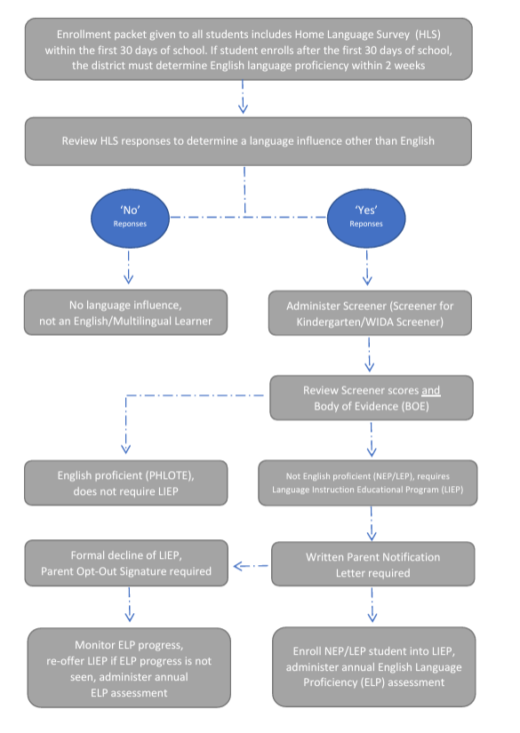
Standardized Identification Procedures
Identification including screening and parent notification within the first 30 days of school.
If student enrolls after the first 30 days of school, the district must determine English language proficiency within 2 weeks.
District investigates language proficiency
District determines language proficiency
Notes:
So how does a student become identified as an English learner? On this slide you will see a visual to describe the standardized identification procedures.
Based on state and federal laws, and with input from stakeholders, Colorado has outlined the following standardized procedure for districts to follow to identify English learners. To ensure an equitable identification process for all students, all students must follow the same process.
During new student registration, the enrollment packet that is distributed to ALL students should also include the home language survey.
The HLS should be collected and reviewed by a trained staff member
If the HLS indicates and school determines a language influence other than English, administer the screener assessment
Screener for Kindergarten in Kinder through first semester first grade students
WIDA Screener is given to students in second semester first grade through grade 12
Use screener score and other BOE to determine language proficiency and appropriate ELD services
Notify parents in writing and document the informed consent for placement into ELD services and programs
All identified English learners which include ELs who are identified but not enrolled in ELD services because of parent opt-out, will take the annual English Language Proficiency assessment, ACCESS
PHLOTE – talk about these students may have an influence other than English, but now impacting access to grade level content… so they don’t receive services and coding looks different (Language Proficiency Codes=00) not on the Language Proficiency Progression.
I am going to pause for a minute and talk about situations when parents answer ‘no’ to any of the HLS questions. Sometimes parents respond ‘no’ due to lack of understanding to the questions like when questions are presented in a language parents cannot read, or they are choosing to not disclose information due to perceived actions that might negatively impact their child. When you notice responses don’t match how the student is accessing grade level content… you have the authority to screen student’s English proficiency in order to ensure you are not missing students who could benefit from LIEPs. Remind yourselves the HLS is a tool to help you investigate your student’s proficiency, but it is not what is used to determine EL designation or edibility for LIEPs. The Screener scores, the student BOE and your professional judgement as an educator are used to determine EL programs and how to code students.

Slide 4
Student Enrollment Packet
The district’s enrollment packet should include the Home Language Survey (HLS). It is provided to and completed by all new and transferring back families as part of the registration process to identify potential students who have a language influence other than or in addition to English.
Responses indicated on the HLS prompts the district to further investigate student’s English Language Proficiency (ELP) level. Please note: the HLS does not determine eligibility but is part of the required process for standardized multilingual learner identification. It should remain on file in the district and should be easily accessible to school and staff and available for CDE audits.
Review responses indicated on the HLS. If the enrolling district confirms a student has a language influence other than English, assess student’s ELP level using the State’s mandated assessments, Screener for Grades 1-12 or Screener for Kindergarten according to student’s grade level. Please see grade cluster guidance prior to test administration.

Slide 5
Home Language Survey (HLS)
The HLS should be created by districts with State guidance and meet Office for Civil Rights (OCR) and Department of Justice (DOJ) minimum requirements. All students must have an HLS on file (questions and answers) and must be a standard part of the enrollment process. US Department of Education EL Toolkit, Chapter 1
DOJ & OCR has established three approved HLS questions. Districts may reword the questions but must ensure that the way the questions are asked do not violate students’ civil rights or ask about US citizenship.
Contact the Office of Culturally and Linguistically Diverse Education (CLDE) for more guidance.
Reminder: Districts should maintain copies of Screener & WIDA ACCESS scores
Site: CDE ELL Funding Factor Count &
Audit Resource Guide
Site: CDE Standardized Procedures for English Learner Identification

Slide 6
ESSA Requires Parent Notification Letter
Screening and Body of Evidence
Request Consent for Placement
Language Instruction Educational Program
Exiting Requirements & Graduation Rates
Meeting Goals of IEP Services, if applicable
Parent Right to Opt Out of Language Instruction
Statutorily Required Elements of the Parent Notification Letter
Notes:
When student has been identified through the standardized procedures, once LEA has identified a student as an English learner, Titles I and III in ESSA require school districts to notify parents of the identification. The notification must be sent within the first 30 days of school, or if a student enrolls later in the school year, within 2 weeks of enrollment.
The letter or communication must be in a language and format that parents can understand and must include
The Reason why child was identified as and English learner,
The Level of English proficiency and how the English language proficiency was assessed,
The Method of instruction used in ELD programs and content classrooms. If the school implements more than one ELD program, the letter should include any program in which the student will participate.
How the instructional program will meet the educational strengths of the child
How program will help child learn English and meet the Colorado Academic Standards
The requirements a student must meet in order to exit the ELD program and graduation rates for secondary students
And How ELD services will be coordinated with and meet the goals of IEP services, if applicable.
While parents are given the right to opt out of formal ELD services for their students, under OCR and DOJ laws, districts and schools are still obligated to provide students with access to the grade-level content, and ensure they are acquiring English. As such, CDE recommends that the school or district work with parents who choose to opt their students out of the ELD program to understand their concerns and reasons for opt out. In these discussions, parents may better understand the evidence-base that supports the chosen ELD programming and may ultimately choose to allow the school to provide ELD services.
If a parent does truly opt their student out of ELD services, the student must still take the ACCESS/Alt. ACCESS assessment annually until the student is redesignated following the same state guidelines as all other students.

Slide 7
Parent Right to Opt-Out
Parents have the legal right to Opt-Out students from ELD services and instruction. Parents cannot opt-out of EL designation, or the annual summative English Language Proficiency (ELP) assessment designed for students with a language proficiency designation of NEP or LEP
Requirement to monitor ELP and academic progress of students who Opt-Out of EL programs and services. Obligation to provide meaningful access to the general curriculum to meet the language and academic needs of identified ELs
Opt-Out of ELD student retains coding in local & state data (Language Background not ‘ENG’, Language Proficiency = NEP/LEP, Language Instruction = 98)
All Opt-Out students (NEP/LEP) take annual ELP assessments (WIDA ACCESS) until they achieve proficiency in reading, writing, listening, and speaking and evaluated for Redesignation
When Opt-Out student does not demonstrate appropriate growth in ELP or maintain appropriate academic levels, district must inform the parents in a language they understand and re-offer LIEP annually
Parent Opt-Out signature is required and secure related documentation at the district. Communicate with parents in a meaningful way, in a language parents can understand and provide free translation services when necessary
Notes:
When parents refuse LIP, this must be documented but does not release the district from its responsibility for providing access to a meaningful education. The district must support the academic learning of all identified English Learners (ELs). The Civil Rights Obligations remains the foundation of the legal rights of ELs.
All identified NEPs & LEPs must take the annual ELP assessment, WIDA ACCESS
Language Proficiency Code = ‘1’ or ‘2’
Language Instruction Program Code = 98
Parents may decline for their child to be enrolled in a Language Instruction Program (LIP) but cannot decline the EL designation or the requirement for students to participate in the annual assessments.

Slide 8

Standardized Redesignation Procedures
Redesignation: WIDA ACCESS Scores & BOE
SCREENER & BOE
NEP (1)
LEP (2)
FEP Monitor Year 1
(6)
FEP Monitor Year 2
(7)
FEP Exited Year 1
(8)
FEP Exited Year 2
(9)
FELL
(5)
Districts must provide English language development instruction for NEP/LEP students until they attain proficiency in all four language domains: listening, speaking, reading and writing (i.e. refer to redesignation cut score guidance)
Redesignation is a process that represents a student’s English language proficiency level has changed from Limited English Proficient (LEP) or Non-English Proficient (NEP) to Fluent English Proficient (FEP) Monitor 1 based on an evaluation of the current year's WIDA ACCESS scores and a collection of evidence which supports this change.

Slide 9
English Learner
State Language Proficiency Progression
NEP (1)
LEP (2)
FEP Monitor Year 1
(6)
FEP Monitor Year 2
(7)
FEP Exited Year 1
(8)
FEP Exited Year 2
(9)
FELL
(5)
All identified NEPs & LEPs must take the annual ELP assessment, ACCESS/Alternate ACCESS
  Language Proficiency Code = ‘1’ or ‘2’
Students entering a district without known EL history but who have a language background other than English
  Screened and found to be an English Learner → Indicate NEP (1) or LEP (2) as applicable
  Screened and found to be English Proficient → Indicate PHLOTE (4)
Students entering a district with known EL history:
  Screened and found to be an English Learner → Indicate NEP (1) or LEP (2) as applicable
  Screened and found to be English Proficient → Indicate FEP, see the state language proficiency progression for coding sequence

Slide 10
Commonly Asked
Student enrolls in your district. Cognos reports show this student was previously identified as NEP/LEP in the previous district.
What should the enrolling district do to ensure accurate and timely designation to meet standardized identification procedures and requirements?
Enrolling district must screen student -> review Screener scores and collection of a body of evidence -> evaluate information & data to make identification and coding decision. If your district has evidence to support a coding change (i.e. student does not follow the Language Proficiency Progression), please submit an EL Exception Request to Data Services.

Slide 11
Important Updates
Screener Domain and Score Resets: never send PII via email, please email to schedule a time to meet over the phone
Screener Certification: required every two years. If the district requires annual re-certification, please follow local policy
Alternate Screener: new assessment available SY25-26
Alternate ACCESS: a new assessment taken by students during Jan-Feb 2024. Pause redesignation until score setting is completed

Slide 12
Students Re-enrolling or Transferring Back to District
Student Re-Enrolls or Transfers back to the District
Reviews Cognos Reports (coding/designation sequence)
Determines language designation and coding location in the language progression sequence *
Student has ML history in CDE Data Pipeline, the enrolling district …
Evaluates scores (must be within the current school year) and collects a local Body of Evidence (BOE)
*Enrolling district remain obligated to make ELP decisions following federal and state identification procedures to provide written parent notification and adhere to timeline requirement (30 days/2 weeks)when students re-enroll or transfer back to the district.
Notes:
Applies to re-enrolled students
If student took ACCESS during the current school year, enrolling district may use scores and local evidence to determine ELP
If student didn’t take ACCESS during the current school year (absent, sick, traveling), enrolling district must keep them in program i.e. can't redesignate!

Slide 13
Re-enrolled Students with Scores
Students re-enrolling with ML history in Data Pipeline
and have current year scores
NEP/LEP Students with WIDA ACCESS scores from the current year, the enrolling districts must evaluate WIDA ACCESS scores to determine:
If a student in fact meets the state criteria for redesignation, following the standardized Redesignation procedures, the enrolling district must gather a local Body of Evidence (BOE) in order to move to student from NEP/LEP to FEP M1.
If a student doesn’t meet state criteria for redesignation, following the Standardized Redesignation procedures, the enrolling district must not redesignate the student, must provide language instruction, continue to designate NEP/LEP, and administer the annual English Language Proficiency (ELP) assessment until the student meets the criteria for redesignation.
Notes:
If ACCESS scores are from the current year, and aligns state criteria for redesignation, enrolling district collect evidence and makes ELP designation and coding decision

Slide 14
Students re-enrolling with ML history in Data Pipeline
but does not have current year scores
If re-enrolled NEP/LEP students WIDA ACCESS/Screener scores are missing, unobtainable, beyond the current year, and/or does not align with local evidence, the enrolling district must determine ELP level through Screener administration and collecting local BOE before making an ELP decision and determining the student’s location in the language progression sequence for Data Pipeline coding.
If re-enrolled PHLOTE and/or FEP students transfer back without WIDA ACCESS/Screener scores from the current year, the enrolling district must collect local BOE following the Standardized Redesignation procedures, prior to making an ELP level decision and determining the student’s location in the language progression sequence for Data Pipeline coding. When local evidence indicates students are not English proficient, the enrolling district must administer Screener.
Notes:
NEP/LEP Students without WIDA ACCESS scores or scores are dated beyond the current school year:
1. If a NEP/LEP student enrolls after Colorado’s WIDA ACCESS test window or enrolls without the most recent school year’s scores, the district must not redesignate student from language instruction. Enrolling district must obtain Screener for Kindergarten or WIDA Screener for Grades 1-12 and collect a local BOE to determine ELP designation and location in the language progression sequence.
2. Enrolling districts must collect a local body of evidence in Reading and Writing that demonstrates PHLOTE and FEP students are continuing to progress academically and linguistically without English Language Development (ELD) instruction. Evidence must confirm or refute the student’s current ELP level. If the district observes the student does not continue to meet academic goals and/or requires additional ELD instruction, administer Screener for Kindergarten or WIDA Screener for Grades 1-12 to determine if re-entry into ELD support and instruction is appropriate.

Slide 15
3 Data Elements Collected about ELs in
Student Demographic File
Language Background
Language Proficiency
EL Data
Language Instruction Program

Slide 16
Student Demographic
Data Fields
Language Background
  Identified on the Home Language Survey (HLS)
  Students who are NEP, LEP, FEP, FELL, or PHLOTE must have a language background other than English (ENG)
Language Proficiency
  Indicates student’s English language proficiency
  (ability to speak, listen, read, and write in English)
Language Instruction Program
  Indicates the type of English language instructional program used to education a student who is an English learner
Not an English Learner | English Learner
0 – Not Applicable 4 – PHLOTE, English Proficient (Primary Home Language Other Than English) | 1 – NEP, Non-English Proficient 2 – LEP, Limited English Proficient 5 – FELL, Former EL 6 – FEP, Monitor Year 1 7 – FEP, Monitor Year 2 8 – FEP, Exited Year 1 9 – FEP, Exited Year 2

Slide 17
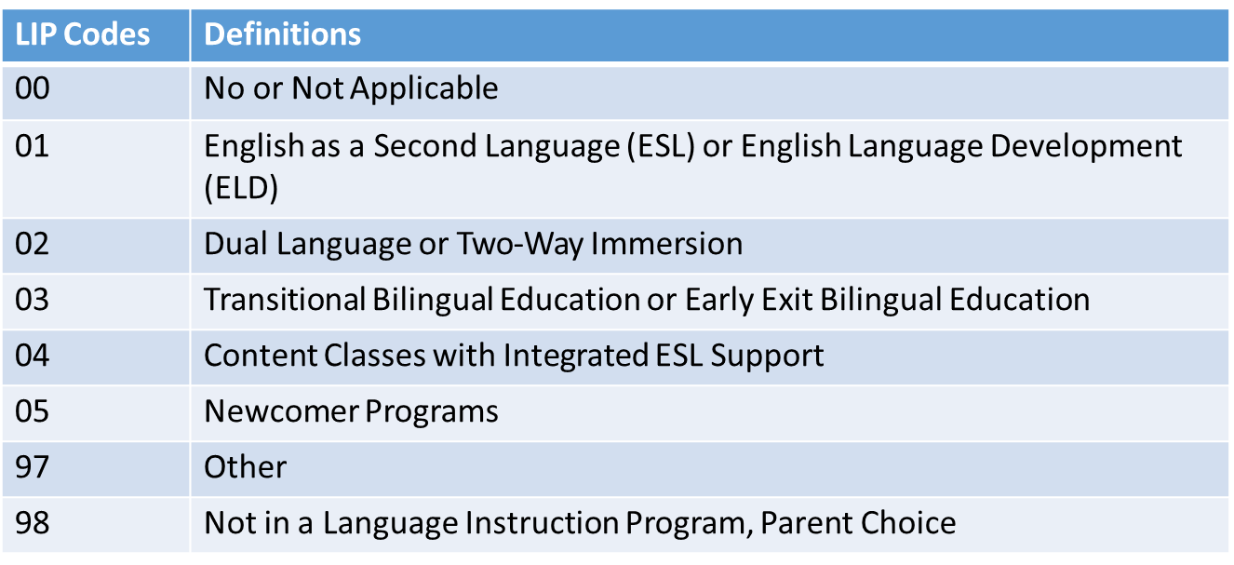
Coding Tips
Language Background = ‘eng’
Language Proficiency Code = ‘0’
Language Instruction Program = ’00’
Language Background ≠ ‘eng’
Language Proficiency Code ≠ ‘0’
Language Instruction Program Dependent on Proficiency Code
Language Proficiency Codes/LIP
  NEP, LEP, FEP Monitor 1, FEP Monitor 2 ≠ ’00’ (LIP)
  PHLOTE or FELL = ’00’ (LIP)
  FEP Exited Year 1 or Year 2 can have any codes (LIP)
Notes:
When thinking through the coding pattern for a student, it is best to first ask yourself, “what is the student’s language background?” If the student’s language background is English, they must have a language proficiency code of zero (or not applicable) and a language instruction program 00 (not applicable). This essentially means that students who speak English should not be enrolled in an English Learning program. On the flip side, if the student’s language background is something other than English, the student must have a valid language proficiency code of something other than 0. The language instruction program is dependent on the language proficiency code described below.
As mentioned before, if a student has a Language Background of English, their LIP must be ‘00’. Otherwise, there are specific instructions for Language Proficiency Codes other than ‘00’. NEP, LEP, FEP Monitor Year 1 and Monitor year 2 Language Proficiency Codes must have a LIP of anything other than ‘00’. PHLOTE or FELL students must have an LIP of ‘00’ since they have demonstrated proficiency in English. FEP exited Year 1 and year 2 can have any of the below codes. If you are concerned that your program is not included in any of the defined programs, please call the Office of CLDE for help in selecting the most appropriate program type.

Slide 18
Language Proficiency
Annual Coding Cycle
Reminder: Districts should maintain copies of Screener & WIDA ACCESS scores
Site: CDE ELL Funding Factor Count & Audit Resource Guide
Site: CDE Standardized Procedures for English Learner Redesignation
Site: Student Interchange File Layout and Definitions-Student Demographic
WIDA ACCESS administered
  NEP/LEP students only
  Parent opt-out students take WIDA ACCESS
October
  Student moves along progression based on WIDA ACCESS scores and BOE
End of Year
  Coding remains same as October
Summer
  Review WIDA ACCESS Scores and BOE
  Plan for next year, follow Colorado’s Standardized Procedures when making EL redesignation decisions
Student End of Year
Is the summation of the current school year
Is not the status of the student for next year

Slide 19
Common SP Errors for EL Exception Requests – Language Proficiency
SP183 - Student does not follow logical sequence for EL. Student is coded FEP Monitor Year 2 (Language Proficiency = 7). Last October the student was coded as NEP (1) or LEP (2). Students who are redesignated to FEP must have a full year as Monitor Year 1 (6) prior to being Monitor Year 2.
SP180 - Student does not follow logical sequence for EL. Student is coded as FEP (Language Proficiency = 6, 7, 8, or 9). Prior year Student October the student was coded as Not Applicable (0). Students should be reported in an EL program prior to being redesignated as FEP.
SP166 - Student does not follow logical sequence for ELL. Student is currently coded as Language Proficiency = 0 (N/A). Prior year Student October the student was an EL student with a Language Proficiency code that was NOT zero (Previous October Language Proficiency = 1, 2, 3, 4, 5, 6, 7, 8, or 9).
Student was coded as ‘Not EL’ last year. If student is identified as EL this year, code as NEP/LEP. Or if student is not identified as an EL this year, code as NA or PHLOTE.
Student was identified as EL last year, review district identification for current EL determination.
SP164 - Student does not follow logical sequence for EL. Student is currently coded as PHLOTE (Language Proficiency = 4). Last October student was coded as in or previously in an EL program (Language Proficiency = 1, 2, 5, 6, 7, 8, or 9). Students who have been in an EL program should not be coded PHLOTE.
Follow EL Logical Sequence: NEP>LEP>FEP M1>FEP M2>FEP Exit1> FEP Exit 2>FELL. Code student as FEP M1 this year.
Student was identified as PHLOTE last year, review district identification for current EL determination.
Notes:
Now let’s talk through some common errors that you may encounter when reporting EL information within our Student October Collection. These errors will flag at the Student Interchange level, specifically our Student Demographic File when a student does not follow the typical language proficiency progression. I will just review a few. SP183 states Student does not follow logical sequence for EL. Student is coded FEP Monitor Year 2 (Language Proficiency = 7). Last October the student was coded as NEP (1) or LEP (2). Students who are redesignated to FEP must have a full year as Monitor Year 1 (6) prior to being Monitor Year 2. This error will flag when a student falls out of sequence. Again, our sequence is NEP>LEP> FEP M1>FEP M2>FEP Exit1> FEP Exit 2>FELL. The system is expecting to code the student as FEP M1 this year. Jumping down to SP166, Student does not follow logical sequence for ELL. Student is currently coded as Language Proficiency = 0 (N/A). Prior year Student October your district reported this student as an EL student with a Language Proficiency code that was NOT zero (Previous October Language Proficiency = 1, 2, 3, 4, 5, 6, 7, 8, or 9). This error is flagging because the student was identified as EL last year. Please review district identification for current EL determination and reach out to our CLDE office for further instruction.

Slide 20
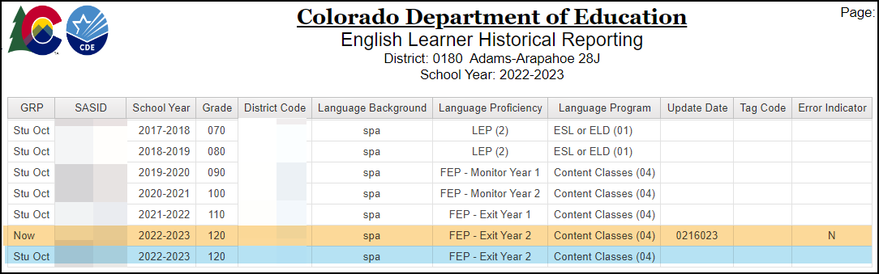
CEDAR/COGNOS: English Learner Historical Reporting SASID Lookup
Reminder: This report is a tool to review EL coding, it does not determine a student’s current Language Proficiency. Follow the State’s standardized identification procedures and redesignation procedures.
Site: CDE Standardized Procedures for English Learner Identification
Site: CDE Standardized Procedures for English Learner Redesignation
Operational report to help districts check the English Learner history for a student by SASID
Reflects data from prior OCT collections and current DEM file
Available to data pipeline users with STD~LEAViewer or STD~LEAUser access

Slide 21
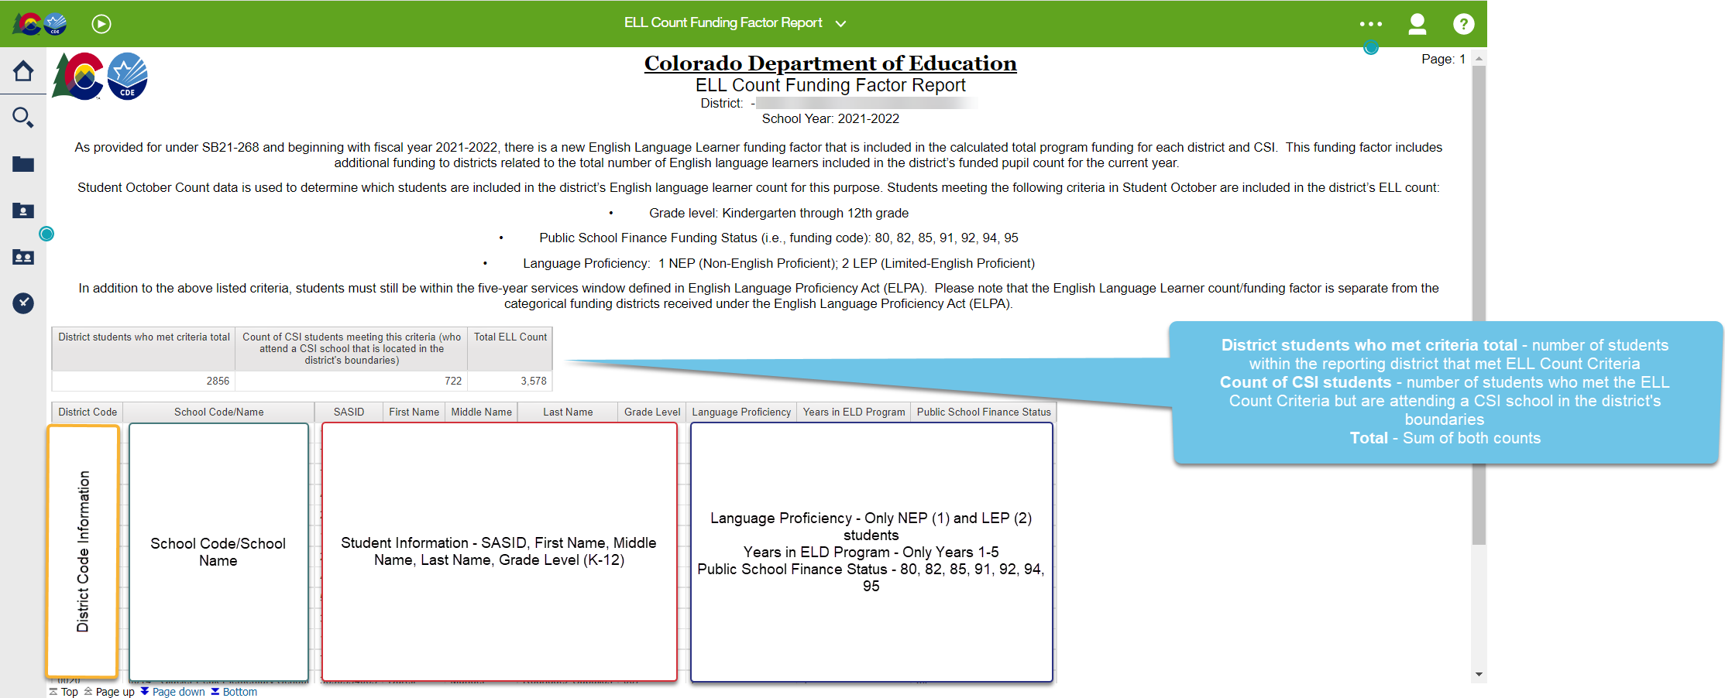
CEDAR/COGNOS: ELL Count Funding Factor Report
Reminder: This report is a tool to review EL coding, it does not determine a student’s current Language Proficiency. Follow the State’s standardized identification procedures and redesignation procedures.
Site: CDE Standardized Procedures for English Learner Identification
Site: CDE Standardized Procedures for English Learner Redesignation
Operational report to help districts check the students meeting ELL Count Funding Factor
K-12, Funding Status (80, 82, 85, 91, 92, 94, 95)
NEP and LEP Students
Students must be within 5-year service window defined in ELPA
Available to data pipeline users with OCT~LEAViewer or OCT~LEAUser access

Slide 22

Personally Identifiable Information (PII)
Personally Identifiable Information (PII) is defined by state and federal laws as information that alone, or in combination, personally identifies an individual
  Includes direct identifiers (i.e. SASID, student names)
  Includes information when combined is identifiable
Colorado’s Student Data Transparency and Security Act outlines requirements for how Student PII is collected, used and shared
See CDE’s data security and privacy site for more information
Syncplicity
  Secure file transfer site used to communicate PII with CDE collection leads
  Each collection lead maintains their own Syncplicity folder and can assign rights to that folder
    Student End of Year, Student October, and Attendance all utilize the same primary folder with subfolders to organize the collections
    Primary Syncplicity Folder: District Code – DISTRICT NAME – Student
Notes:
Before we look at our exception request form, we need to talk about Personally Identifiable information. Personally identifiable information is defined by state and federal laws as information that alone or in combination personally identifies an individual. So, in this instance we're talking about students. It would be direct identifiers such as SASID, student names, date of births or other information that when you combine it together would identify a student. Because of Colorado's student data transparency and Security Act we really need to think about the requirements for how we communicate student PII and how it is used and shared. So, this is data that we do need to keep secure and we do need to keep private. That means that when communicating with CDE staff or communicating amongst one another, it's important to know that e-mail is not considered secure. If personal identifiable information must be sent to CDE staff, we use a system called Syncplicity. This is a secure file transfer site used to communicate student information with collection leads. For Student End of Year, Student October or the Attendance collections, please use the primary Syncplicity folder indicated by District Code – District Name – Student to send student information securely to data collection leads. All exception requests will go through this safe process.

Slide 23
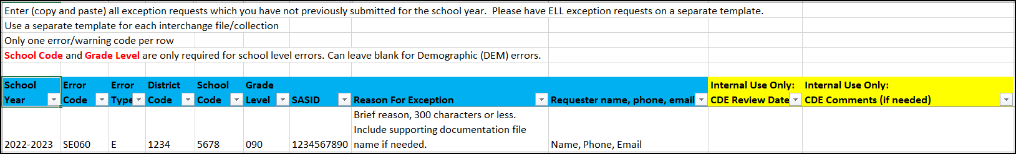
Regular Exception Template
Required for all reporting exceptions, even when additional documentation is also being provided
Uploaded to Syncplicity for Review (Student Folder)
Create a new exception request form when additional exceptions are needed, not a running list
Available on Student Interchange Website

Slide 24
Reason for Exception Examples
Student does not speak a language other than English or student is not EL.
  Consider providing: District has mis-identified the student. District's robust documentation and body of evidence demonstrates this recently identified EL student (2 reporting years or less) is not eligible for language instruction.
Student incorrectly identified as EL student, code student as PHLOTE
  Consider providing: Student was screened in the district on ‘date’. Documented screener scores and body of evidence indicated student is fully proficient in English. Student should have been coded as PHLOTE to begin with and was never provided EL services.
Student's Language Proficiency is FEPM2 (7) (skipped FEP M1 in progression in records - coding)
  Consider providing: Student took ACCESS/ALT ACCESS during ‘school year’. Conference with ELD Team/Dept, documented scores and body of evidence indicated should have been redesignated to FEP M1 last school year. Code as FEP M2 now. Student had mid-year exception approved in Student End of Year Collection.
Student was LEP last year but after October Count so was not reported in October Count with a language. This year, they moved to FEP Monitor 1 (6).
  Student was LEP last year but after October Count so was not reported in October Count as a LEP student. Student was screened upon enrollment after report deadline (Student October). Screener and body of evidence indicated student is fully proficient in English. This year, they moved to Monitor 1 (6). Student had mid-year exception approved in Student End of Year Collection.
Notes:
Student does not speak a language other than English or student is not EL.
Consider providing: District has mis-identified the student. District's robust documentation and body of evidence demonstrates this recently identified EL student (2 reporting years or less) is not eligible for language instruction.
Student incorrectly identified as EL student, code student as PHLOTE
Consider providing: Student was screened in the district on ‘date’. Documented screener scores and body of evidence indicated student is fully proficient in English. Student should have been coded as PHLOTE to begin with and was never provided EL services.
Student's Language Proficiency is FEPM2 (7) (skipped FEP M1 in progression in records - coding)
Consider providing: Student took ACCESS/ALT ACCESS during ‘school year’. Conference with ELD Team/Dept, documented scores and body of evidence indicated should have been redesignated to FEP M1 last school year. Code as FEP M2 now. Student had mid-year exception approved in Student End of Year Collection.
Student was LEP last year but after October Count so was not reported in October Count with a language. This year, they moved to FEP Monitor 1 (6).
Student was LEP last year but after October Count so was not reported in October Count as a LEP student. Student was screened upon enrollment after report deadline (Student October). Screener and body of evidence indicated student is fully proficient in English. This year, they moved to Monitor 1 (6). Student had mid-year exception approved in Student End of Year Collection.

Slide 25
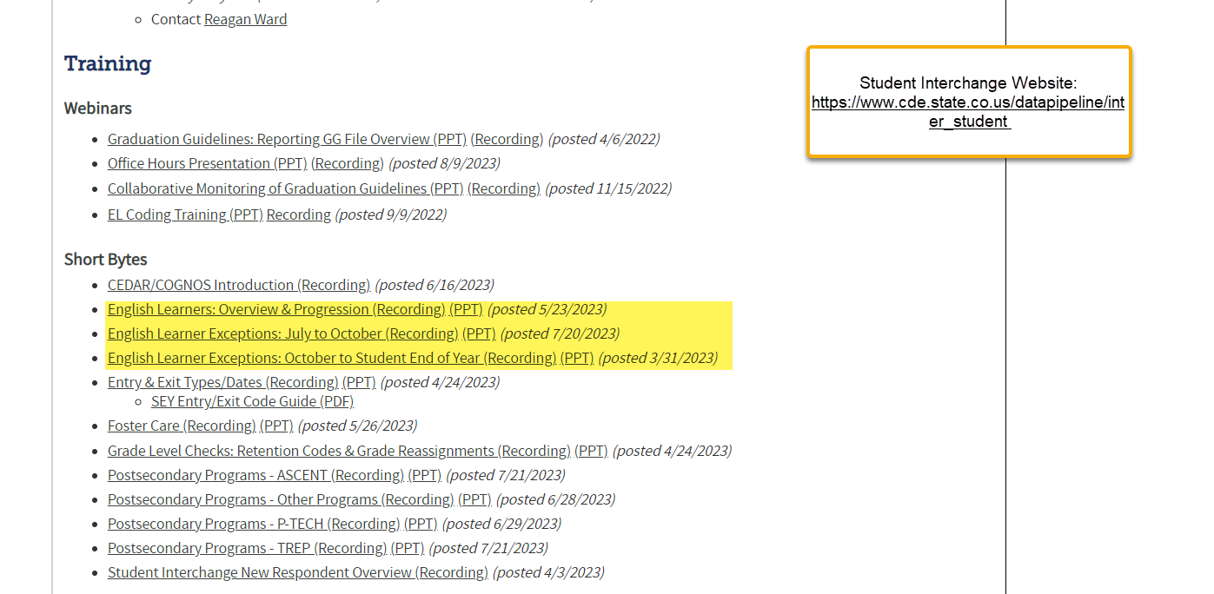
Short Bytes
3 Short Videos on English Language Learners
  Overview
  Student October
  Student End of Year
Available on Student Interchange Website
Notes:
I know both Doris and I went through a ton of information today, but you are in luck, we not only record this presentation and post the PPT, we also have three other short trainings that pertain to English Language Learners already posted on the web. These are called Short Bytes and they are meant to focus in on one subject at a time. We have 3 short videos for EL information: one for a quick overview of this type of information, one for the Student October reporting period and one for our Student End of Year reporting period. These can be found on the Student Interchange website.

Slide 26

Resources
Helpful Webpages
CDE Standardized Procedures for English Learner Identification
CDE Standardized Procedures for English Learner Redesignation
IDM/Data Pipeline
Student Interchange Website
Student October Website
Syncplicity
Brooke Wenzel
StudentOctober@cde.state.co.us
720-441-7963
Doris Nguyen
brock-nguyen_d@cde.state.co.us
720-626-6175

