Slide 1
2024-2025
Student Interchange Office Hours
Brooke Wenzel
Reagan Ward
Student October Email
Attendance Email
Student End of Year Email

Slide 2
Agenda
General Data Respondent Information
Student Interchange Files & Process
Snapshot & Collection Usage
Timeline
Business Rules
Demographic Data Reporting Cycle
Enrollment Record Tracking
Reminders & Resources
  Website Demonstration

Slide 3
General Data Respondent Information

Slide 4
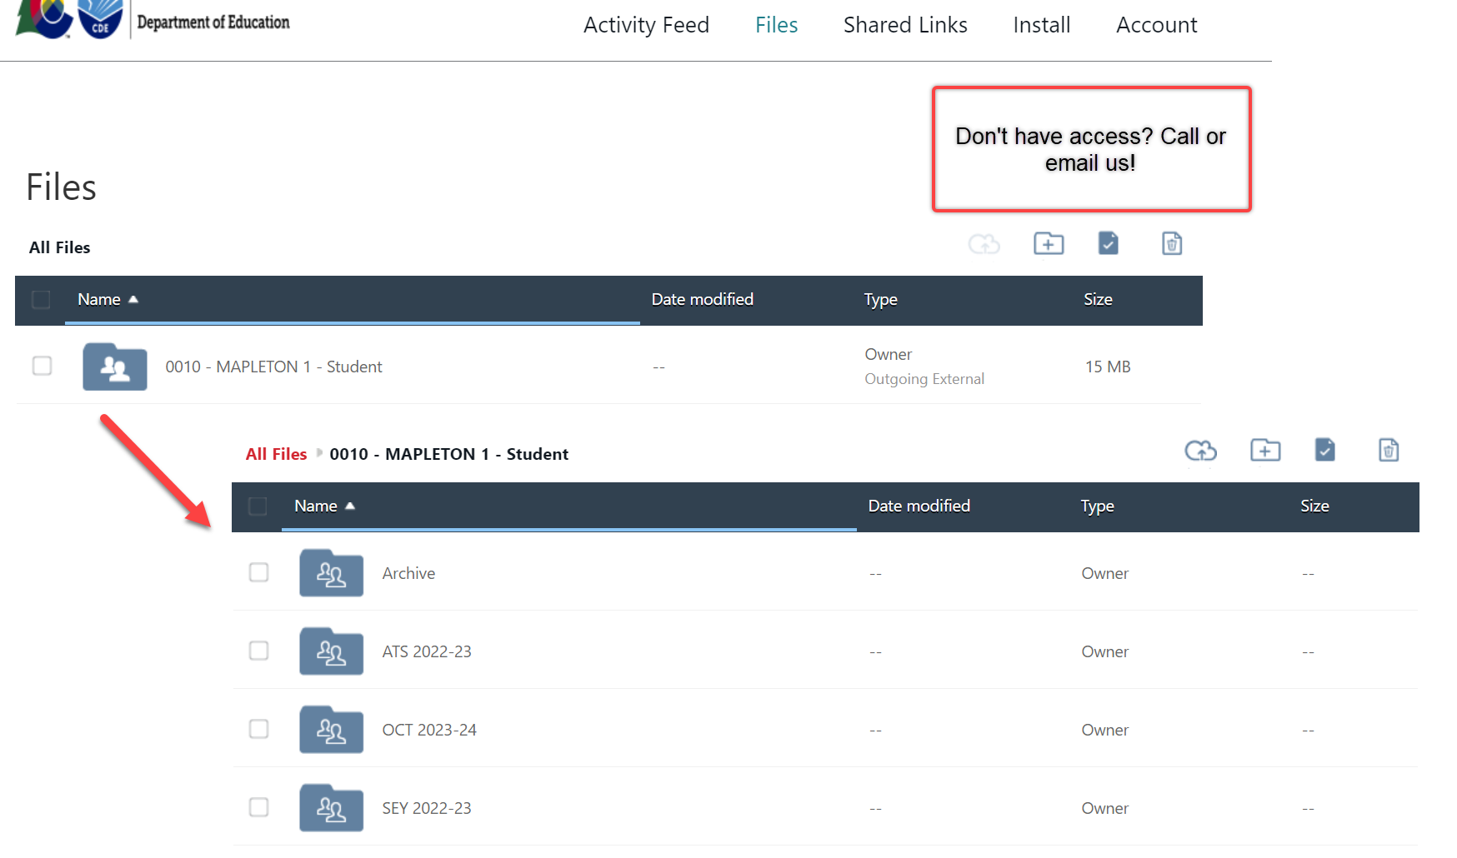


Syncplicity and Town Hall
Syncplicity – CDE’s secure file sharing service of choice
Town Hall – Review various Data Pipeline Collection information/updates
Weekly on Thursdays from 9 – 10 am
Email to subscribe: DATASERVICES-subscribe-request@cdelist.cde.state.co.us

Slide 5
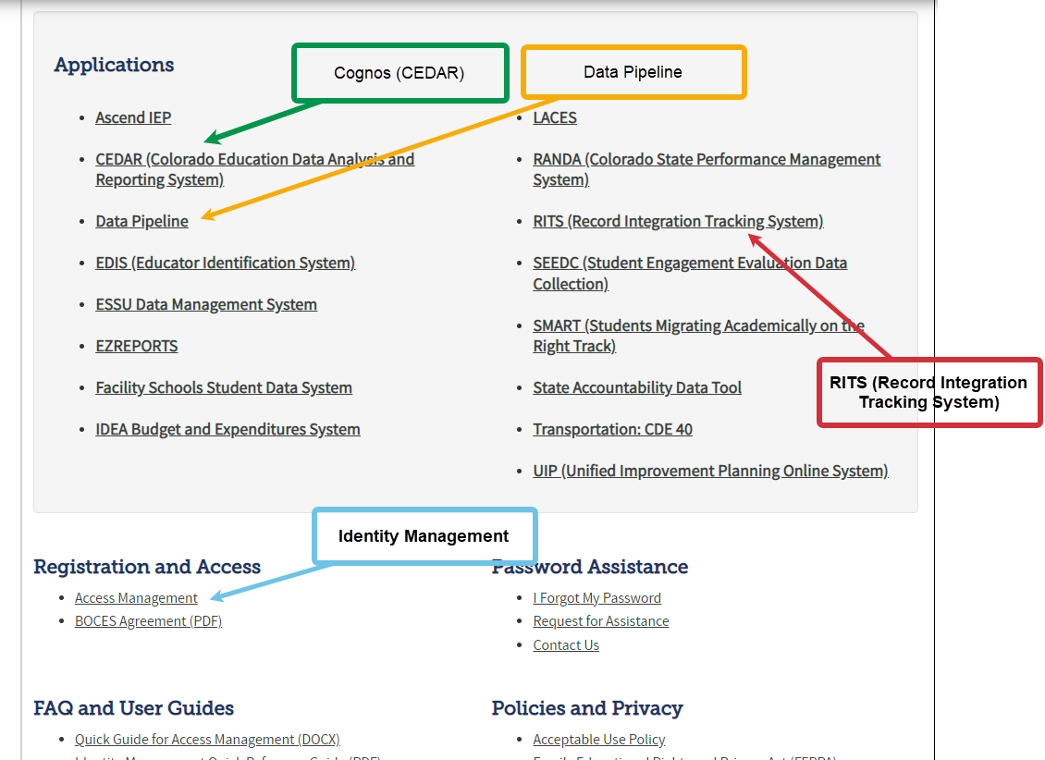
CDE Application Login
IdM Website

Slide 6
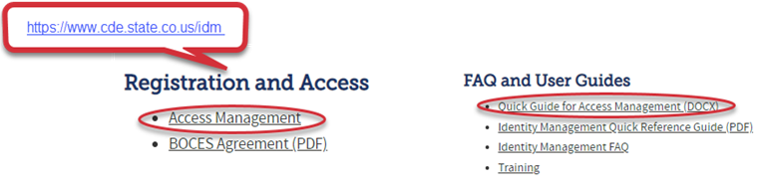
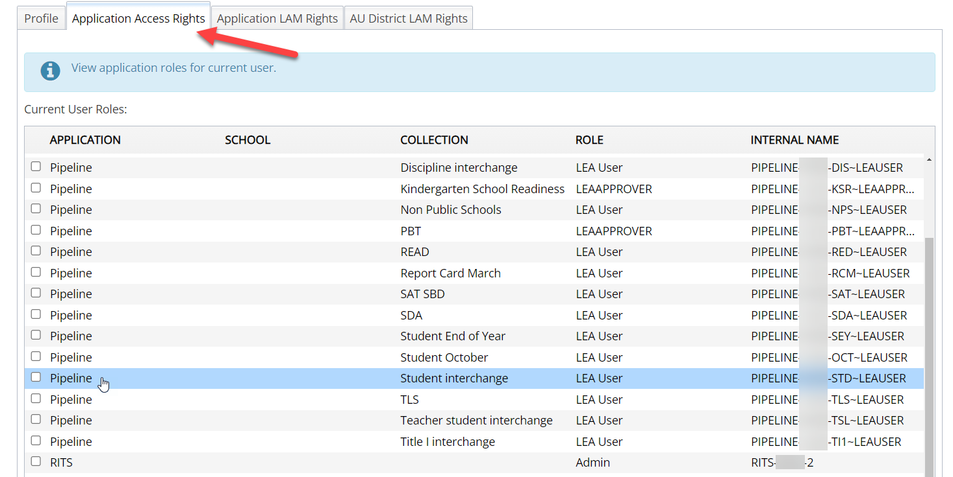
CDE Identity Management
Don’t have access?
Talk to your District’s Local Access Manager (LAM)!
Note: Different roles for different collections
Notes:
In order to dive deeper into account privileges, we must talk about a LAM – Local Access Manager. Each district has a Local Access Manager that is responsible for creating and updating accounts within our IDM system to not only get new colleagues access within Data Pipeline, for example, but also add or remove collection privileges within those accounts. When logging into Access Management, each account will have a tab called “Application Access Rights” which contains a list of collections and the corresponding role the user has for that particular collection. As you can see with this example, this user has many roles withing Data Pipeline for various collections. For our Student Interchange, you must have the STD~LEA USER role (shown highlighted) to edit Student Interchange information within Data Pipeline. STD is the acronym for our Student Interchange and the LEA USER role allows for edit rights. Note that there are other roles within our system like LEA APPROVER, or LEA VIEWER that provide different access rights for that collection. You will want the LEA USER role again for the Student Interchange.

Slide 7
Pipeline Maintenance Window
Every Tuesday around 5:00 p.m. there is a Pipeline Maintenance Window
Avoid any work within Data Pipeline
  Uploading Interchange Files
  Triggering Snapshots
  Etc.
Why?
  Could cause files or snapshots to be stuck in processing
  Unnecessary errors will occur

Slide 8
Student Interchange Files & Process

Slide 9



Student Information System (SIS) Extracts
Download reports (files) from your Student Information System
  Student Demographic, Student School Association, Graduation Guidelines (.xlsx is recommended format) – files could be named differently in SIS
  Do not open file!
Save each file in an accessible location with naming convention
  Example: 0110_DEM_10112023.xls (No spaces in file name are allowed)
  Keep filing system organized
Upload each file to Data Pipeline (steps shown later)

Slide 10





Student Interchange Files
Student Demographic File
  One record per student
Student School Association File
  May include multiple records per student
Student Interchange
Graduation Guidelines File
  Secondary students only
  Expect multiple records per student
Adjustment File
  As needed for SEY Collection

Slide 11
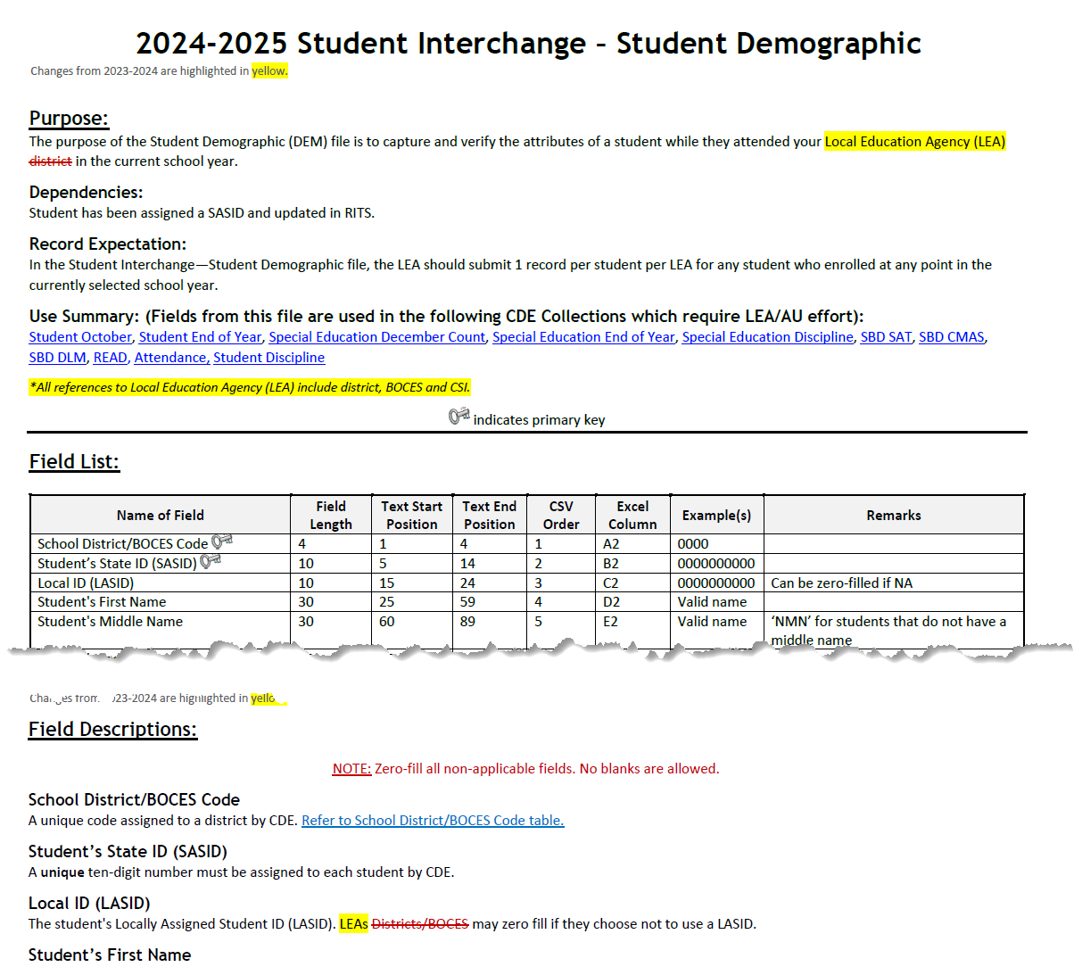
Student Demographic File Layout
One record per student
2024-2025 Student Demographic File Layout
Race/Ethnicity
Language Fields (Proficiency, Background, Program)
Homelessness Information (Homeless, Cause of Housing Crisis, Add. Cause of Housing Crisis)
SPED information (Primary Disability, Alternate Assessment Participant, Transition)
Notes:
Includes fields that are true of student, no matter their enrollment

Slide 12
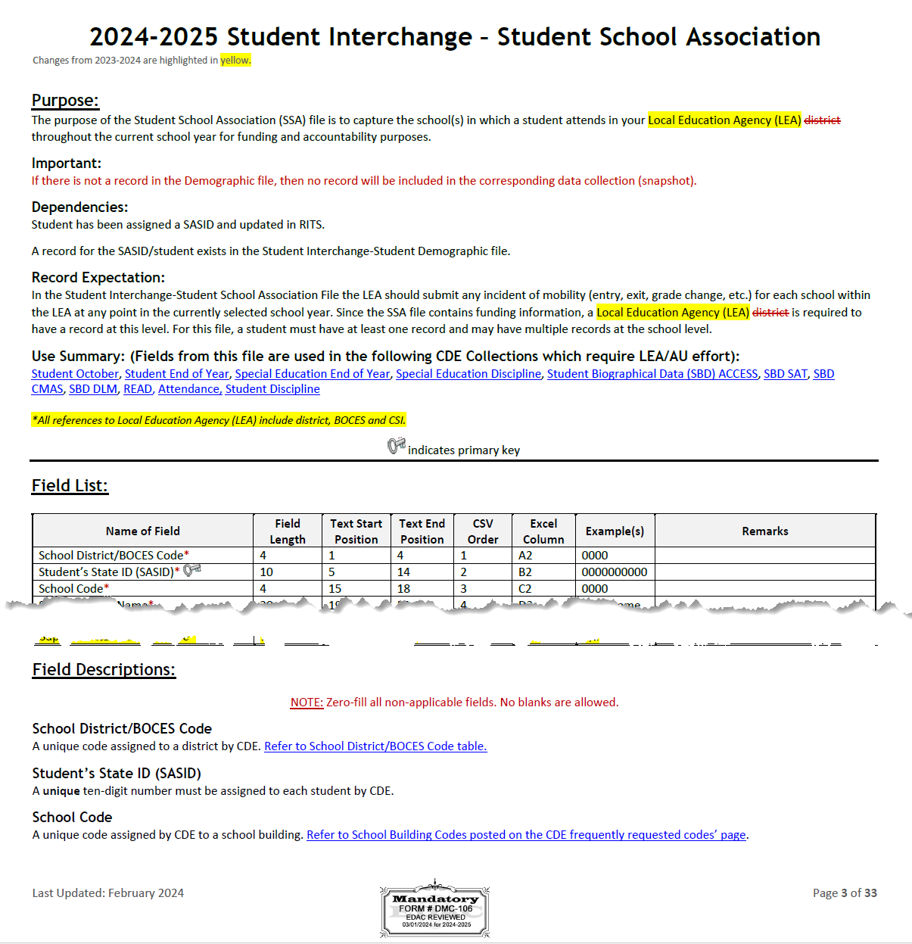
Student School Association File Layout
May include multiple records per student
2024-2025 Student School Association File Layout
Grade Level
Entry/Exit Types
Public School Finance Funding Status
Pupil Attendance Information
Non School Program
Attendance Fields (Total Days Attended, Total Days Excused/Unexcused, Total Possible Days)
New data fields for 2024-2025:
  Independent Study Course, Work-Based Learning Course, Blended Learning Course, Supplemental Online Course
Notes:
Includes data fields specific to enrollment
Primary school = 1 are the types of records that pull into the collections. Primary School = 0 may be on your file, but won’t pull into collections.
Entry Exit Type definitions have been updated

Slide 13
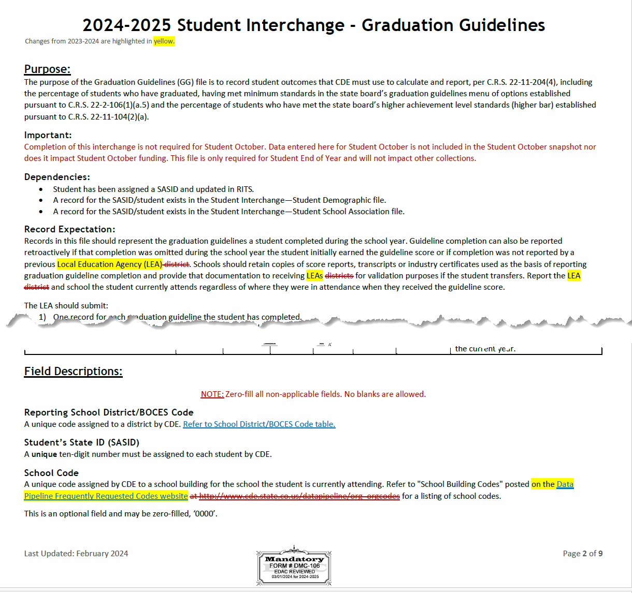
Graduation Guidelines File Layout
Secondary students only
Expect multiple records per student
2024-2025 Graduation Guidelines File Layout
Guideline Type
  0 English
  1 Math
Guideline Name
  Alpha codes only (SAT, ASV, CAP,…)
Guideline Score
  NO LEADING ZEROS
School Year of Completion
  i.e. 20242025
Notes:
GUIDELINE_SCORE has benchmark values. This determines if a student is ‘meeting’ for the given measure. This becomes important when students are graduating since they must meet on at least one math and one English measure.

Slide 14
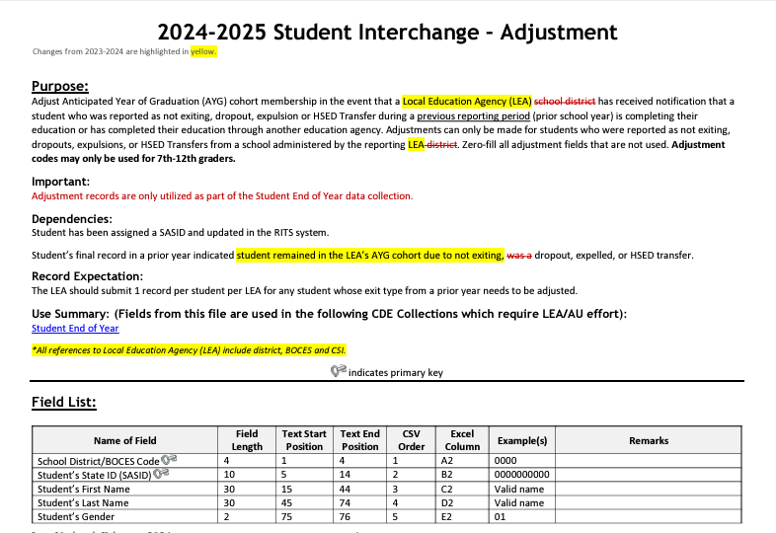
Adjustment File Layout
As needed for SEY collection
2024-2025 Adjustment File Layout
Grades 7-12 only
Only used for Student End of Year (SEY) collection
Adjusts final school exit type in a prior school year under very specific circumstances
Most student information systems do not have an extract as this file may be used for one or two students every few years
Opens in May 2025 when student end of year collection officially begins

Slide 15
Student Interchange Preparation
Upload interchange files
Wait for a Confirmation Email from the Pipeline System
  The email will show you the number of errors in your upload
  Resolve ALL errors in your interchange files
  Check your error reports
Update your Interchange files to address the errors
  Update in SIS → Extract → Upload to Pipeline
Upload Student Demographic File
Upload Student School Association File
Upload Graduation Guidelines File

Slide 16
Snapshot & Collection Usage

Slide 17
What Collections (Snapshots) use the Student Interchange?
Student October
Attendance
Student Discipline
Student End of Year
Special Education Collections
  December Count
  Discipline
  End of Year
SBD Assessment Collections
  Initial assessment files based upon Student October data
READ Act Assessments
  Validates enrollment against SSA file

Slide 18
What is a Snapshot?
Source File A
Source File B
Internal Flags
File A: Element 2
File A: Element 5
File B: Element 3
Internal Flag: 3
Snapshot
File A: Element 1
File B: Element 1
File A: Element 3
File A: Element 4
File B: Element 2
File B: Element 4
Internal Flag: 1
Internal Flag: 2

Slide 19
Snapshot Process
0. Make sure Student Information System is updated
Extract Interchange Files from SIS and upload Interchange files to Pipeline (Student Demographic, Student School Association, Graduation Guidelines)
Check Business Rules Associated with Interchange files
Errors on Interchange files?
  Yes – Correct Errors in SIS and go back to step 0
  No – Move on to step 4*
Create Snapshot
Check Additional Business Rules Associated with Snapshot
Errors?
  Yes - Correct Errors in SIS and go back to step 0
  No – Move on to step 7
Review Reports and Finalize
  If you need to correct any data, you will need to go back to step 0
*Note: Error-free interchange files are not required to take a Snapshot but recommended. Get your interchange files as close to error free as possible before taking a snapshot!

Slide 20
Timeline

Slide 21
Overlapping Years
July 1:
Interchange opens
January:
Spring Semester
May:
Various End of Year Collections Open
June 30:
Reporting Year Ends
December 1: Interchange Closes
Student October
SPED DEC Count
ACCESS for ELs Administered
Spring Assessments Administered
READ Spring Assessments
Assessment SBDs
Attendance
Student Discipline
SPED Discipline & End of Year
Student End of Year
July 1:
Interchange opens
December
Student October
SPED December Count

Slide 22
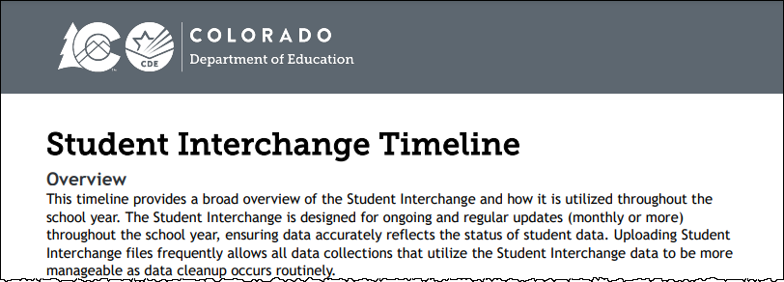
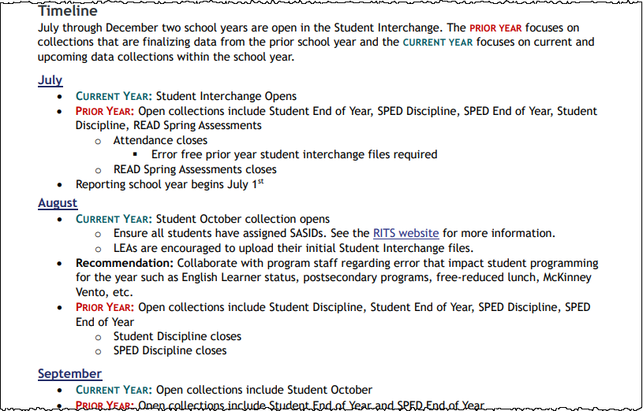
Student Interchange Timeline
Available on Student Interchange website
Best practice: regularly upload student interchange files throughout the year (DEM, SSA, GG)
Current Year collection notes and Prior Year collection notes indicated for each month where two years are open
Recommendations are designed to help LEAs maintain clean data throughout the year to help make data collections more efficient because the source data is already clean

Slide 23
Business Rules

Slide 24
Errors/Warnings:
Overview
Errors
Warnings
Must be addressed
  Update data fields to clear
  Request reporting exception if student data is accurate but does not follow the typical coding pattern as indicated by the error message
Prevent records from pulling into data collections
Indicate possible data inconsistencies/coding issues
Do not prevent record from pulling into data collections
Pro Tip: Review warnings to look for patterns/areas where LEA data could be documented in a more accurate manner
Note: Student interchange business rules address data inconsistencies that apply to multiple data collections (snapshots)

Slide 25
Addressing Errors/Warnings
Preferred Method:
Correct the related data field in your SIS
Extract a new file from your SIS
Upload the new file to Data Pipeline
Alternate Method:
Correct the related data field using the Edit Record screen in data pipeline.
This is not the preferred method for correcting errors because uploading a new file will wipe out any manual edits done in pipeline.
This method is designed for use during the Post-Cross LEA phase of the Student End Year collection only.

Slide 26
2024-2025 Business Rule Changes
English Language Learner Errors
  Some year-to-year checks were checking on a district basis, updated it to check via SASID. Only applied to a small number of ELL errors.
    Ex: Student was in District A with Language Proficiency X in 2023-2024, student moved to District B with Language Proficiency Y in 2024-2025 (error was not flagging before since district was different)
Gifted and Talented Error
  Prior year vs. current year check to verify if a student is gifted in one of the 14 categories, they continue to be identified as such
Date First Enrolled in US
  Changes went into effect April 2024 for the 2023-2024 school year to increase precision in this data field.

Slide 27
Demographic Data Reporting Cycle

Slide 28
Demographic Data Types
Cumulative (Reporting Year)
Homeless Data Fields
  *Homeless
  Primary Nighttime Residence
  Cause of Housing Crisis
  Additional Cause of Housing Crisis
English Learner Data Fields
  *Language Proficiency
  Language Instruction Program
  Language Background
*Military Connected
Free/Reduced Lunch Fields
  **Free/Reduced Lunch Eligibility
  Free Lunch Eligibility Identification
**Immigrant
**Special Education Transition
**Attends District Funded HSED Program
Section 504 Having a Disability
Point in Time
Name, Date of Birth, Gender
**Race/Ethnicity
Military Enlisted
Alternate Assessment Participant
Primary Disability
Note:
*Error triggers if Student End of Year does not match Student October and/or State Assessment
**Warning triggers if Student End of Year does not match Student October

Slide 29
Cumulative Demographic Data
Reporting Cycle
Reminders
Beginning of the Year:
Student October
  7/1 reporting cycle begins
  October represents status on count day
Students who become eligible for a given cumulative data field at some point during the year remain reported as such until the end of the reporting year, 6/30
English Learner status should not change from OCT to SEY if student is continuously enrolled in the LEA
Summer
  Review demographic fields to determine if remain eligible next year
Winter
  Update coding for students who newly qualify for a given DEM status
End of the Year
  6/30 reporting cycle ends
  Cumulative fields match October or move student from ‘no’ to ‘yes’ in a category for students who qualified mid-year

Slide 30
Enrollment Record Tracking

Slide 31
SSA File Design
Important Notes:
  SSA file is designed to include one record per enrollment situation
  Gifted and Talented Fields should be treated like demographic information with identical information on each SSA record
  Date first Enrolled in US should be treated like a demographic field, with identical information on each SSA record.
Typical Enrollment Changes:
  Movement between schools
  Movement in/out of district
  Instances of Mobility
Critical ‘status’ Changes:
  Expelled Education
  **Non-School Program
  *Postsecondary Program
  **Home Based Education (part-time)
  **Innovative Learning Opportunities Pilot
  Pupil Attendance Information
    Impacts if record pulls into a snapshot
Other Changes
(optional ~for now~ since only used in OCT collection)
  County Code of Residence
  District of Parent’s Residence
  Country of Parent’s Residence
  State of Parent’s Residence
  Public School Finance Funding Status
  Independent Study Course
  Work-Based Learning Opportunity Course
  Blended Learning Course
  Supplemental Online Course
Attendance Fields
(used in Attendance Collection only)
  Total Days Attended
  Total Days Excused
  Total Days Unexcused
  Total Possible Attendance Days
  Habitually Truant Status
  Total Days Missed due to Out of School Suspensions

Slide 32
Capturing Enrollment Status Changes
Scenario: student remains enrolled in the same school code, but one of the SSA enrollment fields has changed mid-year
  Non-school program, homebased education, postsecondary program enrollment, ILOP, expelled education (may be exit/entry 56 instead)
Using back-to-back exit/entry dates at the same school code ensures this is not considered an instance of mobility
SSA Record | School Code | Entry Date | Entry Type | Exit Date | Exit Type | Homebased Education | PAI
#1: Point ___ status changes | 8765 | 08/15/2024 | 02 | 10/15/2024 | 11 | 1 | 01 – 08
#2: new ___ status | 8765 | 10/16/2024 | 11 | 00/00/0000 | 00 | 0 | 01 – 08
Note: Postsecondary Program Enrollment newly moved to SSA file in 2023-2024. Best practice is to have enrollment records showing status change when PS status changes but may require some transition for districts. Currently, SEY business rules only check for ASCENT/PTECH/TREP in OCT compared to SEY.

Slide 33
Reminders & Resources

Slide 34
Resources/Helpful Webpages
Site Name/Link | Information/Uses
Data Pipeline Home | Main landing page for the data pipeline information/resources. From here you can navigate to all the various data collection sites
Identity Management (IdM) | This is the landing page with login links to the various CDE data platforms. Data Pipeline COGNOS/CEDAR Reporting RITS EDIS
Data Pipeline Collection Dates (XLS) | Excel document that shows the open/close dates of all data collections & the point of contact at CDE for the collection (collection lead)
Student Interchange | Contains file layouts, templates, business rules, training materials, and resources Student Demographic file Student School Association file Graduation Guidelines file
Syncplicity | Secure file transfer site used to communicate personally identifiable information with CDE if you have questions on specific students during reporting or have exception requests. You should get a separate email from them today to set up an account to access the student file for your district. Other collection leads will need to give you access to the Syncplicity folders (same login, just extra folders) for their collections if you need them.

Slide 35
Resources
Thanks for attending! Stick around for a CDE website demonstration!
Brooke Wenzel
720-441-7963
Reagan Ward
720-484-9057
Student October Email
Attendance Email
Student End of Year Email
Student Interchange Website
Who do I contact and when?
2023-2024 Questions
July 2023 - December 2023, Contact Brooke Wenzel
January 2024 - December 2024, Contact Reagan Ward
2024-2025 Questions
July 2024 - December 2024, Contact Brooke Wenzel
January 2025 - December 2025, Contact Reagan Ward
Need a 1-on-1?
Schedule with Brooke Wenzel (earlier than later) in preparation for Student October

