Slide 1
2024-2025 Special Education December Count Student and Staff Snapshot Training
^{November 13, 2024}
^{Lindsey Heitman}

Slide 2
Special Education December Count
Contact Information
Lindsey Heitman – SpedDecCount@cde.state.co.us 720-456-2033
Special Education Dec Count Snapshot submission
Includes IEP Interchange and Staff Interchange SPED staff questions
*Please include your AU #, District #, Error code # or cognos report name (if applicable) in emails
Resource Webpages
Special Education IEP Interchange
Staff Interchange
Special Ed December Count Snapshot
ESSU Data Management System

Slide 3
Agenda
IdM: Access to Data Pipeline – slides 4-7
Purpose, Timeline, Overview – slides 8-23
Special Ed IEP Interchange: SPED Student Data/Content – slides 24-38
Staff Interchange: Staff Data/Content – slides 39-47
December Count Snapshot Process – slides 48-65

Slide 4

Identity Management (IdM): Access to the Data Pipeline

Slide 5
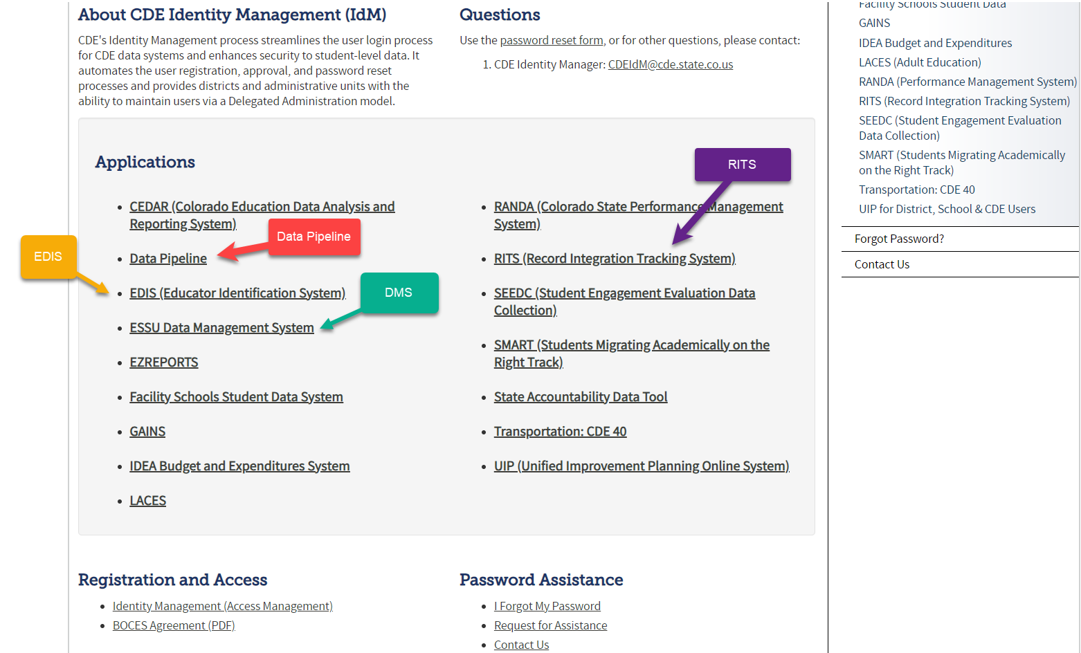
*LAMS: Click Identity Management to add or modify IdM accounts
IdM Homepage – recommended link to bookmark for access to CDE applications
*single sign-on used for all CDE applications listed here
IdM Quick Guide and FAQs located under Registration and Access

Slide 6
December Count: Identity Management Roles
DATA PIPELINE ROLES NEEDED TO COMPLETE DECEMBER COUNT:
Special Education IEP Role:
SPE~LEAUSER – upload and modify Special Education IEP Interchange Files
Special Education December Count Snapshot Roles:
DEC~LEAAPPROVER – Approves, creates, views Snapshot OR
DEC~LEAUSER - creates, views Snapshot OR
DEC~LEAVIEWER- views snapshot
Staff Interchange Roles (AU respondent only needs this role if they are reporting SPED staff):
STF~ LEAUSER – upload and modify staff interchange files OR
STF~ LEAVIEWER – view only staff interchange data
EACH LEA MUST DETERMINE WHO WILL REPORT THE SPED STAFF- DISTRICT RESPONDENT OR AU RESPONDENT?
IMPORTANT NOTES
* Only 1 role per Group
*Data Pipeline email/collection contact lists are generated from these roles. We do not keep manual email lists! Please ask your LAM to update as necessary.

Slide 7
Identity Management – Staff Roles
Staff role needed for District respondent -
STF Associated with the 4 Digit District Code
User may report ALL staff data for the district - regular ed staff and Special Education staff OR just regular ed staff
District respondents reporting all staff must collaborate with AU respondent in accordance with December Count timeline
Example: 0870-STF~LEAUSER
Staff role needed for BOCES respondent uploading BOCES staff-
STF Associated with the 4 Digit BOCES Code
User can report ALL staff for the BOCES – regular ed staff and Special Ed staff
Example: 9025-STF~LEAUSER
Optional - Staff role needed for AU respondent uploading SPED staff
STF Associated with the 5 Digit AU Code
User may only report Special Education staff (flag=1)
Example: 15010-STF~LEAUSER

Slide 8
Timeline & Collection Overview

Slide 9
Special Education December Count Collection Purpose
Purpose
Obtain data on students actively receiving Special Education services as of the annual count date of December 1st
Obtain data on special education staff employed by Administrative Units on December 1st of each year so that appropriate licensure and endorsement of staff may be verified
Student:
determine ECEA funding for students with disabilities
calculate State Performance Plan Indicators
Indicator 5 – LRE Placement
Indicator 6 – Early Childhood Settings
Indicator 9 – Disproportionate Representation in Special Education
Indicator 10 – Disproportionate Representation in Specific Disability Categories
calculate significant disproportionality
generate sample lists from previous December Count for Indicator 8 - Parent Involvement and IEP Record Reviews
used to meet federal reporting requirements - EdFacts
Staff:
linked to the student data to fulfill required staff qualifications
used to meet federal reporting requirements – EdFacts
reports generated for the State Legislature, Federal government, local Administrative Units, and the public

Slide 10
Special Education Student Funding Clarification
IDEA federal funding is calculated from Student October Snapshot data
ECEA (Exceptional Children’s Educational Act) state funding is calculated from December Count Snapshot data
Funding is based on Special Education status as of 12/01 as well as tier A and tier B disability types
Detail Report found in the Special Ed December Count Cognos folder –
Student: Detail Funded by Disability Tier and Member District
You’ll find the funding amount and breakdown for each district/AU at this link:
https://www.cde.state.co.us/cdefisgrant/allocations

Slide 11
Special Education December Count: Staff and Student Snapshot Timeline
November Due Dates
December Due Dates
January Due Dates
30th - Thursday - All errors resolved – complete snapshot
February Due Dates
10th – 18th - Monday – Tuesday - Resolving Duplicates
1st - Sunday - Official count date (or last date prior your school was in session)
30th - Feb 7th Thursday – Friday - Report Review
18th – 21st - Tuesday - Friday - Final Report Review
21st - Friday - Final Submission Due
1st - Friday – Sped December Count Snapshot available in Data Pipeline
13th – Wednesday - Interchange files uploaded - Sped Child, Sped Participation, Staff Profile, Staff Assign
18th - Wednesday: Interchange files error free and at least one snapshot created
Please download the full 24-25 Timeline from the Special Education December Count Snapshot webpage.

Slide 12

Special Education December Count Snapshot
1. Student Snapshot
2. Staff Snapshot
Data is pulled from these Data Pipeline Interchanges and files:
Special Education Child
Special Education Participation
Staff Profile
Staff Assignment
District Responsibility:
Student Interchange
Staff (include SPED staff if AU is not uploading staff data)
AU Responsibility:
Special Education IEP Interchange
SPED Staff (ONLY if district is not uploading)
Student School Association
Student Demographic
STUDENT
IEP
IEP
STUDENT
STAFF
STAFF

Slide 13
Interchanges and Snapshots
Special Education IEP Interchange data is used in the following snapshots during the year:
Staff Interchange data is used in the following snapshots during the year:
Notes on the interchange and snapshot process:
Click ‘Create Snapshot’ to pull records from the interchange files based on the criteria set for that snapshot
The snapshots merge the needed data fields from the interchange files together into one ‘dataset’
Keep in mind you may need to “manually” modify your interchange files’ data based on which snapshot is open to get the right records in your snapshots
Snapshots are not automatically updated when interchange files are reloaded- a new snapshot must be created to pull in the updated records
Check the snapshot file layouts to see which data fields pull into each snapshot
*Note: Error-free interchange files are not required to take a snapshot but recommended.
Records with errors at the interchange level will not pull into your snapshots!
Special Ed December Count
Special Education End of Year
Special Education Discipline
Special Ed December Count
Human Resources
Staff Evaluation

Slide 14
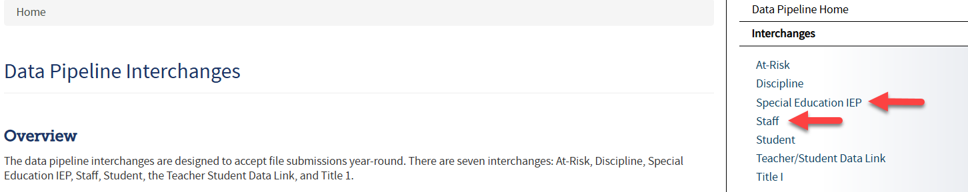
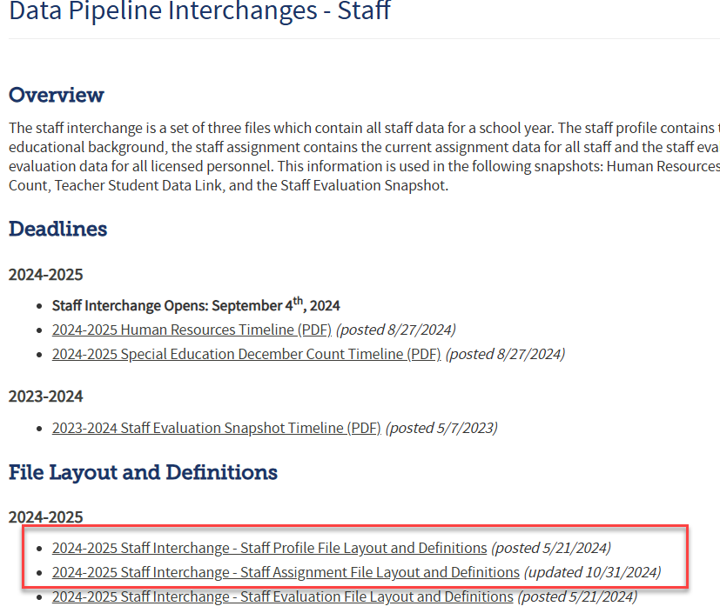
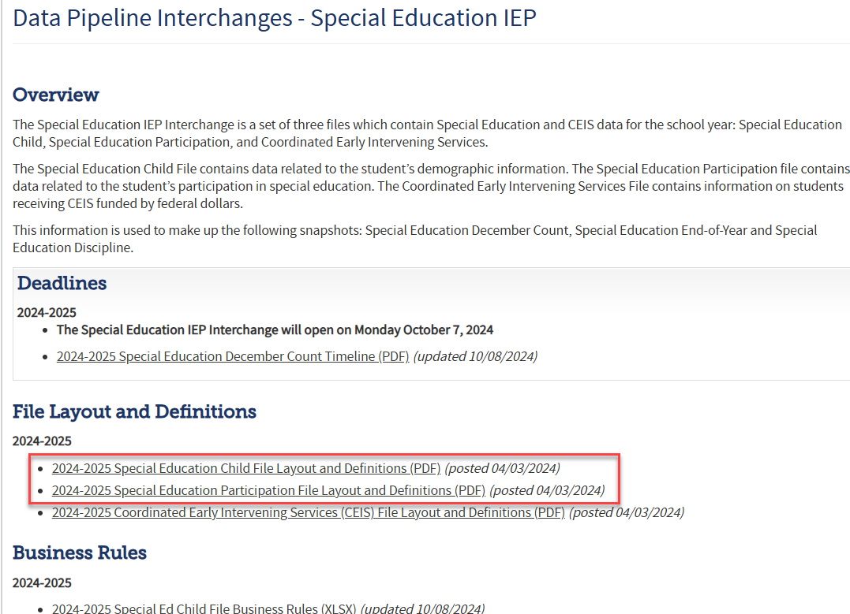
Staff Interchange and SPED IEP Interchange Resources
Data Pipeline Homepage
Bookmark this link for quick access to the Data Pipeline Collection Resources
Staff Interchange Webpage
Special Education IEP Interchange Webpage
At these links you will find:
Timelines
File Layouts
Templates
Business Rules
Training Slides/ Webinars
Additional Resources
Find all codes and definitions:
PAI codes
Ed Environment (setting) codes
Funding Status Codes
PPPS Codes
Find all codes and definitions:
Subject Area of Degree
Job Codes
AIA Codes
TSA Codes

Slide 15
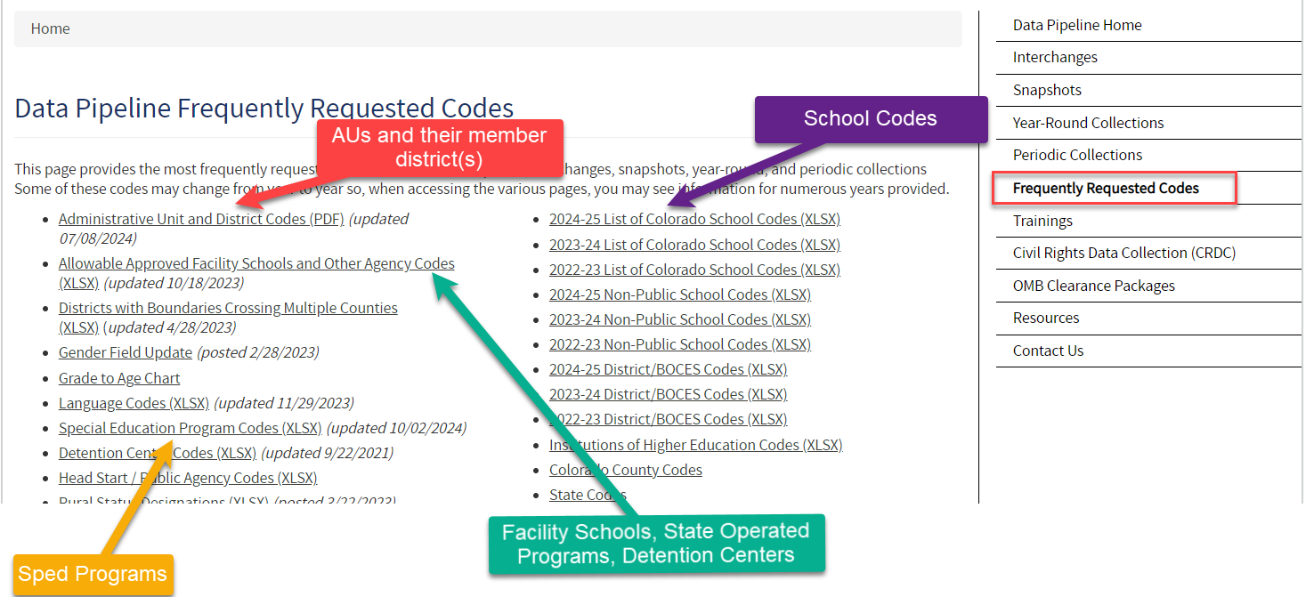
Frequently Requested Codes Webpage
https://www.cde.state.co.us/datapipeline/org_orgcodes
School Codes, AU Codes, Facility School Codes, Sped Program Codes, and more

Slide 16
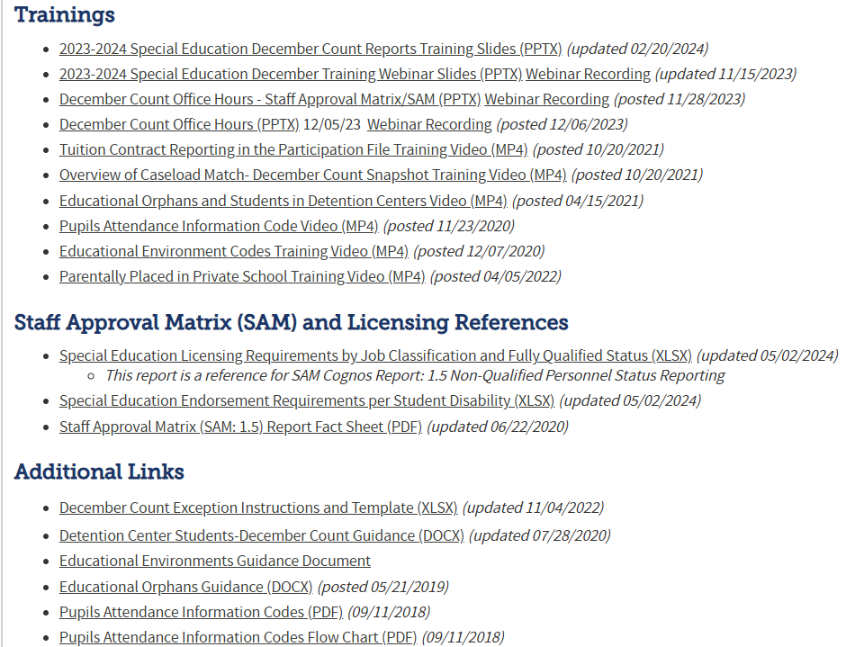
December Count: Snapshot Resources Webpage
Special Education December Count Snapshot Resources
December Count Snapshot Training(s)
Staff Approval Matrix Training slides
Includes short training videos on these topics:
Tuition Contract Reporting
Overview of Caseload Match
Pupils Attendance Information Codes
Ed Orphans and Detention Center Students
Ed Environment Codes
Parentally Placed in Private School
SPED Licensing Requirements by Job Code
SPED Endorsement Requirements per Student Disability
December Count Exception Template
Detention Center Students – Guidance Doc
Educational Environment Guidance Doc
Pupils Attendance Information Codes
Pupils Attendance Information Codes Flow Chart

Slide 17
Special Education December Count: Snapshot File Layout and Definitions Document
Special Education December Count Snapshot Webpage
Find which data fields are being pulled into this snapshot
*not all fields from your Participation file pull into the December Count Snapshot
Criteria for records being pulled in
Name of each field in both the Student and Staff Snapshots
Source interchange and source file the data is pulled from
Ex: Grade level comes from Student Interchange – SSA file
Secondary interchange and secondary file the data is pulled from if record doesn’t exist in the primary interchange
Ex. Approved facility school student records are not generally submitted in the Student Interchange
Helpful remarks/details
Internal flags– fields calculated from existing data fields
Ex: Federal Race and ELL Status

Slide 18
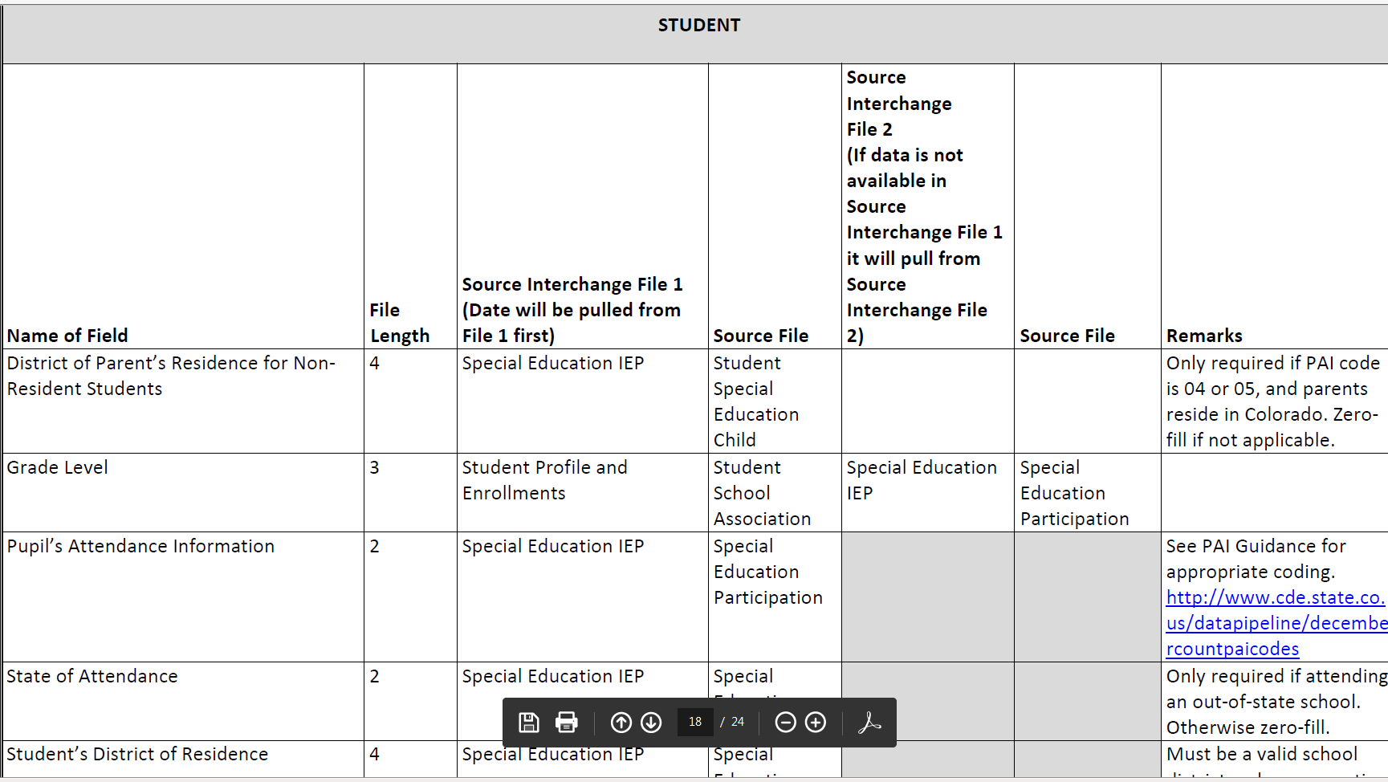
Snapshot File Layout – lists source interchange and source file data pulls from

Slide 19
December Count Staff and Student Snapshot Criteria
Staff records will be included in the snapshot when:
Records are error-free in the Staff Interchange
Staff Assignment File -Special Ed Assignment Flag = 1
AU code is populated in both Staff files
Start date of Assignment is <= 12/01
End Date of Assignment is blank or > 12/01
Employment Status Code = 11, 12, 13, 23, 25 or 26
The Staff Profile and Staff Assignment Association File will be joined based on the following criteria: School year, EDID, Sped Assignment Flag = 1, District (or Admin Unit), and error-free records.
Student records will be included in the snapshot when:
Date of Entry to SPED is <= 12/01
Date of Exit from SPED is zero-filled or > 12/01
OR Parentally Placed in Private School is 02
Pull all error-free records meeting above criteria from the SPED Participation file and match them with records in the Student Interchange. Student Interchange is the authoritative source for: SASID, LASID, First Name, Middle Name, Last Name, Gender, Date of birth, Ethnicity, Race and Grade level.
Data from the Student Interchange will pull primarily from a DEC tagged file. If the district has not tagged a file for DEC, it will pull from the latest student DEM file uploaded and the grade will pull from the SSA file and record with the latest School Entry Date.
If student record is not required to be submitted in the Student Interchange, the demographic data and grade level will pull from the Child and Participation files.
The Child file, Participation file and Student DEM files will be joined based on the following criteria: SASID, LASID, school year, district (or Admin Unit), and error free records.

Slide 20
December Count Snapshot Fields Sourced Primarily from Student Interchange Files
Student Interchange- District Sourced Fields
Student Demographic File
*LASIDs must match for these fields to pull primarily from Student Interchange
SASID
LASID
Student First Name
Student Middle Name
Student Last Name
Student Gender
Student Date of birth
Student Ethnicity
Student Race
Student School Association File
*Grade will pull primarily from Student Interchange if record is included in the SSA file
Grade Level
Data from the Student Interchange will pull primarily into the December snapshot from a DEC tagged file. If the district has not tagged a file for DEC, it will pull from the latest Student DEM file uploaded and the SSA file record with the latest School Entry Date.
Tagging a file for OCT or DEC is not required! An Untagged file works for both snapshots.
*Student’s LASID must match between the Student Interchange and IEP Interchange for the demographic data to be pulled from the Student Interchange into the December Count Snapshot.

Slide 21
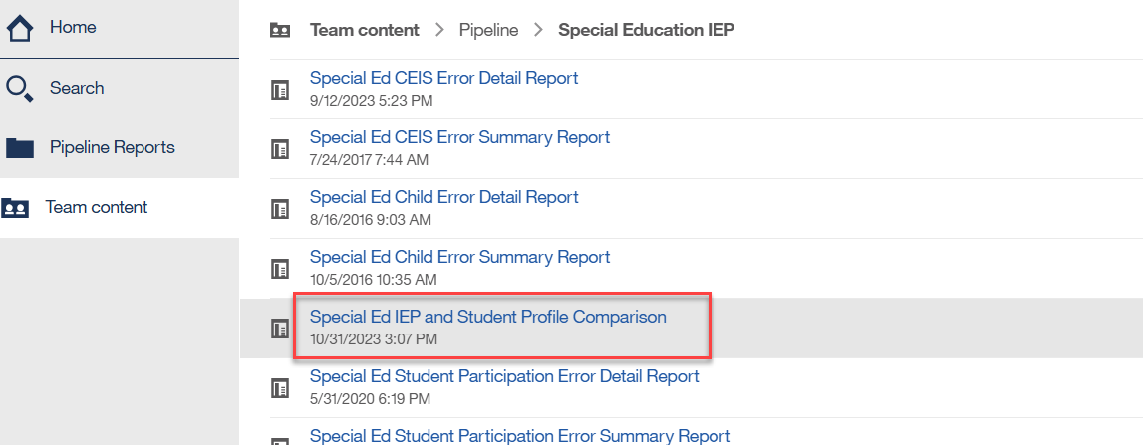
Matching District LASIDs – Why is this so important?
Districts are the authoritative source for race and other demographic fields
If student race is different on December Count vs the race reported in the Student October Snapshot, it can affect risk ratios for Significant Disproportionality
Utilize the Student Interchange and Special Education IEP Interchange Comparison Report – found in Special Education IEP Interchange cognos folder to compare differences in race between the interchanges

Slide 22
Participation File Data Fields and Which Snapshot They Pull Into
Fields in BLACK pull into both snapshots
Fields in RED only pull into December Count Snapshot
Fields in GREEN only pull into Sped EOY Snapshot
Special Ed December Count Student Snapshot - status as of 12/01
Special Ed EOY Snapshot - latest status in the school year in your AU
Primary Disability
School Code/Eligible Facility/Detention Code
Special Education Program Code
District of Attendance
Student’s District of Residence
State of Parent's Residence for Non-Residence Students
State of Attendance
Grade Level
SPED Pupil’s Attendance Information
Educational Orphan
Parentally Placed in a Private School
Special Education Funding Status
Educational Environment
Primary Service Provider’s EDID
Secondary Service Provider EDID fields 1, 2, 3, 4
Primary Disability
School Code/Eligible Facility/Detention Code
Special Education Program Code
District of Attendance
Student’s District of Residence
State of Parent’s Residence for Non-Residence Students
State of Attendance
Grade Level
Date of Entry to Special Education
Date of Exit from Special Education
Hours of Special Education Services per Week
Total School Hours per Week
Extended School Year Services
Basis of Exit
Special Education Referral Type
Current Eligibility and Services

Slide 23
Participation File Data Fields and Which Snapshot They Pull Into: Path 2 and 3 Data Fields – Sped EOY only
Special Education EOY Snapshot Path 2 Data Fields
Special Education EOY Snapshot Path 3 Data Fields
Date Child is Found Eligible for Part C Services
Date of Referral to Administrative Unit from the Local Community Centered Board
Date of Parental Consent to Evaluate C to B
Date Evaluation Completed C to B
Reason for Delay in Completing the Evaluation C to B
Date of Initial Eligibility Meeting
Reason for Delay in Initial Eligibility Meeting C to B
Date IEP was Implemented C to B
Reason for Delay in IEP Implementation C to B
Eligibility and Services Path 2
Date of Parental Consent to Evaluate Part B
Date Evaluation Completed Part B
Reason for Delay in Completing the Evaluation Part B
Date of Initial Eligibility Meeting Part B
Date Initial IEP was Finalized Part B
Reason for Delay in Finalizing the Initial IEP Part B
Date IEP was Implemented Part B
Reason the IEP was Never Implemented Part B
Eligibility and Services Path 3
The edits for these data fields are switched to warnings during the December Count timeframe!

Slide 24
Special Education IEP Interchange- Student Data/Content

Slide 25
Who to Report for December Count
Students in Special Ed who have begun receiving services per an IEP as of 12/01/2024
includes students attending public schools, on-line schools, non-public schools, private facilities, approved facility schools, detention centers, or Sped Programs located within your Administrative Unit and resident students who attend in other Administrative Units.
Parentally Placed Private School Students with a disability – those receiving services per an IEP, ISP, and those not receiving services from the AU (ages 3 -21)
Be sure to include:
All AU residents, regardless of where they attend
All students who attend your AU, regardless of where they live
Resident students who are attending an approved facility school (located anywhere in the state)
Resident students on a contract agreement with a public school, Sped Program, non- public school, Head Start, public or non-public agency, private facility
any possible educational orphans in a residential facility within your AU

Slide 26
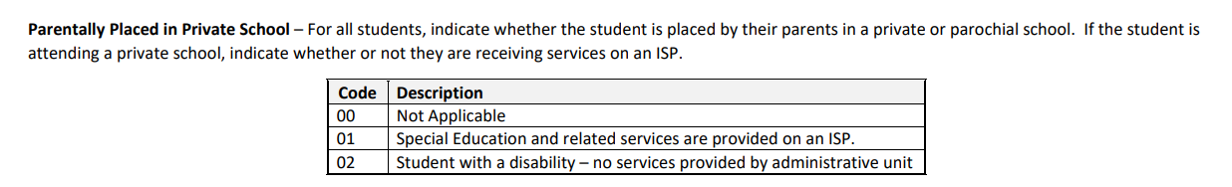
December Count: Private School Student Reporting Tips
PPPS (Parentally Placed in Private School) Field reporting guidance:
Reach out to non-public schools located within your AU boundaries- list posted here https://www.cde.state.co.us/datapipeline/org_orgcodes
Please include students who attend a private school within your AU boundaries and receive services on an ISP. Report like any other student on an IEP and the Parentally Placed in Private School field (PPPS) should =01.
Please include students who attend a private school within your AU boundaries and receive no services whatsoever from the AU. Report with a zero-filled SASID and Sped Referral Code and the Parentally Placed in Private School field (PPPS) should = 02.
Students who are Individual Education Plan (IEP) Team placed in a private school should be reported with PPPS=00. IEP Team placed students have an IEP and are funded on December Count.
These are both reported for proportionate share calculations on two Dec reports.

Slide 27
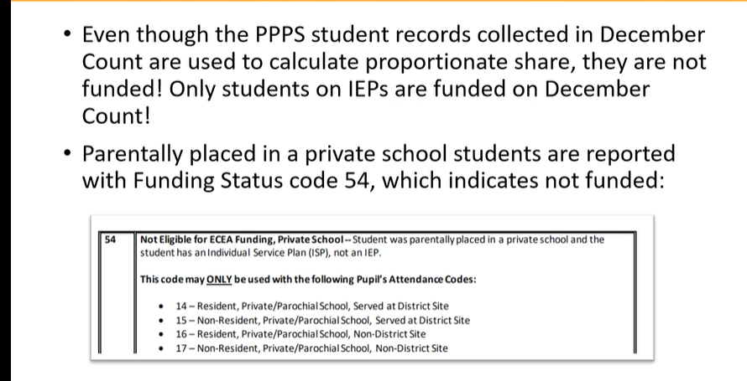
PPPS and Funding Clarification

Slide 28
How the coding differs between PPPS = 01 and 02? December Count
PPPS = 01 Special Education and related services are provided on an Individual Service Plan (ISP)
PPPS = 02 Student with a disability – no services provided by AU
28

Slide 29
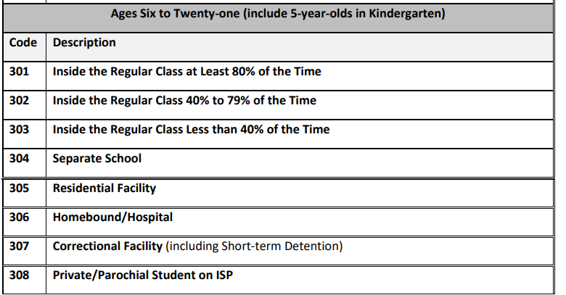
Educational Environment Codes
Educational Environment (also known as Setting Code):
is a 3-digit code representing the major (more than 50% of the student's special education program) instructional setting.
depends on the age of the student as of December 1st, with the exception of 5 year-olds
General Coding Overview:
300 level code options and descriptions:
Early Childhood ages 3-5 | Must be reported with 200 level codes (Excludes 5 year-olds in Kindergarten)
School Age ages 6-21 | Must be reported with 300 level codes (Includes 5 year-olds in Kindergarten)

Slide 30
Pupils Attendance Information Code (PAI Code)
SPED Pupil’s Attendance Information (PAI Code) –
A code from either the “A” or “B” grouping depending on whether the student was attending an educational program operated by the reporting Administrative Unit (A), or student was a resident of the AU and attending an educational program not operated by the reporting Administrative Unit (B).
A - side:
Pupils Attending an Educational Program Operated by the Reporting Administrative Unit, including students served under Schools of Choice and on a tuition contract.
Students attending in the AU
Use codes 01 - 17
Operated by the reporting AU
State Operated Programs must use code 19 for their students
B - side:
Resident Pupils Attending an Educational Program Not Operated by the Reporting Administrative Unit. Do not include students served by another administrative unit under Public Schools of Choice, even if you are paying tuition.
Resident students attending outside the AU
Use codes 22 – 32
Not operated by the reporting AU
Report students based on where they receive their educational services

Slide 31
List of A – Side and B – Side PAI Codes
A-Side District of Attendance Reporting |  | B-Side District of Residence Reporting
01 | Resident, Designated School | n/a | n/a
02 | Resident, Open Enrollment | n/a | n/a
03 | Resident, Non-District Site | n/a | n/a
08 | Resident, Non-Choice | n/a | n/a
04 | Non-Resident, Choice | n/a | n/a
n/a | n/a | 22 | Licensed Eligible Facility Attending On-Grounds School (Approved Facility School)
05 | Non-Resident, Non-Choice | 23 | Licensed Facility, Attending Public School
11 | Non-Resident, Detention Center | 24 | Court-Mandated Juvenile Detention
n/a | n/a | 27 | Non-Oublic School (Contractual Agreement)
n/a | n/a | 28 | Outside of CO, Public Education Agency
n/a | n/a | 29 | Outside of CO, Non-Public School
n/a | n/a | 30 | CO Public Agency (Contractual Agreement)
12 | Non-Resident Administrative Unit Placement | 31 | Administrative Unit (Contractual Agreement)
14 | Resident, Served at District Site | n/a | n/a
15 | Non-Resident, Served at District Site | n/a | n/a
16 | Resident, Non-District Site | n/a | n/a
17 | Non-Resident, Non-District Site | n/a | n/a
19 | State Operated Program | 32 | State Operated Program (AU of residence reporting is optional)

Slide 32
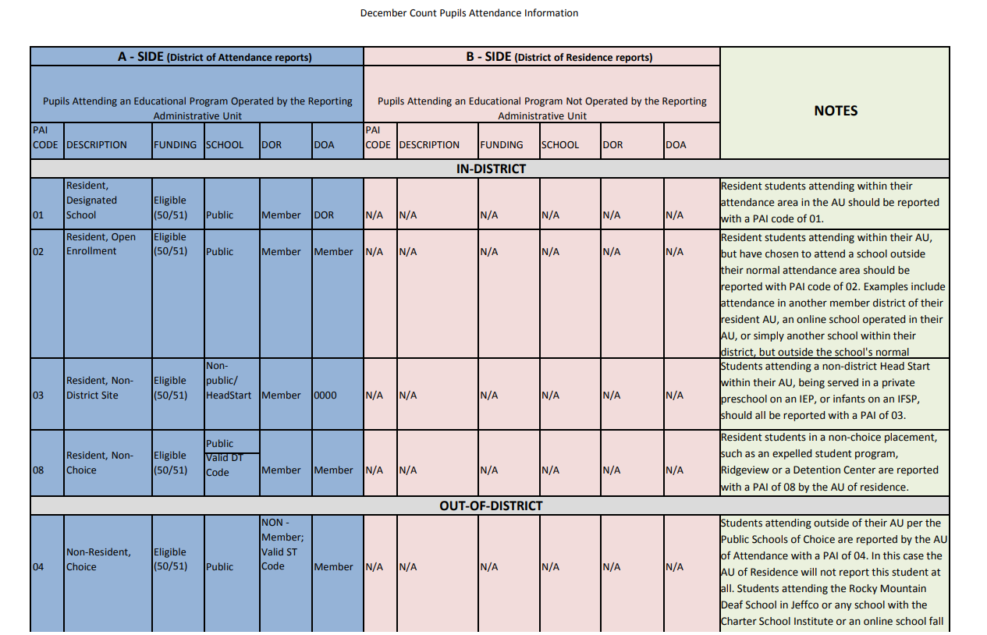
PAI Codes – Please Print for PAI Coding Help
Information on how to report these fields:
School Code
PAI Code
Funding Status
District of Attendance
District of Residence
Helpful coding chart with notes about each code:
http://www.cde.state.co.us/datapipeline/decembercountpaicodes

Slide 33
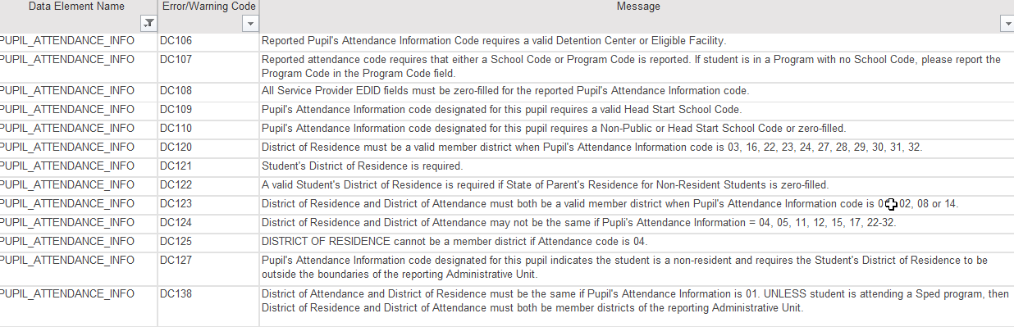
PAI Code Snapshot Errors: Coding Student Records
What type of school is it? Check for correct school code and school type
How did student come to attend that school? parentally placed, choice, etc.
Determine the student’s District of Attendance Code
Determine the student’s District of Residence Code
Use school, DOA, and DOR codes to determine applicable PAI Code
Use PAI Coding Chart to determine Funding Status Code

Slide 34
Funding Status Codes
Funding Status Codes
Only codes relevant for Special Education are listed here
50 | Eligible for ECEA Funding | For use with PAI codes 01, 02, 03, 04, 05, 08, 11, 19, 22, 24, 27, 28, 29, 30, 31
51 | Not Eligible for ECEA Funding, Lapsed IEP | For use with PAI codes 01, 02, 03, 04, 05, 08, 11, 19, 22, 24, 27, 28, 29, 30, 31
52 | Not Eligible for ECEA Funding | For use with PAI codes 23, 24, 32
53 | Not Eligible for ECEA Funding, Tuition Contract | For use with PAI code 12
54 | Not Eligible for ECEA Funding, Private School | For use with PAI codes 14, 15, 16, 17
55 | Not Eligible for ECEA Funding, Detained Student | For use with PAI code 11
Participation File Layout pages 26 – 29. Found on the Special Education IEP Interchange webpage
This field will be used to determine if the student record being submitted is eligible for ECEA (Exceptional Children's Educational Act) funding.
NOTE: Students with lapsed IEP’s (code 51) are not fundable!

Slide 35
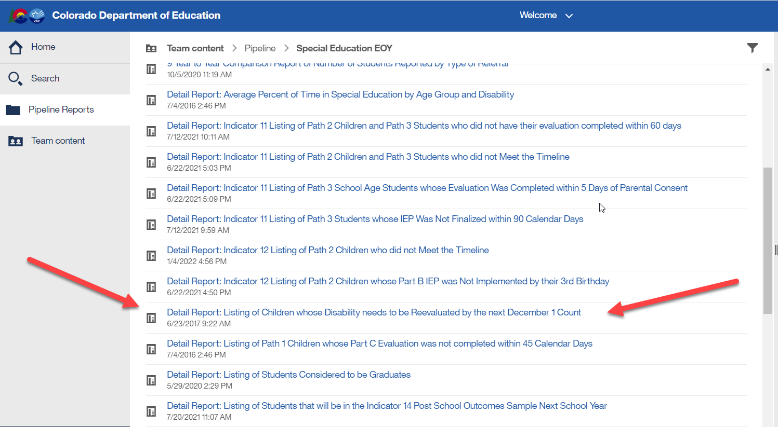
Special Education December Count: Find Students Whose Disability Needs to be Reevaluated by 12/01
Cognos Reports -> Special Education EOY folder:
‘Detail Report: Listing of Children whose Disability needs to be reevaluated by the next December 1 Count’
Download from Sped EOY cognos folder 23-24 collection year

Slide 36
Staff to Student Caseload Match
Every IEP Student Participation File record must have a Primary Provider EDID of a 202 or a 238
Two distinct caseload match processes exist for Special Education Teachers (202) and Speech-Language Pathologists (238):
Grade Caseload Match in the Data Pipeline
happens when a Snapshot is created
grades marked “Yes” in the staff assignment record must exactly match the grades of students in the IEP Participation file
Disability/50% Caseload Match in SAM (Staff Approval Matrix)
Primary provider staff must hold an appropriate special education endorsement for the majority of student disabilities in the IEP Participation file
Student caseload for SAM is based on the staff EDID reported in the Primary Provider field in the IEP Participation file.
Staff EDID reported in any one of the four Secondary Provider fields do not generate a student disability caseload.

Slide 37
Special Education December Count: Troubleshooting Errors DC191 – DC205 (grades of staff and students served must match)
DC191 thru DC205 – these errors look at each individual grade level and compare student grades to grades marked on the staff assignment records.
What to check:
Use Cognos Reports/Special Education December report “Included Snapshot Records: Staff Interchange” to compare grades for your student and staff snapshot records
Cognos Reports/Special Education December Included Snapshot Records: IEP Interchange
Cognos Reports/Special Education December Included Snapshot Records: Staff Interchange
In the IEP snapshot records report, filter/search all 5 EDID fields for each EDID triggering one of the DC191-DC205 error codes and then highlight all student records this staff member is attached to. Then check/highlight the the Entry Grade Level fields to reference all student grades being served by that EDID. Similarly, you can pull up the Staff snapshot records to reference all grade levels marked with 1 on the staffs record(s).

Slide 38
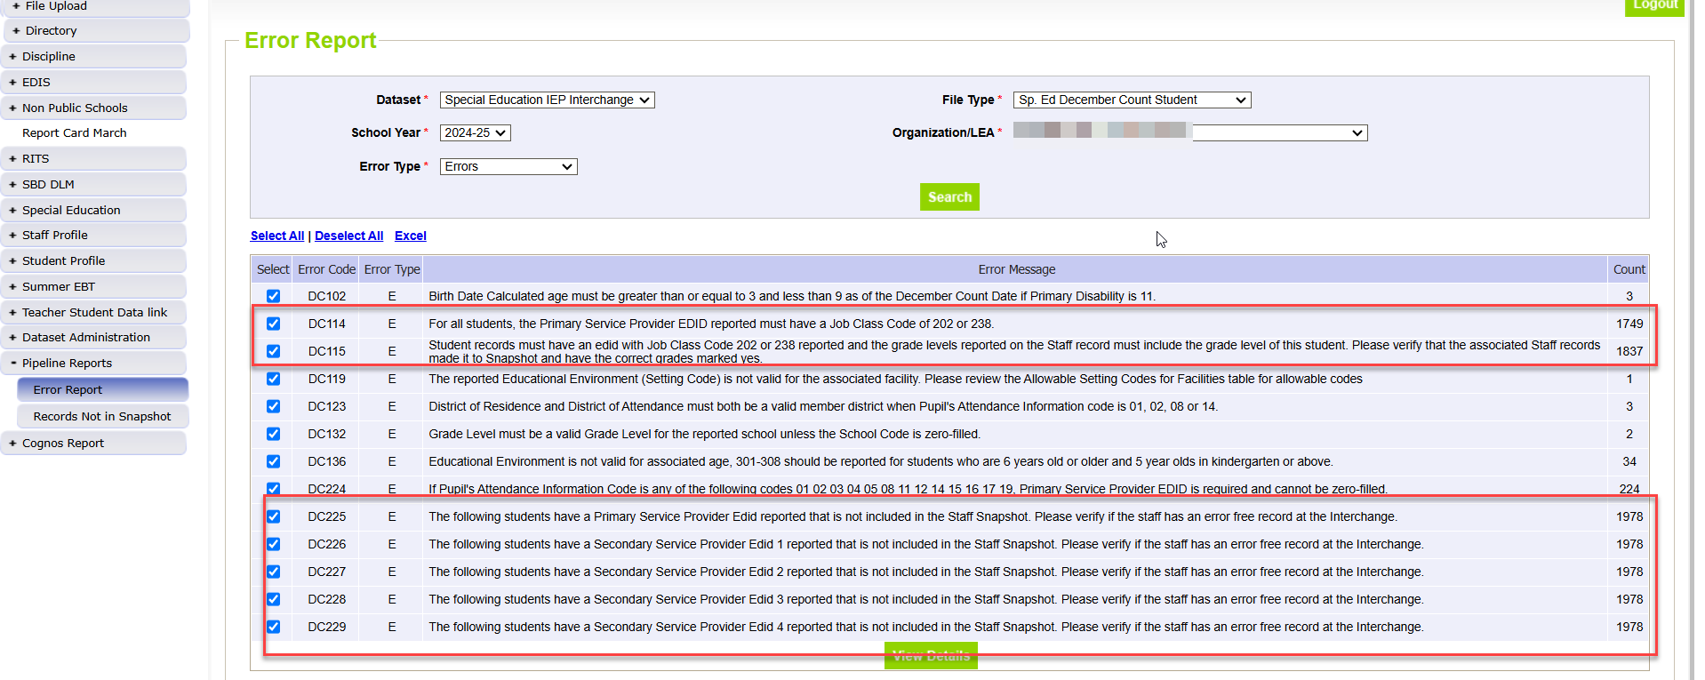
Sped December Count Student: Errors Related to Missing Staff Records

Slide 39
Staff Interchange: Staff Data/Content

Slide 40
Staff Records to Include in December Count Snapshot
Include:
all Special Education staff employed by the district(s) or BOCES
full or Part-time including teachers, paraprofessionals, special service providers
Administrators, support staff, IT, office/clerical
purchased service/contract staff (link to form with more details on what fields are required)
Exclude:
staff that do not support the education of students with disabilities, such as regular education teachers (they pull into the Human Resources snapshot)
substitutes unless they are long term (90 days or more in the same classroom)
temporary workers, such as after school coaches

Slide 41
Staff Interchange Files
Staff Profile
General information per staff
Only 1 record per staff
Must be uploaded first
District Code field - report district code or BOCES code that issue the paycheck
*IMPORTANT: for how data is pulled and displayed for the Staff Evaluation Snapshot
Staff Assignment
Provides specifics to actual duties and locations
multiple records allowed per staff member
District status report found under Cognos Reports/Special Education December Count (DEC role):
Staff: District/AU Activity Report
Lists the status of all Staff Profile and Staff Assignment file uploads
Breaks it out by district and AU

Slide 42
Staff Assignment File Overview
Multiple records are allowed per person based on
Special Education Status
Job Class Code (report a record for each job role staff are fulfilling)
School Code
Teachers (202’s) should break out separate Staff Assignment records for each school served 3 or less
Teachers serving 4 or more schools may be reported with school code 9980 – district wide.
SSPs may be reported with school code 9980- district wide (238, 236, 237)
Administrator Instructional Area (AIA Code)
Must break out preschool staff with AIA 0035
When reporting 2 or more records for a staff member…
Base Salary would be split accordingly
Hours per day would be split accordingly
Contract days would not be split

Slide 43
Special Education December Staff: Grade Caseload Match
All SPED staff must report grade level(s) served
Staff serving district wide may mark all grades as 1
Separate assignment record is required for staff serving- must break out AIA Codes:
Pre-K grade (AIA 0035 Early Childhood/Prekindergarten – except for 211)
Grades K, 1, 2 (AIA 0041 Early Childhood/Elementary)
Grade K only (AIA 0036 Kindergarten)
EDIDs reported in both the Primary Provider and Secondary Provider fields (student IEP Participation File data) compile into the grade caseload match for 202 and 238 staff records.
Note: Early Childhood Special Education (age level 0-8) endorsement is appropriate for services to students in grades PreK through 2 only. For SAM to determine qualified status, a separate assignment record for elementary grades K, 1, 2 (any combination of these grades) is reported with AIA 0041.

Slide 44
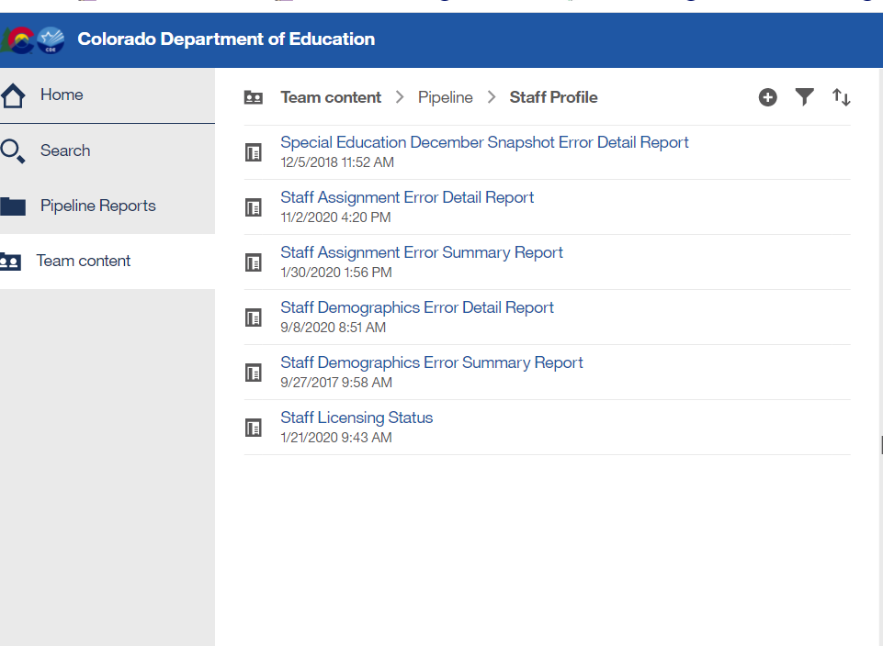
Special Education December Count – Report available for Staff Interchange User to see Dec snapshot errors
Staff Interchange Users and Viewers are able to see their district’s December Count snapshot errors by downloading this report under:
Cognos Reports- Staff Profile- Special Education December Snapshot Error Detail Report
Those with the STF role have access to this error report

Slide 45
Staff Approval Matrix (SAM)
The Staff Approval Matrix (SAM):
is an automated process in the December Count
warnings that trigger when a Sp Ed Dec Count Snapshot is created
found under your Sp Ed Dec Count Staff Snapshot warnings report
pulls in data from the Staff Assignment and IEP Interchange files
connects staff data with Educator Licensing and EDIS records via the reported SSN
determines qualified/non-qualified status for positions requiring a CDE license
Triggers DEC Staff snapshot warnings DC208, DC209, DC210, and DC211

Slide 46
SAM Warnings
SAM Warning DC208 – Staff did not hold a valid license on 12/01
Remind staff to renew their license
SAM Warning DC209 – Staff does not hold an appropriate endorsement for the assignment
Check to be sure you are reporting the correct job code
SAM Warning DC210 – Staff does not hold an appropriate endorsement for the caseload
Check to be sure the primary providers/job codes are correct (i.e. students with disability type 08 or 11 must have a primary provider with a 238 job code)
SAM Warning DC211 – Staff does not hold a valid license
Check to be sure SSN is correct in COOL system and on your Staff Assignment file and in EDIS system

Slide 47
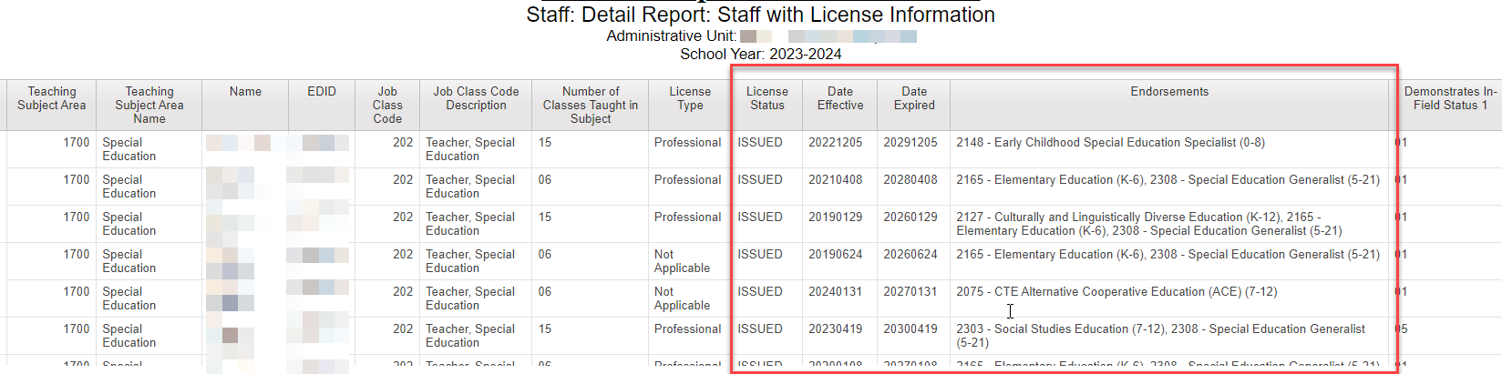
December Count – Proactively Find Expired Licenses
Find expired or expiring teacher (Job Code 202) licenses before the December Count date
Renewal applications must be submitted to Educator Licensing before December 1st
Cognos Reports -> Special Education December -> Staff:Detail Report: Staff with License Information
Export the report to Excel and sort by “Date Expired” column
Follow up with any teacher employed in your AU or district whose license or credential will expire before 12/1/24 and ask them to submit their renewal application as soon as possible and before 12/01/2024

Slide 48

SNAPSHOT PROCESS

Slide 49
Special Education IEP Interchange: Dec Count data collection process for Enrich users
SIS
I.C., PowerSchool, etc
SIS = student information system
Enrich/Frontline
Includes most Child File and Participation File level 1 edits (these should mirror the Pipeline)
Data Pipeline/CDE
IEP Interchange level 1 edits (full edit list - includes additional edits)
December Staff and Student Snapshot level 2 edits
IEP student data system
State reporting system
OFFICIAL ERROR SOURCE
Some data changes should be made here (codes can differ for Sped reporting)
24-25 Child Count – click ‘Send to CDE Data Pipeline’ to transfer files to Data Pipeline system
Child File and Participation File
Verify date range under Collection Settings 7/1/24 – 6/30/25
Some data changes should be made here

Slide 50

Step 1: UPLOAD INTERCHANGE FILES OR VERIFY THEY HAVE BEEN UPLOADED
IEP
Staff
Student
Step 2: Check and resolve Interchange errors for IEP files (and Staff Files if AU is uploading Staff dAta)
Step 3: create Sp Ed Dec Count snapshot and wait for Email confirmation
Step 4: Download DEC STUDENT and DEC STAFF error reports and work with staff respondent on changes needed
Step 5: UPLOAD UPDATED INTERCHANGE FILES and go through steps again

Slide 51
Snapshot Steps
Prior to creating a Sp Ed Dec Count snapshot:
Verify that all 4 files are uploaded and have processed successfully:
Child, Participation, Staff Profile, Staff Assignment
Using:
District/AU Activity Report -->Cognos Reports/Special Education December Count
If you have the STF viewer role, you have more options for viewing in the system:
Batch Maintenance screen
Email confirmations
Status Dashboard
Ideally files are error free, but not required to create a snapshot

Slide 52
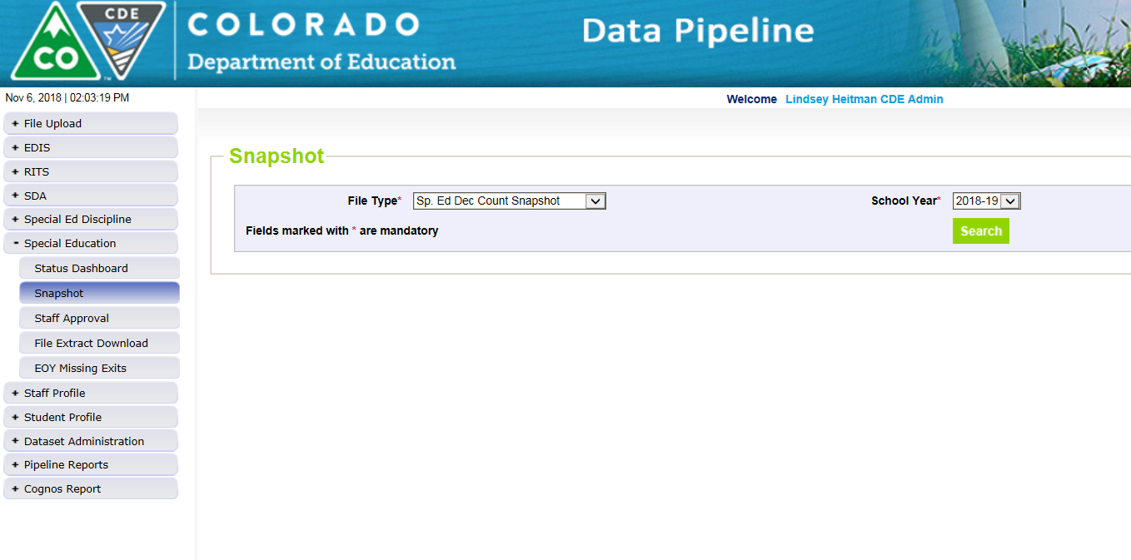
How to Create a Special Education December Count Snapshot
1. Click on Special Education tab
2. Click Snapshot from expanded list
3. Select File Type – Sp. Ed Dec Count Snapshot
School Year – automatically populates with 2024-2025
Organization/LEA – automatically populates based on IdM role
4. Click Search and then screen will display the Create Snapshot green button.
5. Click Create Snapshot button.
you should see a message display across the top left in green: “Snapshot creation triggered and processing. A notification email will be sent upon completion”
Watch for snapshot email confirmation. Snapshot is not finished
processing until confirmation email is sent

Slide 53
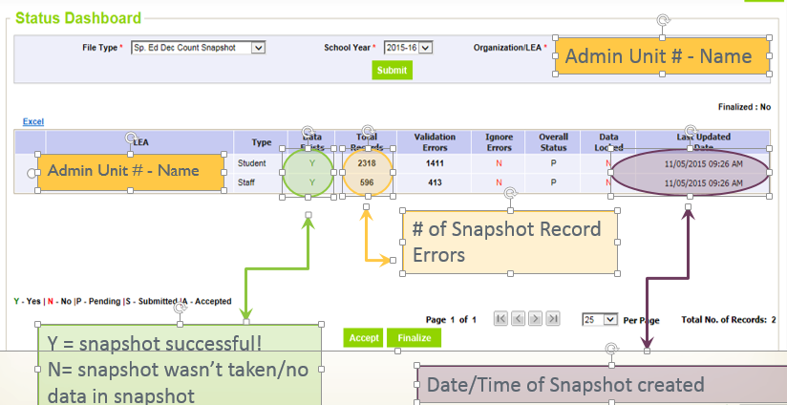
Check Status Dashboard for Dec Student and Staff Snapshot Details
*Email confirmation is the green light for checking status dashboard!
Checking the Status of the Snapshot
Click Special Education->Status Dashboard:

Slide 54
Reviewing Snapshot Errors
Options for viewing errors:
Pipeline Reports - Error Reports/Special Education IEP Interchange
File Type: Sp. Ed December Count Staff OR
File Type: Sp. Ed December Count Student
Cognos Reports – Special Education December Count
Errors: Student Detail Report of Errors to Correct
Errors: Staff Detail Report of Errors to Correct
The list of all December Count Student and Staff Business rules (errors and warnings) can be found at: http://www.cde.state.co.us/datapipeline/snap_sped-december under the ‘Business Rules’ section.

Slide 55
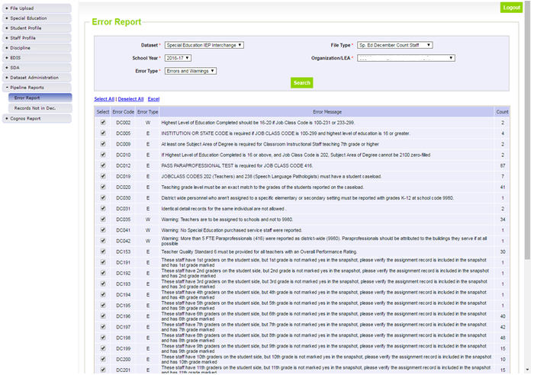
Pipeline Error Reports
File Type may be:
Sp. Ed December Count Staff OR
Sp. Ed December Count Student
Both are ‘DC’ error codes

Slide 56
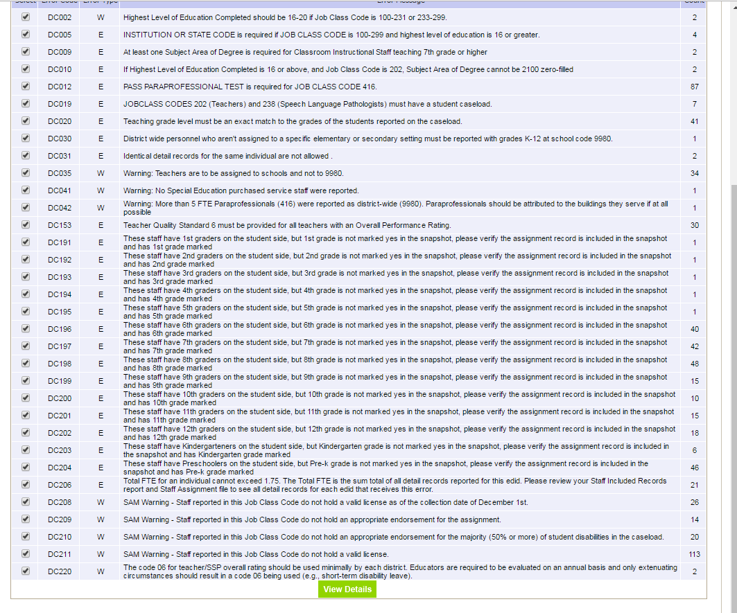
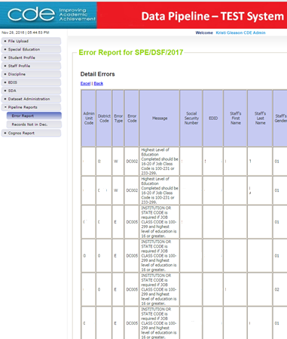
Click Excel
Pipeline Error Report:
Viewing detail error records in Excel
*Only shows first 1000 errors
Click View Details

Slide 57
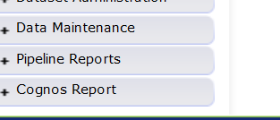
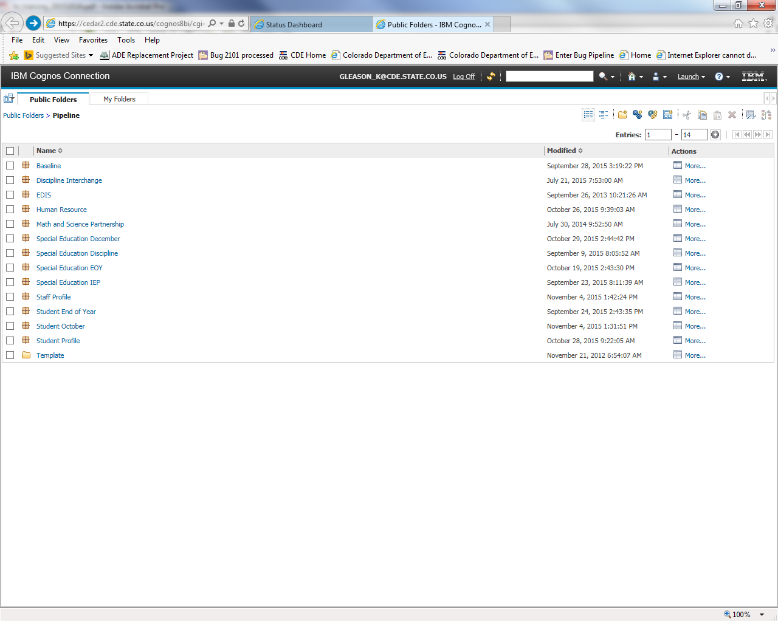
Cognos Reports – option for checking snapshot errors
Opens new window
Special Education December

Slide 58
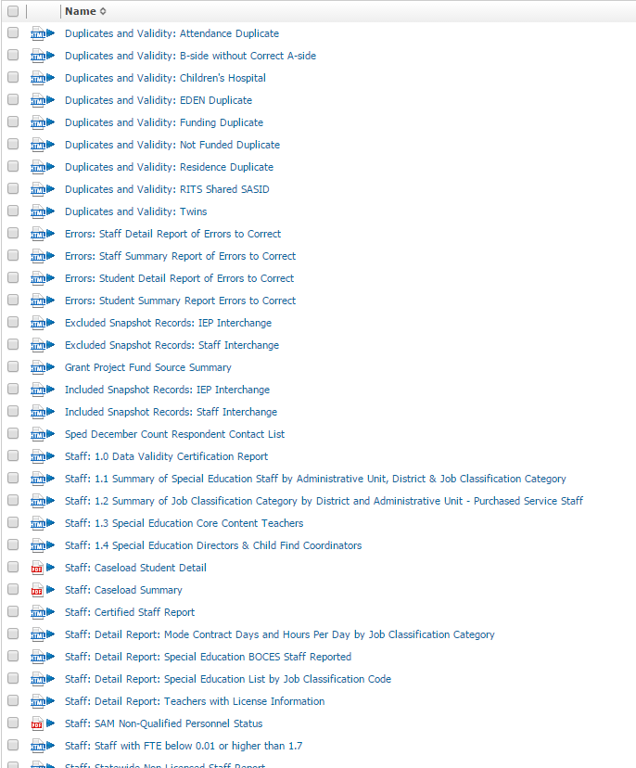
Error Reports: Staff and Student have separate reports
Special Education December Cognos Reports
-->Cognos Reports/Special Education December
Excluded Report: Includes excluded records – those w/ interchange errors

Slide 59
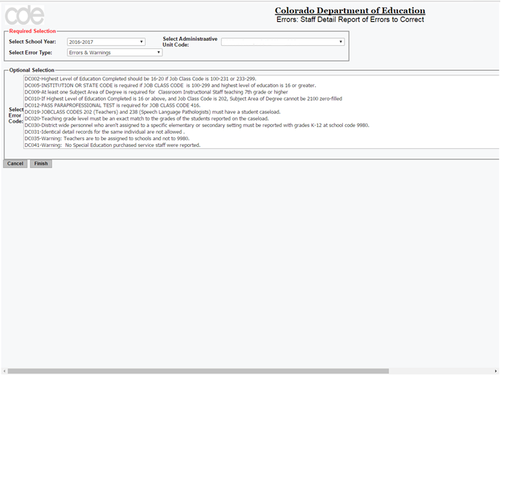
Cognos Error Reports

Slide 60
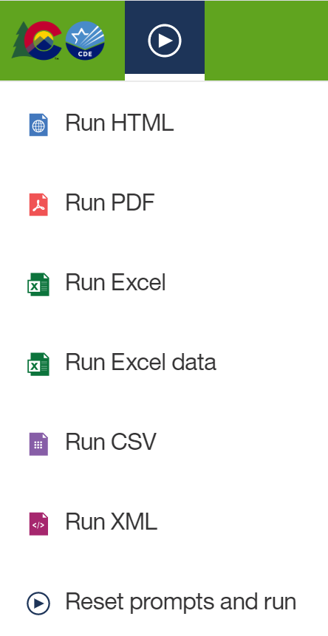
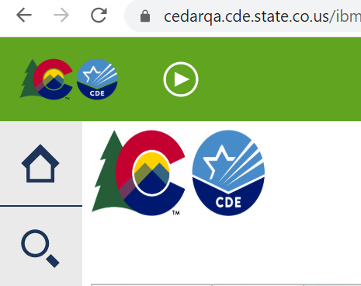
Exporting Cognos Report to Excel
Click on ‘Play’ Button
(available when a report is showing)

Slide 61
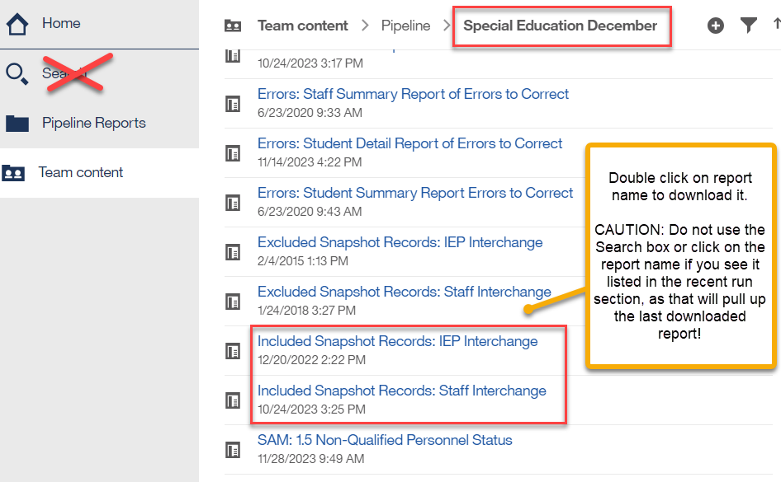
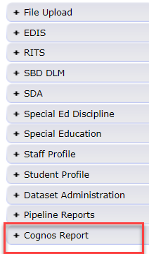
Special Education December Count Snapshot Records Reports
These are your December Student and December Staff Snapshot records.
This is the data you will ultimately approve and submit to CDE.
These reports contain all records in your final snapshots and can be run for any school year going back at least 10 years.
You can use these reports for internal data requests, to compare and search various data fields, and to see which records are pulling into your snapshot.
I recommend saving a copy of these reports for each snapshot (once final).

Slide 62
December Count Snapshot Error Exceptions
The Special Education December Count has 5 Allowable Exceptions.
If you receive one of the following errors, it will be necessary to send CDE an Exception. You will find the exception template under Additional Links here: http://www.cde.state.co.us/datapipeline/snap_sped-december
Student:
DC104 Age is outside of the min/max range for this grade level.
Staff:
DC033 No Special Education Director was reported.
DC043 No Child Find Coordinator was reported.
DC157 FTE total for an individual is outside of 0.005 and 1.71 allowable range
DC206 TOTAL FTE for an individual is outside of allowable range
Please see the Instructions tab for directions in completing the exception template. Paste the template into your AU # Syncplicity folder and let us know via email to look for it. Once approved, CDE will upload the exceptions and let you know to recreate the snapshot bypassing the business rule for the approved record.

Slide 63
Syncplicity – CDE method for sharing student and staff personally identifiable information
IMPORTANT NOTE
Personally Identifiable information (PII) for students or staff should not be shared through email.
This includes information that when combined is identifiable:
Student and staff names, full SASIDs or EDIDs, SSNs
Syncplicity – platform CDE uses for secure file/information sharing
Syncplicity Help
Please email collection lead if you do not yet have a folder.
Once a file has been shared you can access Syncplicity at: my.syncplicity.com
File name is your AU code # (ex. 16010)
Used for exception requests, questions that include PII, information shared with CDE for AUs
Be sure to email CDE when you’ve placed something in the folder for review.

Slide 64
Data Pipeline Process Overview – IEP Interchange Steps can take place throughout the school year
1. Extract Child File and Participation File from SIS and upload files to Data Pipeline
Enrich system uses web transfer to send both files at once to Data Pipeline (no manual upload necessary in Pipeline)
Enrich users select ‘Child Count 24-25’ option when working on December Count Snapshot
Enrich users select ‘EOY 24-25’ option when working on Sped EOY Snapshot
2. Check Batch Maintenance for file upload status and wait for a confirmation email from Data Pipeline system
The email will show you the number of errors in your upload
NOTE: If the file didn’t process, the email should show you which row of data contains a formatting “error”
3. Check and resolve interchange errors in each file
Many of the same IEP Interchange file errors are found in both the Enrich system and the Data Pipeline system
NOTE: Data Pipeline system is the official error source!
Ideally data field corrections are made in SIS (Enrich, IC, PowerSchool, or other IEP systems used)
Extract revised files and upload revised files to Data Pipeline. Repeat steps 1-3 until interchange errors are resolved.

Slide 65
Data Pipeline Process Overview – Snapshot, Report Review, Final Approval
4. Create Snapshot
It is not required to have ALL interchange errors resolved when you start taking snapshots, but it is recommended. Any records with interchange errors will not be pulled into your snapshot.
5. Check and resolve snapshot errors (review warnings too)
Changes made in SIS (Enrich or other IEP systems) and files reloaded to interchange
Go back to steps 1 and 3 – check for new interchange errors before taking a new snapshot
6. Review reports and make any changes necessary
Go back and redo steps 1 – 4 until all errors are resolved and data is accurate
7. Print reports, sign, and upload signed reports to the Data Management System
8. Approve and finalize snapshot in Data Pipeline

Slide 66

66

