Slide 1
Student October New Respondent Training
2024-2025
Brooke Wenzel
StudentOctober@cde.state.co.us

Slide 2
Agenda
Purpose
Student October Timeline
Summary of Process
  Identity Management
  Student Interchange Files
  Snapshot
  Uploading to Pipeline
  Errors/Warnings
  Exceptions
  Other Reporting Pieces
  Snapshot Creation
  Cognos Reports
  Submit Data to CDE
  Duplicate Process
How the Snapshot Works
2024-2025 Changes
School Auditing Office
Preschool Reporting

Slide 3
Purpose of Student October

Slide 4
Purpose of Student October – PSF Act
Obtain student level data required by state and federal statute
  From the Public-School Finance Act of 1994 (CRS 22-54-101)
  From the Elementary and Secondary Education Act ; reauthorized as Every Student Succeeds Act (ESSA)
Data collected in Student October is used to determine district funding
  Visit this webpage for details
Also used for school and district demographic data reported to the federal government as a part of EDFacts

Slide 5
Purpose of Student October - Many Others!
Data from Student October is also used in reports, grants, news articles, and official decision making about schools, districts, and the state.
Student October is meant to be a snapshot in time that gives a general overview of education in Colorado.
Accuracy is paramount
  CDE wants to make sure that districts receive the correct amount of funding
  That demographic reports accurately represent school and district populations
  And finally, accurately reported English Learner (EL) student data is necessary for Federal and State reporting as well as for state funding through ELPA (English Language Proficiency Act)

Slide 6
Ensure Accurate Data
Complete the basics of the collection early (Get files error free and create snapshots by the middle of October)
An error free snapshot does not guarantee accurately reported data
Review, Review, Review!
Make sure exception requests are needed before submitting them!
Pull in Subject Matter Experts to assist with verifying data (Finance Department, English Learner Department, Special Education, Registrar)
COGNOS Reports for verification
How to ensure your data is accurate?

Slide 7
2024-2025 Student October Timeline/Trainings

Slide 8
Data Collection and Cleanup Phase Timeline
Date | Event | Event Description
07/15/2024 | Open | Districts may begin uploading Student Interchange Files (Student Demographic and Student School Association).
08/23/2024 | Open | Districts may begin creating snapshots. Student October Snapshot dependencies are the Student Demographic File, Student School Association File, Title I File (if applicable) and At-Risk File.
08/28/2024 | Training Event | Data Pipeline Training 10-11 a.m.
09/05/2024 | Training Event | New Respondent Training 1-2 p.m.
09/10/2024 | Training Event | English Language Learner Training 11-12 p.m.
09/12/2024 | Training Event | Veteran Respondent Training 11-12 p.m.
09/16/2024 | Training Event | Postsecondary Program Coding Training 11-12 p.m.
09/24/2024 | Other Date | First day of Student October Count Window for districts with 5-day school week.
10/01/2024 | Other Date | Official Count Day 2024
10/02/2024 | Interim Deadline | Upload Student Demographic and Student School Association Files. Upload Title I Interchange File (if applicable). Upload At-Risk Interchange File.
10/08/2024 | Other Date | Last day of Student October Count Window for districts with 5-day school week.
10/09/2024 | Interim Deadline | Error free Student Interchange File uploads
10/14/2024 | Training Event | Mid-Collection Office Hours 10-11 a.m.
10/14/2024 | Interim Deadline | Create an initial Student October Snapshot
10/22/2024 | Interim Deadline | Error free Student October Snapshot
10/24/2024 | Training Event | Data Validation, Transfer Enrollment Exceptions and Cognos Reports 1-2 p.m.
10/28/2024 | Training Event | Data Pipeline Duplicate Process and Submission 9-10 a.m.
11/01/2024 | Report Review | Review Student October Cognos Reports for data validation. Submit Student October Snapshot data as soon as review is complete.
11/08/2024 12:00 p.m. | State Deadline | Submit Student October Snapshot data

Slide 9
Duplicate Count Phase Timeline
Date | Event | Event Description
11/12/2024 12:00 p.m. | Deadline | Duplicate funding documentation due to School Auditing Office
11/18/2024 | Other Date | School Auditing makes decisions on funding duplicates
11/27/2024 | Deadline | Resubmit Student October Snapshot data to CDE based on decisions from School Auditing
12/06/2024 | Deadline | Collection closes Secretary of the Board of Education Verification (sign-off) form due. Data remains embargoed until the official release in January.
01/15/2025 | Data Release | Official data release
General Duplicate Count Process
  Begins once all districts have submitted their Student October Snapshot to CDE, Friday, November 8th
  ~3 business days after running the duplicate process Duplicate Documentation is due to The CDE School Auditing Office
  ~2 business days after documentation received decisions will be sent to districts
Signature Page
  Due Friday, December 6th: Signed by Secretary of Board of Education AND the Chief Financial Officer
    If your district needs an extension, please send Student October Collection lead an email with the day when your School Board Secretary will be able to sign the form

Slide 10
Summary of Process

Slide 11
Identity Management (IDM)

Slide 12
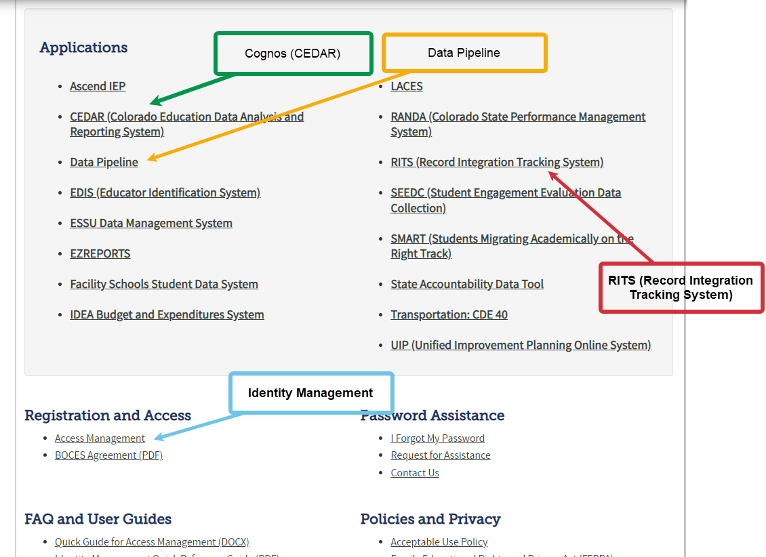
CDE Application Login
IdM Website
Application | Collection | Role | Access Level
Pipeline | Student Interchange | LEA User | Upload and Edit Records for the Student Demographic, School Association, and Graduation Guidelines files
Pipeline | Student October | LEA User | Create Snapshot - cannot submit
Pipeline | Student October | LEA Approver | Create Snapshot and submit
Pipeline | Any | LEA Viewer | View Cognos reports – cannot edit
Pipeline | Title I Interchange | LEA User | Upload and Edit Records
Pipeline | At-Risk Interchange | LEA User | Upload and Edit Records
Notes:
This is our Identity Management System (commonly called IDM). IDM is a one stop shop to all CDE applications including Data Pipeline which you will ultimately use to upload the Student Interchange files as well as other collection data. Please get this webpage book marked, saved or whatever you need to do to remember this site! The IDM page also has a link to RITS (Record Integration Tracking System) which is our system used to track SASIDs for students as well as CEDAR (Colorado Education Data Analysis and Reporting System) commonly called Cognos which creates reports based on the data provided in Data Pipeline to validate data. Reports within this system have many purposes depending on the collection you are working through. There is also a link to Access Management (which we also call Identity Management) which is how you will get registered for these various applications and how you be able to log into Data Pipeline.

Slide 13
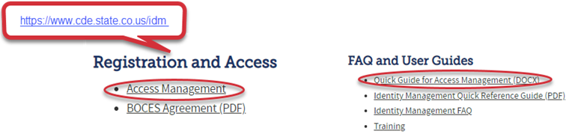
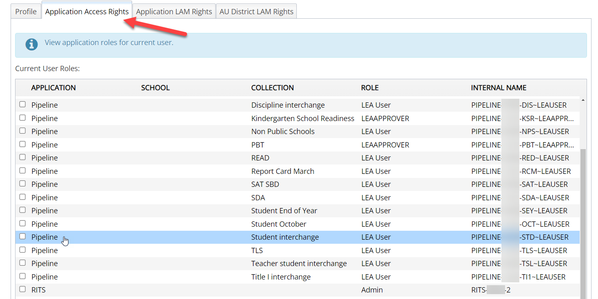
CDE Identity Management
Don’t have access?
Talk to your District’s Local Access Manager (LAM)!
Note: Different roles for different collections
Notes:
In order to dive deeper into account privileges, we must talk about a LAM – Local Access Manager. Each district has a Local Access Manager that is responsible for creating and updating accounts within our IDM system to not only get new colleagues access within Data Pipeline, for example, but also add or remove collection privileges within those accounts. When logging into Access Management, each account will have a tab called “Application Access Rights” which contains a list of collections and the corresponding role the user has for that particular collection. As you can see with this example, this user has many roles withing Data Pipeline for various collections. For our Student Interchange, you must have the STD~LEA USER role (shown highlighted) to edit Student Interchange information within Data Pipeline. STD is the acronym for our Student Interchange and the LEA USER role allows for edit rights. Note that there are other roles within our system like LEA APPROVER, or LEA VIEWER that provide different access rights for that collection. You will want the LEA USER role again for the Student Interchange.

Slide 14
Student Interchange Files

Slide 15
Student Information System (SIS) Extracts
Download reports (files) from your Student Information System
Save each file in an accessible location with naming convention
Upload each file to Data Pipeline (steps shown later)
Student Demographic, Student School Association, Graduation Guidelines (.xlsx is recommended format) – files could be named differently in SIS
Do not open file!
Example: 0110_DEM_10112023.xls (No spaces in file name are allowed)
Keep filing system organized
Notes:
So now you are ready to create extracts from your Student Information System. The first step is to download the Student Demographic file, Student School Association file and Graduation Guidelines files. I have heard that these are commonly called reports in the Student Information Systems. You can do one file at a time, all files, whatever you feel comfortable with. When you extract from your SIS, it should be in a format that Data Pipeline accepts. Do not open your Excel file as this could change the format of the file ultimately causing problems within this file. Next you will save these files (or reports) in a place where you can find again with a filing system and naming convention that makes sense. For example, I have a folder on my desktop for Student Interchange Files. Within that folder, I have subfolders for each of my reports. So, one folder for Student Demographic, one for Student School Association, and one folder for Graduation Guidelines. It also helps to have a file naming convention. For example, your district’s 4-digit code, DEM indicating the demographic file and the date which you extracted. When you download from your SIS, the naming convention isn’t all too helpful so please rename your files. And then finally step 3 is upload these files into Data Pipeline which we won’t jump into just quite yet. Any questions on this?

Slide 16
Student Interchange Files
Student Interchange
Student Demographic File
Student School Association File
Graduation Guidelines File (not for OCT)
Adjustment File (not for OCT)
One record per student
May include multiple records per student
Expect multiple records per student
As needed for SEY Collection
Secondary students only
Notes:
As mentioned, there are three main files that make up the Student Interchange: Student Demographic File, Student School Association File and Graduation Guidelines File with the fourth (not required) file being the Adjustment File. Each one of these files captures different student information related to that student’s record. Our Student Demographic File captures and verifies the attributes of a student while they attended your district. This file only contains one record per student. The Student School Association file captures the schools in which a student attends in your district. This file may include more than one record per student depending on the student's enrollment history. The Graduation Guidelines file captures the students who completed a measure from the state board's graduation guidelines menu of options. A student should have one record for each guideline they have completed. Students are required to meet the minimum benchmark score in at least one English measure and one Math measure by the time they graduate so it is expected to have multiple records per secondary student in this file. Finally, the Adjustment File is a non-required file that is uploaded only as needed during our Student End of Year Collection. When we talk about the Student Interchange as a whole, we normally only reference the three main files.

Slide 17


Other Interchanges
Title 1
  Targeted Assistance schools only
At-Risk Interchange
  Student Census Information
Note: Partner with the person responsible for these files in your LEA as these files are often overseen by someone other than the OCT data respondent in a LEA.

Slide 18
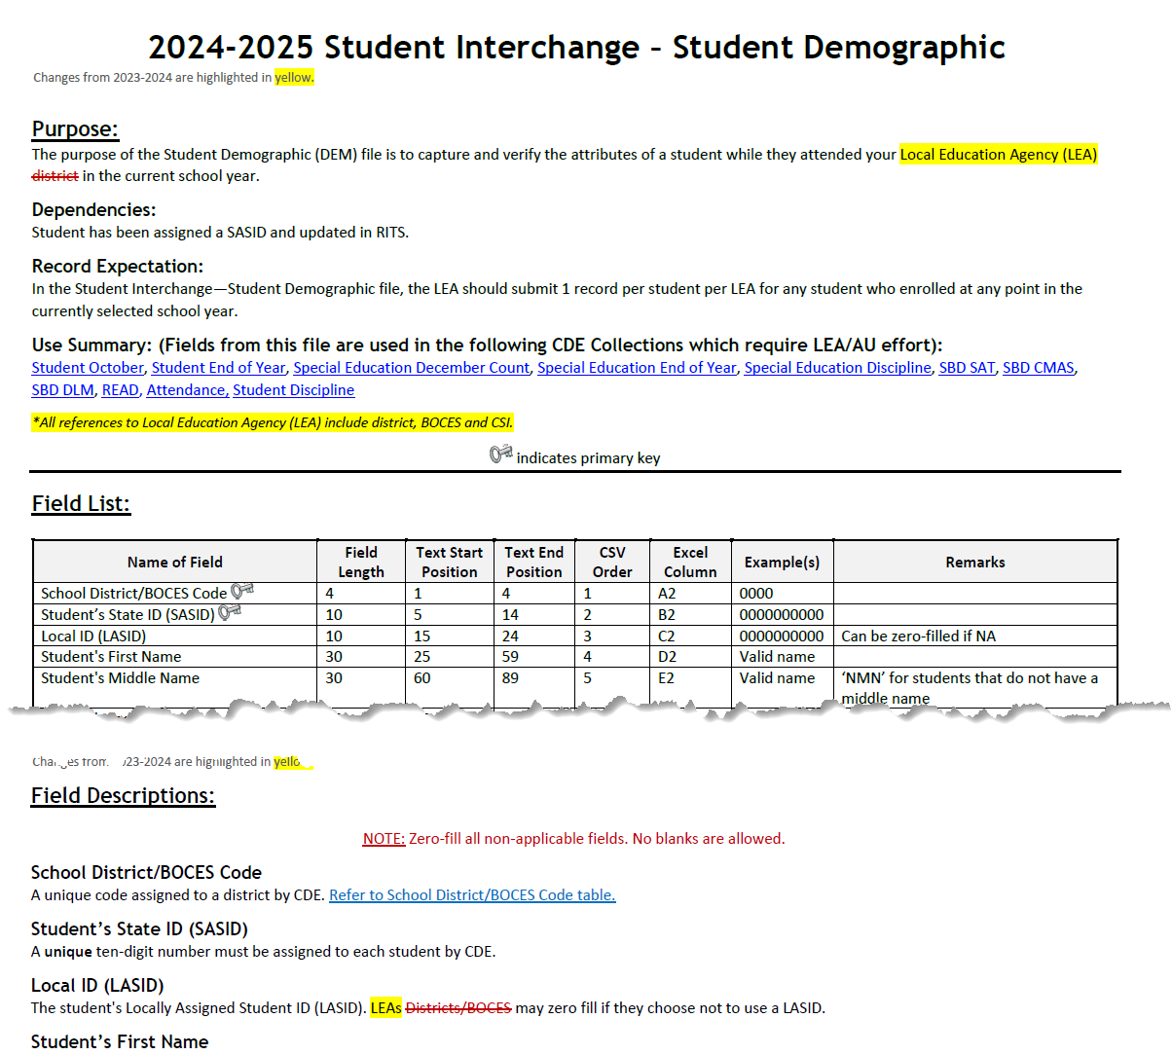
Student Demographic File Layout
One record per student
2024-2025 Student Demographic File Layout
Race/Ethnicity
Language Fields (Proficiency, Background, Program)
Homelessness Information (Homeless, Cause of Housing Crisis, Add. Cause of Housing Crisis)
SPED information (Primary Disability, Alternate Assessment Participant, Transition)
Notes:
Includes fields that are true of student, no matter their enrollment

Slide 19
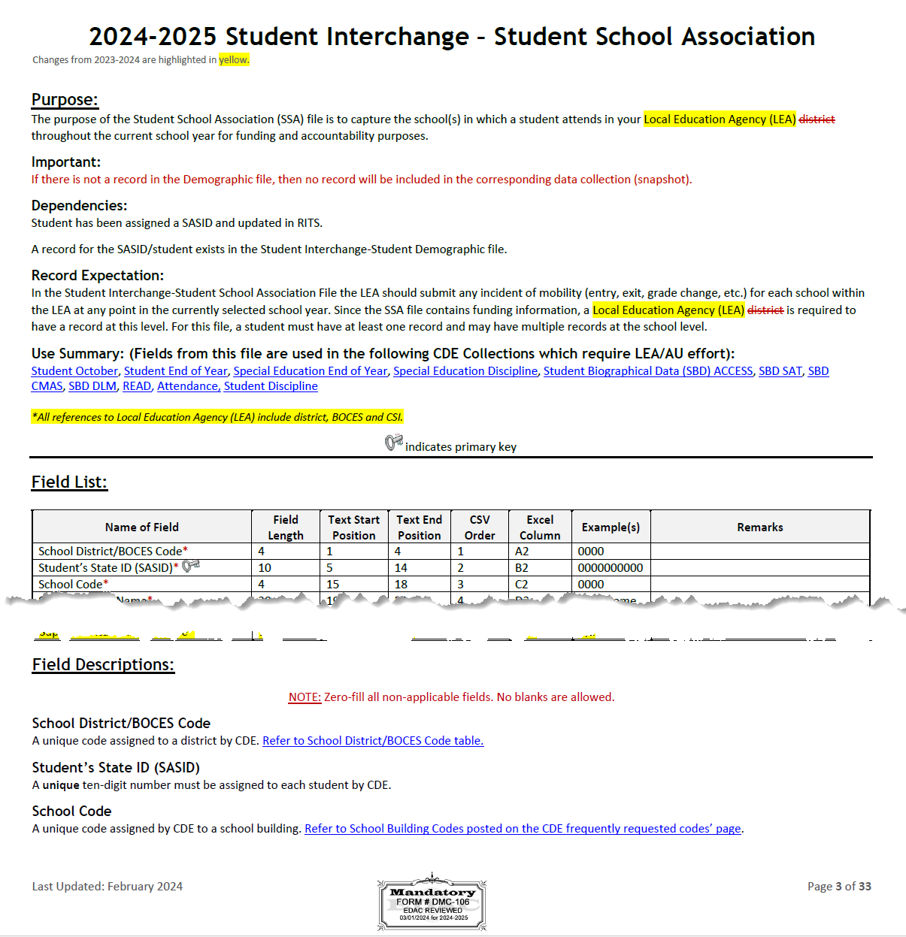
Student School Association File Layout
May include multiple records per student
2024-2025 Student School Association File Layout
Grade Level
Entry/Exit Types
Public School Finance Funding Status
Pupil Attendance Information
Non School Program
Attendance Fields (Total Days Attended, Total Days Excused/Unexcused, Total Possible Days)
Notes:
Includes data fields specific to enrollment
Primary school = 1 are the types of records that pull into the collections. Primary School = 0 may be on your file, but won’t pull into collections.
Entry Exit Type definitions have been updated

Slide 20
Student Interchange Preparation
Upload interchange files
Wait for a Confirmation Email from the Pipeline System
  The email will show you the number of errors in your upload
  Resolve ALL errors in your interchange files
  Check your error reports
Update your Interchange files to address the errors
  Update in SIS → Extract → Upload to Pipeline
  Edit Record Tool (Data Pipeline)
Upload Student Demographic File
Upload Student School Association File
Upload Graduation Guidelines File

Slide 21
Snapshot

Slide 22
What is a Snapshot? - Visual
Source File A
Source File B
Internal Flags
File A: Element 2
File A: Element 5
File B: Element 3
Internal Flag: 3
Snapshot
File A: Element 1
File B: Element 1
File A: Element 3
File A: Element 4
File B: Element 2
File B: Element 4
Internal Flag: 1
Internal Flag: 2
Notes:
A data snapshot begins with uploading the corresponding interchange files. These interchange files become the source of information, or source file for specific data fields on a snapshot.
When a snapshot is triggered, it pulls needed information from the source (interchange) files into a new file called the snapshot.
Snapshots typically won’t use every data element on a source file.
Snapshots often pull in information called “internal flags.” These are calculated pieces of data from information provided on the interchange files or from other internal data in data pipeline.

Slide 23
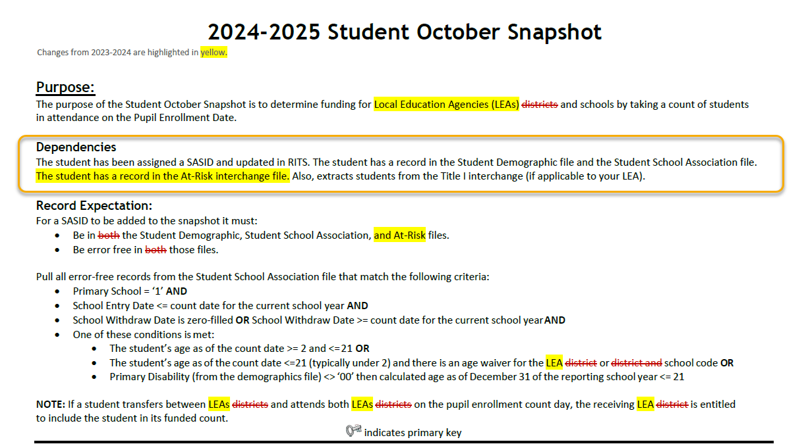
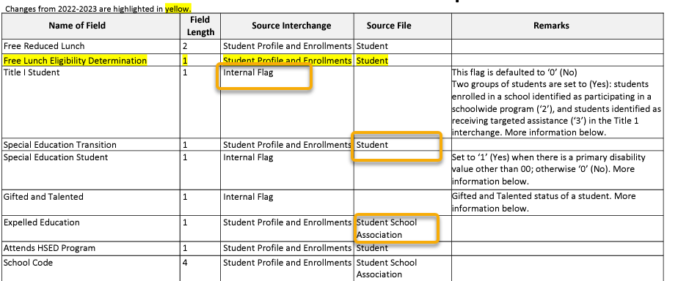
What is a Snapshot?
Interchange File Layout
  Provides a list of each data field included on an interchange (source) with detailed descriptions and codes.
Snapshot File Layout
  Dependencies: List of source interchange files needed for the snapshot
  Criteria: Rules regarding the types of records pulled from a source file into a snapshot
  Data Fields: Includes a list of specific source files for each data field or indicates the field is an internal flag.
  Internal Flag Definitions: Provides detailed descriptions of each internal flag data field and codes.

Slide 24
Another Snapshot Visual
Student October
Student Demographic
Student School Association
At-Risk
Title I (if applicable)
Supporting Files (TREP Allocation, Foster, etc.)
Light Green – District Uploads
Gray – CDE Uploads
Light Blue – District “Triggers”

Slide 25
Snapshot Process - Described
0. Make sure Student Information System is updated
Extract Interchange Files from SIS and upload Interchange files to Pipeline (Student Demographic, Student School Association Files, At-Risk, Title I)
Check Business Rules Associated with Interchange files
Errors on Interchange files?
  Yes – Correct Errors in SIS and go back to step 0
  No – Move on to step 4*
Create Snapshot
Check Additional Business Rules Associated with Snapshot
Errors?
  Yes - Correct Errors in SIS and go back to step 0
  No – Move on to step 7
Review Reports and Finalize
  If you need to correct any data, you will need to go back to step 0
*Note: Error-free interchange files are not required to take a Snapshot but recommended. Get your interchange files as close to error free as possible before taking a snapshot!

Slide 26
Snapshot Process – Cycle Visual
No
Extract from SIS/Upload Interchange Files (DEM, SSA, etc.)
Check first phase of errors
Take Student October Snapshot
Check second phase of errors
Are both the phases error-free?
Yes
Validate Data/Submit

Slide 27
Uploading to Pipeline

Slide 28
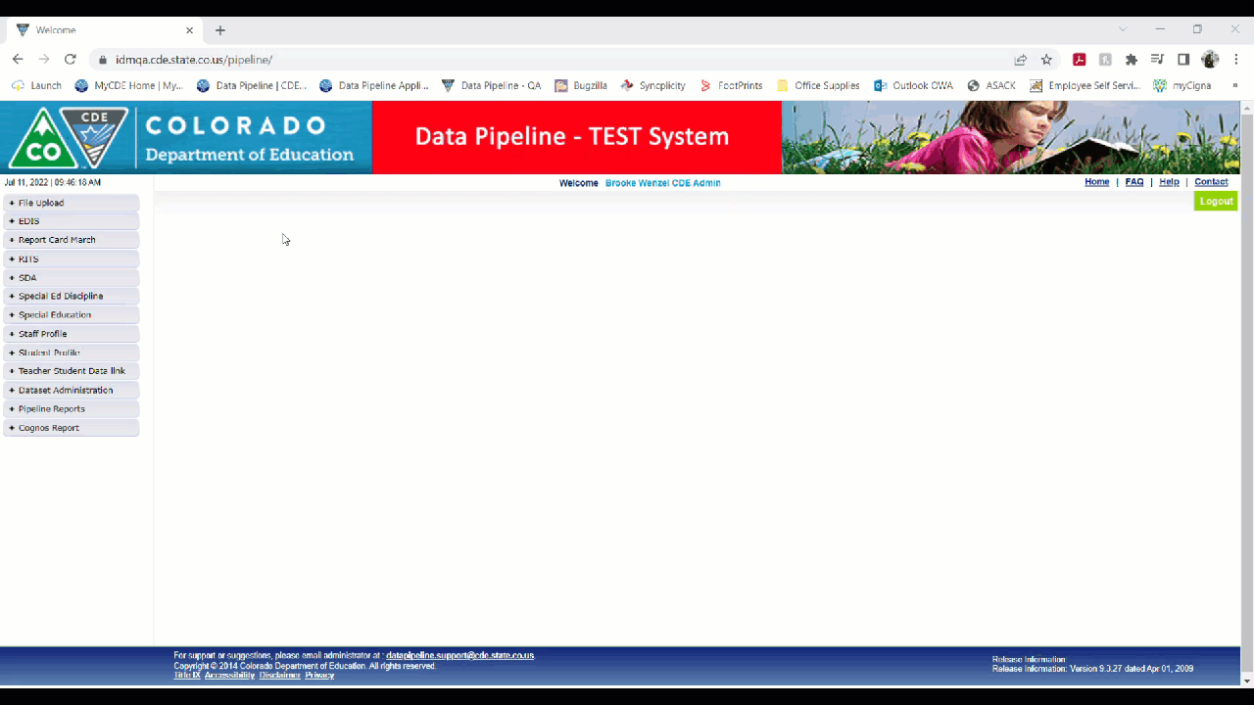
Uploading Interchange Files
Dataset: Student Profile
File Type: Student Demographic or Student School Association
Tag: None
School Year: 2024-25
Organization/LEA: Will autofill to yours
Locate File: Find location of saved extracted file
Upload Type: Replace (will take file and replace everything in Data Pipeline)

Slide 29
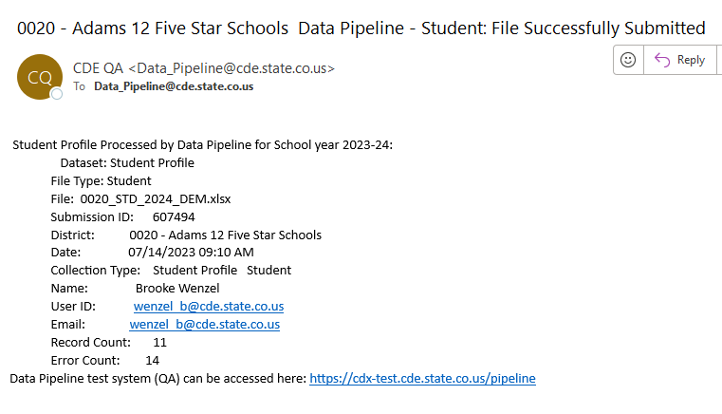
Reviewing File Upload
Upload Files
  Student Demographic
  Student School Association
  Wait until DEM load is complete
    Emails are sent once complete (2 emails with the first being SASID errors)
    Or go to ‘Batch Maintenance’ (on the left side of your screen 3rd down from top) and look-up the file you just uploaded.
Consider creating a folder with rules in your inbox to store Data Pipeline emails

Slide 30
Errors/Warnings

Slide 31
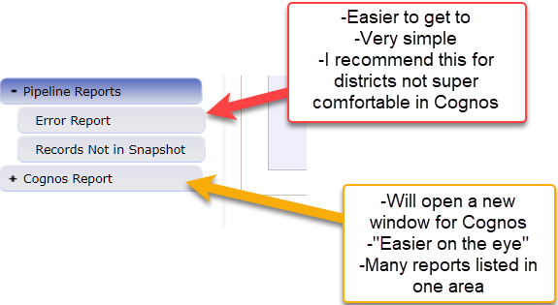
Reviewing Errors from Uploaded Files
Review your errors (two ways)
1. Pipeline -> Pipeline Reports -> Error Report
2. Cognos Report -> Student Profile -> Error Detail Reports

Slide 32
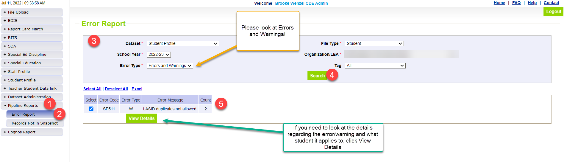
Pipeline Error Report
Errors
Warnings
Must be addressed
  Update data fields to clear
  Request reporting exception if student data is accurate but does not follow the typical coding pattern as indicated by the error message
Snapshot cannot be submitted if there are any errors
Indicate possible data inconsistencies/coding issues
Snapshot can be submitted even if warnings are present
Pro Tip: Review warnings to look for patterns/areas where district data could be documented in a more accurate manner

Slide 33
2 Levels of Errors - Goal
Interchange Level
Student Demographic File = 0 errors
Snapshot Level
Student October Snapshot = 0 errors
Student School Association = 0 errors
Title I (if applies) = 0 errors
At-Risk = 0 errors

Slide 34
Resolving Errors
  Carefully read the error message to understand the error and why it is being triggered.
Option 1 – Edit Record(s)
Change Coding
Make changes in Student Information System
Option 2 – Request an Exception
Student is coded correctly and should not be triggering error
Do not change coding to clear error!
Re-Extract file from SIS, and reupload to Data Pipeline
Request exception through Syncplicity with Exception Template
Send me an email!
Exception processes, resubmit files/recreate snapshot

Slide 35
Exceptions

Slide 36
When are reporting exceptions needed?
Sometimes a student’s records will have accurate information, but their educational history will not follow the anticipated coding patterns outlined in the business rules for an interchange file or snapshot
  These are unique circumstances and apply to few students
Reporting exceptions are used to clear the errors associated with a student’s record without changing the data
Data respondents must work with the data collection lead for a given file/snapshot to request an exception be granted

Slide 37
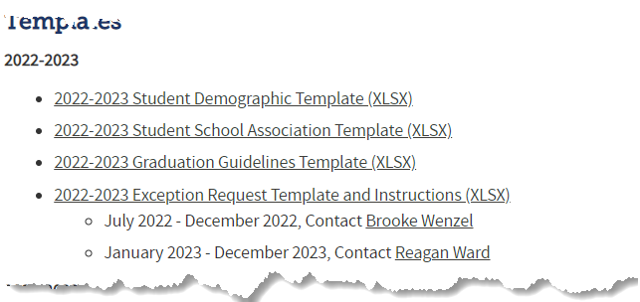

Reporting Exception Process (Option 2)
Complete exception request template
Upload exception request template to your district’s Syncplicity student folder
Folder: 1234 – DISTRICT NAME – Student
Notify the OCT collection lead (StudentOctober@cde.state.co.us) that you’ve uploaded a document for review
Collection lead will review your request and notify you of the outcome
Approved requests – reupload interchange file and/or create a new OCT snapshot
Denied requests – collection lead will provide next steps for clearing the error
Additional information needed – collection lead will request information
Available on Student Interchange Website
Pro Tip: Include the date in name of your exception request file as you may upload more than one exception during the collection cycle

Slide 38
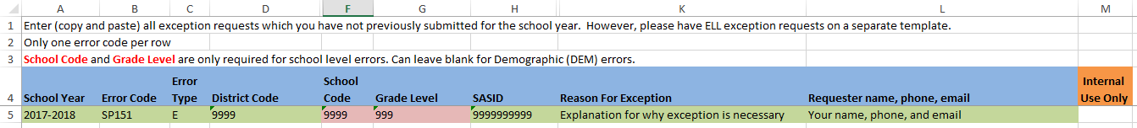
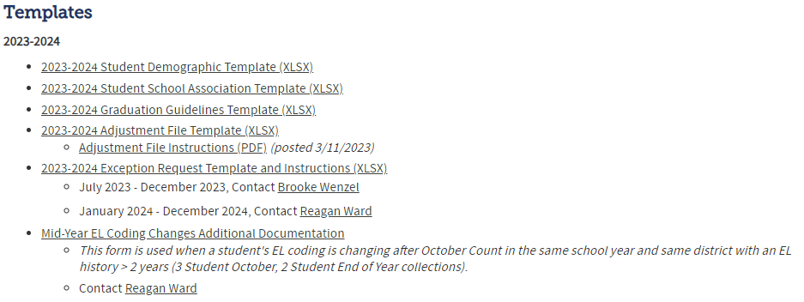
Requesting Exceptions (Option 2)
Each error needs a row, even if the same SASID is generating multiple errors
  You can use the same explanation multiple times though
Fields Required for exceptions to errors in Demographic File
Where do I find the Exception Request Template?
Student Interchange Website

Slide 39
Other Reporting Pieces
(Home School Data, At-Risk, Title I)

Slide 40
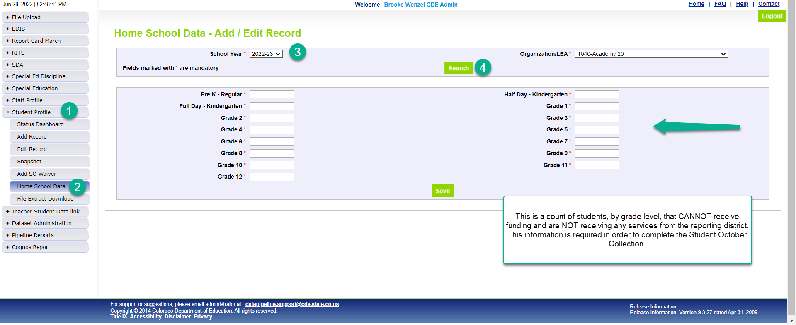
Home School Data – Add/Edit Record
Submit Home School Data
*Please note that you’ll need to include any homeschool students receiving some regular education services provided by the district in your interchange files. They are only eligible for a maximum of part-time funding. For homeschool student receiving no services report them in Home School Data under Student Profile. These students who are not taking any classes offered through the district are not eligible for funding.

Slide 41
New: At-Risk Measure Interchange File Overview
Beginning with the 2024/2025 school year, there is a new Data Pipeline At-Risk Interchange.
The purpose of the At-Risk Interchange is to obtain student level census block information needed to implement the new at-risk measure as described in HB22-1202 with data collection to begin with the 2024-2025 school year as provided for under SB24-188.
The new at-risk measure will be implemented starting with the 2025/2026 school year, and included in the Total Program funding calculation as described in the Public-School Finance Act which will continue to utilize student level data reported through the Student October Count data collection
Information on At-Risk:
  ARMeasure@cde.state.co.us
  At-Risk Interchange Website

Slide 42
Title I Interchange File
Upload Title I Interchange file if necessary
If your district has a Title I Targeted Assistance (TA) funded school you will need to submit a Title I file
Information on Title I:
  Melissa Chaffin
  Title I Interchange Website
The method districts use to report students served with Federal Title I Targeted Assistance (TA) funds.
Data from the Title I Interchange are captured in October Count and End-of-Year snapshots.
  States that accept Title I $$ must report Title I data to the U.S. Department of Education:
  District overall and disaggregated by:
    student groups (race/ethnic, IEP, FRM, EL)
    program (Schoolwide vs. Targeted Assistance)
Accepts TA students only. All students in SW programs are coded Title I.

Slide 43
Snapshot Creation

Slide 44
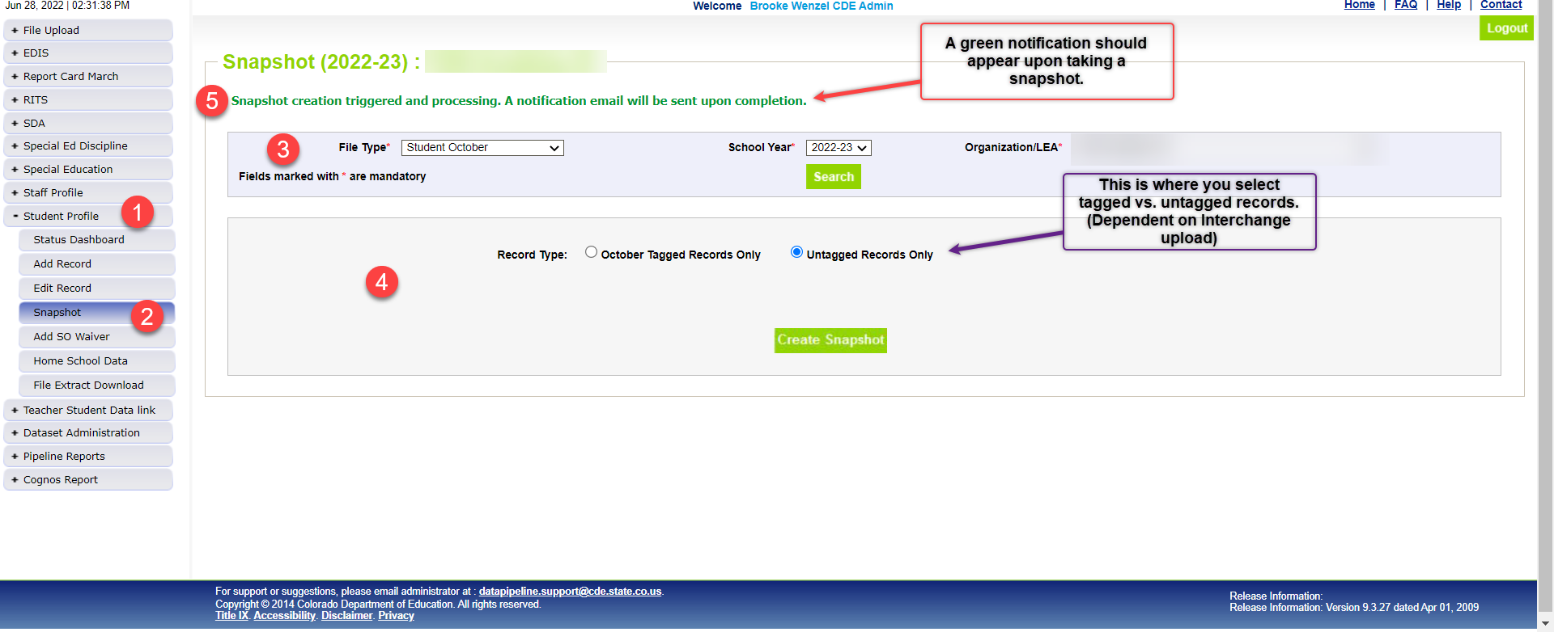
Snapshot Screen
Create a Student October Snapshot
  Record Type: Choose based on use of tagging
  Always Create Snapshot

Slide 45
Snapshot Process – Described (again)
0. Make sure Student Information System is updated
Extract Interchange Files from SIS and upload Interchange files to Pipeline (Student Demographic, Student School Association Files, At-Risk, Title I)
Check Business Rules Associated with Interchange files
Errors on Interchange files?
  Yes – Correct Errors in SIS and go back to step 0
  No – Move on to step 4*
Create Snapshot
Check Additional Business Rules Associated with Snapshot
Errors?
  Yes - Correct Errors in SIS and go back to step 0
  No – Move on to step 7
Review Reports and Finalize
  If you need to correct any data, you will need to go back to step 0
*Note: Error-free interchange files are not required to take a Snapshot but recommended. Get your interchange files as close to error free as possible before taking a snapshot!

Slide 46
Snapshot Process – Cycle Visual (again)
No
Extract from SIS/Upload Interchange Files (DEM, SSA, etc.)
Check first phase of errors
Take Student October Snapshot
Check second phase of errors
Are both the phases error-free?
Yes
Validate Data/Submit

Slide 47
Cognos Reports (CEDAR)

Slide 48

Logging Into Cognos

Slide 49
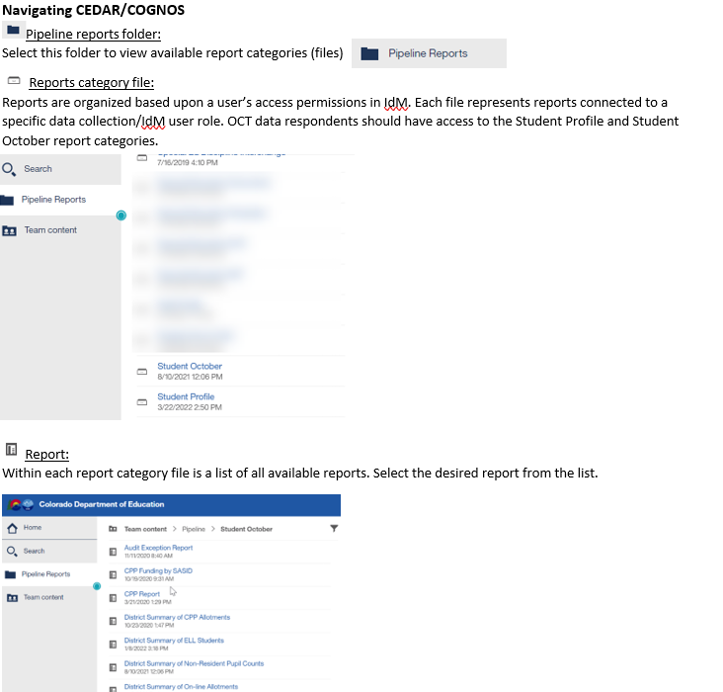
Student Interchange/Student October Reports

Slide 50
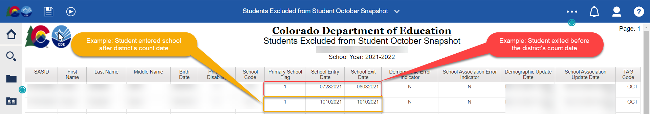
Students Excluded from Student October Snapshot
Includes students who could have errors on the SSA or DEM files but could also contain students that could have zero errors within the interchange, but still are being excluded and therefore are not pulling into the Student October snapshot.
Student could have entry/exit dates that do not align with your district’s count date, the student’s age does not fall within the parameters, etc.
Note: Helpful columns from the Student Interchange have been pulled for your convenience to see if there could be potential reasons the student is not being pulled into the snapshot.

Slide 51
Submit Data to CDE

Slide 52
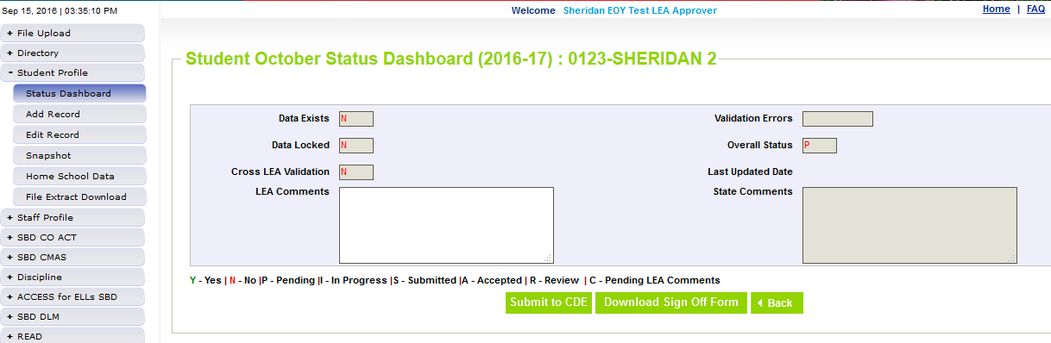
Ready to Submit
Once you have verified the data, submit the snapshot to CDE. Go to:
  Student Profile -> Status Dashboard and click ‘Submit to CDE’
  Must have LEAAPPROVER role in IDM to complete this step
  Once data is submitted it will be locked, must request unlock to make changes (email or call me to request)

Slide 53
Duplicate Process

Slide 54
Phase 2 (Duplicate Process)
Duplicate Process
  Once all districts have submitted data CDE will begin the duplicate process
  Will compare SASIDs across all districts and determine if any students are receiving funding greater than allowed
    For most students this is 1.0 FTE, but there are some instances where a student is only eligible for 0.5 FTE (e.g. home-school students)
  Districts will receive email if they have a duplicate
    Email will include instructions on how to submit documentation to the CDE School Auditing Office to determine who receives funding
    Districts have 3 business days to submit this documentation
Date | Event | Event Description
11/12/2024 12:00 p.m. | Deadline | Duplicate funding documentation due to School Auditing Office
11/18/2024 | Other Date | School Auditing makes decisions on funding duplicates
11/27/2024 | Deadline | Resubmit Student October Snapshot data to CDE based on decisions from School Auditing
12/06/2024 | Deadline | Collection closes Secretary of the Board of Education Verification (sign-off) form due. Data remains embargoed until the official release in January.
01/15/2025 | Data Release | Official data release

Slide 55
What happens if you have duplicate students?
Duplicate Students?
Audit Exception Report
  Created after duplicate process has been run.
  Helps determine which students need documentation to send to CDE School Auditing team during duplicate process
Summary of Pupils Being Reported by Another District
  Like the Audit Exception Report used during the duplicate process, but can be accessed prior to your snapshot being submitted
  Lists SASIDs being reported by another district
  You can then use the Student October Contact List to contact the other district to resolve duplicates prior to duplicate process
Date | Event | Event Description
11/12/2024 12:00 p.m. | Deadline | Duplicate funding documentation due to School Auditing Office
11/18/2024 | Other Date | School Auditing makes decisions on funding duplicates
11/27/2024 | Deadline | Resubmit Student October Snapshot data to CDE based on decisions from School Auditing
12/06/2024 | Deadline | Collection closes Secretary of the Board of Education Verification (sign-off) form due. Data remains embargoed until the official release in January.
01/15/2025 | Data Release | Official data release

Slide 56
End of the Collection!
After documentation received
  CDE School Auditing Duplicate Process
Once data is final and no duplicates remain
  Print out signature page (status dashboard -> Student October)
    Will look like the Cognos Report “District Summary of Pupil Count”
Get it signed by the Secretary of Board of Education AND the Chief Financial Officer and then scan and email to Brooke the Student October Collection Lead at CDE.
Once CDE has received your signature page you are done!
Date | Event | Event Description
11/12/2024 12:00 p.m. | Deadline | Duplicate funding documentation due to School Auditing Office
11/18/2024 | Other Date | School Auditing makes decisions on funding duplicates
11/27/2024 | Deadline | Resubmit Student October Snapshot data to CDE based on decisions from School Auditing
12/06/2024 | Deadline | Collection closes Secretary of the Board of Education Verification (sign-off) form due. Data remains embargoed until the official release in January.
01/15/2025 | Data Release | Official data release

Slide 57
How the Snapshot Works

Slide 58
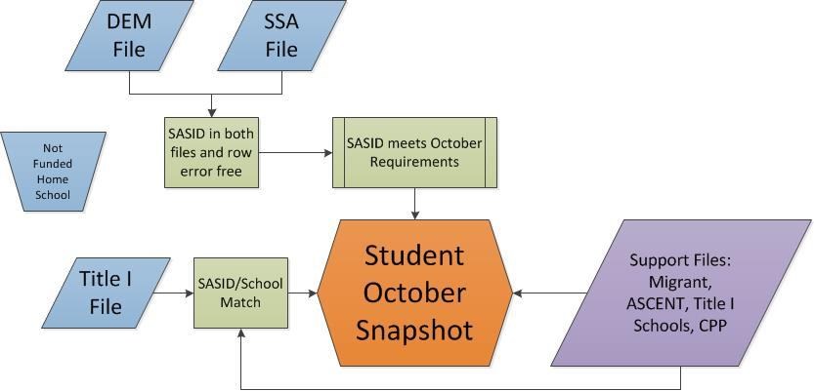
Data Feeds into Snapshot
Student October Snapshot Criteria
  Student record in DEM file, error free
  Student has at least one record in SSA file , error free
  Student has record in At-Risk file, error-free
  Primary School flag = 1
  Entry Date before or on count day and Exit Date after count day
    Or SASID is in Transfer/Alternate Count Day exception file
Support Files/data: Foster, Migrant, Title I School, TREP
At-Risk File

Slide 59
What is a Snapshot? – Back to the Visual
Source File A
Source File B
Internal Flags
File A: Element 2
File A: Element 5
File B: Element 3
Internal Flag: 3
Snapshot
File A: Element 1
File B: Element 1
File A: Element 3
File A: Element 4
File B: Element 2
File B: Element 4
Internal Flag: 1
Internal Flag: 2

Slide 60
2024-2025 Changes

Slide 61
2024-2025 Student School Association
2024-2025 Student School Association File Layout
Added Independent Study Course, Work-Based Learning Opportunity Course, Blended Learning Course and Supplemental Online Course fields
  Will help determine student’s funding eligibility based on documentation (finance/auditing)

Slide 62
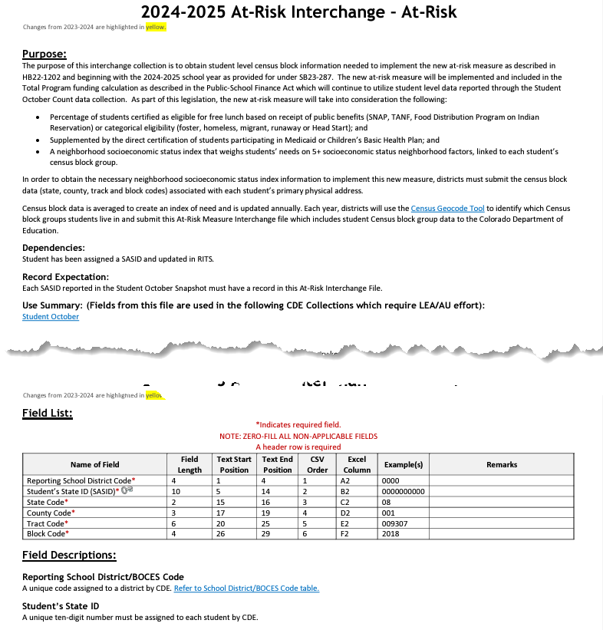
2024-2025 At-Risk
2024-2025 At-Risk Interchange File Layout
Obtain student level census block information needed to implement the new at-risk measure as described in HB22-1202.
At-Risk Interchange Website

Slide 63
School Auditing Office

Slide 64
Reporting vs. Requirements
  Reminders:
  Reporting vs. Requirements (Auditing)
  Review the Student October Count Audit Resource Guide
    Identify unique student and course types that are relevant to your district.
    Make sure you have processes in place for collecting required audit documentation in an electronic format.
    Coordinate with district program staff.
  Auditing has their own trainings!

Slide 65
Audit Syncplicity Folders
All districts have an audit Syncplicity folder for transferring and sharing audit documentation for audit purposes
Naming convention for district folders is: District Number_District Name_Audit_FAST
  For example: 0010_Mapleton 1_Audit_FAST
Each audit Syncplicity folder contains subfolders:
  Annual Audit Review
  At-Risk Count
  Audit Report
  Duplicate Count
  English Language Learner Count
  Pupil Count
  Transportation

Slide 66
Preschool Data Reporting

Slide 67
Student October Expectations
LEAs Will Report
LEAs Will Not Report
All PK students receiving services from the LEA (regardless of UPK funding status)
  These students should have a SASID assigned
All PK students as Not Funded (Public School Finance Funding Status ‘86’, ’87’ or ‘96’) for enrollment purposes
All related Demographic and School information
Any PK students not receiving services from the LEA (optional)
An alternate count date for PK students (if applicable)
  All students will fall under the October Count Date
CPP/ECARE Funding Information – no longer applicable
*LEA = Local Education Agency (district, Charter School Institute and BOCES are included)

Slide 68
Resources

Slide 69
Resources/Helpful Webpages
Site Name/Link | Information/Uses
Data Pipeline Home | Main landing page for the data pipeline information/resources. From here you can navigate to all the various data collection sites
Identity Management (IdM) | This is the landing page with login links to the various CDE data platforms. Data Pipeline COGNOS/CEDAR Reporting RITS EDIS
Data Pipeline Collection Dates (XLS) | Excel document that shows the open/close dates of all data collections & the point of contact at CDE for the collection (collection lead)
Student Interchange | Contains file layouts, templates, business rules, training materials, and resources Student Demographic file Student School Association file Graduation Guidelines file
Syncplicity | Secure file transfer site used to communicate personally identifiable information with CDE if you have questions on specific students during reporting or have exception requests. You should get a separate email from them today to set up an account to access the student file for your district. Other collection leads will need to give you access to the Syncplicity folders (same login, just extra folders) for their collections if you need them.

Slide 70
Thank You for Attending!
720-441-7963
StudentOctober@cde.state.co.us
Student October Website
Student Interchange Website
Identity Management/Data Pipeline
Auditing Office’s Pupil Count Website
At-Risk Interchange Website
Title I Interchange Website

