Slide 1
Collaborative Monitoring of Graduation Guidelines
2022-2023 School Year
November 2022
Robin Russel & Reagan Ward

Slide 2
Agenda
Graduation Guidelines Overview
Reporting Overview
Monitoring GG with CEDAR/COGNOS Reports
Next Steps for Supporting Students
What If…?
Resources & Contacts

Slide 3
Graduation Guidelines Overview

Slide 4
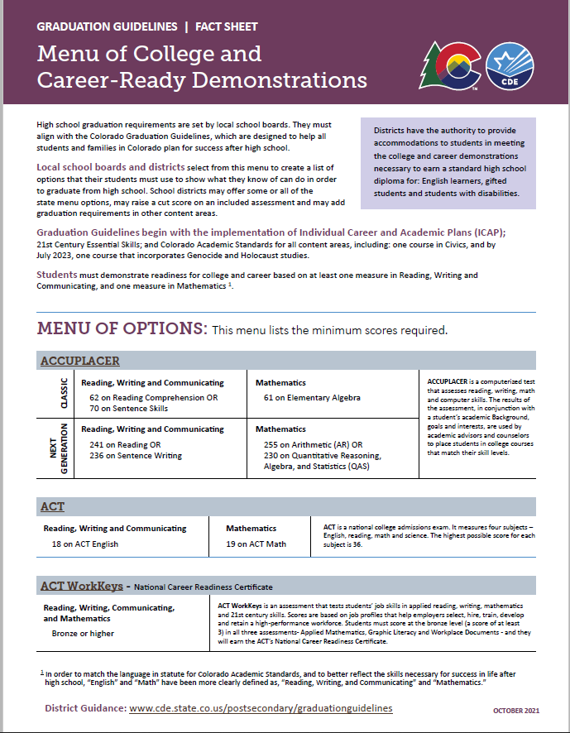
What are Graduation Guidelines?
A student’s demonstration of Postsecondary and Workforce Readiness (PWR) in Reading, Writing, and Communicating (RWC) and Mathematics.
In order to graduate from high school, students choose measures from a Menu of Options – adopted at the local school board level – that show their proficiency in RWC/Math.

Slide 5


What is on the Menu of Options?
Traditional Measures
Performance Assessments
District Capstone
Industry Certificates
Collaboratively developed, standards-based Performance Assessments
ACCUPLACER
ACT
ACT WorkKeys
Advanced Placement
ASVAB
Concurrent Enrollment
International Baccalaureate
SAT

Slide 6
Graduation Guidelines 2022-2023
Full implementation of Graduation Guidelines went into effect for students graduating in the 21-22 school year and beyond.
YES
  4th year seniors (AYG 2023)
  5th (AYG 2022) and 6th (AYG 2021) year seniors; and
  All students who have an Anticipated Year of Graduation (AYG) of 2022 or beyond, including 3-year graduates
NO
  Students from AYG 2020 and prior
    7th year (AYG 2020)

Slide 7






Keeping Track of Graduation Guidelines Measures
District Reporting File for Graduation Guidelines
Who? When? Where?

Slide 8
Meaning vs Compliance
Compliance
Meaning
All students use the same menu options
Students take assessments until they pass a menu option
Menu options may or may not connect to individual students’ PWR goals
Students use the demonstration option from the menu that is best suited to their individual needs/goals
Students are a collaborative partner in selecting the demonstration item from the menu of options that best align to their PWR goals. Families are also involved in the selection.

Slide 9
Reporting Overview

Slide 10
How do districts report Graduation Guidelines?
Graduation Guidelines is a file in the
Student Interchange
File layout, business rules, and template available on student interchange website
Graduation Guidelines is incorporated into the Student End of Year Collection as a validation check for Exit Type = 90, 95, or 96.
Any graduating student must have at least two records (i.e. rows) in the Graduation Guidelines file
At least one English (Guideline Type = 0)
At least one Math (Guideline Type = 1)
Student may have multiple English or Math records
Districts may report measures on any student
Matches with the Student School Association File and Student Demographic file based on SASID.

Slide 11
Who at the district is involved in reporting?
Program/Policy staff & Data Respondents must work together to report GG accurately and effectively.
Best Practice Suggestion
  Data Respondent: pull a list of students who are likely to graduate in the current school year
    Use information from Student Information Systems
    COGNOS contains helpful reports as well, more information in
  Program/policy staff: check which students have met GG with which guideline name from the menu of options
  Data Respondent: Upload Graduation Guidelines file to data pipeline with GG data provided by Program/Policy staff
  Repeat as needed

Slide 12
When do districts report this data?
As with all Student Interchange files, this file can be uploaded multiple times throughout the school year.
  This assists with sharing information on transfer students between districts.
  This allows districts to keep the data up-to-date, simplifying the end of year data collection.
  Allows data respondents and program/policy staff the ability to work on this file throughout the year before the summer break.
Graduation Guidelines is a required file for the 2022-23 Student End of Year (SEY) data collection.
  SEY data collection officially opens in May 2023
  SEY will have a soft-open phase March-April 2023

Slide 13
2022-2023 File Changes
Link: 2022-2023 File Layout
Updated score ranges
Align with vendor files
Act WorkKeys score range 1-7,
3 remains the benchmark
ASVAB score range 1-99,
31 remains the benchmark
Clarified Guideline Type Language
English is synonymous with Reading, Writing, Communicating (RWC)
Math is synonymous with Mathematics
Fields Removed
IEP Accommodation
EL Accommodation
GT Accommodation
District of Completion
Notes:
Note: Although the ‘district of completion’ field was removed, districts may still report graduation guidelines measures completed by a student in a prior district/state per a local district’s policies.

Slide 14
How is this data connected to the Student End of Year collection?
Student End of Year ‘business rule’ or ‘check’
  If student’s Exit Type indicates graduate (Exit 90, 95, 96)
  And student’s AYG is >= 2021
  Search for matching Graduation Guidelines records in data pipeline by SASID
    At least one matching English (Reading, Writing, Communicating) at/above minimum benchmark
    At least one matching Mathematics record at/above minimum benchmark
  If corresponding GG records are found, no business rule triggered
  If missing a GG record for English and/or Math, business rule triggered
    Error indicating need to upload missing GG information

Slide 15
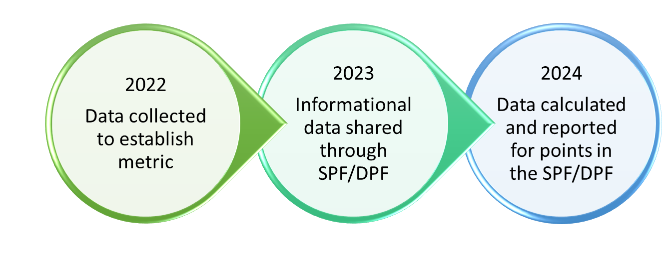
Graduation Guidelines Data Usage
Graduation Rate
Graduates (Exit Codes 90, 95, 96) require reported GG measures in English (RWC) and Math
*New* PWR Measure
“Higher Bar” metric
More information available on Accountability Site
Notes:
Legislation:
C.R.S. 22-2-106
C.R.S. 22-11-204
C.R.S. 22-11-501
C.R.S. 22-11-504
S.B. 17-272
RWC = reading, writing, communicating
Math = Mathematics

Slide 16
Monitoring GG Completion with
COGNOS/CEDAR Reports

Slide 17
General Tips for Monitoring GG
Data Staff
Program Staff
Extract COGNOS/CEDAR reports for review by Program Staff
Ensure all graduation guidelines measures are extracting correctly from your Student Information System
  Who is entering this data?
Support entry of GG measures into Student Information System
Use local process for tracking completion of GG measures
Ensure all graduating students have GG measures entered in your student information system
  Who is entering this data?
Review COGNOS/CEDAR reports shared by data staff

Slide 18
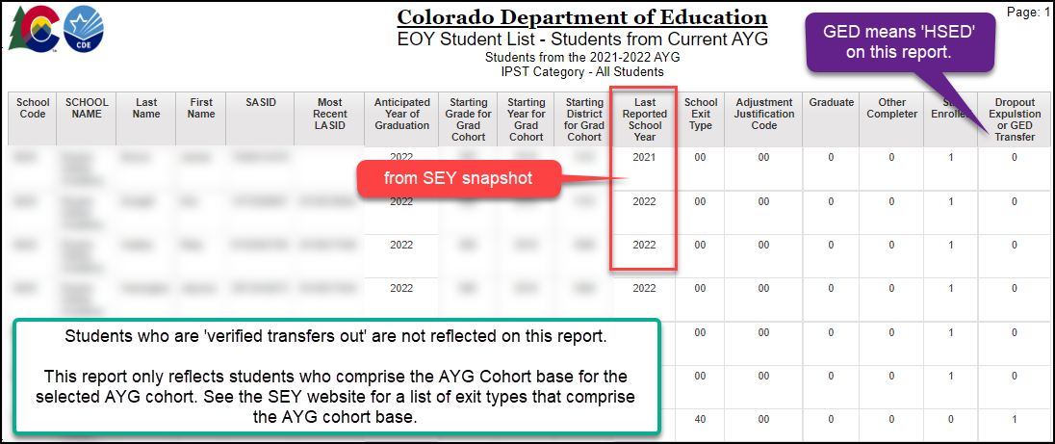
EOY Student List – Students from Current AYG
Document: SEY COGNOS/ CEDAR Report Guide
List of all students in the graduation base for a given Anticipated Year of Graduation (AYG) cohort
Shows final status of the student
  Graduate, completer, dropout, still enrolled, HSED transfer
Filter report by ‘school exit type’ to find students in the AYG cohort who may need to be reconciled (i.e. Exit 19 – transfer to allowable approved facility; Exit 26 – transfer to a detention center)
Notes:
If the SEY collection has not yet opened, select the current year as the AYG and 3 years as the number of years in cohort to review the AYG cohort based on the prior year’s data.
Once the SEY collection has opened and your district has created a snapshot, select the current year as the AYG and 4 years as the number of years in cohort to review the AYG cohort based on the current year’s data.

Slide 19
Tips for using this report…
EOY Student List – Students from Current AYG
Download this report to sort AYG cohort by school and review students anticipated to graduation in the 2022-2023 school year.
  August 2022-March 2023
    Select ‘2022-2023’ Cohort and ‘3 years in cohort’ to view a list of students for the 2023 AYG cohort.
    This list does not reflect students who transferred in/out of your district during the 2022-2023 school year.
  March 2023*-December 2023
    *As soon as you begin working on the SEY collection, this list updates
    Select 2022-2023 cohort with ‘4 years in cohort’ to view a list of all students from the 2023 AYG cohort
    This list will reflect students who transferred in/out of your district during the 2022-2023 school year
Important Note: Once a student’s AYG is set, it does not change even if they experience a grade acceleration or retention during their high school career.
  Document: Internal Flag Calculation – Anticipated Year of Graduation
  Document: Exit Types that Comprise the AYG Graduation Cohort Base

Slide 20
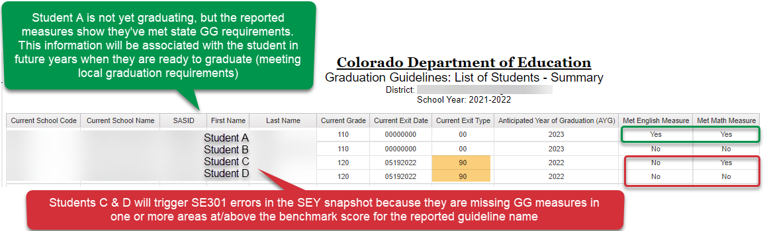
Graduation Guidelines –
Student Summary List
Document: SEY COGNOS/ CEDAR Report Guide
Reflects all students on your current SSA file who also have reported GG information.
  Reflects reported measures from any year and district
Shows the students AYG if it has been assigned.
  AYG updates as SEY snapshots are created, so this may be ‘0000’ for a student who is new to your district or new to 9th grade if no SEY snapshot has yet been taken for the year.
Designed as a quick check if a student has met both English & Math measures

Slide 21
Tips for using this report…
Graduation Guidelines – Student Summary List
Upload 2022-2023 SSA & GG files
Extract report to filter by School, AYG, and name
Review local information for any student who has not met GG in English and/or Math
  Add GG measures to your GG file if student has already completed measures
  Check that GG measures in your SIS are correctly extracting if you expect the measure should have already been reported
  Support student in completion of missing measures
The exit type field will likely show ’00’ until students begin to be marked as graduates on your SSA file. SSA file will not allow future dates to be uploaded.

Slide 22
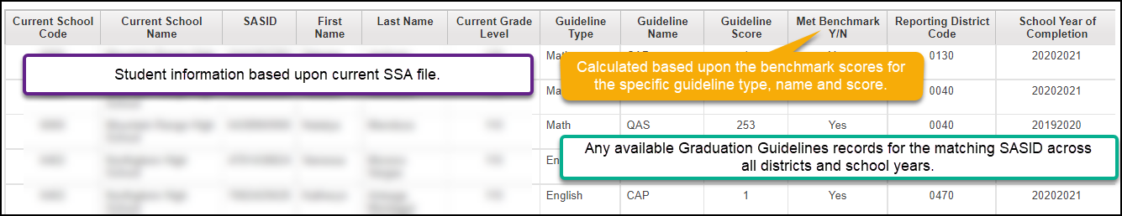
Graduation Guidelines: Student Completion List
Document: SEY COGNOS/ CEDAR Report Guide
Reflects all students on your current SSA file who also have reported GG information.
Reflects reported GG from any year and any district
Only reflects reported measures. A student may have completed a measure in a prior district that has not been reported to CDE.
Notes:
List of any completed measures for all students in district
If the student does not have any reported measures, they are excluded from the list
Student list based upon current SSA file
Graduation Guidelines measures based upon any reported measures (all years/districts) found in data pipeline
Matched on SASID
Includes ‘Met Benchmark Y/N’ field
Can be exported to excel

Slide 23
Tips for using this report…
Graduation Guidelines: Student Completion List
Upload 2022-2023 SSA & GG files
Extract report to filter by School, AYG, and name
Use this report to dig deeper into the list of GG measures a student has attempted
Shows the specific score values for each reported measure
Shows the reporting district, which allows districts to determine if they will locally count the GG measure reported by another district for transfer students

Slide 24
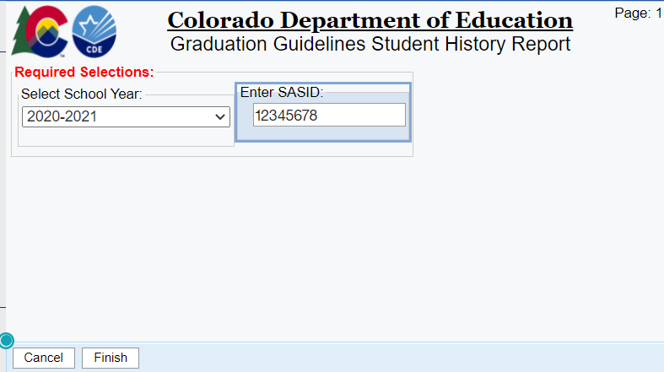
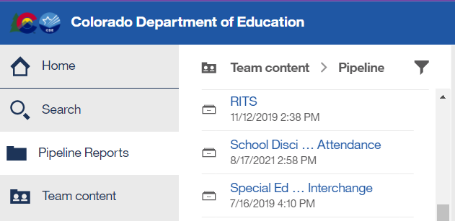
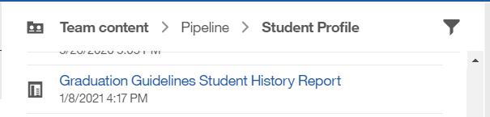
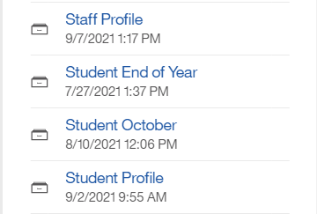

Graduation Guidelines Student History Report
Document: SEY COGNOS/ CEDAR Report Guide
This report reflects information for a given SASID that has been reported by a CO district
Reflects data for any student grades 9-12 that has been reported by any CO district
One tool to assist in determining GG measures for transfer students
It is best practice to upload/update your GG file frequently throughout the school year

Slide 25
Tips for using this report…
Graduation Guidelines Student History Report
Use to quickly see all reported data on a specific student
Great tool to see if an incoming student has reported measures from another district
Use when researching individual student receiving a SE301 (missing GG) error in the SEY collection

Slide 26
Pro Tip: Using SEY Soft-Open Phase to Monitor GG
During the Soft-Open phase (March/April) upload files that isolate potential graduates coded as graduates and then create a SEY snapshot.
  Requires manual edit of SSA file to change exit date and exit type for any potential graduates
  Pull error report for all SE301 errors and provide to program staff
  Reupload clean (unaltered) files after you’ve done this so you can focus on other SEY elements until students officially graduate

Slide 27
Next Steps for Supporting Students

Slide 28
Start Early
Begin conversations about graduation guidelines in 9th grade
Incorporate Graduation Guidelines as an element in a student’s ICAP
Communicate graduation guidelines menu of options with all stakeholders (students, families, teachers, administrators, etc.)

Slide 29
Students Who Receive Accommodations
Districts have the authority to provide accommodations to students in meeting the graduation guidelines college and career demonstrations necessary to earn a standard high school diploma for:
  English Learners
  Gifted Students
  Student with Disabilities
    Colorado Graduation Provisions: Students with Individual Education Programs

Slide 30
Students graduating in 2022-2023
Use the monitoring reports to identify students who may be missing graduation guidelines information
  If students have completed measures, ensure GG are entered into your student information system for reporting
  If needed, create a plan for the Spring semester to support these students in completing a menu item in the needed area (English (English (RWC) and/or Math)

Slide 31
What if …

Slide 32
Grade 12 students without GG measures at the end of the school year
Scenario 1: Student is retained to complete their education in the 2023-2024 school year. Student should complete GG measures before graduating in 2023-2024.
Scenario 2: Student completes GG measures before August 31, 2023, through summer school program. GG measures are uploaded for 2022-2023 and student is counted as a graduate for 2022-2023 school year.
Scenario 3: Student completes education as a non-diploma recipient (Exit 92). Student counts as a completer for completion rates but does not count as a graduate for graduation rates.
  Non-diploma certificate of completion is locally determined per local policies
Scenario 4: Student discontinues education as a dropout (Exit 40). Student does not count as a graduate or completer for graduation/completion rates. Student counts as a dropout for dropout rates.

Slide 33
Are there exceptions?
There is an exception process that would allow a student to be counted as a graduate (Exit 90/95/96) without the corresponding reported GG measures.
  These exceptions are exceedingly rare and considered on a case-by-case basis
  Require additional supporting documentation
    Available on the Student End of Year website
    Form should be completed by program staff
    Form is submitted to CDE by data staff through Syncplicity to the SEY Data Collection Lead (ward_r@cde.state.co.us)
  Districts may submit an exception request even if corresponding error is not triggering yet (in anticipation of an issue)
  Exception Requests are reviewed by a committee at CDE
    Approved – student remains coded as a graduate
    Denied – student’s exit type is updated to one of the following status
      Exit 92 non diploma recipient – per district policy
      Exit 40 dropped out

Slide 34
Resources & Contacts

Slide 35
Resources
Reporting Resources
General Information
Student Interchange
  GG File Layout and Definitions
  GG Business Rules
  GG Template
Student End of Year
  GG training resources
  SEY resources
Graduation Guidelines
  Background and History
  Menu of Options
  Timeline
  Students Who Receive Accommodations
  Promising Practices
  FAQs
  Resources

Slide 36
Contacts
Name | Area of Expertise | Contact Info
Reagan Ward | Student End of Year Graduation Guidelines Reporting | ward_r@cde.state.co.us 720-484-9057
Robin Russel | Graduation Guidelines Manager | russel_r@cde.state.co.us

