Slide 1
Special Education December Count 2023-2024
December Count Reports
February 2024

Slide 2
Why do we have reports?
The U.S. Department of Education (Department) requires CDE to ensure the timeliness and accuracy of data reported by the State under Sections 616 and 618 of the Individuals with Disabilities Education Act (IDEA).
Timely and accurate data submission is one element of an AU’s Determination issued annually as required under Section 616 (D) of the Individuals with Disabilities Education Act Part B
The reports are evidence that the Special Education Director has reviewed the data and certified that the data are accurate, valid, and reliable.

Slide 3
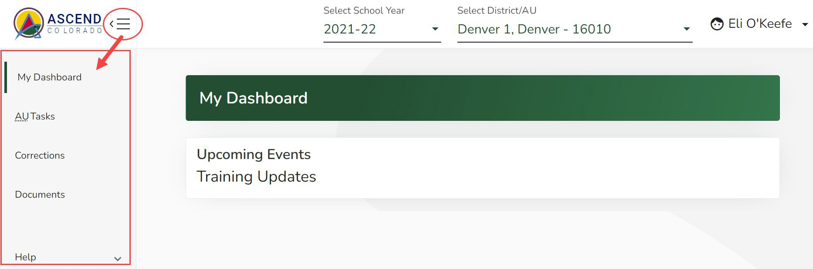
Deadlines
February 23, 2024
  Upload Required Reports to the Data Management System
    Staff Report #’s: 1.0, 1.1, 1.2, 1.4, SAM 1.5
    Student Report #’s: 2.0, 2.1, 2.2, 2.3, 2.4, 2.5, 2.6, 2.7, 2.8, 2.9, 2.10
Reports are to be uploaded to the Data Management System to the Documents (Same location as the Discipline and EOY Reports)

Slide 4
When do reports become available?
Special Education December Count Reports become available once interchange data have been successfully uploaded and a snapshot has been created.
Only pipeline users with the DEC role can see the Special Education December Count Reports.
You can still see the reports when you have errors at the interchange, but data related to those errors won’t be included in the report.
You can still see the reports when you have errors at the Snapshot, but the reports won’t be complete.

Slide 5



Data Collection Process Flow
Upload interchange files
Become error-free at the interchange level
Take a snapshot
Re-take snapshot
Become error-free at the snapshot level
Examine the reports

Slide 6
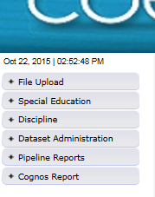
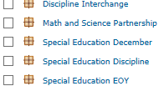
How do I view the reports?
From the Data Pipeline website, click
on +Cognos Report
In COGNOS choose
Special Education December
The following types of reports are available
  Included – Staff and Student
  Excluded – Staff and Student
  Error Reports – Summary and Detail for Staff and Student
  Staff Summary and Detail Reports
  Student Summary and Detail Reports
  Staff and Student Data Validity Certification Reports
  SAM Reports
  Educational Orphan (New)

Slide 7
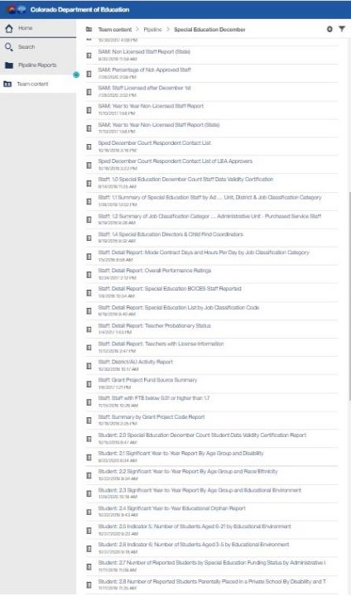
Kinds of reports:
Both Staff and
Student
Error Reports
Included and Excluded
Reports
Data Summary Reports
Indicator Reports
Data Validity
Certifications
Detail Reports

Slide 8
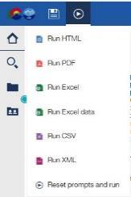
Important Note
When you are ready to create a hard copy of a “signature” report for your Director’s Signature, ALWAYS view the report in PDF Format.
This will ensure:
The best layout of the report for a printed page (no columns will be cut off).
Informative headers and footers will appear on every page, including the time and date the report was generated.
Pages will be automatically numbered.
You will see ALL the pages
including the
Signature Page.
Selecting the right format for your Report
This applies to Staff Reports 1.1 through 1.4 and the Validity Certificates 1.0 and 2.0. GOOD NEWS – The rest of the reports have been formatted to automatically populate as a PDF!

Slide 9
Preparing for
Report Review

Slide 10
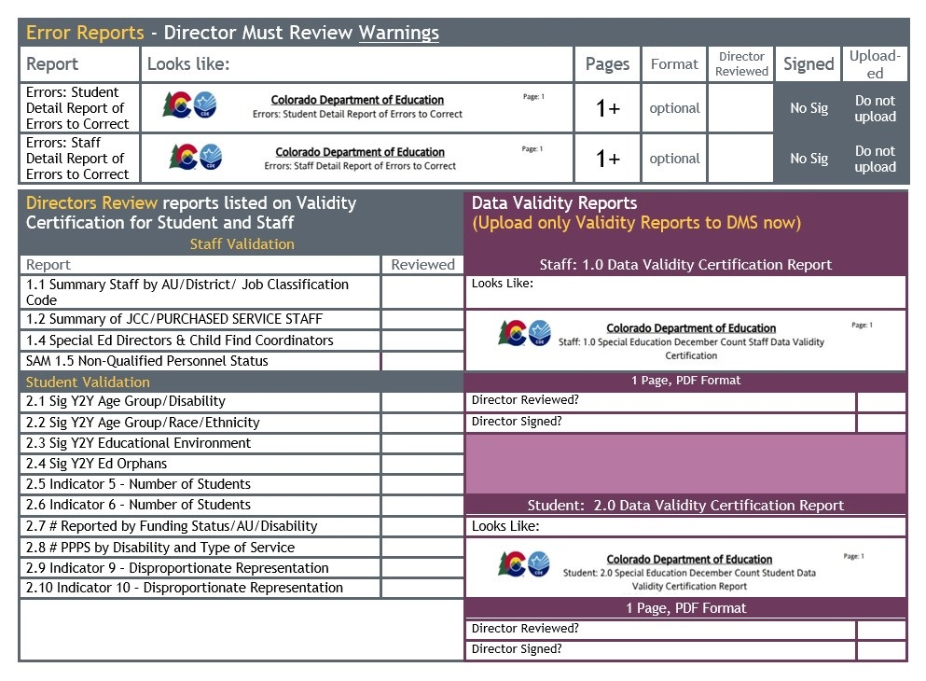
Report Checklist
https://www.cde.state.co.us/datapipeline/decembercountreportchecklist

Slide 11
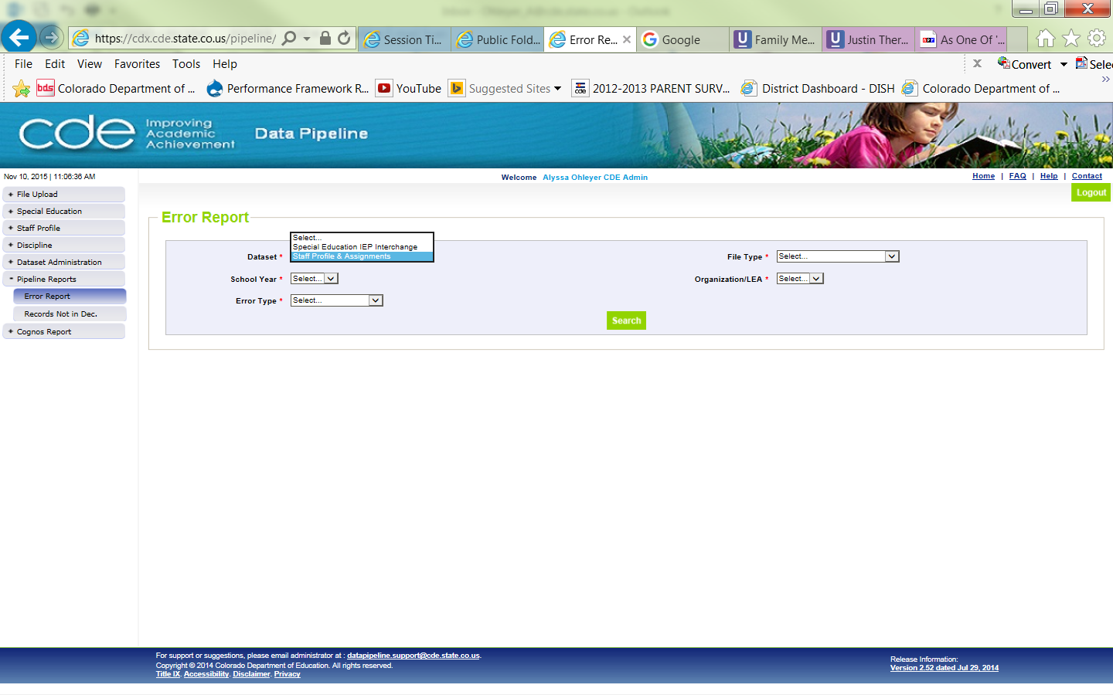
View Student or Staff Interchange Error Reports from Pipeline Reports
Dataset: Special Education IEP Interchange
File Type:
  Sp. Ed December Count Staff
  Sp. Ed December Count Student
If you see ERRORS -> These must be resolved before your final snapshot submission to CDE.
If you see WARNINGS -> These records will make it into snapshot, but there is something unusual with the records. Please check before proceeding.
Tip
+Pipeline Reports > Error Reports
It is important to review Warnings!

Slide 12
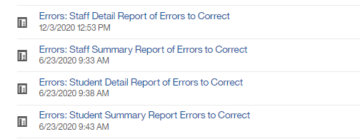
Student & Staff Snapshot Error Reports in COGNOS
>Cognos Report
>Pipeline
>Special Education December
  The Error Reports themselves are not submitted, but your Administrator will be asked to sign off that Error Report Warnings have been reviewed.
Notes:
Grey heading indicate that the report should be reviewed but should not be included in the packet of reports uploaded to the CDE.

Slide 13
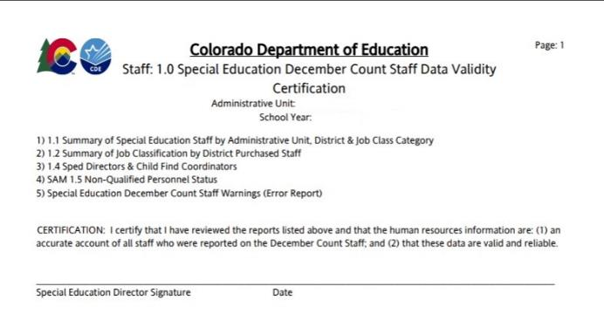
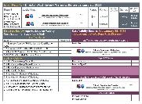
STAFF
DATA VALIDITY Certification Report
Your Director must certify that they have reviewed all these reports. Reports 1.1, 1.2, 1.4, and 1.5 will be uploaded to the DMS in February, after the CDE had reviewed state data for duplicates.
Report slides are color coded to match Checklist!

Slide 14
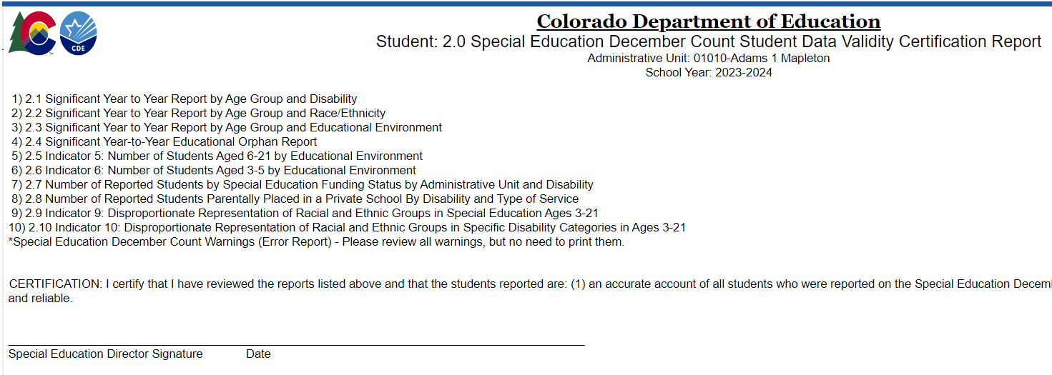
Student Data Validity Certification Report
☑
Your Director must certify that they have reviewed all these reports. Report Numbers 2.0-2.10 will be uploaded to the DMS in February, after the CDE has reviewed state data for duplicates.
Notes:
Before the January due date your director must review the Error Reports for Warnings. Your director must also review the other reports listed and they may want to review “detail” reports that are tied to these.

Slide 15
Uploading to DMS
In order to upload files to the Data Management System, you must be able to log into the Ascend DMS:
Please check that you can do this before the upload deadline.
Your Local Access Manager (LAM) can assign you an appropriate role that will allow you to log in.
  If you encounter any trouble with the Ascend DMS, please email Josh Fails (Fails_J@cde.state.co.us).

Slide 16
STAFF REPORTS
Special Education December Count Reports

Slide 17
February 23, 2024
These are the same reports that your director reviewed prior to Validity Certification Authorization
These reports are run again after the CDE has reviewed all data submitted to the state for duplicates and duplicates have been resolved.
These reports must be signed by your director.

Slide 18
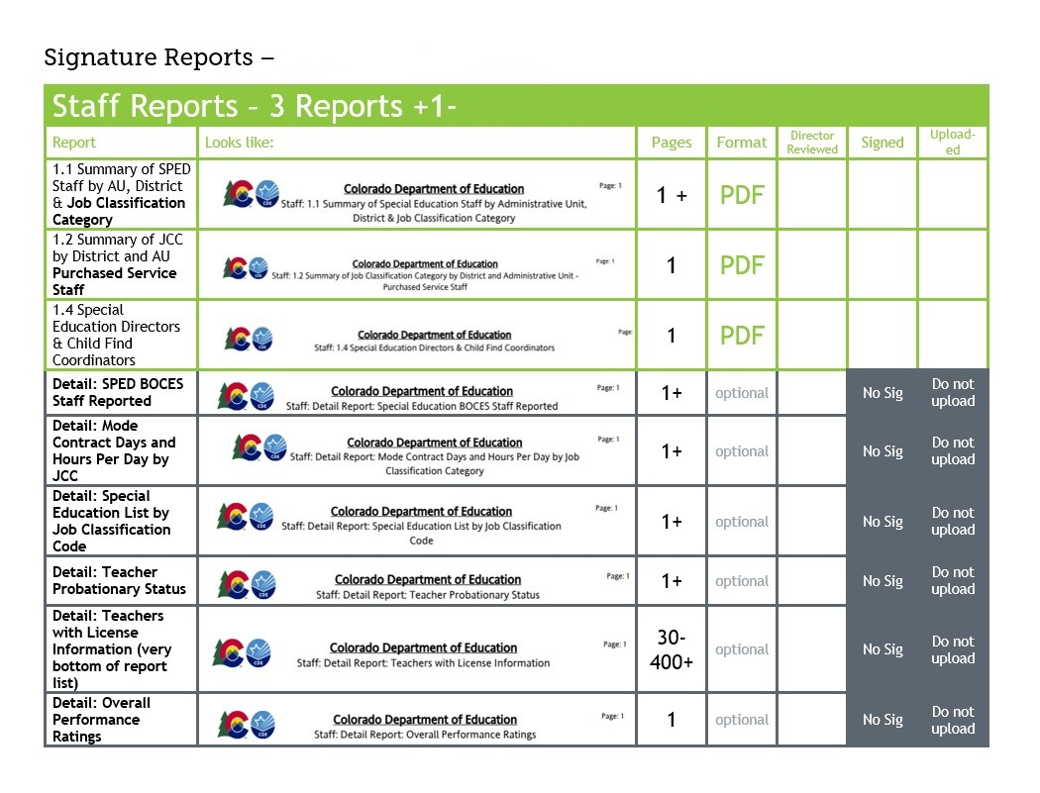
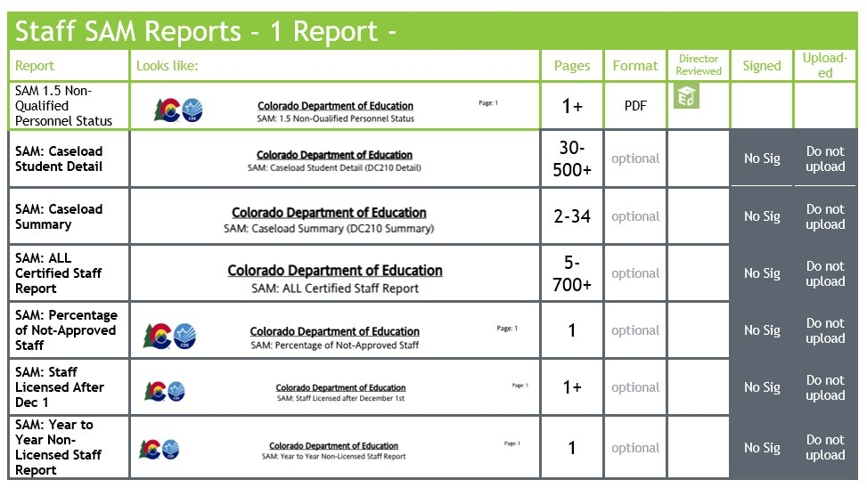
Staff Report Checklist Pages

Slide 19
Staff Report Lists
Reports for Your Director’s Information
4 Reports to be Uploaded
District/AU Activity Report
SAM: ALL Certified Staff Report
SAM: Caseload Student Detail (DC210 Detail)
SAM: Caseload Summary (DC210 Summary)
SAM: Percentage of Not-approved Staff
SAM: Staff Licensed after December 1st
SAM: Temporary Educator Eligibility (TEE)
SAM: Year to Year Non-Licensed Staff Report
Detail: Mode Contract Days and Hours Per Day by JCC
Detail: Overall Performance Rating
Detail: SPED BOCES Staff Reported
Detail: SPED List by JCC
Detail: Teacher Probationary Status
Detail: Teachers with License Info
Grant Project Fund Source Summary
Staff with FTE below 0.01 or higher than 1.7
Summary by Grant Project Code
1.1 Summary of Special Education Staff by AU, District & Job Classification Category
1.2 Summary of Job Classification Category by District and AU Purchased Service Staff
1.4 Special Education Directors & Child Find Coordinators
SAM 1.5 Non-Qualified Personnel Status

Slide 20
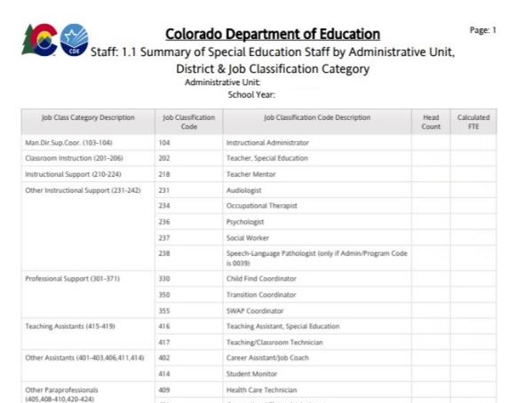

Staff: 1.1 Summary of Special Education Staff by Administration Unit, District &
Job Classification Category

Slide 21
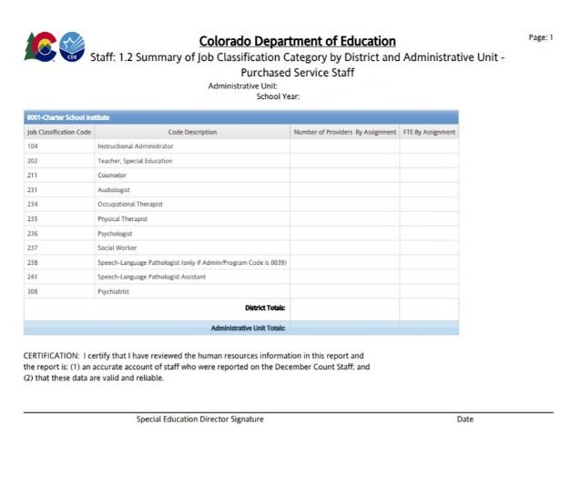
Staff: 1.2 Summary of Job Classification Category by District and Administrative Unit Purchased Service Staff
Select Criteria: Employment Status Code = 23
Average Daily Rate = summed base salary (calculated base salary for hourly employees) divided by mode contract days for job class code divided by the summed FTE
Average Hourly Rate = summed base salary (calculated base salary for hourly employees) divided by the sum of (contract days * hours per day)

Slide 22
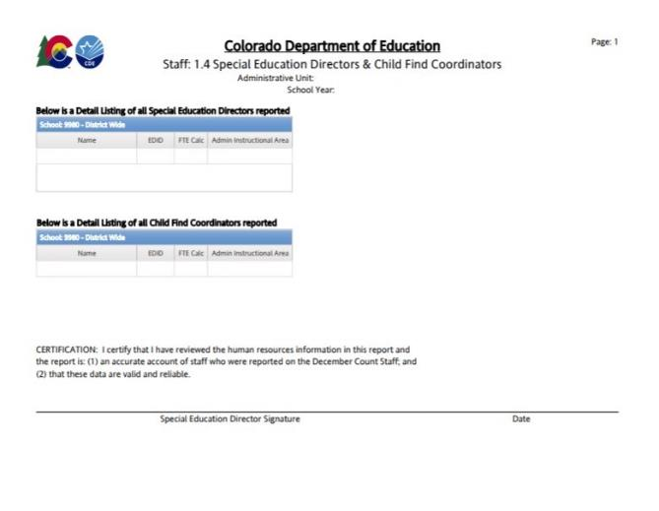
Staff: 1.4 Special Education Directors & Child Find Coordinators
Job Classification Codes 102 and 330

Slide 23
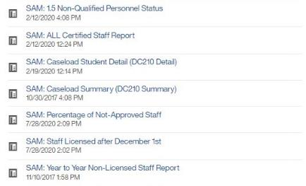
SAM Reports
Staff
  Signature
    SAM 1.5 Non-Qualified Personnel Status
  Detail
    SAM: ALL Certified Staff Report
    SAM: Caseload Student Detail (DC210 Detail)
    SAM: Caseload Summary (DC210 Summary)
    SAM: Percentage of Not-approved Staff
    SAM: Staff Licensed after December 1st
    SAM: Year to Year Non-Licensed Staff Report

Slide 24
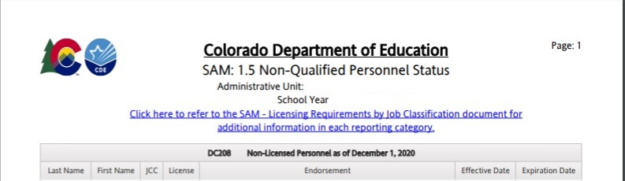
SAM: 1.5 Non-Qualified Personnel Status
This report will automatically generate as a PDF
This report has multiple sections:
Staff with expired licenses
Staff with no licenses
Staff with caseload discrepancies
Staff with an inappropriate license for their position (broken out by position)
Notes:
In previous years this report was compiled by hand. Last year, this report was uploaded to the DMS and directors were contacted by their AU Partner to review the issues. This year the report is generated along with December Count Reports and the report requires a signature.

Slide 25
Special Education December Count
Reports
Student Reports

Slide 26
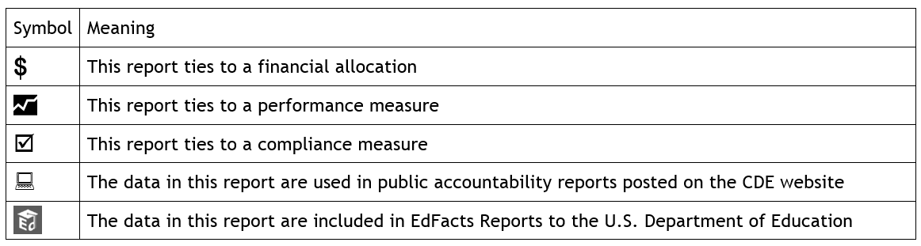
Checklist Symbols

Slide 27
Student Reports
10 +1 STUDENT Reports to be Uploaded to the Data Management System
Year to Year
Data Summary Reports
    2.7 Number of Reported Students by Special Education Funding Status by AU and Disability
    2.8 Number of Reported Students Parentally Placed in a Private School By Disability and Type of Service
    2.5 Indicator 5
    2.6 Indicator 6
    2.9 Indicator 9
    2.10 Indicator 10
  Year-to-Year:
    2.1 By Age Group and Disability
    2.2 By Age Group and Race/Ethnicity
    2.3 By Age Group and Ed. Environment
    2.4 Educational Orphan
  December Count Flag Explanations if you have flags on any of the above Year-to-Year.
Indicators

Slide 28
Student Reports (continued)
Reports for Your Director’s Information (Please don’t upload)
Reports for Reference Only
Indicator 5: Students Aged 5 (in kindergarten) - 12 by Ed Environment and School
Indicator 6: students Aged 3-5 (not in kindergarten) by Ed Environment and School
Student: Detail Listing of Educational Orphans
Student: Detail Listing of Students reported with Funding Status 51
Student: Detail Number of Students Eligible for Special Education Funding by Age Group, Disability and Educational Environment
Student: Detail Number of Students Reported by Age Group, Disability and Administrative Unit/Agency/Facility of Attendance

Slide 29
Student Reports (continued 2)
Reports for Reference Only
Indicator 5: Detail Listing of Students Aged 5 (in kindergarten) -21 by Educational Settings
Indicator 6: Detail Listing of Students Aged 3-5 (not in kindergarten) by Educational Settings
Indicator 9 and 10: Detail Listing of Students by Race/Ethnicity and Disability

Slide 30
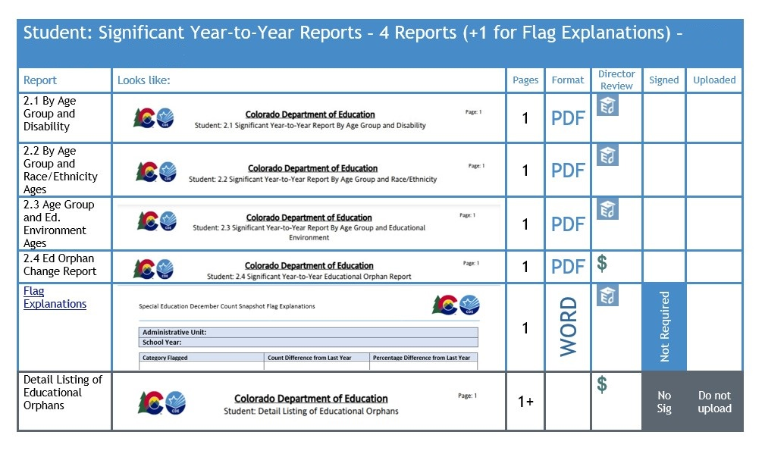
Year-to-Year Checklist Page

Slide 31
4 Significant Year-to-year Reports (Plus Flag Explanations)
2.1 Significant Year-to-Year Change Report by Age Group and Disability
2.2 Significant Year-to-Year Change Report by Race/ Ethnicity
2.3 Significant Year-to-Year Change Report by Age Group and Educational Environment
2.4 Significant Year-to-Year Ed Orphan Change Report
Flag Explanations

Slide 32
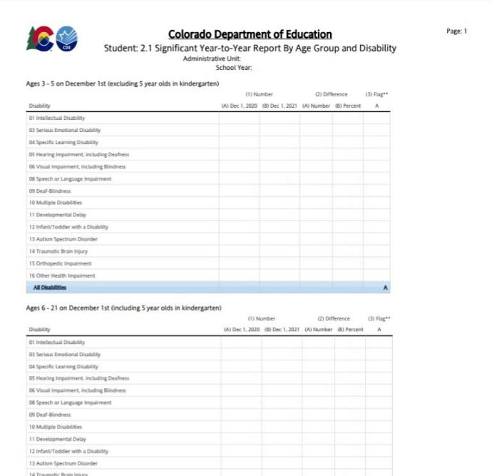

2.1 Significant Year-to-Year Change Report
By Age Group and Disability
Example of flags to explain on the Flag Explanation form
This report will automatically generate as a PDF
Select Criteria: Funding Status = 50.
Calculated Age as of December 1

Slide 33
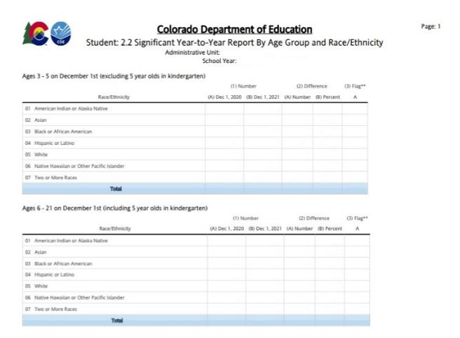
2.2 Significant Year-to-Year Change Report By
Age Group and Race/ Ethnicity
This report will automatically generate as a PDF
Select Criteria: Funding Status = 50.
Calculated Age as of December 1

Slide 34
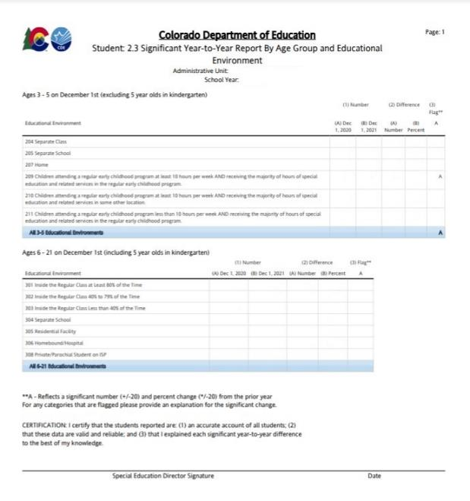
2.3 Significant Year-to-Year Change Report by Age Group and Educational Environment
This report will automatically generate as a PDF
Select Criteria: Funding Status = 50.
Calculated Age as of December 1

Slide 35
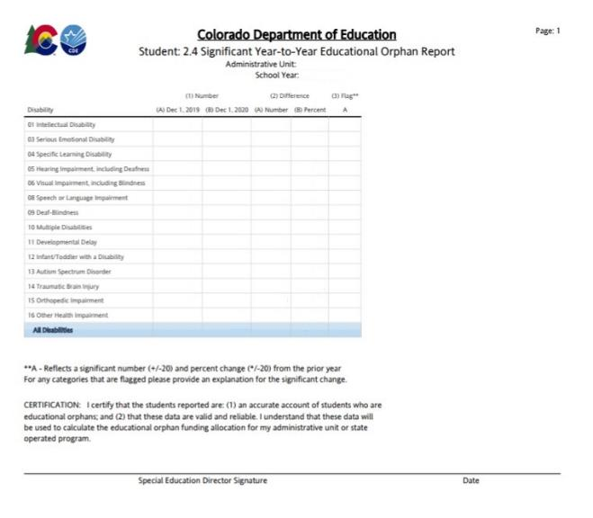
2.4 Significant Year-to-Year Ed Orphan Change Report
$
This report will automatically generate as a PDF
Select Criteria: Number of Educational Orphans reported by year

Slide 36
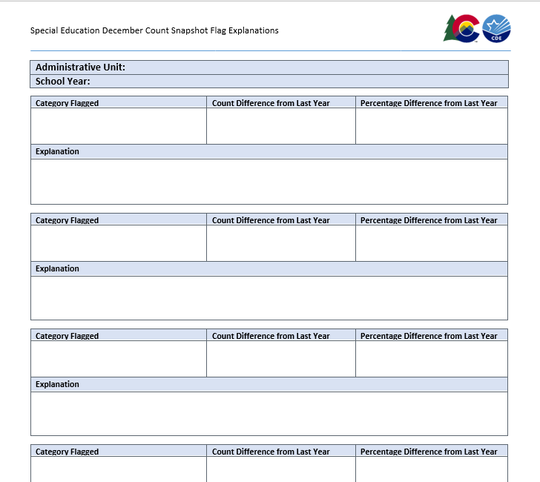
Flag Explanations
Complete Flag Explanations for any flags in the 4 Year-to-Year Comparison Reports. These can be included on the same form when the name of the report is included in the Category Flagged field.
Flag Explanation Report can be found Here: Flag Explanations (.docx)
When you go to upload this, please upload it as a Word Document. All comments are compiled into a master file and it is easier to copy/paste than type it in!
Notes:
If you find yourself copy/pasting an explanation, stop and just add the category flagged and count data to the top three boxes.

Slide 37
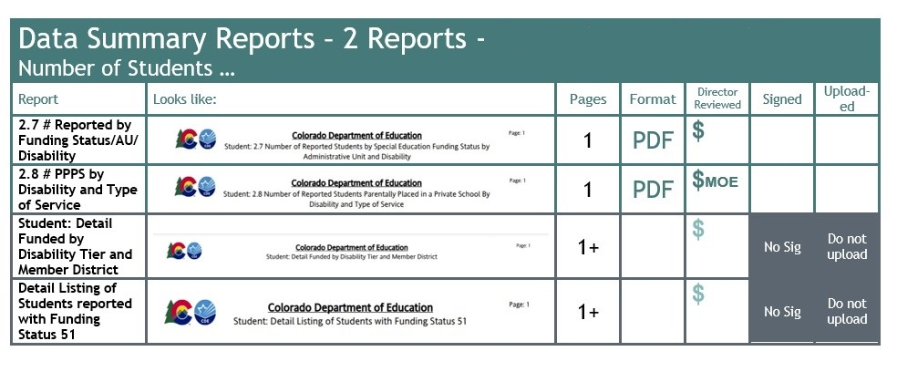
Data Summary Checklist Page

Slide 38

2 Data Summary Reports
    2.7 Number of Reported Students by Special Education Funding Status by AU and Disability
    2.8 Number of Reported Students Parentally Placed in a Private School By Disability and Type of Service

Slide 39
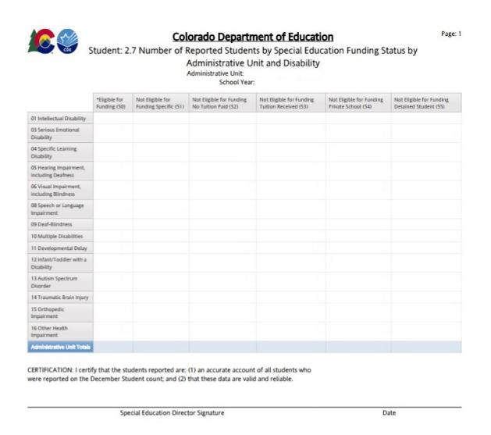
Student 2.7 Number of Reported Students by Special Education Funding Status by Administrative Unit and Disability
$
This report will automatically generate as a PDF
This report includes all records with a valid disability code
This report is 1 Page

Slide 40
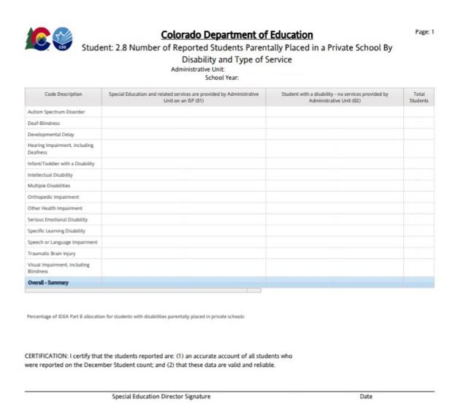
Student: 2.8 Number of Reported Students Parentally Placed in a Private School by Disability and Type of Service
$ MOE
This report will automatically generate as a PDF
Select criteria: Parentally Placed in a Private School = 01 or 02 and Disability is not zero filled
This report is 1 Page

Slide 41
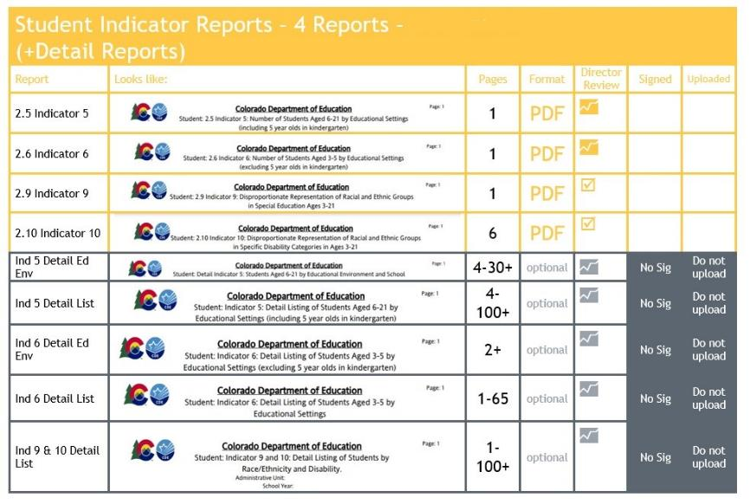
Indicator Report Checklist Page

Slide 42
4 Student Indicator Reports
📈
2.5 Indicator 5:
Number of Students Aged 5 (in kindergarten) -21 by Educational Settings
2.6 Indicator 6:
Number of Students Aged 3-5 (not in kindergarten) by Educational Settings
2.9 Indicator 9:
Disproportionate Representation of Racial and Ethnic Groups in Special Education
2.10 Indicator 10:
Disproportionate Representation of Racial and Ethnic Groups in Specific
Disability Categories
☑


Slide 43
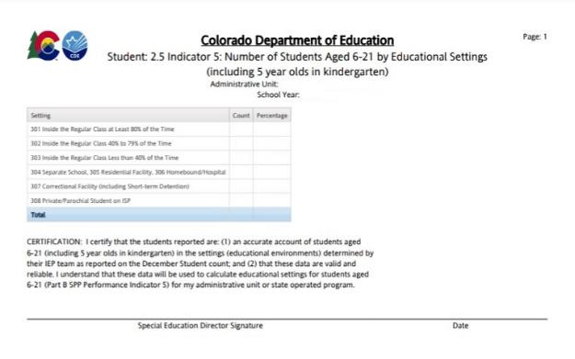
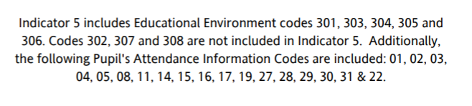
2.5
Indicator 5
Number of Students Aged 5 (in kindergarten) -21 by Educational Settings
📈

This report is 1 page
This report will automatically generate as a PDF
Remember there are two Indicator 5 reports available. Your director must review both - this report of the count and the Detail Report, but you should only upload THIS report to the CDE.

Slide 44
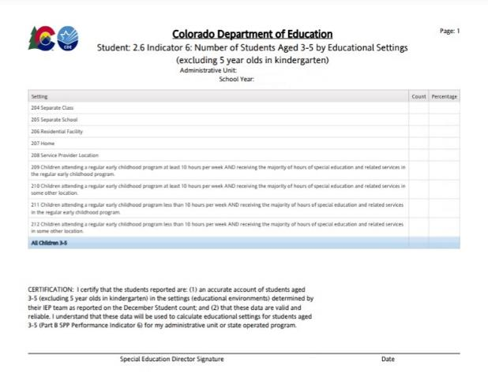
2.6
Indicator 6
Number of Students Aged 3-5 (not in kindergarten) by Educational Settings
Select Criteria: Educational settings = 204-212
PAI 01 02 03 04 05 08 11 14 15 16 17 19 22 27 28 29 30 31
📈

This report is 1 page
This report will automatically generate as a PDF
Remember there are two Indicator 6 reports available. Your director should review both - this report of the count and the Detail Report, but you should only upload THIS report to the CDE.

Slide 45
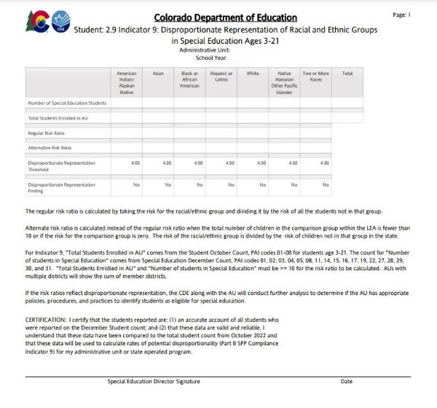
2.9 Indicator 9 Disproportionate Representation of
Racial and Ethnic Groups in Special Education
☑

This report is a 1-page Report
This report will automatically generate as a PDF
When there are at least 10 students with IEPs and 10 students enrolled in the racial/ethnic group, the risk ratio will be calculated. If the risk ratio is 4.0 or more, the ratio will flag.

Slide 46
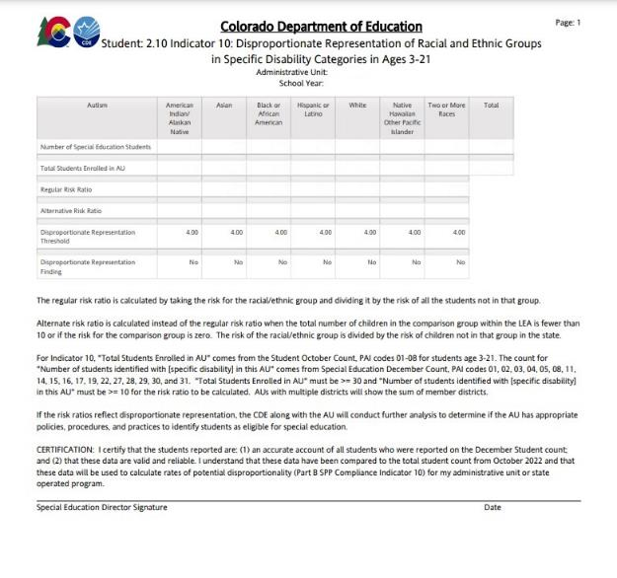
2.10 Indicator 10 Disproportionate Representation of
Racial and Ethnic Groups in Specific Disability Categories
☑

This report is a 6-page Report
This report will automatically generate as a PDF
When there are at least 10 students with IEPs and 30 students enrolled in the racial/ethnic group, the risk ratio will be calculated. If the risk ratio is 4.0 or more, the ratio will flag.

Slide 47
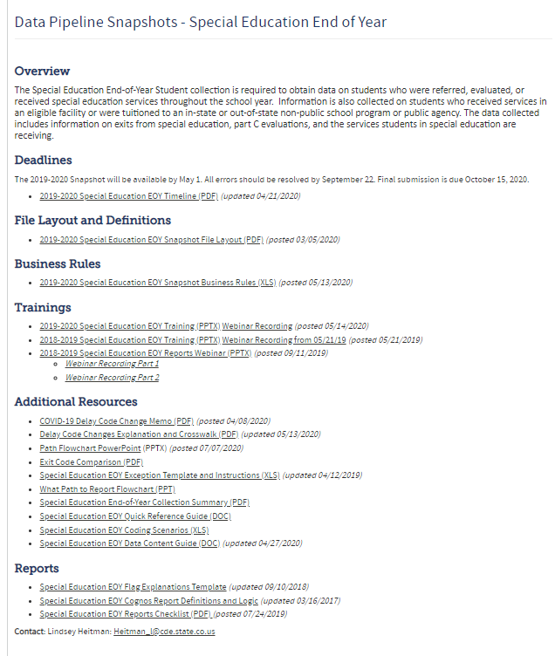
Flag Explanation Templates
AUs are required to submit an explanation for each A flag.
Use the flag explanation templates in the technical assistance document found here under the Reports section: https://www.cde.state.co.us/datapipeline/2022-2023specialeducationdecembercounttimeline

Slide 48
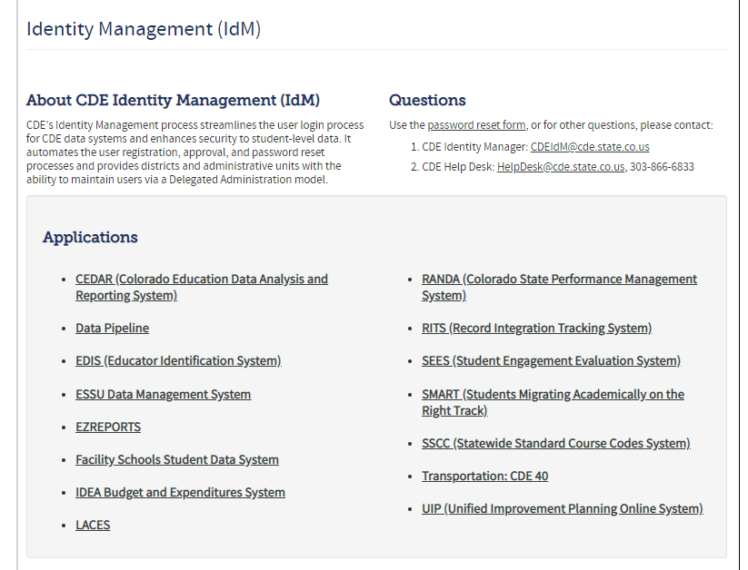
Uploading to the Ascend Data Management System
Log into the Ascend Data Management System
Click “ESSU Data Management System” Link to Data Pipeline Single Sign-on Page (opens in browser)

Slide 49
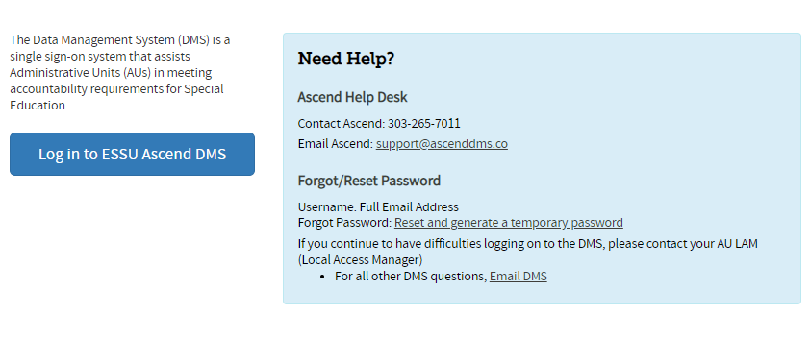
The Ascend Data Management System

Slide 50
Uploading to Ascend DMS
Please Note!!
In order to upload files to the “Documents,” you must be able to log into the Ascend DMS
Please check that you can do this before the upload deadline.
Your Local Access Manager (LAM) can assign you an appropriate role that will allow you to log in.
  If you encounter any trouble with the Ascend DMS, please email Josh Fails (Fails_J@cde.state.co.us).

Slide 51
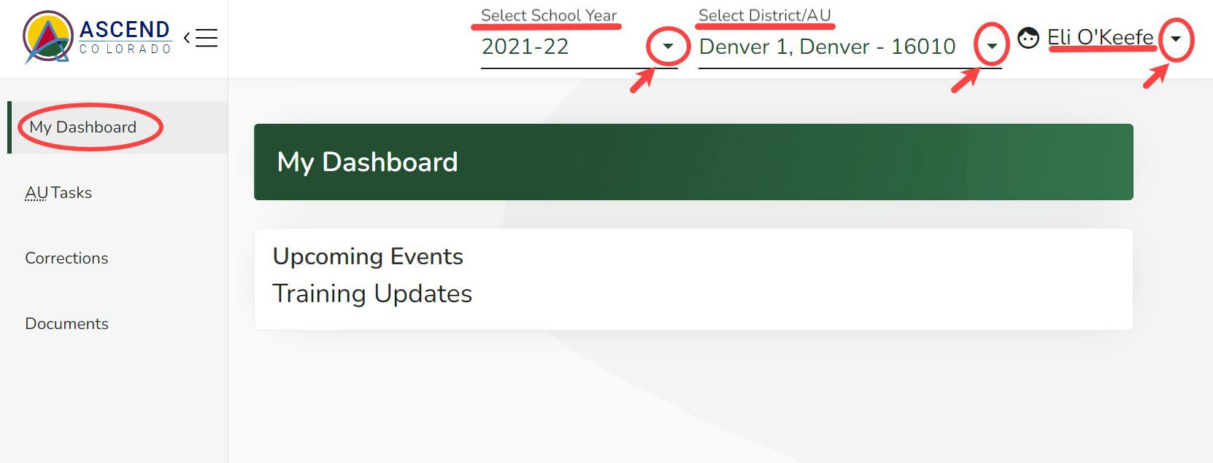

Quick Navigation in the New Data Management System – Overview
Ascend DMS Dashboard
Upon logging into Ascend DMS, you will land on the “My Dashboard” page. Along the top right side of the screen, you will see 3 drop-down fields:
Select School Year
District/AU (*only shows your AU)
Username
Clicking on the shaded caret will give you further options.
When uploading documents, the year in the dropdown is not important.
Caret → 

Slide 52
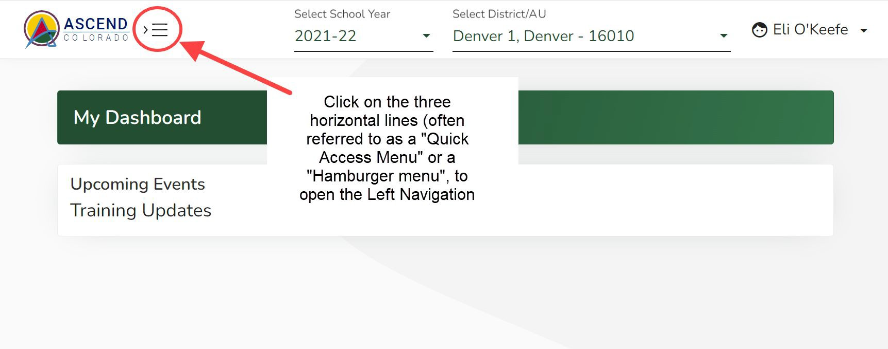
Ascend DMS Left Navigation Pane
Ascend may open with the left navigation pane closed. The left navigation pane contains the links to the various module pages such as AU Tasks, Corrections, Documents, and Help.
To open the left navigation pane:
Click on the Quick Access menu (3 horizontal lines icon) located to the right of the ASCEND logo located in the upper left corner of the screen.
To upload your Reports, select Documents from the menu

Slide 53
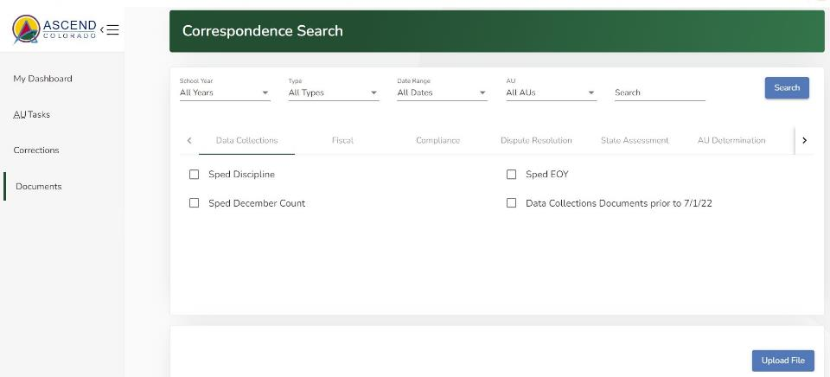
To Upload Documents
Find your “Upload File” button on this Documents Dashboard

Slide 54
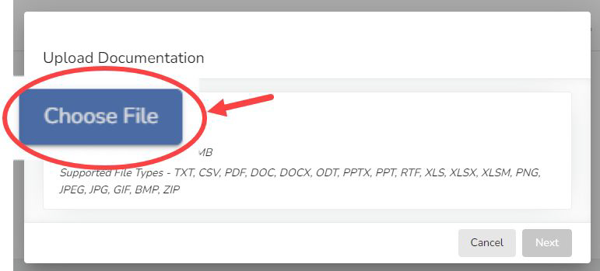
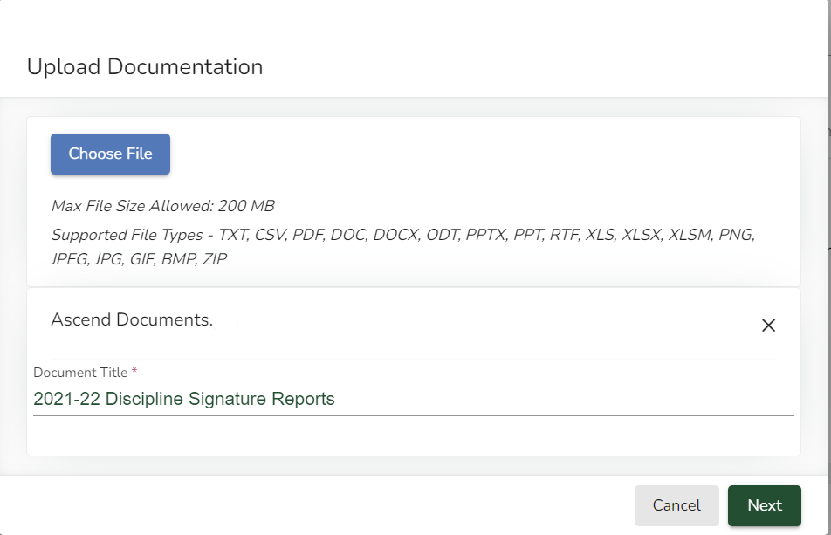
Uploading December Count Report Documents
To upload documents:
Choose the file(s) from your computer
Provide The Document Title
“2023-24 December Count Signature Reports” for the PDFs
“2023-24 December Count Flag Explanations” for the Flag Explanations Word file
2022-23 December Count Signature Reports

Slide 55
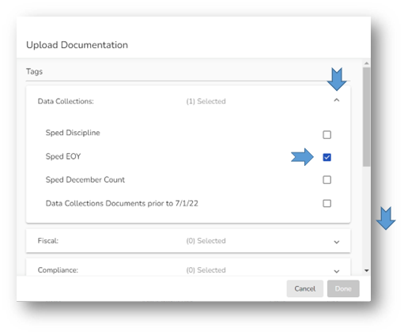

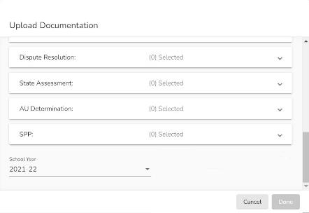

Tagging your Document
Use the carets on the right side of the Upload Documentation box to open Tag selection field for Data Collections
Select Sped December Count
Scroll down
Select 2023-24 for the School Year
Click the “Done” button when it turns green (if it has not turned green, you have missed required info)

Slide 56
Flow of Reports Submission
Download the 16 numbered reports from Pipeline (export to PDF) and make sure all the reported numbers are accurate.
Sign the reports and scan them into one PDF.
Download the “Year-to-Year Flag Explanation Document” found under the Reports section: https://www.cde.state.co.us/datapipeline/specialeducationdecembercountreportschecklist-0 .
Explain the A flagged count differences using the templates in the flag document (2nd page).
Upload the following to Documents in the Data Management System:
  Signed and scanned reports (in one single pdf)
  Filled out year to year explanation template (separate Word document)

Slide 57
Special Education December Count
Special Education Team contact information
Lindsey Heitman – SpedDecCount@cde.state.co.us 303-866-5759
Orla Bolger – bolger_o@cde.state.co.us 720-921-0524
Josh Fails – fails_j@cde.state.co.us 720-618-0538
Thank You!

