Slide 1
2022-2023 School Discipline Data Collection Training May 3rd, 2023

Slide 2
Purpose of the School Discipline Collection
Districts are required to report to CDE, and CDE is required to report to the public and US Department of Education:
The total count of each Behavior Type and Disciplinary Action
ALL students Disciplined by their Demographic information
All Firearms brought to school and Disciplinary Action

Slide 3
School Discipline Training
The goal of this training is to help Districts/Local Education Agencies (LEAs) provide CDE (and ultimately the public) discipline data more efficiently and accurately.
This training will include:
File Information
Reporting Preschool Suspensions/Expulsions
Reporting ,”No Reportable Incidents”
Uploading and Submitting the School Discipline files
Batch Maintenance
Reviewing Errors and Reports
Finalizing the Data

Slide 4
School Discipline Reporting: Quick Guidance
Only report the incidents occurring for the current school year
If there were no incidents and/or no firearms to report, the corresponding file(s) are NOT uploaded into pipeline
The number of students reported as disciplined must be the same or greater than the number of incidents reported

Slide 5
Timeline

Slide 6
Reporting Preschool Discipline Data

Slide 7
Suspension and Expulsion Reporting for Preschool Students
In May of 2019, HB 19-1194 was signed into law.
This law limits the suspensions and expulsion of children in grades preschool through second grade.
It is important that programs work to positively address behaviors that may be challenging rather than suspending and expelling children in preschool.
“Research indicates that young children who are suspended or expelled from school are several times more likely to experience disciplinary action later in their academic careers, drop out or disengage from high school, report feeling disconnected from school, and be incarcerated later in life (HB 19-1194)”

Slide 8
How are suspensions and expulsions defined in early childhood?
In-school suspension -separates or removes a child from the classroom or activity
Out-of-school suspension -temporarily removes a child from the program
Expulsion -permanently removes a child from the program
Soft-expulsion (reported as expulsion in the collection) -when a program inconvenient for a family or unwelcoming to the point they must stop attending
Disenrollment (reported as expulsion in the collection) -permanently unenrolls a child from a program
Early pick-up – (reported as out of school suspension in the collection) when a program requires a child to be picked up early
Colorado Shines Resource-Preventing Suspensions and Expulsions
Any action that meets one of the above definitions must be documented as a suspension or expulsion in preschool

Slide 9
Examples of Suspension in Early Childhood
The following are examples that must be counted when reporting out of school suspensions in early childhood:
Asking a family member to pick up a child early from preschool due to concerning or challenging behavior
Limiting the amount of time a child may attend programming due to concerning or challenging behavior

Slide 10
Examples of Expulsion in Early Childhood
The following are examples that must be counted when reporting expulsions in early childhood:
Families are told the program is a “bad fit”
Families are informed that the program cannot provide the support that the child needs without any effort to implement strategies and accommodations.
Families are made to feel that they are not welcome in the program due to a child’s behavior

Slide 11
In-School Suspensions and Classroom Removals in Early Childhood
In-school suspensions are not specifically addressed in the law however, it is still part of the school discipline data collection. The following is an example of in-school suspensions in preschool:
Requiring a child to spend time in the principal or director’s office for remainder of day or extended days due to disciplinary purposes
Classroom removal is also not specifically addressed in the law however, it is still part of the school discipline data collection. The following example is counted when reporting classroom removal:
A child is temporarily removed from the classroom (moved to hallway, separate room, principal/director’s office) for disciplinary purposes.

Slide 12
Which children need to be reported and how is this tracked?
Districts are responsible to track suspensions and expulsions, and this includes preschool programs serving children funded through CPP or children served with IEPs. This also includes children who are receiving state funding and enrolled in a district program, charter school or community partner program.
The district data respondents needs to work closely with their district early childhood leadership (CPP Coordinators, Preschool Directors, early childhood directors, etc.) to develop a system of documentation and data collection on suspensions and expulsions in preschool.

Slide 13
School Discipline Files
Discipline by Action
Count of Incidents
Discipline by Student Demographics
Count by students by demographics
Firearm Discipline
Count of number of firearms brought or possessed to each school

Slide 14
Discipline by Action File
Collects the
NUMBER of INCIDENTS
by CATEGORY
for each SCHOOL
Discipline by Action

Slide 15
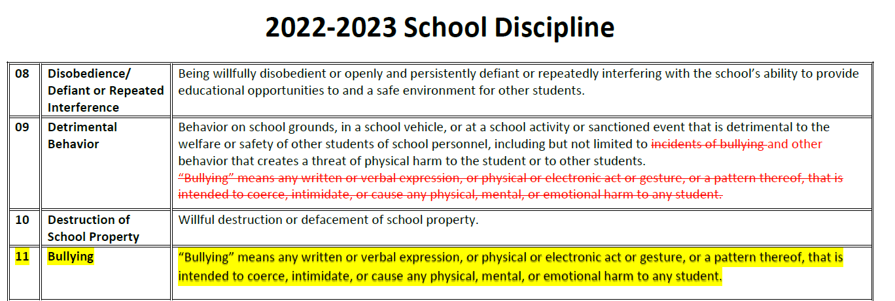
Added Behavior Code for the 2022-2023 Discipline by Action File

Slide 16
Bullying
Any written or verbal expression, or physical or electronic act or gesture, or a pattern thereof, that is intended to coerce, intimidate, or cause any physical, mental, or emotional harm to any student.
-Legal definition of bullying in Colorado
Notes:
In Colorado, the legal definition of bullying is quite complicated. Bullying is defined in Colorado law as: “Any written or verbal expression, or physical or electronic act or gesture, or a pattern thereof, that is intended to coerce, intimidate, or cause any physical, mental, or emotional harm to any student.”

Slide 17
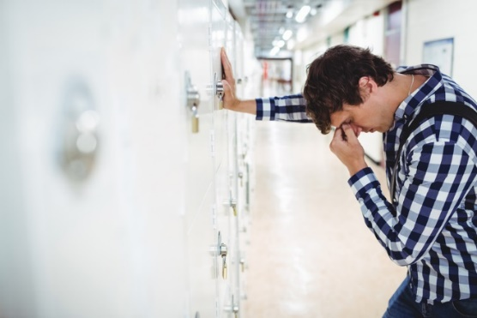
Bullying - Clarifications
Intent
Repeated
Imbalance of Power
(See Gladden et al., 2014)
Notes:
Perhaps an easier way to understand bullying comes from the research on the topic. Researchers suggest that there are three components that differentiate bullying from other forms of aggression.
The first component is that bullying behavior is intentional. It is not an accident. When a student perpetrates bullying against another student, it is done so with the purpose of causing harm.
The second component is that the bullying behavior is repeated or likely to be repeated. Bullying often does not happen just once.
Finally, there is an imbalance of power inherent in bullying situations. This means that the student perpetrating the bullying has power in some form or fashion over the target. The stereotypical portrayal of this power imbalance is that of a bigger, stronger student bullying a smaller, physically weaker student. Think, Biff Tannen bullying George McFly in the movie Back to the Future.
Another way that a power imbalance may play out is if one student is more popular, or has more social power, than another. Examples of this type of power imbalance can be found throughout movies like, Mean Girls.

Slide 18
CATEGORIES
The Categories used are the Behaviors/Allegations codes outlined by state statute and the Office of Civil Rights data collection (Civil Rights Data Collection aka CRDC):
01 - Drug
02 - Alcohol
03 - Tobacco
04 - 1st, 2nd Degree
05 - Dangerous Weapons
06 - Robbery
07 - Other Felony
08 - Disobedience
09 - Detrimental Behavior
10 - Destruction of School Property
11- Bullying
12 - Other Code of Conduct
13 - 3rd Degree
14 - Marijuana
15 - Sexual Violence
16 - Rape
17 - CRDC - Threats
18 - CRDC - Allegations
19 - CRDC - Allegations
20 - CRDC - Allegations
21 - CRDC - Allegations
22 - CRDC - Allegations
Discipline by Action

Slide 19
Record Expectations
A student is suspended, expelled or referred to law enforcement
=
Include and Report the behavior code for the disciplinary action.
If there is not a category code for the behavior, use code 12: “Other Violations of Code of Conduct”
An incident occurs that is classified as a behavior code between 01 and 11 or between 14 and 16
=
Include and Report the incident, along with the resulting action. If student was not suspended, expelled or referred to law, then use ‘Other Action Taken’.
Incidents of behavior code 12: “Other Violations of Code of Conduct” with only ‘Other Action Taken’ ARE NOT included in file.

Slide 20
Reporting the Discipline by Action Data
Each record in the Discipline by Action File represents the total incident information for of each category at the school
Simple Example- at school 1234, there were 4 incidents of drug violations, all resulting in expulsion:
District Code | School Code | Behaviors | Weapon | # Of Incidents | Class Removal | In Schl Susp | Out Schl Susp | Expulsion | Law Referral | Other Action | Optional Field
1111 | 1234 | 01 | 0 | 4 | 0 | 0 | 0 | 4 | 0 | 0
Discipline by Action

Slide 21
Reporting the Discipline by Action Data: Behaviors
Each Behavior Incident can only have 1 Action taken
Report most severe action taken if multiple (i.e., expulsion over suspension)
Exception is for Referrals to Law Enforcement –
ALL Law Enforcement Referrals must be reported in addition to any other action taken for the incident
Number of Incidents reported must be greater than 0
Only report those behaviors that occurred at the school for the year
If there were no incidents of a behavior, no record is needed for that behavior code
Optional Field – allows you to report 1 record per incident if this is easier. Use an identifying number to keep track of each incident in the file to ensure there are no duplicates.
Discipline by Action

Slide 22
Reporting the Discipline by Action Data: CRDC Allegations
Each Allegation would not have any Action Taken reported
Each Allegation record would be reported with the:
Number of Incidents reported
Weapon description if applicable
Allegation counts are only used for pre-populating the Civil Rights Data Collection (CRDC) for LEAs
Discipline by Action

Slide 23
Discipline by Student Demographic File Purpose
Collects the
NUMBER of STUDENTS
by DEMOGRAPHICS
AND
DISCIPLINARY ACTIONS
for each SCHOOL
Discipline by Student Demographics

Slide 24
DEMOGRAPHICS AND DISCIPLINARY ACTIONS
Demographic Information:
Ethnicity/Race
Gender
Grade Level
IDEA/Special Education status
Section 504 Status
ELL Status
This data element optional field
was new in 2020-2021
may use this for SASID/LASID
Disciplinary Actions:
Unduplicated Count of Students Disciplined
Classroom Removals
In-School Suspensions
Received Only One Out-of-School Suspension
Received More than One Out-of-School Suspension
Total Out-of-School Suspensions
Expulsions With Educational Services
Expulsions Without Educational Services
Law Enforcement Referral
School Related Arrest
Other Action
Discipline by Student Demographics

Slide 25
Reporting the Discipline by Student Demographics Data
Each student disciplined is counted by their demographic information and counted for each disciplinary action throughout the year. The student is counted as 1 in the unduplicated count field.
Simple example: there were 4 white female 8th grade students disciplined at school 1234. All 4 were expelled.
District Code | School Code | Federal Race | Gender | Entry Grade Level | Sped | Section 504 | ELL | Undup Count | Class Removal | In Schl Susp | Rcvd One Out Schl Susp | Rcvd Multi Out Schl Susp | Total Out Schl Susp | Expul With Services | Expul Without Services | Law Referral | School Related Arrest | Other Action | Habitually Disruptive
1111 | 1234 | 05 | 01 | 080 | 0 | 0 | 0 | 4 | 0 | 0 | 0 | 0 | 0 | 4 | 0 | 0 | 0 | 0 | 0
Discipline by Student Demographics

Slide 26
Reporting the Discipline by Student Demographics Data: Additional Info
The Unduplicated Count reports the number of students disciplined at least once
New Optional Field – allows you to report 1 record per student if this is easier. Use an identifying number to keep track of each student in the file to ensure there are no duplicates.
If this field is used, the Unduplicated Count would be ‘1’ for every record
Discipline by Student Demographics

Slide 27
Discipline by Action VS. Discipline by Demographics
Discipline by Action
Count of Incidents
Type of Behavior Reported (drug, alcohol, fights, etc.)
1 incident = 1 action taken
(+ any Referral to Law)
Discipline by Demographics
Count of Students
All disciplinary actions taken are reported
Summarized by Student Demographic Information
Discipline by Action
Discipline by Student Demographics

Slide 28
Important Note
Discipline by Student Demographic
>
or
=
Discipline by Action
Count of Students Disciplined
Count of Incidents
multiple students may be disciplined for 1 incident
2 students
disciplined
1 fight
>

Slide 29
Firearm (GFSA) Discipline File Purpose
Collects the NUMBER of
FIREARMS BROUGHT TO SCHOOL
by TYPE
and DISCPLINARY ACTION
for each SCHOOL
Firearm (GFSA) Discipline

Slide 30
Firearm Types and Disciplinary Actions
Firearm Types:
Handgun
Rifle/Shotgun
Other Firearm
Multiple Firearms
Optional Field-
may use this for SASID, LASID or
incident ID
Disciplinary Actions:
Brought or Possessed at School
Students Expelled
Students Expelled Less Than One Year
Students Referred And Expelled Less Than One Year
Students Expelled At Least One Year
Students Referred And Expelled At Least One Year
Students Not Disciplined
Students Disciplined Other
Students Removed Other
Firearm (GFSA) Discipline

Slide 31
Reporting the Firearm (GFSA) Data
Each record in the Firearm (GFSA) file represents the total number of each type of firearm brought/possessed at the school
Simple example: there were 2 handguns brought to the school; each resulting in an expulsion for one calendar year with a referral to an alternative school/program:
District Code | School Code | Grade | Weapon | Sped | Brought/ Possessed | Expulsion | Expul < 1 Yr | Expul < 1 Yr & Referred | Expul 1 Yr | Expul 1 Yr & Referred | Not Discp | Other Discp | Other Removal | Other ID
1111 | 1234 | 080 | 01 | 0 | 2 | 2 | 0 | 0 | 2 | 2 | 0 | 0 | 0
Firearm (GFSA) Discipline

Slide 32
Firearm (GFSA) Discipline File Flowchart
(A) Brought or Possessed at School
(B1) Expelled
(B2) Other Discipline Action
(B3) Remove Other
(B4) No Action Taken
(C1) Less Than Mandatory One Calendar Year
(C2) Full Mandatory One Calendar Year
(D2) Referred to Alternative School/Program
(D1) Referred to Alternative School/Program
Action Taken
Length
Firearm (GFSA) Discipline
Alt Program

Slide 33
Reporting the Firearm (GFSA) Data: Additional Information
If there were no firearms at any of your schools, DO NOT upload a Firearm (GFSA) file
If you do have firearms to report, there is the new Optional Field that can be used; allows you to report 1 record per student if this is easier. Use an identifying number to keep track of each student in the file to ensure there are no duplicates.
Firearm (GFSA) Discipline

Slide 34
Data Pipeline Process

Slide 35
Identity Management Roles
IdM Role | Enables User to:
SDA~LEAAPPROVER | Finalize, Submit, Modify and View Data
SDA~LEAUSER | Submit, Modify and View Data
SDA~LEAVIEWER | View Data
To have access to the SDA periodic collection, one of the following 3 roles would need to be assigned to you by your Local Access Manager:
If you plan to ‘do it all’ – you will want the SDA~LEA Approver Role
~This role will also allow you to complete the Attendance Snapshot

Slide 36
Pipeline Access
To log into Data Pipeline to submit a SDA File you will use this link: https://www.cde.state.co.us/idm
You can bookmark this link for easier access
Click on Data Pipeline Log in to Data Pipeline

Slide 37
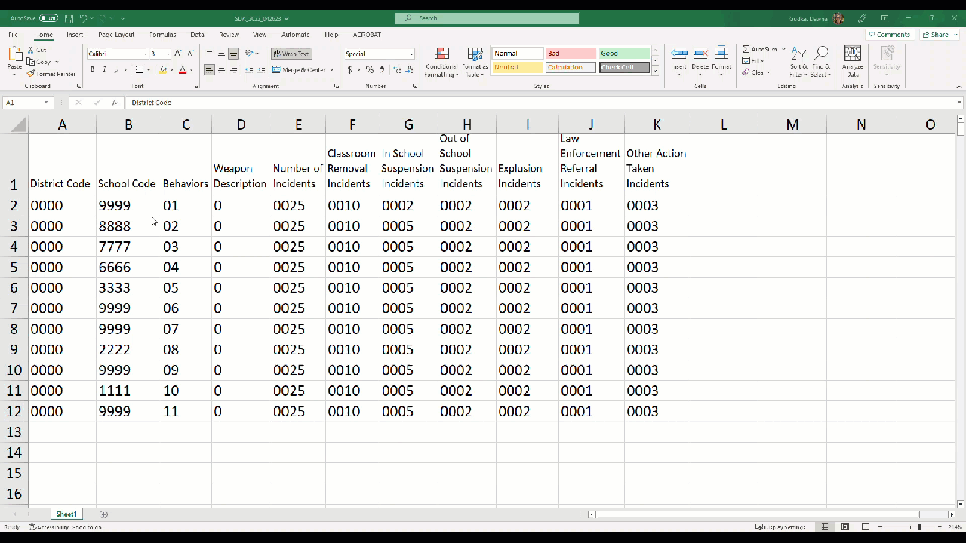
SCHOOL DISCIPLINE FIRST STEP
EXTRACTING YOUR SCHOOL DISCIPLINE FILE FROM YOUR STUDENT INFORMATION SYSTEM
Discipline by Action
Discipline by Student Demographics
Firearm Discipline
Analyzing your data in your Discipline by Action file to determine what schools in your LEA has discipline data to report
Analyze your data in your Firearm Discipline file to determine what schools in your LEA has discipline data to report
gudka_d@cde.state.co.us Dawna Gudka (303) 598-7901

Slide 38
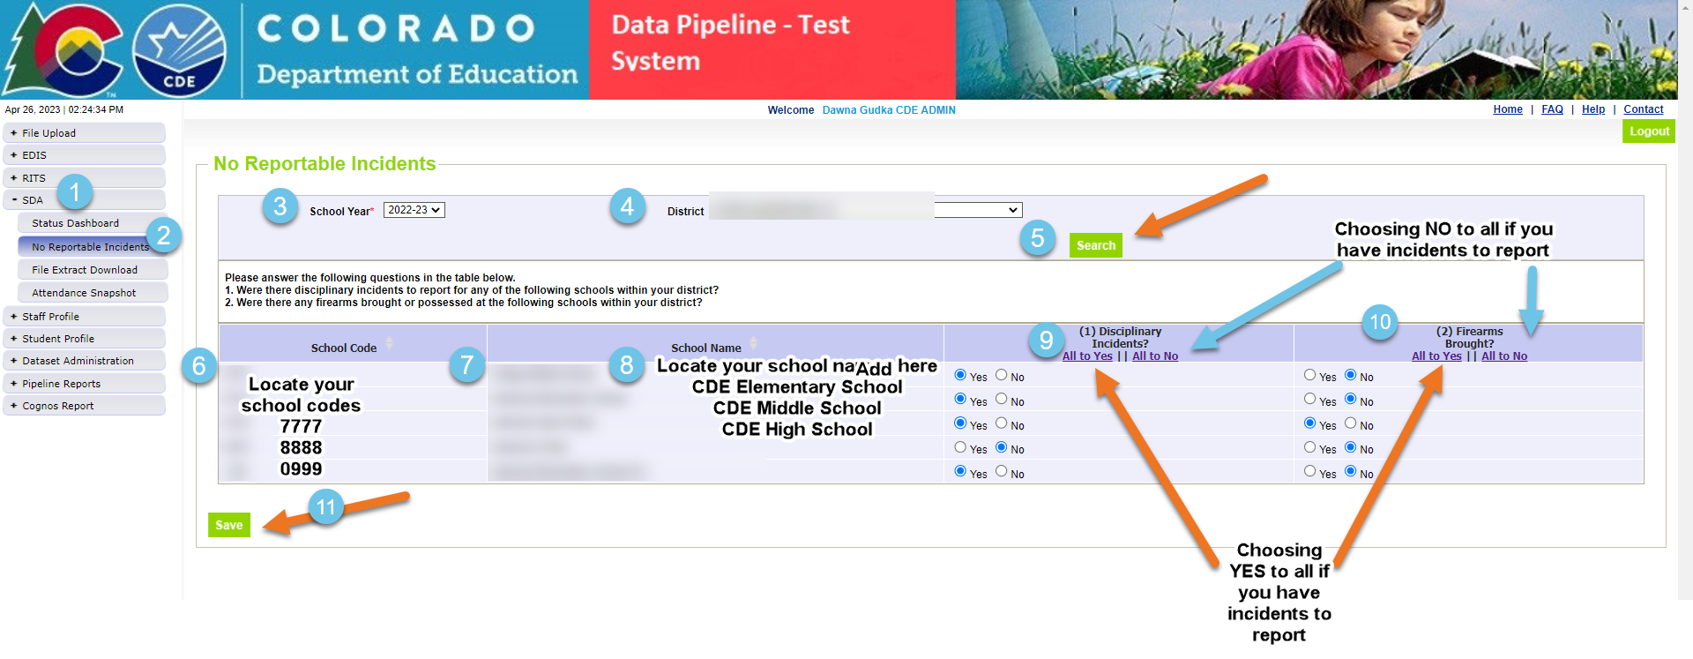
SCHOOL DISCIPLINE 2nd Step: NO REPORTABLE INCIDENT TAB UPDATED
To populate all your schools in your LEA, choose ALL
gudka_d@cde.state.co.us Dawna Gudka (303) 598-7901

Slide 39
No Reportable Incidents – Disciplinary Incidents
Yes – Disciplinary Incidents
School MUST be included BOTH Discipline by Action file
AND Discipline by Student Demographic file
No – Disciplinary Incidents
School CANNOT be included in the Discipline by Action file OR the Discipline by Student Demographic file
IF ALL schools marked with “No”, then the Discipline by Action file AND the Discipline by Student Demographic files ARE NOT UPLOADED

Slide 40
No Reportable Incidents – Firearm Incidents
Yes – Firearm Incidents
School MUST be included the Firearm (GFSA) file
No – Firearm Incidents
School CANNOT be included in the Firearm (GFSA) file
IF ALL schools marked with “No”, then the Firearm (GFSA) file is NOT UPLOADED

Slide 41
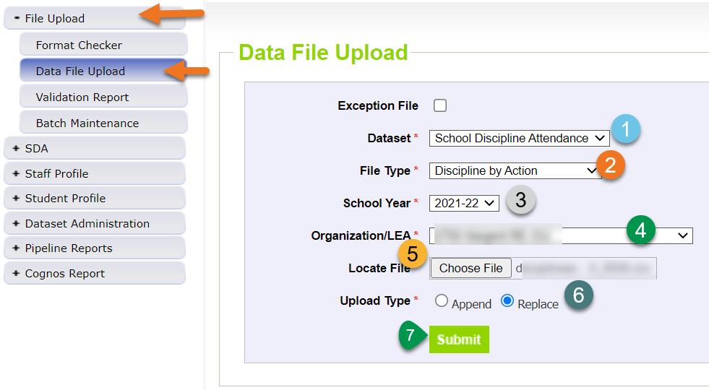
Uploading School Discipline Discipline by Action

Slide 42
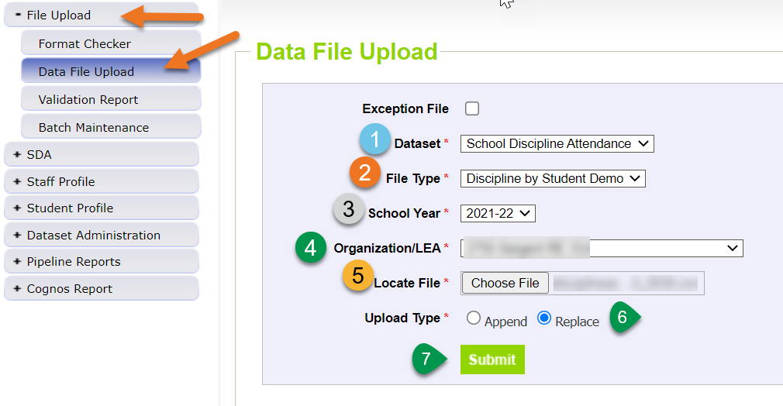
Uploading School Discipline Discipline by Student Demographics

Slide 43
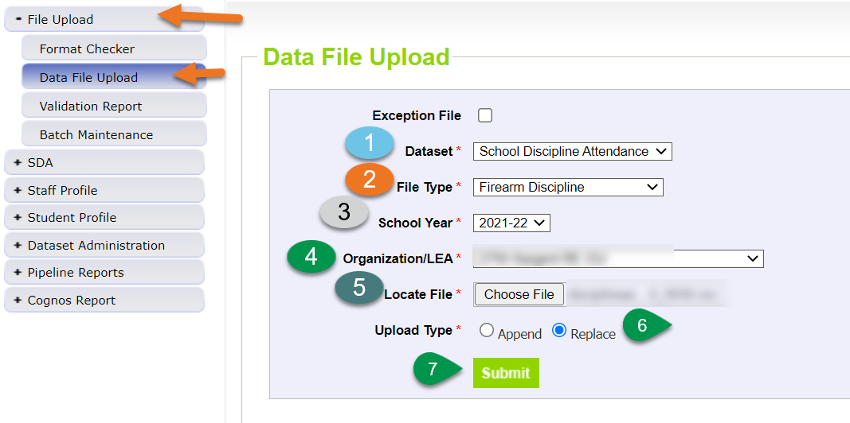
Uploading School Discipline Firearm Discipline

Slide 44
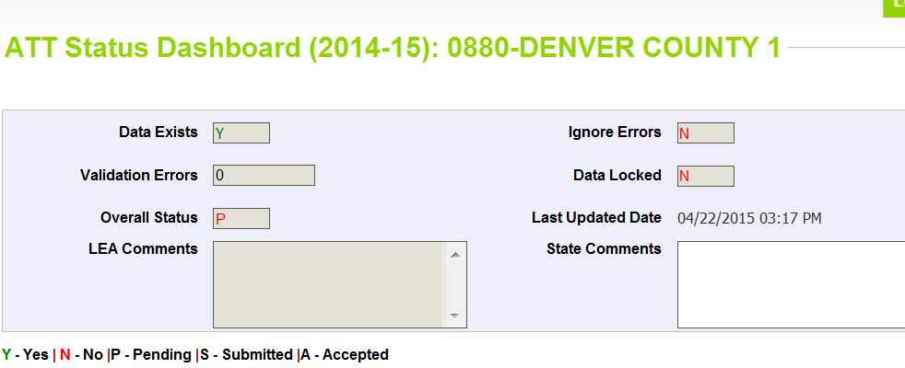
Status Dashboard
Confirms file processed and provides the error count in the file
Data Exists = Y (data processed) or N (data not processed)
Validation Errors = # (# of errors in file)
Overall Status = P (Pending) or N (No data)
Last updated date = last date of upload

Slide 45
Review Errors and Warnings
Two options:
Using Cognos
Using Pipeline Error Reports
You may use either option exclusively or both throughout

Slide 46
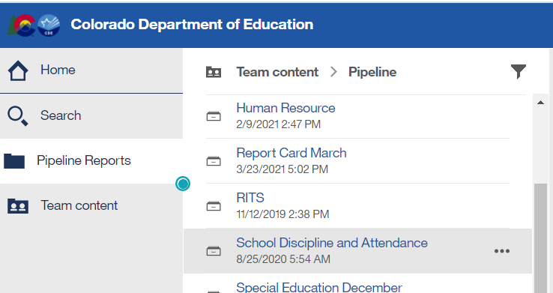
Using Cognos (Errors and Warnings)
In cognos, choose ‘Pipeline Reports’ and then ‘School Discipline and Attendance’

Slide 47
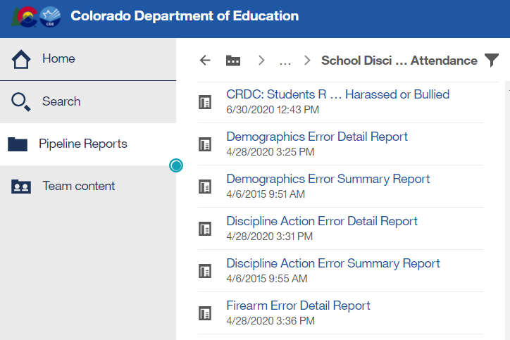
Cognos Error Reports
Select the appropriate Error Report
If there are no errors for your district for the file OR the file was not processed for your district yet, there will be no error report available
Error reports can be downloaded into excel

Slide 48
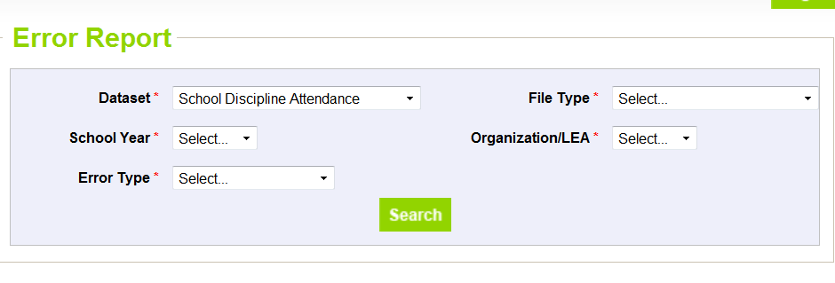
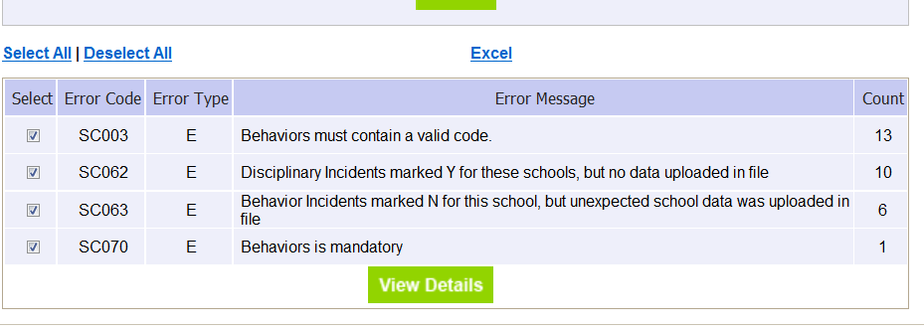
Using Data Pipeline Reports (Errors and Warnings)
Select file type, year, LEA and Errors and Warnings – then select “Search”
Select View Details and then Excel to view report in Excel

Slide 49
Correct Data
Update data in data files based on errors/warnings and re-upload files as needed
Repeat steps until all errors in file are resolved for all files

Slide 50
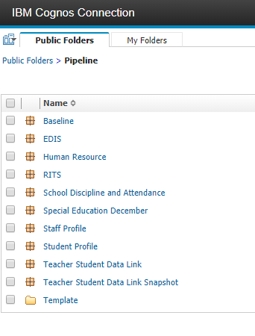
Accessing Cognos Reports to Validate

Slide 51
Discipline by Action Taken Reports
Discipline Action Error Detail Report
Discipline Action Error Summary Report
Summary of Behavior by Action
Count Incidents by Action Trend
Comparison of Incidents Reported and Students Disciplined

Slide 52
Discipline by Student Demographic Reports
Comparison of Incidents Reported and Students Disciplined
Count of Students Disciplined Trend
Summary of Disciplinary Actions by Federal Race/Ethnicity
Summary of Disciplinary Actions by Gender
Summary of Disciplinary Actions by Grade
Summary of Disciplinary by Demographic File
Demographics Error Detail Report
Demographics Error Summary Report

Slide 53
Firearm (GFSA) Data Reports
Firearm Error Detail Report
Firearm Error Summary Report
Summary of Firearm Data

Slide 54
Key Words used in Report Titles
Error Detail Report
Includes record with each error
Error Summary Report
Provides count of records with each error
Trend
Data provided for current year, prior year and 2 years prior
Summary
Grouping the data reported into categories

Slide 55
Summary of Behavior by Action
Provides the Type of Behavior (code and description) AND totals as reported for each by School:
Number of Incidents
Classroom Removals
In-School Suspensions
Out-of-School Suspensions
Expulsions
Law Enforcement Referrals
Other Action Taken
Discipline by Action

Slide 56
Count Incidents by Action Trend
Provides data reported in the Discipline by Action Taken File for the current year, prior year and 2 years previously
Total Number of Incidents
Classroom Removal Incidents
In School Suspension Incidents
Out of School Suspension Incidents
Expulsion Incidents
Law Referral Incidents
Other Action Taken Incidents
Discipline by Action

Slide 57
Comparison of Incidents Reported and Students Disciplined
Provides the total counts of incidents reported per school
Provides the total count of students disciplined reported by school
These numbers will assist with any comparison error(s) in your data file and to verify accuracy of both reports
Recall, the count of students disciplined should be either more than or equal to the count of incidents reported
Discipline by Action
Discipline by Student Demographics

Slide 58
Count of Students Disciplined Trend
Provides data reported in the Discipline by Student Demographic File for the current year, prior year and 2 years previously
Number of Students Reported as Disciplined (unduplicated count)
Number of Students Reported with Classroom Removals
Number of Students Reported with In School Suspension
Number of Students Reported with Out of School Suspension
Number of Students Reported with Expulsions (with or without services)
Number of Students Reported with a Law Enforcement Referral
Number of Students Reported with an Other Action Taken
Total Number of Students Disciplined (duplicated count)
Discipline by Student Demographics

Slide 59
Summary Reports for Discipline by Student Demographic
Summary of Disciplinary Actions by Federal Race/Ethnicity
Total of each disciplinary action reported by Federal Race/Ethnicity for each School
Summary of Disciplinary Actions by Gender
Total of each disciplinary action reported by Gender for each School
Summary of Disciplinary Actions by Grade
Total of each disciplinary action reported by Grade for each School
Summary of Discipline by Demographic File
Total of each disciplinary action reported by Federal Race/Ethnicity, Gender, Grade, Special Education, 504, and ELL status for each School
Discipline by Student Demographics

Slide 60
Summary of Firearm Data
Provides data only if Firearm file was uploaded
Provides Firearm data by School, Grade Level and Firearm Weapon Code/Description
Firearm (GFSA) Discipline

Slide 61
CRDC Reports
All will have title “CRDC: %%%%”
These reports will have data included for review

Slide 62
Finalize Data
New file is available to finalize all 3 files at once; this file is titled “All Discipline”
All files must be uploaded and error free OR indicated as “No” for all schools in No Reportable Incidents tab prior to finalizing
By finalizing the “All Discipline” file ALL 3 files are finalized
Download sign off form will indicate which schools have data reported

Slide 63
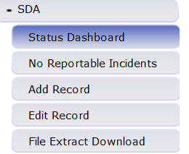
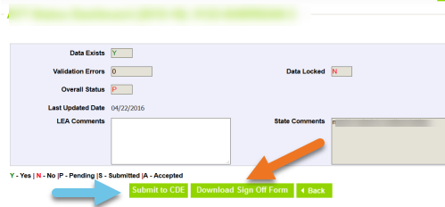
Finalize Data Steps
Only the SDA~LEAAPPROVER role can perform this step
Submit to CDE
Download Sign off Form

Slide 64
Quick Review of Process
Update ‘No Reportable Incidents’ Tab
Upload Data files in order (if applicable)
Discipline by Action File
Discipline by Student Demographic File
Firearm (GFSA) Discipline File
Review error reports, correct data and re-upload files as needed
Review data reports for accuracy
Finalize data file utilizing the ‘All Discipline File’

Slide 65
Thanks for Attending!
Any questions or if you need any assistance with the School Discipline collection, please contact me.
Dawna Gudka
Gudka_d@cde.state.co.us
(303) 598-7901
School Discipline Website

