Slide 1
February 6, 2025
Data Pipeline Town Hall
The goal of the webinar is to provide updates on the Data Pipeline, current, and upcoming data collections. These webinars also provide a forum for districts, BOCES, and Administrative Units to have questions answered about Data Pipeline.

Slide 2
Colorado Department of Education
Identity Management (IdM)
Identity Management Site
Frequently Asked Questions
How do I add myself or others to the email listserv for town hall emails and/or a specific collection?
  Email lists are dependent on a person’s access rights in IdM. Contact your LAM to get an account or be assigned to a specific collection.
Where can I find the IdM role mappings for Data Pipeline and other applications?
  Role Mapping (XLS)
I am a LAM. How do I update the user permissions for someone in my district?
  Follow the steps outlined in the IdM Quick Guide for Access Management (DOCX)
Important: Users are not automatically removed from IdM when their email address is no longer active in your district. The LAM must deactivate their IdM account to ensure only designated staff can access CDE’s data reporting system.
Notes:
LAMs, please check the IdM roles for your district. Remove permissions for users who have retired, left your district, or are no longer assigned to a collection. Add roles for new hires and newly assigned respondents for specific collections.

Slide 3

What is PII?
Student and Staff Personally Identifiable Information (PII) is defined by state and federal laws as information that, alone or in combination, personally identifies an individual
  This includes direct identifiers
  (i.e. student and staff names, SASID, EDID, etc.)
  Includes information that when combined is identifiable
Colorado’s Student Data Transparency and Security Act outlines requirements for how Student PII is collected, used and shared
See the Data Privacy and Security website for prepared guidance on how to comply with this and other privacy laws.

Slide 4

Sharing Data
Use secure methods to transfer any PII to CDE
  Contact Data Collection leads with questions about how to transmit PII securely
    Each Data Collection leads maintains their own Syncplicity folders for specific collections, reach out to the collection lead for access
  Use Syncplicity to encrypt emails to CDE
Avoid sending PII via unencrypted email or to unsecured faxes when sharing data between or within districts
  Use Syncplicity to encrypt emails to CDE
Check local policies for restrictions, requirements, etc. regarding PII
  Do not use PII in trainings, presentations, etc.
  Do not share PII with unauthorized individuals
  Do not share passwords
  Follow local policies when transmitting PII to any third party

Slide 5
Today’s Agenda
Agenda Topic | Presenter
Open Data Collections and Upcoming Deadlines in Data Pipeline | Host: Lindsey Heitman
Teacher Student Data Link | Peter Hoffman
Special Education December Count | Lindsey Heitman
Summer EBT | Collin Slutzky

Slide 6
Open Collections and
Upcoming Deadlines in
Data Pipeline

Slide 7
Open Collections and Upcoming Dates:
Year-Round & Interchanges
Name | Category | Status | Key Dates
RITS | Year Round | Open | N/A
EDIS | Year Round | Open | N/A
Directory | Year Round | Open | Reduced Academic Calendar: 2/5/2025 to 5/9/2025 School Code Change Requests: 2/5/2025 to 6/30/2025
Student | Interchange | Open | February Recommendation: Update DEM & SSA files
At-Risk | Interchange | Closed | N/A
Title I | Interchange | Open | May 2025: Update file in preparation for SEY and ATS reporting
Special Education IEP | Interchange | Open | Error free files required for SPED December Count
Staff | Interchange | Open | Error free files required for SPED December and Human Resources
Teacher Student Data Link | Interchange | Open | Opened 12/11/2024
Data Pipeline Resources: Data Pipeline Collection Dates (XLS)

Slide 8
Open Collections and Upcoming Dates:
Snapshots
Name | Category | Status | Final Deadline Date | Next Milestone | Looking Ahead
Special Education December Count | Snapshot | Open | Feb. 21, 2025 | Interim Deadline: 02/10/2025 Snapshot error-free again | 2/10/2025 – 2/18/2025 Resolving duplicates and data validity issues
Human Resources | Snapshot | Open | Feb. 21, 2025 | Interim Deadline: 2/14/2025 Error free Interchanges and Snapshot | Collection deadline 2/21/25
Teacher Student Data Link |  | Closed | Aug. 29, 2025 | Interchange Opened: 12/11/2024 | Snapshot Opens: 2/19/2025
Data Pipeline Resources: Data Pipeline Collection Dates (XLS)

Slide 9
Open Collections and Upcoming Dates:
Periodic
Name | Category | Status | Final Deadline Date | Next Milestone | Looking Ahead
Summer EBT | Periodic | Open | Feb. 28, 2025 | Collection Closes: 2/28/2025 LEAs must submit an error-free file
Data Pipeline Resources: Data Pipeline Collection Dates (XLS)

Slide 10
Teacher Student Data Link (TSDL)
Peter Hoffman

Slide 11
2024-2025 TSDL Timeline
Date | Event | Event Description
Wednesday, February 19, 2025 | Open | TSDL Snapshot opens.
Friday, May 16, 2025 | Interim Deadline | TARGET: Date by which you should have uploaded the TSDL Upload interchange file at least once
Friday, June 13, 2025 | Interim Deadline | TARGET: Date by which the TSDL Upload interchange should be uploaded and error free.
Friday, June 27, 2025 | Interim Deadline | TARGET: Date by which the TSDL snapshot should be created at least once.
Friday, August 22, 2025 | Interim Deadline | TARGET: Date by which you should have a complete Teacher Student Data Link Snapshot. Complete Teacher Student Data Link Snapshot means: All TSDL interchange errors are resolved All TSDL snapshot errors are resolved If you anticipate that you will not be able to meet this deadline, please contact CDE at TeacherStudentDataLink@cde.state.co.us
Monday, August 25, 2025 – Thursday, August 28, 2025 | Report Review | Final Snapshot Report Review – This is your opportunity to review reports in detail and make any data corrections you deem necessary to make sure you are reporting valid and reliable data. All data corrections must be completed during this time.
Friday, August 29, 2025 | Deadline | Required to have TSDL snapshot error free and finalized before or on this date. TSDL closed and final report is signed and provided to CDE via email TeacherStudentDataLink@cde.state.co.us
Teacher Student Data Link
TeacherStudentDataLink@cde.state.co.us

Slide 12
CDE Identity Management Roles for TSDL
Users will require 2 roles to complete TSDL, one for the interchange / data file upload, and one for the snapshot
Teacher Student Data Link Interchange Roles:
  TSL~ LEAUSER – upload and modify TSDL interchange files OR
  TSL~LEAVIEWER – view (only) TSDL interchange data
Teacher Student Data Link Snapshot Roles:
  TLS~LEAAPPROVER – Approves, creates, views Snapshot OR
  TLS~LEAUSER - creates, views Snapshot OR
  TLS~LEAVIEWER- views snapshot
Please note the swapped letters in the prefix TLS vs TSL
  Often, users are given 2 roles with the TLS prefix in error which does block access
  “S” at the end is for “Snapshot”
Teacher Student Data Link
TeacherStudentDataLink@cde.state.co.us

Slide 13
9th Grade Success Reporting Updates
2024-2025 TSDL data will be utilized as a part of 9th grade success reporting. Please ensure that your course completion status field is being calculated / populated correctly.
  Link to Colorado Legislature HB24-1282
  The number and percentage of first-time ninth grade students who at the end of the school year have not earned at least four core credits or have failed one or more core credits
  Reported for the school in total and disaggregated by race, ethnicity, gender, English language learner status, and whether the student has an individualized education program
Teacher Student Data Link
TeacherStudentDataLink@cde.state.co.us

Slide 14
2024-2025 Business Rule / Snapshot Updates
New error: 100% in one course completion field being reported for the school. Note – this is an error that is eligible for an exemption.
New warning: There are no records for 9th grade students with a core subject areas for schools that include 090 grade.
New warning: AP courses should be set to course level “G” since the AP SCED code designates it as an AP course.
New warning: a single student has more than 15 records for a single subject area (01,02,03,04)
Additional student demographics fields will be included in snapshot (Race/Ethnicity, ELL Status, IEP Status,) and a new one for second year 9th graders will be added.
Teacher Student Data Link
TeacherStudentDataLink@cde.state.co.us

Slide 15
Questions & Resources:
Teacher Student Data Link
Peter Hoffman
720-925-8611
TeacherStudentDataLink@cde.state.co.us
Teacher Student Data Link Interchange Website

Slide 16
Special Education
December Count Snapshot
Lindsey Heitman

Slide 17
Special Education December Count:
Staff and Student Snapshot Timeline
February Due Dates
10th – 18th - Resolving Duplicates
18th – 21st - Final Report Review
21st - Friday - Final Submission Due
10th - Complete Error Free Snapshot
NEXT DEADLINE February 10th
  Date to have an error-free Special Education December Count Snapshot
  Duplicate checks start on 2/11 on error free data statewide
Special Education December Count – Lindsey Heitman
SpedDecCount@cde.state.co.us

Slide 18
Special Education December Count - Student and Staff Signature Reports – Please review now but not due to signed or printed for upload until February 21
Cognos Reports→ Special Education December Folder:
December Student Cognos Validation Reports: 2.0 Student Data Validity Certification 2.1 Significant Year to Year Report by Age Group and Disability
2.2 Significant Year to Year Report by Age Group and Race/Ethnicity
2.3 Significant Year to Year Report by Age Group and Educational Environment
2.4 Significant Year-to-Year Educational Orphan Report
2.5 Indicator 5: Number of Students Aged 6-21 by Educational Environment
2.6 Indicator 6: Number of Students Aged 3-5 by Educational Environment
2.7 Number of Reported Students by Special Education Funding Status by Administrative Unit and Disability
2.8 Number of Reported Students Parentally Placed in a Private School by Disability and Type of Service
2.9 Indicator 9: Disproportionate Representation of Racial and Ethnic Groups in Special Education Ages 3-21
2.10 Indicator 10: Disproportionate Representation of Racial and Ethnic Groups in Specific Disability Categories in Ages 3-21
*Please review Student Warnings
December Staff Cognos Validation Reports:
1.0 Staff Data Validity Certification
1.1 Summary of Special Education Staff by Administrative Unit, District & Job Classification Category
1.2 Summary of Job Classification by District Purchased Service Staff
1.4 Special Education Directors & Child Find Coordinators
SAM 1.5 Non-Qualified Personnel Status
*Please review Staff SAM Warnings DC208, DC209, DC210, DC211
SpedDecCount@cde.state.co.us

Slide 19
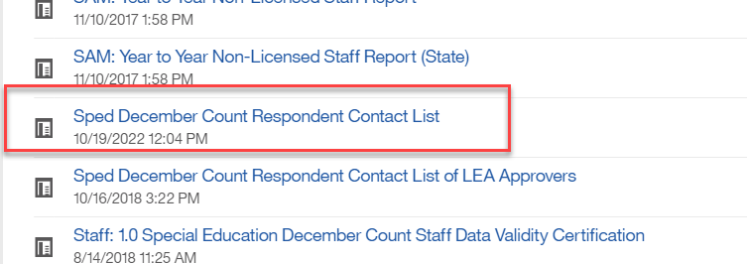
Special Education December Count:
Student Duplicate Warnings
Duplicate Students – check for these warnings
  DC154: Another AU is also claiming a Funding Status of 50 for this student. Please verify attendance and enrollment records for December 1st. If your record is correct, you may leave it the same.
  DC214: Another AU is reporting that this student is attending in their AU. Please verify attendance and enrollment records for December 1st. If your record is correct, you may leave it the same and ignore this warning.
    The other reporting AU is included in the far right column of the error report
    Reference ‘Pupils Attendance Information Codes’ document from December Count Snapshot webpage under Additional Links for help with PAI and Funding Status Codes.
    Contact List found in Cognos→Special Education December folder
Special Education December Count – Lindsey Heitman
SpedDecCount@cde.state.co.us

Slide 20
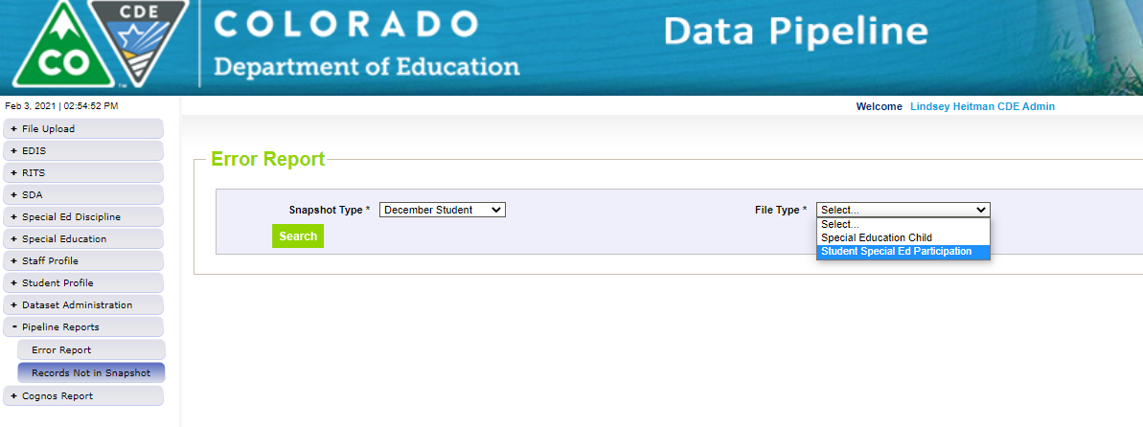
Pipeline Reports → Records Not in Snapshot
December Count – IMPORTANT CHECK FOR MISSING STUDENT RECORDS:
Records Not in Snapshot Report
Not all records on this report should be in your snapshot. Records are correctly excluded if they have a Start Date or Exit Date that doesn’t overlap 12/01 or no Start Date at all. They are fine to hang out in the Interchange (holding place) until Sped EOY.
Records are excluded from snapshot if :
  They have interchange errors - these records should likely be in the snapshot
  They don’t have a matching SASID or LASID in the Child and Participation files – these records should likely be in the snapshot
Filter on Snapshot Type ‘December Student’ and each file
Missing records= missed funding! Check for records that were receiving SPED services as of 12/01/23.
Special Education December Count - Lindsey Heitman - SpedDecCount@cde.state.co.us

Slide 21
Questions & Resources:
Special Education December Count
Lindsey Heitman
SpedDecCount@cde.state.co.us
(720) 456-2033
Special Education IEP Interchange Webpage
Special Education December Snapshot Webpage

Slide 22
Summer EBT
Collin Slutzky

Slide 23
Summer EBT Data Collection
Data Collection opened February 3rd.
File layout is unchanged from last year.
Error-free files must be submitted by February 28th.
Districts have the following options for submitting student records:
  Submit data for all students enrolled in National School Lunch Program sites only.
  Submit data for all students enrolled in NSLP sites and data for any F/R eligible transfer students to non-NSLP sites during the school year (any student that was enrolled at a NSLP site, even for a short period of time, would be eligible for S-EBT benefits)
  Submit data for all enrolled students at both NSLP sites and non-NSLP sites.
Submitting data for all enrolled students will be the easiest option for most districts, as your S-EBT reports from your SIS likely use this option.
Summer EBT
s-ebt@cde.state.co.us
Notes:
Your district schools are most likely receiving calls from families to update their address, make sure you are in contact with the appropriate people to make sure this updated information is being captured in the summer EBTcorrections.

Slide 24
Summer EBT Data Collection:
Preparing your file
Verify that Free and Reduced Lunch status is up-to-date for all students.
Every student must have one listed parent/guardian with a valid address.
  Issues with parent/guardian info will delay benefit issuance.
Check the S-EBT report in your SIS and make sure it matches the S-EBT file layout available on the data collection resource page.
  If the S-EBT report from your SIS is missing or incorrect, please contact your vendor immediately and include Collin Slutzky (slutzky_c@cde.state.co.us) on communications.
Plan to submit your first file by Friday, February 7th so you have plenty of time to correct errors.
Bookmark the form to schedule office hours in case you have issues uploading your file or resolving errors.
A data collection manual covering the basic process of submitting S-EBT data is available soon on the collection resources page.
Summer EBT
s-ebt@cde.state.co.us

Slide 25
Summer EBT Data Collection:
Additional Notes
Some errors were not behaving correctly and have been changed to warnings:
  PB272: There are students included in the October Student Count report that are not included in the S-EBT submission for the District.
    This error did not account for students included in October Count for administrative purposes only.
  PB276: Parent's Primary Telephone Number must be a valid year but phone number.
    This error contradicts guidance in the file layout to use “None” for parents/guardians with no phone number.
Please let us know if you think any other errors are behaving incorrectly.
Summer EBT
s-ebt@cde.state.co.us

Slide 26
Questions & Resources:
Summer EBT
Collin Slutzky
s-ebt@cde.state.co.us
(720) 760-3569
S-EBT Data Collection Resources

Slide 27

Thank you for Joining Today!
Next Town Hall will be February 13th
Reminder:
Syncplicity folders are specific to a collection. Email the collection lead if you need access to your LEA’s Syncplicity folder for a collection.
Tip: Bookmark the Syncplicity login site.

