Slide 1



Selecting an Instructional Program
Notes:
Welcome. This training on Selecting an Instructional Program is presented to you by Colorado Department of Education’s Literacy Team. All districts and schools in Colorado are required to use curricula that is scientifically and evidence-based. We share common goals and responsibility in ensuring that our students are confident and skillful readers. In working towards these shared goals, selecting an instructional program can be an important step. In this training, we will go through some high-level information on scientifically and evidence-based reading instruction and walk through two tools that can be used to help in this decision-making process

Slide 2
THE SIMPLE VIEW OF READING
Word Recognition
Language
Comprehension
Reading
Comprehension
x
=
Notes:
We will begin with grounding ourselves in scientifically based theoretical models in how we learn to read. The first is The Simple View of Reading. This model organizes the skills needed to become a proficient and successful reader into two categories: word recognition and language comprehension. The Simple View of Reading is a basic formula for reading comprehension. It says this: Reading Comprehension is the product of word recognition skills and language comprehension skills. We need both sides of the equation for students to become skilled, proficient readers. Students need efficient word recognition or decoding skills where they are accurately and automatically reading the words on the page without aid of context clues or pictures. They also need fully developed language comprehension skills which references the ability to understand language. In order for a student to understand text, they need to decode the words on the page and then make meaning of the words, sentences, and overall text.

Slide 3




KEY TAKEAWAYS FROM READING RESEARCH
Learning to read is NOT natural.
Each reader must master the same set of skills in
order to comprehend text.
Nearly all students can learn to read — if they are taught the right way.
Teaching reading is complex and challenging.
There is no one curriculum or intervention program that can replace teacher knowledge and effective practices.
Notes:
Reading is the most studied aspect of human learning and through decades of research several important findings have been made. The first is that learning to read is not a natural process. Human brains are naturally wired to speak; they are not naturally wired to read and write. Reading and writing systems are man-made. Reading doesn’t happen by osmosis from being read to or being in a literacy or print rich environment – it needs to be explicitly taught.
The second conclusion from research is every child learns to read in the same way. Each reader must master the same set of skills in order to comprehend text. There is a known pathway for skilled reading—some students may acquire the pathway more easily while some readers will need more repetitions.
That brings us to our next conclusion that nearly all students can learn to read. With the right instruction even students with reading disabilities can learn to read. All students benefit from explicit and systematic, research-based instruction in the skills that form the reading pathway.
Teaching reading is complex and may be challenging—it requires considerable knowledge and skill. Teaching reading is a job for an expert. No instructional program can replace teacher knowledge and skill. Choosing an instructional program that aligns with the science of reading provides a framework – there is no perfect program, every program has strengths and weaknesses – expert knowledge is needed to identify gaps in skills and knowledge in students and also gaps or weaknesses in programs and then how to remediate or supplement what has been identified.

Slide 4
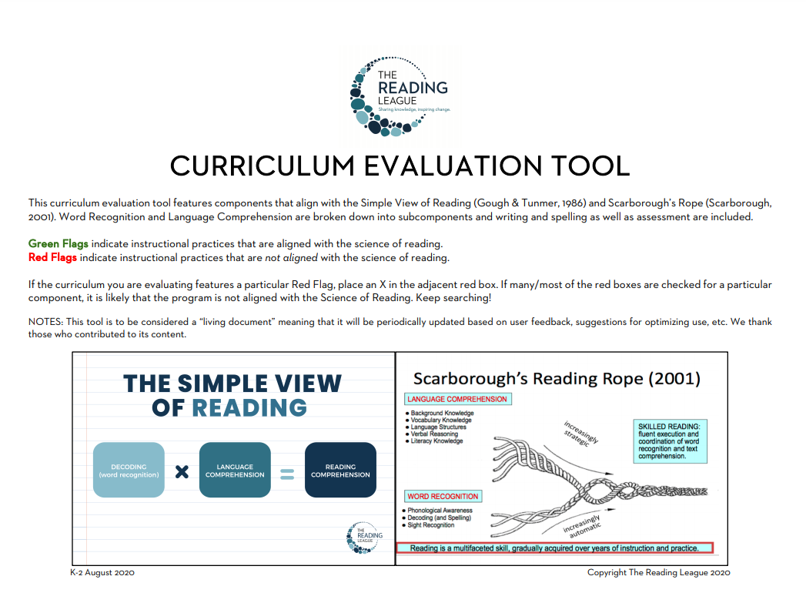
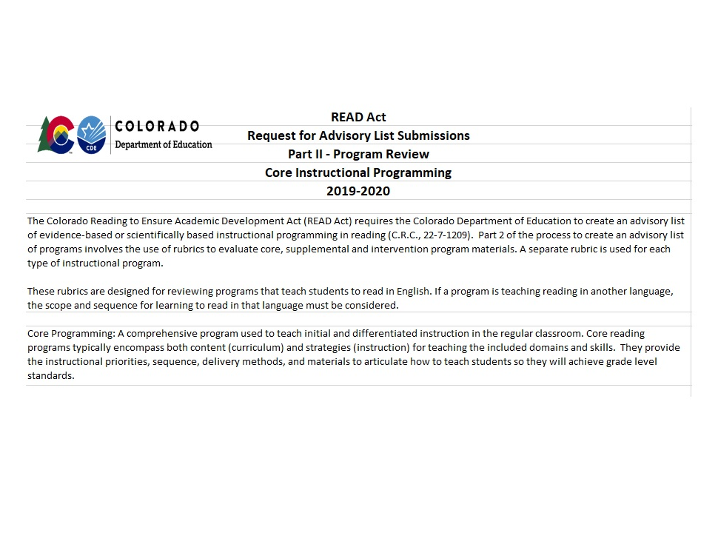
Tools for Selecting a Program
The Reading League’s
Curriculum Evaluation Tool
Colorado Department of Education’s
Core Instructional Programming Rubric
Notes:
We are going to walk through some tools that can be used to help you make these instructional decisions as well as evaluate your current instructional programs. We will be looking through The Reading League’s Curriculum Evaluation Tool which identifies green flags for instructional practices that align with the science of reading and red flags for practices that do not. And then we will look through CDE’s rubric for core instructional programming. These tools are based on what rigorous research indicates is the most effective way to teach reading.

Slide 5
Tools for Selecting a Program
The Reading League’s
Curriculum Evaluation Tool
Notes:
First let’s look at the Curriculum Evaluation Tool. This resource is linked on our website for you to follow along, but can also be found on the Reading League’s Website under Frequently Requested Resources

Slide 6



The Reading League’s
Curriculum Evaluation Tool
Phonological
Awareness
Assessment
Phonics
Writing
Fluency
Overall Design
Background
Knowledge
& Vocab
Comprehension
Language & Text
Structure,
Verbal Reasoning
Notes:
The components in the Curriculum evaluation tool align with the simple view of reading and the reading rope. Word recognition and language comprehension are broken down into the subcomponents: phonological awareness, phonics, fluency, background knowledge, vocabulary, language structure, verbal reasoning, and literacy knowledge. Writing, spelling, assessment, and overall design are also evaluated.
We will go through the parts of the evaluation tool in the presentation. You may follow along with a printed or electronic version of this tool linked on our website or on the Reading Leagues website.

Slide 7


CHOOSING A PROGRAM
Strong curriculum is important but does not substitute for deep educator knowledge about scientifically evidence-based reading instruction.
Green Flags
Red Flags
Green Flags indicate instructional practices that are aligned with the science of reading.
Red Flags indicate instructional practices that are not aligned with the science of reading.
Notes:
A strong curriculum is an important step in delivering effective literacy instruction but does not substitute for deep educator knowledge about scientifically evidence-based reading instruction. Using the following tools will help determine how well a curriculum may be aligned with the science of reading, but high-quality professional development is imperative to reap the benefits of implementation.

Slide 8
PHONOLOGICAL AWARENESS
Green Flags
Red Flags
Green Flags indicate instructional practices that are aligned with the science of reading.
Red Flags indicate instructional practices that are not aligned with the science of reading.
** Adapted from The Reading League. Curriculum Evaluation Tool. January 2021.
Notes:
We will begin with the first subcomponent in word recognition skills which is Phonological and phonemic awareness. This is found on page 2 of the evaluation tool. Green Flags indicate instructional practices that are aligned with the science of reading. Red Flags indicate instructional practices that are not aligned with the science of reading.
If the curriculum you are evaluating features a particular Red Flag, place an X in the adjacent red box. If many/most of the red boxes are checked for a particular component, it is likely that the program is not aligned with the Science of Reading.
Let’s start with the green flags or what we are looking for in the phonological awareness component.

Slide 9
Green Flags
Instruction includes larger units of phonological awareness (syllable, rhyme, onset-rime) as well as the phoneme level.
Instruction includes all phoneme awareness tasks including those that feature advanced manipulation (isolating, blending, segmenting, deletion, substitution, reversal).
Advanced phoneme proficiency instruction is evident beyond K-1; students are both accurate and automatic with these skills.
Phonemic awareness is taught directly, explicitly, and systematically.
When phoneme awareness is taught, awareness of individual phonemes is established prior to introduction of corresponding graphemes.
All levels of phonological and phoneme awareness are assessed and monitored regularly.
** Adapted from The Reading League. Curriculum Evaluation Tool. January 2021.
Notes:
Green flags indicating features that we are looking for are:
Instruction includes larger units of phonological awareness (syllable, rhyme, onset-rime) as well as the phoneme level.
Instruction includes all phoneme awareness tasks including those that feature advanced manipulation (isolating, blending, segmenting, deletion, substitution, reversal).
Advanced phoneme proficiency instruction is evident beyond K-1; students are both accurate and automatic with these skills.
Phonemic awareness is taught directly, explicitly, and systematically.
When phoneme awareness is taught, awareness of individual phonemes is established prior to introduction of corresponding graphemes.
All levels of phonological and phoneme awareness are assessed and monitored regularly.
Additional criteria to look for are included in our other tool, the CDE core programming rubric, found in Phase 2 for kindergarten and first grade. Some notable things to look for are: a detailed scope and sequence for phonological awareness skills from easier to more difficult, lessons support students to produce the sounds themselves, there are high levels of engagement and opportunities to respond, and the program materials provide a suggestion for how to group students so that students in the small group have the same phonemic need.
Let’s move onto red flags in the phonological and phonemic awareness component.

Slide 10
Red Flags
Instruction only attends to larger units of phonological awareness (syllables, rhyme, onset-rime) without moving to the phoneme level (e.g., blends such as ‘tr’ are kept intact rather than having students notice their individual sounds).
Phoneme awareness instruction does not include more advanced manipulation tasks.
Phoneme awareness instruction discontinues after K-1.
Phonemic awareness is taught implicitly and briefly.
When phoneme awareness is taught, phonemes are immediately connected to graphemes (printed letters).
Phonological and phoneme awareness are not assessed and monitored regularly.
** Adapted from The Reading League. Curriculum Evaluation Tool. January 2021.
Notes:
Some red flags are:
Instruction only attends to larger units of phonological awareness (syllables, rhyme, onset-rime) without moving to the phoneme level (an example of this could be teaching blends such as ‘tr’ as a unit where they are kept intact rather than having students notice their individual sounds).
Phoneme awareness instruction does not include more advanced manipulation tasks.
Phoneme awareness instruction discontinues after K-1.
Phonemic awareness is taught implicitly and briefly.
When phoneme awareness is taught, phonemes are immediately connected to graphemes (printed letters).
Phonological and phoneme awareness are not assessed and monitored regularly.
Some additional red flags identified through use of the CDE core programming rubric are: having no clear progression of easier to more difficult skills, Phonological and phonemic awareness lessons are incidental or driven only by the mistakes students make while reading, phonemic awareness lessons work only at the syllable or word level, and also lessons don't include manipulatives or movement.

Slide 11
The Reading League’s
Curriculum Evaluation Tool
Phonological
Awareness
Phonics
Assessment
Writing
Fluency
Overall Design
Background
Knowledge
& Vocab
Comprehension
Language & Text
Structure,
Verbal Reasoning
Notes:
The next subcomponent to review is phonics instruction found on page 3 of the Curriculum evaluation tool.

Slide 12
PHONICS
Green Flags
Red Flags
Green Flags indicate instructional practices that are aligned with the science of reading.
Red Flags indicate instructional practices that are not aligned with the science of reading.
** Adapted from The Reading League. Curriculum Evaluation Tool. January 2021.
Notes:
Once again we will be looking for green flags or practices that are aligned with science of reading and watching out for red flags or those practices which are not aligned.

Slide 13
Green Flags
Letter-sound correspondences are taught in an explicit, systematic, and sequential fashion, from simple to complex.
Phonics instruction is robust with explicit instruction, cumulative review, and application in reading and writing.
The initial instructional sequence includes a mixture of short vowels and consonants.
Segmenting and blending are taught explicitly and practiced regularly, in both decoding and encoding.
Explicit instruction directs students’ attention to the structure of the word; the emphasis is on phonic decoding.
Instruction includes letter sounds correspondences, syllable types, word families, word analysis skills for multisyllabic words, and morphemes.
Irregular high-frequency words are taught by drawing attention to both regular and irregular sounds.
Opportunities to practice decoding words in isolation are provided.
Instruction includes recursive review of phonics/encoding skills.
Phonics skills are practiced by applying letter-sound knowledge in decodable texts that match the phonics elements taught, securing phonic decoding.
** Adapted from The Reading League. Curriculum Evaluation Tool. January 2021.
Notes:
Instruction aligned with the science of reading will include:
Letter-sound correspondences taught in an explicit, systematic, and sequential fashion, from simple to complex.
Phonics instruction that is robust with explicit instruction, cumulative review, and application in reading and writing.
The initial instructional sequence includes a mixture of short vowels and consonants.
Segmenting and blending are taught explicitly and practiced regularly, in both decoding and encoding.
Explicit instruction directs students’ attention to the structure of the word with emphasis on phonic decoding.
Instruction includes letter sounds correspondences, syllable types, word families, word analysis skills for multisyllabic words, and morphemes.
Irregular, high-frequency words are taught by drawing attention to both the regular and irregular sounds within the word.
The instruction provides Opportunities to practice decoding words in isolation
Instruction should always include recursive or frequent, cumulative review of phonics/encoding skills.
Phonics skills are practiced by applying letter-sound knowledge in decodable texts that match the phonics elements taught, securing phonic decoding.
The CDE Core programming rubric has many additional details by grade level in what to look for in the phonic component. Some highlights to look for are explicit routines apparent in lessons, frequent distributed practice that results in automaticity, programs include decodable text that matches the phonics scope and sequence, and program materials direct teachers to use assessments to create and change groups based on skill.

Slide 14
Red Flags
Letter-sound correspondences are taught opportunistically or implicitly during text reading.
Phonics instruction takes place in short “mini-lessons.”
The initial instructional sequence introduces a large number of (or all) consonants before a vowel is introduced, or vowels are all taught in rapid succession.
Segmenting and blending are not explicitly taught nor practiced.
Instruction encourages students to memorize whole words, guess at words in context, or use picture clues.
Instruction in phonics ends once letter sounds correspondences are taught.
Irregular high-frequency words are taught as whole-word units, often as stand-alone “sight words” to be memorized.
No opportunities for word-level decoding practice are provided.
Instruction is typically “one and done”; phonics/encoding skills are introduced but with very little or very short-term review.
Early text is predominantly predictable, leveled texts which includes phonic elements that have not been taught and encourages memorizing patterns and using picture clues rather than phonic decoding.
** Adapted from The Reading League. Curriculum Evaluation Tool. January 2021.
Notes:
The following red flags will hinder students from being able to read the words on the page in an efficient and automatic manner.
Watch out for instruction where:
Letter-sound correspondences are taught opportunistically or implicitly during text reading.
Phonics instruction takes place in short “mini-lessons.”
The initial instructional sequence introduces a large number of (or all) consonants before a vowel is introduced, or vowels are all taught in rapid succession.
Segmenting and blending are not explicitly taught nor practiced.
Instruction encourages students to memorize whole words, guess at words in context, or use picture clues.
Instruction in phonics ends once letter sounds correspondences are taught.
Irregular high-frequency words are taught as whole-word units, often as stand-alone “sight words” to be memorized.
No opportunities for word-level decoding practice are provided.
Instruction is typically “one and done”; phonics/encoding skills are introduced but with very little or very short-term review.
Early text is predominantly predictable, leveled texts which includes phonic elements that have not been taught and encourages memorizing patterns and using picture clues rather than phonic decoding.
The core programming rubric identifies specific details by grade level of what you would like to see as part of a phonic routine. We encourage you to avoid any program that prompts students to guess at the word, has students draw an outline around the word, utilizes memorization as a primary strategy, or focuses on features such as the size of the letters. Students should be using their phonics skills and knowledge as their primary strategy for decoding words.

Slide 15
The Reading League’s
Curriculum Evaluation Tool
Phonological
Awareness
Assessment
Phonics
Writing
Overall Design
Fluency
Background
Knowledge
& Vocab
Comprehension
Language & Text
Structure,
Verbal Reasoning
Notes:
In the previous two sections we talked about phonological awareness and phonics which are areas focused on word recognition skills in the simple view of reading model. As we move towards focusing more on language comprehension, we are going to talk about fluency which bridges these two skill areas.

Slide 16
FLUENCY
Green Flags
Red Flags
Green Flags indicate instructional practices that are aligned with the science of reading.
Red Flags indicate instructional practices that are not aligned with the science of reading.
** Adapted from The Reading League. Curriculum Evaluation Tool. January 2021.
Notes:
In following along with your two tools, you should be on page 4 in the curriculum evaluation tool and looking at the criteria for Text Reading and Fluency in first through third grade in the CDE Core Programming Rubric.

Slide 17

Green Flags
Instruction includes teacher-led modeling, oral reading by students, and immediate feedback.
Reading accuracy and automaticity are emphasized.
Word-level fluency practice is provided.
Fluency is practiced in a variety of texts (narrative, informational, poetry, lists, etc.).
Fluency is measured using a normed Oral Reading Fluency assessment.
** Adapted from The Reading League. Curriculum Evaluation Tool. January 2021.
Notes:
Aspects of fluency instruction to look for in an effective program are:
The Instruction includes teacher-led modeling, oral reading by students, and immediate feedback.
Reading accuracy and automaticity are emphasized.
Word-level fluency practice is provided.
Fluency is practiced in a variety of texts (like narrative, informational texts, poetry, or lists).
Fluency is measured using a normed Oral Reading Fluency assessment.
CDE’s core programming rubric guides us to look for some additional items including that the text used for practicing to automaticity and fluency follows the phonics scope and sequence, a sufficient number of controlled decodable text that align with that scope and sequence, and materials available for teachers to read aloud for the purpose of modeling fluent reading which of course serves other purposes as well such as building vocabulary and background knowledge. Navigate to the Text Reading and Fluency section in the rubric in each grade level for more specific criteria to identify.

Slide 18

Red Flags
Instruction focuses primarily on student silent reading.
Rate is emphasized over accuracy; attention is given to students reading words quickly.
Word-level fluency practice is not provided. Fluency is viewed only as text-reading fluency.
Fluency is practiced only in narrative text or with repeated readings of patterned text.
Fluency assessment allows teachers acceptance of incorrectly decoded words if they are close in meaning to the target word.
** Adapted from The Reading League. Curriculum Evaluation Tool. January 2021.
Notes:
Some red flags to watch out for are:
Instruction which focuses primarily on student silent reading
Programs where rate is emphasized over accuracy or where attention is given to students reading words quickly
Programs which do not include word-level fluency practice and where fluency is only viewed as text-reading fluency
Programs which only use narrative text or with repeated reading of patterned text
And any assessment that accepts incorrectly decoded words if they are close in meaning to the target word
These red flags are all indicators that the chosen program does not align with the science of reading.

Slide 19
The Reading League’s
Curriculum Evaluation Tool
Phonological
Awareness
Assessment
Phonics
Overall Design
Writing
Fluency
Comprehension
Background
Knowledge
& Vocab
Language & Text
Structure,
Verbal Reasoning
Notes:
Moving on we will begin to focus more on the language comprehension side of the simple view equation. We will begin by looking at background knowledge and vocabulary.

Slide 20
BACKGROUND KNOWLEDGE &
VOCABULARY
Green Flags
Red Flags
Green Flags indicate instructional practices that are aligned with the science of reading.
Red Flags indicate instructional practices that are not aligned with the science of reading.
** Adapted from The Reading League. Curriculum Evaluation Tool. January 2021.
Notes:
Locate these components in the evaluation tool starting on p. 5 and in the rubric by grade level.

Slide 21
Green Flags
Background Knowledge
Read-aloud opportunities feature a variety of complex texts (narrative and expository texts above grade-level) to develop background knowledge and vocabulary in a variety of subject areas.
Opportunities are provided to make connections between a new word or concept and other known words or concepts, relating ideas to experiences.
Vocabulary
Vocabulary instruction includes robust conversations in order to support an understanding of literal and inferential comprehension of word knowledge within text.
Explicit instruction in vocabulary for Tier 2 and 3 words is evident, as well as instruction in the context of texts (most Tier 1 words).
Tier 2 words are taught explicitly, with students taught to use these words in their speech, see them in print, and use them in writing (when appropriate).
Explicit instruction in morphology is provided.
** Adapted from The Reading League. Curriculum Evaluation Tool. January 2021.
Notes:
In the area of background knowledge look for programs where read aloud opportunities feature a variety of complex texts to develop background knowledge and vocabulary in a range of subject areas. Look for places where connections are made between new words and concepts and previously learned words and concepts.
For vocabulary instruction, look for materials that include robust conversations to support understanding of literal and inferential comprehension of word knowledge within the text. Explicit instruction of vocabulary for tier 2 and tier 3 words should be evident as well as instruction in the context of texts. In tier 2 word instruction, words should be taught explicitly with students being taught to use these words in speech, see them in print, and when appropriate also use the words in writing. In building vocabulary skills and knowledge, explicit instruction in morphology should be provided.
Using CDE rubric, we encourage you to look for a cumulative review and practice of previously learned words. Look for activities and materials designed to elicit high levels of responding and engagement. See the core programming rubric to find additional items to look for by grade level.

Slide 22
Red Flags
Background Knowledge
Read-aloud opportunities emphasize stories or narrative texts. Read-aloud text is not sufficiently complex.
Opportunities to bridge existing knowledge to new knowledge is not apparent in instruction.
Vocabulary
Vocabulary instruction does not include opportunities for rich conversations; worksheets or activity sheets are used instead.
Instruction includes memorization of isolated words and definitions out of context.
Tier 2 words are not taught deeply.
Explicit instruction in morphology is not apparent.
** Adapted from The Reading League. Curriculum Evaluation Tool. January 2021.
Notes:
Red flags for instruction on background knowledge would be having read aloud materials that only focus on stories or narrative texts or where read aloud text is not sufficiently complex. Another red flag would be one where new knowledge is not bridged with existing knowledge.
In the vocabulary component, stay away from programs that do not include opportunities for rich conversations and programs that rely on worksheets or activity sheets. Beware of instruction that includes memorization of isolated words and definitions out of context or where tier 2 words are not taught deeply to students. The final red flag would be for programs which do not explicitly teach morphology.
Let’s move on to our next component.

Slide 23
The Reading League’s
Curriculum Evaluation Tool
Phonological
Awareness
Assessment
Phonics
Overall Design
Writing
Fluency
Background
Knowledge
& Vocab
Comprehension
Language & Text
Structure,
Verbal Reasoning
Notes:
In this next section we will be looking at knowledge of language structures, verbal reasoning, and literacy knowledge.

Slide 24
KNOWLEDGE OF LANGUAGE STRUCTURES, VERBAL REASONING, & LITERACY KNOWLEDGE
Green Flags
Red Flags
Green Flags indicate instructional practices that are aligned with the science of reading.
Red Flags indicate instructional practices that are not aligned with the science of reading.
** Adapted from The Reading League. Curriculum Evaluation Tool. January 2021.
Notes:
Information for green and red flags for these subcomponents are found on page 7 in the curriculum evaluation tool and in the listening and reading comprehension sections of the core programming rubric.

Slide 25
Green Flags
Knowledge of Language Structures
There is a clear scope and sequence for teaching conventions of print, grammar, and syntax (sentence structure) in reading and writing.
Instruction includes sufficient time for discussion, including teacher modeling of conversational conventions, appropriate tone and rate, and development of full ideas and complete sentences.
Verbal Reasoning
Inferencing is explicitly taught within text, including opportunities for metacognition and use of appropriate/accurate background knowledge.
Literacy Knowledge
Appropriate genre types and features are explicitly taught.
** Adapted from The Reading League. Curriculum Evaluation Tool. January 2021.
Notes:
Like with our other components, look for a clear scope and sequence for instruction on language structures. These would include conventions of print, grammar, and syntax in reading and writing. Instruction should include time for discussion, teacher modeling of conversational conventions, instruction on appropriate tone and rate, and how to develop full ideas and complete sentences.
In the area of verbal reasoning, inferencing needs to be explicitly taught within text. Students should be taught metacognition strategies and use of background knowledge.
Moving onto literacy knowledge, look for explicit instruction in genres types and features. The rubric includes some more details of what to look for in this area such as: features of informational texts like titles, headings, graphs, and charts. Review the grade level details for these subcomponents using the rubric and score accordingly.

Slide 26
Red Flags
Knowledge of Language Structures
There is not a clear scope and sequence for teaching; conventions of print, grammar, and syntax are taught implicitly or opportunistically.
Instruction does not include sufficient opportunities for discussion. Teacher modeling is not apparent.
Verbal Reasoning
Inferencing is not taught explicitly and may be based only on picture clues and not text (“picture walking”).
Literacy Knowledge
Genre types and features are not explicitly taught.
** Adapted from The Reading League. Curriculum Evaluation Tool. January 2021.
Notes:
On the flip side red flags would be programs that do not have a clear scope and sequence for explicitly teaching language structure or programs that do not include sufficient opportunities for instruction or teacher modeling.
Red flags in verbal reasoning would be programs that rely on picture walking or using only picture clues to teach inferencing.
And in literacy knowledge, be watchful for programs that do not explicitly teach genre types and features.

Slide 27
The Reading League’s
Curriculum Evaluation Tool
Phonological
Awareness
Phonics
Assessment
Overall Design
Writing
Fluency
Background
Knowledge
& Vocab
Comprehension
Language & Text
Structure,
Verbal Reasoning
Notes:
Moving on to our next component, we will discuss comprehension.

Slide 28
COMPREHENSION
Green Flags
Red Flags
Green Flags indicate instructional practices that are aligned with the science of reading.
Red Flags indicate instructional practices that are not aligned with the science of reading.
** Adapted from The Reading League. Curriculum Evaluation Tool. January 2021.
Notes:
Following along with the curriculum evaluation tool and core programming rubric, you will be on p. 8 in the evaluation tool and in the listening and reading comprehension sections of the rubric.

Slide 29
Green Flags
The foundation for reading comprehension is built through rich read aloud experiences before children are able to read independently.
Emphasis on direct teaching of comprehension strategies via gradual release of responsibility (I do, we do, you do) using appropriate instructional text.
Materials for comprehension instruction include sufficiently complex literary and informational texts.
** Adapted from The Reading League. Curriculum Evaluation Tool. January 2021.
Notes:
Green flags identified for comprehension instruction are:
Programs where the foundation for reading comprehension are built through rich read aloud experience before children are able to read independently. Programs which directly teach comprehension strategies using a gradual release of responsibility. And where comprehension instruction utilizes complex literary and informational texts.
One additional criterion provided in the core programming rubric is for programs to have the specific content knowledge throughout the year clearly stated, mapped out across the year, and preparing students for later grades. See the rubric for additional items to look for in a high-quality, research-based program.

Slide 30

Red Flags
The foundation for reading comprehension emphasizes strategy instruction in text before children are able to read independently.
Emphasis on independent reading and book choice; no evidence of direct teaching of comprehension strategies.
Materials for comprehension instruction are predominantly leveled texts and repetitive patterned texts.
** Adapted from The Reading League. Curriculum Evaluation Tool. January 2021.
Notes:
Programs that emphasize strategy instruction before students can read independently are not aligned with the science of reading. Be on the lookout for programs that emphasize independent reading and book choice and where there is no evidence of direct instruction of comprehension strategies. And finally, programs that provide predominantly leveled or repetitive, patterned texts for comprehension instruction will also be in opposition of quality practice informed by research.

Slide 31
The Reading League’s
Curriculum Evaluation Tool
Phonological
Awareness
Assessment
Phonics
Writing
Overall Design
Fluency
Background
Knowledge
& Vocab
Comprehension
Language & Text
Structure,
Verbal Reasoning
Notes:
The next area we will focus on is writing instruction. Reading and writing draw upon the same body of skills and knowledge. Teaching writing can help students become better readers as well as writers.

Slide 32
WRITING
Green Flags
Red Flags
Green Flags indicate instructional practices that are aligned with the science of reading.
Red Flags indicate instructional practices that are not aligned with the science of reading.
** Adapted from The Reading League. Curriculum Evaluation Tool. January 2021.
Notes:
Green flags and red flags are found on p. 9 in the evaluation tool and cover handwriting, spelling, and composition.

Slide 33
Green Flags
Handwriting
There is explicit instruction related to letter formation, posture, grip, and opportunities for cumulative practice.
Handwriting instruction utilizes lined paper that guides letters formation.
Handwriting instruction is integrated into core reading and writing instruction and follows the sequence of letter learning.
Spelling
There is a clear scope and sequence for explicit spelling instruction, closely aligned with the phonics scope and sequence in K-1.
Patterns taught for decoding are also practiced in encoding/spelling lessons.
Composition
Writing is taught through a gradual release of responsibility (I do, we do, you do) and includes sufficient time for modeling, planning, and brainstorming ideas before drafting.
Writing is structured; models and graphic organizers are provided to support composition and promote executive functioning.
Conventions of print, grammar, and syntax (sentence structure) are taught explicitly in the context of writing.
Writing instruction includes a variety of text types (narrative, informational, persuasive).
** Adapted from The Reading League. Curriculum Evaluation Tool. January 2021.
Notes:
In the area of handwriting, we are looking for programs that are explicitly teaching letter formation and providing many opportunities for practice and mastery. This instruction should be integrated in the reading and writing instructional blocks and should follow the sequence of letter learning.
In the area of spelling, spelling instruction should be included as part of phonics instruction and aligned with that scope and sequence- so that patterns that are taught for decoding are also practiced in spelling.
For composition, look for lessons where writing instruction is taught through a gradual release of responsibility, where models are provided, and graphic organizers are used to help support composition and organizing thoughts. Conventions of print, grammar, and syntax should be taught explicitly in the context of writing. And lastly, writing instruction should include a variety of text types.

Slide 34
Red Flags
Handwriting
There is no direct instruction in handwriting.
Unlined paper and picture paper are featured.
Handwriting instruction is treated as an isolated add-on.
Spelling
No evidence of explicit spelling instruction; scope and sequence is not aligned with any other aspect of instruction.
Patterns in decoding are not featured in encoding/spelling; spelling lists are relatively random.
Composition
Writing prompts are provided with little time for modeling, planning, and brainstorming ideas.
Writing is primarily unstructured, with few models or graphic organizers.
Conventions, grammar and sentence structure are not taught or are taught implicitly or opportunistically.
Writing instruction is primarily narrative or unstructured choice.
** Adapted from The Reading League. Curriculum Evaluation Tool. January 2021.
Notes:
Refrain from using programs that do not include this instruction, programs that do not include direct, explicit instruction or programs that treat the areas of handwriting, spelling, and composition as separate, isolated skills.
Weekly spelling lists or quizzes that are separate from and unrelated to the phonics lesson or phonics scope and sequence are a red flag. Decoding and encoding are reciprocal skills and should be treated as such.
Programs that introduce composition in an unstructured way with little modeling or planning should be avoided.

Slide 35
The Reading League’s
Curriculum Evaluation Tool
Phonological
Awareness
Assessment
Phonics
Writing
Fluency
Overall Design
Comprehension
Background
Knowledge
& Vocab
Language & Text
Structure,
Verbal Reasoning
Notes:
Our next component in the evaluation tool is assessment. Reading assessment is essential for supporting effective reading instruction. Data from assessments provides teachers with important information to guide their instructional decisions. Assessment data can also aid and guide school leadership in making reading curriculum decisions.

Slide 36
ASSESSMENT
Green Flags
Red Flags
Green Flags indicate instructional practices that are aligned with the science of reading.
Red Flags indicate instructional practices that are not aligned with the science of reading.
** Adapted from The Reading League. Curriculum Evaluation Tool. January 2021.
Notes:
Green and red flags are found on p.10 in the evaluation tool. Criteria for assessment are found within the rubric under each section in each grade level.

Slide 37

Green Flags
Assessments include screening, diagnostic, and progress monitoring.
Foundational skills assessments identify students’ instructional needs.
Phonics skills are assessed using both real and nonsense words in all syllable patterns.
Normed ORF (Oral Reading Fluency) assessments are used.
** Adapted from The Reading League. Curriculum Evaluation Tool. January 2021.
Notes:
Look for programs where assessments include screening, diagnostic, and progress monitoring. Where foundational skills assessments identify students’ instructional needs. We want our assessments to pinpoint where further instruction is needed. In assessing phonics skills both real and nonsense words should be used to assure that students are grasping the concepts learned. And finally programs should be using normed oral reading fluency assessments to see how students perform compared to other students doing the same task.

Slide 38

Red Flags
Assessments result in benchmarks according to a leveled text gradient.
Foundational skills assessments are primarily running records (or similar assessments that focus on assessment of high frequency words and can be read by looking at the first letter or blend and confirming with picture support).
Phonics skills are assessed using real words only.
Normed ORF assessments are not available.
** Adapted from The Reading League. Curriculum Evaluation Tool. January 2021.
Notes:
Do not use programs that use assessments that result in benchmarks according to a leveled text systems. Running records or similar assessments that focus on assessment of high frequency words that can be read by looking at the first letter and can be confirmed by picture supports are not in alignment with the science of reading. These assessments also do not give information that identifies a student’s instructional need. Assessments where only real words are used are a red flag as they may not as accurately identify some students with word reading deficits. And finally, avoid programs that do not used normed oral reading fluency assessments.

Slide 39
The Reading League’s
Curriculum Evaluation Tool
Overall Design
Notes:
We covered all of our main components found in the reading rope model, but we also need to look at a programs overall design. If a program has all the components we are looking for, we would also like to make sure that it will be easy for teachers to use

Slide 40
OVERALL DESIGN
Green Flags
Red Flags
Green Flags indicate instructional practices that are aligned with the science of reading.
Red Flags indicate instructional practices that are not aligned with the science of reading.
** Adapted from The Reading League. Curriculum Evaluation Tool. January 2021.
Notes:
Green and red flags are found in the evaluation tool on p. 11 and in the core programming rubric in the Usability and professional development tab.

Slide 41

Green Flags
There is a clear and consistent instructional framework, featuring a comprehensive scope and sequence of foundational skills taught in an explicit system. The system features application of taught skills in real reading and writing.
** Adapted from The Reading League. Curriculum Evaluation Tool. January 2021.
Notes:
When looking at the overall design look for programs where there is a clear and consistent instructional framework, featuring a comprehensive scope and sequence where skills are taught in an explicit manner. The system should feature application of taught skills in reading and writing.
Items listed for usability in the core programming rubric include materials that are well organized and easy to locate, teacher editions are concise and easy to manage with clear connections between resources. Reading selections should be a central focus of the materials. The content should fit within a school year reasonably with guidance on pacing and the amount of time for tasks within lessons.

Slide 42

Red Flags
The instructional framework is primarily a workshop approach, emphasizing student choice and implicit, incidental, or embedded teaching of foundational skills.
** Adapted from The Reading League. Curriculum Evaluation Tool. January 2021.
Notes:
Do not use programs where the framework is primarily a workshop approach. Programs which emphasize student choice and where teaching of foundational skills is implicit, incidental, or embedded should be avoided.

Slide 43
Tools for Selecting a Program
The Reading League’s
Curriculum Evaluation Tool
Colorado Department of Education’s
Core Instructional Programming Rubric
Notes:
In going through the curriculum evaluation tool, we’ve added some details from the core programming rubric and where to find aligning criteria within the rubric. The Core programming rubric contains far too much detail to go through it line by line in this training. We encourage you to use these two tools together to most effectively evaluate and select instructional programs.

Slide 44
Tools for Selecting a Program
CDE’s Core Instructional Programming Rubric
Notes:
We will now go through some additional suggestions and best practices for using the core instructional program rubric.

Slide 45

CONSIDERATIONS FOR USE
Members of the team have knowledge in science of reading and instructional design
Review all the teacher and student materials, not just sample lessons
Allow reviews adequate time to complete the process
Multiple reviewers are necessary
Keep notes in the evidence/feedback column of rubric
Notes:
There are a few considerations to take into account when using this rubric as a tool. Because the value of the ratings depends on the judgements of the review team, it is important that members of the team have knowledge of the science of reading and instructional design. When reviewing a reading program thoroughly, it is not sufficient to examine only a sample of lessons. In order to determine whether a program is aligned with current reading research, it is essential to review all the teacher and student materials. This process may take more time than anticipated, so be sure that reviewers have adequate time to complete this process.
It is recommended that each set of instructional materials be assigned to at least two different reviewers to determine inter rater reliability and agreement among the reviewers. Keeping notes in the evidence/feedback column will be helpful in making final decisions on criterion where raters have disagreed.

Slide 46
PHASE 1
Research Alignment
Sequential Instruction
Systematic & Cumulative Instruction
Coordinated Components
Explicit Instruction
Related Elements
Notes:
The rubric has two phases- if a program meets the basic criteria mandated by legislation for scientifically and evidence-based core instruction, it will move to phase two where it will be reviewed by content area for each grade level kindergarten through third grade. In phase 1, we are looking for evidence of research alignment, explicit instruction, sequential instruction, systematic and cumulative instruction, coordinated components and related elements that are optimal for delivering effective instruction. Rating for the criteria in phase one is either Met or Not Met. If the program meets the minimum threshold of 20 out of 25 points, it will move onto phase 2. A program may appear to meet these phase 1 requirements but on further, more detailed review in phase 2, reviewers may find evidence might be contrary to the initial, cursory review.

Slide 47
PHASE 2
Phonological and Phonemic Awareness
Phonics and Word Study
Vocabulary
Text Reading and Fluency
Listening and Reading Comprehension
Notes:
In phase two reviewers will thoroughly review phonological and phonemic awareness, phonics and word study, vocabulary, text reading and fluency, and listening and reading comprehension by grade level. Ratings in this section are fully met for 2 points, partially met for one point and not met for zero points.

Slide 48
The Core Program Summary Tab Ratings
Meets
Expectations
Doesn’t Meet
Expectations
For a grade level to be rated as Meets Expectations, all but one section must be rated as meets expectations.
If any one section is rated as Doesn’t Meet Expectations, the grade level does not meet expectations.
Notes:
The Core Program Rating Summary tab will tally the point total for each section and identify if that section meets expectations, partially meets expectations, or does not meet expectations. For a grade level to be rated as Meets Expectations, all but one section must be rated as meets expectations. If any one section is rated as Doesn’t Meet Expectations, the grade level does not meet expectations.

Slide 49


REVIEW COMPLETE
Alignment with the science of reading
Program strengths
Program weaknesses
Feel free to contact the READ Act email, readact@cde.state.co.us, with rubric requests or questions related to instructional program review.
Notes:
Once your review is complete using both the Curriculum Evaluation Tool and the Core Programming Rubric, you should have adequate information on whether the program aligns with the science of reading, program strengths, and program weaknesses.
Feel free to contact the READ Act email, readact@cde.state.co.us, with rubric requests or questions related to instructional program review.

