Slide 1
Spring 2019 READ Act Data Collection
Thanks for joining us!

Slide 2
Objectives
Data privacy and security
Purpose of the READ data collection
READ collection timeline
2018-19 data elements
Review the budget planning survey
Summary of process in Data Pipeline
Common problems and questions
Q&A session

Slide 3
Data Privacy and Security

Slide 4
What is PII?
Student Personally Identifiable Information (PII) is defined by state and federal laws as information that, alone or in combination, personally identifies an individual
This includes direct identifiers (i.e. name, SASID, etc)
Includes information that when combined is identifiable
Colorado’s Student Data Transparency and Security Act introduces a number of new requirements for how student PII is collected, used and shared
CDE has prepared guidance on how to comply with this and other privacy laws which can be found here:
http://www.cde.state.co.us/dataprivacyandsecurity

Slide 5
How to Share Data
Check local policies for restrictions, requirements, etc.
Ensure that you are following local policies when transmitting PII to any third party
Use secure methods to transfer any PII to CDE
Call CDE (303-866-6395) with questions about how to transmit PII securely
Use Syncplicity to encrypt emails to CDE
Avoid sending PII via unencrypted email or to unsecured faxes when sharing data between or within districts
Do not use PII in trainings, presentations, etc.
Do not share PII with unauthorized individuals
Do not share passwords

Slide 6
Purpose of the READ Data Collection

Slide 7
Purpose of the READ Collection
The purpose of the READ collection is to collect student level data needed to fulfill statutory requirements for the annual legislative report on the implementation on the READ Act
Data collected in READ is also used to determine distribution of per-pupil intervention funds for students identified as having significant reading deficiencies (SRD)
The Early Literacy Fund provides districts with per-pupil intervention funds to help support programs to meet the needs of students with SRDs who received services
Data from the READ collection is also used for reports, grants, news articles and official decision making about schools, districts and the state

Slide 8
Purpose of the READ Collection
Accurate data is the primary goal of the collection
CDE wants to make sure that districts receive the correct amount of funding
How to ensure your data is accurate?
Complete the basics of the collection early!
Get files error free by early June
An error free file does not guarantee accurately reported data
Thoroughly review your data
Ask your district’s READ lead or other content area experts to assist in verifying data
Use Cognos reports available through Data Pipeline to assist in data verification
Do NOT report inaccurate data to avoid errors
If a student is generating errors please call Whitney to find out how to properly code the student

Slide 9
Criteria
Each spring districts create and submit records for all K-3rd grade students enrolled at the time of data submission and 4-12th grade students who are included in the READ 4-12th grade cohort from any district AND;
The Budget Planning Survey in Pipeline that asks districts to identify which of the five statutory intervention categories they intend to use in the coming budget year to support students identified as having an SRD

Slide 10
READ Collection Timeline

Slide 11
2018-19 READ Collection Timeline
March 1: READ collection & budget survey soft open – districts can submit beginning READ files and budget planning surveys
April 1: READ collection opens
May 17: Target – first upload of READ file
June 14: Deadline to submit READ data file & budget planning survey to CDE – all submissions are finalized and locked
June 21 – July 1: Districts work with each other to clear duplicate sasids
July 1: Deadline to resubmit data files with duplicate sasids removed and READ collection closes
READ Data Verification forms due by July 5 signed by superintendent
July 22: Emails sent to READ data respondents and superintendents with final SRD numbers submitted through Data Pipeline for district confirmation
August 5: Final SRD numbers and funding amounts emailed to district READ respondents and superintendents
Week of August 12: Distribution of READ funds to districts

Slide 12
2018-19 READ Collection Data Elements

Slide 13
READ 4-12th Grade Cohort
For the 2018-19 collection you will include all K-3 students enrolled at the time of data submission and 4-9th grade cohort students
Why do we report 4-12th grade cohort students?
Once a student has been identified as having an SRD they are put on an individual READ plan. Their READ plan remains in place until they attain reading competency, regardless of grade level
Who is included in the 4-12th grade cohort?
Students who exited 3rd grade identified as having an SRD in the spring of 2013 collection became the first group of cohort students. Those 3rd graders identified with an SRD in spring of 2013 are now 9th graders in spring of 2019. The cohort will continue to increase each year (next year will be 4-9th graders) until students reach 12th grade
Students who exit 3rd grade identified with an SRD (READ Status = 2) and/or remain on a READ plan at the end of third grade are calculated into the READ cohort group
When does a student exit the cohort?
Once a student has reached reading competency (determined locally) they are removed from their READ plan and will be coded as READ plan = 0 (No) which will remove them from the cohort group

Slide 14
How to Identify your 4-12th Grade Cohort Students
Step 1
Run the “Student extract of 4-12th Graders with a Significant Reading Deficiency in the Prior Year” Report in Cognos
Step 2
Run this report for the current school year (2018-19). Districts will be able to download an excel file pre-loaded with all READ fields for the 4-12th graders except for the READ plan field.
Step 3
Districts must add the value of READ plan (0 or 1) to indicate if the cohort student remains in the cohort or if they have exited from the cohort based on READ plan (0 – No or 1 – Yes)
Step 4
Districts will then copy and paste this information into their READ file before submitting data

Slide 15
2018-19 READ Data Elements

Slide 16
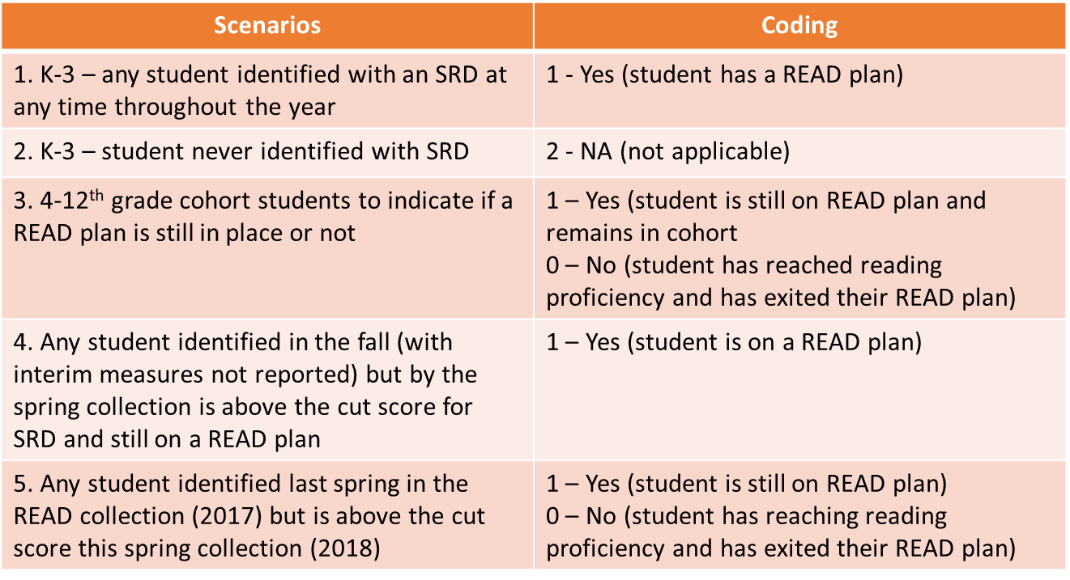
2018-19 READ Data Elements
How to use the READ Plan field

Slide 17
2018-19 READ Data Elements

Slide 18
2018-19 READ Data Elements

Slide 19
2018-19 READ Data Elements

Slide 20
2018-19 READ Data Elements

Slide 21
Summary of Process

Slide 22
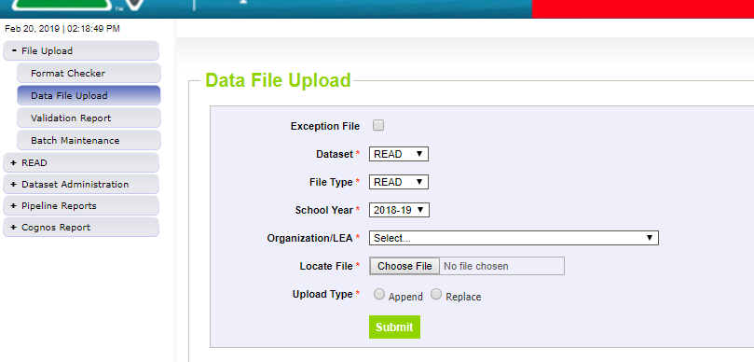
Summary of Process
Upload Student Interchange files, Student Profile (or Demographics/DEM) and Student School Association (SSA) file
1. Select Data File Upload
2. Select your district
4. When you are resubmitting your file to fix errors please remember to choose “Replace”
3. Browse and load your file
5. Submit your data

Slide 23
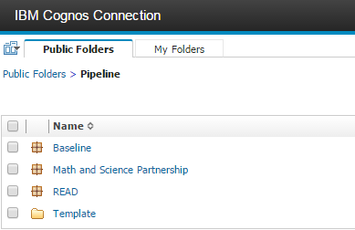
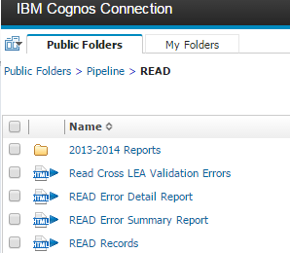
Summary of Process
1st
2nd
3rd
This will give you record by record where the errors are.
This report will give the error code and the error summary. This will help you understand the logic behind the error.

Slide 24
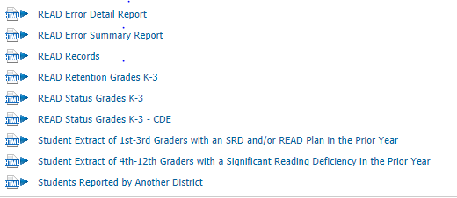
Summary of Process
Shows all records submitted in your file and grade level
Shows the number of students identified with SRDs by school and grade level
Pre-populated report that identifies your 4-9th grade cohort students
Report districts can pull to identify students reported by another district

Slide 25
Summary of Process
Once you have verified data, submit READ file to CDE
Within pipeline > READ > Status Dashboard and click ‘Submit to CDE’
Must have REDLEAAPPROVER role in IDM to complete this step
Once all districts have submitted READ files then the duplicate SASID process runs to identify students reported by multiple districts
Districts resubmit files with duplicates removed by July 1, close of business

Slide 26
Budget Planning Survey
Budget Planning Survey
Districts will be required to submit budget planning information to CDE prior to the distribution of funds
Click here to view the guidance document on completing the Budget Planning Survey
CDE is required per statute to review fund usage for the following services:
Summer school literacy programs
Targeted, scientifically or evidence-based intervention services

Slide 27
Budget Planning Survey
The READ Budget Planning Survey will consist of five, Yes or No questions that will be collected at a district level and submitted in addition to the LEP’s READ data file
To access the survey:
User will select “READ Budget Planning Survey” on the initial Pipeline screen for READ
User will select current school year and district

Slide 28
Budget Planning Survey
The survey can be submitted at any time throughout the collection; however, it is encouraged that LEPs submit this survey as soon as possible even if READ data file is not finalized
Survey may not have blank questions, but users will be able to save the survey questions already answered and come back to survey at a later time to complete
User must have REDLEAUSER user role for completing and editing the survey and the REDLEAAPPROVER role to finalize and submit the survey to CDE
If the LEP does not have any students identified as having an SRD for the upcoming budget year, submission of the budget planning survey is not required

Slide 29
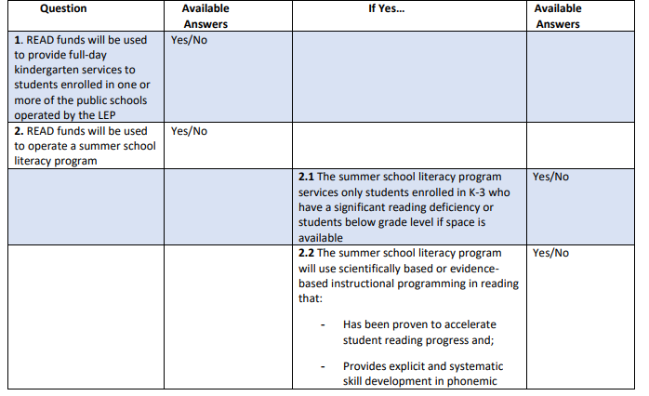
Budget Planning Survey
The READ Budget Planning survey will include the following questions:
An error message will be presented if user tries to submit the survey without agreeing to both assurances

Slide 30
Budget Planning Survey

Slide 31
Budget Planning Survey

Slide 32
Budget Planning Survey

Slide 33
Common Problems & Questions

Slide 34
Common Problems & Questions
Warnings
Do not require exceptions
Do not prevent students from being included in the READ file or from submitting the file
They’re for informational purposes or that there is a possible data issue
Losing Leading Zeros
Opening a file in excel and format is not already set to ‘text’
Files will not upload properly and will create errors
CDE has a guide to keeping leading zeros here

Slide 35
Common Problems & Questions
An English Language Learner in our district was tested because she is not NEP and she is beyond her first year in a US school. She received a score low enough on PALS to qualify as having a significant reading deficiency. We don’t believe the score accurately reflects SRD because we have a body of evidence that says she can read fluently in her first language.
READ Plan = 2 (NA because student was not identified with a SRD)
READ Status = 4
READ Test = 07
READ Score = 0170
READ Testing Date = 05202019
Recommended Retention = 2
Retained = 2
READ Plan Support = 0 for each

Slide 36
Common Problems & Questions
A student in my district was unable to be tested due to excessive absences, but the child was enrolled during the period for testing and has a READ Plan in place
READ Plan = 1
READ Status = 0
READ Test = 06
READ Score = 9999
READ Testing Date = 05202019
Recommended Retention = 2
Retained = 2
READ Plan Support = Indicate the supports the student received

Slide 37
Common Problems & Questions
An English Language Learner in our district wasn’t tested because he is Non-English Proficient (NEP) and in his first year in a US school.
READ Plan = 2
READ Status = 0
READ Test = 04
READ Score = 9999
READ Testing Date = 05202019
Recommended Retention = 2
Retained = 2
READ Plan Support = 0 for each

Slide 38
Common Problems & Questions
A 1st grade student in our district was placed on a READ plan earlier this year. The Spring DIBELS score is above the cut score so she is no longer identified as having a significant reading deficiency. However, the body of evidence doesn’t demonstrate she is at grade level yet. We will keep her on a READ plan.
READ Plan = 1
READ Status = 1
READ Test = 07
READ Score = 0812
READ Testing Date = 05202019
Recommended Retention = 2
Retained = 2
READ Plan Support = 0 for each

Slide 39
READ Resources
READ Collection resources can be found at: http://www.cde.state.co.us/coloradoliteracy/readdatapipeline
Upcoming webinars
Data collection timeline
Data elements & definitions
File layout
Business Rules
Additional resources such as FAQ document, assessment cut scores, template for submitting budget planning survey, etc.
Questions?
Contact Whitney Hutton, READ Data Collection Manager
Email: Hutton_W@cde.state.co.us
Phone: 303-866-6421

