Slide 1
State Reporting from Enrich Child File and Participation File

Slide 2
All students and student data shown in this presentation is from the CDE Sandbox and is not real.

Slide 3
Collecting Data and Sending to the CDE Data Pipeline

Slide 4
Collecting Data and Sending to the CDE Data Pipeline – Home Page
You can access the data collections from the Home page near the bottom of the screen: CDE Data Pipeline in the Special Education Section
Both the December Count Child Count and End of Year files can be generated from CDE Data Pipeline

Slide 5
Collecting Data and Sending to the CDE Data Pipeline – Select School Year and Collection
Data files for December Count Child Count and End of Year are collected separately for each school year. Choose the school year and collection you want here
Choose the Year and Collection you want to work on

Slide 6
Collecting Data and Sending to the CDE Data Pipeline – Collect the Data
To run the files for the selected data collection select Collect Data, then Collect Only in the popup box
Select Collect Only to collect the data but not submit to Data Pipeline yet
Collect the data here
The Errors you see here mirror the validation errors you would receive in Data Pipeline IEP Interchange level, except the RITS or other edits that rely on CDE databases not linked with Enrich
Once the files have been collected you can see the number of records and validation errors in the Details section

Slide 7
Collecting Data and Sending to the CDE Data Pipeline – Errors and Records
Errors can be corrected in an override screen or the actual student record screens
File date ranges can be altered in Settings
If there are no errors showing here in Enrich but there are errors in Data Pipeline, you can still get to the affected records by clicking into the records of the file here
See the errors and a link to the affected records here

Slide 8
Collecting Data and Sending to the CDE Data Pipeline – Error Validation Report
Click into the Errors of either the Child or Participation file for the detailed error messages
See the details of each error by clicking on the number in the Count column
See the errors and a link to the affected records here

Slide 9
Collecting Data and Sending to the CDE Data Pipeline – Error Details
Details of SE005 on the Child file
Clicking on the name will bring you to that Student’s actual record where you can Edit the permanent record
Clicking on View will bring up just the data in this file on an Override screen where you can change it in this file only
If you ever need to manually remove a record from your file submission you can click the X, be sure to remove it from both Child and Participation files

Slide 10
Collecting Data and Sending to the CDE Data Pipeline – View Record
When you View the record it will look like this showing all the data fields in that file
Clicking to Override Values will bring up a popup asking you to confirm, click OK

Slide 11
Collecting Data and Sending to the CDE Data Pipeline – Override Screen
Once a record has been overridden, it can only be changed in this screen until you Restore Link. These changes are for this file only.

Slide 12
Collecting Data and Sending to the CDE Data Pipeline –Student Profile Page
If you had clicked on the Name instead of View you would be taken to the student’s Profile page
Edit Student Record to update the data field permanently and not just for that one file extract

Slide 13
Collecting Data and Sending to the CDE Data Pipeline – Edit Student Record
Update the data field needed, then scroll down and Save the change
Edit Student Indicates you are Editing the record
Please note that data changes made to a Student’s Profile page may be overwritten by nightly SIS imports if it’s a data field that pulls through from your SIS. Please be sure to update the SIS source as well. Changes made to the collected file on the Override screen will not be affected by SIS imports.

Slide 14
Collecting Data and Sending to the CDE Data Pipeline – Recollect the Data
Once you have completed the changes in the actual Student records, you will need to collect the data again
Collect Data here

Slide 15
Collecting Data and Sending to the CDE Data Pipeline – Send to Data Pipeline
Once you are ready choose Send to CDE Data Pipeline and a popup will ask for your IdM login info

Slide 16
Collecting Data and Sending to the CDE Data Pipeline – Download Sent Files
If you would like to download a copy of the collected files you may do so by clicking Download Files

Slide 17
Administrative Edit to Change Data in the Enrich Record Permanently

Slide 18
Administrative Edit to Change Data – Programs History
Search for the student you need to edit, you can search for the student by name or sasid in the Search box at the top right. Once you have the student page, click on the Programs tab, then click View History. From the Program History screen you can click on the Item/Event you need to edit and pull up the data associated with that event.

Slide 19
Administrative Edit to Change Data – Administrative Edit Button
Once you have clicked into the Item/Event you want to edit, you will want to click on Administrative Edit, which has a little pencil next to it and is above the padlock image.

Slide 20
Administrative Edit to Change Data – Confirm Administrative Edit
Once you click Administrative Edit you will get a popup asking you to Click Continue to confirm you want to make changes.

Slide 21
Administrative Edit to Change Data – Save Edited Data
Change the data you need to, then click the purple Save button in the lower right.

Slide 22
Administrative Edit to Change Data – Confirm Save of Edited Data
You will get a popup asking you to confirm your Save by clicking the Save button.

Slide 23
Administrative Edit to Change Data –Administrative Edit Completed
You will get another popup letting you know the Administrative Edit is complete and you will click the Close button.

Slide 24
Administrative Edit to Change Data – Close the Record
Finally, click the blue Close button at the lower right. Your data changes have been saved to the source data and will pull into the Participation file. Notice how the purple save button now has a check-mark and says Saved.

Slide 25
Which fields in Enrich pull into the Paths in the Participation File?

Slide 26
Path 1: Part C Evaluation Data for the Participation File

Slide 27
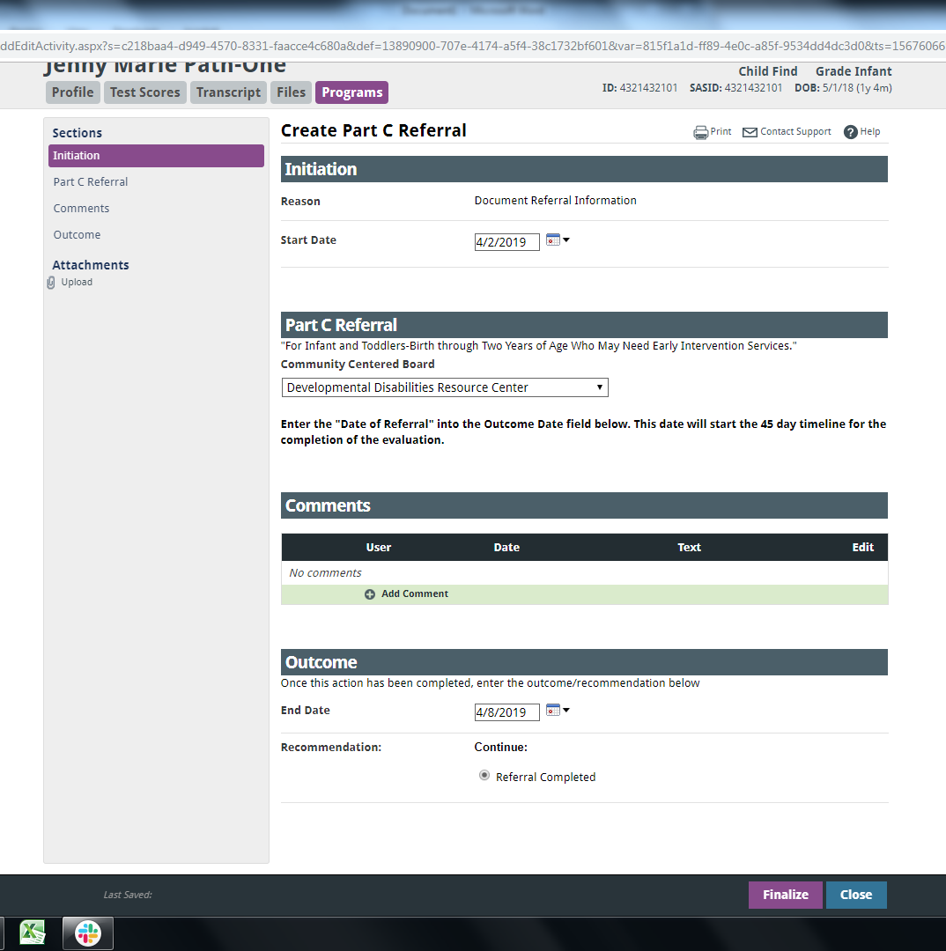
Path 1: Part C Evaluation – Create Referral
Create Part C Referral
Outcome End Date is the Path 1 – Date Referred for Part C Evaluation

Slide 28
Path 1: Part C Evaluation – Create Evaluation
Create Evaluation
Date parental consent was provided to the Community Centered Board (CCB) is the Path 1 – Date of Parental Consent to Evaluate Part C

Slide 29
Path 1: Part C Evaluation – Evaluation Sections
Scroll down beyond the assessment details sections, our next data field for Path 1 is below these…

Slide 30
Path 1: Part C Evaluation – Compliance Checks
In the Compliance Checks section you will find the date the evaluation was completed in the Outcome End Date
Outcome End Date is the Path 1 – Date Evaluation Completed Part C
If the Outcome End Date is more than 45 days from referral, a dialog box will appear after you click Finalize to enter the delay reason that will populate the Path 1 – Reason for Delay in Completing the Evaluation Part C
If the evaluation is NOT completed at all this is where you will indicate why. Selecting one of these should result in Path 1: Eligibility and Services being 00.

Slide 31
Path 1: Part C Evaluation – Create Documentation of Eligibility
Create Documentation of Eligibility
The Eligibility Yes/No is the Path 1 – Eligibility and Services

Slide 32
Path 2: Part C to Part B Transition Data for the Participation File

Slide 33
Path 2: Part C to Part B Transition – Referral Information
Part C to Part B Referral
Path 2 – Date Child is Found Eligible for Part C Services
Path 2 – Date of Referral to the AU from the Local CCB

Slide 34
Path 2: Part C to Part B Transition – Consent to Evaluate
Consent for Initial Evaluation
Consent to Evaluate Date Response Received is the Path 2 – Date of Parental Consent to Evaluate C to B

Slide 35
Path 2: Part C to Part B Transition – Evaluation Outcome
Initial Evaluation or Reevaluation Outcome and Compliance Checks sections
Outcome End Date is the Path 2 – Date Evaluation Completed C to B
If the Outcome End Date is beyond the 60 day timeline a popup will appear where you will select the Reason for the Delay in Completing the evaluation C to B

Slide 36
Path 2: Part C to Part B Transition – Eligibility Meeting
Eligibility Meeting sections
Path 2 – Date of Initial Eligibility Meeting C to B
If this date is on or after the third birthday, a popup will appear where you will select the Reason for the Delay in Initial Eligibility Meeting C to B

Slide 37
Path 2: Part C to Part B Transition – IEP Early Childhood
IEP Early Childhood (3-5)
Start Date is the Path 2 – Date IEP Implemented C to B

Slide 38
Path 2: Part C to Part B Transition – Eligibility Outcome
Eligibility Determination
Outcome End Date is the Path 2 – Eligibility and Services

Slide 39
Path 3: Part B Initial Evaluation Data for the Participation File

Slide 40
Path 3: Part B Initial Evaluation – Program View History
Programs -> View History
Also, note that you can perform Administrative Edits on most data fields by clicking into that Item/Event and selecting Administrative Edit

Slide 41
Path 3: Part B Initial Evaluation – Consent for Evaluation
Consent for Initial Evaluation
Date Response Received is the Path 3 – Date of Parental Consent to Evaluate Part B

Slide 42
Path 3: Part B Initial Evaluation – Evaluation Outcome
Initial Evaluation or Reevaluation
Outcome End Date is the Path 3 – Date Evaluation Completed Part B
If this date is beyond the 60 day timeline a Reason for the Delay in Completing the Evaluation Part B should be noted

Slide 43
Path 3: Part B Initial Evaluation – Evaluation Compliance Checks
Here is an example of a Compliance Check popup where you select a Reason for Delay

Slide 44
Path 3: Part B Initial Evaluation – Eligibility Meeting
Eligibility Determination
Path 3 – Date of Initial Eligibility Meeting Part B

Slide 45
Path 3: Part B Initial Evaluation – IEP Meeting
IEP School Age (6-14) for younger or older students the age range will vary
Path 3 – Date Initial IEP was Finalized Part B
If this date is beyond the 90 day timeline a Reason for the Delay in Finalizing the Initial IEP Part B should be noted

Slide 46
Path 3: Part B Initial Evaluation – IEP School Age
IEP School Age (6-14) for younger or older students the age range will vary
Initiating Meeting Date is the Path 3 – Date Initial IEP was Finalized Part B
Start Date is the Path 3 – Date IEP was Implemented Part B

Slide 47
Path 3: Part B Initial Evaluation – Eligibility Outcome
Eligibility Determination
Outcome Recommendation is the Path 3 – Eligibility and Services

Slide 48
How to Enter Path 1 Part C Evaluations into Enrich

Slide 49
How to Enter Path 1 Part C Evaluations into Enrich – Adding Schools and Students
If not already there, you will want to create a placeholder school to assign the Part C records to, such as “Child Find” or “Part C Evals Sped EOY”
If you are a Boces with more than one member district you will need to create a school within each district
Give this placeholder school a 4-digit school code of 0000
Add the students
Add the Part C events for each student

Slide 50
How to Enter Path 1 Part C Evaluations into Enrich – Adding Schools
First, click into the Administration screen
Second, click Manage Districts & Schools
Third, click Add School for each district you need to

Slide 51
How to Enter Path 1 Part C Evaluations into Enrich – Save the Added School
Click Save after you enter the school information
Then you will see it appear in the School list for that district

Slide 52
How to Enter Path 1 Part C Evaluations into Enrich – Adding Students
Next we will Add New Student to create a record for each student. Your SIS import already does this step for school-age students, but Part C evaluation children are not enrolled in school and likely do not have an SIS record yet. If these students are already in your SIS system and populate into Enrich automatically you can skip this step.

Slide 53
How to Enter Path 1 Part C Evaluations into Enrich – Enter Student Contact Info
Add all of the student’s info.

Slide 54
How to Enter Path 1 Part C Evaluations into Enrich – Enter Student Personal Info
Be sure to assign a School and a Grade Level.

Slide 55
How to Enter Path 1 Part C Evaluations into Enrich – Start Program
To begin entering the Part C event dates and info, click Start Program.
Select Part C Child Find in the Program drop down menu, then click Next.

Slide 56
How to Enter Path 1 Part C Evaluations into Enrich – Create Part C Referral
Create Part C Referral (Date Referred for Part C Evaluation)
Finalize Part C Referral
Close Part C Referral

Slide 57
How to Enter Path 1 Part C Evaluations into Enrich – Add Evaluation
Click to Create the Pending: Evaluation and then click Next

Slide 58
How to Enter Path 1 Part C Evaluations into Enrich – Create Evaluation
Complete the consent date, other evaluation dates and results

Slide 59
How to Enter Path 1 Part C Evaluations into Enrich – Evaluation Outcome
In the Outcome section fill in the End Date for the evaluation completed date, or if it was not completed at all, please provide the reason why

Slide 60
How to Enter Path 1 Part C Evaluations into Enrich – Finalize Evaluation
Finalize the evaluation in the popup

Slide 61
How to Enter Path 1 Part C Evaluations into Enrich – Compliance Checks
If the Part C evaluation was completed more than 45 days after parental consent a Compliance Check popup will ask for the delay reason
Once the delay reason is saved you may Close Evaluation

Slide 62
How to Enter Path 1 Part C Evaluations into Enrich – Documentation of Eligibility
Next Create the Pending: Documentation of Eligibility
Click Next

Slide 63
How to Enter Path 1 Part C Evaluations into Enrich – Finalize Documentation of Eligibility
Complete the eligibility information, these dates are likely the same as the evaluation dates
Click to Finalize and then to Close Documentation of Eligibility

Slide 64
How to Enter Path 1 Part C Evaluations into Enrich – View History
Under Programs click to View History to see the Part C Path 1 events and dates. Changes can be made via Administrative Edit by clicking into the event you would like to edit.

Slide 65
How to Enter Path 2 Part C to Part B Transition Evaluations into Enrich

Slide 66
How to Enter Path 2 Part C to Part B Transition Evaluations into Enrich – Add Schools and Students
Depending upon how your AU tracks C to B Transition students, you may want to create a placeholder school to assign the records to, such as “Child Find” or “Part C to B Evals Sped EOY”
If you are a Boces and use place holder schools for C to B students, you will need to create a school within each district
Give this placeholder school a 4-digit school code of 0000
Add the students
Add the Part C events for each student

Slide 67
How to Enter Path 2 Part C to Part B Transition Evaluations into Enrich – Add Schools
First, click into the Administration screen
Second, click Manage Districts & Schools
Third, click Add School for each district you need to
Finally, Save the school info once you have entered it

Slide 68
How to Enter Path 2 Part C to Part B Transition Evaluations into Enrich – Add Students
If the Part C to Part B children are not in your SIS imports, then you will need to add them manually
Click to Add New Student

Slide 69
How to Enter Path 2 Part C to Part B Transition Evaluations into Enrich – Enter Student Info
Be sure to populate the School and Grade Level sections

Slide 70
How to Enter Path 2 Part C to Part B Transition Evaluations into Enrich – Start Program
Click the Programs tab, then Start Program.

Slide 71
How to Enter Path 2 Part C to Part B Transition Evaluations into Enrich – Create Referral
Populate the dates in the Create Part C to Part B Referral , then click to Finalize and Close

Slide 72
How to Enter Path 2 Part C to Part B Transition Evaluations into Enrich – Create Consent for Initial Evaluation
Create Consent for Initial Evaluation, then click Next

Slide 73
How to Enter Path 2 Part C to Part B Transition Evaluations into Enrich – Finalize Consent
Populate the dates and other fields in Create Consent for Initial Evaluation, then click Finalize

Slide 74
How to Enter Path 2 Part C to Part B Transition Evaluations into Enrich – Finalize and Close Consent
Confirm the Finalize and Close Consent for Initial Evaluation

Slide 75
How to Enter Path 2 Part C to Part B Transition Evaluations into Enrich – Create Initial Evaluation
After finalizing the consent, Create Initial Evaluation or Reevaluation

Slide 76
How to Enter Path 2 Part C to Part B Transition Evaluations into Enrich – Complete Initial Evaluation
Complete the dates and fields in the Create Initial Evaluation or Reevaluation, then Finalize

Slide 77
How to Enter Path 2 Part C to Part B Transition Evaluations into Enrich – Finalize Initial Evaluation
Finalize and Close Initial Evaluation or Reevaluation

Slide 78
How to Enter Path 2 Part C to Part B Transition Evaluations into Enrich – Create Eligibility Determination
Create Eligibility Determination

Slide 79
How to Enter Path 2 Part C to Part B Transition Evaluations into Enrich – Create Eligibility Meeting
In the Create Eligibility Determination you will also need to Create a new meeting for this Eligibility Determination

Slide 80
How to Enter Path 2 Part C to Part B Transition Evaluations into Enrich – Eligibility Outcome
Complete the dates and fields all the way down through Outcome and then click Finalize

Slide 81
How to Enter Path 2 Part C to Part B Transition Evaluations into Enrich – Finalize Eligibility Determination
Finalize then Close Eligibility Determination

Slide 82
How to Enter Path 2 Part C to Part B Transition Evaluations into Enrich – Create Consent for Services
Create Consent – Init Provision of Spec Ed and Related Svcs

Slide 83
How to Enter Path 2 Part C to Part B Transition Evaluations into Enrich – Consent for Initial Placement
Complete the dates and fields all the way down through Outcome, then click Finalize

Slide 84
How to Enter Path 2 Part C to Part B Transition Evaluations into Enrich – Finalize Consent for Services
Finalize and Close Consent – Init Provision of Spec Ed & Related Svcs

Slide 85
How to Enter Path 2 Part C to Part B Transition Evaluations into Enrich – Create IEP
Create IEP

Slide 86
How to Enter Path 2 Part C to Part B Transition Evaluations into Enrich – Create IEP Meeting
Create IEP Meeting
Complete the various sections of the IEP, any sections needing to be filled out will highlight red when you try to finalize and not let you finalize until all needed sections are completed.

Slide 87
How to Enter Path 2 Part C to Part B Transition Evaluations into Enrich – Finalize IEP
Agree, Finalize the IEP and the Close IEP

Slide 88
How to Enter Path 3 Part B Initial Evaluations into Enrich

Slide 89
How to Enter Path 3 Part B Initial Evaluations into Enrich
Path 3 Initial Part B Evaluations will complete most of the same actions and documents that were completed for a C to B
The only difference is in the first few clicks of starting a program – select Consider Eligibility for Special Education
Then continue through the same steps as for a C to B – consent, evaluation, consider eligibility, consent for services and IEP

Slide 90
How to Enter Path 3 Part B Initial Evaluations into Enrich – Start Program
Start Program
Special Education
Consider Eligibility for Special Education
Click Next
See the slides from Path 2 to see the next steps after starting the program

Slide 91
Records Missing from Child File or Participation File

Slide 92
Records Missing From Child and Participation
Verify the date range of the file you are collecting
December Count Child Count 7/1 to 12/1
End of Year 7/1 to 6/30
If you see the record in Enrich but not in the collected file
Is there a school and grade level assigned?
If an Initial Evaluation, are all the data fields needed to populate the Path completed?
If all else fails you can manually add the record after you collect the data file

Slide 93
CDE Data Pipeline

Slide 94
CDE Data Pipeline
Please refer to the CDE Data Pipeline webpages for Special Education IEP Interchange, December Count and Sped EOY for collection specific guidance and training for the Data Pipeline side of the data collections
Data Pipeline Special Education IEP Interchange
Data Pipeline Special Education December Count
Data Pipeline Special Education End of Year
For help with Enrich please contact:
Orla Bolger - bolger_o@cde.state.co.us 303-866-6896
Melissa Chaffin – chaffin_m@cde.state.co.us 303-866-6819

