Slide 1
Welcome to Ascend
Colorado Department of Education’s Data Management System (DMS)

Slide 2
Topics Covered
System Requirements
System Features
Login
Dashboard & Left Navigation Pane
Help Options
AU Tutorials - Professional Learning System
Correspondence Search

Slide 3
Ascend DMS System Requirements
How to check browser versions: Chrome:
https://support.google.com/chrome/answer/954 14?hl=en&co=GENIE.Platform%3DDesktop&oc o=0
System Requirements:
Most current versions of Google Chrome, Apple Safari, Firefox, & Microsoft Edge. Check that your browser is updated to the latest version.
Your pop-up blocker must be disabled.
*You may experience better functionality with Google Chrome.
Safari:
https://support.apple.com/en-us/HT204416
Firefox:
https://support.mozilla.org/en-US/kb/update-firef ox-latest-release
Microsoft Edge: https://support.microsoft.com/en-gb/microsoft-e dge/find-out-which-version-of-microsoft-edge-yo u-have-c726bee8-c42e-e472-e954-4cf5123497 eb

Slide 4
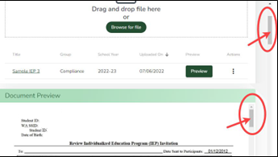
Ascend DMS Tips
System Features:
Caret = an open or filled arrowhead. Clicking on a caret will open hidden information. Re-clicking on a caret will hide the revealed information.
Quick Access Menu (a.k.a. Hamburger Menu) = 3 short stacked horizontal lines. Clicking on a Quick Access icon will reveal hidden information/options.
Modals, pop-ups, and new tabs = may appear as you click on buttons and links. A modal is a text message that will appear on the screen to indicate success or failure on an action.
Vertical and Horizontal Scroll Bars = Be sure to check if the sides and top and bottom of the page, or if any sections or pop-up boxes have these scroll bars used to reveal more information.
# of items per page and page over arrows = may exist at the bottom of the page. You can change the # of items displayed or page over to reveal more information.
Auto-save = Ascend DMS automatically saves when you are working in the system.
4

Slide 5
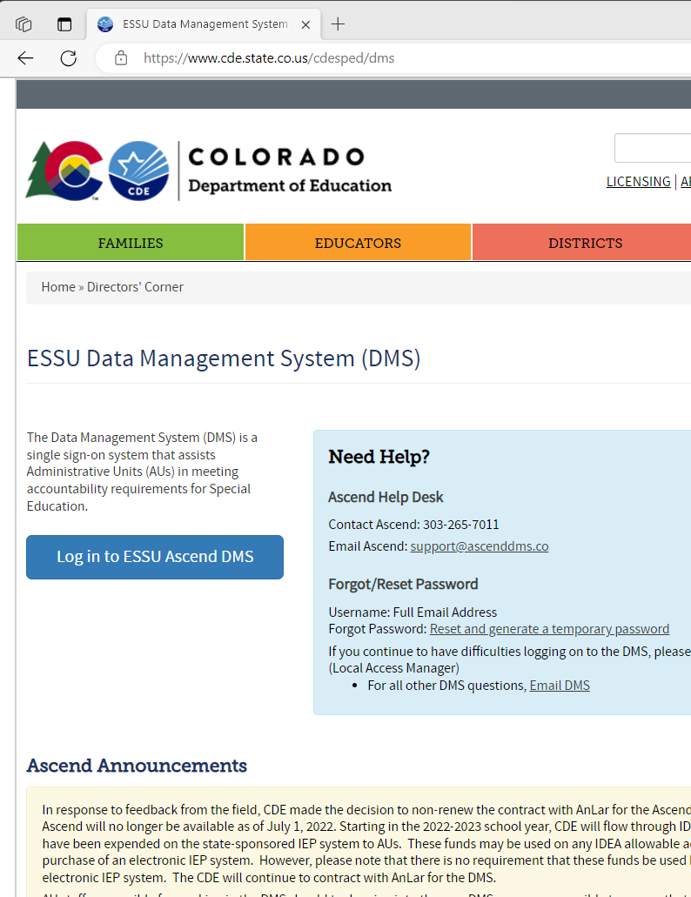
Ascend Login
Go to CDE’s Webpage at: ESSU Data Management System (DMS) | CDE (https://www.cde.state.co.us/cde sped/dms).
Look for the blue button labeled: “Log in to ESSU Ascend DMS” located on the left side of the webpage.
Click on the “Log in to ESSU Ascend DMS” blue button.

Slide 6
Single-Sign-On
In the gray “Welcome” box on the right side of the webpage, type in your Username (this is your full email address) and Password.

Slide 7
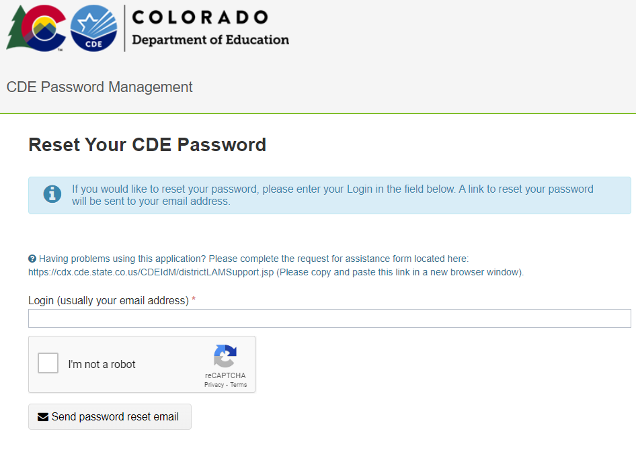
Single-Sign-On – Forgot Password
Forgot your Password? Go to: Reset and generate temporary password (https://edx.cde.state.co.us/passwordmanagement/CDEPasswordApplication.html#/).
If you continue to have difficulties logging on to the DMS, please contact your AU LAM (Local Access Manager).

Slide 8
Ascend DMS Dashboard
System always defaults to current school year
Upon logging into Ascend DMS, you will land on the “My Dashboard” page. Along the top right side of the screen, you will see 3 drop-down fields:
Select School Year (*default is current school year)
District/AU (*only shows your AU)
Username
Clicking on the shaded caret
(down-pointing arrow) to the right of these fields will reveal options to:
Select the school year;
Show your District/AU;
Adjust your settings or sign out of the system.
7

Slide 9
Ascend DMS Left Navigation Pane
Ascend may open with the left navigation pane closed. The left navigation pane contains the links to the various module pages such as AU Tasks, Corrections, Documents, and Help.
To open the left navigation pane:
Click on the Quick Access menu (3 horizontal lines icon) located to the right of the ASCEND logo located in the upper left corner of the screen.

Slide 10
Ascend DMS Help
For Help with Ascend DMS, click on the “Help” label in the left navigation pane.
Help contact information will appear in the left navigation pane below the “Help” label.

Slide 11
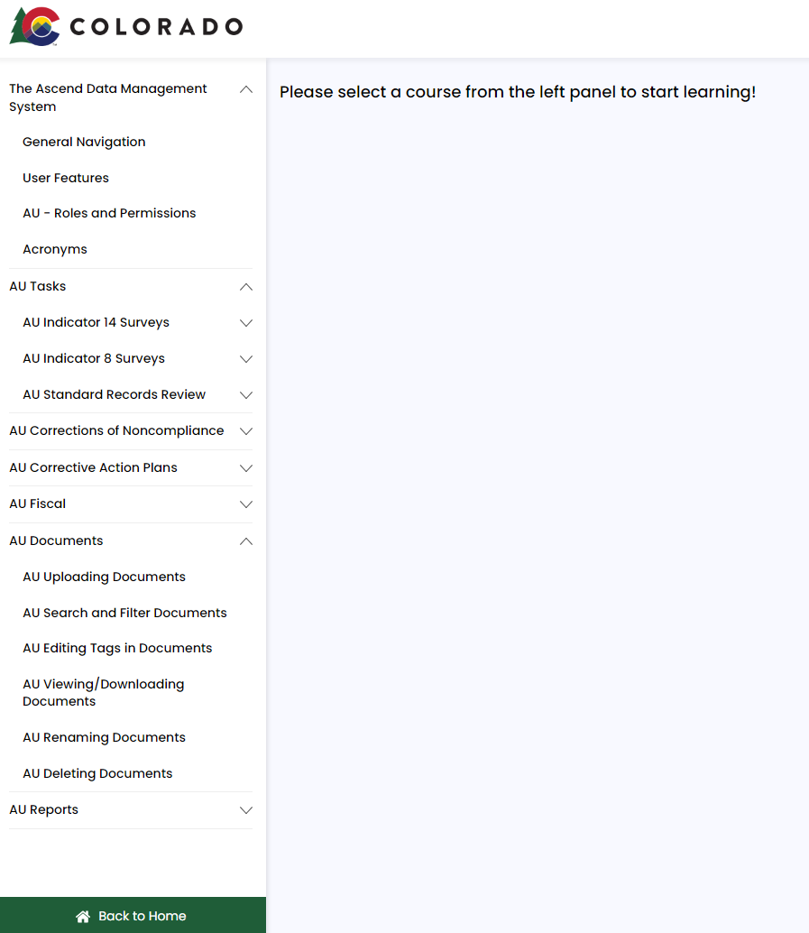
AU Tutorials
For Help with navigating and using Ascend DMS (including troubleshooting):
Visit the Professional Learning System AU User Tutorials Online self-paced guide
10

Slide 12
Correspondence Search
To search for specific documents:
Use the filter fields (School Year, Type, Date Range) at the top of the page. Select from the drop-down list that opens.
Click on the category (Data Collections, Fiscal, Compliance, etc.) to select the desired filter tag.
Click the blue Search button.

Slide 13
Contacts
Ascend Help Desk
Contact Ascend: 303-265-7011
Email Ascend: support@ascenddms.co
Forgot/Reset Password
Username: Full Email Address Forgot Password: Reset and generate a temporary password
If you continue to have difficulties logging on to the DMS, please contact your AU LAM (Local Access Manager)
For all other DMS questions, Email DMS

