Slide 1
GASB Update
Colorado pera
Catherine maninger, Controller
Lawrence Mundy, Accounting/Financial Reporting manager

Slide 2
This publication is intended for informational/educational purposes only and should not be used to replace the advice of a qualified professional. It is not intended to be a substitute for professional advice, whether actuarial, accounting, legal, or otherwise. While efforts are made to verify the information presented, PERA does not guarantee the accuracy or completeness of the information. PERA owns the rights to this publication and it may not be reproduced, republished, or re‐disseminated in any manner without the prior written consent of PERA. PERA cannot be held liable for any information provided in this publication.

Slide 3
Agenda
1. Overview of the calculation of the collective net pension liability
Total pension liability
Discount rate determination
2. Overview of the general GASB 68 reporting process (historically)
Schedules issued by PERA
Calculations typically performed by employers
5. Comprehensive educational journal entry discussion
What are the typical entries?
Fiduciary net position
What does each typical entry mean?
3. General overview of SB 18-200
4. Changes to look out for with GASB 68
Changes to contributions
Changes to benefits
Special funding situation for certain divisions
Change in discount rate for certain divisions

Slide 4
Overview of the calculation of the collective net pension liability
Basic formula for the collective net pension liability for a pension fund:
total pension liability - fiduciary net position = net pension liability
Total pension liability is:
determined by an actuarial firm
the PV of future benefit payments
based on economic and demographic assumptions
4
Notes:
Lawrence

Slide 5
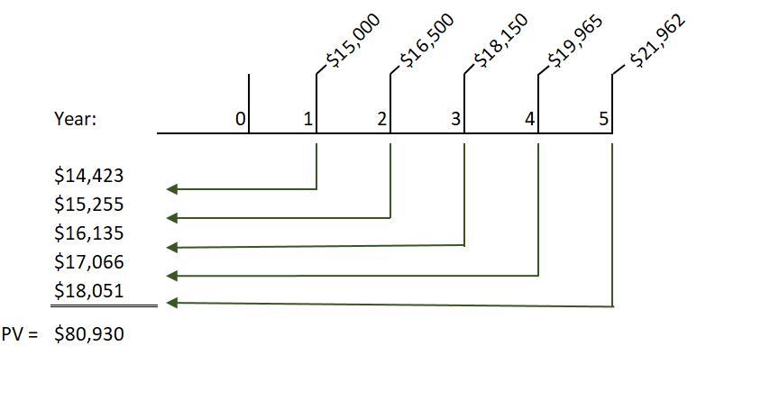
Overview of the calculation of the collective net pension liability
Present value calculations are not limited to pensions/OPEB as these types of calculations are performed to comply with other accounting standards
For example, GASB 87 Leases (paragraph 21) requires a lessee to calculate the present value of future payments of a lease to determine the liability for financial reporting purposes.
To illustrate:
* Based on a discount rate of 4% (i.e. assumed incremental borrowing rate)
5
Notes:
Lawrence

Slide 6
Overview of the calculation of the collective net pension liability
The total pension liability is a complex calculation with many assumptions and can be better understood by thinking of it in the same type of present value frame work
Projection of future benefit payments depends on assumption such as:
  When do the payments start in the future
    assumptions of when a member will retire or become disabled
  How much is the benefit payment in the first expected period of retirement
    what will their highest average salary be at retirement
    how much service credit will they have earned throughout their career
    what benefit structure(s) did they earn the service credit
    salary growth assumptions
  How much will the payment increase over time
    depends on the annual increase (i.e. COLA)
  How long with the retirement payment continue
    mortality
6
Notes:
Lawrence

Slide 7
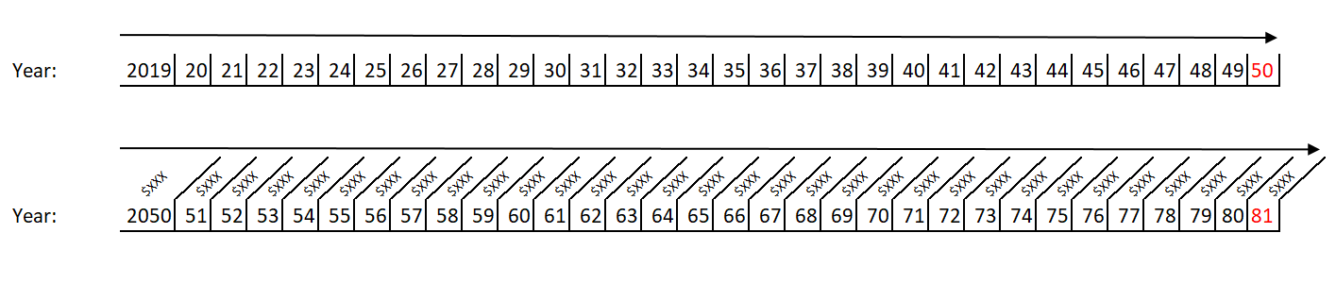
Overview of the calculation of the collective net pension liability
As of 12/31/2018, PERA has over 600,000 members
211,584 Actives
270,407 Inactives
122,189 Retired
That is a lot of math!
7
Notes:
Lawrence

Slide 8
Overview of the calculation of the collective net pension liability
The Discount Rate should be the single rate that reflects:
  The long-term expected rate of return on pension plan investments that are expected to be used to finance the payment of benefits, to the extent that
    The pension plan’s fiduciary net position is projected to be sufficient to make projected benefit payments and
    Pension plan assets are expected to be invested using a strategy to achieve that return, and
  A yield or index rate for 20-year, tax-exempt general obligation municipal bonds with an average rating of AA/Aa or higher, to the extent that the above conditions are not met
8
Notes:
Lawrence

Slide 9
  Overview of the calculation of the collective net pension liability
Must perform a test to determine a crossover date, if any
Projections of the pension plan’s fiduciary net position are compared to the plan’s projected benefit flows in each period (year) to determine if
  Projected plan fiduciary net position is sufficient to pay projected benefit payments of the current membership, or
  There is a point of crossover from projected plan fiduciary net position
    Sufficient to cover projected benefit payments in each period
    Not sufficient to cover remaining projected benefit payments
Crossover date does not necessarily mean that the plan runs out of money
9
Notes:
Lawrence

Slide 10
  Overview of the calculation of the collective net pension liability
If the plan fiduciary net position is projected to be sufficient for all future periods (and pension plan assets are expected to be invested using a strategy to achieve the long-term rate of return)
  The long-term expected rate of return on investments can be used as the GASB Discount Rate
If the plan fiduciary net position is projected to be insufficient considering all future periods (a crossover date occurs)
  A blended, single discount rate is calculated considering both
    The long-term expected rate of return and
    A 20-year municipal bond index rate
10
Notes:
Lawrence

Slide 11
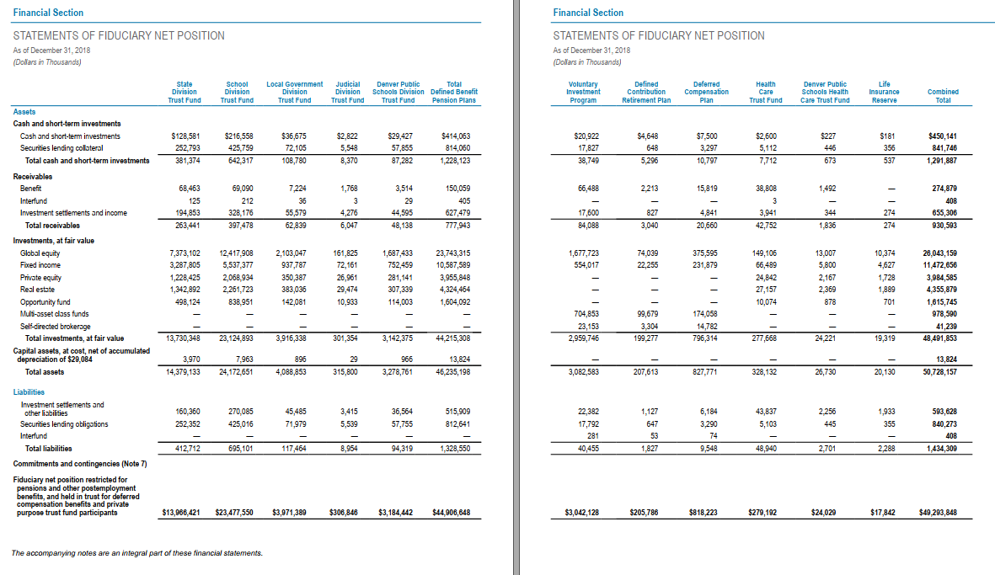
Overview of the calculation of the collective net pension liability
11
Notes:
Lawrence

Slide 12
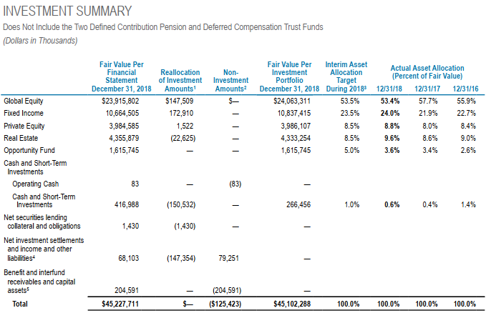
Overview of the calculation of the collective net pension liability
12
See page 147 of PERA’s 2018 CAFR for more information.
Notes:
Lawrence

Slide 13
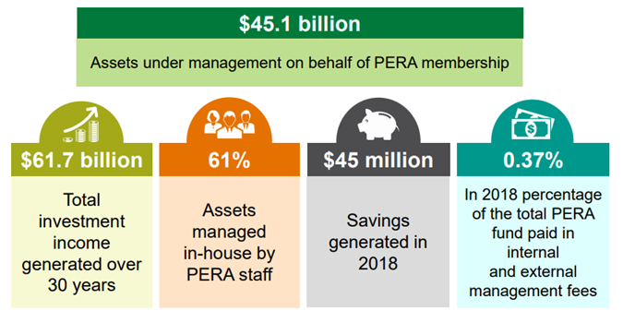
Overview of the calculation of the collective net pension liability
13
Notes:
Lawrence

Slide 14
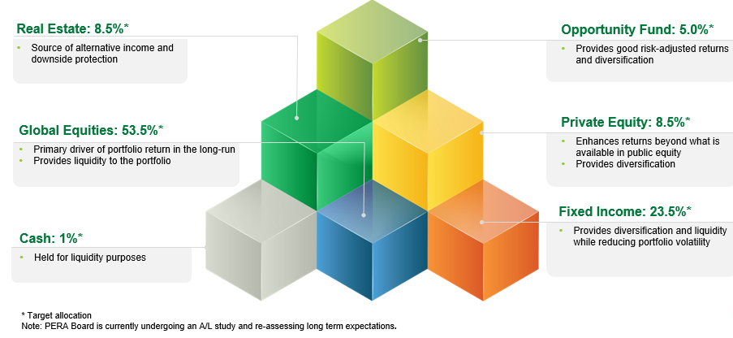
  Overview of the calculation of the collective net pension liability
PERA’s strategic asset allocation is the largest determinant of the long-term rate of return assumption (currently 7.25%)
Each asset class fulfills a specific role (e.g. diversification, returns, liquidity, etc.) within the Total Fund.
14
Notes:
Lawrence

Slide 15
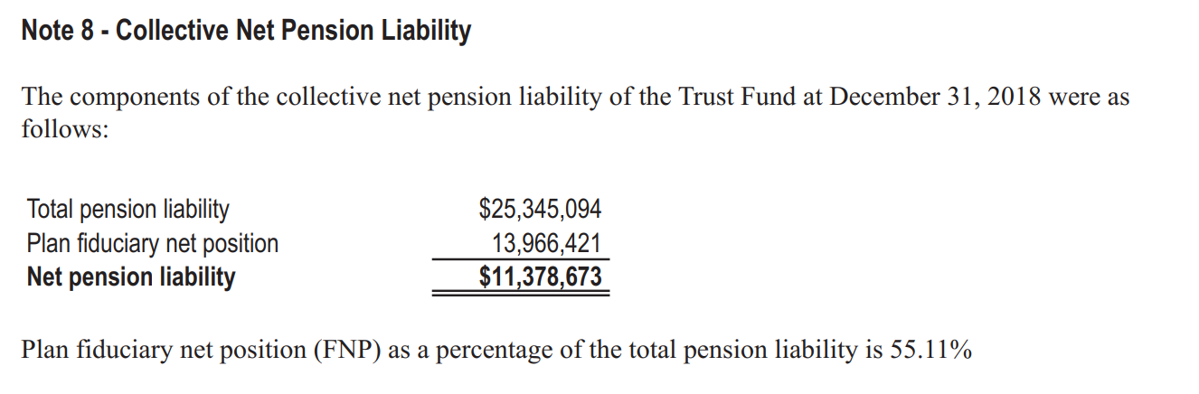
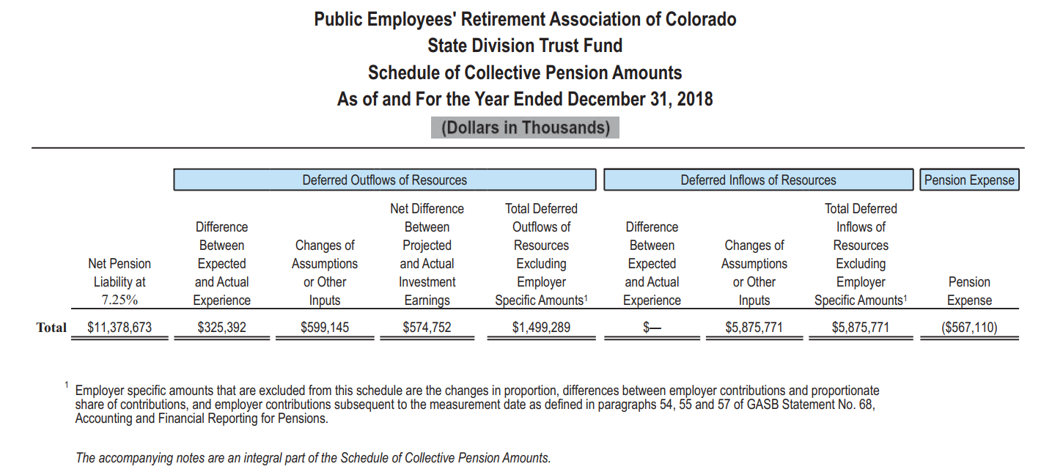
Overview of the calculation of the collective net pension liability
15
Notes:
Lawrence

Slide 16
Questions
Questions
16
Notes:
Catherine

Slide 17
Overview of the general GASB 68 reporting process (historically)
For the 2017 reporting period, PERA provided the following information schedules to assist PERA-affiliated employers
GASB 68:
  Audited Schedule of Employer Allocations and Schedule of Collective Pension Amounts for 12/31/17
  Employer-Specific Payroll Contribution Reconciliation for 2017*
Updated sample note disclosures for pensions
GASB 75:
Audited Schedule of Employer Allocations and Schedule of Collective OPEB Amounts for 12/31/16 & 12/31/17
Employer-Specific Payroll Contribution Reconciliation for 2016 and 2017*
Updated sample note disclosures for OPEB
17
*a single spreadsheet file was provided for the reconciliations for both pensions and OPEB
Notes:
Catherine

Slide 18
Overview of the general GASB 68 reporting process (historically)
Employer’s would use the schedules and their own internal information to create their journal entries and allocate to funds that are accounted for on an accrual basis
Share of Collective NPL
Share of Collective Pension Expense
Share of Collective Deferrals Outflows
Share of Collective Deferred Inflows
Employer Level Deferred Outflows
Employer Level Deferred Inflows
Amortization of current-year deferrals into pension expense
Amortization of past deferral balances into pension expense
Employer’s use the contribution reconciliation spreadsheets as support for their allocation percentages
Employer’s use the sample footnote disclosures provided by PERA and reviewed by the OSA as a starting point for their disclosures
18
Notes:
Catherine

Slide 19




General overview of SB 18-200
Increase Contributions
Modify Benefits
Align Contributions
With Benefits
Automatic Adjustment Provision
19

Slide 20
Overview of changes in 2018
Contribution Changes
  Pay contributions on sick-leave pay out (June)
Benefit Changes
  Annual Increase suspended for retirees
Direct Distribution
  First $225M annual allocation received from State budget
20

Slide 21
Overview of changes in 2019
  Member increase +.75% (to 8.75%)
  Employer increase +.25% (to 20.4%)
  Pay contributions on deductions made to cafeteria or qualified transportation plans for new members
Contribution Changes (as of 7/1/2019)
Benefit Changes
  Annual Increase suspended for retirees (second year)
  Defined Contribution choice expanded to Local Government Division and State-classified employees in higher education
21

Slide 22



Automatic adjustment provision
Four Components
Employer Contributions
Employee Contributions
Annual Increase (AI)
Direct Distribution (reduction only)
  Financial report indicates PERA is behind schedule and adjustments are needed
Implement
adjustments
  Process
  occurs again
June 2019
July 1, 2020
Annually
22

Slide 23
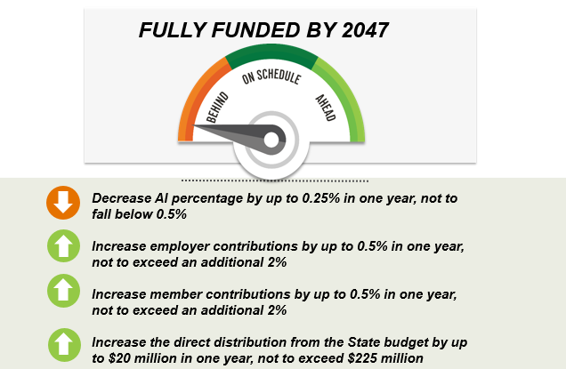
Automatic adjustment provision
23

Slide 24
Questions
Questions
24
Notes:
Catherine

Slide 25
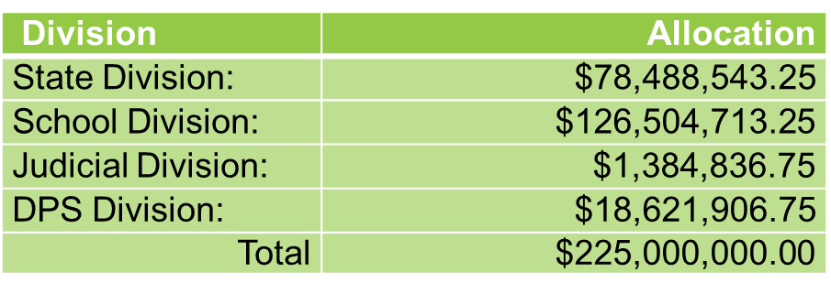
GASB 68 changes: special funding situation for certain divisions
C.R.S. 24-51-414 requires the State of Colorado to contribute $225 million annually to Colorado Public Employees Retirement Association (PERA) starting July 2018.
The annual payment is to be allocated to the State, School, Judicial and DPS Division Trust Funds based on annual covered payroll.
  The annual payment made in July 2018 was allocated as follows:
25

Slide 26
GASB 68 changes: special funding situation for certain divisions
Special funding situations are circumstances in which a nonemployer entity is legally responsible for making contributions directly to a pension plan that is used to provide pensions to the employees of another entity or entities and either of the following conditions exists:
a. The amount of contributions for which the nonemployer entity legally is responsible is not dependent upon one or more events or circumstances unrelated to the pensions. Examples of conditions that meet this criterion include:
  (1) a circumstance in which the nonemployer entity is required by statute to contribute a defined percentage of an employer’s covered-employee payroll directly to the pension plan and
  (2) a circumstance in which the nonemployer entity is required by the terms of a pension plan to contribute directly to the pension plan a statutorily defined proportion of the employer’s required contributions to the pension plan.
  b. The nonemployer entity is the only entity with a legal obligation to make contributions directly to a pension plan.
  *GASB Implementation Guide question 5.122.9. specifies that it’s possible for a contribution for a “flat dollar amount” be considered a special funding situation.
26

Slide 27
GASB 68 changes: special funding situation for certain divisions
Determining the employer’s proportion—a measure of the proportionate relationship of
  (1) the employer (and, to the extent associated with the employer, nonemployer contributing entities, if any, that provide support for the employer but that are not in a special funding situation) to
  (2) all employers and all nonemployer contributing entities. The basis for the employer’s proportion should be consistent with the manner in which contributions to the pension plan, excluding those to separately finance specific liabilities of an individual employer to the pension plan, are determined.
27

Slide 28
GASB 68 changes: special funding situation for certain divisions
For 2018, PERA provided an audited:
  Schedule of Employer and Nonemployer Allocations for the State, School, Judicial, and DPS Division Trust Funds
    Each of the four schedules reflects the direct distribution payment
    Each of the schedules includes the direct distribution payment into the calculation of the allocation percentage
  Schedule of Employer Allocations for the Local Government Division Trust Fund, Health Care Trust Fund, and DPS Health Care Trust Fund
    The format and overall calculation methodology has not changed from the prior year
These schedules were provided in July 2019 and believes they will be primarily used by PERA-affiliated employers with fiscal-year ends of December 31, 2018, June 30, 2019 to December 31, 2019.
28

Slide 29
GASB 68 changes: special funding situation for School and DPS
The entire amount of the Direct Distribution payment allocated to the School and DPS Division Trust Funds
  Is considered a contribution from a nonemployer contributing entity
  Meets the definition of a special funding situation
  Has the effect of reducing the allocation percentage of each PERA-affiliated employer
  The State of Colorado receives an allocation percentage as a nonemployer contributing entity
PERA-affiliated employers are ultimately responsible for concluding whether the amount is considered a special funding situation based on their own unique circumstances and relationship with the State of Colorado
29

Slide 30
GASB 68 changes: special funding situation for State and Judicial
The direct distribution payment allocated to the State Division and Judicial Division Trust Funds
  PERA-affiliated employers included in the State of Colorado’s financial reporting entity
  PERA-affiliated employers not included the State of Colorado’s financial reporting entity
  Recognition of the direct distribution payment as an employer/nonemployer contribution requires knowledge of the employment/financial reporting relationships of the PERA-affiliated employers with the State of Colorado
Colorado PERA received direction from the Colorado Office of the State Controller on the following aspects of the Schedule of Employer and Nonemployer Allocations:
  The portion of the direct distribution payment that is to be considered an employer contribution versus a nonemployer contribution
  The PERA-affiliated employers that are included/outside the State of Colorado’s financial reporting entity
  The allocation methodology of the portion of the direct distribution payment recognized as an employer contribution to PERA-affiliated employers included in the State’s financial reporting entity
30

Slide 31
GASB 68 changes: special funding situation for State and Judicial
The direct distribution payment apportioned to the State Division and Judicial Division Trust Funds
  A portion is considered an employer contribution and a portion is considered a contribution from a non employer contributing entity
  The portion recognized as a nonemployer contribution has the effect of decreasing the allocation percentage of PERA-affiliated employers outside of the State of Colorado’s financial reporting entity.
  The State of Colorado receives an allocation percentage as a nonemployer contributing entity
PERA-affiliated employers are ultimately responsible for concluding whether the amount is considered a special funding situation based on their own unique circumstances and relationship with the State of Colorado.
31

Slide 32
GASB 68 changes: special funding situation for certain divisions
GASB 68 requires additional financial reporting and note disclosures for PERA-affiliated employers who determine they have a special funding situation:
  Financial reporting and note disclosure requirements:
  80 (j): The amount of revenue recognized for the support provided by nonemployer contributing entities
  Note disclosure requirements:
  76 (c) (2) identification of the authority under which contribution requirements of employers, nonemployer contributing entities, and employees are established or may be amended;
  78 (b) Assumptions made about projected cash flows into and out of the pension plan, such as contributions from employers, nonemployer contributing entities, and employees
  80 (b) The employer’s proportion (percentage) of the collective net pension liability, the basis on which its proportion was determined, and the change in its proportion since the prior measurement date
  80 (a) The employer’s proportionate share (amount) of the collective net pension liability and, if an employer has a special funding situation, (1) the portion of the nonemployer contributing entities’ total proportionate share (amount) of the collective net pension liability that is associated with the employer and (2) the total of the employer’s proportionate share (amount) of the collective net pension liability and the portion of the nonemployer contributing entities’ total proportionate share of the collective net pension liability that is associated with the employer
32

Slide 33
  GASB 68 changes: special funding situation for certain divisions
  Financial reporting and note disclosure requirements:
  80 (j): The amount of revenue recognized for the support provided by nonemployer contributing entities
  See GASB Illustrative Example 5b*:
  Sample Pension Plan:
    (A) Collective Pension Expense:……………………………………………….......... $1,163,898
    (B) Total of all Employer Contributions (10% of all contributions):………………… $100,473
    (C) Total Nonemployer Contributions (90% of all contributions):………………….. $904,257
    (D) Total Contributions…………………………………………………………………. $1,004,730
  Sample School District:
  (E) Sample School District Contributions............................................................... $206
  (F) Sample School District Proportion:………………………….…………………….. .02% rounded
  In addition to the pension expense that the sample school district recognizes due to their employer contributions to the pension plan and amortizations of employer-level deferrals into pension expense; the employer in a special funding situation will recognize pension expense and revenue:
  The nonemployer contributing entity’s proportionate share of the collective pension expense recognized by the sample school district as revenue and expense.
  Sample Calculation: (90% * 1,163,898) * (.02% / 10%) = $2,095
*See illustration 5B: Net Pension Liability, Deferred Outflows of Resources and Deferred Inflows of Resources related to Pensions, and Pension Expense for
Sample School District in Illustration 5a - GASB Codification P20.901
33

Slide 34
  GASB 68 changes: special funding situation for certain divisions
  Note disclosure requirements:
  80 (a) (1) the portion of the nonemployer contributing entities’ total proportionate share (amount) of the collective net pension liability that is associated with the employer
  See GASB Illustrative Example 5a*:
  Sample Pension Plan:
    (A) Collective Net Pension Liability………………………………………………....... $7,455,024
    (B) Total of all Employer Contributions (10% of all contributions):………………… $100,473
    (C) Total Nonemployer Contributions (90% of all contributions):………………….. $904,257
    (D) Total Contributions…………………………………………………………………. $1,004,730
  Sample School District:
  (E) Sample School District Contributions............................................................... $206
  (F) Sample School District Proportion:………………………….…………………….. .02% rounded
  In addition to the proportionate share of collective NPL that the sample school district recognizes on their financial statements prepared using an economic resources and accrual basis of accounting; the employer in a special funding situation will include it’s proportionate share of the net pension liability arising from the special funding situation in the Notes to their Financial Statements:
  Sample Calculation: (90% * 7,455,024) * (.02% / 10%) = $13,419
  *See illustration 5A: Note Disclosures and Required Supplementary Information for a Cost-Sharing Employer That Applies Paragraphs (Special Funding Situation No Other
  Nonemployer Contributing Entities) - GASB Codification P20.901
34

Slide 35
  GASB 68 changes: special funding situation for certain divisions
  Sample Pension Plan:
    (A) Collective Net Pension Liability………………………………………………....... $7,455,024
    (B) Total of all Employer Contributions (10% of all contributions):………………… $100,473
    (C) Total Nonemployer Contributions (90% of all contributions):………………….. $904,257
    (D) Total Contributions…………………………………………………………………. $1,004,730
  Sample School District:
  (E) Sample School District Contributions............................................................... $206
  (F) Sample School District Proportion:………………………….……………………. .02% rounded
Sample school district proportionate share of the net pension liability (A * F) | $1,491
The Nonemployer Contributing Entity’s proportionate share of the net pension liability associated with the Sample School District Sample Calculation: (90% * 7,455,024) * (.02% / 10%) | $13,419
Total | $14,910
35

Slide 36
Questions
Questions
36
Notes:
Catherine

Slide 37
GASB 68: sample journal entry information
37

Slide 38
Deferred inflows and outflows of resources
38

Slide 39
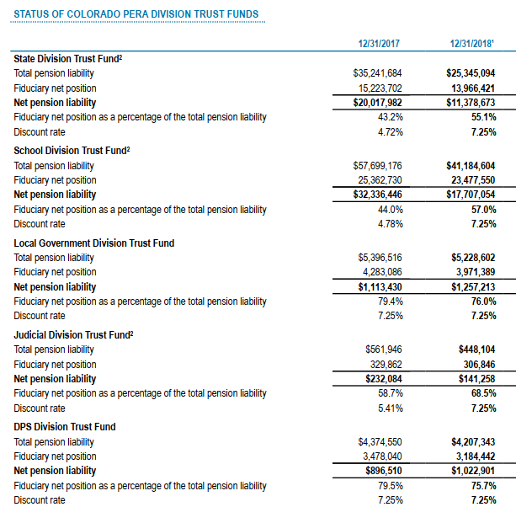
  GASB 68 changes: change in discount rate for certain divisions
39

Slide 40
Sample journal entries for GASB 68 net pension liability
40

Slide 41
Sample journal entries for GASB 68 deferred outflows of resources
41

Slide 42
Sample journal entries for GASB 68 deferred inflows of resources
42

Slide 43
Sample journal entries for GASB 68 pension expense
43

Slide 44
What you can do
PERA affiliated-employers should obtain the following information from PERA’s Secure Website (STARS)
  Audited GASB 68 Employer Schedules
  Division Specific Letter regarding the NPL
  Employer Specific Contribution Reconciliation Spreadsheet
  Sample Note Disclosures
Speak to your external auditor to let them know of the direct distribution payment
Review PERA’s sample journal entry publication to learn more about the calculations you may need to perform for your financial reporting entity
External auditors will need to obtain the schedules directly from their clients
44

Slide 45
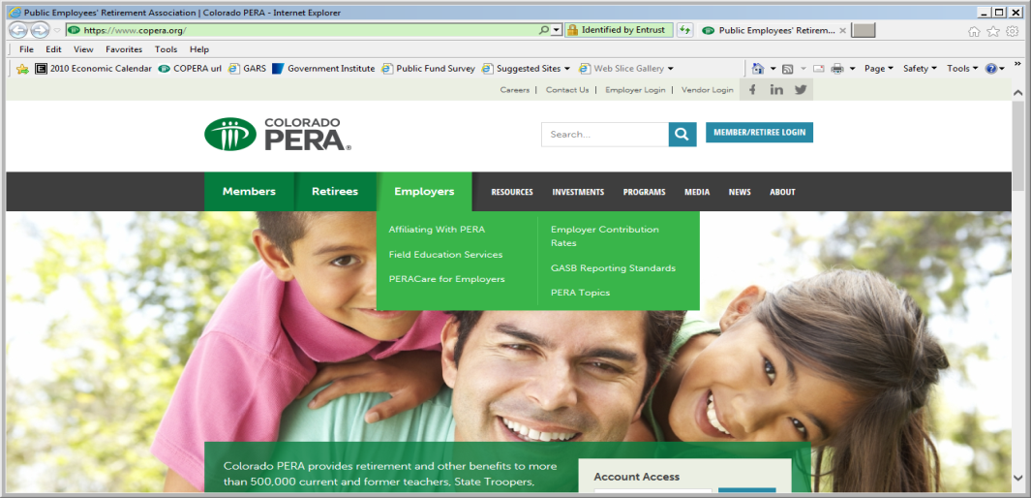
Get engaged – stay involved
  PERA – GASB reporting standards internet address:
  https://www.copera.org/employers/gasb-reporting-standards
  PERA – GASB reporting standards e-mail:
  GASBMail@copera.org
45

