Slide 1
Disclaimers
Disclaimer Meeting Recording and Transcription Notice Please be aware that the meeting will be recorded and transcribed for training and reference purposes. By participating in this meeting, you consent to the recording and the use of the transcript for training and accommodation purposes. Disclaimer Artificial Intelligence This online training event is offered by the CDE Assessment Division to support the District Assessment Coordinator prepare for the 2024-2025 ACCESS for ELLs administration window. By participating in this event attendees agree that they will not record, capture, share, or publicly post its contents without expressed permission. Attendees may not use artificial intelligence (AI) software or services to capture the content of the event. CDE reserves the right to remove any attendee employing such services.

Slide 2
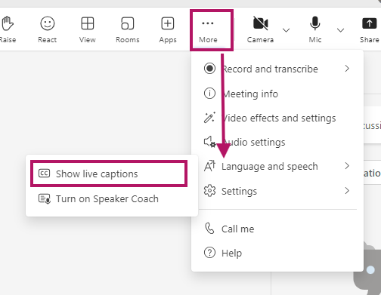
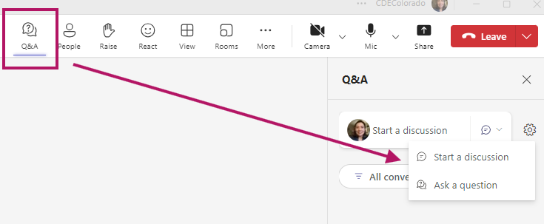
Teams Meeting Logistics
Enable closed captioning
Above More select the 3 dots (…) → Settings → Language and speech → Show live captions
Question and Answer (Q&A)
Select the Q&A icon → Ask a question

Slide 3
2024-2025 District Technology Coordinator Kickoff
CDE Assessment Division October 17, 2024
Notes:
Start the recording!!!

Slide 4
Welcome and Agenda
General Information
DTC responsibilities and privileges
DTC Listserv
State Assessment Schedule
ACCESS/DRC updates
CMAS/Pearson updates
CoAlt/KITE updates
PSAT/SAT Technology Updates

Slide 5
General Information

Slide 6
Spring 2025 Colorado Assessments
Colorado Measures of
Academic Success
(CMAS)
Colorado Alternate (CoAlt)
Assessments
CO PSAT/SAT
SAT – Grade 11
PSAT – Grades 9 and 10
Math (DLM)
Math
Math
ELA (DLM)
Reading and Writing
Optional SAT Essay
ELA
Science
Science
Social Studies*
ACCESS
for ELLs
NAEP **
and International Assessments
Social Studies*
*Social Studies administered in a representative sample of schools as required by state statute
**Reading and math administered in grades 4 and 8 in selected schools

Slide 7
Online Assessment Platforms
Assessment | Test Engine | Student Info System | Features
ACCESS for ELLs® |  | WIDA AMS | Caching server Clients for Windows, Linux, Mac OSX, Chromebooks, iPads and Android
CMAS |  |  | Caching server available Installable apps for desktop, Chromebooks, and iPads
CoAlt Science/ Social Studies | N/A
CoAlt ELA and Math (Dynamic Learning Maps) | Student Portal | Educator Portal | KITE Student Portal installed on each student device
PSAT and SAT | Student Portal: Bluebook App | Test Day Toolkit (TDTK) | Bluebook is an installable app for Windows, Mac, iPad or school-managed Chromebooks TDTK is accessed through an established College Board account

Slide 8
Chrome OS Requirements
Devices/OS | CMAS TN Supported Versions | ACCESS Insight Supported Versions | PSAT/SAT Bluebook Supported Versions | CoAlt DLM KITE
Tablets, Chromebooks, Chromeboxes
Chrome OS | Stable Channel (S) | Stable Channel (S) | Chromebooks must be school-managed, run in kiosk mode, and from 2017 or later.
 | 124 S+ | 114 S+ | 114+ max 126 | 108+
 | Long-term support (LTS)*
 | 120+ LTS
 | No tablet mode for Convertible Chromebooks
Stable channel update for Chrome OS
Stable channel update for Chrome OS

Slide 9
Windows OS Requirements
Devices/OS | CMAS TN Supported Versions | ACCESS Insight Supported Versions | PSAT/SAT Bluebook Supported Versions | CoAlt DLM KITE
Windows | 10 x64 - 21H2, 22H2 | Windows 10 in S mode, 21H1, and 21H2 | 10 and 11 (Home, Pro, Education, and Enterprise) | Windows 10
 | 11 x64 - 21H2, 22H2 | Windows 11 in S mode, 21H2, and 22H2 | Windows in S mode is not supported. | Windows 11
 | Windows 11 23H2 | Windows Server 2016, 2019, and 2022 | Windows 11SE is not supported.
Stable channel update for Chrome OS
Stable channel update for Chrome OS

Slide 10
iPadOS, Linux, and macOS Requirements
 | CMAS TN Supported Versions | ACCESS Insight Supported Versions | PSAT/SAT Bluebook Supported Versions | CoAlt DLM KITE
iPadOS | 16.x, 17.3+, 18.x | 15.4.x-16.x, 17.x | 15.x, 16.x, 17.1+ | 15.8.2 – 18.0
Laptops, Desktops
Linux | Fedora 39+ x64 |  | Not Supported | Not Supported
 | Ubuntu 24.04+ x64 | Ubuntu, 20.04, 22.04 and 24.04 LTS version with Gnome Shell
macOS | 13, 14, 15 | 11.x, 12.x, 13.x,14.x | 11.7.5,- 14.6.1 | 11.7 - 13.3
Stable channel update for Chrome OS
Stable channel update for Chrome OS

Slide 11
Assessment Technology Minimum Hardware Specifications 1 of 3
Minimum Hardware Specifications | CMAS TN Supported Versions | ACCESS Insight Supported Versions | PSAT/SAT Bluebook Supported Versions
Processor | x64 - AMD, ARM, ARM64, or Intel-based™ | Minimum: CPU benchmark rating of 600* | 1 GHz processor
 |  | Recommended: CPU benchmark rating of 3000* or higher
Memory | Recommended - 4 GB RAM Minimum - 2 GB RAM | Minimum – 2 GB RAM Recommended – 4 GB RAM or higher | 2 GB RAM
 | Linux and iOS - 2 GB RAM; Minimum - 1 GB RAM
Stable channel update for Chrome OS
Stable channel update for Chrome OS

Slide 12
Assessment Technology Minimum Hardware Specifications 2 of 3
Minimum Hardware Specifications | CMAS TN Supported Versions | ACCESS Insight Supported Versions | PSAT/SAT Bluebook Supported Versions
Free Disk Space | Local File access to home directory OS X, macOS Windows | 1 GB | 150 MB free hard drive space on Chromebook, iPads, macOS.
 |  |  | 250 MB free hard drive space for Windows device.
Screen Size | 9.5-in | 9.5-in | 10 inches on Desktops and Laptops, 8 inches on tablets.
Resolution | 1024 x 768 | 1024 x 768 | 1024 x 768
Stable channel update for Chrome OS
Stable channel update for Chrome OS

Slide 13
Assessment Technology Minimum Hardware Specifications 3 of 3
Minimum Hardware Specifications | CMAS TN Supported Versions | ACCESS Insight Supported Versions | PSAT/SAT Bluebook Supported Versions
External Mice and Keyboards | Windows (required), iOS (recommended) | Headset with Microphone | External keyboards are required on iPads.
 | External keyboard and mouse (or touchpad) for touchscreen devices | Windows and ChromeOS: Both touchscreen and non-touchscreen devices
 |  | macOS and Linux: Non-touchscreen devices only
 |  | iPadOS: iPads that support iPadOS 15.x or above
Stable channel update for Chrome OS
Stable channel update for Chrome OS

Slide 14
DTC Responsibilities and Privileges

Slide 15
CDE Assessment Technology Support
Primary technology contact for the district who works with CDE Assessment Division regarding online administration of state assessments
Receive critical, in-depth testing vendor communications directly from CDE during administrations
Communicate pertinent technology information to district stakeholders concerning the online administration of state assessments

Slide 16
CMAS Support
DTC support for CMAS math, ELA, science and social studies
DTCs are escalated to Pearson’s Level 2 Technical Support when contacting the help desk with questions regarding the online assessment system
Note: Only the one officially identified DTC for each district is escalated
Request support directly from Collin Bonner in the CDE Assessment Division

Slide 17
District Technology Coordinator (DTC) Contact Information
It is important to identify a DTC for the district – make sure this position is updated if there is a change
Superintendent-appointed
DTC receives emails from CDE with information about training and technology updates throughout the year
DTC email to identify the correct contact information and secondary contact for CMAS
http://www.cde.state.co.us/assessment/DTC

Slide 18
DTC Listserv

Slide 19
DTC Listserv Details
Option to unsubscribe from this listserv reply to dtc-unsubscribe-request@cdelist.cde.state.co.us
Delivery errors automatically deleted from the list when:
errors have been reported for a period of 4 days or more or,
more than 100 delivery errors have been received
I will only reach out when active DTCs receive errors.
Contact me to request additional district subscriptions.
Notes:
Official DTC automatically added

Slide 20
2024-2025 State Assessment Schedule

Slide 21
Tentative 2024-25 State Assessment Calendar
Assessment | Grade(s) | Tentative Window
ACCESS for ELLs® | K through 12 | January 13 through February 14, 2025
CMAS and CoAlt: Science CMAS and CoAlt: Social Studies¹ CMAS: Math and ELA (CSLA²) | 5, 8, 11¹ 4 and 7 3 through 8¹ | April 7 through 25, 2025
CoAlt: DLM ELA and Math | 3 through 8 | Aligned to CMAS: Math and ELA schedule
CO PSAT CO SAT | 9 and 10 11 | April 14 through April 25, 2025 Dates may be selected based on district/school preference within this window
CoAlt: DLM ELA and Math | 9 through 11 | Aligned to PSAT and SAT schedules
Notes:
¹Social studies administered at selected schools only
²CSLA is for eligible multilingual learners in grades 3 and 4 only
Check With your District Assessment Coordinator for your District’s Testing window.

Slide 22
WIDA ACCESS for ELLs®

Slide 23
ACCESS for ELLs® Key Dates
ACCESS Testing Window
Monday, January 13 through Friday, February 14, 2025
WIDA AMS Test Setup Available
December 3, 2024, through February 19, 2025

Slide 24
WIDA AMS Changes
New Landing Page
Import Management
Student Management
Test Management
Test Monitoring
Reporting Services
Notes:
WIDA AMS Landing Page:
The names on some WIDA AMS landing page tiles have been renamed:
Import Students has changed to Import Management – with the addition of the import registrations functionality in fall 2024, users will not only use the application to import students.
Test Sessions has been removed from the Manage Registrations button.
Download Individual Student Reports has been changed to Download Student and Status Reports, reflecting the addition of Test Status and Student Status features in Reporting Services.
The Download Status Reports button has been removed and replaced with Knowledge Articles to provide users with an easy way to access this customer support resource.

Slide 25
Technology Updates
INSIGHT Secure Application Version 15
Cross Website Tracking
No longer required for iPadOS 16.2 and higher
Central Office Services (COS) Service Device - Version 8
iPad COS Configuration Registration
Requires Org Unit ID and Device Name
Content Management
EWD369 - WIDA Screener Assessment - for the 24-25 administration
EWD372 - Sample Item
EWD361 - ACCESS for ELLs Assessment - for the 24-25 administration
Notes:
Refer to the Online Help in Import Management for the file layout and sample file

Slide 26
DRC INSIGHT Network Connectivity
Additional URLs to be added to your network’s allowlist
DRC INSIGHT Allowlist URLs
WIDA AMS Allowlist URLs
WIDA AMS Allowlist URLs
New Set-up and Config Allowlist URL
A complete list can be found in the System Requirements and Testing Information section of the Technology User Guide located in WIDA AMS under My Applications / General Information / Documents.

Slide 27
Disable Background Processes
For both test security and device performance, DRC recommends that unnecessary background processes and software be disabled.
Test Performance
Update processes or unnecessary applications and features running in the background on testing devices consume CPU and memory
Can affect the testing experience
Audio playback may be choppy
Speaking test responses may be distorted
Test Security
Software that can compromise test content

Slide 28
Disable Background Applications
The following are five (5) types of applications sites should review before devices are used for testing:
Instructional Software
Automatic Updates
Intelligent Personal Assistant (IPA)
iPadOS, Chrome OS, Netbook Devices
Collaboration Tools
Microsoft Game Bar and Other Screen Capture Software
Notes:
The following are five (5) types of applications sites should review before devices are used for testing:
Instructional Software
Typing assistant or grammar checking application (e.g., Grammarly, Ginger Software, ProWritingAid)
Classroom monitoring tools (e.g., Linewize Classwize, Impero Wellbeing, GoGuardian, Securly)
Remote access/remote control tools (e.g., TeamViewer, AnyDesk, Remote PC, LogMeIn)
Automatic Updates –
Automatic Updates - Audio playback may be choppy
Speaking test responses may be distorted
Intelligent Personal Assistant (IPA)
iPadOS, Chrome OS, Netbook Devices - unnecessary applications and features
Collaboration Tools – MS Teams
Microsoft Game Bar and Other Screen Capture Software

Slide 29
CDE Access Support
Webinars
DRC and WIDA will be hosting a series of Technology Webinars for Technology Coordinators in the 2024-2025 school year.
Pre-Testing: Software Updates and Tech Readiness Checklist
Pre-Testing: Technology Installations - Part 1
Pre-Testing: Technology Installations - Part 2
Pre-Testing: Technology Support and Online Preparedness
During Testing: Technology Troubleshooting

Slide 30
CMAS Mathematics, English Language Arts/Literacy, Colorado Spanish Language Arts (CSLA) & Science

Slide 31
CMAS Administration
Science
Grades 5, 8 and 11
Math
Grades 3 through 8
ELA
CSLA: ELA accommodation for eligible multilingual learners in grades 3 and 4
Social Studies
Grades 4 and 7
Grades 3 through 8
Administered only at selected schools
Window: April 7 through 25, 2025
Notes:
Precaching content 2 weeks before

Slide 32
PearsonAccess^{next}
The online platform used for CMAS data management and administration
DAC grants district accounts and permissions throughout the year in PearsonAccess^{next}
DTC will need access to complete the TestNav Configuration if your have a proctor caching configuration.

Slide 33
TestNav Requirements Policy
OS: | Based on manufacturer support Pearson will support: | Resources:
OS X and macOS | The two past releases as of July 15. | N/A
iOS | The two past releases as of July 15. | iOS Life Cycle Management
ChromeOS | Releases Google supports as of July 15 of the current calendar school year. | Chrome Update Policy
Windows | Releases Microsoft supports as of July 15 of the current calendar school year. | Windows lifecycle fact sheet
Ubuntu | The last two long-term releases. | N/A
Notes:
Stable channel update for Chrome OS

Slide 34
TestNav Components 2024-25
Component | Installation
Proctor Caching | No updates, uninstall and reinstall current version if necessary
TestNav Server side software | No install required apps are automatically updated
Desktop Client App | The new app can be pushed out to Mac OS or Windows OS devices without the need to uninstall the old version Apps on windows stores now support auto updates
iPad Client App | Auto updates are supported
Chromebook Client App | Auto updates are supported

Slide 35
Site Readiness Activities 2024-25
CDE recommends:
Conduct CMAS Test Simulator Form through the PearsonAccess^{next} Training Site
Provides a way to test the local online assessment environment to verify the network, proctor caching devices and student testing devices are configured correctly using CMAS items
Highly recommended for districts and schools using virtualized device solutions

Slide 36
2024 CMAS Administration

Slide 37
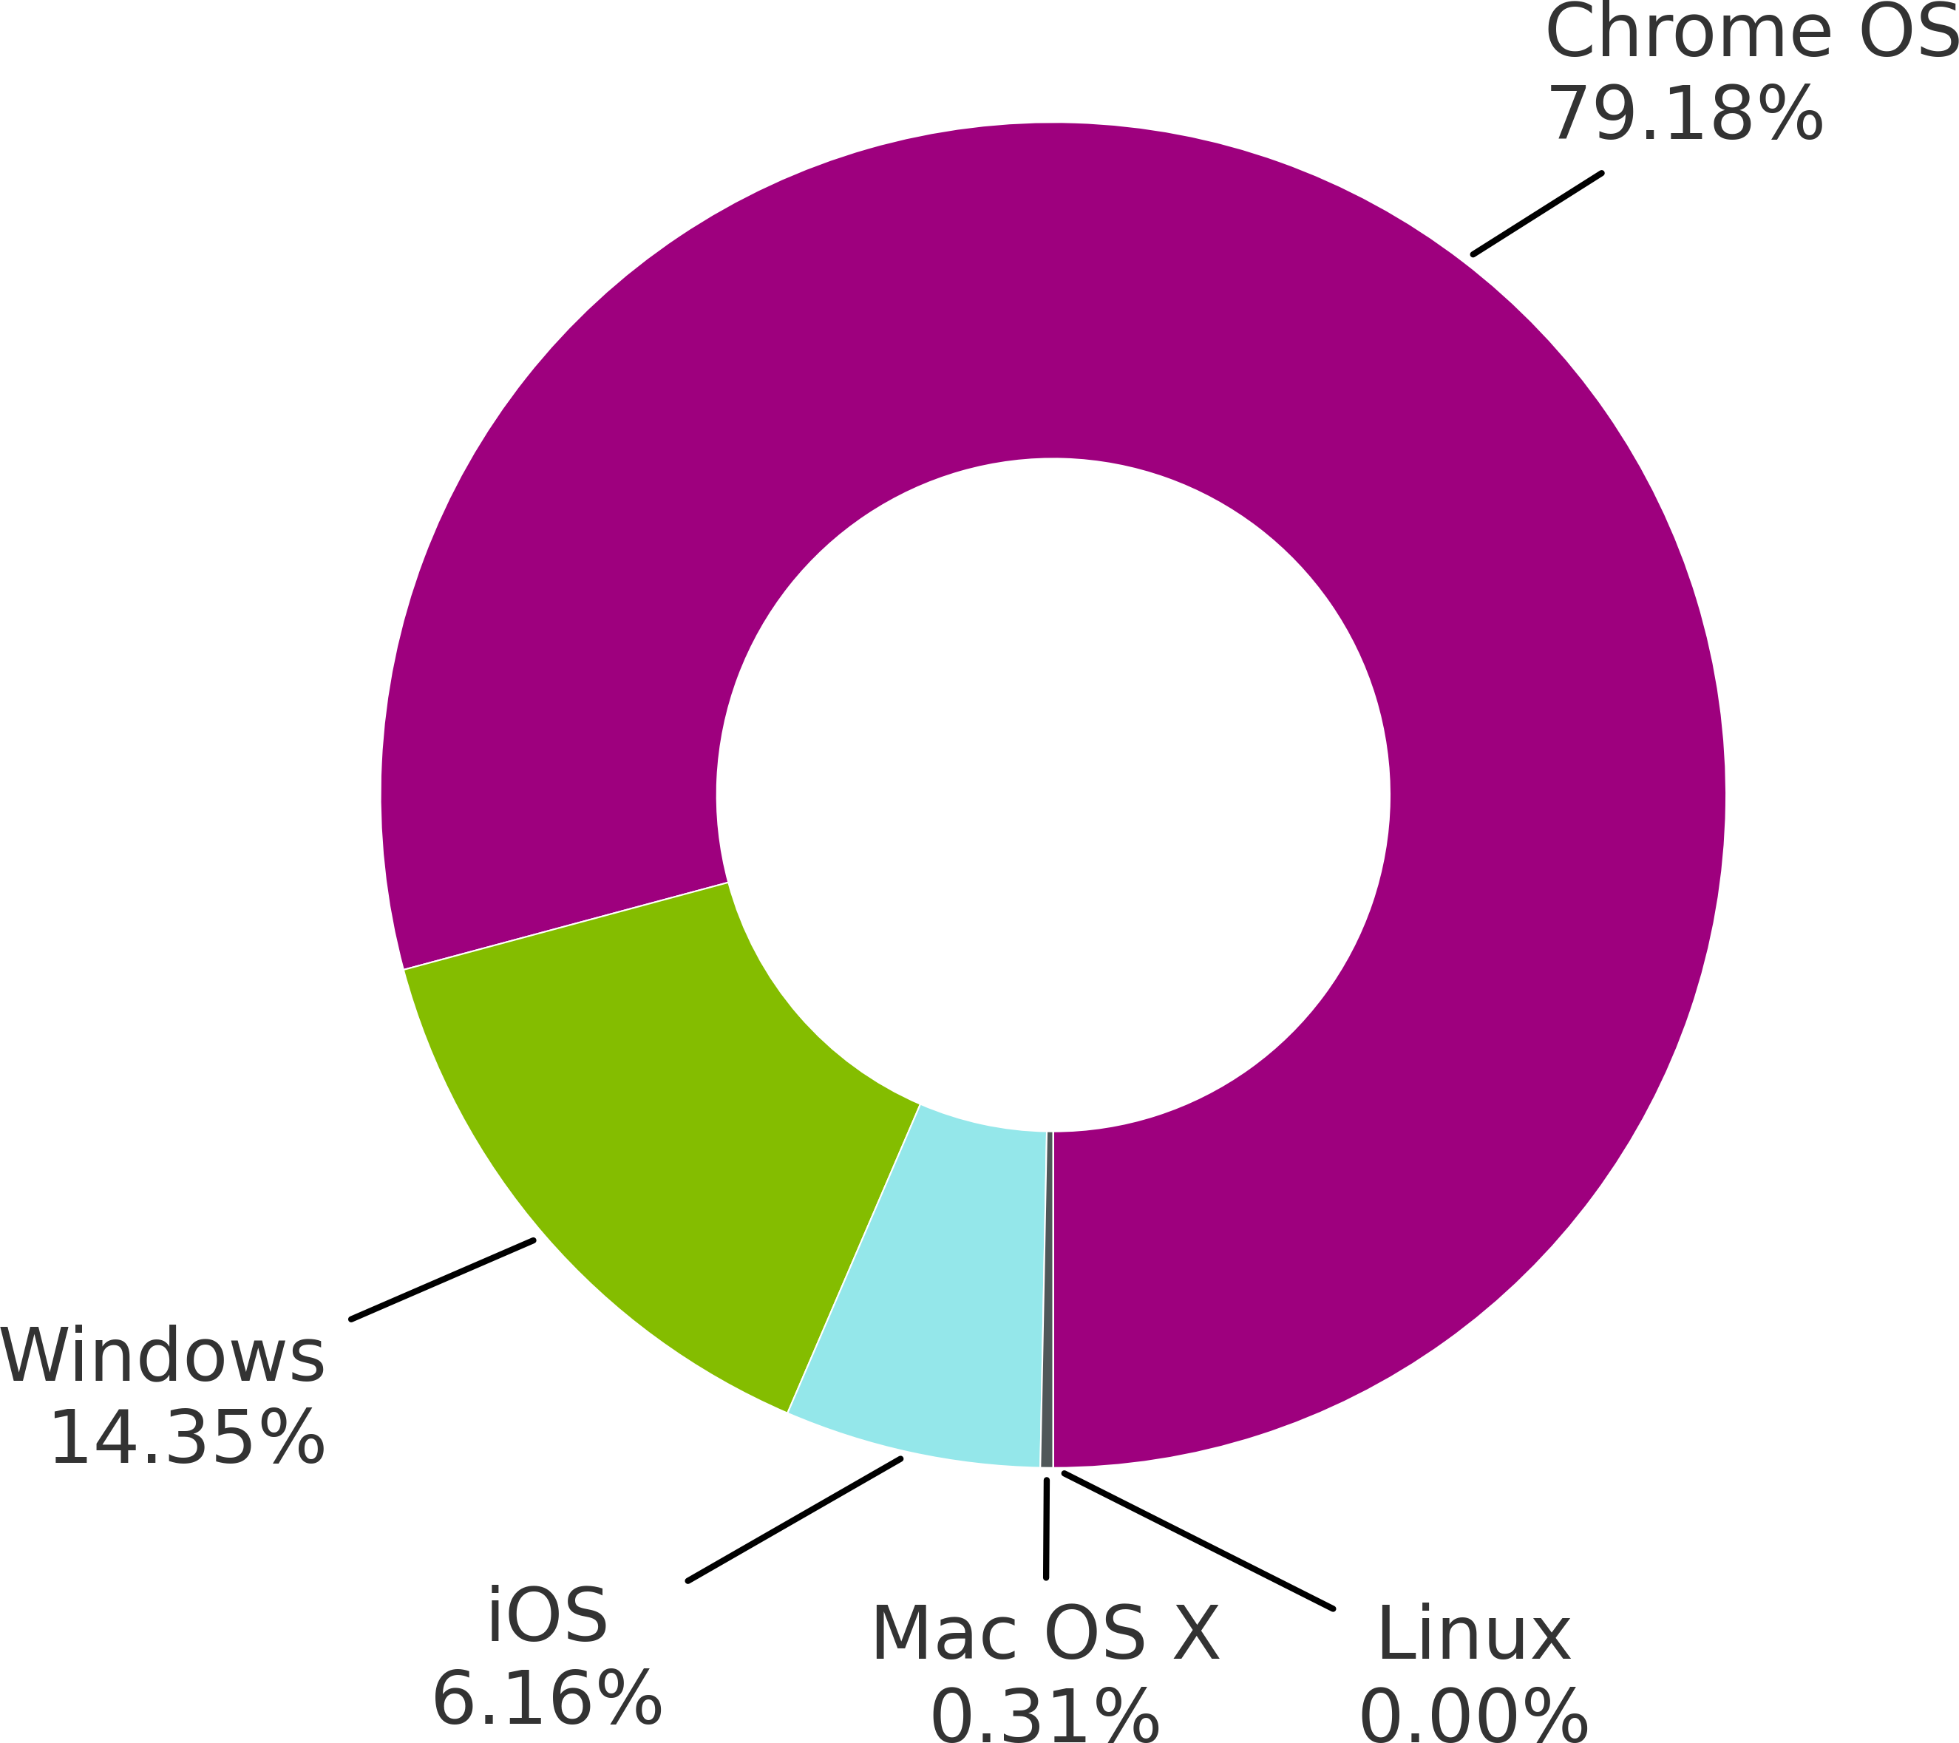
2024 CMAS Operating System Usage
Most Common
Devices using Chrome OS were the most-used during this testing period, accounting for 1,791,912 tests.
Least Common
Mac OS X was the least common operating system; it was used for only 3,726 tests.

Slide 38
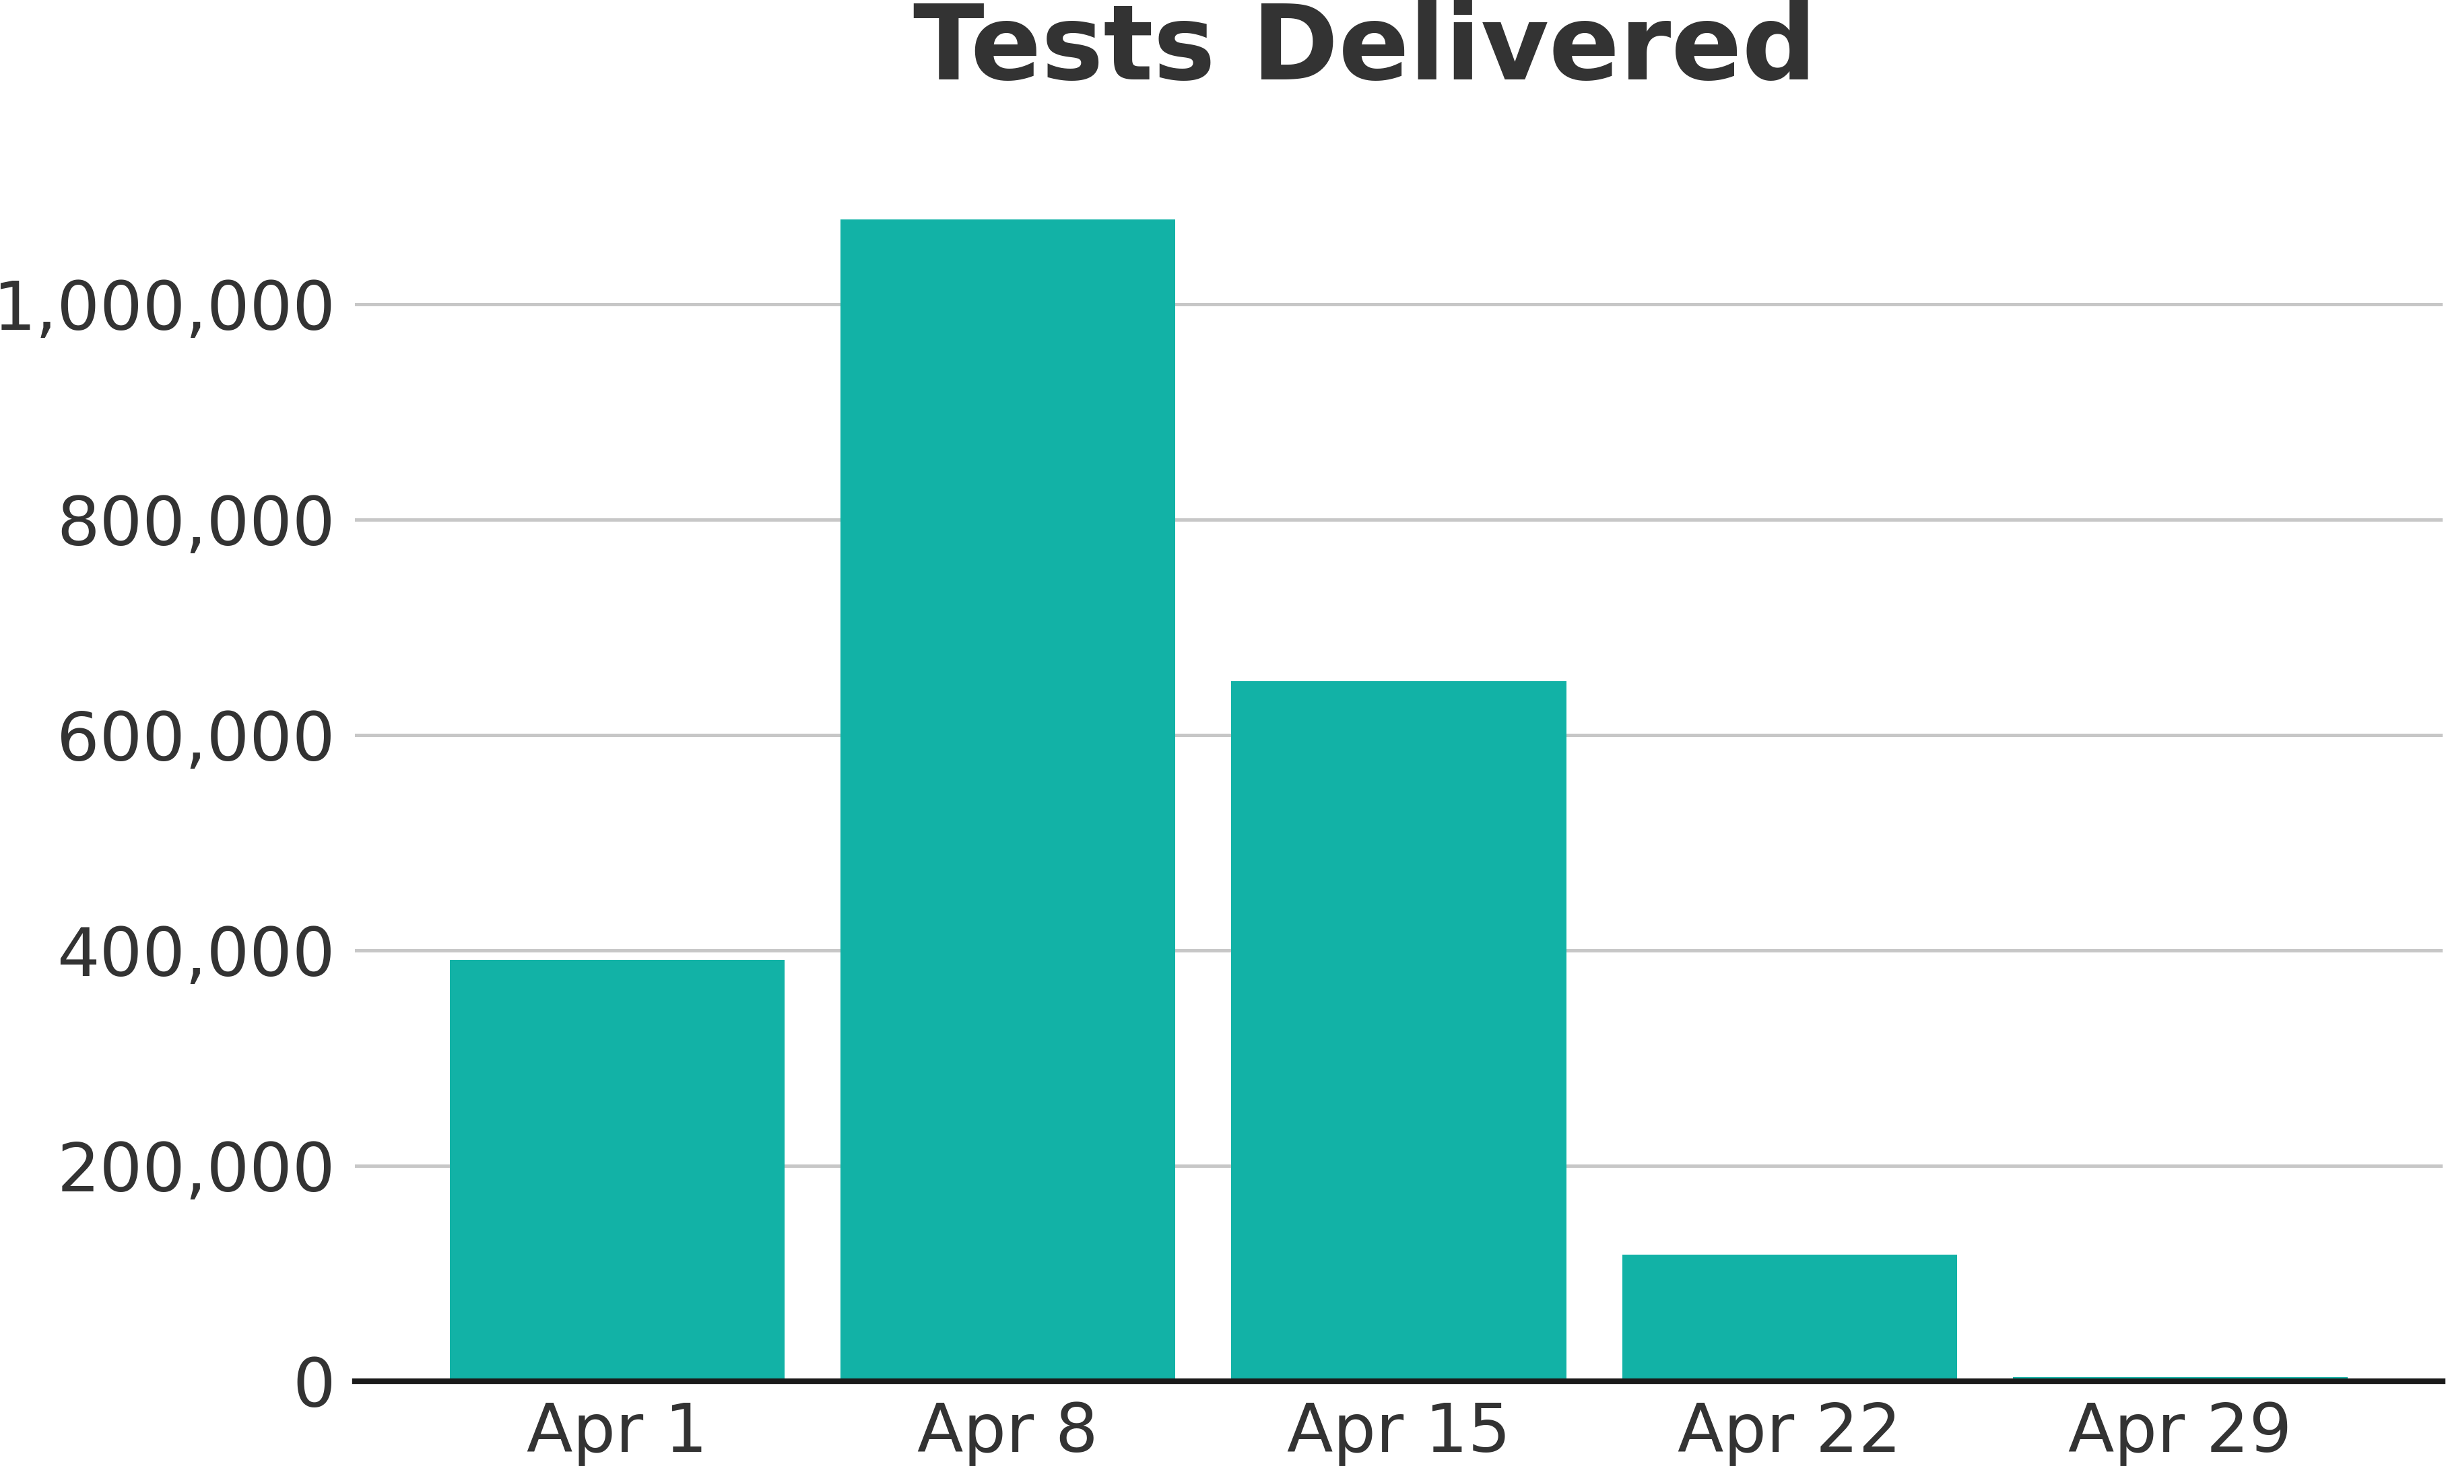
Spring 2024 Testing Volume
Testing Period
For this season, testing occurred between the weeks of April 1 and April 29.
Peak Volume
Testing was at its highest volume during the week of April 8, during which 1,078,827 tests were administered.

Slide 39
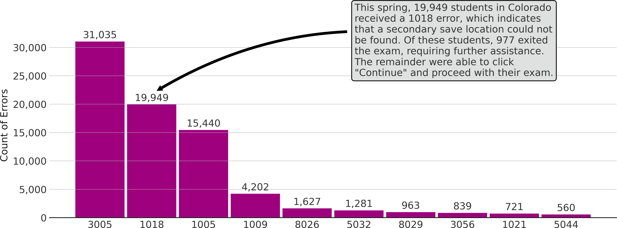
Top Errors
Top Ten Errors Observed 2023
Notes:
3005- TN another app attempted to take focus
1018- “Alternate SRF location is not writable”
1005 - No saved response file found
1009 - The Testing server cannot be reached. Any un-sent responses have been saved on this computer..
8026- Unable to connect to the proctor caching computer.
5032- TestNav has detected a prohibited application '<processname>' running in the background that is preventing you from continuing this test.

Slide 40
Testing Interruptions
Error | Count | Description
1005 | 17,655 | No saved response ﬁle found. Student was in Resumed-Upload status. Student presented an option to either Skip Upload or Exit Test.
1018 | 23,978 | Alternate SRF location is not writable. Your responses will be saved in Primary save location only. 875 students exited this test after receiving this error, requiring further assistance. The rest selected continue and proceeded with the test.
3005 | 49,973 | TestNav has detected that another application attempted to become the active window, which may compromise the security of this test. TestNav has been shut down. You may need assistance from your test monitor to restart the test.
3124 | 142,194 | TestNav has closed the test session due to inactivity. To continue testing, ask your proctor to resume your test, and sign in again.
8026 | 1,831 | Unable to connect to the proctor caching computer.
Notes:
Counts represent total number of occurances. A single student may have experienced multiple interruptions.

Slide 41
Removing Secondary SRF Save Locations in PearsonAccess^{next} Configurations
Pearson, in partnership with CDE, is undertaking an initiative to improve the testing experience and interactions with error codes encountered during testing.
On 9/30 we removed all secondary file save locations from your PearsonAccess^{next} TestNav Configuration file.
This will not impact other fields in your proctor cache configurations.
Rational for removing Secondary SRF Save Locations
SRF files are saved directly to Pearson Servers first.
SRFs are saved locally on the student device in the event of a network interruption.
SRFs are written to Pearson each time a student navigates to the next question and every 2 minutes during constructive responses.
There has not been a documented use of an SRF being recovered from a secondary file save location since 2017.

Slide 42
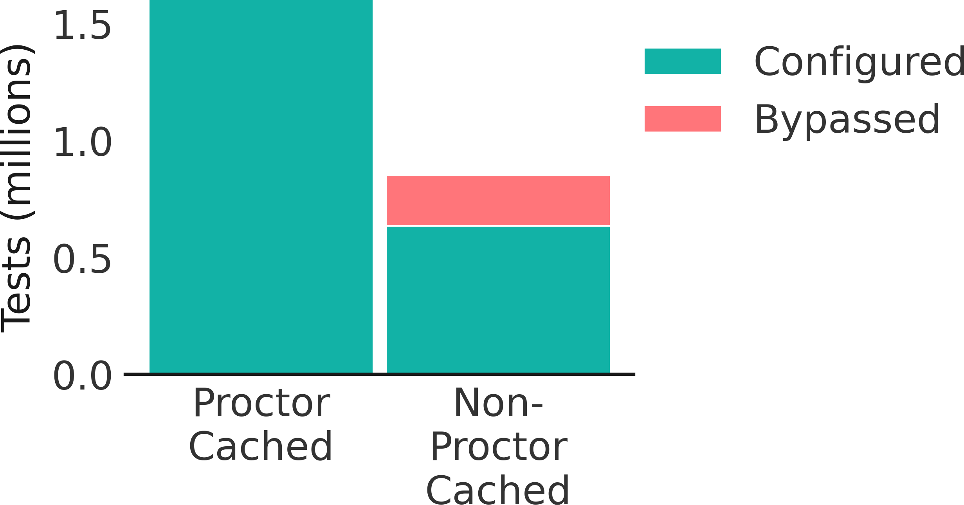
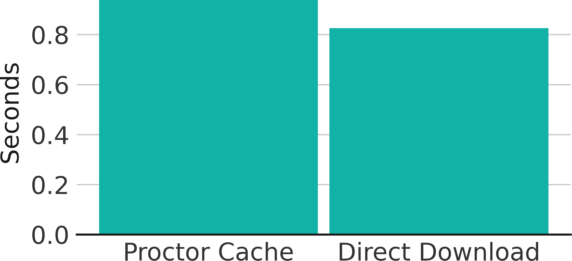
Testing Conﬁguration Performance 2024
Proctor Cache
ProctorCache Usage
65% of Colorado testers utilized Proctor Caching. However, more than 216,000 tests were unable to connect to the local cache at login due to misconﬁguration, typically leading to delays of 20–30 seconds prior to starting the test. The enabled cache override option allowed these students to bypass the cache and test without further interruption.
Median Item Load Time
For those who used Proctor Caching, the median test item load time was 0.94 seconds. For those who did not use Proctor Caching the median test item load time was 0.83 seconds.

Slide 43
CMAS Science and Text-to-Speech Assessment Size
CMAS Grade 5 Science Practice Assessment with Text-to-Speech
Typical YouTube Video
Notes:
Take away
CMAS Science and Text-to-Speech network activity mostly occupies Kbps with one initial spike of 10Mbps
while YouTube network activity regularly exceeds 10 Mbps.

Slide 44
CDE CMAS Support
Technical Training Online – Detailed Training
Follow the structure of documentation
Detailed instructions with links to documentation
Coming in December
Check http://www.cde.state.co.us/assessment/newassess-dtc for details.
Site Readiness Support Request
Pearson Field Engineering Services meetings 15, 30, or 60 minutes
Request a Technical Site Visit

Slide 45
CoAlt Science CoAlt English Language Arts & Mathematics (DLM)

Slide 46
DLM Admin System: KITE Components
Component | Software Version | Recommendations
KITE Local Caching Server |  | Not Available
KITE Student Portal | 11.0.0 | Must uninstall and reinstall on Mac and PC student devices. Chromebooks will auto update.

Slide 47
Kite® Student Technology Updates
iOS 17.1 & 17.2 are unsupported
If you plan to use Android tablets for the 2024-25 school year, please contact the Kite Service Desk first. Some Android tablet models may not be supported for secure testing and must be approved prior to completing assessments in Kite Student Portal.
Avoiding Locked iPads During Testing
Tap the Close Kite button at the top of the home screen or select the Sign Out button.
Tap Quit in the pop-up window that appears.

Slide 48
DLM KITE Resources
DLM Training for District Roles
Technology Specifications Manual (pdf)
KITE Client whitelist settings
KITE Client bandwidth requirements
Troubleshooting Kite Upload Errors

Slide 49
Colorado PSAT & SAT

Slide 50
Colorado PSAT and SAT Administration
PSAT 9
Administered to all* students in 9th grade
SAT
PSAT 10
Administered to all* students in 10th grade
Administered to all* students in 11th grade
*Students who participate in CoAlt take the DLM ELA and Math assessment instead of PSAT/SAT

Slide 51
Digitally-based Colorado PSAT and SAT
Assessment | Grade | Administration Dates*
PSAT 9 PSAT 10 SAT | 9 10 11 | April 14 through 25, 2025 Dates may be selected based on district/school preference within this window
*To the extent practicable, students taking the CoAlt DLM ELA/Math assessments who participate in a general education class should be assessed at the same time as their general education peers to avoid missed instruction. Schools may also ensure students taking the alternate assessment do not miss instruction from their general education class(es) through other means.

Slide 52
PSAT 9, PSAT 10, SAT Test Times
Test | Digital |  | Paper- (Accommodated | based Only)
Section | Test Times | Test Times + Breaks (10 min) | Test Times | Test Times + Breaks (10 min)
PSAT 9 | 134 minutes | 144 minutes | 164 minutes | 174 minutes
PSAT 10 | 134 minutes | 144 minutes | 164 minutes | 174 minutes
SAT | 134 minutes (without essay) 184 minutes (with essay) | 144 minutes (without essay) 204 minutes (with essay) | 164 minutes (without essay) 214 minutes (with essay) | 174 minutes (without essay) 229 minutes (with essay)
Notes:
Standard Test Times
***To reduce the risk of misadministration, it is recommended to choose a specific day to assess your paper-based students

Slide 53
Testing Staff Roles and Responsibilities Overview
Test Coordinator
Oversees planning and test day activities for ALL students, including those with accommodations
Works with technology staff to ensure devices being used for testing meet technical requirements and Bluebook is installed.
Manages all staff involved in test preparation and on test day (proctors, monitors, etc.)
Technology Coordinator
Works with Test Coordinator and SSD Coordinator to meet student needs for test day.
Ensures devices used for testing meet technical specifications.
Install Bluebook on student devices for testing.
Completes Digital Readiness Check.

Slide 54
PSAT and SAT Digital Testing
Test Format
PSAT 9, PSAT 10 and SAT tests will be presented in a digital format through the Bluebook app
Paper-based testing will be reserved for accommodated students only
Digital testing platforms
Test Day Toolkit – Test administration site used by testing staff
Bluebook – Testing application used by students

Slide 55
PSAT and SAT Technology Updates
September 26, 2024: Required Update Released
August 19, 2024: Critical Release Could Require Reinstall on macOS 11
Device Type | Latest Bluebook Version
Windows | VSN-0.9.328 BT-2024-09-26 19:23
Chromebooks | BT-2024-09-26 19:27
Macs | VSN-1.13.3 BT-2024-09-26 19:29
iPads | VSN-1.13.3 BT-2024-09-26 19:29

Slide 56
About Bluebook Digital Testing- Content
Content is downloaded at the form level and not the item level
All student test content will be downloaded when the student authenticates.
Adaptive assessment means three forms will be downloaded: Initial, form A, and form B.
Once content has been downloaded, testing can continue without internet connectivity.
Student must have internet connectivity to upload answer files and submit the assessment.

Slide 57
About Bluebook Digital Testing- Response and Accommodations
Answer files are continually uploaded to College Board.
Answer files are transferred to College Board on periodic intervals or “heartbeats” with continued internet connectivity.
This allows a student to switch devices in the event of a device failure or power loss.
The student’s process is tracked and can be viewed by the test administrator.
Bluebook requires operating system (OS) accessibility features for some accommodations
This may require additional device configuration. i.e., Chromebook floating accessibility menu or third-party accessibility software.

Slide 58
Bluebook Resources
Bluebook Technology for Professionals
Network Readiness
Digital SAT Device Requirements
Device Readiness
Chromebook Installation
Windows Installation
iPad Installation
Mac Installation
Bluebook Updates
Accommodations and Assistive Technology
Bluebook Technology Training
To Be Determined

Slide 59
CDE Support for PSAT and SAT
Watch for an announcement of a December training

Slide 60
Thank You
CDE Support Collin Bonner CDE Assessment Technology Specialist 303-895-5750 bonner_c@cde.state.co.us

Slide 61
Questions?

