Slide 1
Interpreting Assessment Results
CMAS and CoAlt Science and Social Studies
CMAS Mathematics and English Language Arts, including Colorado Spanish Language Arts
CDE Assessment Unit
2018

Slide 2
Topics
CMAS Reports
Individual Student Performance Reports
District and School Reports
Disaggregated Reports
CoAlt Science and Social Studies Reports
Additional Information
Resources

Slide 3
General Information
Many reports contain Personally Identifiable Information (PII) and are not meant for public distribution
Sample reports do not contain real data
  Generated for training purposes only
Disclaimer on reports:
  This report is NOT for public review. Distribution within your school/district must be in accordance with state and federal privacy laws, and local school board policy.

Slide 4
General Information
All state assessment results were embargoed and could not be publicly disseminated, distributed, or published by any means until they were publicly released by the state
  State level results were presented during the August State Board of Education meeting
District and school exceptions to embargo:
  Confidential individual student performance reports could be shared with parents
  Aggregated and individual student level results could be used internally for informational and planning purposes before results are publicly released
Any data released by a district or school after the State Board meeting must have the appropriate suppressions applied to meet federal and state data privacy requirements

Slide 5
Acronyms
CAS – Colorado Academic Standards
CMAS – Colorado Measures of Academic Success
CoAlt – Colorado Alternate
CSLA – Colorado Spanish Language Arts
ELA – English Language Arts
GLE – Grade Level Expectation
PGC – Prepared Graduate Competency
PLD – Performance Level Description
SD – Standard Deviation
SEM – Standard Error of Measurement
SPR – Student Performance Report

Slide 6
CMAS Reports

Slide 7
Purpose
CMAS assessments measure the degree to which students have mastered the CAS in the assessed content areas at the end of the tested grade level
CMAS results are intended to provide one measure of a student’s academic progress relative to the CAS
Track yearly student growth
Allow teachers to see how their students are performing against the standards and identify areas they may need to adjust in their practice in the future
Provide school and district comparisons and accountability information for parents, students, and the community

Slide 8
CMAS Performance Levels
Math and ELA (including CSLA) have five performance levels; science and social studies have four performance levels
Performance Levels:
  Exceeded Expectations¹
  Met Expectations¹
  Approached Expectations
  Partially Met Expectations
  Does Not Yet Meet Expectations (Math and ELA/CSLA only)
Performance Levels are Criterion Referenced
  Based on meeting the expectations of the Colorado Academic Standards
  Not dependent on the performance of other students
¹The top two levels are indicators of being on track for college and career in the content area

Slide 9
CMAS Performance Levels
Math and ELA/CSLA | Science and Social Studies
Level 5: Exceeded Expectations | Level 4: Exceeded Expectations
Level 4: Met Expectations | Level 3: Met Expectations
Level 3: Approached Expectations | Level 2: Approached Expectations
Level 2: Partially Met Expectations | Level 1: Partially Met Expectations
Level 1: Did Not Yet Meet Expectations

Slide 10
CMAS Performance Levels and Policy Claims
Students who...
Students who exceeded or met expectations are considered on track for college and career in the assessed content area
Exceeded Expectations | Demonstrate a distinguished command of the concepts, skills, and practices embodied by the Colorado Academic Standards assessed at their grade level. They are academically well prepared to engage successfully in further studies in this content area.
Met Expectations | Demonstrate a strong command of the concepts, skills, and practices embodied by the Colorado Academic Standards assessed at their grade level. They are academically prepared to engage successfully in further studies in this content area.

Slide 11
CMAS Performance Levels and Policy Claims
Students who…
Approached Expectations | Demonstrate a moderate command of the concepts, skills, and practices embodied by the Colorado Academic Standards assessed at their grade level. They will likely need academic support to engage successfully in further studies in this content area.
Partially Met Expectations | Demonstrate a limited command of the concepts, skills, and practices embodied by the Colorado Academic Standards assessed at their grade level. They will likely need extensive academic support to engage successfully in further studies in this content area.
Did Not Yet Meet Expectations | Do not yet meet academic expectations for the concepts, skills, and practices embodied by the Colorado Academic Standards assessed at their grade level. They will need academic support to engage successfully in further studies in this content area.

Slide 12
Types of Scores Appearing on Reports
Scale scores put student performance on a common scale
  Overall scale score
    Comparisons can be made within the current assessment year and across years
  Subscale score
    Comparisons can be made within the current assessment year and across years
Percent correct
  Comparisons can be made within the current assessment year

Slide 13
Reporting Levels
Organization
  State
  District
  School
Population
  Subgroup
  Individual Student
Scores
  Overall Test – Overall Performance Level
  Math and ELA
    Reporting Category
    Subclaim Category
    Domain
    Evidence Statement
  Science and Social Studies
    Standard – Reporting Category
    Prepared Graduate Competency (PGC)
    Grade Level Expectation (GLE)
    Item Type

Slide 14
CMAS Files and Reports
Math and ELA/CSLA | Science and Social Studies
Student Data File
Summary Data File
District Summary of Schools
School Student Roster | Content Standards Roster (page 1)
Performance Level Summary
Content Standards Roster
Evidence Statement Analysis | Item Analysis Report
Student Performance Report

Slide 15
Individual Student Performance Reports

Slide 16
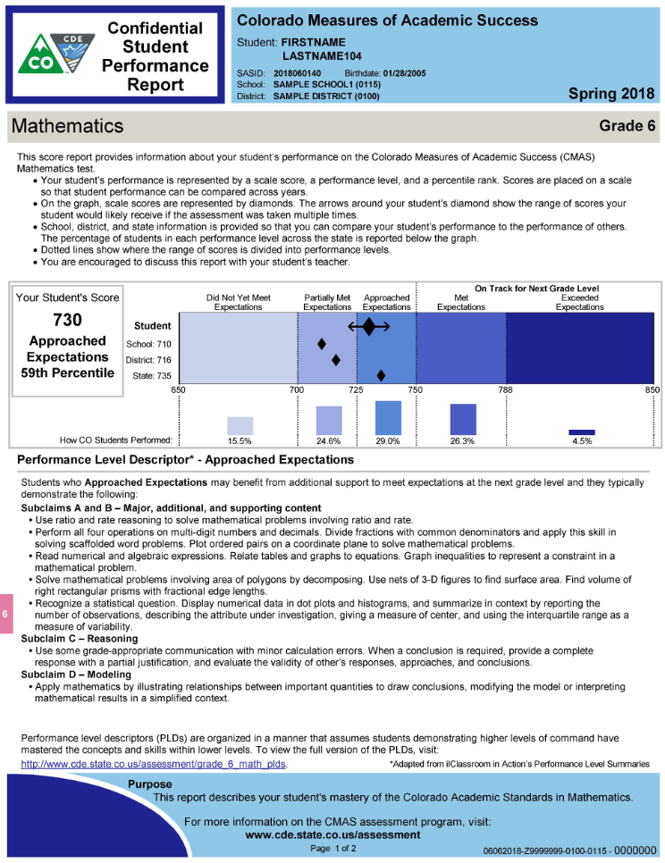
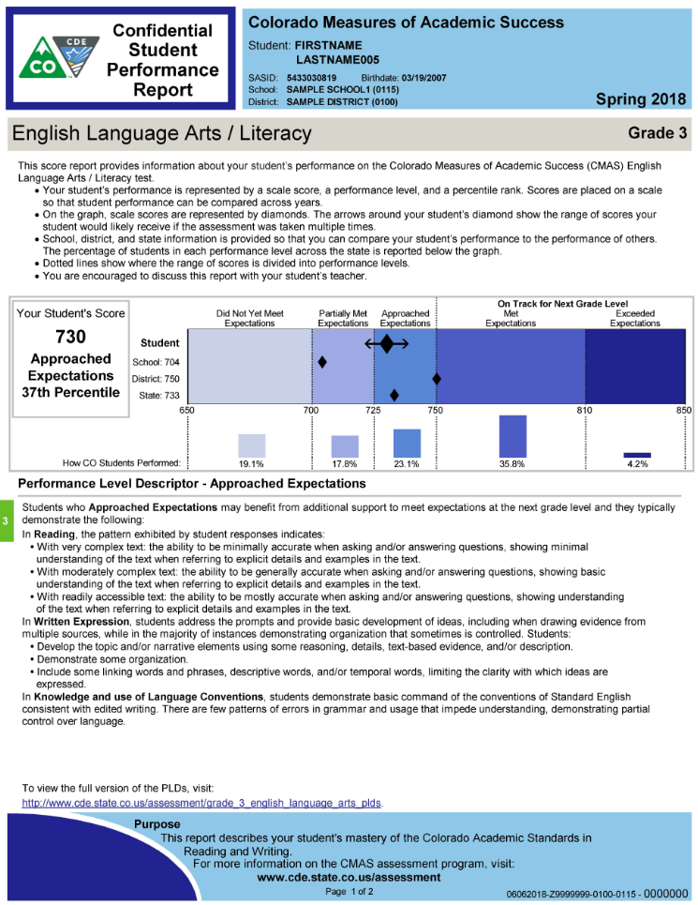
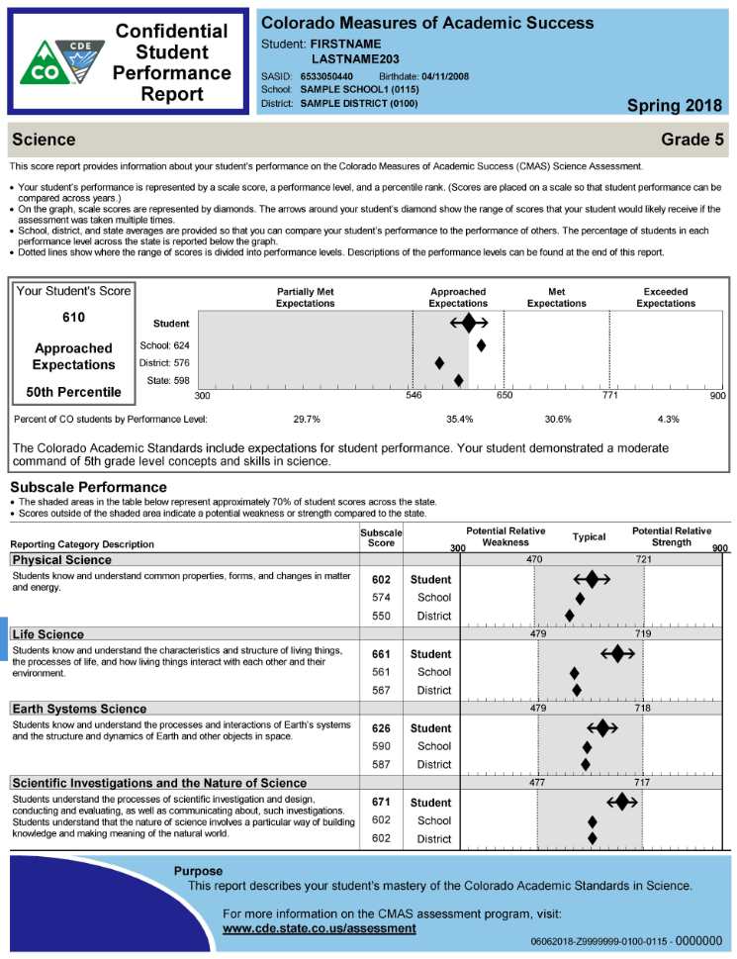
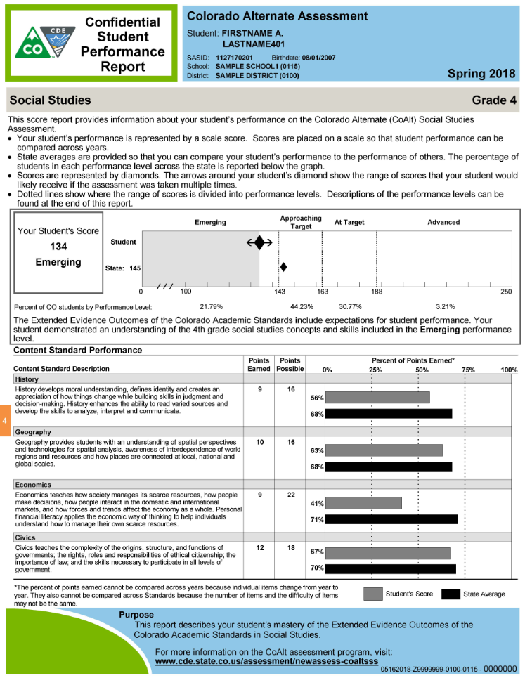
CMAS Individual Student Performance Reports
Created for each student who takes a CMAS assessment
Provided to help parents understand their child’s command over the CAS in the assessed grade level and content area(s)
Includes the scale score, performance level, percentile rank, reporting category performance, percent correct performance

Slide 17
CMAS Student Performance Report Scale Scores
Overall
  Range is displayed
  Arrows (↔) around student scores represent the standard error of measurement (SEM)
    The SEM is the estimated range of scores that the student might receive if they took the test multiple times
Reporting Category/Subscale Performance
  Overall Reading Reporting Category
  Science and Social Studies Content Standards, including Scientific Inquiry/Nature of Science
Item Type (Science and Social Studies only)
  Performance on constructed response and selected response questions
State, district, and school level information is provided in relevant sections of the report to help understand how the student’s performance compares to other students
  Data suppressed if fewer than 16 students in a category

Slide 18
CMAS Performance Level Cut Scores
Science and Social Studies*
Grade Level | Partially Met Expectations | Approached Expectations | Met Expectations | Exceeded Expectations
Grade 4 Social Studies | 300-556 | 557-698 | 699-792 | 793-900
Grade 5 Science | 300-545 | 546-649 | 650-770 | 771-900
Grade 7 Social Studies | 300-591 | 592-700 | 701-769 | 770-900
Grade 8 Science | 300-555 | 556-651 | 652-784 | 785-900
High School Science | 300-542 | 543-672 | 673-773 | 774-900
*Cut scores were set by Colorado educators based on the specific content that students should be able to engage with at each performance level. Elementary and middle school cut scores were adopted by the State Board of Education in August 2014; high school cut scores were adopted in April 2016.

Slide 19
CMAS Performance Level Cut Scores
Mathematics and English Language Arts (ELA)*
Performance Level | Start | End
Exceeded Expectations | 783-810* | 850
Met Expectations | 750 | 782-809*
Approached Expectations | 725 | 749
Partially Met Expectations | 700 | 724
Did Not Yet Meet Expectations | 650 | 699
*Varies by assessment

Slide 20
CMAS Performance Level Cut Scores
Colorado Spanish Language Arts (CSLA)
Grade Level | Did Not Yet Meet Expectations | Partially Met Expectations | Approached Expectations | Met Expectations | Exceeded Expectations
Grade 3 | 650-699 | 700-724 | 725-749 | 750-778 | 779-850
Grade 4 | 650-699 | 700-724 | 725-749 | 750-771 | 772-850
CSLA Scale Scores are on the same scale as CMAS ELA (650-850)

Slide 21
CMAS Student Performance Report Percentile Rank
Shows how well the student performed in comparison to other students who took the same assessment across the state
  Example: A student in the 70th percentile performed better than 70 percent of students in the state
Percentiles are independent of the performance level
  A student in the 60th percentile can still be in the Approaching Expectations performance level if most students taking that test are not at the Met Expectations performance level

Slide 22
CMAS Student Performance Report Percent Correct Scores
Based on the particular items that appeared on the year’s test
  Cannot be compared across years
    Can be compared to district and state to spot trends*
  Based on a small number of items
    Do not necessarily cover the entirety of a topic
    Should not be the sole basis for instructional adjustments
Math and ELA
  Overall Writing Reporting Category
  Subclaims
Science and Social Studies
  Prepared Graduate Competency (PGC)
  Grade Level Expectation (GLE), if there is more than one GLE in a PGC
*If a school performed worse than the previous year (percent correct went down by a small amount) but a school goes from being below the district average to above the district average, it could be an indication that there was improvement

Slide 23
CMAS Math and ELA/CSLA Student Performance Reports

Slide 24
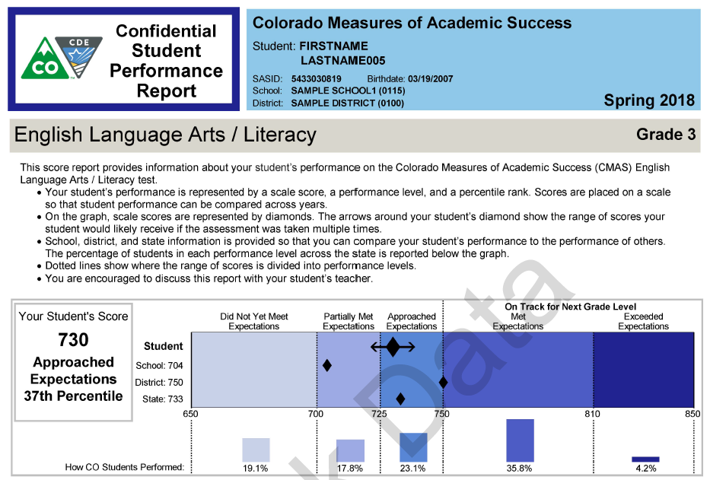

Math and ELA Overall Scale Score and Performance Level
Overall scale score range is 650-850
This student
  Approached expectations
  Performed better than 37 percent of students across the state
  May benefit from additional support to meet expectations at the next grade level

Slide 25
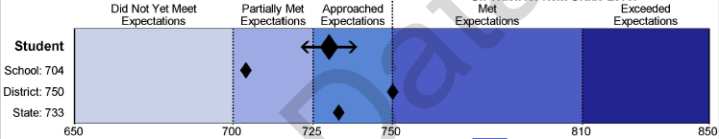


Math and ELA Overall Scale Score and Performance Level
This student
  Performed better than school average, but below the district and state averages
Percentage of students within the state at each of the performance levels

Slide 26

Math and ELA Performance Level Descriptions
The concepts and skills students in each performance level typically demonstrate for the assessed grade and content area
The PLD that corresponds to the student’s performance level is included at the bottom of page 1
This is a partial list of concepts and skills from the PLD
Visit website for full version

Slide 27
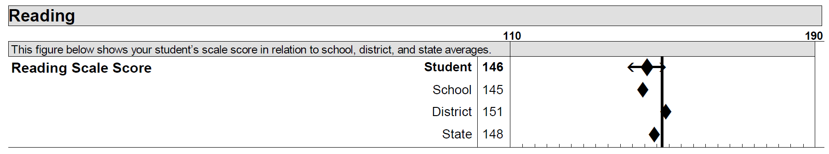
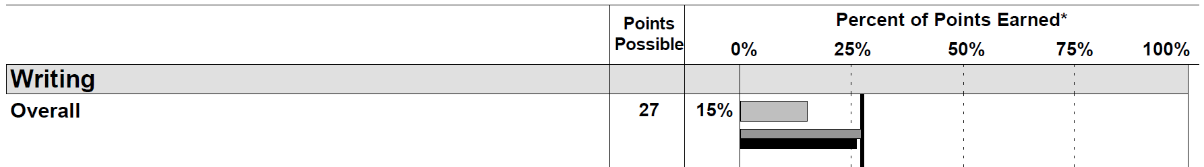
ELA Reporting Category Performance
Reading Reporting Category
  Provided as a scale score (i.e., 110-190)
  Different from the overall scale score
  This student performed better than the school average, but below the district and state averages:
Writing Reporting Category
  Provided as overall percent of points earned
  This student performed below the district and state averages

Slide 28
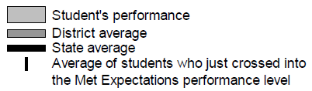
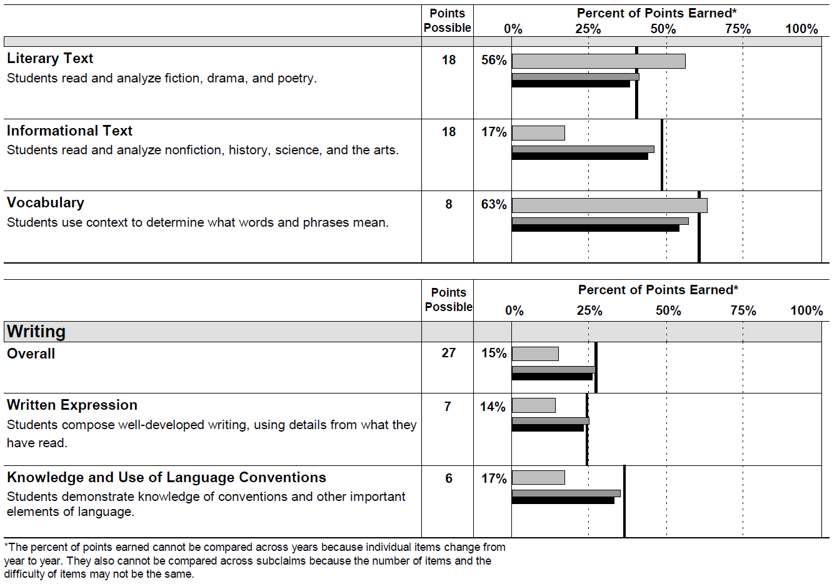
Math and ELA Subclaim Performance
Subclaims describe specific skill sets
Presented as a percent of points earned
ELA subclaims are divided by reporting category (i.e., Reading and Writing)
Reading
Writing

Slide 29
Math and ELA Subclaims 2017 to 2018
2017 Categories
  CMAS PARCC assessments provided categories based on the overall Performance Level for subclaims using IRT (not based on standard setting)
2018 Percent Correct
  2018 CMAS subclaims are reported as a Percent Correct
  Easier to interpret, harder to over-interpret
  Average percent correct for students who just crossed into Met Expectations shows the average performance on that subclaim for students who are proficient without making a specific claim about “proficiency” on that subclaim

Slide 30
Writing Claim 2017 to 2018
Writing
  In 2018, the ELA writing claim was reported as a percent correct rather than as a scale score (10 to 60) as in previous years
  Writing scores are based on two written essay prompts
    Task types vary by grade – all three types still appear on the assessment
    Rubrics are available on the CDE website (http://www.cde.state.co.us/assessment/cmas)
  Zeros
    Number of zeros in 2018 are consistent with 2017 when comparing the number of students who received a zero on two out of three PCRs in 2017
    To compare individual student performance to 2017, look at the Content Standards Roster from 2017 which provides Percent Correct data by PCR and each Writing subclaim

Slide 31
CMAS Science and
Social Studies
Student Performance Reports

Slide 32
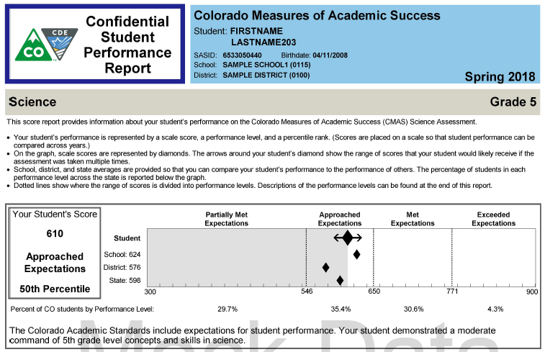

Science and Social Studies Overall Scale Score and Performance Level
Overall scale score range is 300-900
This student
  Approached expectations
  Performed better than the district and state averages, but below the school average
  Performed better than 50 percent of students across the state
Percentage of students within the state at each performance level

Slide 33
Science and Social Studies Subscale Performance
Reporting Category scores are displayed as Subscale Scores
  On the same scale as the Overall Scale Score (300-900)
  Split into three “Performance Indicators”
    Potential Relative Weakness
    Typical (shaded area)
    Potential Relative Strength
  Performance Indicators are set one standard deviation (a measure of the spread of the scores) above and below the state average
    Around 70% of students perform within one standard deviation of the state average

Slide 34
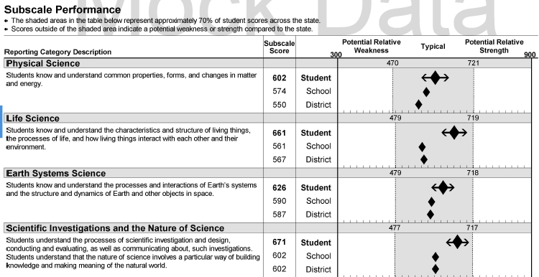
Science and Social Studies Subscale Performance
1 SD around State Average

Slide 35

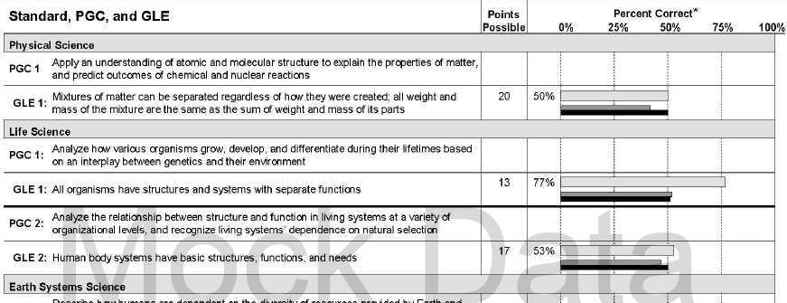
Science and Social Studies PGCs and GLEs
Prepared Graduate Competencies and Grade Level Expectations
  Percent correct for the student, district, and state for the assessed PGCs and GLEs
  GLE number is taken directly form the standards – PGCs are not numbered in the standards and do not always line up in order with the GLEs
  PGC information is not shown if there is only one GLE in a PGC
Standards text for PGCs and GLEs

Slide 36
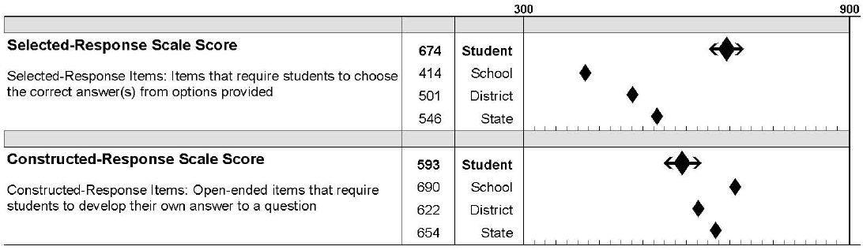
Science and Social Studies Selected Response and Constructed Response
Nearly half the points on the science and social studies assessments come from constructed response items
  This scale score can be compared across years (300-900)

Slide 37
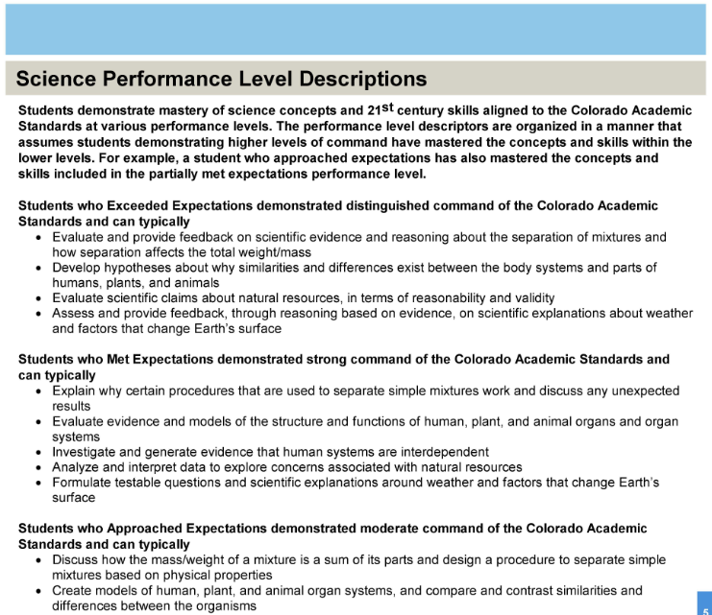
Science and Social Studies Performance Level Descriptions
The concepts and skills students in each performance level typically demonstrate for the assessed grade and content area
PLDs for each performance level are found on page 4

Slide 38
District and School Reports

Slide 39
Data Files
Student Data File
  District and school level
  Contains all student records
    Student records do not have aggregate score information if the school/district indicated an invalidation code (i.e., Not Tested or Void) for the record
  Data can be used for district and school accountability purposes
Summary Data File
  District and school level
  Contains summarized performance data for all valid test attempts
  Includes data for the district and each school within the district
    Rows correspond to the disaggregated groups on the Performance Level Summary report
    Each level of aggregation is reported separately
  Only students with scores are included in aggregated score field calculations
    Students without scores and students with suppressed scores are not included in the denominator for average scores or in the percentage of students at each performance level

Slide 40
District Summary of Schools
District level only
Available for each grade and content area assessed at each school
Provides data aggregated at the state, district, and school levels by
  Math and ELA/CSLA
    Overall average scale score
    Reading overall average scale score
    Writing overall percent of points earned
    Subclaim percent of points earned
  Science and social studies
    Overall average scale score
    Reporting category performance and average scale score
    PGC/GLE
      Percent correct for each GLE
      If there is more than one GLE within a PGC then percent correct by PGC is also provided

Slide 41
Math and ELA/CSLA Student Roster Report
School level only
Available for each grade and content area assessed at each school
Provides aggregated data at the state, district, and school levels including
  Overall scale score
  Overall performance level
  Reporting category (ELA only)
    Reading overall scale score
    Writing percent of points earned
  Subclaim category percent of points earned

Slide 42
Content Standards Roster
School level only
Available for each grade assessed at each school
Lists every student for whom a test book/answer document or online record was submitted
For each student, provides performance on
  Math and ELA
    Domain and standard percent correct
  Science and social studies
    Overall performance – overall scale score and performance level
    SEM range
    Reporting category/content standards performance and scale score
    PGC/GLE percent correct
Provides the same information aggregated at the state, district, and school levels

Slide 43
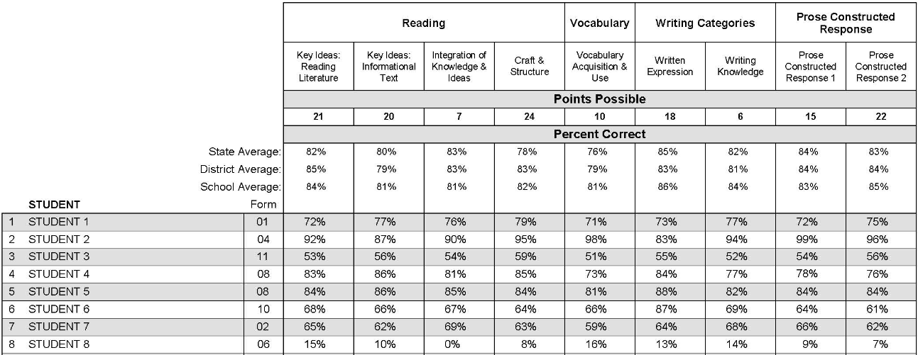


CMAS Math and ELA Content Standards Roster
Percent of points earned by domain and standard group
  Averages by state, district and school
  Individual student performance

Slide 44
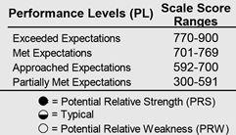
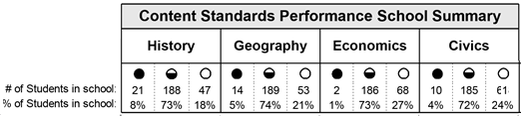
CMAS Science and Social Studies Content Standards Roster (Page 1)
Key
  Lists performance levels with scale score ranges
  Explains content standards performance symbols
School summary
  Number and percentage of students in the school at each standards performance indicator

Slide 45
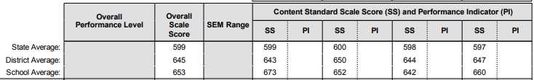
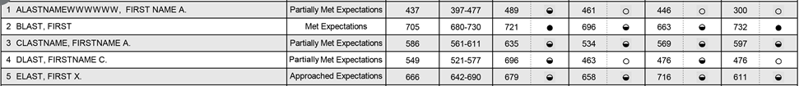
CMAS Science and Social Studies Content Standards Roster (Page 1)
Average scale scores by state, district, and school
Individual student performance
  Overall test level
  Content standards

Slide 46
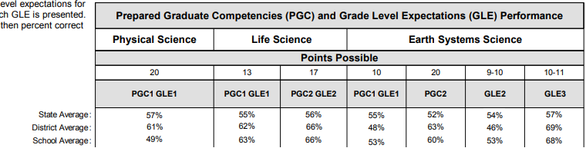
CMAS Science and Social Studies Content Standards Roster (Page 2)
PGC and GLE performance
  Header includes the points possible and the average percentage for state, district, and school
  PGC and GLE number is the same as on the SPR
    The language and number on the SPR is included in the Interpretive Guide for reference
PGC percent correct provided if more than one GLE within a PGC

Slide 47
CMAS Performance Level Summary
District and school level
Available for each assessed content area at each grade
Contains aggregated performance level information across the school, district, and state (percentage of students meeting each performance level)
Contains disaggregated performance level data by student demographic and program categories and subgroups for either the school or the district
  Gender, Race/Ethnicity, Language Proficiency, Disability, etc.
  Results for students for whom no demographic or program information was coded are included in the “not indicated” subgroups
  No Scores are NOT included in the denominator for the % in each level

Slide 48
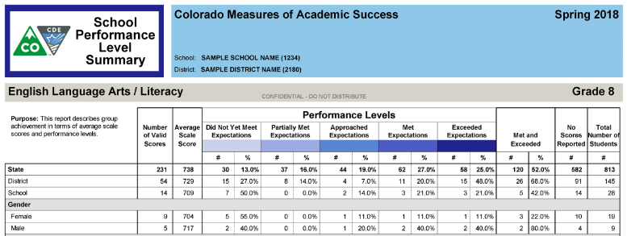
CMAS Performance Level Summary
Includes data for the state on the district level report; data for the state and district on school level reports
Average scale scores
Performance levels distribution

Slide 49
CMAS Item Analysis Report
District and School level
Available for each grade assessed at each school
  Only if the number of students is greater than 15
Science and Social Studies
  Performance on individual items
  1 point items: % of students answering correctly
  Multi-point items: average points earned divided by the number of possible points
Includes item information

Slide 50
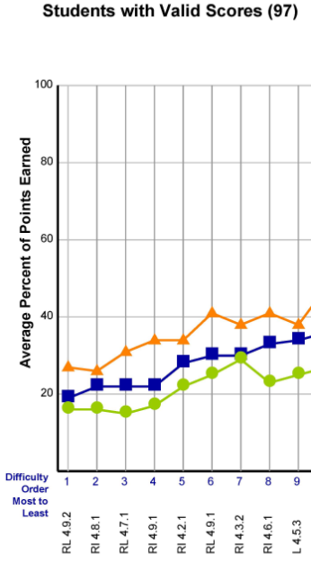

CMAS Science and Social Studies Item Analysis Report (Page 1)
Graph:
  Average percent correct by item for State, District, and School
  Ordered by difficulty from most to least difficult (based on State level data)
  Label on the bottom
    Standard and GLE

Slide 51
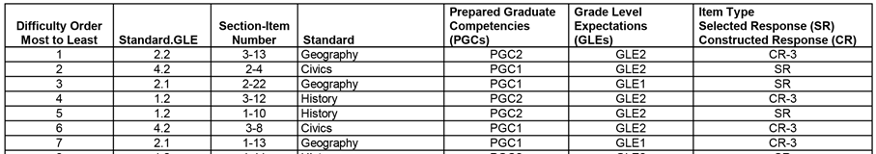
CMAS Science and Social Studies Item Analysis Report (Page 2)
Item Information
  Ordered by difficulty – matches the order on Page 1
  Location on the test – section and item number
  Related PGC and GLE
  Item type
    SR – Selected Response
    CR – Constructed Response (includes point value)

Slide 52
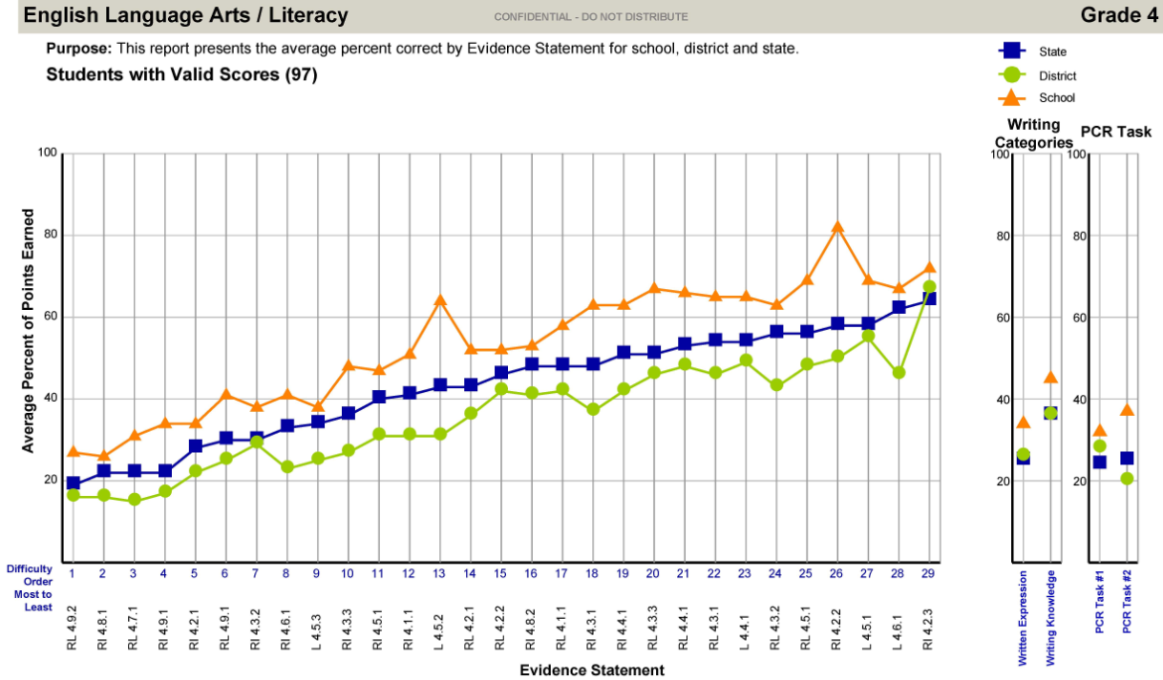
CMAS Math and ELA/CSLA Evidence Statement Analysis (page 1)
Summary of district and school performance by evidence statement
Evidence statements describe the knowledge and skills an item or task assesses
  The most specific level of information on student achievement
ELA/CSLA only

Slide 53
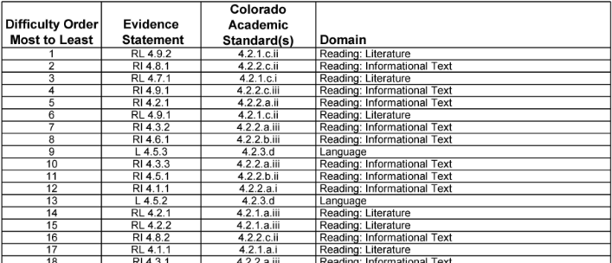
CMAS Math and ELA/CSLA Evidence Statement Analysis (Page 2)
Item Information
  Ordered by difficulty – matches the order on Page 1
  Evidence Statement
  Colorado Academic Standard
  Domain – corresponds to domains on the Content Standards Roster

Slide 54
Disaggregated Reports

Slide 55
State Level CMAS Performance Level Results Including Participation
State results are available by
  Overall by grade and content area
  Gender
  Race/ethnicity
  Free-reduced lunch status
  Special programs
  Language proficiency
School and district results are available by
  Overall by grade and content area
These data are posted publicly to the CDE Assessment webpage on the “Data and Results” subcategory under each assessment

Slide 56
State Level CMAS Performance Level Results Including Participation
CMAS Science, Social Studies, Math, ELA/CSLA
  http://www.cde.state.co.us/assessment/cmas-dataandresults
CoAlt Science and Social Studies
  http://www.cde.state.co.us/assessment/coalt-sciencesocial-dataandresults

Slide 57
CoAlt Science and Social Studies Reports

Slide 58
CoAlt Science and Social Studies Scoring
4 point items (selected response)
  4 points – answered correctly independently
  3 points – answered correctly with an additional prompt
  2 points – answered correctly after being told the correct answer
  1 point – answered incorrectly after being told the correct answer
  0 points – did not respond to the question
2 point items (in groups of 3)
  2 points – answered correctly
  1 points – answered incorrectly
  0 points – did not respond to the question

Slide 59
Interpretation of Overall CoAlt Scores
CoAlt measures both entry skills and content
Points available for demonstration of entry skills:
  2 points can be earned per selected response item with no evidence of content knowledge
  These points allow students to demonstrate consistency in entry skills (responding when asked a question and repeating an answer)
CoAlt is intended to measure content knowledge
  All performance levels above Emerging require evidence of some content knowledge
  Cut scores for the performance levels are at the higher end of the point/scale range due to the way the items are scored

Slide 60
CoAlt Performance Levels
CoAlt has four performance levels
  Advanced
  At Target
  Approaching Target
  Emerging
Advanced and At Target are considered ready to continue academic study in the content area
Inconclusive Designation
  Students who attempt the assessment, but do not respond to any items

Slide 61
CoAlt Performance Levels and Policy Claims
The Advanced and At Target levels are ready for continuing study in the content area
Advanced | Students performing at this level demonstrate a solid understanding of the concepts and skills represented by the Extended Evidence Outcomes (EEOs) of the Colorado Academic Standards (CAS). They are academically well prepared to engage in further studies in the content area with appropriate supports.
At Target | Students performing at this level demonstrate a foundational understanding of concepts and skills represented by the EEOs of the CAS. They are academically prepared to engage in further studies in the content area with appropriate supports.
Approaching Target | Students performing at this level demonstrate a limited understanding of concepts and skills represented by the EEOs of the CAS. They will likely need moderate academic supports to engage successfully in further studies in the content area.
Emerging | Students performing at this level demonstrate an initial understanding of concepts and skills represented by the EEOs of the CAS. They will need extensive academic supports to engage successfully in further studies in the content area.

Slide 62
CoAlt Performance Levels Cut Scores
Science and Social Studies*
Grade Level | Emerging | Approaching Target | At Target | Advanced
Grade 4 Social Studies | 0-142 | 143-162 | 163-187 | 188-250
Grade 5 Science | 0-134 | 135-159 | 160-183 | 184-250
Grade 7 Social Studies | 0-133 | 134-162 | 136-190 | 191-250
Grade 8 Science | 0-127 | 128-163 | 164-189 | 190-250
High School Science | 0-139 | 140-163 | 164-192 | 193-250
*Cut scores were set by Colorado educators based on the specific content that students should be able to engage with at each performance level. Elementary and middle school cut scores were adopted by the State Board of Education in August 2014; high school cut scores were adopted in April 2016.

Slide 63
CoAlt Science and Social Studies Reports
Student Performance Report
  Intended for parents and teachers
Content Standards Roster
  School level only
District School Roster
  District level only
Performance Level Summary
  District level only

Slide 64
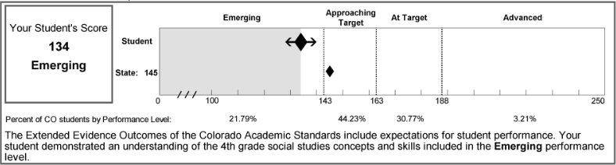
CoAlt Student Performance Report
Scale Score
  Overall test score
  Range of 0 to 250
  First 100 are compressed
  Arrows around student scores are the SEM

Slide 65
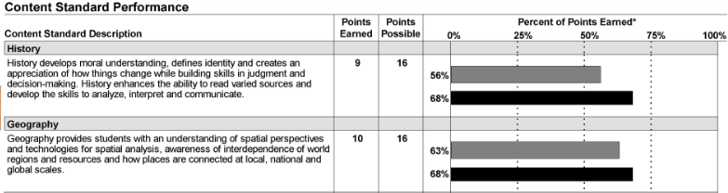

CoAlt Student Performance Report
Compares student percent correct to state average percent correct
  Points earned and points possible are listed
  Content standard descriptions are from the CAS and are the same as CMAS
Performance level descriptions are found on page 2
  The concepts and skills students in each performance level typically demonstrate for the assessed grade and content area

Slide 66
CoAlt Content Standards Roster
School level only
Overall scale score and content standards percent correct
  Averages for state, district, and school
  Student level for all students

Slide 67
CoAlt District School Roster
District level only
Available for each grade assessed at each school
Provides data aggregated at the state and district levels by
  Average scale score
  Reporting category performance (average percent of points earned)
Information also provided for each school in the district

Slide 68
CoAlt Performance Level Summary
District level only
Describes group achievement by performance levels and average scale scores
Includes the inconclusive designation
  Students with an inconclusive designation are included in the denominator for the performance level percentage

Slide 69
Additional Information

Slide 70
Format of CMAS and CoAlt Results
Electronic Files – available through PearsonAccess^{next}
  Student Data File
  Summary Data File
Electronic PDF reports – available through PearsonAccess^{next}
  District Summary of Schools
  Student Roster (Math, ELA/CSLA)
  Performance Level Summary
  Content Standards Roster
  Item Analysis Reports/Evidence Statement Analysis
  Student Performance Reports
Hard copy reports – sent to DACs
Student Performance Reports (two copies*)
  One copy for parents/guardians, one copy to be kept on file locally
  Distribute to parents/guardians as soon as possible
*For CSLA, one Spanish and two English SPRs are received

Slide 71
Disclaimers
Only scale scores can be compared across years
  CMAS Science and Social Studies
    Overall, Content Standards, and Item Type
  CMAS ELA and Math
    Overall, Reading Reporting Category
  CoAlt Science and Social Studies
    Overall only
Scores cannot be compared across grades
  No vertical scaling
Percent scores cannot be compared across years, grades, subclaims, domains, or PGCs/GLEs
  Items in a subclaim, domain, or PGC/GLE will change between years

Slide 72
Resources

Slide 73
Interpretive Guide to Assessment Results
http://www.cde.state.co.us/assessment/cmas-dataandresults
  English – Full Guide
  Spanish – Guide for Parents
  Spanish SPR shells, with standalone PLD document

Slide 74
CDE Communications Resources
http://www.cde.state.co.us/assessment/resources
  Score report resources
    Parent’s Guide to Understanding the Score Reports
    How to Use the Test Results to Support Your Student
  Available in English and Spanish

Slide 75
Contact
Jasmine Carey – carey_j@cde.state.co.us
Shangte Shen – shen_s@cde.state.co.us

Slide 76
Questions?

