Slide 1
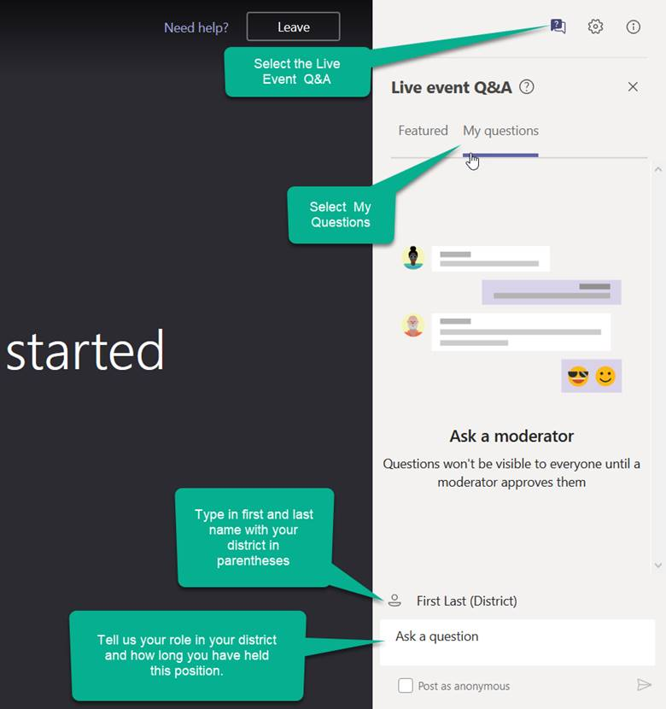
2020-2021 CMAS TestNav Technical Site Readiness Training
Welcome!
Introduce Yourself
From the top of the right-hand navigation select the Live event Q&A
Below the Live event Q&A heading select My questions.
At the bottom of the Q&A box enter your name using this format: First Last (District)
In the Ask a question section tell us your district role and how long you have held your position.
Select the paper airplane icon in the bottom right corner of the window to send it.

Slide 2
CMAS TestNav Technical Site Readiness Training
Spring 2021
Notes:
Do Introductions
Start the recording!!

Slide 3
Online Testing Components Network Preparation Proctor Caching Device Preparation Infrastructure Trial Support During Testing
Section 1
1
2
3
4
5
6

Slide 4
Online Testing Components
Online Resources
Components
TestNav
Proctor Caching
PearsonAccess^{next}
Student Responses
Best Practices and Recommendations

Slide 5
Online Resources
DTC Site Readiness Support: http://www.cde.state.co.us/assessment/newassess-dtc
PearsonAccessnext : https://support.assessment.pearson.com/x/BYDy
TestNav Pearson Documentation: https://support.assessment.pearson.com/x/BAACAQ

Slide 6
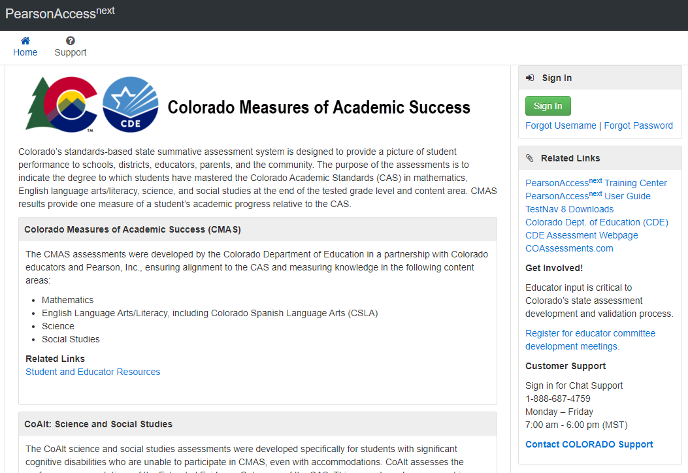
CMAS Online Resources

Slide 7
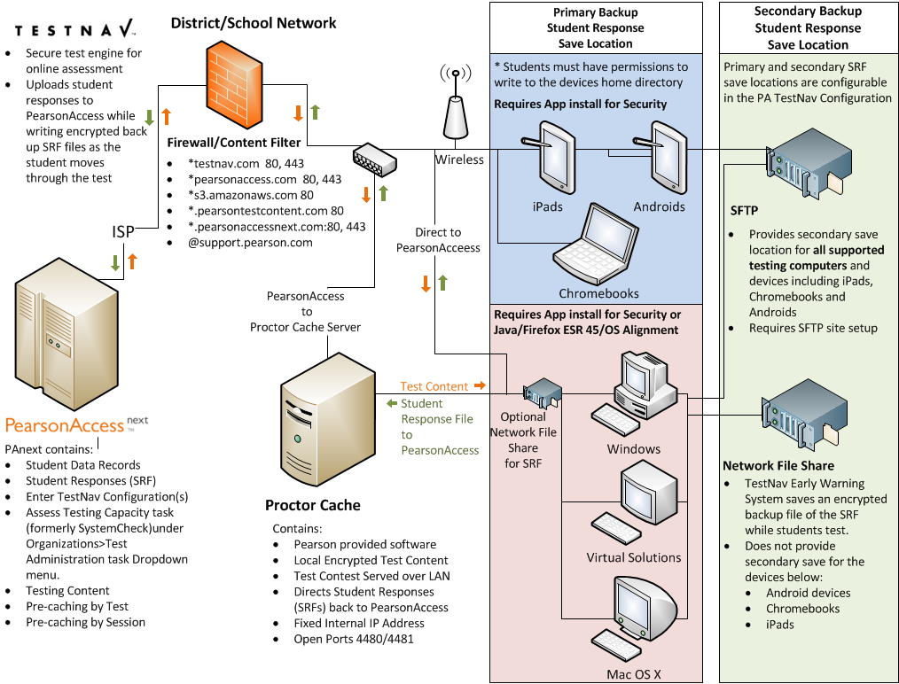
Online Testing Components Diagram

Slide 8
TestNav Components
Component | Current Software Version | Next Release date | Installation
Proctor Caching | v2020.1 | TBD | Uninstall and reinstall newest version
TestNav Server side software | v8.15 | TBD | No Install required apps are automatically updated
Desktop App | V1.9.7 | TBD | The new app can be pushed out to Mac OS or Windows OS devices. Uninstall and reinstall newest version
iPad App | v1.9.1 | TBD | Auto updates are supported
Chromebook App | v1.9.107 | TBD | Auto updates are supported
Notes:
Note: Testing for TestNav Server side software v8.12 is currently in process

Slide 9
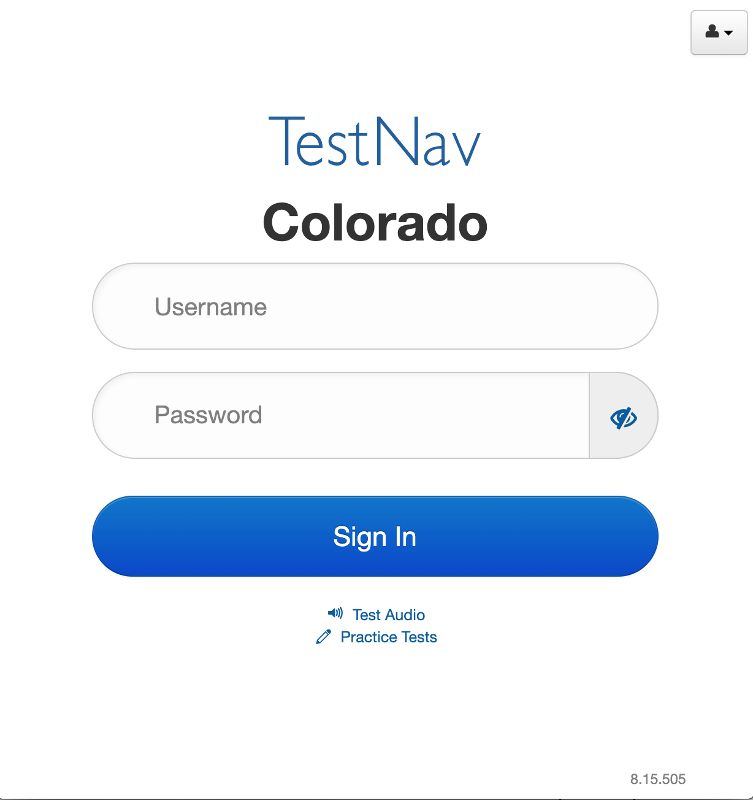
Finding the Current Server Version of TestNav

Slide 10
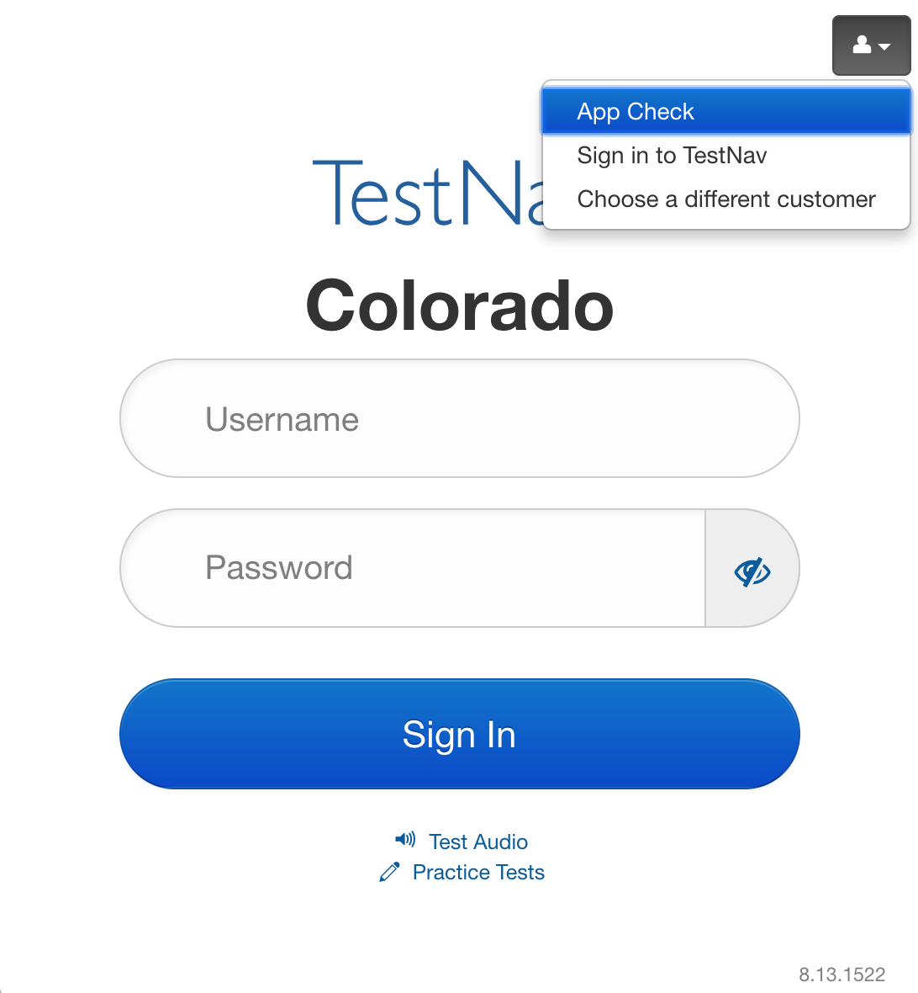
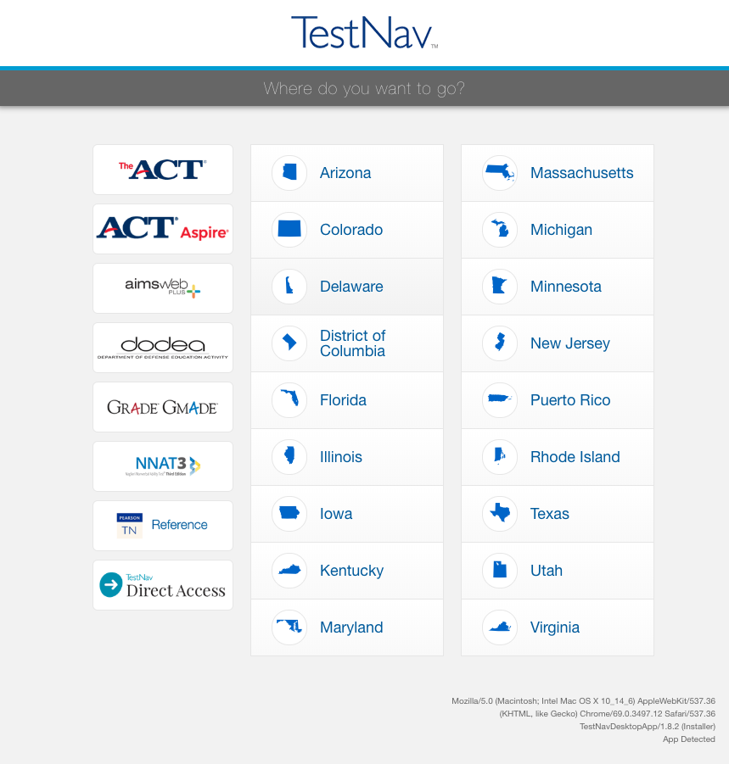
Finding the Current App Version of TestNav

Slide 11
TestNav 8.15 Options
Installable TestNav
Available for
Chrome
iOS
Linux Ubuntu
Mac OS X
Windows
Windows 10 in the app store
Does not depend on other software, such as a browser or Java.
Access your test by starting the TestNav app and choosing your test.
Complete requirements can be found at: https://support.assessment.pearson.com/x/BAACAQ

Slide 12
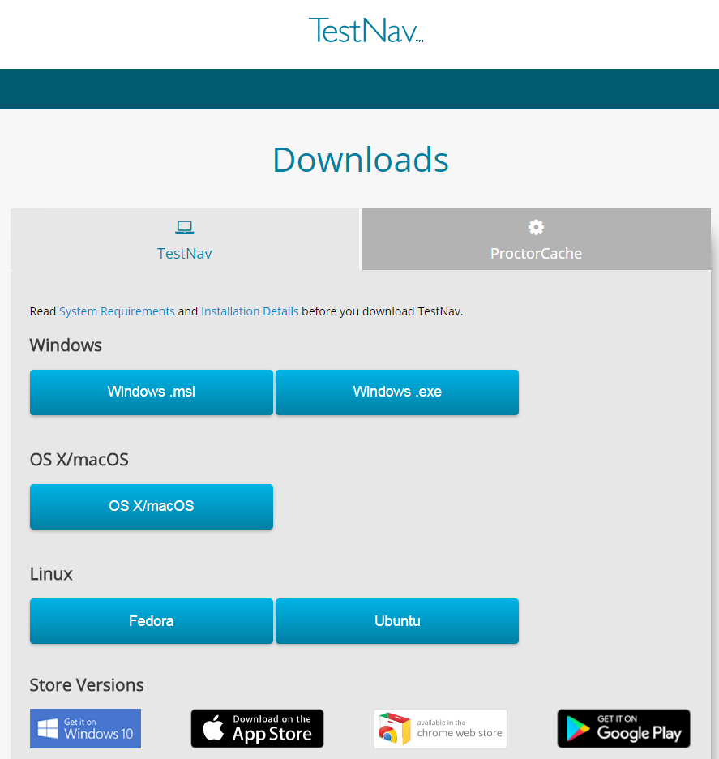
TestNav App Installers
msi (Microsoft installer) file - contains explicit instructions about installing and removing an application.
.exe (executable) file - provides a built-in installation wizard. You can choose program file locations using this type of installation.
The Desktop Installation
Generally only takes a few minutes on an individual computer; network installations will vary depending on your environment.
TestNav Desktop Update
TestNav program file updates are saved in {user_home}\AppData\Local\Pearson. You must give students write access to the update directory.
http://download.testnav.com
Notes:
If your school is downloading the TestNav 8 app, it is accessible at http://download.testnav.com.
If you are using a device that requires an application installation, or if you are planning to use the TestNav Desktop application for laptops and desktops, you can download the app or apps that you will need from this site, or you can go to the applicable device store for Chromebooks, iPads, and Android devices. We will talk more about these device types shortly.
For now, if you are installing TestNav Desktop, there are options for Mac, Windows, and Linux.
There are two options for Microsoft Window: .msi and .exe.
The .msi file is optimized for network installation as a group and pushing out to multiple computers.
The .exe file is for downloading onto individual computers.

Slide 13
Proctor Caching
Proctor Caching is Pearson-supplied software that is used in conjunction with TestNav to reduce bandwidth requirements and accelerate the delivery of test content.
Allows you to pre-cache test content to your local network before a test.
Reduces the burden on your ISP by eliminating redundancy in requests for test content.
Stores an encrypted local copy of all pre-cached tests
CanStock Photo
Notes:
What is Proctor Caching?
Proctor Caching is Pearson-supplied software that is used in conjunction with TestNav to reduce bandwidth requirements and accelerate the delivery of test content.
It allows you to pre-cache test content to your local network before testing.
It reduces the burden on your Internet service provider (ISP) by eliminating redundant requests for test content.
Cached content is encrypted and stored locally.

Slide 14
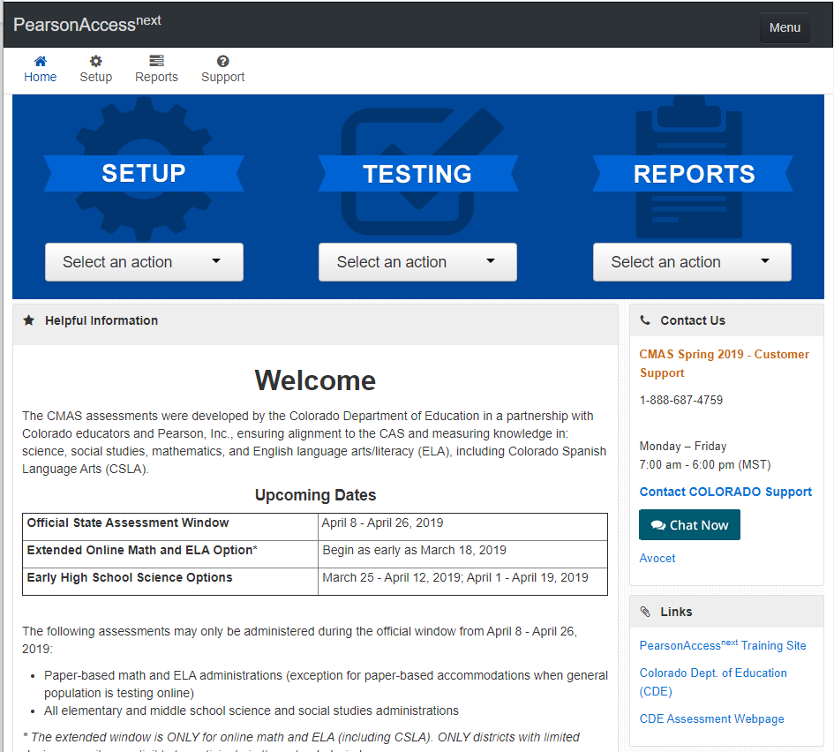
PearsonAccess^{next}
Create TestNav configurations and save file locations.
Create test sessions.

Slide 15
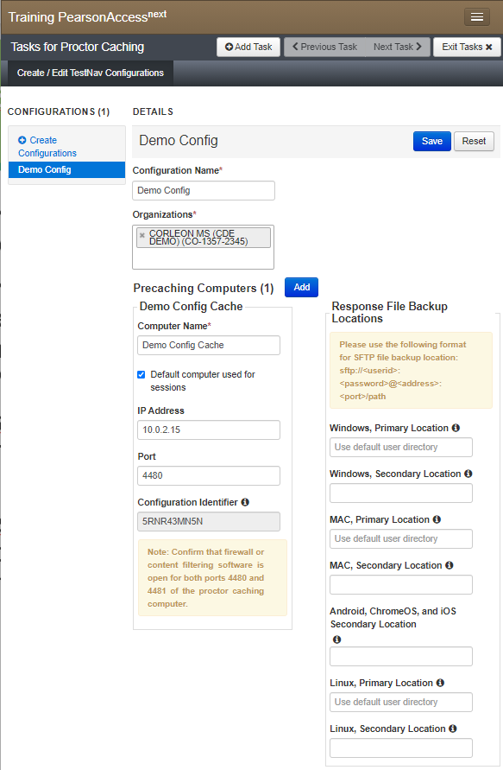
PearsonAccess^{next} Configurations
TestNav requires at least one working save location.
TestNav by default saves student response data to: <home dir>/Pearson/student/srf
Create a TestNav Config in PearsonAccess^{next} to specify custom Primary and Alternate file locations
Notes:
When a student responds to a test question, TestNav saves the response in a saved response file (SRF) and sends these responses to the Pearson server. After the responses successfully save to the Pearson server, TestNav deletes the SRF.
Before testing, refer to your PA next user guide to configure TestNav and complete the following steps.
Configure primary and a secondary save location through PA next .
Configure student accounts to have complete read, write, and delete access in these save locations.
Communicate SRF and log file locations to test proctors.

Slide 16
PearsonAccess^{next} Configurations
Best Practice
Students must have full access to designated Response File Locations.
Primary Response File Location should be on the student workstation.
The alternate Response File Location should use a Secure File Transfer Protocol (SFTP) address to ensure that TestNav saves backup SRF files for all computers.
Designated in TestNav config in PearsonAccess^{next}.
Notes:
When a student responds to a test question, TestNav saves the response in a saved response file (SRF) and sends these responses to the Pearson server. After the responses successfully save to the Pearson server, TestNav deletes the SRF.
Before testing, refer to your PA next user guide to configure TestNav and complete the following steps.
Configure primary and a secondary save location through PA next .
Configure student accounts to have complete read, write, and delete access in these save locations.
Communicate SRF and log file locations to test proctors.

Slide 17
Device Preparation
Any software that would allow secure test content on student computers to be viewed on another computer must be turned off.
Any applications that may automatically launch on a computer are configured not to launch during testing sessions.
Allow local file access to home directory.
<home dir>/Pearson/ and any alternative SRF save locations.

Slide 18
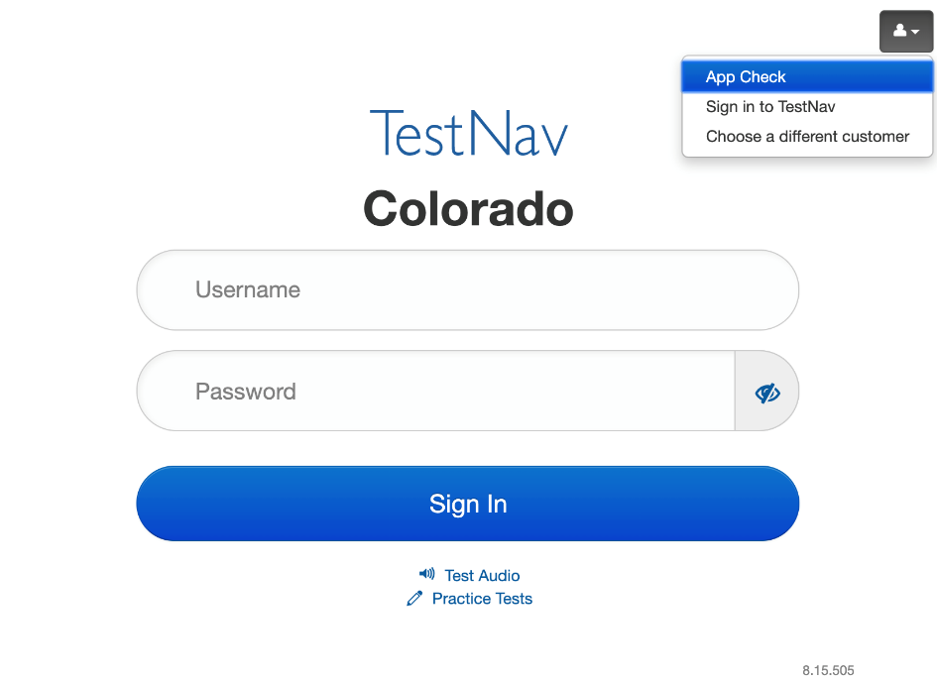
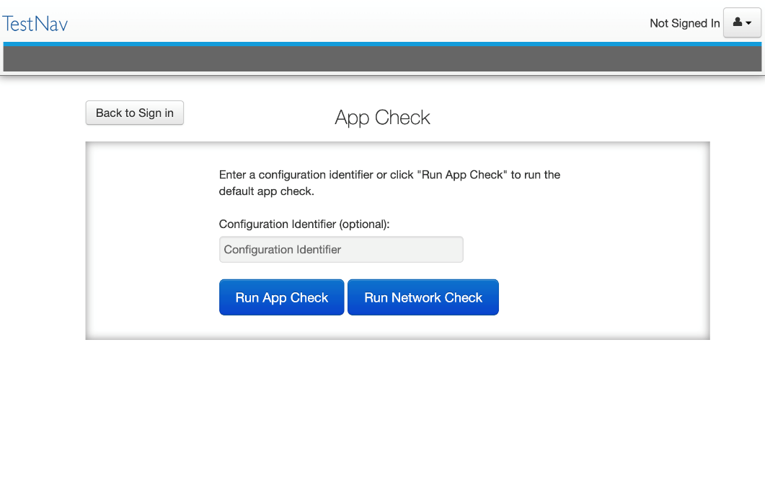
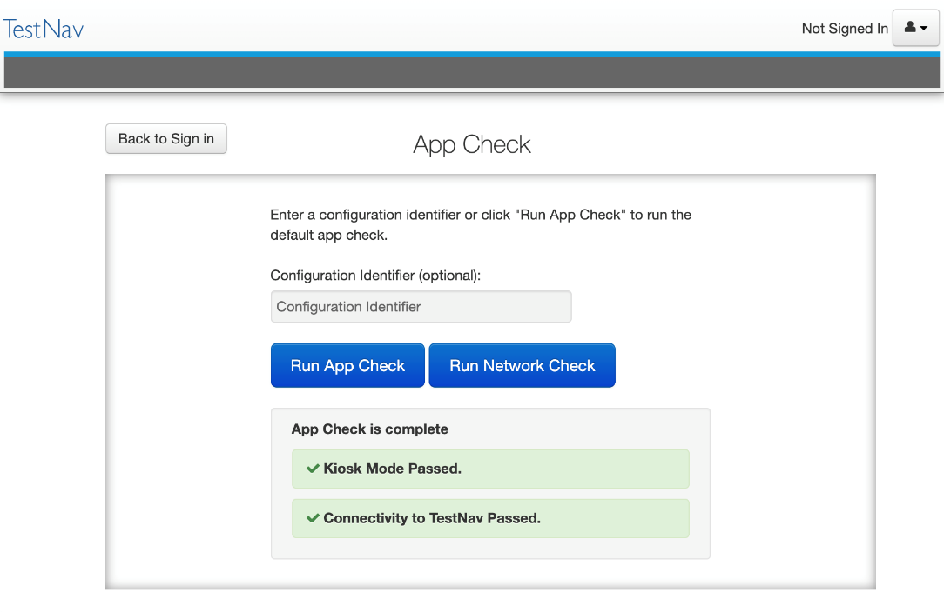
TestNav Desktop App Check
Notes:
Replaces the TN quick verification.
Can now check connection to the Proctor caching device with a configuration identifier created when you configure TN in PearsonAccess^{next}

Slide 19
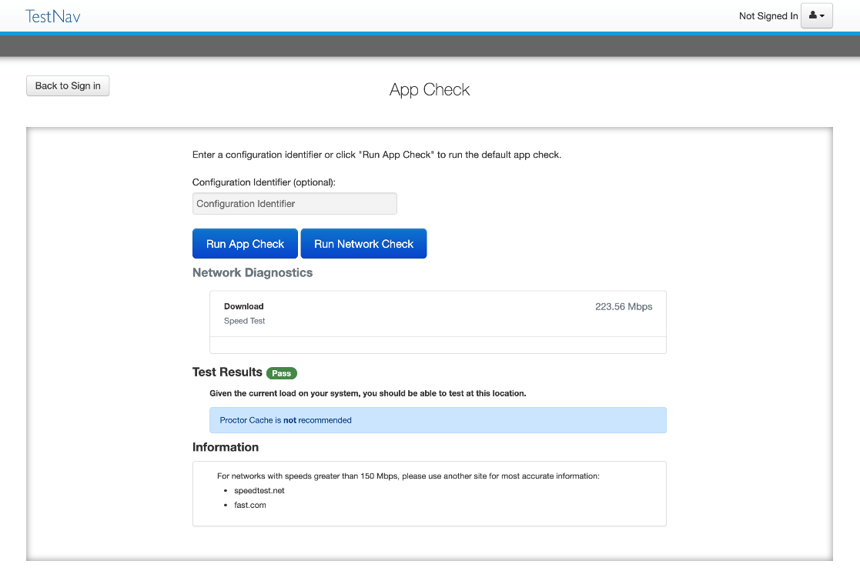
TestNav Desktop Network Check
Notes:
Replaces the TN quick verification.
Can now check connection to the Proctor caching device with a configuration identifier created when you configure TN in PearsonAccess^{next}

Slide 20
Best Practices and Recommendations
Use Proctor Caching if you have bandwidth concerns for best network performance.
Use the CMAS PearsonAccess^{next} Training center to run Site Readiness test forms to verify testing devices, proctor cache devices, and network configurations.
Best Practice

Slide 21
Online Testing Components Network Preparation Proctor Caching Device Preparation Infrastructure Trial Support During Testing
Section 2
1
2
3
4
5
6

Slide 22
Network Preparation
Online Resources
Configure Content Filter & Antivirus Software
Wireless Network Best Practices
Antivirus Software
Verify Bandwidth Capacity
ISP Notification

Slide 23
Online Resources
TestNav 8 Hardware and Software Requirements
https://support.assessment.pearson.com/x/AxZgAQ

Slide 24
Configure Content Filter & Antivirus Software
Allow traffic on ports 4480 and 4481 to flow freely on the network. Proctor Caching uses these ports.
*testnav.com: 80, 443
*.pearsonaccessnext.com:80, 443
*.pearsontestcontent.com: 80, 443
*.thawte.com
*.usertrust.com
*.comodoca.com
google-analytics.com (optional)
ALL Pearson domains and ports must be allowed to pass through your Internet firewalls, content filters or spam filters for inbound and outbound traffic.
Notes:
TestNav content is dynamically hosted in the cloud. No static IP addresses or ranges can be provided.

Slide 25
Content Filter & Antivirus Software
Some antivirus software can scan test content even if it has been whitelisted causing performance issues during testing. Additional configuration may be required.
CDE recommends using the CMAS Site Readiness form in a practice test in the PearsonAccess^{next} training environment to be sure you have your Content Filter & Antivirus Software configured correctly.
Work directly with your Content Filter & Antivirus Software provider to find an optimal configuration.

Slide 26
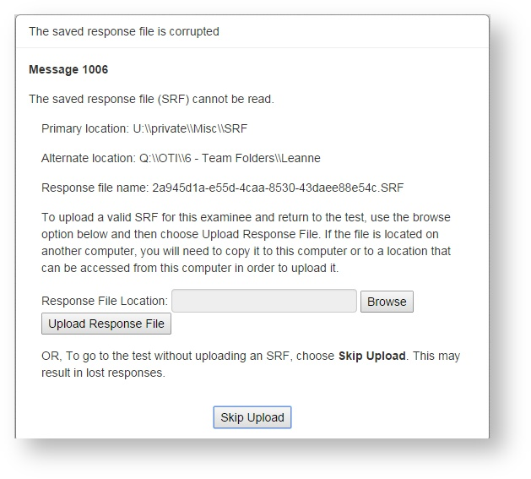
Troubleshooting
Error Messages 1001 and 1006.
Aggressive content filters attempt to open and alter an SRF file before saving it.
Data manipulation corrupts the SRF and invalidates it from future use.
https://support.assessment.pearson.com/display/TN/Early+Warning+System+Triggers

Slide 27
Wireless Network Best Practices
Minimizing Impact
Before testing:
Disable low end wireless protocols that are not being used.
Turn off students’ mobile devices to avoid potential interference during testing.
Before the Sign in and preparation phase:
Ask classrooms to stagger logins to minimize initial loading time.
For example, in a class of 30 students, the proctor can have 10 students log in each minute, decreasing the strain on the network.
Notes:
The increase in devices accessing school networks increases the need for stable WiFi networks, daily monitoring, and maintenance. To help network admins stabilize WiFi for online testing and classroom activities, Pearson field engineers collaborated with IT departments to present these requirements, recommendations, and troubleshooting tips.

Slide 28
Wireless Network Best Practices
Conduct a Site Survey
Evaluate the district’s infrastructure, network design, and WiFi needs to determine how many wireless access points (APs) in each school.
A site survey should include:
Evaluating the existing infrastructure.
Counting the number of user devices.
Examining the type of user traffic and interference.

Slide 29
Wireless Network Best Practices
Design for Density
Install APs more densely to decrease potential for overload with too many student devices.
Reduce WiFi interference from construction materials. The following solid materials can slow WiFi speed or completely block wireless signals:
Brick, concrete, and metal
Filing bookshelves
Cabinets
If your WiFi access points have adjustable antennas, point the antenna to aim the signal at the student devices to improve the throughput.
Reduce interference from other WiFi networks.
Notes:
Construction materials in schools can impact WiFi coverage and speed.
If possible, move the student devices directly under the AP. Even just couple of feet can make a big difference in throughput and signal strength.
When WiFi networks are set to use the same channel, they compete for limited bandwidth. Check for other WiFi names by opening the wireless options on your device for a list of WiFi networks. If you see many networks to choose from, you may encounter interference from these other networks.

Slide 30
Wireless Network Best Practices
Design for Density
Check your AP user guide to find out whether your APs can detect the least congested WiFi channel.
Reduce interference from other devices. These can include:
Cordless phones
Bluetooth-enabled devices
Student mobile devices
If you previously had channel auto-switching allowed, but notice slow speeds or poor connections, manually configure the channel and perform speed tests to find the fastest channel.
Temporarily turn off or unplug electronics to reduce wireless interference during testing.
Notes:
Electronic devices that are not connected to the school's WiFi network, can still use the same 2.4GHz or 5GHz frequencies to connect
Personal devices communicate on the network, even while inside backpacks or bags. Email and social media notifications require the devices to send requests to maintain connectivity with the AP.

Slide 31
ISP Notification
Notify your Internet Service Provider of your online testing window.
Confirm that no scheduled maintenance or outages are planed during that time.
Best Practice

Slide 32
Online Testing Components Network Preparation Proctor Caching Device Preparation Infrastructure Trial Support During Testing
Section 3
1
2
3
4
5
6

Slide 33
Proctor Caching
Online Resources
Pre-Installation Planning
Install & Device Requirements
Configure TestNav in PearsonAccess^{next}
Proctor Caching Monitoring

Slide 34
Online Resources
Proctor Caching v2020.1 Hardware and Software
Requirements:
https://support.assessment.pearson.com/x/HAACAQ
Software:
http://download.testnav.com/

Slide 35
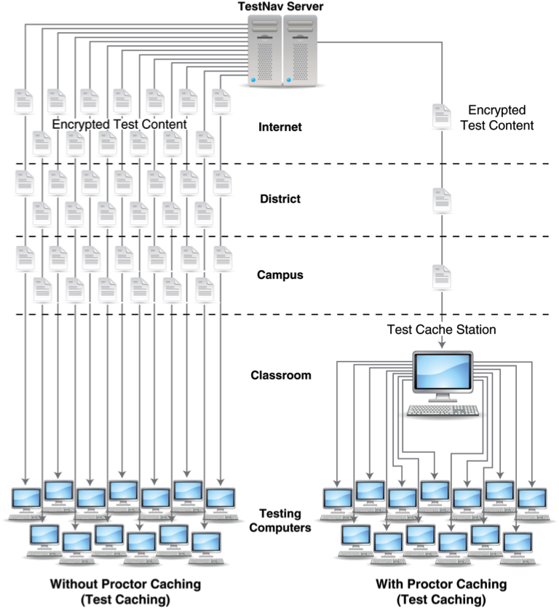
Proctor Caching – The Network
Notes:
This diagram illustrates the network traffic differences between using and not using Proctor Caching. Without Proctor Caching, as demonstrated on the left, multiple redundant copies of the same test are downloaded over the district’s ISP connection while students are waiting for the test to load. This heavy use of bandwidth not only affects how quickly tests load for students, but also the available bandwidth for all other Internet-related activities within the district.
With Proctor Caching, as seen on the right, districts will pre-cache one copy of each test and tests will be served to the students from the Proctor Caching machine. This minimizes redundant requests for test content over the district ISP connection, loads tests faster for students, and minimizes the effect of computer-based testing on district bandwidth utilization.
Districts have the flexibility to decide where to implement Proctor Caching in the network environment. Based on local network considerations, districts can implement Proctor Caching machines at the district, school, or classroom level.
Proctor Caching is highly recommended.

Slide 36
Proctor Caching Requirements
Windows
v2020.1
Processor
x86/x32 and x64
Minimum
2 GHz
Memory
Recommended: 4 GB RAM
Minimum: 2 GB RAM
MacOS
Pearson is no longer developing Proctor Caching software for MacOS.
Contact Pearson Level 2 support, 1-888-687-4759, and request the installation file for the legacy version of ProctorCache for OSX.

Slide 37
Proctor Caching in CMAS 2019
CMAS 2019
Over 889,000 Tests Completed
95% Proctor Cache Usage
Proctor caching was bypassed over 59,000 times or nearly 6.98% of students.
44% of Tests Completed with a Secondary Save Location
Average Load Time
With proctor caching 1.3 seconds
Without proctor caching: 1.1 seconds.

Slide 38
Proctor Caching History
ProctorCache was originally developed in 2001 to support testing environments with:
Very low network and or internet bandwidth.
Tests with large media files like Colorado Science and Social Studies simulations and Text to Speech forms.
Early TestNav versions that attempted to download the entire test at sign in.

Slide 39
Proctor Caching Considerations
Districts with increased network and or internet capacity may conduct an infrastructure trial to determine if the capacity exists to test without caching ELA or Math content.
District may explore having either schools or grade levels administer an assessment without ELA or Math content cached.
CDE recommends caching Science and Social Studies as well as Text to Speech forms due to the large file sizes for these assessments.
Contact CDE and Pearson if you would like to explore administering ELA or Math assessments with out proctor caching.

Slide 40
Pre-Installation Planning
If you need to update ProctorCache to a more recent version, uninstall the previous version. Then, reboot the computer and install the more recent version. You can uninstall ProctorCache using the software removal process for your operating system.
Must have full local administrator permissions on the PC device & working knowledge of your network.
Network connection 100 Mbps full-duplex or higher recommended.
Minimum network connection is 10/100.
Network is set to use IPv4 DNS (Domain Name System) servers.

Slide 41
Proctor Caching Requirements
Must have Fixed internal IP address.
Open traffic on TCP Ports include: 80 & 443 (Internet), 4480, and 4481 (Local Network).
Does not require an underlying server-based operating system.
For setting up an upstream proxy, refer to the Windows Upstream Proxy Configuration.
https://support.assessment.pearson.com/x/HAACAQ
Notes:
Proctor Caching runs solely on Windows.
It does not require an underlying server-based operating system. It can run on desktop class hardware and a desktop class operating system, which gives districts flexibility on what machines they use for Proctor Caching.
Proctor Caching uses TCP Port 80 for communication between the Proctor Caching machine and the Pearson servers, and ports 4480 and 4481 for communication between testing workstations and the Proctor Caching machine.
Because testing workstations must know a predictable network location for the Proctor Caching machine, Proctor Caching requires a fixed internal IP address. Those districts that require Internet traffic to pass through an upstream proxy server will have to configure Proctor Caching to point to their proxy server. For details on setting up an upstream proxy, refer to the Windows or Mac “Tips on Proctor Caching” section in the TestNav 8 Proctor Caching User Guide.

Slide 42
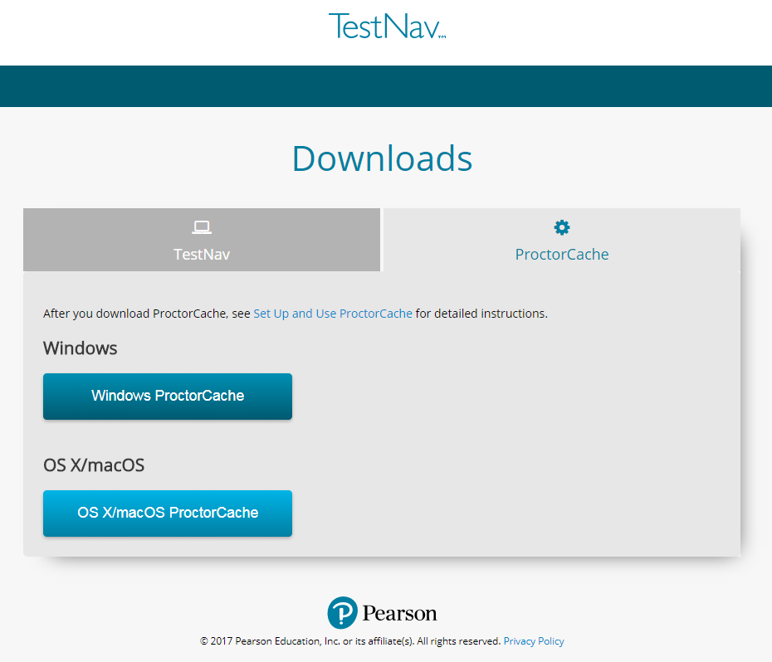
Install & Device Requirements
Download Proctor Caching installer from http://download.testnav.com/
Run the installer and Start Proctor Caching if not already started by the installer.
Visit the ProctorCache administration page to verify that the ProctorCache service has started.
Use the Configuration Identifier and AppCheck from a client computer to verify that Proctor Caching is functional.

Slide 43
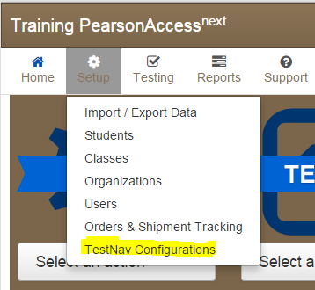
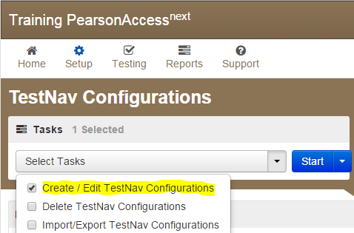
Configure TestNav Setup
Sign in to the CMAS PearsonAccessnext website at
https://trng-co.pearsonaccessnext.com/customer/index.action
Select Setup > TestNav Configurations.
Select /Edit Configurations; click Start to launch Create the configuration.
Notes:
Next you will need to create a TestNav configuration. Sign in to the CMAS PearsonAccess^{next} website. Technology staff will need to receive secure access from their district coordinator.
The Configuration screen can be accessed by selecting Setup and then TestNav Configurations from the drop-down menu. This will allow you to access the configurations settings to set primary and secondary temporary student response save locations for TestNav, and if applicable, set up a connection to your Proctor Caching machine(s).
Select Create/Edit Configurations from the tasks menu to launch the Configuration screen.

Slide 44
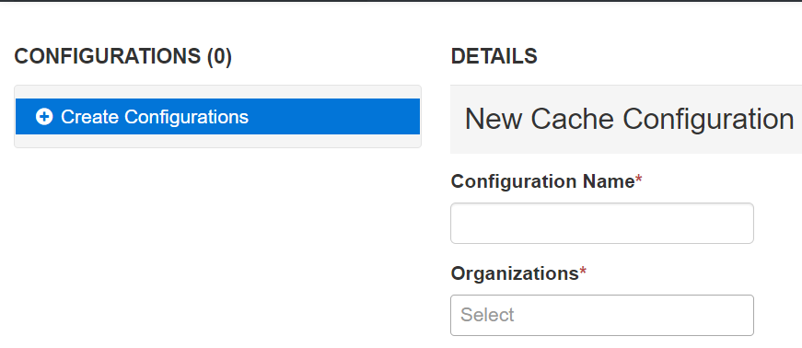
Configure TestNav Setup
Enter a Configuration Name.
Using the Organizations drop-down menu, select your school or district.
Notes:
You will be prompted to name your configuration. Configuration names must be unique within the CMAS PearsonAccess^{next} website for your state. Note that the Training site is shared by multiple states so configuration names must be unique across multiple states in the Training site. Pearson recommends using only letters and numbers in this field, as other characters may cause problems with test delivery. For example, Computer Lab 1 and Computer Lab 2, or High School and Middle School.
Next, using the Organizations drop-down menu, select the appropriate school or district from the menu. Regardless of the organization level, you will have the ability to add multiple settings (and Proctor Caching machines) to the configuration.

Slide 45
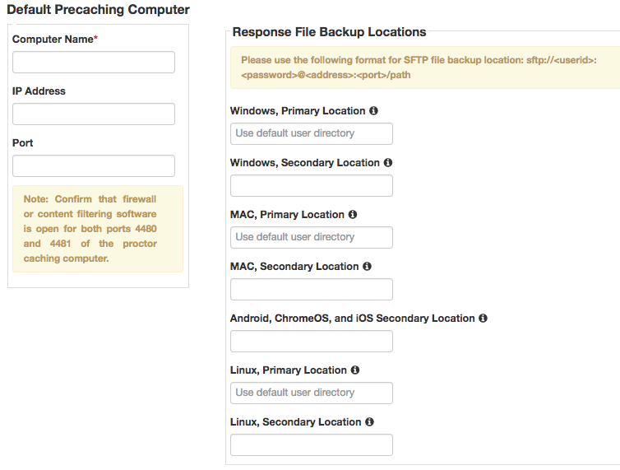
Configure TestNav Setup
Then specify student response file backup locations, and click Create.
SFTP file backup location format: sftp://<userid>:<password>@<address>:<port>/path
Notes:
Next, you can identify the Proctor Caching computer. In the “Default Precaching Computer” section, enter a computer name, the computer’s IP address, and port information.
The computer name will be the name that displays when selecting a Caching machine during test session creation. If you will be Proctor Caching, provide the internal network IP address of the caching machine and the port number, which unless modified is 4480 for Pearson-supplied Proctor Caching. The IP address should be a static address to ensure students can access content during testing. Also note, the computer selected for Proctor Caching should not be a student testing machine.
Check “Uses Pearson Precaching Software.”
If you will be using a non Pearson-supplied caching solution, you will uncheck the box next to “Uses Pearson Precaching software” and make sure the port is the correct port for the caching solution you will be using.
If you will not be Precaching, simply leave the IP Address and Port fields blank; you will still need to complete the next steps for TestNav.
For Response File Backup Locations, it is recommended that a Secondary Location be specified for Windows and Macintosh computers. The Secondary Location must be writeable by students and can be a network share on school network or a shared location on the local computer.

Slide 46
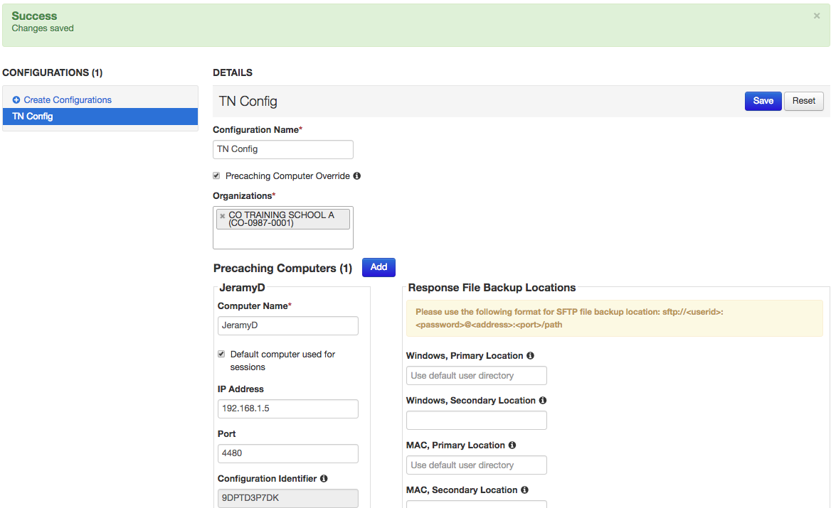
Completed TestNav Configurations
Notes:
A green Success! message will display after successful configuration. A red error will appear if there are issues.
To view, add, or make changes to an existing configuration, click on the configuration name under “Configurations.”
Also note that the configuration identifier has now been added. Use this unique number to test that specific configuration with AppCheck.

Slide 47
Import and Export TestNav Configurations
Notes:
Date when Configurations can be added will go here once available.

Slide 48
Proctor Caching Monitoring
Test
Provides information about test content and caching status.
Content Details displays status of individual test items.
Clients
Displays clients by IP address that have connected to TestNav.
Client Details displays details by computer.
Settings
Allows you to set a custom password to refresh, reload, or purge cached content with access to http://localhost:4480/settings.jsp.
URL: http://<Static IP Address>:4480

Slide 49
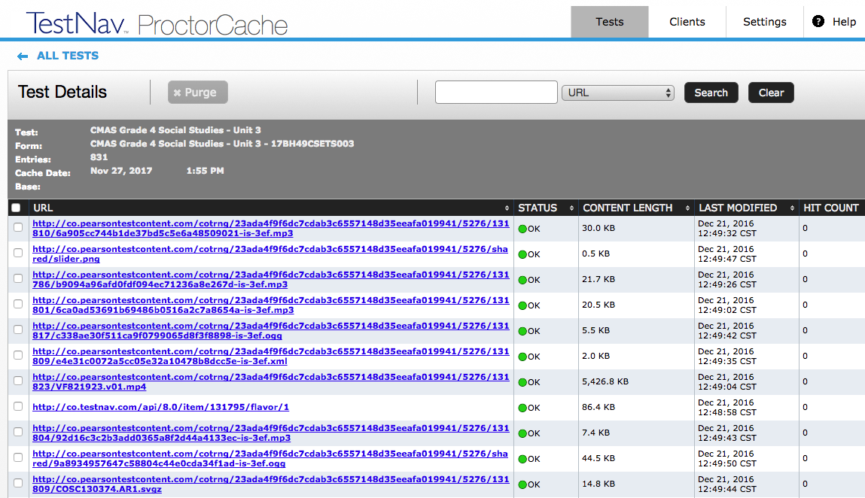
Tests Tab
Content is displayed at the Test and Form level.
Functionality is available to Refresh or Purge selected test content.
Clicking on a test name will display the Test Details screen which displays individual items in a test.
Notes:
On the Tests tab content is displayed at the Test and Form level.
Functionality is available to refresh, reload, or purge selected test content if necessary, and requires a password. The password is available in the Proctor Caching User Guide to protect against unauthorized deletion of cached content.
Clicking on a test name will display the Test Details screen which displays individual items in a test.

Slide 50
Tests Tab – Status
Ok – Content is successfully cached.
Not Loaded – Content is not cached.
Waiting… - Loading Content.
Loading… - Loading Content.
Failed to load content – There was a failure to load content.
MD5 Check Invalid – MD5 comparison Failed.
MD5 Mismatch – MD5 comparison was completed but files did not match.
In general, any status in red is a critical problem. Any content with a red status should be checked and Reloaded. If the problem is not resolved contact Pearson Support.
Notes:
The Tests tab provides status indicators for each item of cached test content.
An OK status means the content has successfully cached.
The yellow status indicators appear when the content is in the process of being cached.
Not Loaded means the content is not cached.
Waiting… means the content is in the queue, waiting to be loaded,
and Loading… means the content is currently loading.
Red status indicators indicate problems with cached content.
Failed to load content means there was a failure to download content .
Proctor Caching also performs an MD5 check once an item has been cached to compare the test content on the Pearson servers with the cached item. The MD5 check should show that the items are identical.
MD5 Check Invalid means the MD5 comparison could not be completed successfully.
MD5 Mismatch means the MD5 comparison was completed but the files did not match.
In general, any status in red is a critical problem. Any content with a red status should be checked and reloaded.
If the problem is not resolved, contact Pearson Support for technical assistance.

Slide 51
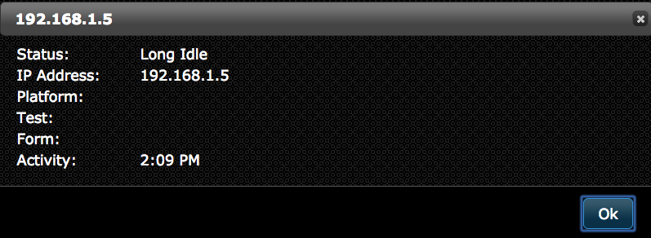
Client Tab
Clients which have connected to TestNav are listed by IP address.
Clicking on a computer will display the Client Details screen which displays information regarding a particular computer connecting to Proctor Caching.
Notes:
The Clients tab offers a quick view into client computer connections. Each computer can be clicked to bring up an individual Client Details screen. It provides visibility to which testing workstations have requested test content from the Proctor Caching server.

Slide 52
Client Tab – Status
Ok – Client is active.
Idle – 5 to 30 minutes since client was active.
Long Idle – 30 minutes to 12 hours since client was active.
Clients are removed after 12 hours of inactivity.
Notes:
The Client List tab also provides status indicators including:
Ok – meaning client is active
Idle – 5 to 30 minutes since client was last active
Long Idle – 30 minutes to 12 hours since client was last active
Clients are removed after 12 hours of inactivity.

Slide 53
ProctorCache Password
ProctorCache requires a password to refresh, reload, or purge content. You can use the default password, or you can change the default password at any time these instructions.
Connect to ProctorCache on your local host - http://localhost:4480.
*If you access ProctorCache from a remote computer using an IP address (for example,http://10.25.99.142:4480), you cannot view the Settings tab, which contains the option to change the default password.
Click the Settings tab.
Enter the old password, and then enter the new password twice in the required fields.
Click Submit.
Notes:
What does the new Proctor Caching software offer?
The user interface has been redesigned to include the following enhancements:
renaming the Contents tab to Tests and the Client List tab to Clients for clarity,
simplifying use by consolidating information previously displayed on the Home page into the Clients and Tests tabs,
resolving issues with Internet Explorer 11 not displaying the list of cached content,
Enabling a more robust comparison between content on the caching computer and content on the Pearson server, to verify the cache has the most up-to-date content, and
renaming the “undefined” directory to “Was not Preloaded” to eliminate confusion.
CMAS recommends that all schools upgrade to the latest version to take advantage of these enhancements.

Slide 54
Additional Technical Notes
Java runtime is included with Windows install.
Java runtime plugin is required for PearsonAccess^{next} pre-caching functionality.
If you must direct the ProctorCache machine to an upstream proxy server to access the Internet, the ProctorCache service can be configured to use the proxy server.
Notes:
Note that Java runtime is included with Windows install and Java runtime plugin is required for PearsonAccess^{next} pre-caching functionality.
For additional help, refer to the Proctor Caching User Guide. The guide provides details for planning, installing, and monitoring, as well as “Tips on Proctor Caching.” The “Tips” section provides guidance on changing computer settings and how to edit the configuration file to point to an upstream proxy computer if needed.

Slide 55
Online Testing Components Network Preparation Proctor Caching Device Preparation Infrastructure Trial Support During Testing
Section 4
1
2
3
4
5
6

Slide 56
CMAS Computer OS System Support
Windows
7, 8.1, 10
Windows 10 TN App available in the Microsoft App Store
Operating System
Platform
Additional Considerations
TN Desktop App
Disable Cortana, XBox Game Bar, and clipboard history

Slide 57
CMAS Computer OS System Support
OS X /macOS 10.13, 10.14, 10.15
Disable Siri and/or Dictation services
Operating System
Platform
Additional Considerations
TN Desktop App

Slide 58
CMAS Computer OS System Support
Linux
Fedora 28 (64-bit);
Ubuntu 18.04 (64 bit)
TBD
Operating System
Platform
Additional Considerations
TN Desktop App

Slide 59
CMAS Computer Tablet System Support
Chrome OS 83 - 86
Install TN app
Operating System
Platform
Additional Considerations
TN Desktop App
Set up Kiosk Mode
User Data Settings
Unmanaged Chromebooks cannot run in kiosk mode
Chromebooks
iPads
iOS
12 – 14.x
Install TN app
Operating System
Platform
Additional Considerations
TN Desktop App

Slide 60
Hardware Requirements
Specs | Windows | OS X | Linux
Supported devices | Desktops Laptops Tablets | Desktops Laptops | Desktops Laptops
Processor | x86/x32 and x64x64 | Intel-based™ | x86/x32 and x64
Memory | Recommended 4 GB RAM Minimum 2 GB RAM | Recommended 2 GB RAM Minimum 1 GB RAM | Recommended 2 GB RAM Minimum 1 GB RAM
Minimum screen size | 9.5-in | 9.5-in | 9.5-in
Minimum screen resolution | 1024 x 768 | 1024 x 768 | 1024 x 768
Other | 1) Windows RT tablets are not supported. 2) External keyboard and mouse (or touchpad) for touchscreen devices required. 3) Wired hardware is recommended Local File access to home directory. | Local File access to home directory.
Windows: 7, 8.1, 10
OS X/macOS: 10.13, 10.14, 10.15
Linux:
Fedora 28 (64-bit)
Ubuntu 18.04 (64-bit)
Notes:
Even though TestNav can be installed, the application still has a few minimum technology requirements. We will cover Windows, Mac OS X, and Linux now, and then discuss Chromebooks, iPads, and Android devices separately.

Slide 61
Installable TN on Windows, OSX, & Linux
Install TestNav Desktop.
Start TestNav Desktop.
Preform a TestNav app check to to ensure that it installed properly.
Point TestNav 8 App Toward TestNav URL.
Set up Proctor Cache on your proctor caching computer(s).
Configure Proctor Cache in PearsonAccessnext to Set Up Response File Backups, and set up a Secondary Save Location.
Run an infrastructure trial.
TestNav Setup

Slide 62
TestNav Desktop Mass Install
TestNav Desktop Patch Updates
TestNav program file updates are saved in {user_home}\AppData\Local\Pearson
Updates when the app opens or a student authenticates.
Can be pushed by using a snap shot of an updated Pearson folder pushed out to student devices.
Major TN updates that may require reinstallation will be scheduled in Winter and Summer student breaks.
TN Login Preferences
Go to {user_home}\AppData\Local\Pearson. Exists in the update file folder, named with the update version number (for example, 1.6.5)
The default file, which stores the customer login preference for the next login can be pushed out as well.
Notes:
Because TestNav installation does not add entries to the Windows registry, you can copy the TestNav application and push it to student computers for mass installation.
TestNav program file updates are saved in {user_home}\AppData\Local\Pearson. You must give students write access to the update directory.
Any necessary patch updates automatically install whenever TestNav starts or when a student attempts to log in.
You can also push the latest TestNav update, rather than waiting until each student opens TestNav.
To push an update, take a snapshot of the Pearson folder, and push that folder to all student computers.
Updates that require reinstallation of the TN app are scheduled for winter and summer breaks.
Pearson will communicate all updates with instructions in advance.
When you install TestNav Desktop, it creates the TestNav folder within the Pearson folder shown in the path above. The TestNav folder contains the following:
The default file, which stores the customer login preference for the next login

Slide 63
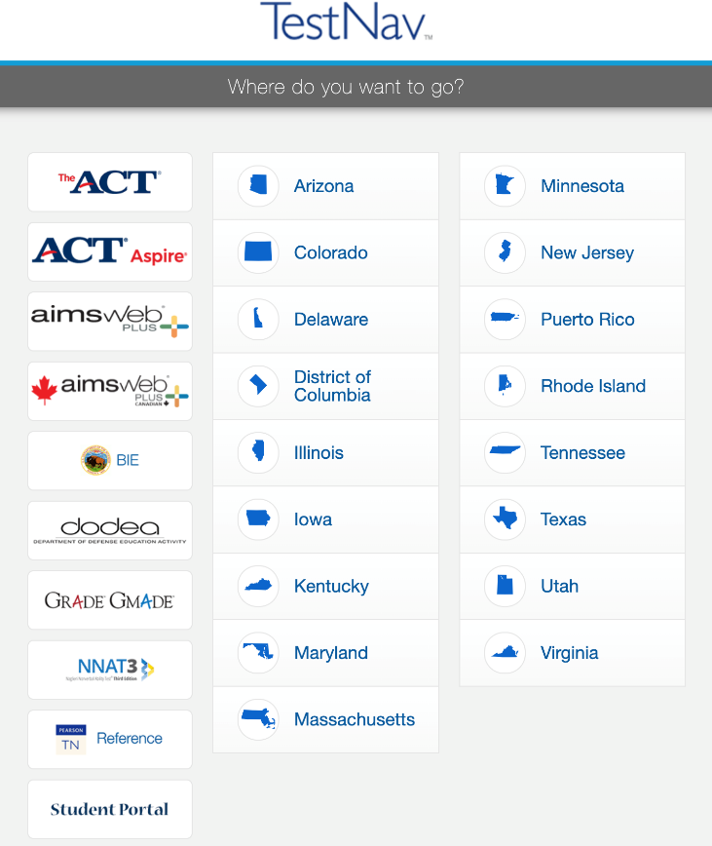
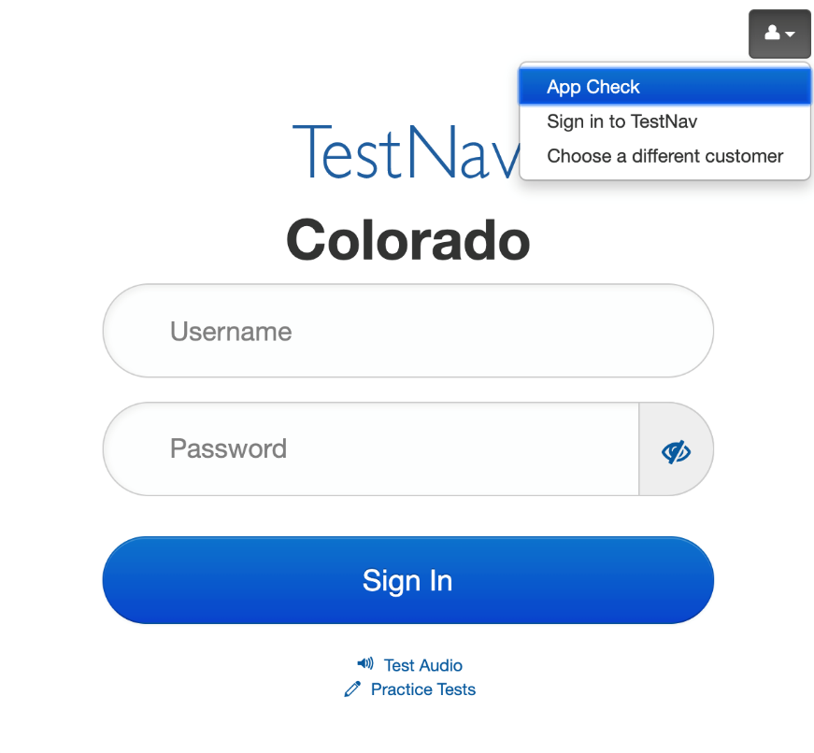
Point TestNav 8 App Toward TestNav URL
Choose the icon in the top right hand portion of the screen and select > Choose a different customer.
Select Colorado for all operational assessments Science, Social Studies as well as for CMAS ELA and Math assessments.

Slide 64
Chromebook System Requirements
Specifications | Chrome OS
Supported devices | Chromebooks
Processor | any
Memory | Recommended 4 GB RAM Minimum 2 GB RAM
Minimum screen size | 9.5-in
Minimum screen resolution | 1024 x 768
Other | Convertible Chromebooks can not be used in tablet mode
Hardware and software requirements.
Memory requirements.
No Java or browser dependencies.
Must use the Installable TestNav application for Chromebook and not a browser
Notes:
Before we go into the actual setup steps, let’s have a look at the system requirements. It’s important to note some highlights for the Chromebooks. Listed on the slide and also found on the TestNav 8 support pages are the minimum and recommended memory requirements. TesNav requires at least Chrome OS 57 or higher.
There are no Java or browser requirements for Chromebooks, as students will use the TestNav 8 App to access their test content. It is important to note that TestNav cannot be launched using a browser on a Chromebook.

Slide 65
Chromebook Highlights
Requires TestNav App for security.
Chromebook must be set to Kiosk mode.
Be sure the Do not erase all local user data is selected in the Admin console.
To locate SRF & Log files press <ctrl><shft>z, while hovering over the username or password field, and the File Viewer box will then appear.
Unmanaged Chromebooks/Chromeboxes purchased in 2017 and later cannot run in kiosk mode. See Google Support for more information.
https://support.assessment.pearson.com/x/NgccAQ
Notes:
Add a note about googles policy change
Add update policy

Slide 66
iPad System Requirements
Specifications | iOS
Supported devices | iPads
Processor | any
Memory | Recommended 4 GB RAM Minimum 1GB RAM
Minimum screen size | 9.5-in
Minimum screen resolution | 1024 x 768
Other | External (wired) keyboard recommended
Hardware and software requirements.
Memory requirements.
Operating system.
No Java or browser dependencies.
Must use the Installable TestNav application for iPad and not a browser.
Notes:
Now let’s look at iPads. Before we go into the actual setup steps, let’s have a look at the system requirements. It’s important to note some highlights for the iPad. Listed on the slide and also found on the TestNav 8 support pages are the minimum and recommended memory requirements. TesNav requires at least iOS 10.1 and higher.
There are no Java or browser requirements for iPads, as students will use the TestNav 8 App to access their test content. Again, like Chromebooks, TestNav cannot be launched using a browser on an iPad.

Slide 67
iPad Highlights
Requires TestNav App for security.
iOS TestNav has Automatic Assessment Configuration:
Allow Microphone.
Allow App Self-Lock prompt .
Confirm App Self Lock message, click or tap Yes to continue.
Students select no, cannot continue testing in the secure test.
If Students select no, restart the app and select yes to continue testing.
Locate SRF & Log files using iPad’s Safari Browser: testnav://admin.
https://support.assessment.pearson.com/x/OAccAQ

Slide 68
Virtual Devices and Online Assessment
There are many different types of virtualization technologies in use in school environments, many of which have broadly different implications on both test security as well as the potential for performance impacts to a student experience.
The DTC must ensure virtualization solutions for online testing can both:
ensure appropriate test security during the assessment
as well as provide a comparable student experience in order to prevent performance issues from impacting student performance on the assessments.

Slide 69
Online Testing Components Network Preparation Proctor Caching Device Preparation Infrastructure Trial Support During Testing
Section 5
1
2
3
4
5
6

Slide 70
Online Resources
How-to Videos
Create a TestNav Configuration - https://www.youtube.com/watch?v=xT0Oo8zHKUs
Create an Online Test Session - https://www.youtube.com/watch?v=HnKXqPp-brg
Precache Test Content - https://www.youtube.com/watch?v=wbBjic1dHMA
TestNav Configuration
https://support.assessment.pearson.com/x/L4Dy
Configure Response File Backup Locations
https://support.assessment.pearson.com/x/LIDy
Proctor Caching
https://support.assessment.pearson.com/x/LYDy
PearsonAccessnext User Guide
https://support.assessment.pearson.com/x/LYDy

Slide 71
Description
An Infrastructure Trial is a full scale dress rehearsal a school can run to confirm that can
TestNav is configured correctly.
Devices can successfully run TestNav.
Network will bear the full load of simultaneous test-takers.
School personnel know what to do for computer-based assessments.
Students are familiar with the computer-based tools and formats.

Slide 72
Technology Setup
Complete Technology Setup prior to Infrastructure Trial
Configure the Network.
Proctor Caching.
Proctor Caching Configuration.
Notes:
Before conducting an Infrastructure Trial, it is important that the Technology Setup be completed and that technology coordinators, school personnel, and students are all equally prepared to participate in the Infrastructure Trial.
For the Technology Setup, it is recommended that these steps be completed:
Configure the network, so that network security devices such as content filters and firewalls allow connectivity with PearsonAccess^{next}, TestNav, Proctor Caching, and email communication with Pearson.
Proctor Caching software should be installed on selected computers with local static IP addresses.
TestNav and Proctor Caching configurations will then need to be added to PearsonAccess^{next} for both the production site and the training site.
Practice tests available in the Training site, as well as sample items and student tutorials can be utilized to gain further experience with TestNav and the CMAS test administrations.
Once the Technology Setup is completed, schools can then conduct an Infrastructure Trial to collectively evaluate the test environment. This will allow schools to identify and resolve any remaining potential issues prior to the CMAS test administrations.
For detailed steps on Proctor Caching and TestNav configuration please reference the “Proctor Caching & TestNav Configuration” training module.

Slide 73
PearsonAccess^{next} Setup
Complete Tasks in PearsonAccess^{next} prior to the Infrastructure Trial
Create Sample Students.
Enter TestNav Configuration.
Create Sessions.
Print Student Testing Tickets.
Notes:
Once TestNav and Proctor Caching configurations have been added to PearsonAccess^{next}, the next set of tasks can be completed by school personnel:
Sample Students can be created in the PearsonAccess^{next} Training site in order to administer an Infrastructure Trial.
Online Testing Sessions will then be created.
And from each session print Student Testing Tickets, Session Unlock Codes, and Rosters may be printed in preparation for the Infrastructure Trial.
We will now demonstrate each of these tasks.

Slide 74
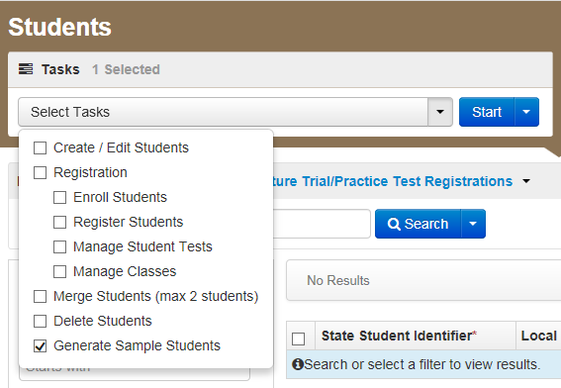
Create Sample Students
Log into the PearsonAccess^{next} Training Site.
Choose the Colorado > 2020 - 2021 > CO CMAS: Site Readiness (Available Jan 2021).
Click Setup and select Students.
Select Generate Sample Students from the Tasks menu.
Click Start to continue.
Notes:
To begin, we will log into the PearsonAccess^{next} Training Site. We will then choose the either the Spring PBA or EOY Administration. Infrastructure Trial testing is only available in either of these two administrations.
To Create Sample Students:
On the PearsonAccess^{next} home page, click Setup, select Students from the menu.
Next, select Generate Sample Students from Tasks menu; click Start to continue.

Slide 75
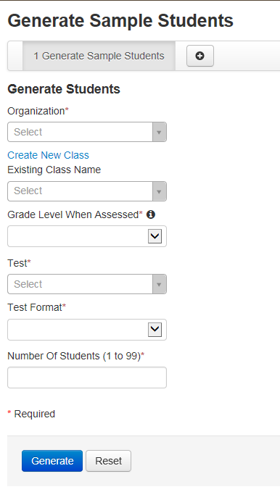
Create Sample Students
Complete the Generate Sample Students screen.
Click Generate to complete the process.
Notes:
You will need to complete these fields:
Organization: Select your school/organization
Class: Add an Existing Class Name or you may choose to create a new class
Grade Level When Assessed
Test: Choose one of the Practice Tests available from the pull down menu.
Test Format: Select Online for this option
Number Of Students: input a number between 1 through 99.
Click Generate
A confirmation screen will appear once the sample students have been created
Repeat the steps above until you have created sample students for the number of testing devices that will be tested concurrently, plus at least 10% additional sample students.

Slide 76
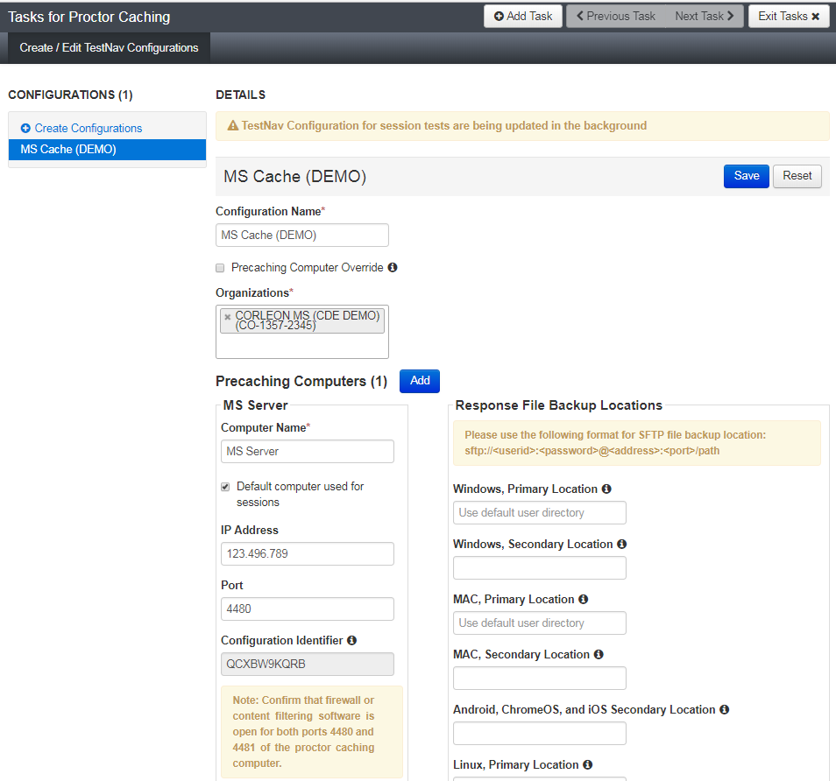
Completed TestNav Configurations
Notes:
A green Success! message will display after successful configuration. A red error will appear if there are issues.
To view, add, or make changes to an existing configuration, click on the configuration name under “Configurations.”

Slide 77
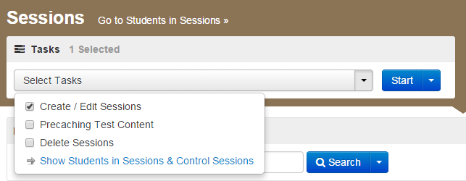
Create Sessions
Go to the Testing tab and click Sessions.
From the Select Tasks pull-down menu select Create/Edit Sessions and click Start.
A test session in PearsonAccess^{next} is an assessment containing certain units.
Notes:
In the Training site, go to the Testing tab and click Sessions.
From the Select Tasks pull-down menu select Create/Edit Sessions and click Start.
A test session in PearsonAccess^{next} is an assessment containing certain units.

Slide 78
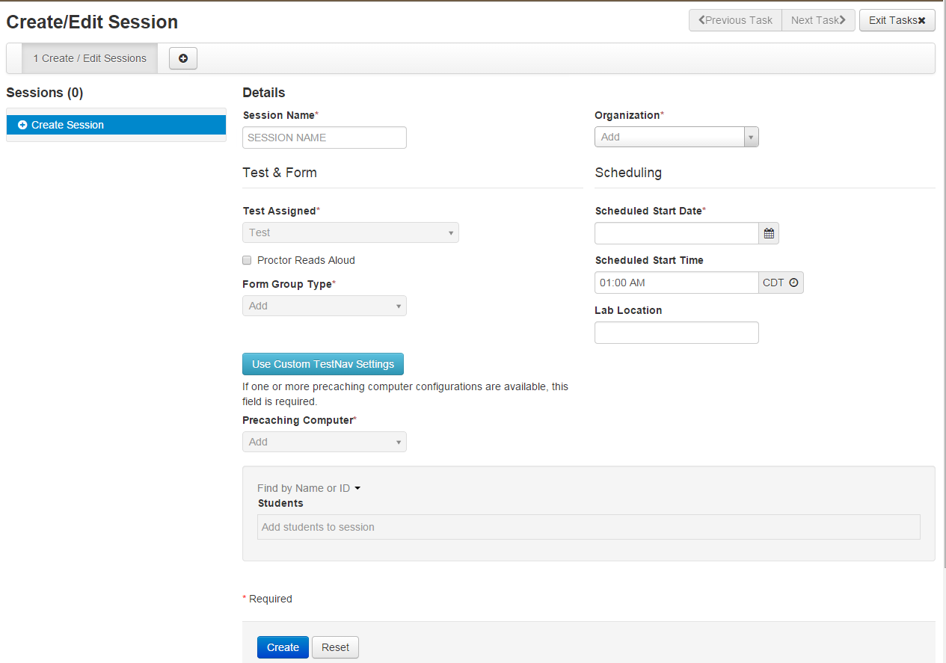
Create Sessions
Complete Test Details
Notes:
Complete the test session details by entering the Session Name and selecting the Organization (School or District) from dropdown menu.
Next, complete the Test & Form section. Select Test Assigned and choose the appropriate Practice Test from the dropdown.
Form Group Type to be set to “Main”.
If Precaching test content, select Precaching Computer from drop down menu.
Then, enter Scheduled Start Date in Scheduling section.
Scheduled Start Time and Lab Location are not required fields but it is recommended to complete both.
Note: The Scheduled Start Date and Scheduled Start Time for a session are intended primarily for planning purposes, it is not enforced. A test session will not be started until you click Start on the Session Details screen, regardless of the scheduled start date and time.

Slide 79
Create Sessions
Add students to session
Notes:
Finally add students assigned to this session.
Note: you can add individually by name or id association or in bulk using the class option. To add students by class, select the Find by Class button and select the class containing the sample students you would like to add to the session.
Click Create to create the session. A confirmation message will be displayed once the session has been successfully created. Exit tasks when finished.

Slide 80
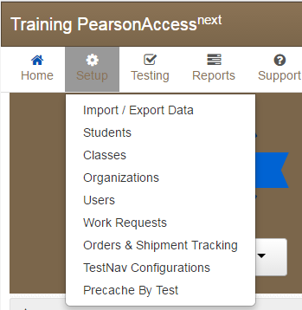
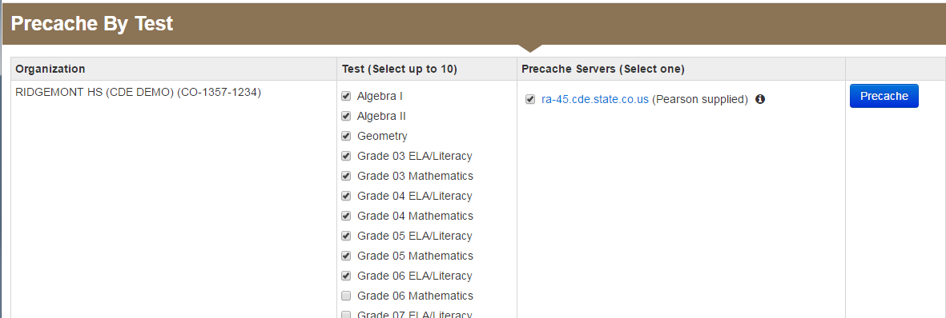
Precaching Content by Test
Choose Precache By Test under the Setup tab.
Select up to 10 Test and the Proctor Caching Server for the tests to be cached.

Slide 81
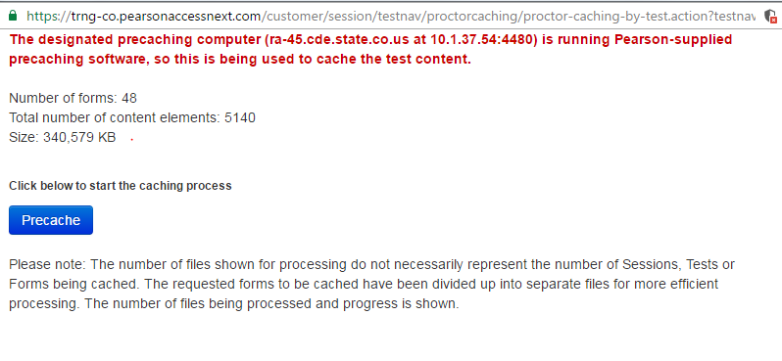
Precaching Content
Click the Precache button on the Proctor Caching Test Content screen.
Notes:
This will bring up the “Proctor Caching Test Content” screen. On this screen you can click the Precache button to Proctor Cache the session. You can also click the “View Status” button to bring up the Proctor Caching Interface for the specified machine listed.

Slide 82
Precaching Content
Precaching is in progress…
Notes:
This message will appear once you have clicked the Precache button. You will need to click the Back button to return the “Precaching Test Content” screen.

Slide 83
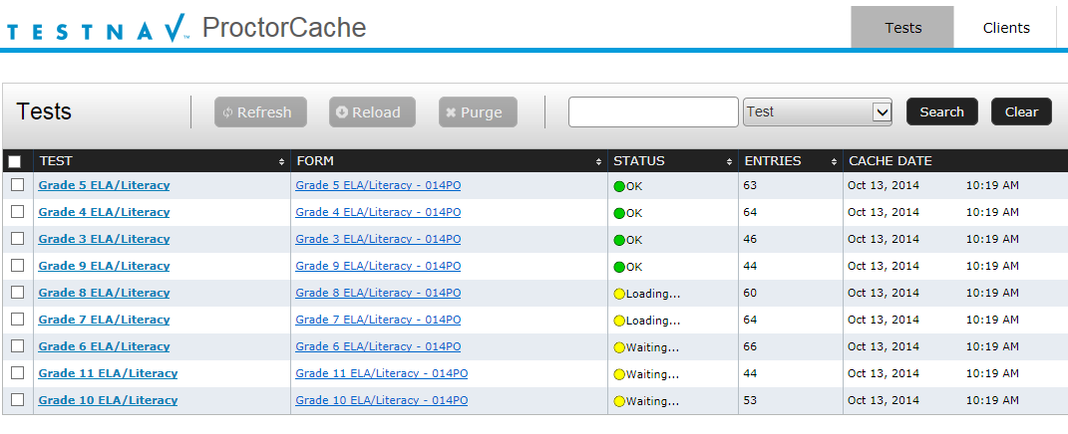
Precaching Content
Proctor Cache - Tests Screen will appear in a second window.
Notes:
Depending on your browser, a second tab or window will appear shortly. This window will display the Proctor Cache – Tests tab. It will detail each Test, Form, and status.
You may open the proctor cache monitor by typing in localhost:4480 or “IPaddress”:4480

Slide 84
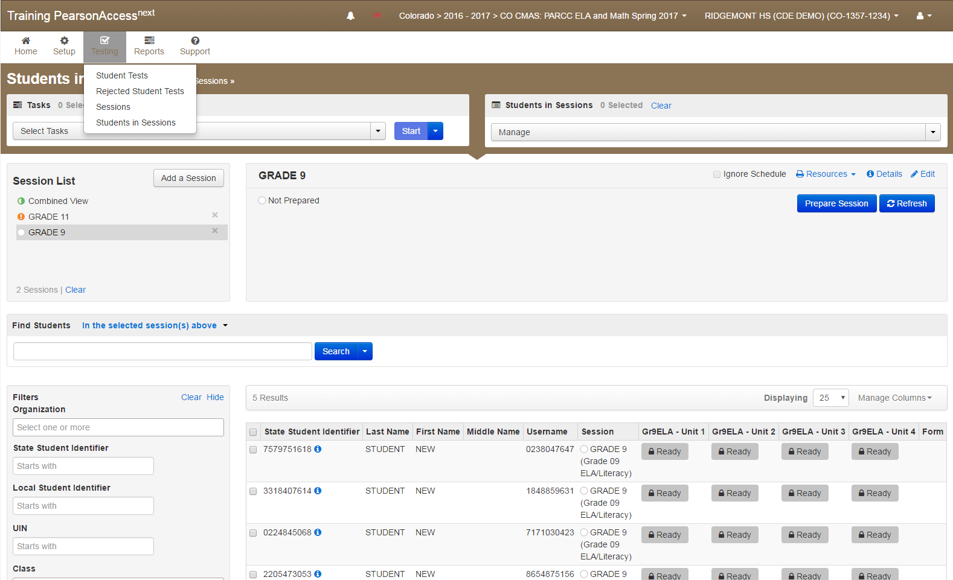
Session Management
Preparing a Session
Notes:
Now that we have created a session with sample students, we will now need to work with sessions.
To view sessions go to the Testing tab and click Students in Sessions.
Click the session name from the Session List. The Session Details screen will appear for the test session selected. If multiple sessions are selected, the option to Combine View appears.
Click the green Start in the Session Details screen. If multiple sessions are selected and are combined, there is an option to start all sessions.

Slide 85
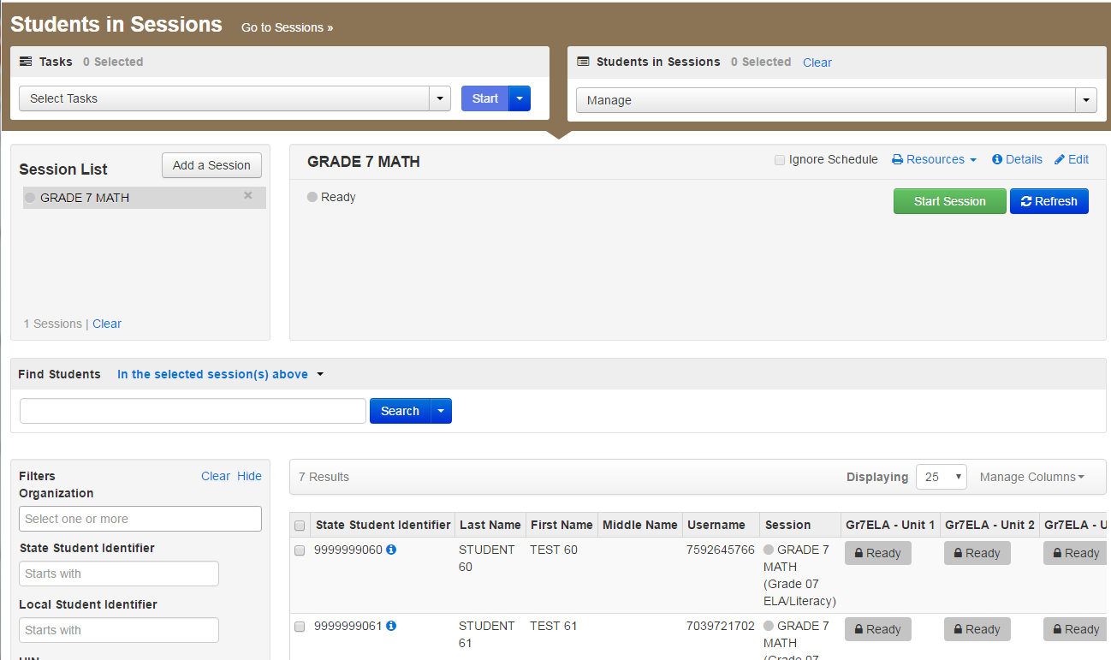
Session Management
Start a Session
Notes:
Now that we have created a session with sample students, we will now need to work with sessions.
To view sessions go to the Testing tab and click Students in Sessions.
Click the session name from the Session List. The Session Details screen will appear for the test session selected. If multiple sessions are selected, the option to Combine View appears.
Click the green Start in the Session Details screen. If multiple sessions are selected and are combined, there is an option to start all sessions.

Slide 86
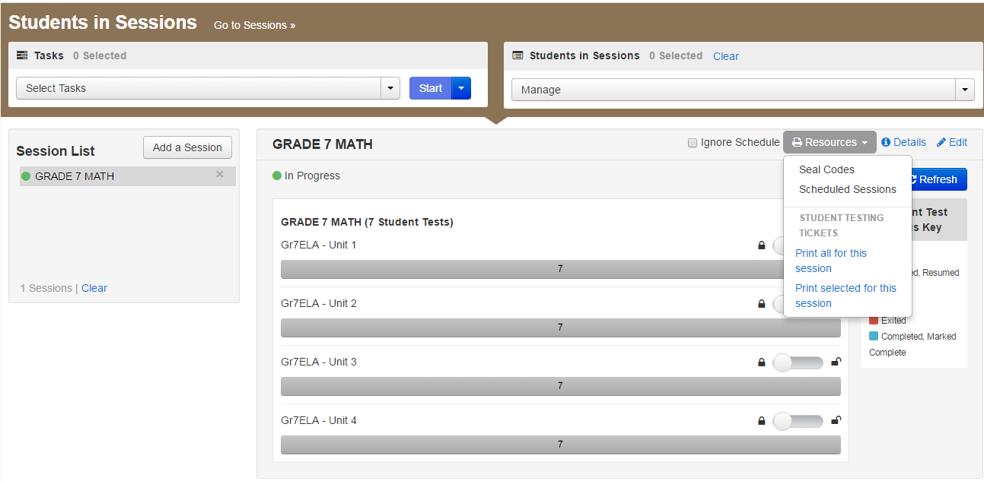
Session Management
Print Student Authorizations & Session Unlock Codes
Notes:
Once the session is started, the Start button will change to a Stop button to allow you to Stop a session.
Use the Download Resources pull-down menu to view and print:
Session Unlock Codes
The Session Roster
and Student Testing Tickets
The Update Cache button may be used to update the Proctor Caching machine’s test content.
The Refresh button can be used to update the screen if needed.

Slide 87
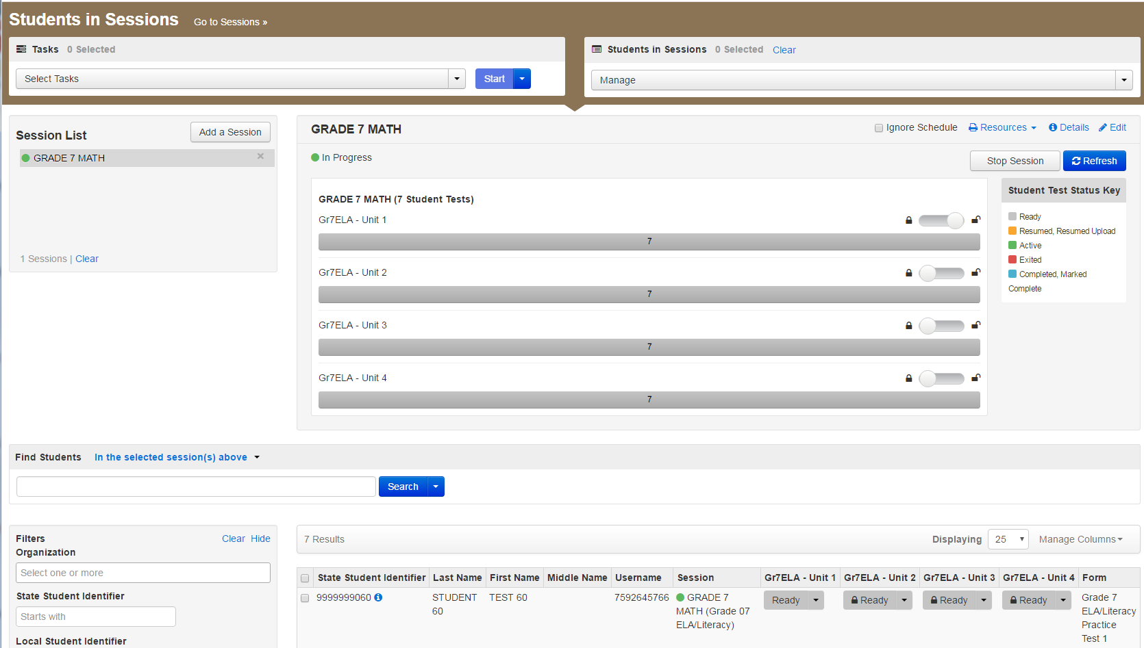
Session Management
Student Test Status Key
Notes:
The Student Test Status will change individually for each student. The different color codes status are displayed in the Session window for your benefit. The individual students are displayed below along with their individual Student Test Status and other information.
Status key includes:
Ready - The student has not logged in to the session yet, but is ready to log in
Resumed, Resumed Upload - The student is ready to log back in to the session or the student is ready to log back in to the session and some responses were not sent to Pearson servers before exiting. Students will be prompted to have saved responses uploaded before resuming the test.
Active - The student is currently in the test.
Exited - The student has exited the session, but has not submitted his or her responses yet. Students in Exited status will need to be resumed by a Test Administrator to re-enter the test
Completed, Marked Complete - The student has completed the test and has successfully submitted his or her responses or the student’s test has been marked complete by the Test Administrator rather than being submitted through TestNav.

Slide 88
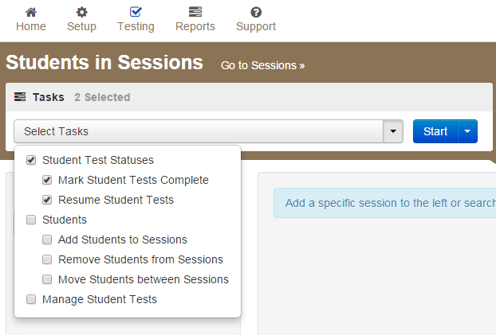
Session Management
Resuming, Marking Students Complete
Notes:
Once a session has been started, there are a number of actions that may need to be carried out in order to complete the Infrastructure Trial. These actions include resuming sample students, resuming sample students with saved responses, and marking tests complete. The Test Administrator should have their own device to perform these actions.
To mark test complete, resume student tests or undoing student test submissions, go to Testing tab, select Students in Session. Be sure the session name is selected within Session List. Check box next to student(s) name. Select from menu action you would like to complete.
To stop session, select the red stop button located on Student sessions. Please note, all students must be marked complete before stopping a session. You may also need to remove any students left in “Ready” status to successfully stop a session.

Slide 89
Infrastructure Trial - Demo
Notes:
Demo TestNav Configuration.

Slide 90
Online Testing Components Network Preparation Proctor Caching Device Preparation Infrastructure Trial Support During Testing
Section 6
1
2
3
4
5
6

Slide 91
Online Resources
Test Administration Support
TestNav 8 Online Support Troubleshooting Section https://support.assessment.pearson.com/x/CgACAQ
TestNav 8 Error Codes https://support.assessment.pearson.com/x/DwACAQ
EWS Potential Scenarios https://support.assessment.pearson.com/x/DgACAQ

Slide 92
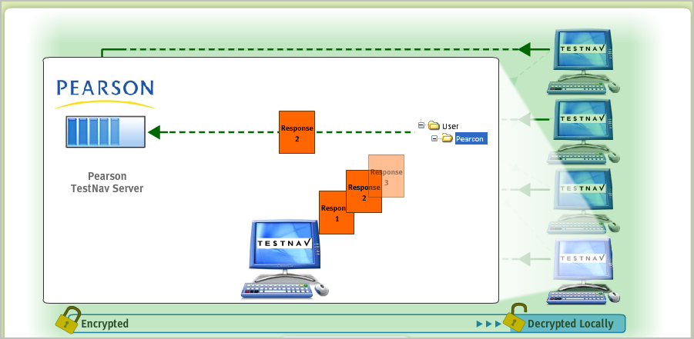
Early Warning System (EWS)
The Early Warning System (EWS) is integrated functionality that gives TestNav a high degree of fault tolerance and provides additional fail-safes in the event of unexpected network disruptions during online testing.

Slide 93
Early Warning System Design
Minimal interruptions for students.
Multiple physical file backups to safeguard against data loss.
Notification Screens designed for Test Proctors.
Early Warning System notifications often involve IT staff so technical knowledge may be necessary to correct any issues during testing.

Slide 94
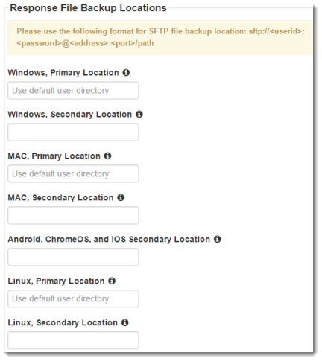
Student Responses – SRF Files
The EWS writes continuously in the background to the student response files. Both the Primary and Alternate files are written to at the same time.
The SRF file has a response data threshold that once reached will trigger TestNav to send response data to Pearson.
Uploading of response data is continuous. If an upload fails, TestNav will cycle and attempt another upload.
If the response data upload is successful, TestNav will create a new empty SRF file and begin the process again. TestNav will only delete an SRF file once it is successfully uploaded.
Notes:
Illustrate the benefits of supplying a secondary response location.
Note that SRF and log files can be retrieved if necessary. Full instructions can be found on the support site.

Slide 95
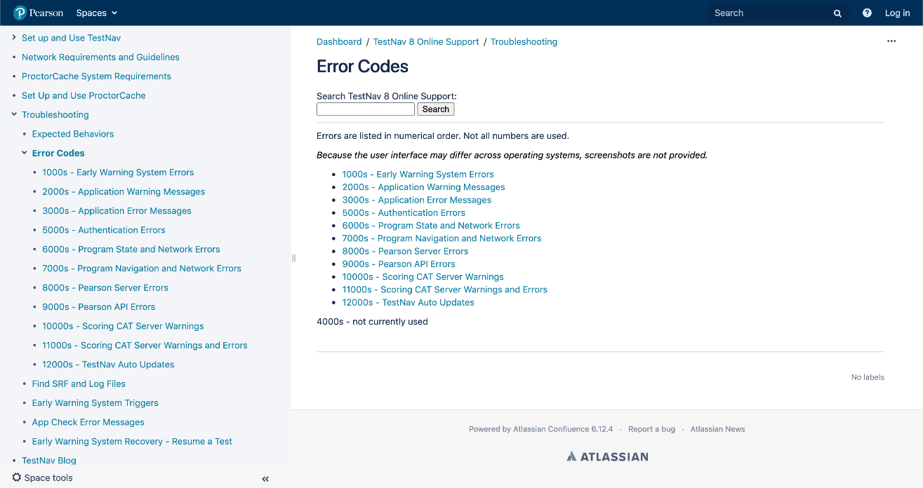
TestNav 8 Error Codes
The TestNav 8 Error Codes should be available to all test proctors to help support students as they test.
The Guide provides a list of all the warning messages that TestNav may display, what generally causes the message, and how to resolve it.
Available through https://support.assessment.pearson.com/x/DwACAQ

Slide 96
Online Test Security
Maintaining Security of the Assessments.
Prepare Devices to Meet Security Needs.
Monitoring and Reporting Security Breaches and Testing Irregularities.
Item Irregularities.
http://www.cde.state.co.us/assessment/dtcsoa

Slide 97
Maintaining Security of the Assessments
All secure test materials must be secured while in the Test Administrator’s possession.
No duplication of secure CMAS materials is permissible.
No cell phones or other communication, reproduction, or recording devices are allowed during test sessions unless required for accessibility.
(Test Administrators may have cell phones to communicate with SACs and DTCs as long as the ringer is turned off and the phone is not used for any other purposes.)
Students should be aware that cell phones or other electronic devices are prohibited. Students who are found with these electronic devices in their possession during testing (including if they have finished testing but other students have not) or during a break may lead to the invalidation of not only their test, but to the invalidation of others’ tests as well.
All individuals are strictly prohibited from taking photos of TestNav screens. Please ensure that individuals in your district are aware of this critical instruction.

Slide 98
Prepare Devices to Meet Security Needs
Any software that would allow secure test content on student devices to be viewed on another device must be turned off.
Any applications that can automatically launch on a device should be configured not to launch during testing sessions. Common applications that can launch automatically include anti-virus software performing automatic updates, power management software on laptops (low-battery warning), screen savers, and email message notifications.

Slide 99
Monitoring and Reporting Security Breaches and Testing Irregularities
All instances of security breaches and testing irregularities must be reported to the SAC, and subsequently, the DAC, immediately.
The DAC will contact the state immediately upon receiving the call.
Testing Irregularity or Security Breach
SAC will complete the Form to Report a Testing Irregularity or Security Breach (Appendix E)
DAC submits completed form through Syncplicity in the CMAS folder.

Slide 100
Item Irregularities
If an item does not display or if students indicate an issue with an item, this should be reported immediately to the Pearson call center.

Slide 101
CMAS Support
Customer Support Sign in PearsonAccess^{next} for Chat Support 1-888-687-4759
Monday – Friday
7:00 am - 6:00 pm (MST)

Slide 102
CDE Support Collin Bonner CDE Assessment Technology Specialist 303-866-6752 bonner_c@cde.state.co.us
Thank you for your Time!
Pearson Support 888-687-4759
Districts/Schools should use Pearson as the first contact for support during testing

